Slide 1


Slide 3
TIMELINE
1994
Mirror Image Opens • Dallas, TX
2000
Mirror Image Moves • Los Angeles, CA
2006
Mirror Image Manufactures Backlit Mirrors
2016
Mirror Image Starts R+D for Smart Mirrors

Slide 4
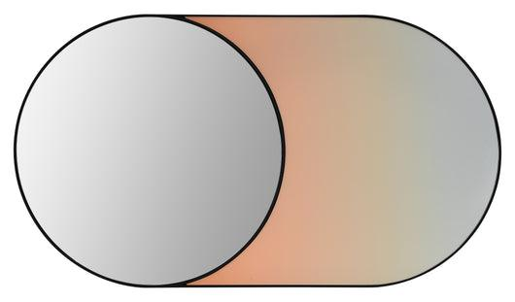
WHAT WE DO
WE MANUFACTURE CUSTOM ART + MIRRORS
16123

Slide 5
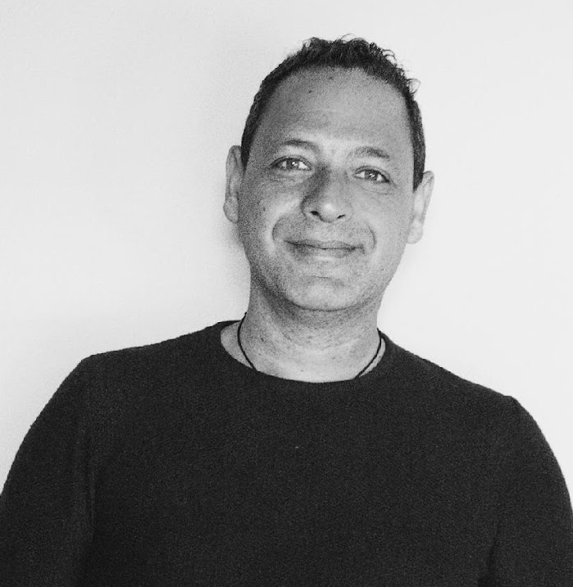






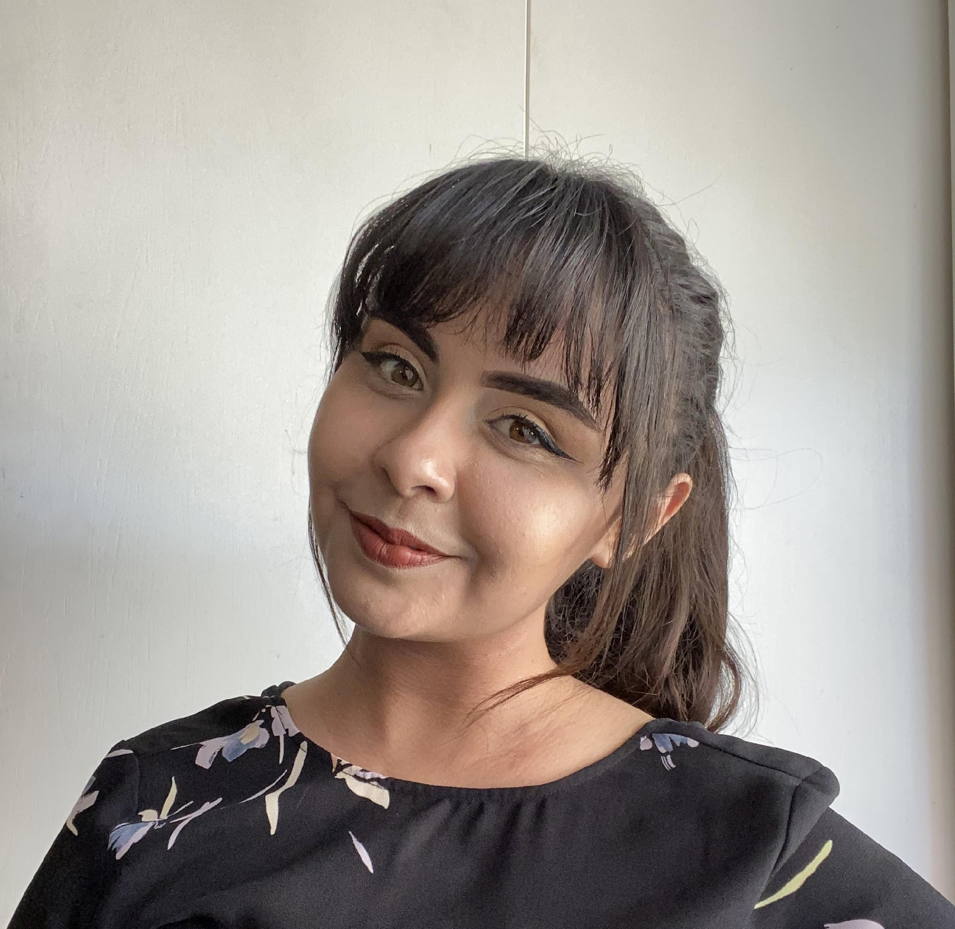
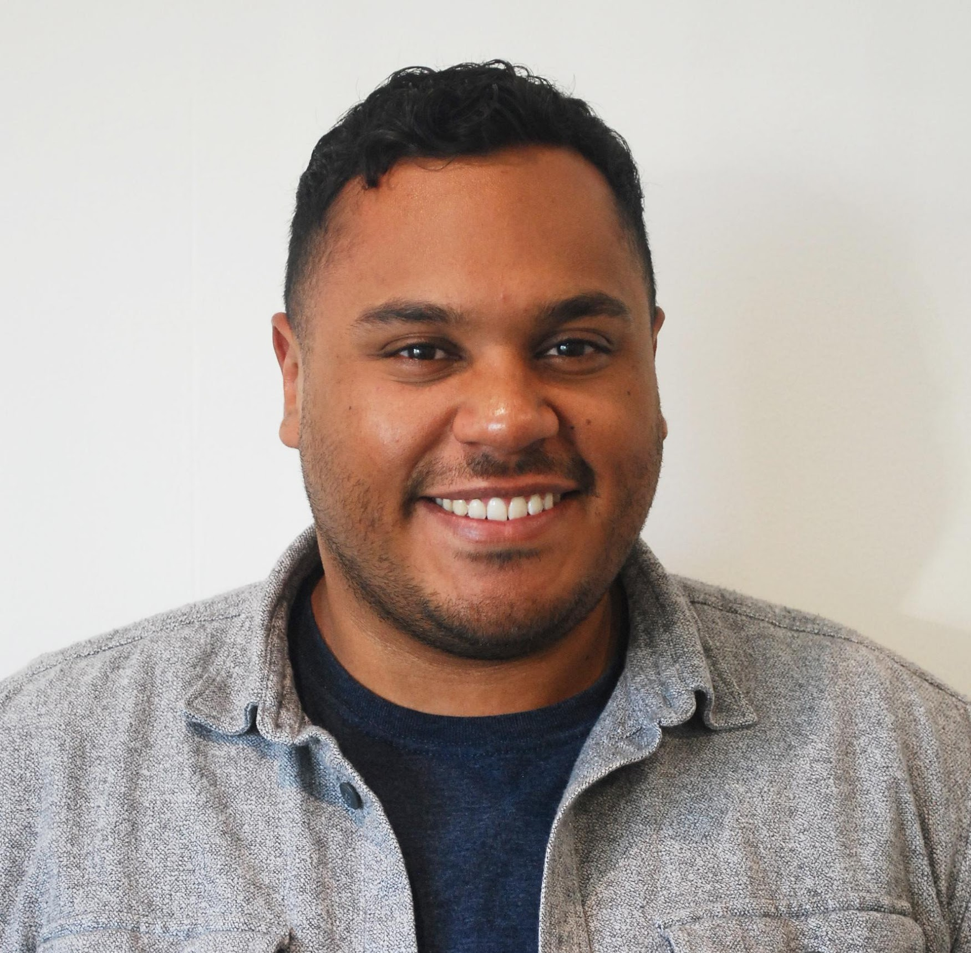


MEET OUR EXECUTIVE TEAM
GLENN NEUGARTEN
PAIGE DANSKER
STEFAN LASEK
OWNER/CEO
PRESIDENT
VP OF SALES
VINCENT FLANAGAN
TATIANNA GONZALES
MATTHEW VARGAS
VP OF OPERATIONS
DIRECTOR OF PROJECTS
QUOTING MANAGER

Slide 6

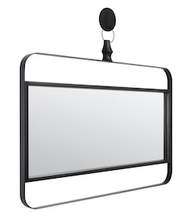
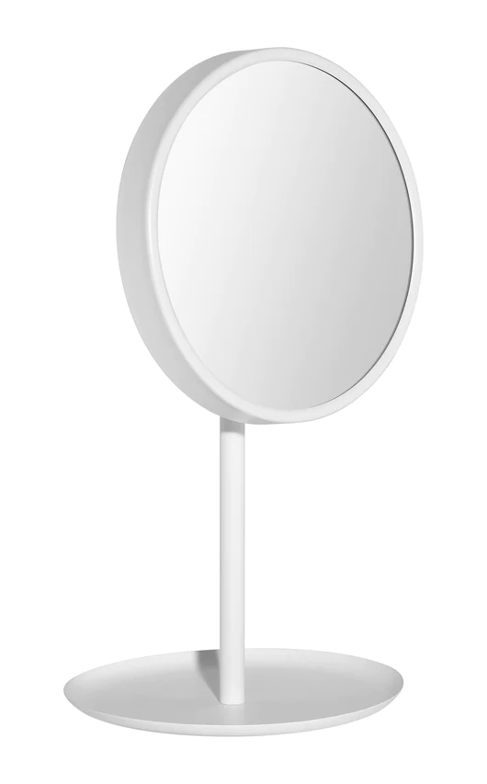
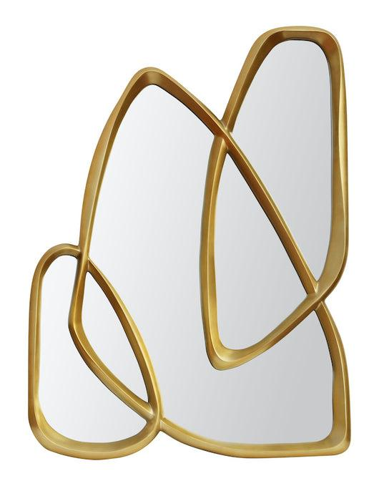
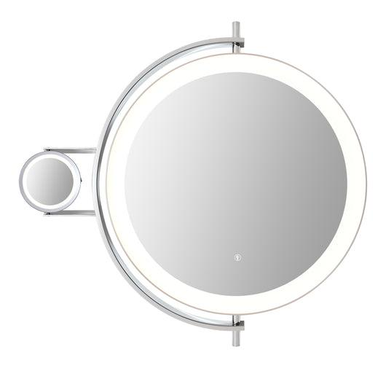
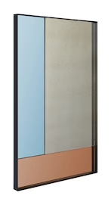
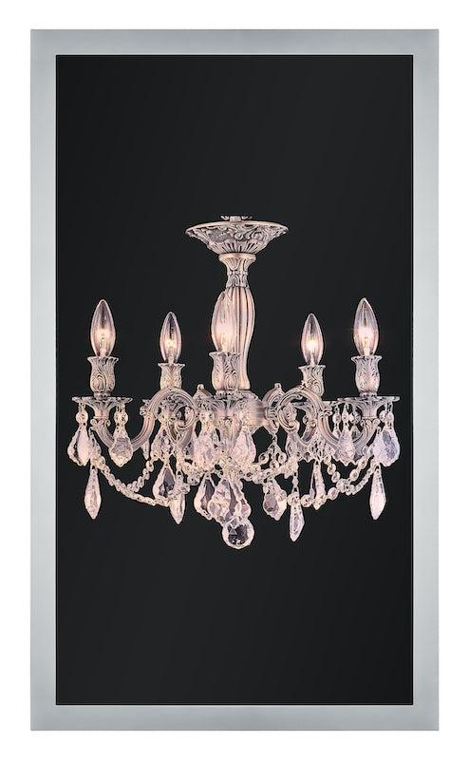
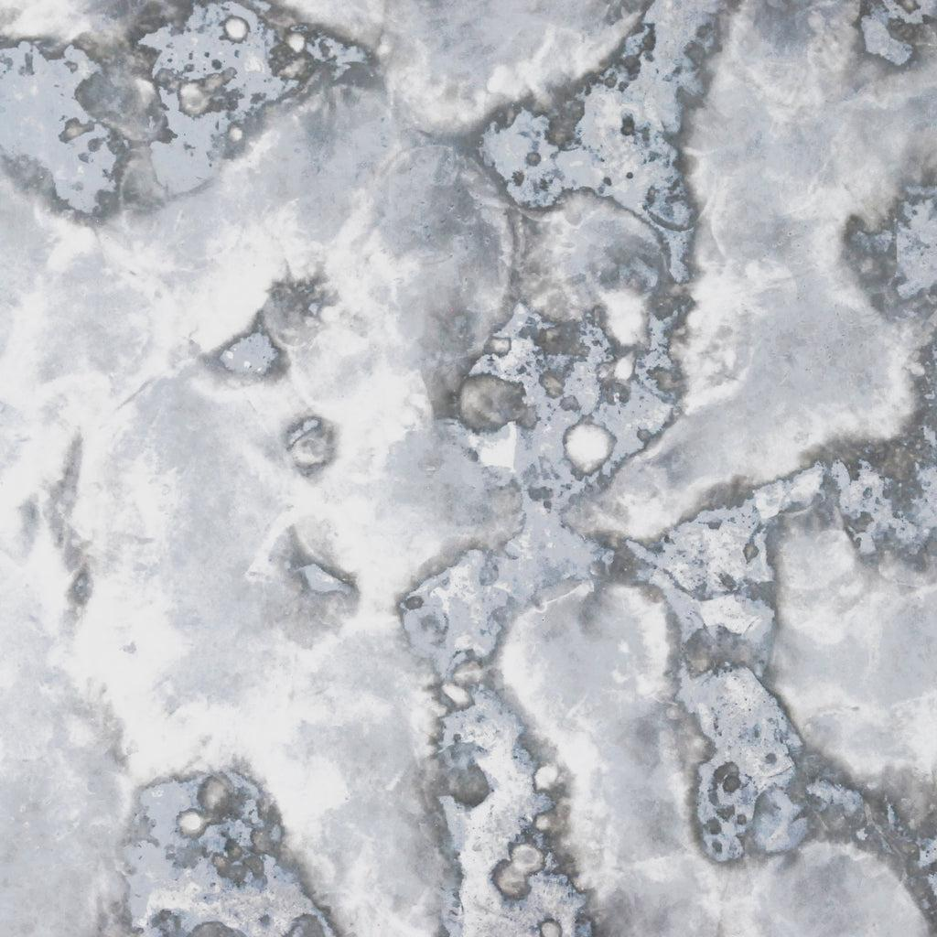
MIRROR TYPES
BACKLIT MIRRORS
NON LIT MIRRORS
MAKEUP MIRRORS
DECORATIVE MIRRORS
SMART MIRRORS
ART
MIRROR SHEETS
ANTIQUE + COLOR MIRRORS

Slide 7
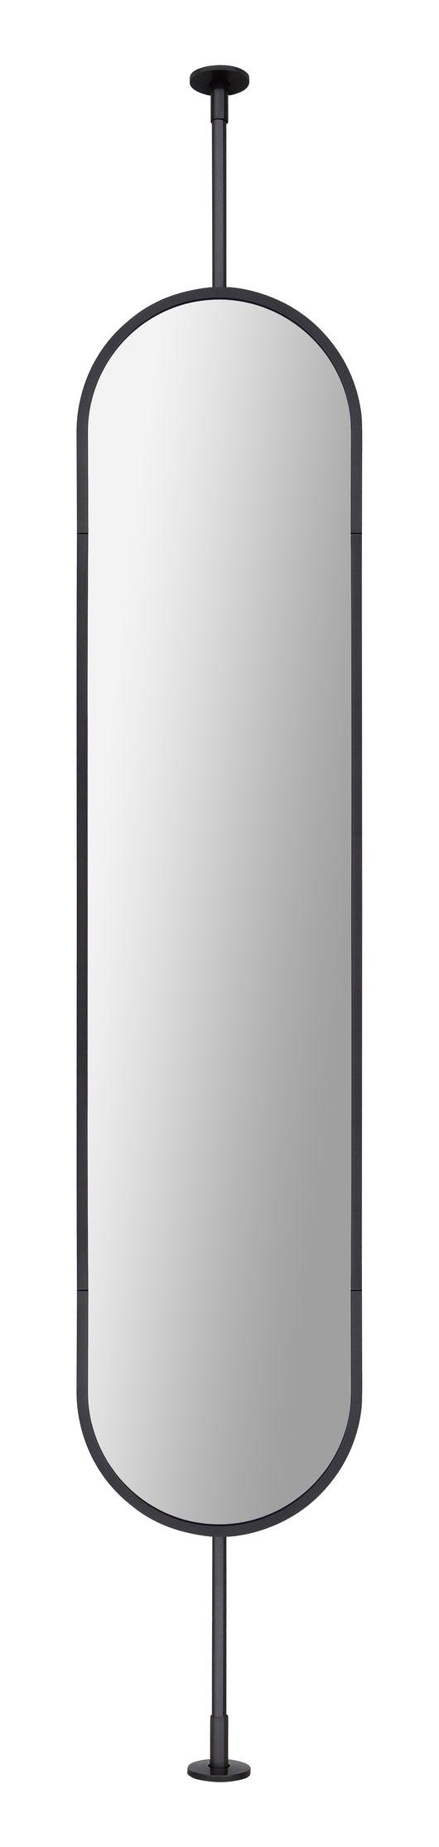
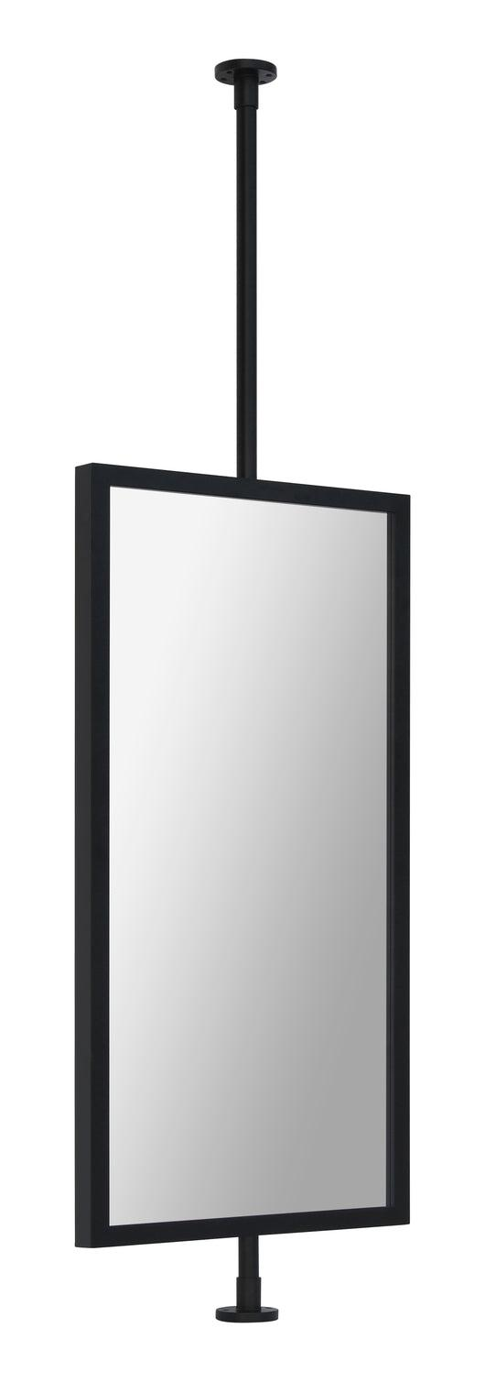
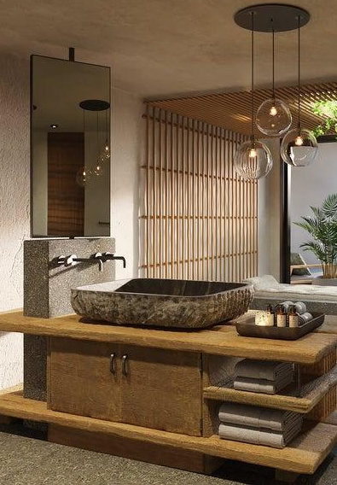
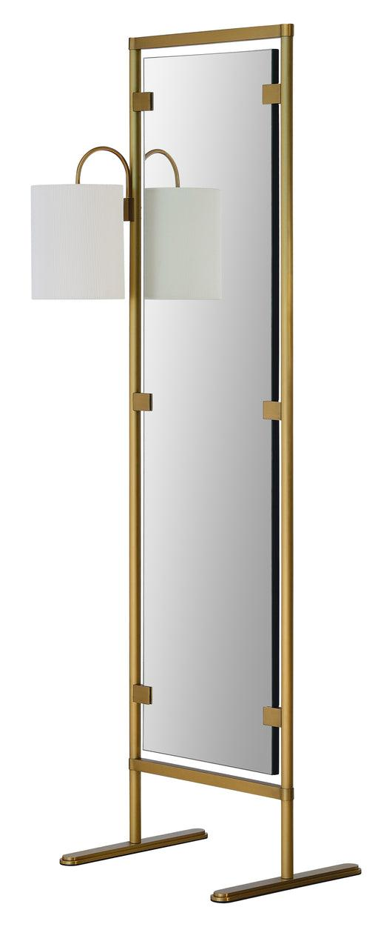
MIRROR MOUNTING OPTIONS
FLOOR AND OR CEILING
1 Hotel Hanalei Bay
16167
16125
16177

Slide 8
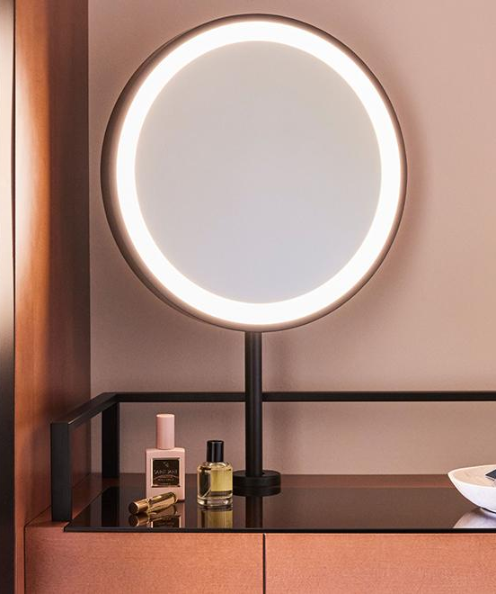
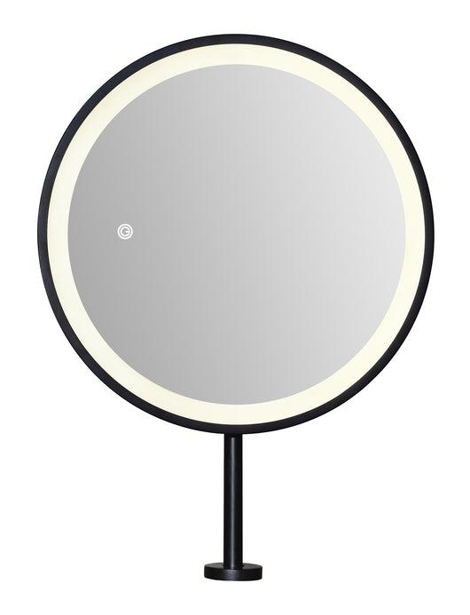
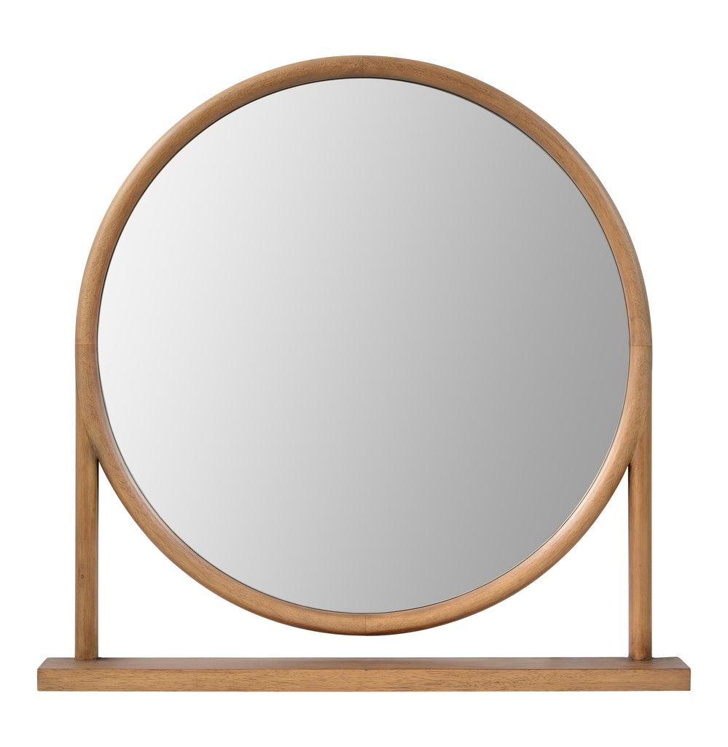
MIRROR MOUNTING OPTIONS
COUNTER
16088
Omni Boston Seaport
16155

Slide 9
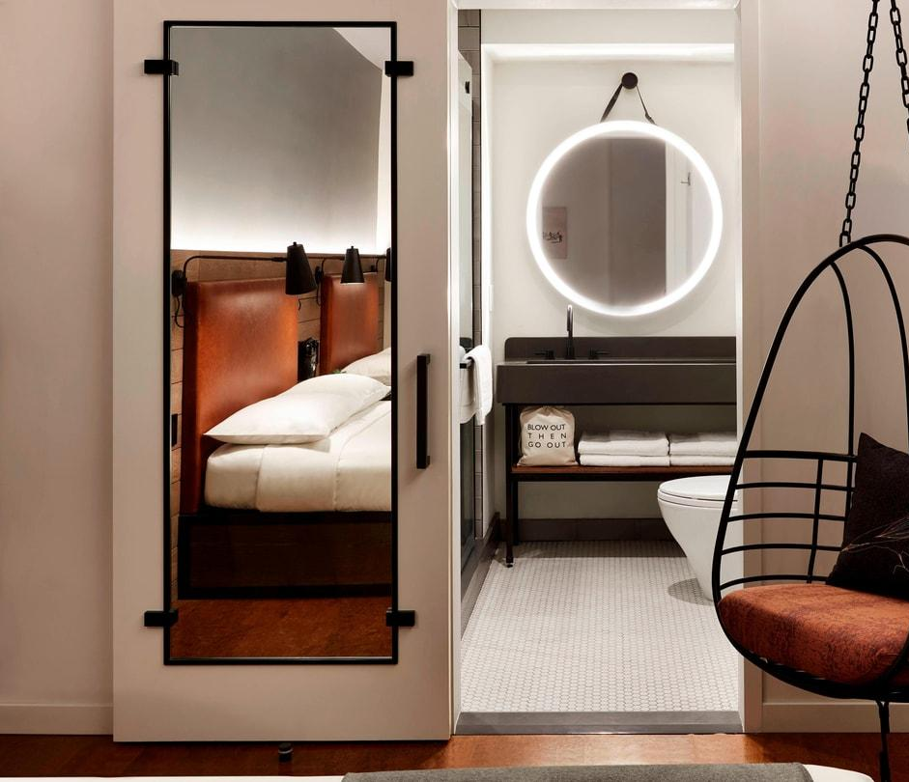
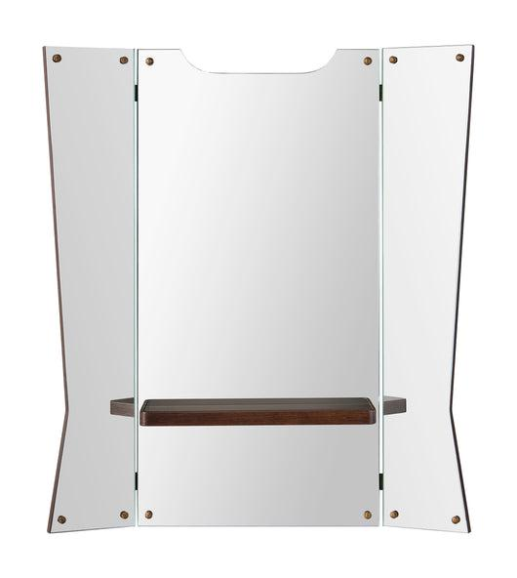
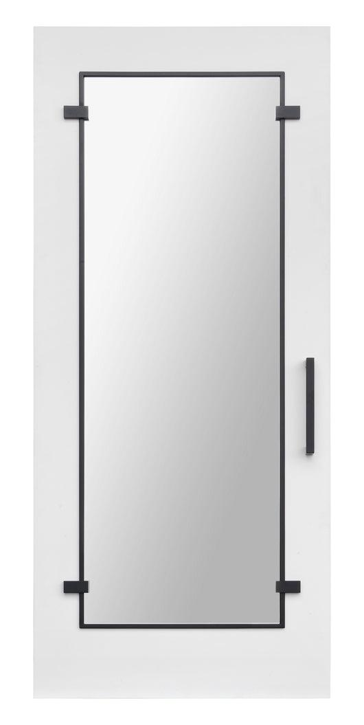
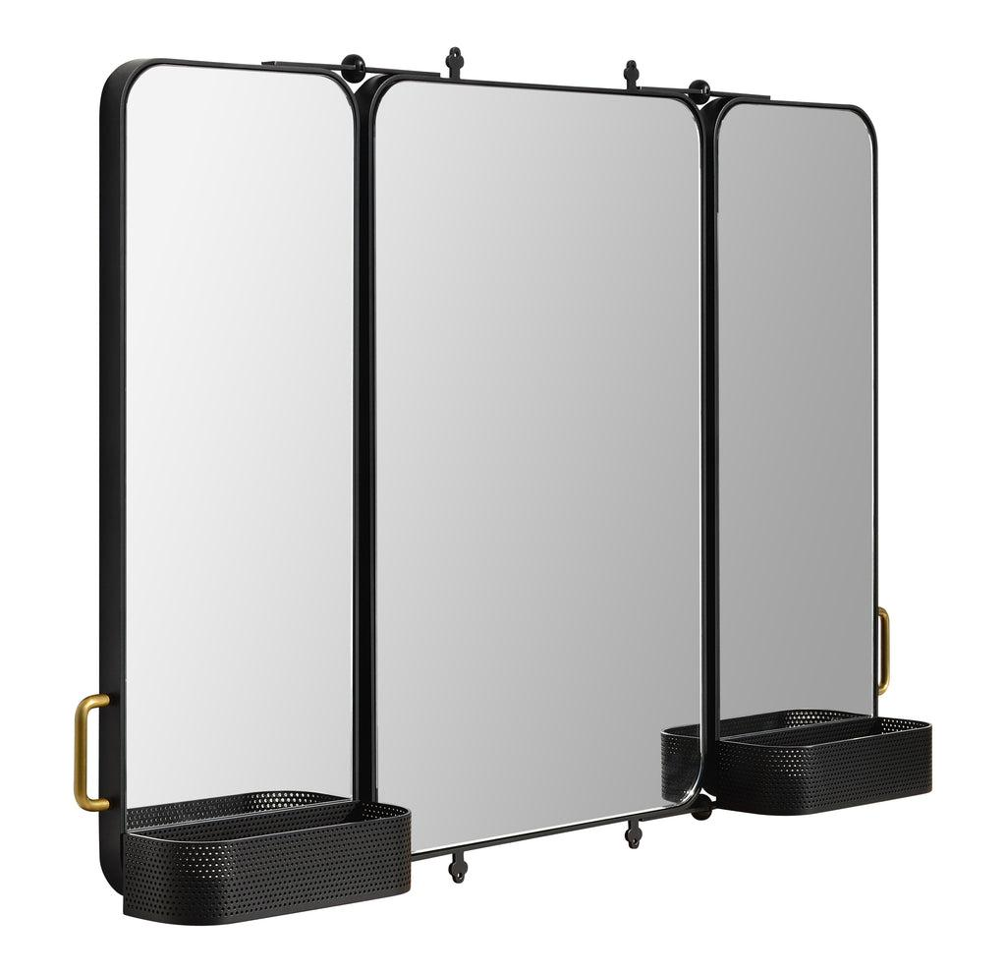
MIRROR MOUNTING OPTIONS
WALL
16178
Moxy Downtown NYC
15920

Slide 10
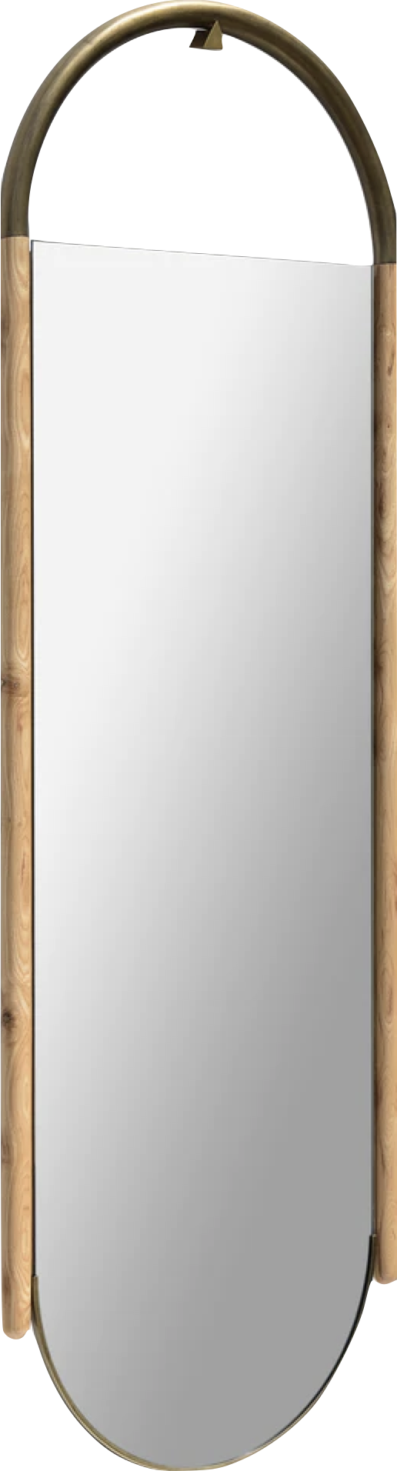
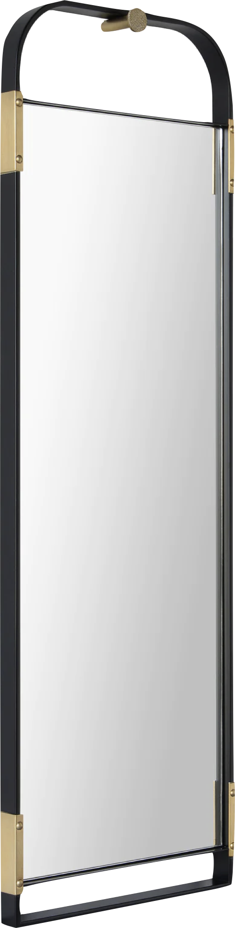

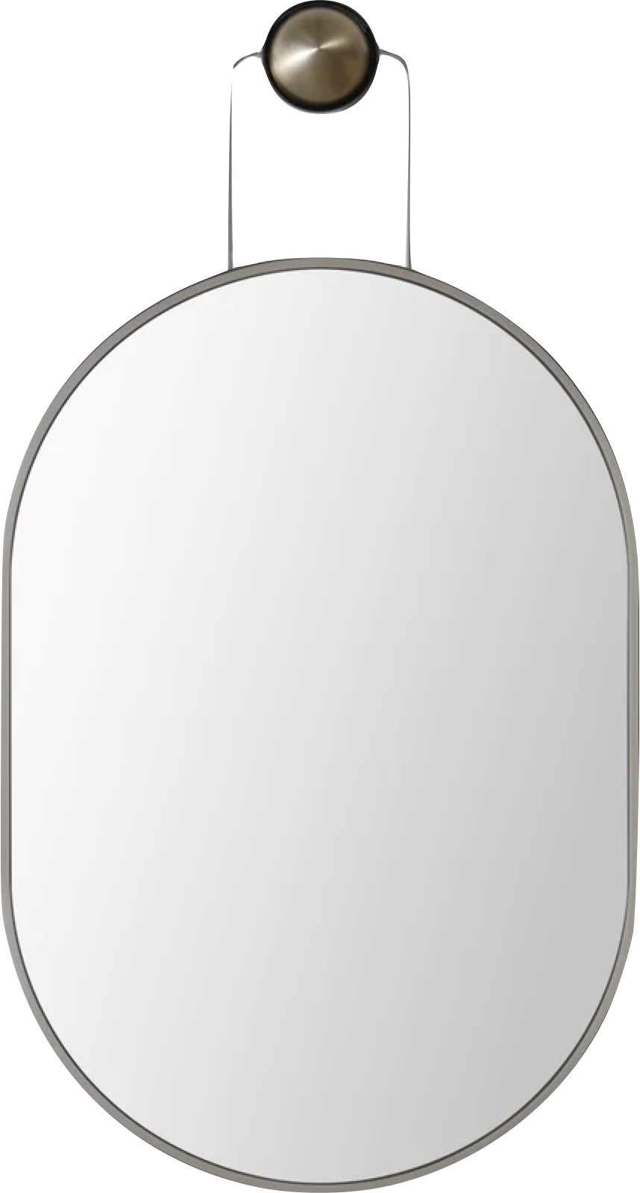
SUSPENDED MIRRORS
16194
16222
16042
16232

Slide 11
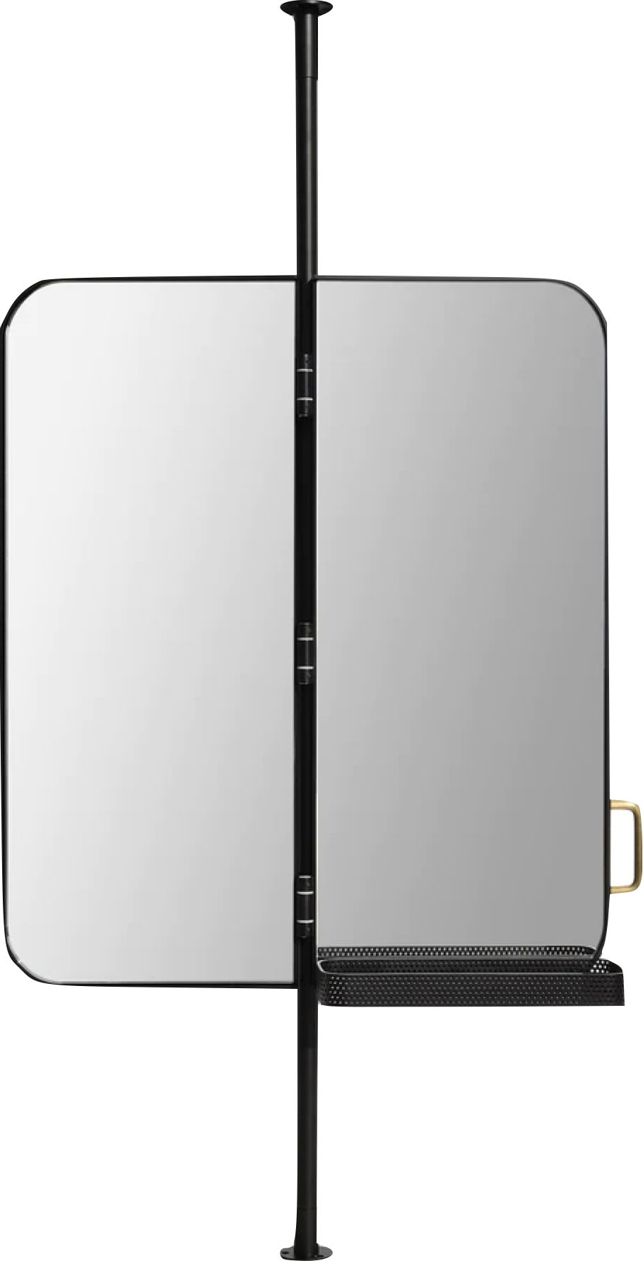
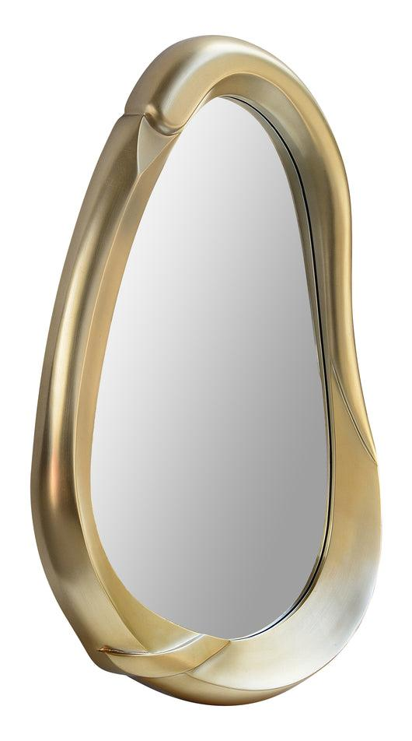
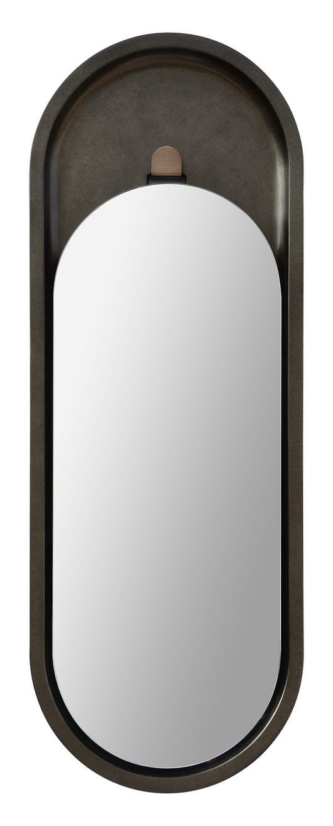
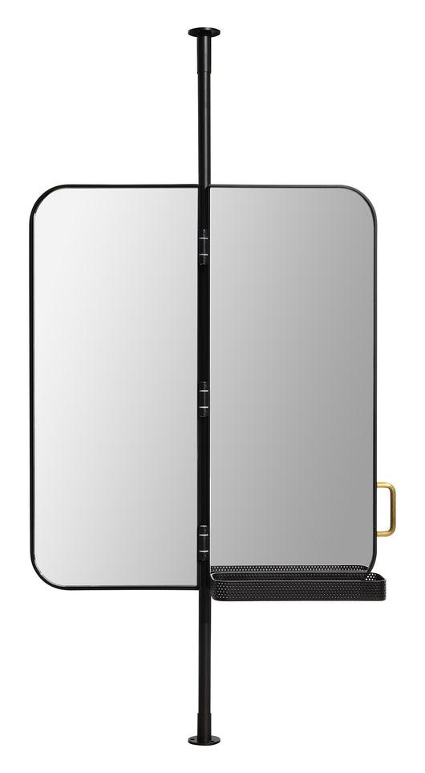
EXCITING MATERIALS
+ FINISHES
POLYURETHANE
16024
PERFORATED METAL
16147
16109

Slide 12
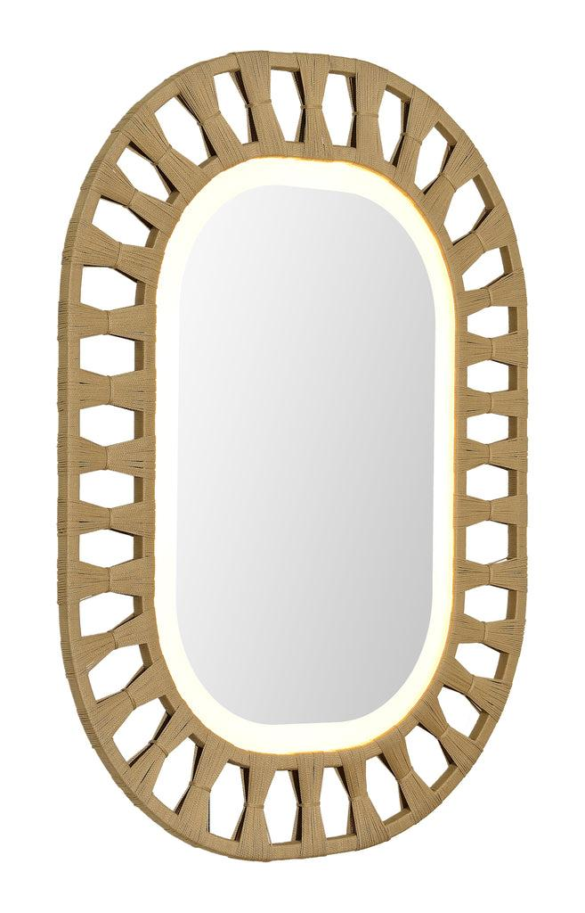
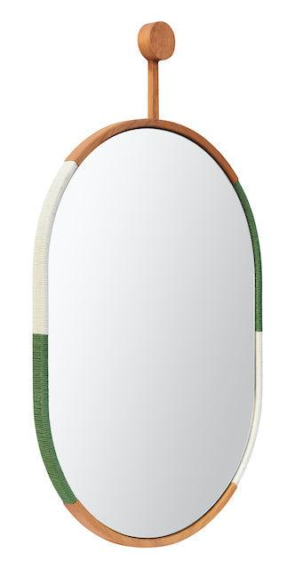
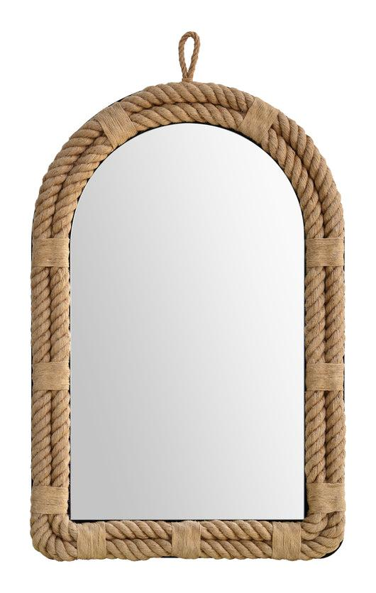
EXCITING MATERIALS
+ FINISHES
ROPE
16219
16319
16206

Slide 13
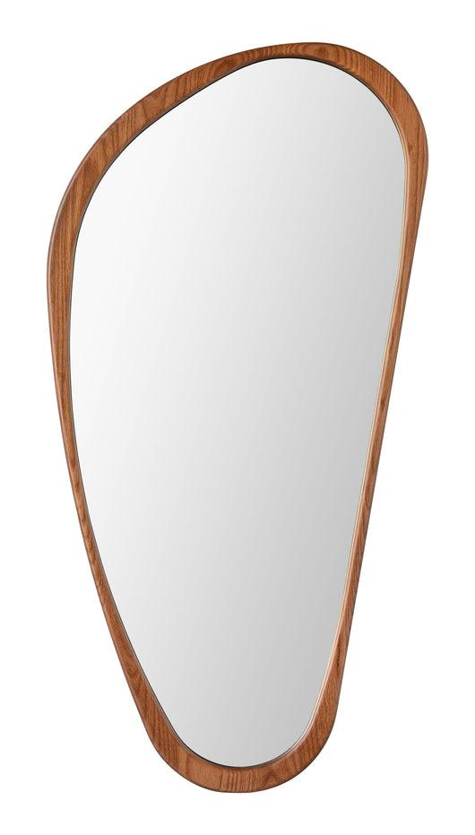
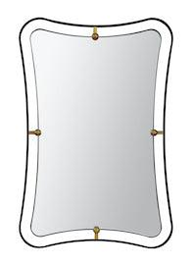
UNIQUE
SHAPES
16303
16217
16322

Slide 14

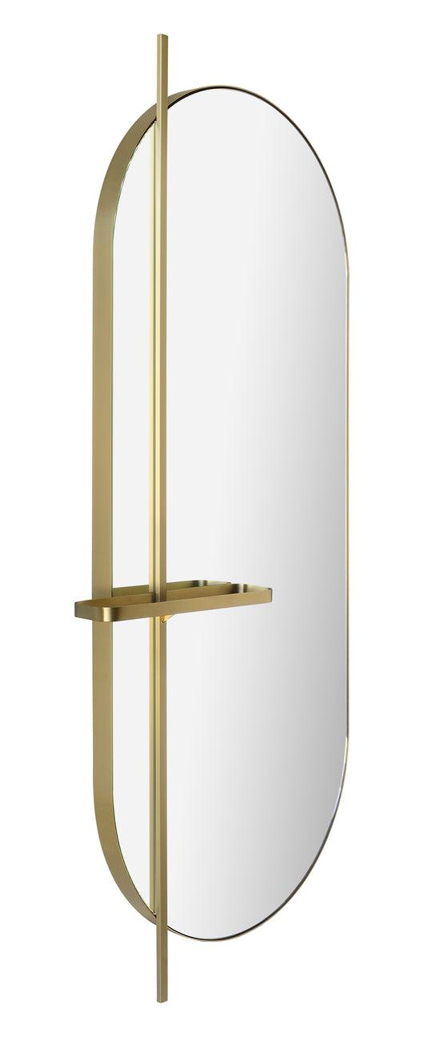
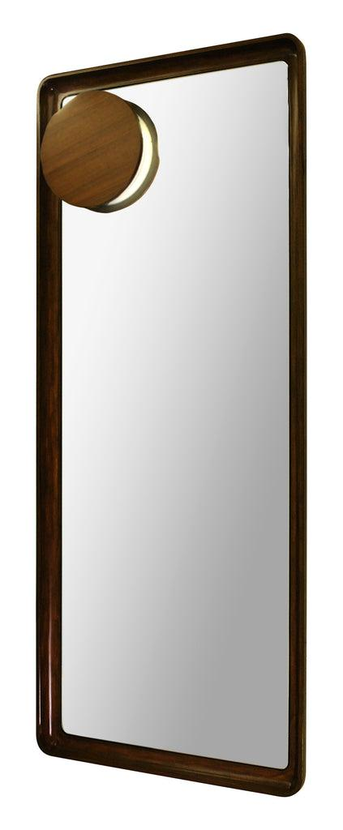
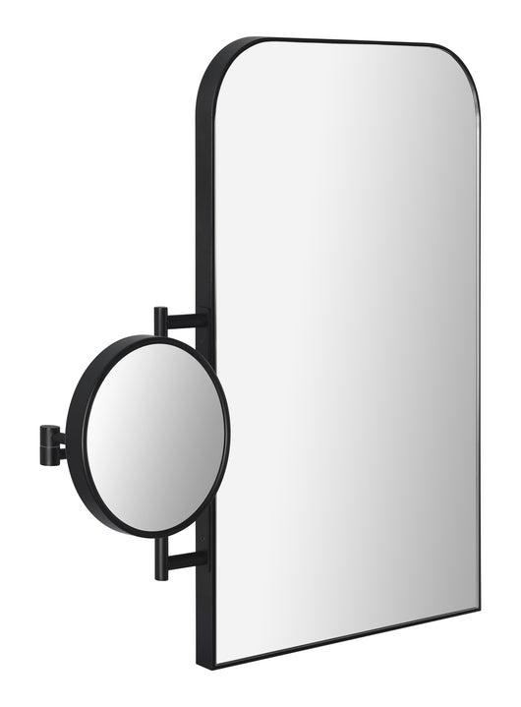
ACCESSORIES
HOOK
SHELF
SCONCE
16160
16224
MAKEUP MIRROR
30055
16225

Slide 15
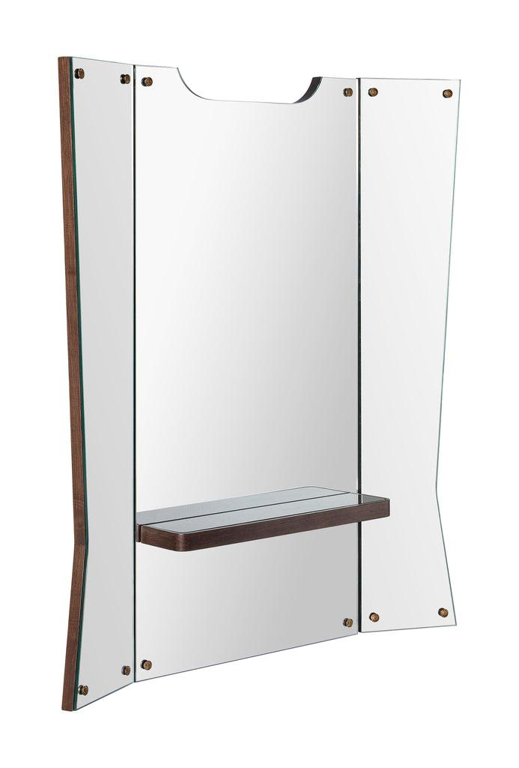
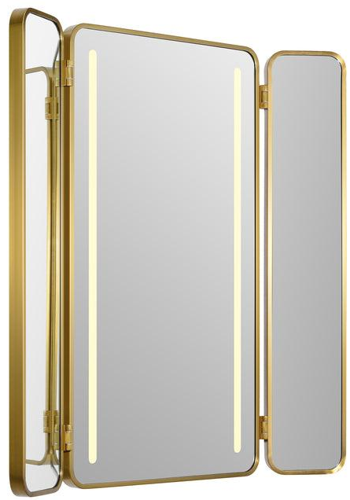
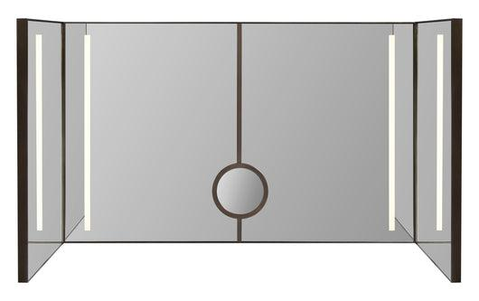
MULTI PANEL
HINGES CAN BE FIXED OR OSCILATE
DEPENDING ON GIVEN DEGREE
16178
16164
16244

Slide 16
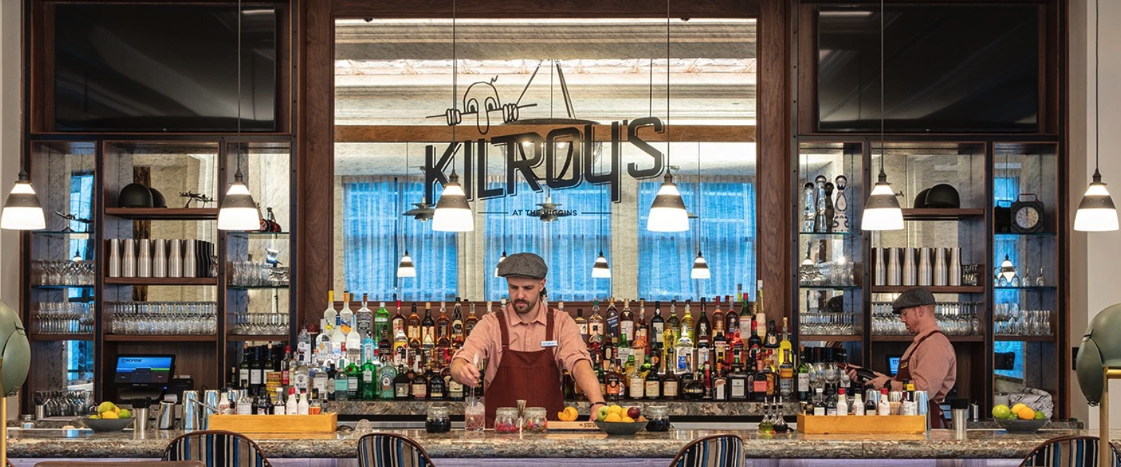
ANTIQUE + COLOR MIRROR

Slide 17
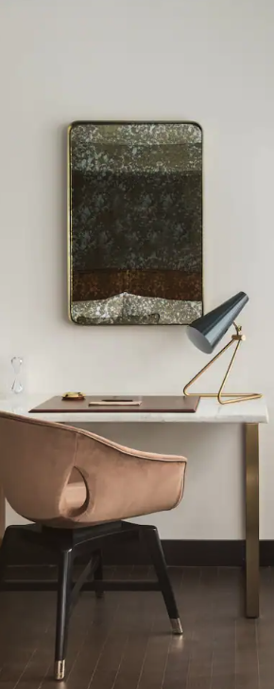
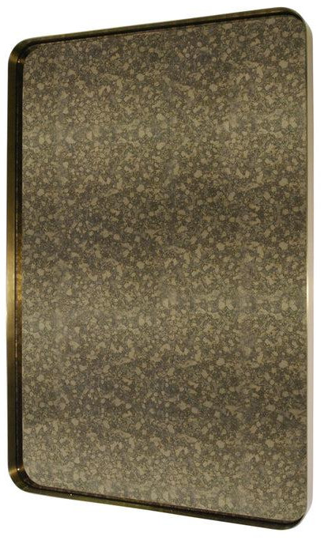
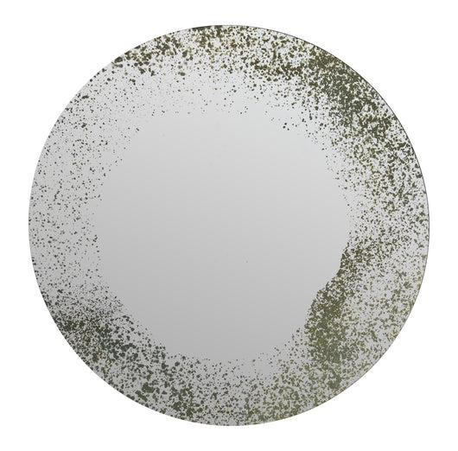
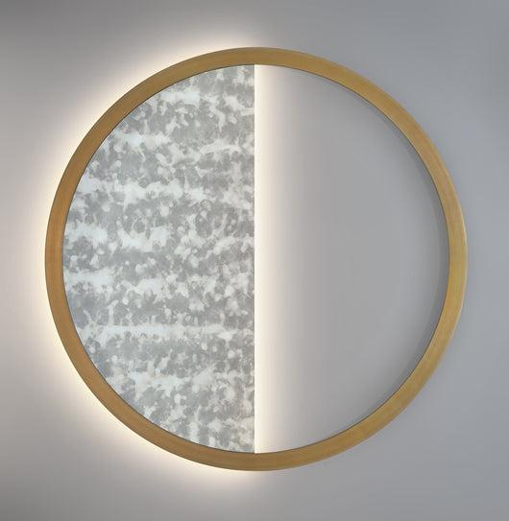
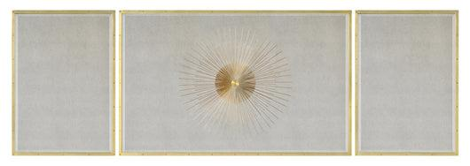
ANTIQUE MIRROR
30067
16124
16175
Thompson Dallas 30067
16288

Slide 18


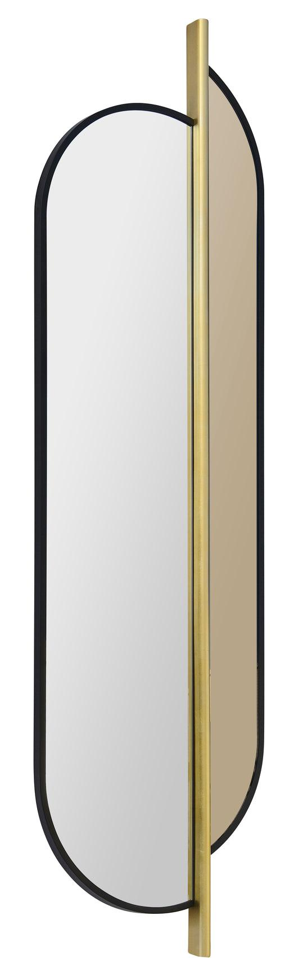
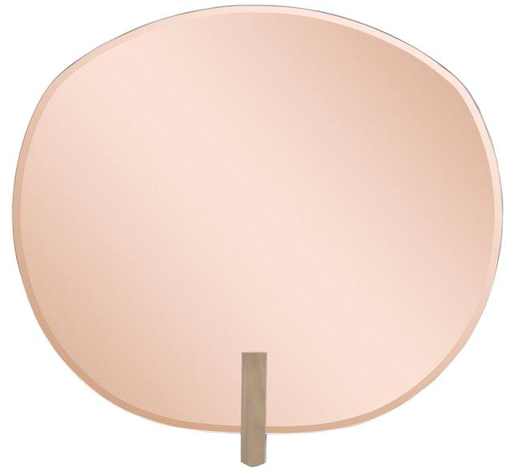
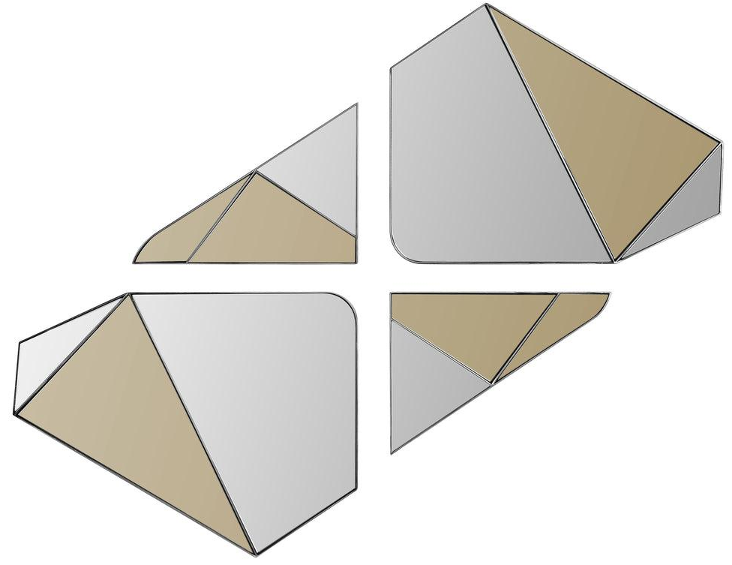
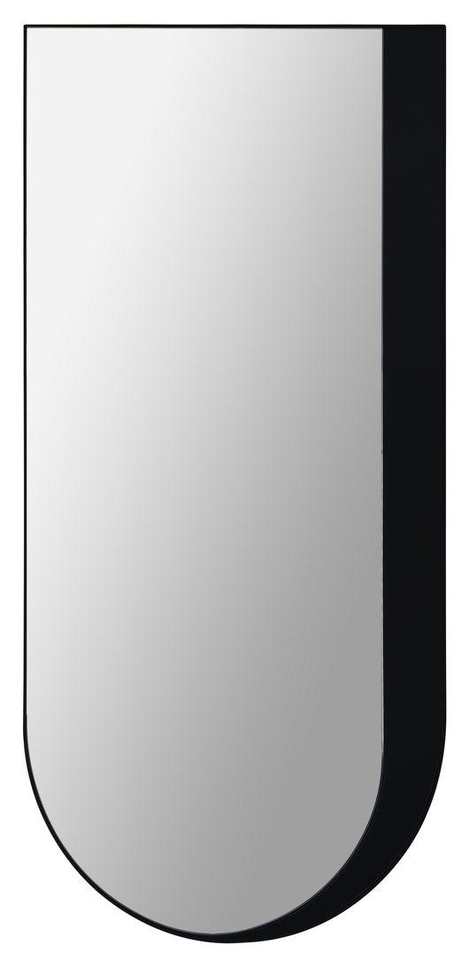
16072
16032
16107
16032
COLOR MIRROR
16051

Slide 19





BACKLIT MIRRORS
16212
16331
16166
16323
16193

Slide 20



UNIQUE LIGHTING OPTIONS
LIGHTING INSET
IN FRAME
THOMPSON AUSTIN HOTEL + RESIDENCES
16085
16282

Slide 21



UNIQUE LIGHTING OPTIONS
SCONCES
Thompson DC | 15969
15999
16238

Slide 22
WHEN SPECIFYING CONSIDER…
BACKLIT MIRRORS
Cord Type (Hardwire, flat plug, standard plug and cord length
J Box Location
Are there room controls for this mirror to connect to?
Dimmer Switch? If so, where should it dim from?
CRI (Coloring Rendering Index) Mirror Image Standard is 93
Light Source – will this be the only light source in the room? If so lets turn it up a notch
Bulb Temperature

Slide 23




MAKEUP MIRRORS
MM15230
30109
MM15218
WALL MOUNTED
MM15213PB

Slide 24





MAKEUP MIRRORS
The Shay Hotel
16157
16215
COUNTERTOP
MM15217
16138

Slide 25




MAKEUP MIRRORS
16029
16144
16030
AS AN ACCESSORY
TO A MIRROR
15992
16225

Slide 26






PLUS
ADD TECHNOLOGY TO ANY OF OUR MIRRORS
Bluetooth with Embedded Speakers
Charging
Defogger
Lifestyle Dimmer
Lifestyle Lighting
Motion Sensor Lighting
Nightlight

Slide 27






PUTTING THE IMAGE IN MIRROR IMAGE
PRINT ON GLASS
16063
16133
PRINT ON
WOOD + MIRROR
PRINT ON
DURATRANS
PRINT ON
ANTIQUE MIRROR
PRINT ON
MIRROR
PRINT ON WOOD

Slide 28
PRODUCT LEAD TIMES
READILY AVAILABLE
SIMPLE FRAMING
MIRROR
SHEETS
MODEL
ROOMS
CUSTOM PRODUCT
AVAILABLE IN LOS ANGELES WITHIN 5-7 BUSINESS DAYS
AVAILABLE TO SHIP FROM LOS ANGELES WITHIN 2-6 WEEKS
IF STOCKED, SHIPPED WITHIN 5-7 BUISNESS DAYS
OTHERWISE, 8-12 WEEKS
DEPENDING ON THE PROJECT BUT CAN BE MADE WITHIN 30 DAYS FROM ALL APPROVALS IF NEEDED
12-16 WEEKS DEPENDING ON THE PROJECT

Slide 29
THANK YOU
STEFAN LASEK
STEFAN@MIRRORIMAGEINC.COM
www.mirrorimageinc.com

