Slide 1

Blackhole Transmission Network (BHTN) Zero-Residency Data Architecture (ZRDA) Platform
A new foundational layer for secure data movement that eliminates data-at-rest entirely.
BHTN Technologies, Inc (Est. 2025)
Matthew Korn
Dr. Jonathan Wayne Korn

Slide 2
The Problem
Data at rest is the single greatest liability in modern computing, it creates:
ransomware exposure,
breach vulnerability,
insider access risk,
compliance overhead,
and centralized attack surfaces.
No matter how well it’s encrypted, monitored, or segmented… if data exists at rest, it can be stolen, locked, leaked, or misused.

Slide 3
The Breakthrough
Zero-Residency Data Architecture (ZRDA)
The world’s first architecture that eliminates reconstructible data at rest entirely.
Data never sits. Data never accumulates. Data never becomes an attack surface.
Instead:
Data exists only in encrypted motion, continuously distributed across a dynamic, self-healing mesh.
No files.
No storage.
No persistence.
No reconstructible artifacts.
Nothing an attacker can steal, encrypt, exfiltrate, or ransom.
ZRDA is not storage.
ZRDA is not compute.
ZRDA is a new category: data-in-motion architecture.

Slide 4
Core Innovation (High-Level)
Zero Residency
No reconstructible data at rest—anywhere.
Data never becomes a static asset.
The attack surface collapses to zero.
Fragment Motion
Data is encrypted, atomized, and kept in continuous motion across the mesh.
Nothing sits. Nothing accumulates. Nothing can be stolen.
Distributed Mesh
A dynamic WAN/LAN network where fragments circulate, self-heal, rebalance, and evaporate.No central store.
No single point of compromise.
Client-Side Compute
All encryption, fragmentation, and reconstruction occur only in volatile client memory.
No server ever sees plaintext, keys, or reconstructible data.
HSM-Backed Tokenization
Keys never touch the mesh.
Hardware-rooted tokens authorize reconstruction without exposing secrets.Ephemeral, single-use, tamper-proof.
Automatic Evaporation
Fragments self-expire via deterministic TTL logic.
Keys are destroyed after use.
Data disintegrates automatically—even if no one deletes it.

Slide 5
Prototype Milestones
LAN Mesh Prototype — Completed
Fully functional fragment-motion mesh running in RAM only.
Demonstrated secure upload, distributed motion, TTL evaporation, and reconstruction.
WAN + LAN Unified Mesh — In Progress
Global distributed mesh with NAT-safe WAN peers integrating into LAN topology.
Cloudflare-based discovery, unified peer tables, and WAN fragment motion.
Client-Side ZRDA Architecture — Completed
Local-only encryption, fragmentation, and reconstruction in volatile memory.
Enables true end-to-end zero residency with no server-side plaintext exposure.
Provisional Patent Filed — ZRDA + BHTN Architecture (Application #63/930,024)
Comprehensive IP submitted covering zero-residency architecture, fragment motion, distributed reconstruction, and tokenized key release.

Slide 6

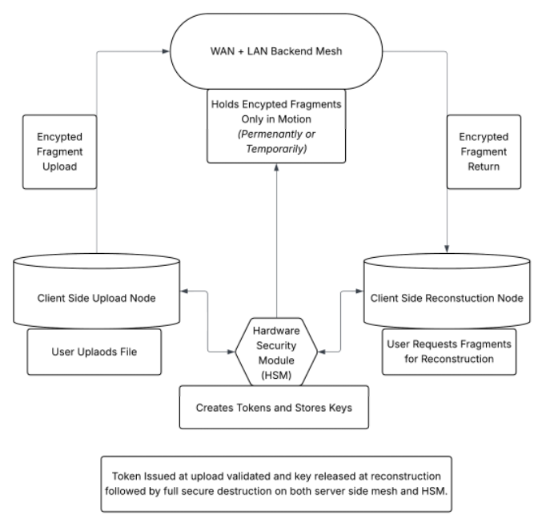
Architecture (Redacted High-Level Diagram)

Slide 7
Market Impact
Secure File Transfer (Zero-Residency)
End-to-end encrypted, ephemeral, client-side reconstructed transfers. Perfect for finance, legal, government, and enterprise workflows. No server ever holds retrievable data.
Medical, EHR & PHI Delivery
Compliant-by-design data movement. PHI exists only in volatile memory—never stored, never retained. Eliminates HIPAA breach vectors and audit burdens.
CDN-Grade Artifact Delivery (RAM-Only)
Software artifacts, binaries, media, and updates delivered via a motion-based mesh. No origin storage, no repository compromise, no tamper surface.
Zero-Trust Communications (Messaging + Email)
Messages transmitted as vanishing encrypted fragments. No inboxes, no servers holding content, no breach blast radius. A redefinition of secure communication.
Decentralized Storage Alternative
Not storage — post-storage architecture. Data never sits, never rests, never accumulates. A distributed mesh replaces the need for centralized stores.
AI Model + Dataset Distribution
A secure distribution layer for LLM weights, embeddings, datasets, and inference artifacts. Protects proprietary models and sensitive training data. Eliminates IP leak risk and central repository exposure.

Slide 8
Why We Are Reaching Out
1. Strategic Alignment With Vast’s Vision
Vast is building a global, disaggregated data platform.
ZRDA introduces the next evolution: a data layer where nothing ever resides — only moves.
This extends Vast’s architecture into the post-storage frontier.
2. Next-Generation Distributed Compute
BHTN moves the industry from: data-at-rest → data-in-motion, static stores → self-healing meshes, centralized persistence → dynamic, ephemeral compute.
Aligned with Vast's push toward Exabyte-scale, global data fabrics.
3. Zero-Trust & Zero Data-at-Rest Future
Regulators, enterprises, and governments are shifting toward architectures that eliminate breach surfaces.
ZRDA enables: zero-residency, zero persistence, zero reconstructible artifacts
This directly complements Vast's security posture and long-term cloud strategy.
4. Potential for Integration, Partnership, or Co-Development
BHTN is not competing with storage — it redefines the layer above it.
Opportunities include: Secure motion layer integrated with Vast’s global namespace, Joint innovation around ephemeral compute fabrics, Co-branded government/enterprise offerings, Strategic investment or acquisition pathway

Slide 9
What We Can Show
1. A 15-Minute Technical Deep-Dive (Non-Sensitive)
A clear high-level walkthrough of ZRDA and BHTN:
Why zero-residency is a new category, How data-in-motion replaces data-at-rest, How tokenized reconstruction works without revealing IP, How the mesh eliminates traditional storage risks
Designed to respect NDAs and protect our proprietary mechanisms.
2. Architectural Strategy & Integration Potential
We outline the future state:
How a zero-residency mesh complements Vast’s global namespace, How ephemeral compute aligns with Vast’s disaggregated architecture, Where ZRDA fits within modern data, AI, and security ecosystems, Pathways for partnership, co-development, or strategic investment
This positions the conversation at a strategic, visionary level.
3. Live Prototype Demonstration
We can demonstrate core functions of the working MVP:
Client-side ZRDA encryption + fragmentation in RAM, WAN + LAN mesh fragment motion, Real-time TTL evaporation, Tokenized reconstruction, End-to-end ephemeral data delivery.
No mockups. No animations. A real, running system. This shows credibility, execution ability, and technical depth.

Slide 10
Thank you
Matthew Korn
631-456-9901
mattkorn10@gmail.com
Dr. Jonathan Wayne Korn
631-210-4162
jonathankorn71@yahoo.com

