Slide 1
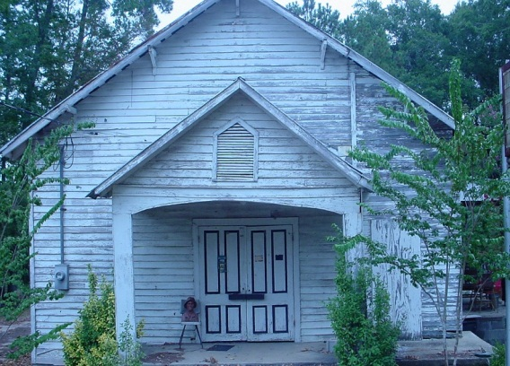
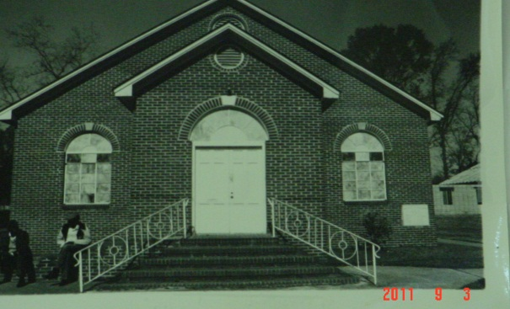
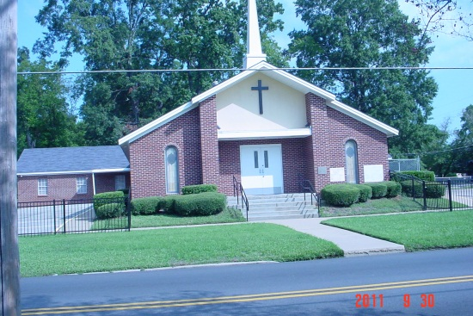

Greater St. Paul Missionary Baptist Church
Rev. E. J. Marshall, Sr., Pastor
Deacon G. L. Miller, Chairman
A Collage of History

Slide 2
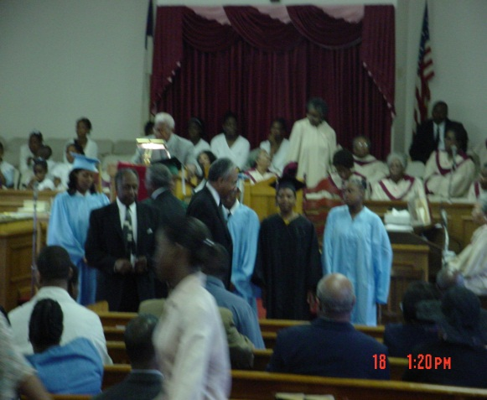
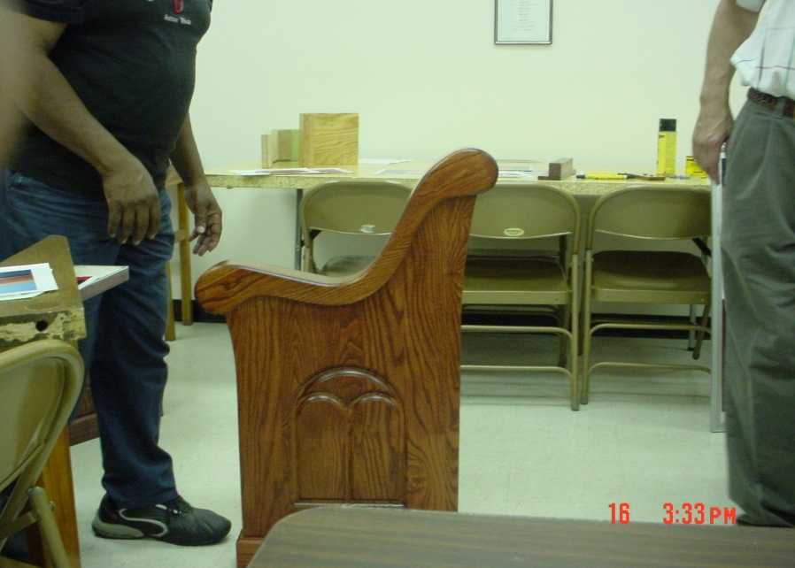
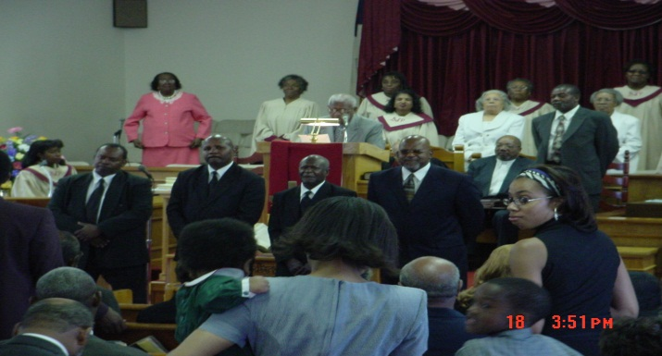
Down Through The Years The Lord Has Been Good To Our Church Family!!!!

Slide 3
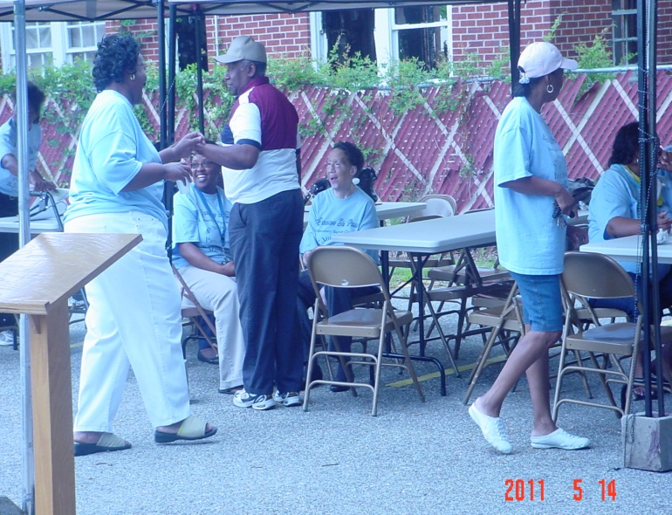
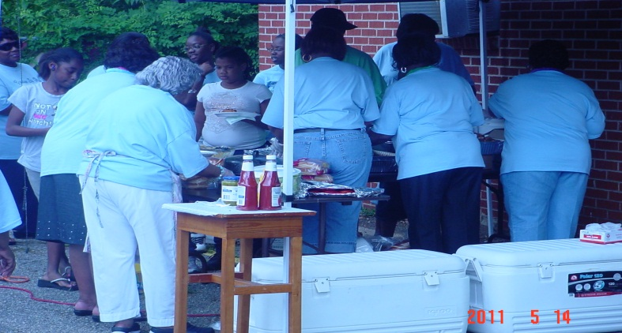
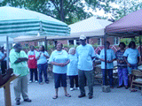
To God Be The Glory
The Joy of Fellowship

Slide 4
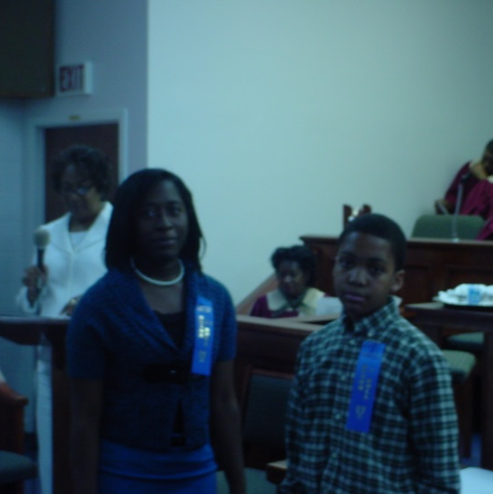
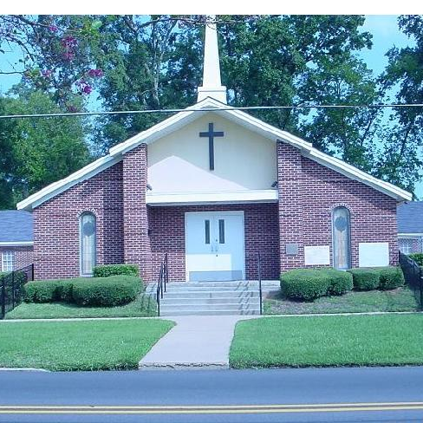
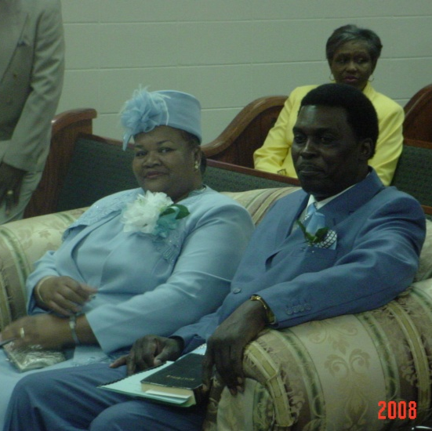
“To God Be The Glory”
Greater St. Paul Missionary Baptist Church

Slide 5
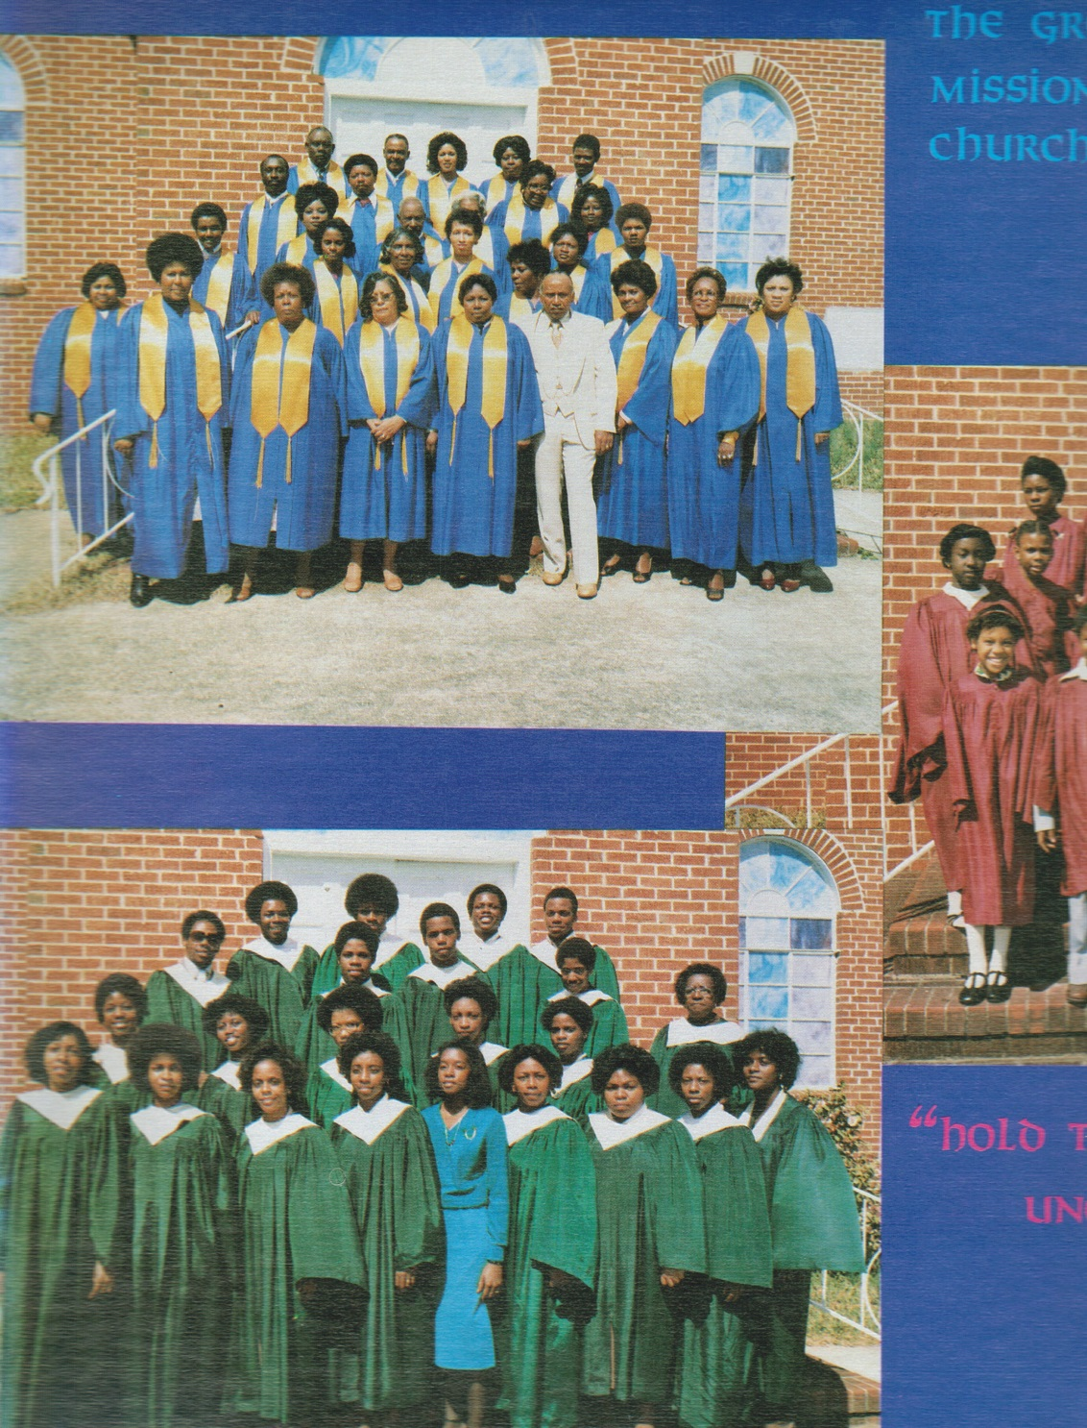
The Greater St. Paul Missionary Baptist Church are so thankful for all the blessings that God has allowed this Family of Believers to accomplish.

Slide 6
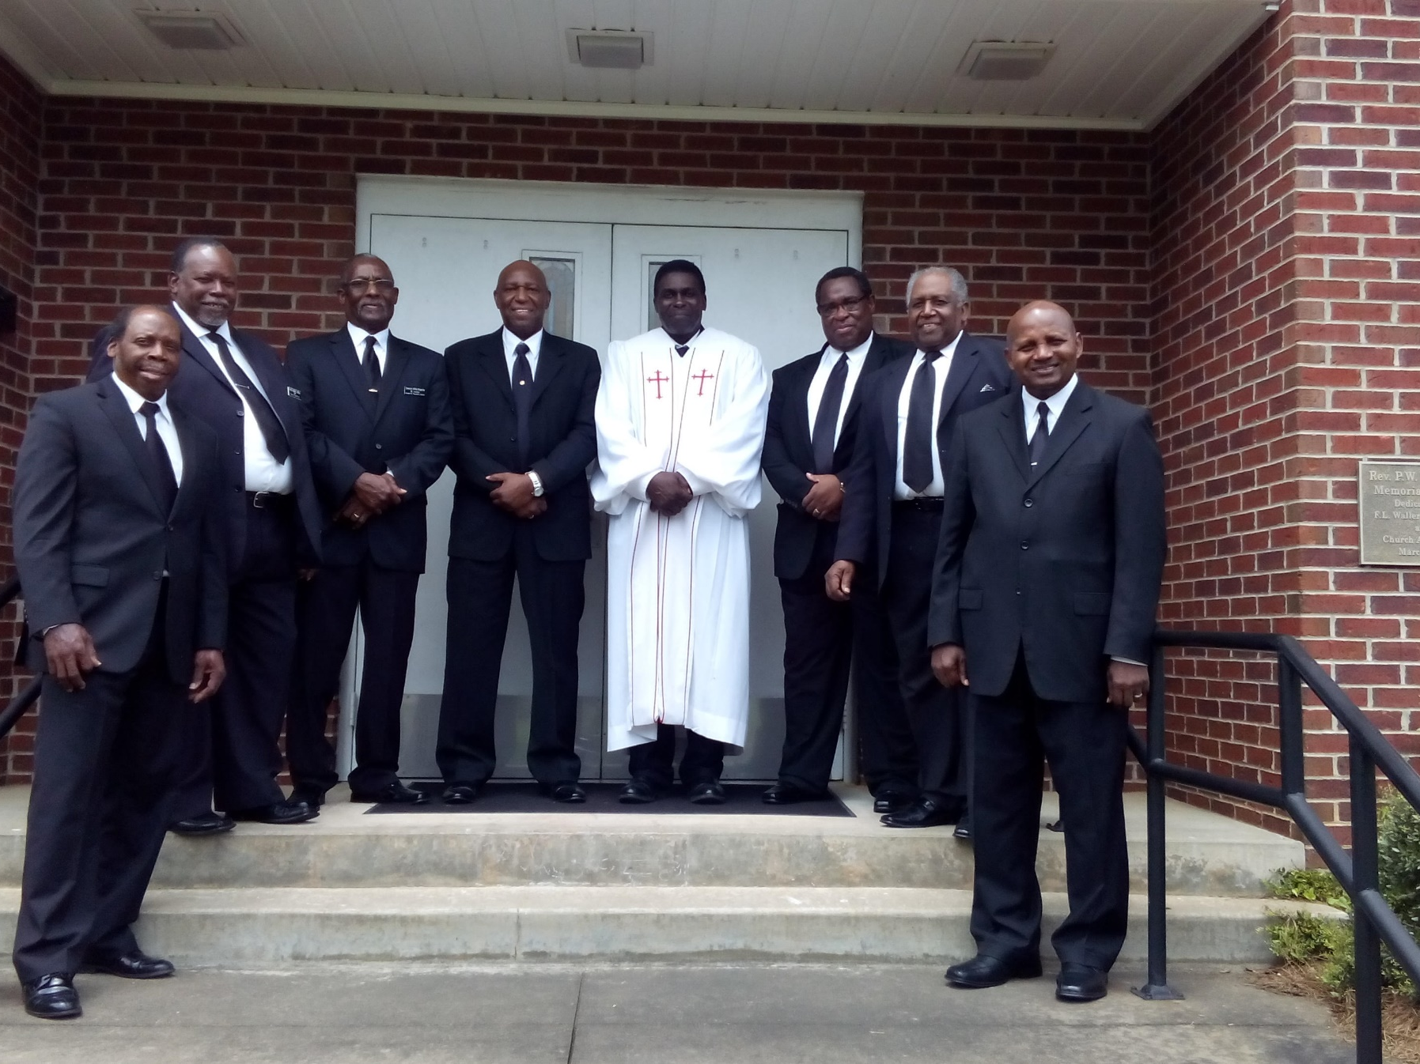

Slide 7
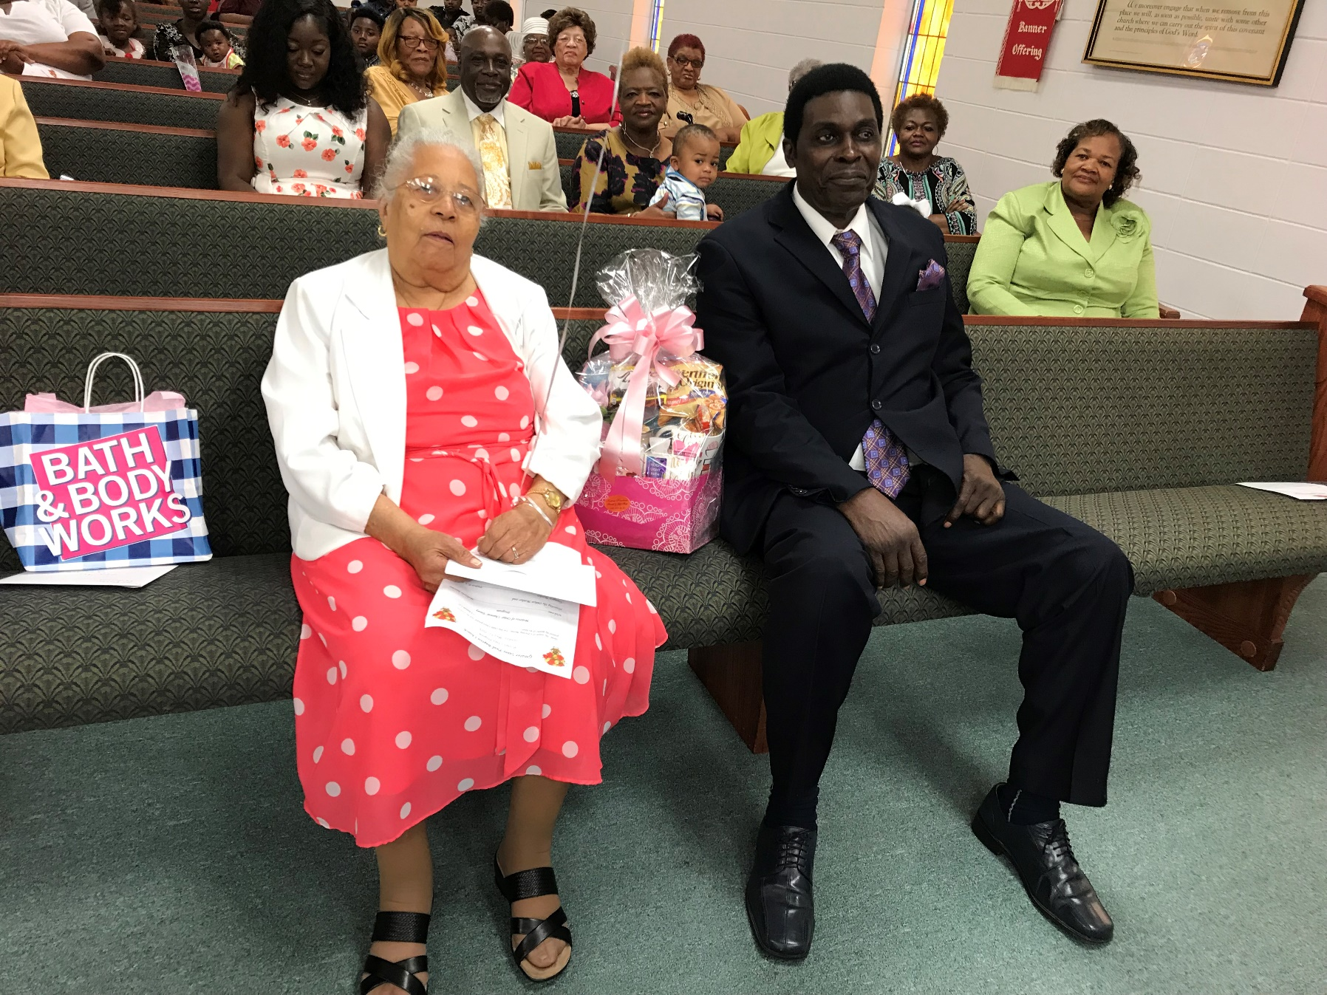

Slide 8
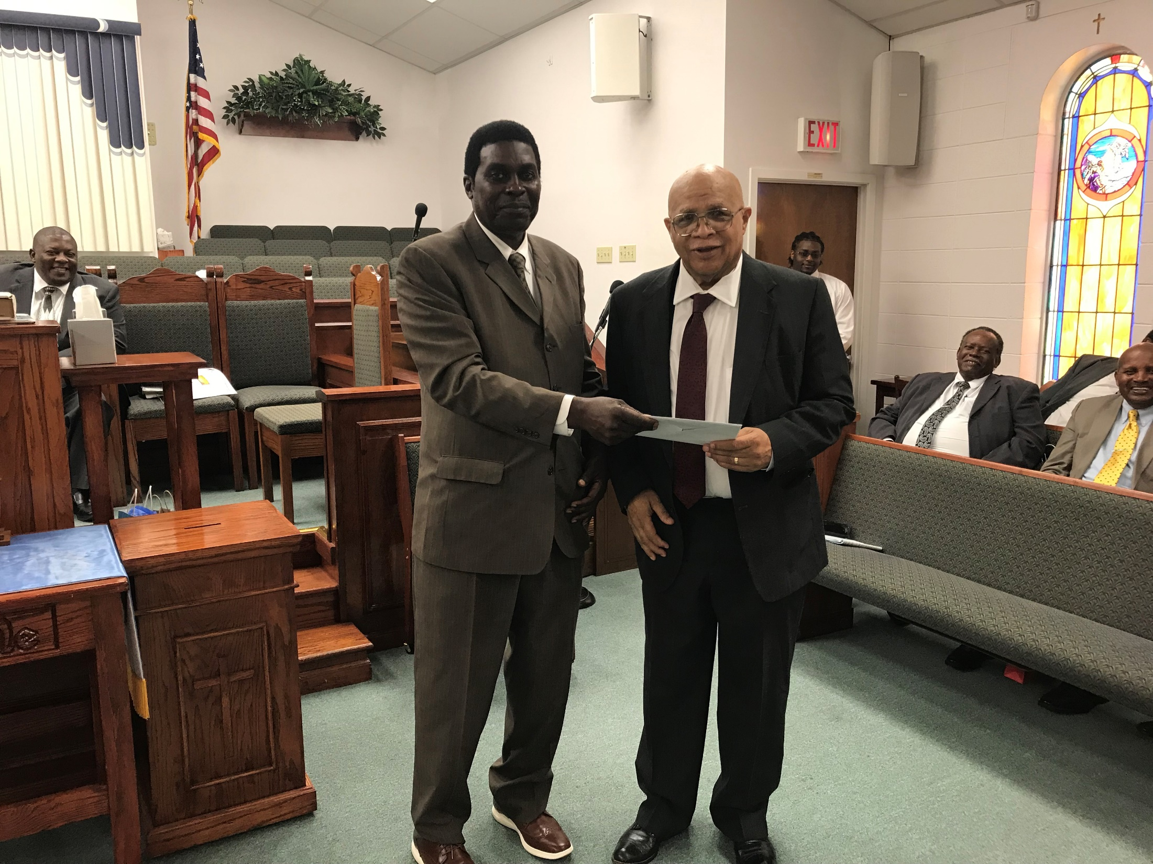

Slide 9
