Slide 1
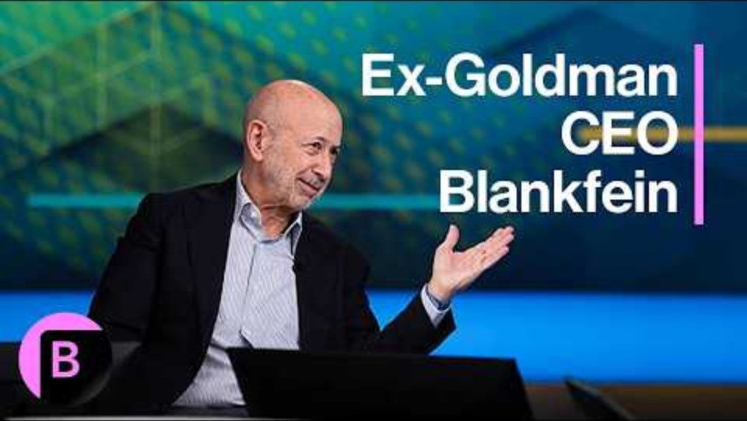
Goldman & Sache
HOLDINGS LTD CO.
Investor Presentation
Service Analysis & Growth Strategy
DALLAS, TEXAS | APRIL 2026 | CONFIDENTIAL
Notes:
This is an educational review of the firm’s strategic direction. Offering an embedded and scripted first look. The presentation assumes and considers that the audience might be a futures investor. Covering service analysis from the perspective of a firm’s executive leadership. Providing background information on the products and services, such as characteristics, target customers, and competitors. Additionally, analyzes the firm's current pricing strategies and suggests ways the firm and others can increase the profits generated by the product or service. Offering justification for private equity markets and extrapolations. Importance of contingency planning towards sustainability. Economic disruptions and the need behind protecting firms’ reputational value.

Slide 2
ABOUT THE FIRM
Company Overview
A diversified holdings and business advisory firm delivering institutional-grade solutions to small and mid-market enterprises.
FOUNDED
HEADQUARTERS
Multi-Service Holdings Company
Dallas Financial District
Providing strategic advisory, risk management, and operational consulting to small and mid-market businesses across Texas and beyond.
701 Commerce St, Ste 500, Dallas, TX 75202 — strategically positioned in the heart of the Dallas financial district.
MISSION
CORE PHILOSOPHY
Institutional-Grade Advisory
Disciplined Value Creation
To deliver institutional-grade advisory services and asset protection strategies to underserved small and mid-market enterprises.
Proactive risk mitigation, regulatory compliance, and value creation through disciplined management — protecting and growing client assets.
GOLDMAN & SACHE HOLDINGS LTD CO.
Advisory · Risk Management · Financial Structuring · Compliance

Slide 3
Services Portfolio
Business Advisory & Consulting
Risk Management & Insurance Advocacy
Strategic planning, operational optimization, and growth advisory for small and mid-market companies. Hands-on engagement model with dedicated advisory teams.
End-to-end claims management, carrier negotiation, regulatory filings (TDI, state DOI), and policyholder advocacy. Maximizing recovery and ensuring carrier accountability.
Financial Structuring & Loan Services
Regulatory Compliance & Legal Strategy
Loan modification, co-obligor structuring, debt restructuring, and capital advisory. Helping businesses access and optimize capital for sustainable growth.
Navigating state and federal regulatory frameworks, pre-litigation strategy, statutory compliance (Texas Insurance Code, DTPA), and administrative proceedings.
INTEGRATED SOLUTIONS UNDER ONE ROOF

Slide 4
EXECUTIVE ANALYSIS
Service Characteristics
What makes Goldman & Sache's service delivery distinctively effective
High-Touch, Relationship-Driven
Every engagement is managed by a senior advisor with direct client access. No call centers, no ticket queues — dedicated personal attention from day one.
Outcome-Based Delivery
Services structured around measurable client outcomes: dollars recovered, claims resolved, loans restructured. Results define success, not billable hours.
Regulatory Expertise as a Core Competency
Deep institutional knowledge of Texas Insurance Code, DTPA, prompt payment statutes, and state regulatory processes — a true structural advantage.
Integrated Service Model
Clients benefit from cross-service synergies — a risk management engagement naturally feeds into financial structuring and compliance advisory.
Scalable but Personalized
Standardized frameworks and playbooks allow consistent delivery at scale while maintaining bespoke, white-glove client attention.
GOLDMAN & SACHE HOLDINGS LTD CO.
Confidential

Slide 5
Target Customer Segments
Small Business Owners
Mid-Market Enterprises
$500K – $10M Revenue
$10M – $100M Revenue
INDUSTRIES
INDUSTRIES
Retail
Hospitality
Services
E-Commerce
Real Estate
Manufacturing
Logistics
Healthcare
Commercial RE
PAIN POINTS
Prof. Services
Underserved by large advisory firms
PAIN POINTS
Lack in-house risk management capabilities
Growing regulatory compliance burden
Vulnerable to insurance carrier disputes
Complex multi-carrier insurance programs
Need capital restructuring guidance
Capital structure optimization needs
TYPICAL ENGAGEMENT
Need institutional-grade advisory access
Insurance claims advocacy, regulatory filings, loan modification
TYPICAL ENGAGEMENT
Full-service advisory retainer, regulatory compliance program, financial restructuring
Addressable Market:
3.3 Million
small businesses in Texas alone
Source: U.S. SBA Office of Advocacy, 2024

Slide 6
Competitive Positioning
GOLDMAN & SACHE
TRADITIONAL COMPETITORS
Integrated Multi-Service Platform
Siloed Services
Advisory, risk management, finance, and compliance under one roof.
Separate firms for legal, insurance, and financial advisory — fragmented experience.
Deep Texas Regulatory Expertise
Dedicated knowledge of TDI, Texas Insurance Code, and DTPA.
Generalist Knowledge
No state-specific regulatory depth — one-size-fits-all approach.
Outcome-Based Pricing Options
Alignment of interests with clients — fees tied to measurable results.
Hourly Billing Only
No skin in the game — fees accrue regardless of client outcomes.
Senior-Level Attention on Every Engagement
VS
No junior handoffs — experienced advisors from start to finish.
Large Firm Bureaucracy
Clients lost in the pipeline — layers of process before action.
Policyholder Advocacy DNA
Built to fight for the client, not the carrier. Advocacy is the foundation.
Carrier-Aligned Public Adjusters
Conflicted incentives — often working closer with carriers than policyholders.
COMPETITOR CATEGORIES
Large National Consultancies (Deloitte, Accenture)
Independent Public Adjusters
Standalone Insurance Attorneys
General Practice CPAs

Slide 7
Current Pricing Strategies
Flexible engagement models designed to align firm incentives with client outcomes
RECURRING
PERFORMANCE
FIXED SCOPE
HYBRID
Retainer-Based Advisory
Contingency & Success Fees
Project-Based Engagements
Blended Model
$5K–$15K/month
15%–30% of Recovery
$10K–$75K per project
Retainer + Success Fee
Ongoing strategic advisory and compliance monitoring for mid-market clients. Predictable recurring revenue with dedicated senior advisor access.
Insurance advocacy and claims recovery engagements. Fee earned only upon successful outcome — aligns firm and client interests completely.
Loan modifications, regulatory filings, one-time compliance audits, and financial restructuring. Defined scope and deliverables.
Hybrid structure for complex, multi-phase engagements. Base retainer plus upside participation — maximizes client value and firm revenue.
Fee structures aligned with client success
No hidden fees or junior handoffs
Custom arrangements available for enterprise engagements
GOLDMAN & SACHE HOLDINGS

Slide 8
How We Have Increased Profits
Key strategies driving profitability — Manager's Perspective
Service Bundling
PROFIT IMPACT BY STRATEGY
Relative Contribution
Cross-selling integrated engagements increases avg. revenue per client by 2.4×
Contingency Fee Upside
Service Bundling
2.4×
Success-based pricing on high-value claims — e.g., $315K claim = up to $94.5K in fees
Contingency Fees
30%
Recurring Revenue Shift
Recurring Revenue
LTV ↑
Monthly retainers create predictable cash flow & increase lifetime client value
Op. Leverage
–35%
Operational Leverage
Case Selection
Win ↑
Standardized playbooks & templates reduce delivery cost by ~35%
Strategic Case Selection
Focusing on claims with strong statutory support increases win rates & avg. recovery
2.4×
REVENUE PER
BUNDLED CLIENT
35%
COST REDUCTION
PER ENGAGEMENT
$94.5K
MAX FEE ON
$315K CLAIM
Goldman & Sache Holdings LTD Co. — Confidential

Slide 9
PERFORMANCE DASHBOARD
Traction & Key Metrics
87%
$42K
91%
Claims Recovery Rate
Avg. Engagement Value
Client Retention Rate
Percentage of pursued claims resulting in positive recovery for clients
Blended average across all advisory, risk, and financial service lines
Year-over-year retention on retainer-based advisory clients
$285K
68%
40+
Revenue per Employee
Gross Margin
Active Client Relationships
Lean, high-output operating model with senior-level talent
Low variable cost, high-expertise professional services model
Growing pipeline across Texas and surrounding states
Goldman & Sache Holdings LTD Co.
Confidential

Slide 10
GROWTH STRATEGY
Strategic Growth Roadmap
Three-phase expansion plan to scale from Texas market leadership to national presence and product innovation.
PHASE 1
PHASE 2
PHASE 3
2026
2027
2028+
Foundation & Texas Dominance
Regional Expansion
National Scale & Product Innovation
Complete buildout of Dallas operations center
Expand to OK, LA, AR & NM markets
Selective expansion into CA, FL & NY
Establish market leadership in Texas policyholder advocacy
Hire senior advisors in each new market
Launch Risk Intelligence platform (SaaS)
Target 150 active clients
Target $10M+ annual revenue
Reach 75 active clients
Introduce proprietary compliance technology platform
Explore strategic acquisitions of complementary firms
Launch retainer program for mid-market segment
Goldman & Sache Holdings LTD Co.
Current Phase
Planned

Slide 11
INVESTMENT THESIS
Why Invest in Goldman & Sache
1
Massive Underserved Market
Millions of small and mid-market businesses lack access to institutional-grade advisory, risk management, and insurance advocacy — creating enormous untapped demand.
2
Proven Revenue Model
Blended pricing — retainers + contingency + project fees — delivers both stability and upside, with 68% gross margins demonstrating strong unit economics.
3
Regulatory Moat
Deep expertise in Texas Insurance Code, DTPA, and state regulatory processes creates a defensible competitive advantage that is difficult and time-intensive to replicate.
4
Capital-Light, High-Margin Business
Professional services model requires minimal capital expenditure; growth funded primarily by operating cash flow, preserving equity value and maximizing investor returns.
5
Experienced Leadership
Management team with direct operational experience in claims advocacy, financial structuring, and regulatory compliance — executing, not just advising.
Institutional-grade services · Defensible moat · Capital-efficient growth

Slide 12
Let's Build Together
Goldman & Sache Holdings LTD Co. invites qualified investors to participate in the next phase of growth.
Goldman & Sache Holdings LTD Co.
701 Commerce St, Ste 500
Dallas, Texas 75202
This presentation is confidential and intended solely for the use of the intended recipient. It does not constitute an offer to sell or a solicitation of an offer to buy any securities.

