Slide 1
The knolls and firewising
Is your LOT really firewised?

Slide 2
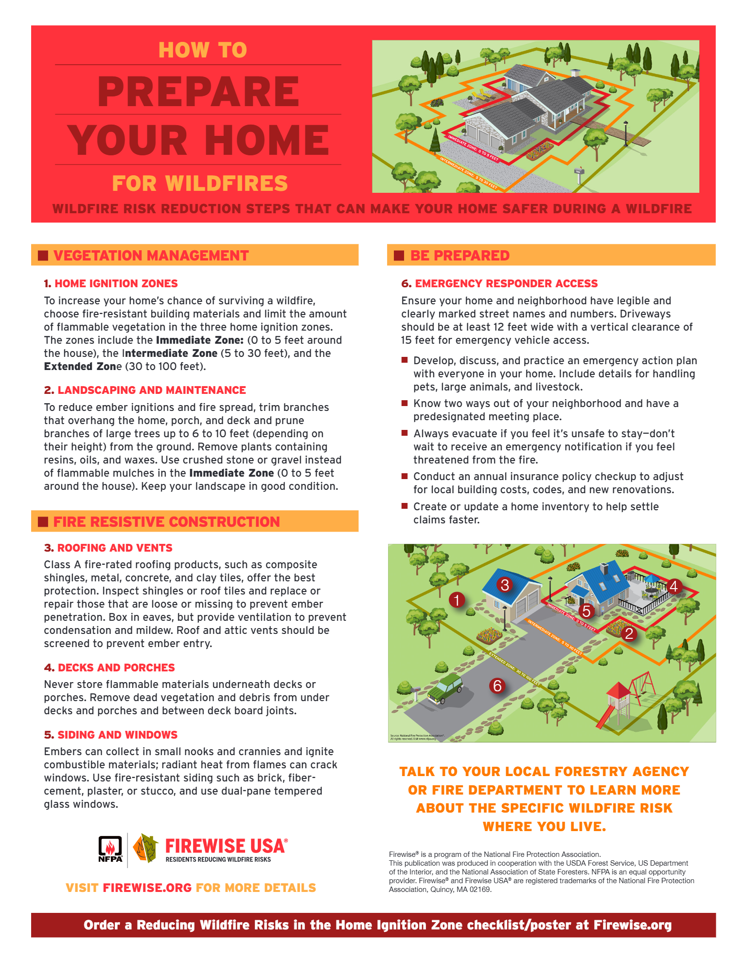
Standard firewise brochure
Firewising your home and safe spaces around it is very important. This information can be found on our website under “Fire Safety”.
This presentation is more about Firewising your LOT.

Slide 3
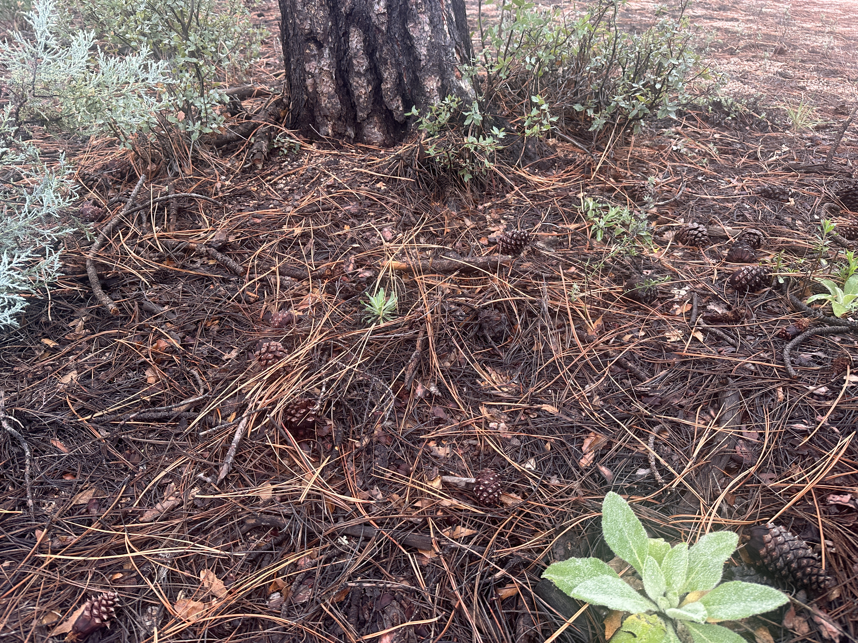
Ground cover (pine needles) removal
For raking needles, we highly recommend raking at least the 0'-5' every year. As for the entire lot, it would be an absolute bonus to get it done yearly however that can take a ton of time and manpower based on the lot sizes. This would help break up the horizontal continuity of ground fuels that could potentially move fire into thicker brush or ladder fuels.
Kyle Klein
Fire Prevention Lead - Central Zone
Arizona Department of Forestry and Fire Management

Slide 4
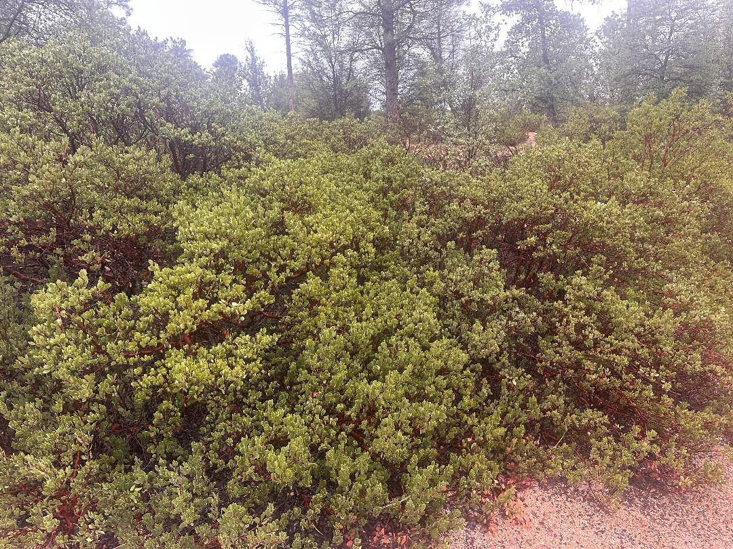
Overgrown Manzanita
For manzanita, in my fire experience they are highly flammable under the right conditions. cleaning these up and limbing them up helps prevent the entire plant from going up in flames if enough heat gets established within or in close proximity to the plant. However, I have heard these plants can be pretty temperamental when pruning. you CAN take too much out leading to a possibility of the plant dying due to sun exposure etc. This is where I would recommend going one limb at a time and removing the very low hanging or dead material.
Kyle Klein
Fire Prevention Lead - Central Zone
Arizona Department of Forestry and Fire Management

Slide 5
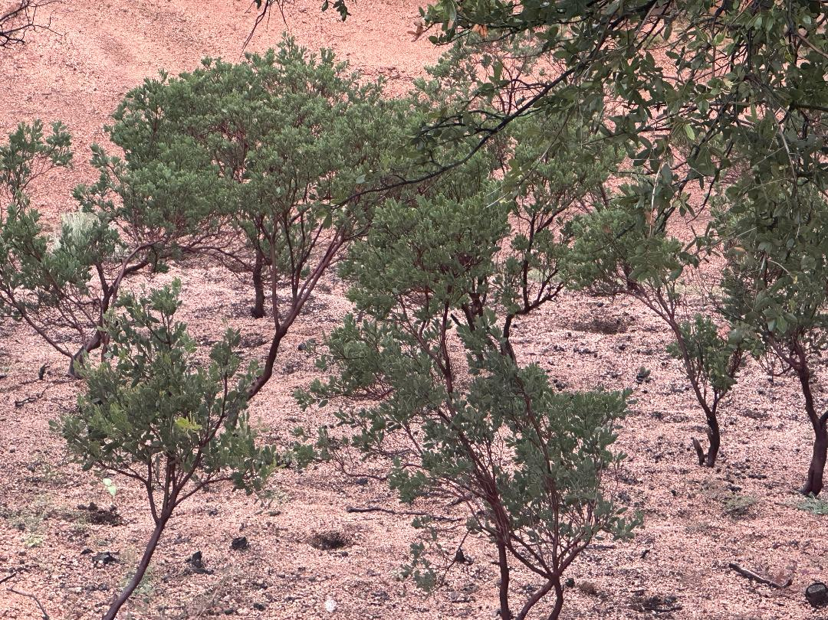
Manzanita pruning done right
Great example of pruned manzanita.
Helps with rodent nesting also.

Slide 6
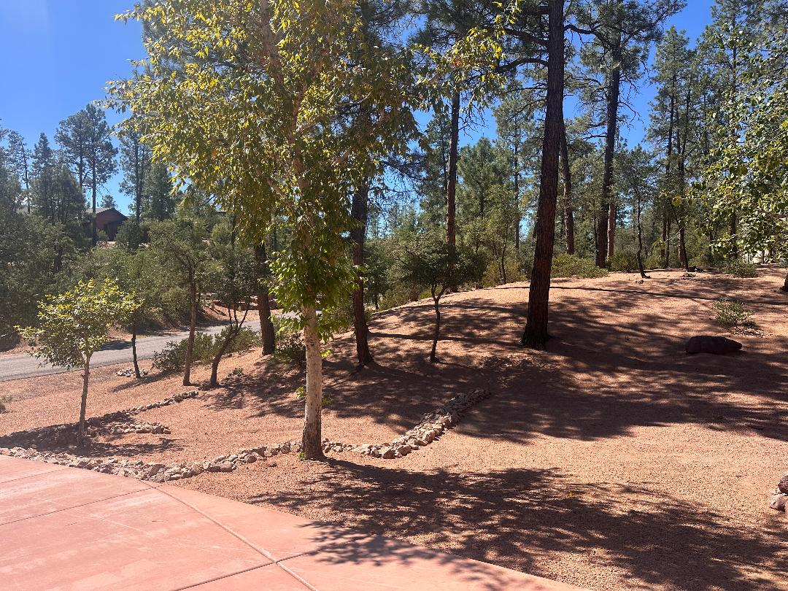
Great examples of knolls firewising
Trees trimmed up.
Manzanita trimmed and sized.
Ground fuel raked and removed.
Dead branches removed.
Stumps excavated and removed.

Slide 7
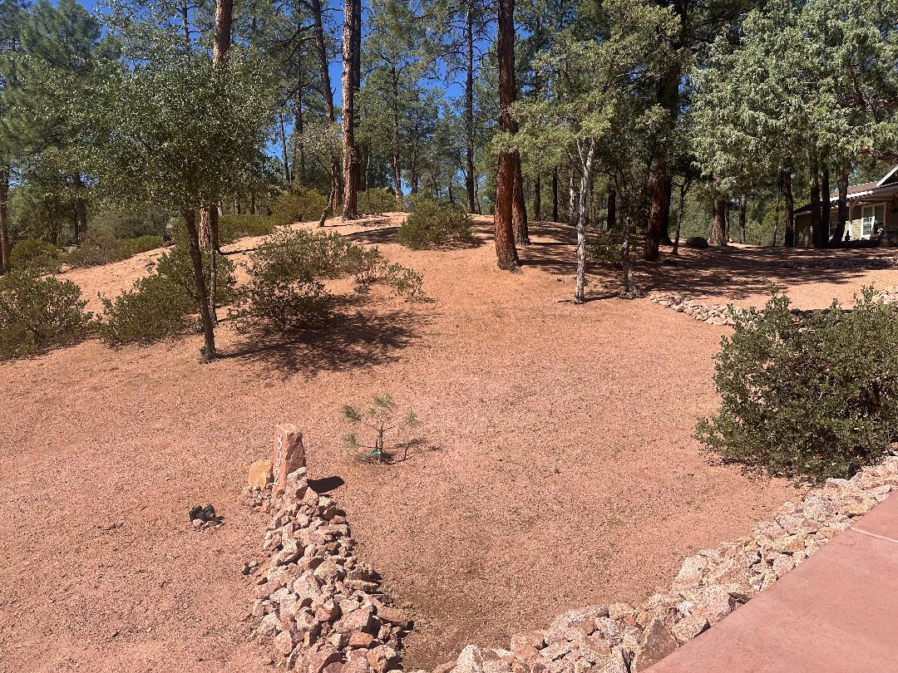
Great examples of knolls firewising
Manzanita kept thin and small.
No place for rodents to breed.

Slide 8
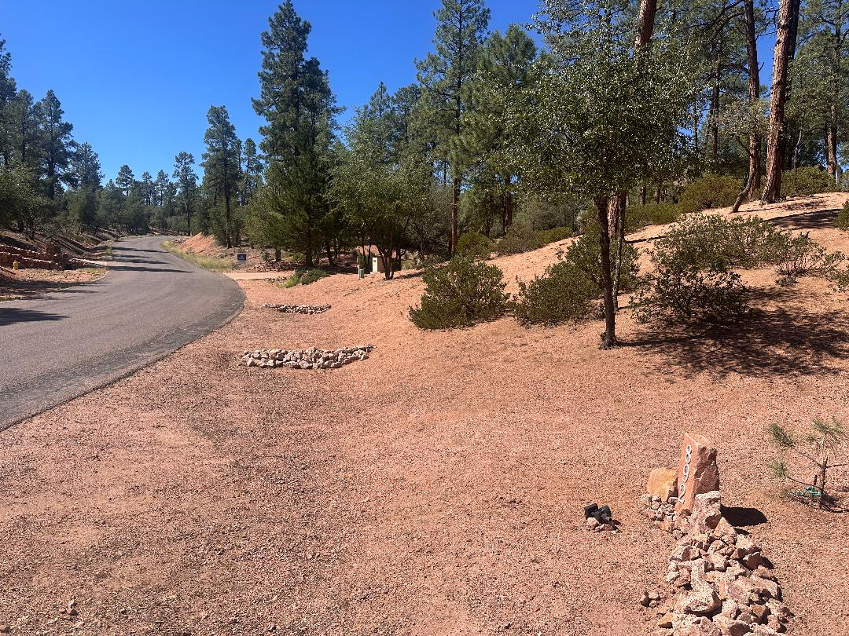
Great examples of knolls firewising
Great access for fire fighters.
No fuel on the ground to ignite and blow into other lots.

Slide 9
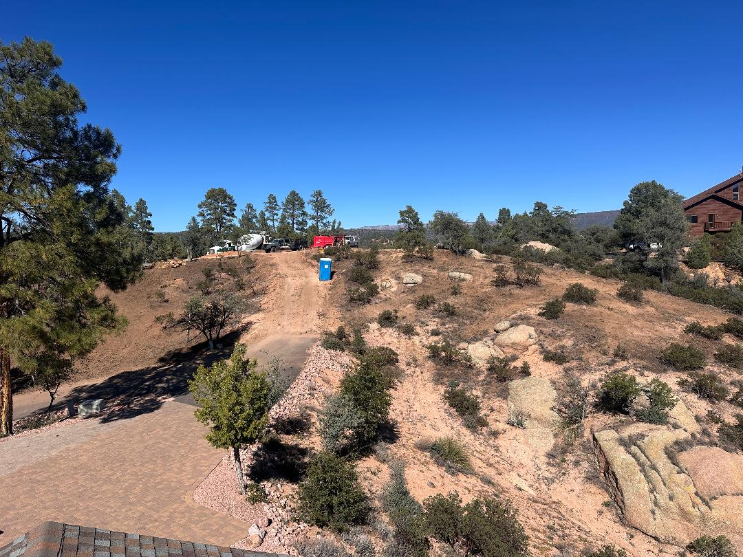
Great examples of knolls firewising
The ACC is encouraging all new home builds to firewise their entire lot before new home construction starts.

Slide 10
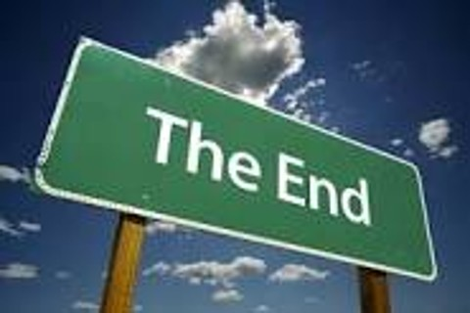
knolls firewising
For now, more to come.

