Slide 1

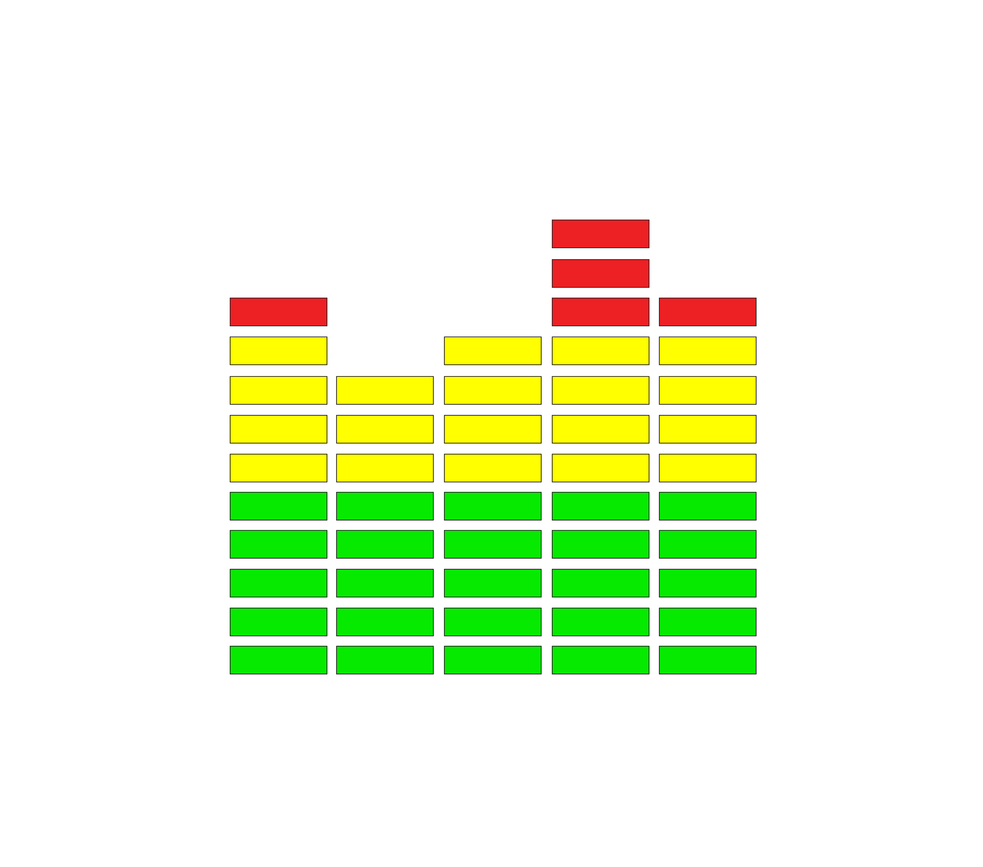

Friday June 14, 2024
Galaxy 707 Club - 475 North Service Rd E Oakville, Ontario
A LOCAL FUNDRAISING EVENT IN SUPPORT OF CANCER RESEARCH
Sponsor Information Package
TOGETHER WE CAN MAKE A DIFFERENCE.
Tickets and Details:
http://www.retrorewindclub54.com/
WWW.RETROREWINDCLUB54.COM

Slide 2
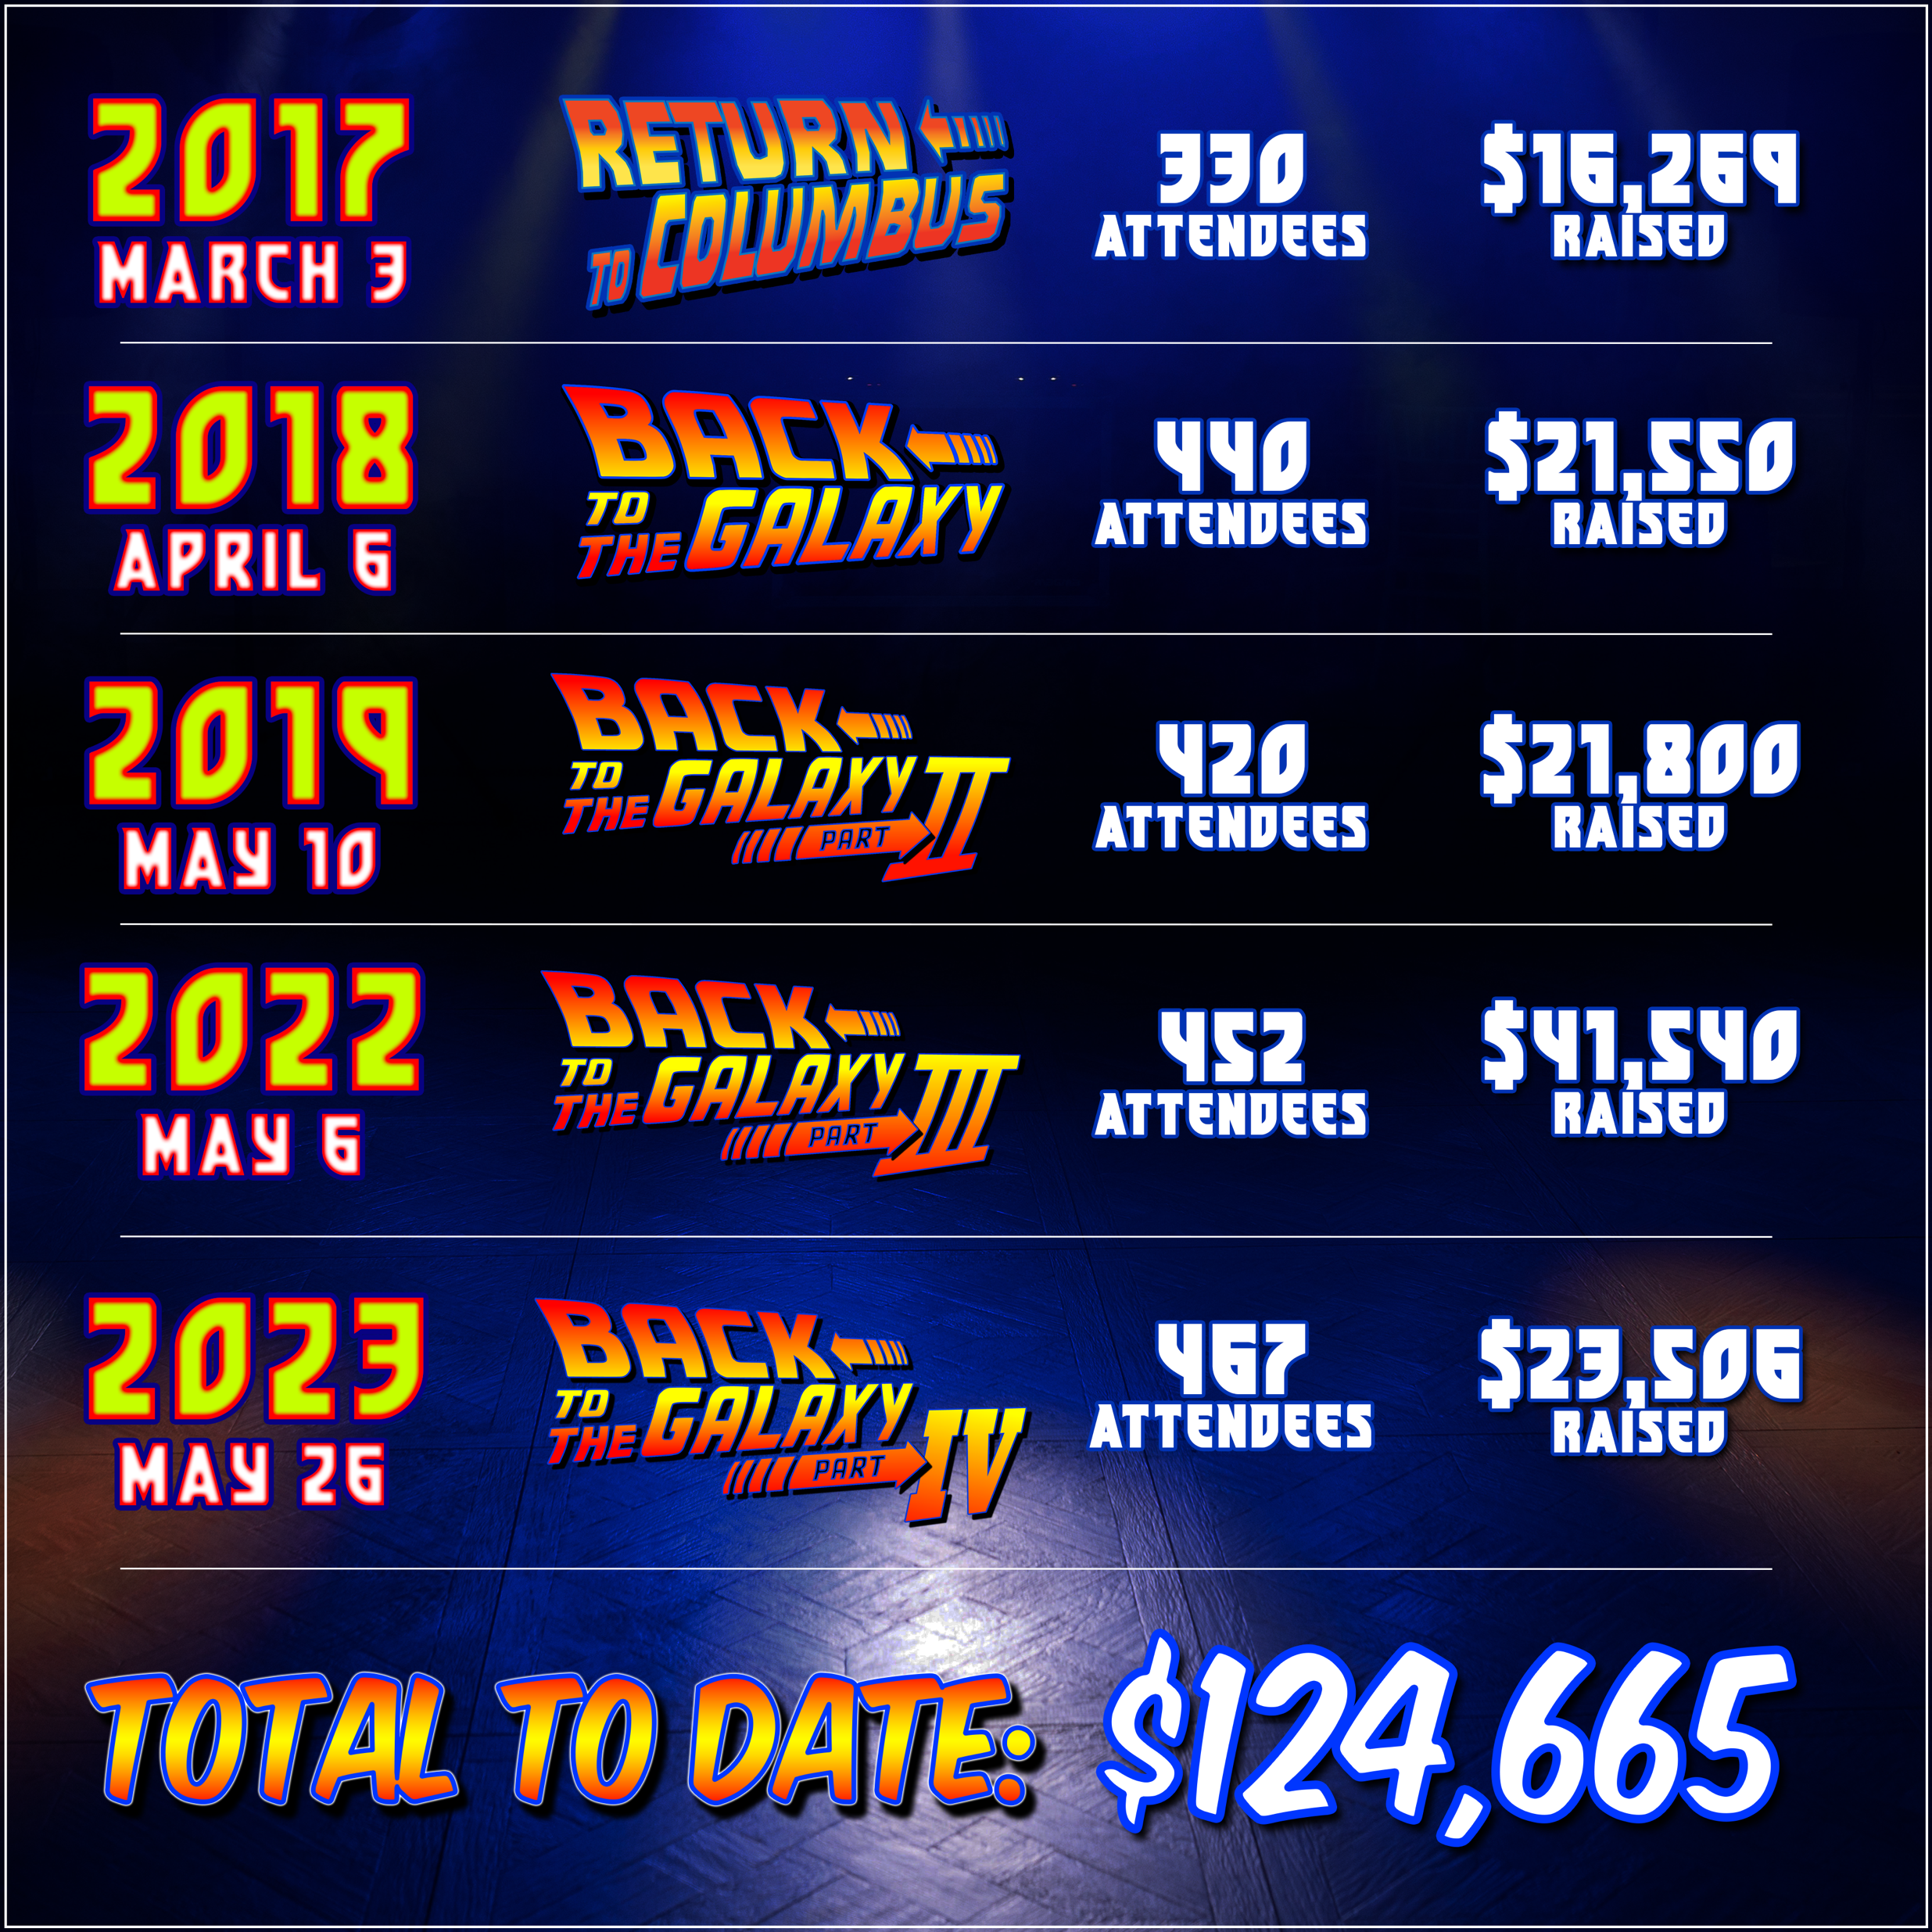
What started out as a 30 year high school dance reunion turned into so much more…
The idea was simple, rent the same banquet hall (Knights of Columbus), enlist the same school DJ (Frankie F Fresh), bring in food and drinks and relive our high school glory days in the actual venue where we used to party back in 1987.
Tragically, during the process of organizing the event, two childhood friends (and supporters) of the event lost their battle with cancer. In addition, the organizer’s mother and mother-in-law were also diagnosed with the disease. What became immediately apparent is that this event had to be a fundraiser, in honour of those whose attendance was denied by cancer.
Did you know that 1 in 2 Canadians will be diagnosed with cancer in their lifetime?
Transforming a high school dance reunion into a spectacular 80s-themed fundraising gala on March 3, 2017, proved to be an extraordinary endeavor. Welcoming over 350 attendees, the evening immersed guests in nostalgic delights, featuring iconic elements such as music, the DeLorean from Back to the Future, Star Wars storm troopers, Ghostbusters, and more. The resounding success of this event was evident as $16,300 was generously raised in support of the Canadian Cancer Society. The overwhelming response to the cause prompted four subsequent events at the 707 Galaxy, amassing an impressive total of $124,500 in contributions. The upcoming event on Friday, June 15, 2024, promises to continue this impactful journey. Join us in supporting this vital cause by becoming a sponsor and making a meaningful difference in the fight against cancer.
This event promises to be even bigger and better with an expected attendance of over 450 people!
SPONSOR US AT:
https://fundraisemyway.cancer.ca/campaign/retrorewind
WWW.RETROREWINDCLUB54.COM

Slide 3
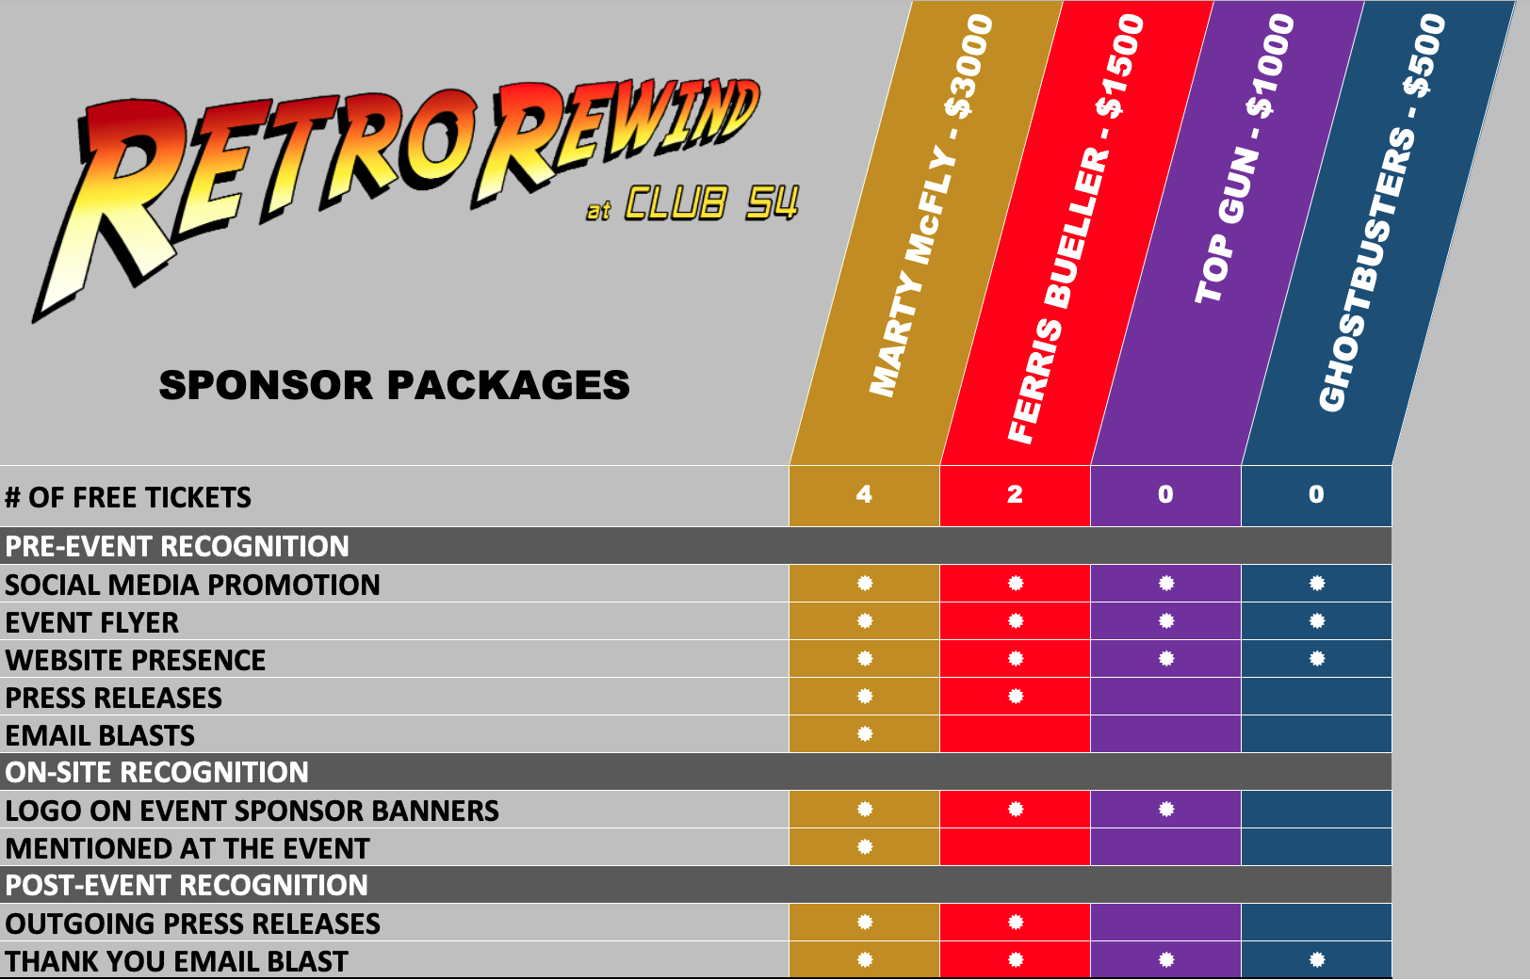
SPONSORING THIS EVENT IS AN IDEAL AND COST-EFFECTIVE WAY TO ADVERTISE YOUR BUSINESS & SUPPORT OUR COMMUNITY.
We thank you in advance for your consideration of this request to support our Back to the Galaxy fundraising event. We invite you to consider the following sponsorship options:
=
*
*
*
*
*
* Organizers will also accept raffle prizes in lieu of cash and the retail value of that prize will be applied to the appropriate sponsor level above.
SPONSOR US AT:
https://fundraisemyway.cancer.ca/campaign/retrorewind
WWW.RETROREWINDCLUB54.COM

Slide 4

SPONSOR COMMITMENT FORM
Yes, I would like to support the 2024 Back to the Galaxy V fundraising gala to help raise money for the Canadian Cancer Society. My sponsor commitment is:
Marty McFly - $3,000
Ferris Bueller - $1,500
Top Gun - $1,000
Ghostbusters - $500
Sponsor Name: __________________________________________________
Contact: ________________________________________________________
Telephone: (_____)_______-_____________
Email: _________________________________________________________
URL (Optional): __________________________________________________
Sponsorship is simple! Simply donate the amount corresponding to the package you prefer at:
https://fundraisemyway.cancer.ca/campaign/retrorewind
Contact: Frank Fortino
E-mail: frankieffresh@backtothegalaxy.ca
Paying by cheque?
Complete this form and submit along with full payment payable to “Back to the Galaxy Fundraiser”
Tax Receipt will be provided directly from the Canadian Cancer Society. The event organizers cannot provide a tax receipt for any donations made directly to the event.
Provide high-resolution colour logo artwork in jpeg, png or gif format.
Sponsorships are offered on a first-come basis and are confirmed only upon receipt of full payment.
WWW.RETROREWINDCLUB54.COM

Slide 5


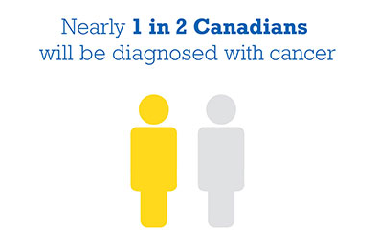
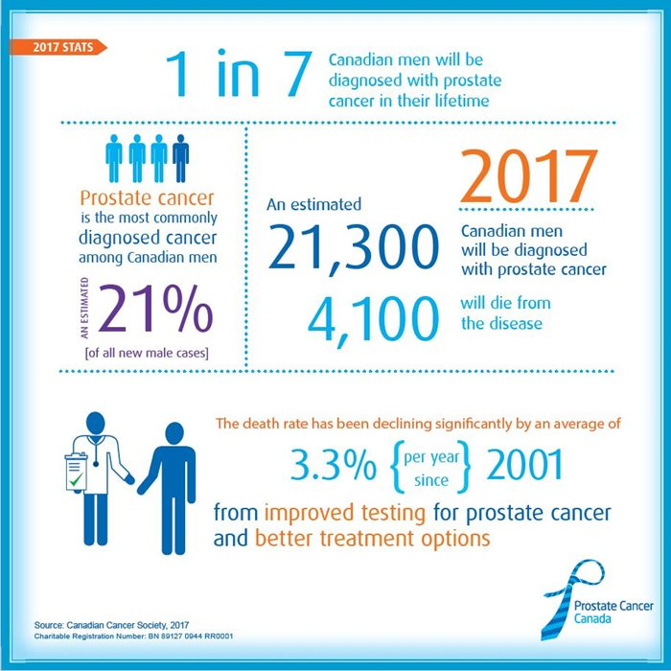
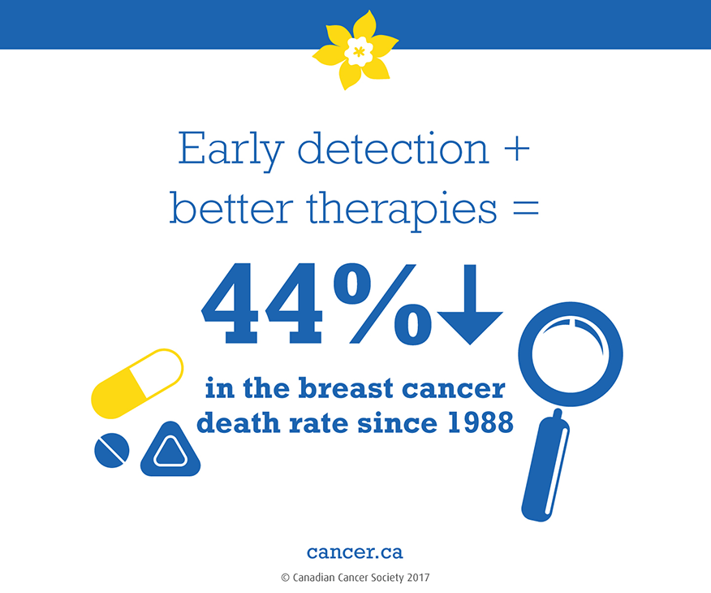
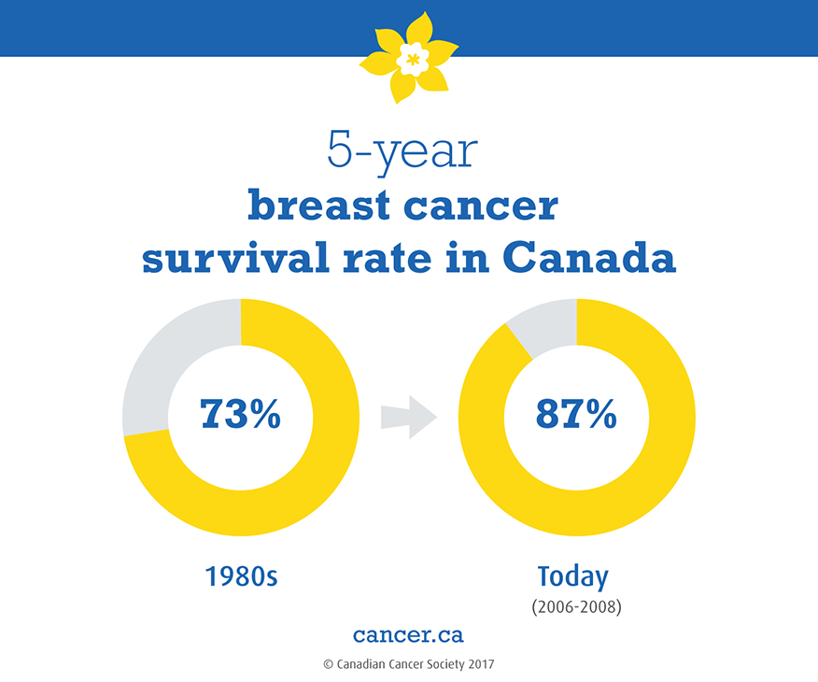
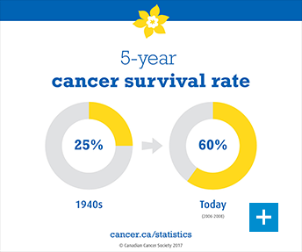
1 in 7
Canadian men will be diagnosed with prostate cancer in their lifetime
2018
Nearly 1 in 2 Canadians will be diagnosed with cancer in their lifetime! Most diagnosed between the ages of 50-65. An alarming 206,200 Canadians will be diagnosed with some type of cancer in 2018, of those 80,800 will loose their battle.
Cancer will be beaten.
Thank you for your generous support.
WWW.RETROREWINDCLUB54.COM

