Slide 1
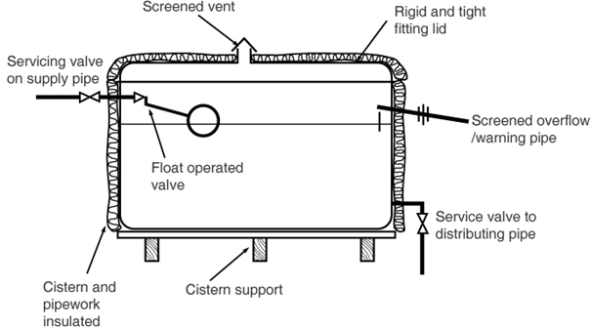

Slide 2
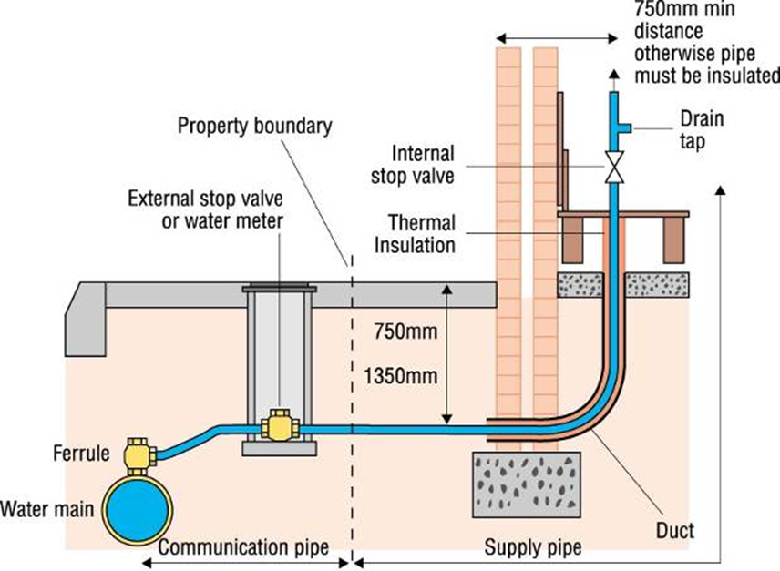

Slide 3
Sealed vent connection
350mm
Service valve
50mm from waterline
Part 2
25mm from waterline
Service valve
150mm overhang
No insulation
25mm Clearance

