Slide 1
The Construction Team

Slide 2
Building Services Sector
The Building Engineering Services Sector consists of the following crafts:
  Plumbing
  Heating
  Ventilating
  Electrical
  Refrigeration and air conditioning
  Gas engineer

Slide 3
Plumbing industry
Types of company:
Sole trader
Partnership
Limited company
Public limited companies (PLCs)
Whatever their size, all companies have a legal status.

Slide 4

80% of plumbing businesses employ between 1 and 4 operatives.

Slide 5
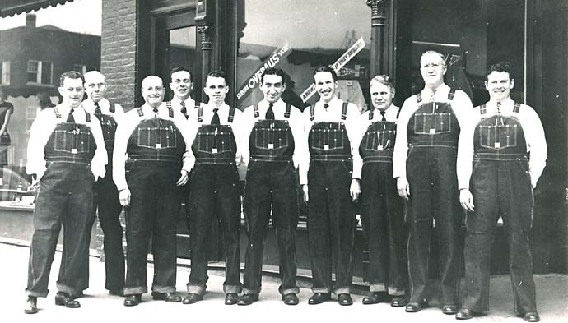
In the construction industry, 90% of businesses employ between 1 and 13 operatives.

Slide 6
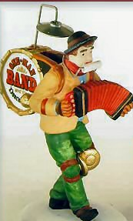
Sole trader
One person owns and runs the business, looking after everything involved.
May employ one or two people.
Account for the largest proportion in the plumbing industry, comprising 80% of businesses.
  Main advantage - the business does not need to be registered with Companies House, which set out the rules for registered business. The owner is also entitled to all of the profits generated from the business.
  The main disadvantage - they are also liable for the debts of the business and could lose their own savings.

Slide 7

Partnerships
This is another popular model for small business.
The set up is very similar to that of the sole trader, but in this case any profits and losses are shared by the parties involved.

Slide 8
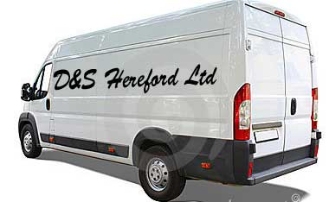
Limited company (private)
Most businesses tend to go limited if they start to expand.
This is because there are tax advantages:
The individuals running the company are not personally liable for any debts should the business fail. Only the amount they invest is at risk.
Public limited companies are allowed to trade their shares on the stock market as long as they have a share capital of at least £50,000.
These are sometimes known as private limited companies as they cannot trade their shares on the stock market.

Slide 9
Site management team
Quantity surveyor
Client
Architect
Building surveyor
Local Authority
Structural engineer
Health and Safety Inspector
Clerk of works
Building services engineer
Building Control Officer
Building
contractor
Civil engineer
Buyer
Estimator
Subcontractor
Suppliers

Slide 10

Construction team members
Architect
The designer of the project and considered the leader of the management team
They convert clients’ ideas and requirements into a building design and working drawings
They liaise with the client regularly at the early stages, and throughout the project

Slide 11
Construction team members
Clerk of works
(project manager)
Generally appointed by the architect; act as their representative on site
Ensure the building is constructed as per the drawings, standard of work and quality of materials
Liaise regularly with the architect and the construction teams on site
Can sign a variation order

Slide 12
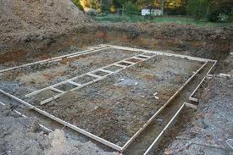
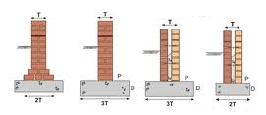
Construction team members
Structural engineer
(specialist engineer)
They work closely with the architect to find the most efficient method of construction
They calculate loads, forces, variances from wind and rain, looking at structural safety
They are sometimes involved in insurance claims, repair work and alterations to properties

Slide 13


Construction team members
Surveyor
Sometimes known as the Building Surveyor
They have to position the building on the land, and ensure Building Regulations are followed throughout the process
They will discuss problems on the way and try to resolve difficulties
They will visit the site regularly to ensure the building process is being carried out correctly

Slide 14
Construction team members
Building services engineer
(specialist engineer)
Design the internal services within the building which will be cost effective, environmentally sensitive, and with good maintenance access:
    Heating and ventilation
    Hot water and cold water
    Air conditioning
    Drainage
May also be responsible for electrical distribution, fire protection, lifts, escalators, acoustics etc

Slide 15
Construction team members
Quantity surveyor
Suggest construction methods within the client’s budget
Calculate the amount of labour and materials required to complete the project. These details are then collated in the bill of quantities, which is used by contractors to produce an estimate/quotation
Visits the site to measure work carried out, to produce interim payments and final accounts

Slide 16
Construction team members
Building contractor
The contractor will enter into a contract with the client to carry out the work in accordance with the drawings, bill of quantities and specification
Each contractor will tender for jobs
They will need to employ specialists within the trade to undertake key roles

Slide 17
Construction team members
Buyer
(works for the contractor)
Sources the materials needed to complete a project by obtaining quotations from suppliers for materials, with delivery times and quality assurance
Estimator
(works for the contractor)
Breaks down the bill of quantities into unit parts, which represent the amount it will cost a contractor to complete each stage
Add company overheads and profit margin

Slide 18
Construction team members
Contracts manager
(works for the contractor)
Supervises the contract – creation, planning and building
Liaises with head office and the site agent
Site agent
Sometimes known as the construction manager, they are responsible for running the site
Plan ahead and make sure the work is carried out safely

Slide 19
Construction team members
Subcontractors
Enter into a contract with the main building contractor to carry out a specific or specialist area of work:
  Plumbing
  Heating and ventilation
  Air conditioning
  Electrical installation
  Plastering
  Bricklaying
  Joinery etc

Slide 20
Construction team members
Trade supervisor
The different trades will have their own supervisor who is responsible for the running of their part of the contract.
  Allocation of duties
  Coordinate with other trades
  Attendance records
  Explaining and enforcing regulations
  Overseeing workforce
  Resolving problems and grievances

Slide 21


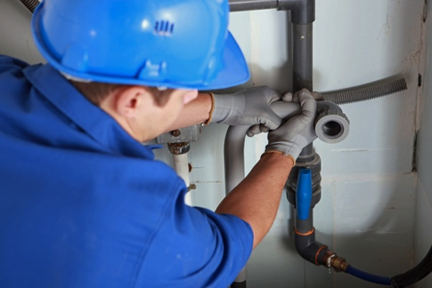
Construction team members
Bricklayer (craft)
Construct building to the architect’s specification using bricks, blocks and stone
Carpenter (craft)
Also known as joiner
First fix: doorways, window frames, joists and trusses
Second fix: doors, skirting and architraves
Plumber (craft)
Install hot and cold water, heating and gas
First fix: pipe carcasses
Second fix: appliances

Slide 22

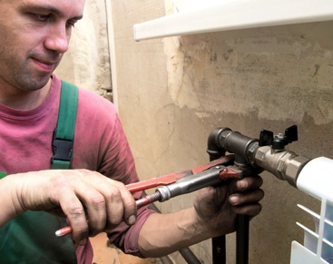
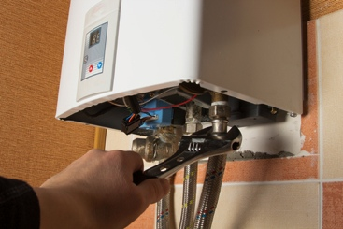
Construction team members
Electrician (craft)
Install and test electrical installations for lights, sockets, fire alarms, intruder alarms
First fix: cable, conduit and trunking
Second fix: appliances
Heating and ventilation (craft)
Also RAC engineers
Large diameter pipework and ducting
Gas fitter (craft)
On commercial sites, gas fitter may be required to install the gas pipes and appliances

Slide 23



Construction team members
Plasterer (craft)
Responsible for wall and ceiling finishes, dry lining, rendering
Using modern and traditional methods
Painter (craft)
Also known as a decorator
Paint and wallpaper walls, ceilings, woodwork
Tiler (craft)
Responsible for tiling floors and walls in properties
Specialists may be needed to tile swimming pools and wet rooms

Slide 24
Construction team members
Groundworker
Sometimes known as a general operative or labourer
Mix concrete, lay drains, offload materials and generally assist craft operatives
Specialists
These can include scaffolders, glaziers, suspended ceiling installers etc

Slide 25
Construction team members
Inspectors
Health and safety inspector
Usually works for the HSE but can be employed by the local authority
Can arrive unannounced to ensure health and safety law is being implemented by the building contractor
Building control officer (BCO)
Works for local authority in the planning office and makes sure Building Regulations are being observed in planning and construction
Have power to reject plans but can also offer advice
Visit site at different stages and finally sign off the work

Slide 26
Construction team members
Inspectors
Water inspector
Employed by the water undertaker
Key role is to reduce the risk of contamination in the public water supply
They enforce Water Regulations by randomly inspecting occupied properties and all new builds
May also inspect in cases of contamination or problems
Electrical services inspector
Employed by the local electricity supplier
They inspect new electrical installations to ensure they comply with all IEE wiring regulations

Slide 27
Legislation and employment
You could have included:
  The Equality Act 2010
  The Employment Relations Act 2003
  The Sex Discrimination Act 1975
  The Equal Pay Act 1970
  The Race Relations Act 1976
  The Disability Discrimination Act 1995
  The Data Protection Act 1998
  Any More….?

Slide 28
Information sources
Legislation
Data Protection Act
  This gives everyone the right to know what information is being held about them and makes sure the data is handled properly.
Freedom of Information Act
  Allows access to the information about you.
Equal Opportunities
  Equality Act; Sex Discrimination Act; Equal Pay Act; Race Relations Act; Disability Discrimination Act.

Slide 29
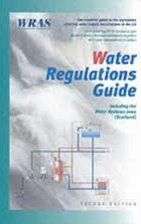


Information sources
Regulations
Plumbing is one of the most regulated trades within BES. Failure to comply with regulations can result in prosecution with fines or prison sentences. These are mandatory.
Water Supply (water fittings) Regulations
Gas (installation and use) Regulations
Building Regulations
Each of these will be discussed within their area.

Slide 30
Information sources
Building Regulations Approved Documents:
Part A: Structure (notching and drilling of joists)
Part B: Fire safety
Part C: Site preparation and resistance to moisture
Part D: Toxic substances
Part E: Resistance to the passage of sound
Part F: Ventilation
Part G: Sanitation, hot water safety and water efficiency
(G3 states water must not exceed 100⁰C)
Part H: Drainage and waste disposal
Part J: Combustion appliances and fuel storage systems
Part K: Protection from falling, collision and impact
Part L: Conservation of fuel and power (SEDBUK and
primary pipework insulation next to cylinder of 1 metre)
Part M: Access to and use of buildings
Part N: Glazing (safety relating to impact, opening, cleaning)
Part P: Electrical safety

Slide 31
Information sources
Building Regulations Approved Documents
Building Regulations part L
Part L F(N) – Northern Ireland
Conservation of fuel and power in Approved Document L:
L1a : New dwellings
L1b : Existing dwellings
L2a: New buildings other than dwellings
L2b: Existing buildings other than dwellings

Slide 32
Information sources
British Standards approved documents
Building Regulations part P
Under this regulation you do not, as a plumber, have to be part P qualified to replace a like-for-like component, unless it is in a danger zone
A danger zone is within a bathroom, kitchen or outhouse. If an airing cupboard door is on the landing it is not a danger zone, but in the bathroom it is. If the boiler is in the loft it is fine, but in the kitchen it is not. To replace parts on these items in these locations you need to be a part P qualified plumber
Under part P you can install a single fused spur or replace damaged appliance cable

Slide 33

Information sources
British Standards
These offer guidance on interpreting and following the regulations
They are not enforceable, but set out the minimum standard to comply with the regulations – so by complying it will be seen to satisfy the regulations
British Standards are not a primary source of information when installing appliances and can be overridden by manufacturers’ instructions
BSI stands for British Standards Institute
BS kitemark

Slide 34
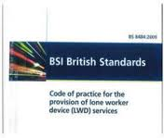
Information sources
Codes of Practice
Approved codes of practice are produced by BSI as a guide to following the standards
They specify what is considered to be good practice in the trade area, but in themselves are not a legal document
They cover both BS and BS EN standards

Slide 35
Information sources
Manufacturers’ guidance
The manufacturers’ installation, servicing, maintenance and user instructions are some of the most important documents you will access.
Guidance must be followed or:
Warranty could be void
Installation could be dangerous
You might inadvertently break a regulation
Manufacturers’ instructions must be followed at all times, even if they contradict the Regulations and BS.

Slide 36
Contract Documentation
Specification
  Information that cannot be relayed by drawings alone
  Includes standards of materials and workmanship
Schedules
  Information on a range of similar components, eg washbasins, radiators
Bill of Quantities
  Used for estimating; interim payments

Slide 37
Other Documentation
Health and safety file
  Completed under CDM and a legal requirement
Variation order
  modification of the specification by the client or architect
  Cost adjustment may result

Slide 38
Estimate
An estimate is a rough price for a job or materials. It should only be used as a guideline as it is not a fixed price.
Invoice
An invoice is the request for payment.

Slide 39
Purchase orders
A purchase order states: description of material, quantity, price and most importantly job/contract.
Purchase orders are sometimes given to you after you have submitted a quotation.
For example you may receive one after quoting to re-plumb 10 flats for £4,500 each, confirming you will re-plumb 10 flats at £4,500 per unit.
This now becomes a contract.

Slide 40
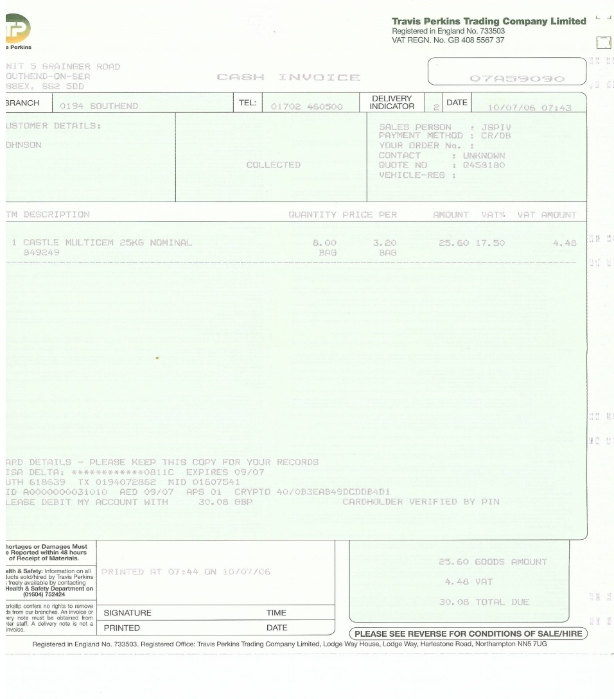
Remittance advice note
A remittance advice note shows the balance of payment to be made on an invoice.

Slide 41
Plumber’s Business Documentation – how it works
Customer asks plumber for a quote.
Plumber visits customer, measures up, estimates materials.
Plumber gets a quotation for the materials from the merchant.
Plumber finalises quote to customer.
Customer accepts; and quote given to customer in writing.
Plumber orders materials from merchant.
Plumber receives delivery of materials, confirmed by a delivery note.
Job is carried out.
Plumber receives invoices for payment of materials and also invoices the customer for the work carried out.
A remittance advice (record of payment) is sometimes issued.
A receipt may be given to the customer.

Slide 42
Plumber’s Business Documentation
Handover information: At the end of a contract the customer/client must be given certain information. Manufacturers’ instructions
  Benchmark certificate
  Warranty
  Contact numbers
  Be shown around the installation; how to use/set items
In large contracts this will also include the health and safety file.

Slide 43
Contract of Employment
Mutual agreement between employer and employee
Basis of ‘employment relationship’
Contract is made when offer of employment is accepted

Slide 44
Statement of employment
Must include:
  the name of your employer and your name
  the date your employment started
  your job title and a summary of your duties
  the period of employment; is it a permanent position?
  the place of work
  how much you will be paid, how often, and the method of payment;
  hours of work
  holiday entitlement
  procedures for dealing with absence from work through illness, or for other reasons,
  details of pension scheme if applicable
  details of how to terminate employment (eg, length of notice required)
  disciplinary rules and procedures (usually contained in a staff handbook)
  grievance procedures (which again could be contained in a staff handbook

Slide 45
Communicating with others
Letter
Written formal communication with a record
Email
Fax
Face to face
Verbal informal communication with no record
Telephone

Slide 46
Written communication
Letters:
Official method of communication that can help towards a good image if written well.
Needs good grammar and formal English.
Official company business should always be in a written form on company headed paper: sales, quotations, information, enquiries.
Emails:
The use of emails has increased dramatically over the past few years, due to convenience and speed.
Needs to be well set out with good grammar
Faxes:
These can be used to convey copies of formal documents: invoices, quotations, contracts.
A cover page needs to be used

Slide 47
Verbal informal communication
Things to consider include:
What you are saying
Tone of voice
Body language
The response
Listen carefully
Verbal communication quite often needs to be backed up with written confirmation.

Slide 48


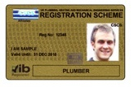
Communicating with others
ACAS: Advisory, Conciliation and Arbitration
Service offers arbitration in large disputes.
Union: Principle trade union of the plumbing
sector is UNITE, who negotiate with
employers on our behalf.
Testimonial: A customer may ask for a testimonial concerning your work and ability.
Toolbox talks: Help with overall communication.
CSCS card: JIB – Joint Industry Board for
plumbing mechanical engineering services in
England and Wales. Issue CSCS cards.

Slide 49
Consequences of poor communication
This can be very harmful to your business and the individual, leaving the overall effect as negative within the company.
Mistrust of management
Argue/reject management input
Grievances
Avoidance
No responsibility

