Slide 1
Join our cause

Slide 2
Objectives
By the end of Module 10 Checking and Setting Appliance Burner Pressures and Gas Rates, you should be able to show understanding in the following areas:
Reasons for excessive pressure loss at the appliance
Effects of excessive pressure at the appliance
Procedures for measuring the working pressure of appliances
Where to find confirmation of the required pressure
Procedures and methods of calculating gas rates
Using different types of meter
The requirements for range rated appliances
Use of electronic pressure gauge (calibration requirements).

Slide 3
The Gas Safety (Installation & Use) Regulations 26(9)c
‘Where a person performs work on a gas appliance, he shall immediately thereafter examine:
(c) its operating pressure or heat input or where necessary both, and forthwith take all reasonably practical steps to notify any defect to the responsible person and,
where different, the owner of the premises in which the appliance is situated or, where neither is reasonably practicable, the supplier of gas to the appliance’.
Notes:
The Gas Installer has a responsibility under The Gas Safety (Installation and Use) Regulations, Regulation 26(9)(c)
This means that when any work, for example installation, servicing or fault finding, is carried out on an appliance the installer must check among other things the pressure or gas rate, and where a problem is suspected both.

Slide 4
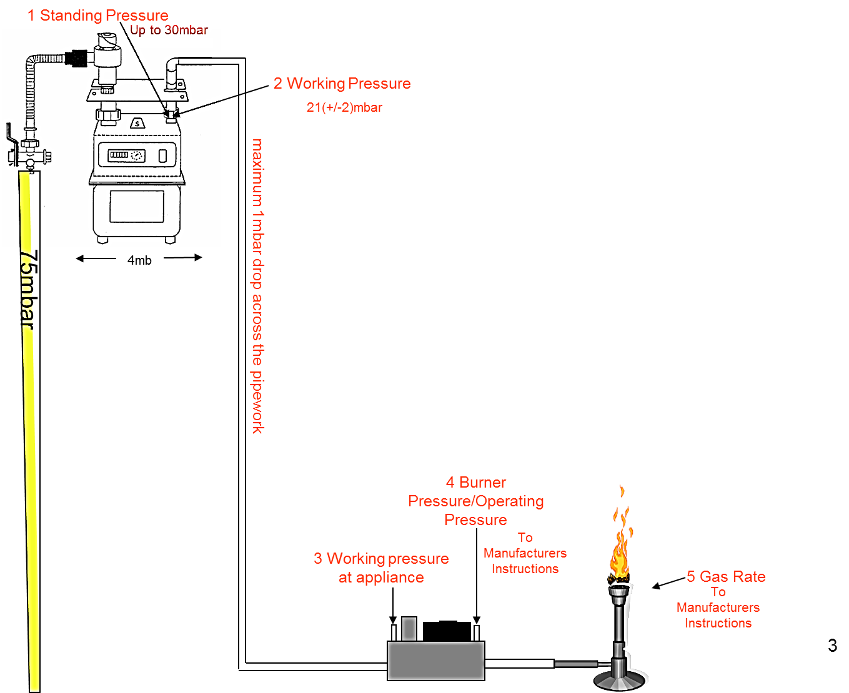
Terminology

Slide 5
Checking and Setting Burner Pressure
You have already studied Module 5 Installation of Pipework and Fittings and Module 7 Checking and/or Setting Meter Regulators.
Contained within these sections we have seen that the meter regulators should be set to deliver a working pressure of 21mbar +/2mbar and the installation should be designed to give a pressure loss of no more than 1mbar.
Notes:
With this information the appliance manufacturer can assume that the inlet pressure arriving to any equipment will be in the region of 22mbar to 18mbar
Therefore, the majority of modern appliances are not supplied with individual regulators; the exceptions to this are range rated appliances (these will be dealt with later).

Slide 6
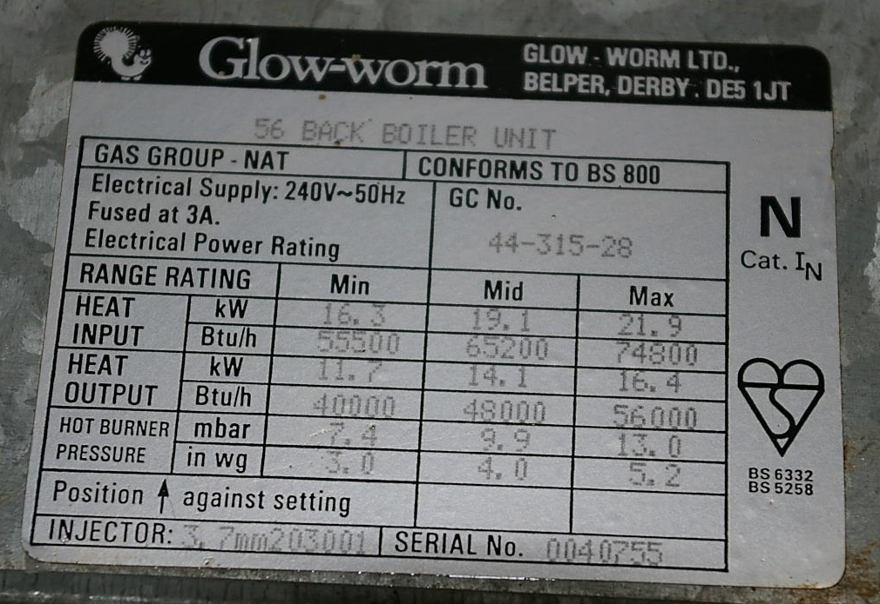
How to Find What Pressure is Required
There are two sources of information available that will give the recommended burner pressure
The manufacturer’s instructions are the primary source of information about any appliance
The installer must leave these instructions with the householder following installation, to comply with The Gas Safety (Installation and Use) Regulation 29
Information required will also be present on the appliance data badge
The data badge will be prominently situated, usually within the appliance case, so some dismantling of the appliance may be needed.
Notes:
The slide shows an appliance data badge for a central heating back boiler, located on the burner tray below the gas fire
The burner (operating) pressure can be clearly identified as 7.4, 9.9 or 13mbar, depending upon the required heat output
As you can see, the pressure reading should be taken when the appliance is hot as stated on the data badge in order to achieve accurate readings.

Slide 7
Checking the Appliance Burner Pressure - Basic Rules
Firstly the appliance burner/operating pressure is a working pressure and as such the appliance must be turned on
If the appliance is turned on and the burner lit, it is important that the gauge tube is securely attached
If the gauge tube were to fall off, the gas flowing out may ignite, causing a dangerous situation
To measure burner pressure the gauge must be attached after the control tap or on the outlet side of the gas valve
The gauge must be attached prior to ignition of the appliance and removed after the appliance is turned off, or ignition of gas from the test point may take place.
Notes:
When the manufacturer’s instructions give specific instructions for burner pressure checking, these should be followed
In the absence of instructions the following procedures may be used
Before we look at the procedure it is important that some basic rules are discussed as in the slide.

Slide 8
Checking the Appliance Burner Pressure - Basic Rules
Some appliances only have a pressure test point on the inlet to the appliance
This is actually measuring supply pressure, which should be approximately 20mbar
Again, if the gauge tube became loose or fell off, gas would flow, causing possible ignition, creating a dangerous situation
Above all remember that you are working with live gas and a source of ignition, therefore, utmost care be taken.

Slide 9
Suggested Procedure for Testing Appliance Burner Pressure
Assemble and zero U gauge or use suitably calibrated electronic pressure recorder
Dismantle appliance as required to enable access to data badge if necessary, and test point (generally near to injector(s)
Attach gauge and tube securely to test point
Turn on and ignite appliance, check burner pressure is in accordance with data badge or manufacturer’s instructions (a warm up period may be necessary)
• Turn off appliance, remove gauge and tube and replace test point
Re-ignite appliance and check the test point with leak detector solution.
Notes:
In the absence of manufacturer’s instructions the following procedures may be used, as a method for burner pressure testing
If the burner pressure is found to be incorrect at an appliance which has no pressure adjustment, it must be assumed that there is a problem with the supply to the appliance
Investigation must be undertaken, as an appliance cannot be left if the operating pressure is found to be incorrect, either high or low.

Slide 10
Excessive Burner Pressure
Excessive pressures at an appliance will more likely be attributed to a faulty meter governor
Checking the working pressure at the meter will verify this as the cause
Excessive pressure at an appliance can be extremely serious
Problems which can occur include incomplete combustion, appliance overheating and a flue system unable to handle extra products of combustion
If excessive pressures are encountered at an appliance and it is due to the meter regulator, the appliance must be turned off and the gas supplier emergency service advised.

Slide 11
Inadequate Pressure at an Appliance
The main problems encountered in terms of installation pipework are:
Inadequate pipe size
Partial stoppage within the pipework
Damaged pipework.
Notes:
Low pressure at an appliance could also be attributed to the meter governor, and if it is, follow the same actions as for high pressure
However, in the vast majority of cases it can be shown to be installation pipework problems.

Slide 12
Range Rated Appliances
Range rated appliances allow the output of the appliance to be adjusted to suit the heating demand of the premises in which they are installed
In this way a central heating boiler, for example, rated at 15kW to 22kW, can be adjusted to give the correct output any where between 15kW and 22kW
This is achieved by checking and altering the burner pressure to that specified in the manufacturer’s instructions as giving the correct output required
Pressures above maximum and below minimum are unacceptable and cannot be tolerated.
Notes:
Where it is not possible to set the pressure to the required level, the operative must identify why the appliance pressure will not alter
If inlet pressure is too low, this must be attributed to supply or installation pipework and this must be dealt with in the same way as in non adjustable appliances
High pressures are more than likely the result of a faulty regulator, which may need replacing
The appliance must not be left operating incorrectly.

Slide 13
Use of Electronic Gauges
The most important things to consider when choosing an electronic gauge for Appliance Burner Pressure testing are:
Is the pressure range sufficient?
What is the accuracy of the gauge? (the gauge needs to be capable of reading millibars to two decimal places to accurately read 0.25mbar
Is the gauge intrinsically safe? (i.e. will not provide a source of ignition to ignite the gas)
Has the gauge been calibrated? (gauges should be calibrated at least every twelve months)
A typical electronic gauge is illustrated.

Slide 14
Use of Electronic Gauges
As a general guide, when using an electronic gauge the following actions should be taken:
Check the overall condition and soundness of the gauge and the rubber tubing
Check gauge has a current calibration sticker
Select the appropriate scale (e.g. mbar, “W.G”, etc.)
Adjust the scale to read zero in accordance with the manufacturer’s instructions.

Slide 15
Use of Electronic Gauges
Connect the rubber tubing to the appropriate connection of the gauge and the appropriate pressure point on the gas installation (ensure there are no sources of ignition in the vicinity)
Ensure the rubber tubing is not ‘kinked’
Allow the gas to enter the gauge slowly
Note/record the pressure reading and compare with required pressure reading
Take any necessary actions as a result of the obtained pressure readings
Remove the rubber tubing; seal the pressure point and test using leak detection fluid.

Slide 16
Checking Appliance Gas Rates and Burner Pressures
The gas rate depends on more than the burner pressure set by the regulator
The gas rate is determined by the calorific value of the gas, burner pressure and size of the injector orifice
Assuming that the calorific value and burner pressure do not change, we can vary the heat input or gas rate to an appliance by changing the size of the orifice in the injector
A smaller hole will reduce the input and a larger one will increase the input
So, you can see, that simply having the correct burner pressure is not sufficient evidence to state that the appliance has the correct heat input
A wrongly sized injector, for example from an LPG appliance, would give us the wrong gas rate
To confirm that the appliance is burning efficiently and correctly we must check both burner pressure and gas rate.
Notes:
For an appliance to operate correctly it must have the correct gas rate
It is appropriate to think that appliances must have the correct operating pressure, and that pressure and gas rate are linked
These indicate the satisfactory operation of the appliance, and this is why the manufacturers provide pressure test points.

Slide 17
How to Find an Appliance’s Required Gas Rate
The data badge as we have seen will generally provide among others the following information:
• The rated input of the appliance (kW)
• Injector size(s)
• Burner pressure setting (mbar)
• Gas family prepared (CAT G20) for natural gas
• Appliance serial number
With this information from the appliance data badge and the calorific value (CV) of the gas, currently 38.6MJ/m3 or 34.7MJ/m3 net, it is possible to assess the operational input to an appliance.
Notes:
The gas rate, which is measured in m3/hr, will in many cases not be given by the manufacturer either within the appliance manufacturer’s instructions or indeed on the appliance data badge
What will actually be given is the appliance rated input measured in kW
We must understand that the input and gas rate are dependant upon each other, and a calculation using the gas rate and calorific value of the fuel will give the input (this will be shown later).

Slide 18
How is the Gas Rate Measured?
The measurement of the gas rate is made a little more complex by two factors.
The first is that the gas rate is measured in cubic metres per hour (m³/hr )
It is extremely unlikely that anyone would measure the rate passing through the meter for one hour, so a calculation is required
Secondly there are two types of meter in popular use by gas suppliers. Both measure gas in different units and require slightly different procedures to find the quantity of gas flowing
Both types of meter will be dealt with separately in the next slides.
Notes:
To measure the gas rate of the appliance we first need to measure the quantity of gas flowing into the appliance
The supplier’s gas meter is used for this purpose
We need to assess the gas rate first and then convert to input to check with the requirement of the appliance.

Slide 19
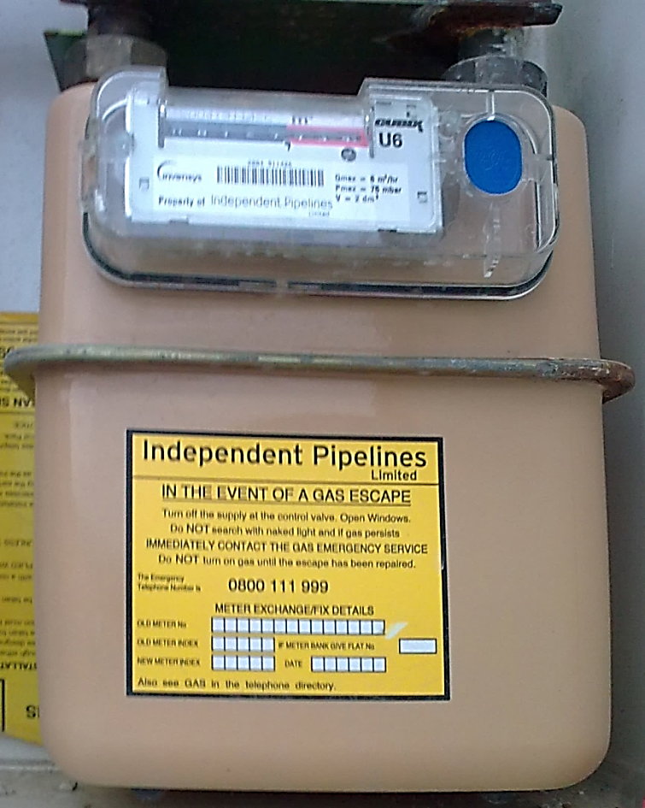
Measuring Gas Rate from Unit Construction Meters
The most common type of gas meter installed within the UK is the unit construction meter
Domestic properties will usually have the U6 meter installed, as shown here
The designation U6 means that the meter is of unit construction and the badged rating is 6m³/hr.
U6 Meter

Slide 20
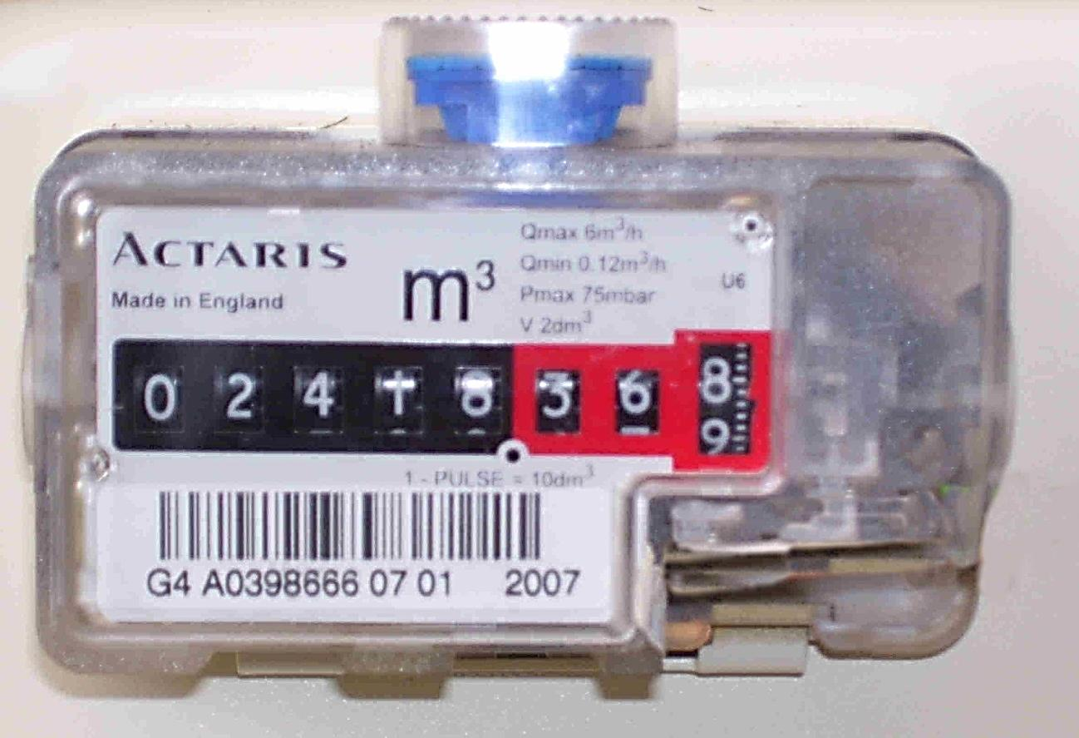
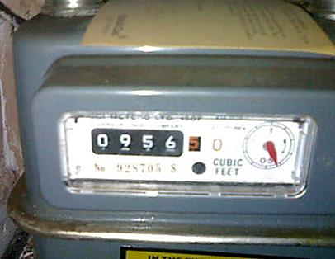
Measuring Gas Rate from Unit Construction Meters
The U6 unit construction has a ‘direct reading index’ for ease of reading in cubic meters and cubic feet
Notes:
Although it is no longer permitted to supply or install imperial indexed meters, the majority of those currently installed measure gas in cubic feet and the gas consumption is shown in hundreds of cubic feet by the first four digits
For the calculation of gas rates we are interested in the meter test dial on the right hand side of the index
One full revolution of this dial will indicate that one ft3 of gas has flowed.

Slide 21
Measuring Gas Rate from Unit Construction Meters
To find the gas rate of a particular appliance, all other appliances supplied by the same meter must be turned off, and the appliance to be checked turned on at full rate
The test dial of the meter must be watched and the time taken to complete one full revolution noted in seconds
The figure of 3600 must be divided by the number of seconds taken for one revolution to convert to cubic feet per hour.
Notes:
Gas rates are, however, usually stated on appliance literature or data badges in metric units, therefore we have to convert ft³/hr to m³/hr by multiplying by 0.028.

Slide 22
Measuring Gas Rate from Unit Construction Meters
Example 1
A domestic gas fire is turned on and the meter test dial takes 3 minutes to pass one cubic foot.
What is the gas rate of the appliance?
3600 = 20 x 0.028 = 0.56m³/hr
180
Converting Ft/m3 to m3/hr
Notes:
This is how we calculate the gas rate
As we have discussed previously, the manufacturer’s instructions give the input in kW, so we need to convert the gas rate to kW
We will cover this calculation after we look at electronic meters.

Slide 23
Metric U6 Meters are Identified as G4 Meters
The meter index has five digits (black) normally used for billing purposes, which register cubic metres, and three check digits (red), which register hundredths of cubic metres
These check digits are used for calculating gas flow rates
G4 meters offer resistance to the passage of gas that varies with the position of the valves and bellows moving inside
To obtain an accurate reading the gas flow rate should be measured over a two-minute period, using the same method shown for electronic meters later.

Slide 24
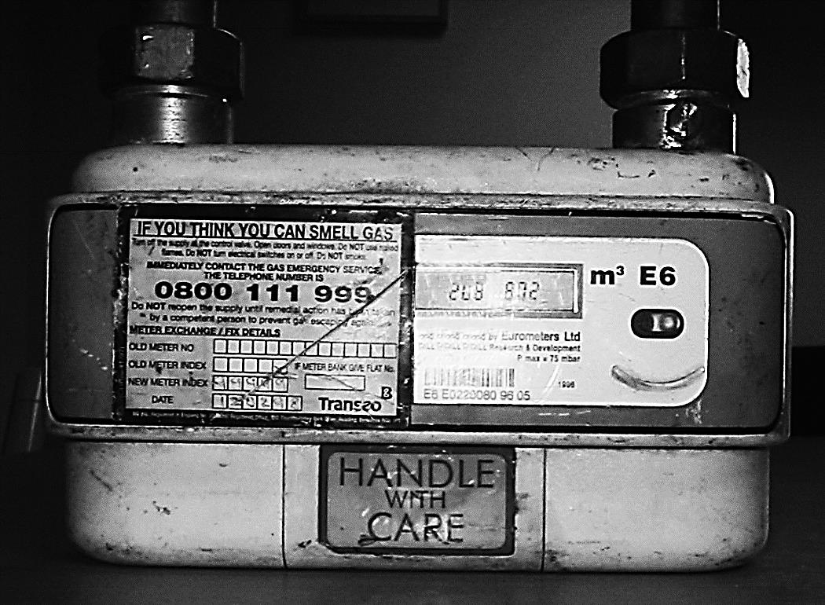
Measuring Gas Rates from Electronic Meters
The electronic meter has a liquid crystal display with a direct reading index, and this meter reads the consumption of gas in units of m³
The image shows on the meter dial three sets of digits
The left five numbers denote the gas consumption in cubic metres, to be used by the gas supplier for billing
For gas rates we are interested in the middle set of three numbers denoting cubic decimetres
The final number is a number 6 and shows the rated meter capacity.
Notes:
It is becoming more frequent that the installer encounters installations fitted with one of the electronic meters installed by the supplier
The meters come in a number of guises, all with the same dial
The slide shows an example of an electronic E6 meter
E stands for electronic and 6 as in the U6 meter denotes the badged rating as 6m³/hr.

Slide 25
Measuring Gas Rates from Electronic Meters
The following method of working out a gas flow rate may also be used for U6 metric meters (G4):
Turn on appliance to be tested; allow approximately 10 minutes for appliance to reach operating temperature.
Record initial reading on display and immediately start a stopwatch.
After two minutes read and record display for a second time.
Deduct the initial reading from the second reading to give the gas flow rate over two minutes.
5. Multiply gas flow rate over two minutes by 30, to give gas flow rate per hour.

Slide 26
Measuring Gas Rates from Electronic Meters
Example 2
Initial reading = 00796. 425m³
Second reading = 00796. 476m³
Gas flow rate over two minutes
= 00796. 476m³ - 00796. 425m³
= 0.051m³
Gas flow rate over one hour = 0.051 x 30 = 1.53m³/hr

Slide 27
Calculating Appliance Inputs using Gas Rates and Calorific Value
To calculate the heat input to an appliance we need in addition to the gas rate, to find the calorific value of the gas
This is the quantity of energy that is contained within a given amount of a fuel
The calorific value of natural gas is approximately 38.6MJ/m³ or 34.7MJ/m³ net
This may be used with reasonable accuracy
If in doubt the calorific value is printed on every gas bill.
Notes:
It is quite simple to calculate the gas rate of an appliance - we do not even need to remove a screw
However, as we have discussed, to check the performance with the manufacturer’s instructions or data badge we need to find the input in kW

Slide 28
Calculating Appliance Inputs using Gas Rates and Calorific Value
Now to calculate the input to an appliance the formula is:
Heat Input = Gas Rate x Calorific Value
This formula will however give the heat input in MJ/hr and we need the answer in kW.
To achieve this we divide by 3.6. Let us try an example:
What is the input of the gas fire in example 1 assuming a gross CV of 38.6MJ/m³?
Heat Input = 0.56 x 38.6 = 6kW
3.6
3.6 is a constant

Slide 29
Calculating Appliance Inputs using Gas Rates and Calorific Value
Example 3 (assume gross CV 38.6MJ/m3)
A domestic central heating boiler is turned on and the meter test dial takes 45 seconds to pass 1ft³.
What is the heat input of the appliance in kW?
Gas Rate = 3600 = 80 x 0.028 = 2.24m³/hr
45
Therefore:
Heat Input = 2.24 x 38.6 = 24kW
3.6
Notes:
Following calculations, if the gas rate is found to be incorrect, the fault must be rectified or the appropriate action taken to comply with the Gas Safety (Installation and Use) Regulations.

Slide 30
Converting kW/hr to BTUs/hr
You have now learned how to calculate gas rates and heat inputs in metric units; however, many older appliances only give their inputs in BTUs or British Thermal Units
To convert an input in kW to BTUs simply multiply by 3,412.
Example 4
The central heating boiler in Example 3 has an input of 24kW.
What is this in BTUs?
24kW x 3,412 = 81,888 BTUs

Slide 31
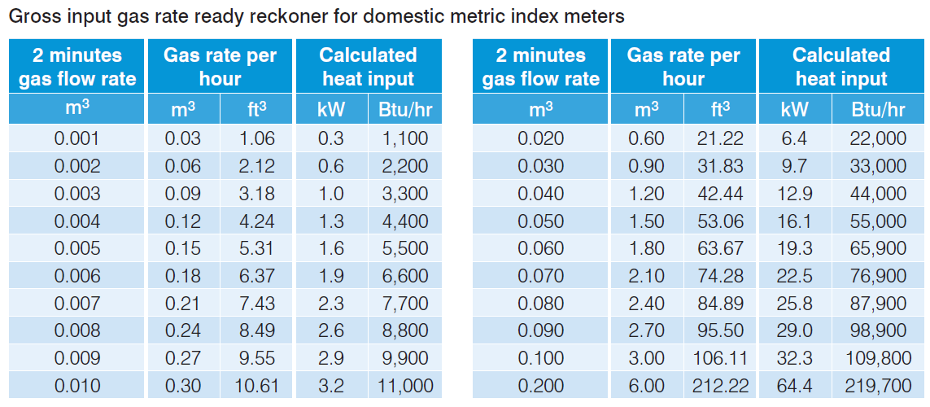
Calculating Appliance Inputs using Gas Rates and Calorific Value
Notes:
To use this ready reckoner simply look up the 2 minutes Gas Flow Rate in the left hand column of the appropriate table and look across for the correct heat input
For Gas Flow Rate readings that are not listed, add the figures from each table to calculate the correct heat input.

Slide 32
Calculating Appliance Inputs using Gas Rates and Calorific Value
Example 5
Taking the 2 minutes Gas Flow Rate from example 2 of 0.051m³ we see that this figure does not appear in either of the tables
So we take the input for 0.050m³ =16.1kW and the input for 0.001m³ = 0.3kW then add the two inputs for a gross input of 16.4kW.
For a net input figure divide by 1.1
i.e. 0.050m³ =16.1kW gross + 0.001m3 = 0.3kW gross = 16.4kW gross ÷ 1.1 = 14.91kW net.

Slide 33
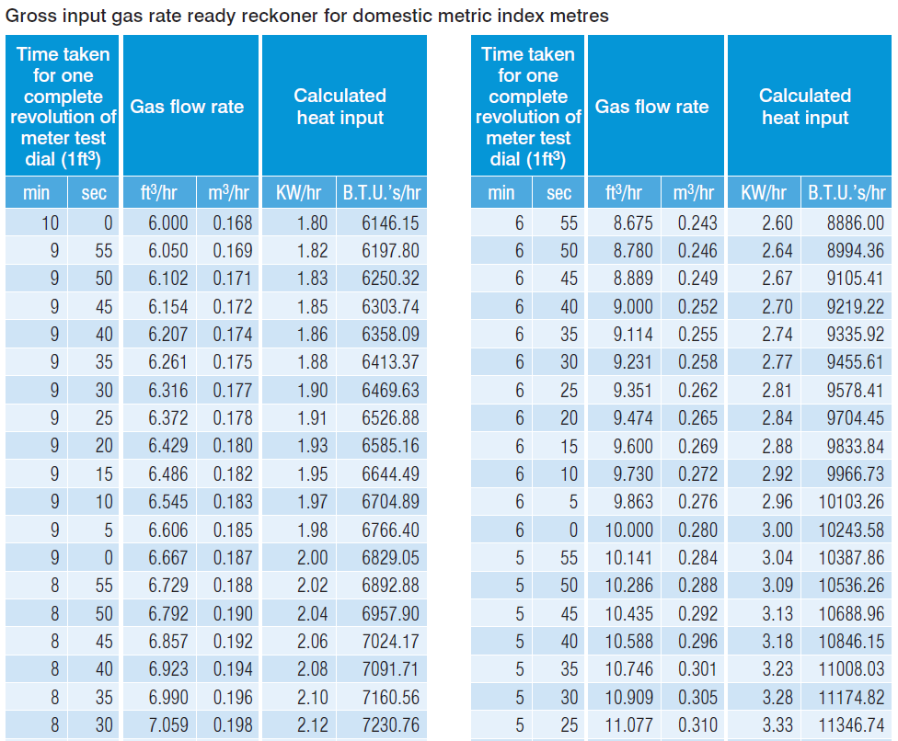
Calculating Appliance Inputs using Gas Rates and Calorific Value
Gross input gas rate ready reckoner for domestic metric index metres - see BPEC manual pages 12 and 13 for full tables

