Slide 1

Join our cause

Slide 2
Heat pump revision
ASHP A7W35 A=air
GSHP B0W35 B=brine
Low pressure 7bar
High pressure 22-26bar
Monovalent=heat pump only heat source
Bivalent=dual system heat pump and perhaps another source

Slide 3
RHI e-mail is sent every twelve months to confirm, installation is unchanged
No TRVS are good for circulation
Placing damp proof course under ASHP will prevent foundation damaged
Solar deemed RHI only
Above 50c RHI payment is almost zero
Oil hybrids require buffers of 20 litres per 1 kw
Fan coil sprays 45c to avoid nuisance
Refractometer measures light reflection
Blue coat has teflon in for durability
Defrost can cause steaming

Slide 4
Heat pump revision
ASHP has blue coat technology to prevent ice forming and corrosion
GSHP Glycol-Propelene is used non toxic
ASHP Glycol-Ethelene tonic to plants/pets
Pipe work is a W plan heating priority should system fail hot water is shut off

Slide 5
Heat pump revision
GSHP lay out
Remove stones
Wet ground and damp areas are best for heat source
GSHP lay out must be 0.8m apart
Slinky method is not recommended
i.e
10kw GSHP – 2.5kw = 7.5kw
7.5kw x 1000 = 7500
7500 ÷ 24 = 300m2 area (24 is ground heat source for a damp soil)
300m2 ÷ 0.8 = pipe needed

Slide 6
Heat pump revision
Efficiency determined by dividing
Heat pump output
Electrical input/usage
SPF seasonal performance factor
Heat pump energy used over year
Factors
Peak load Controls Demand

Slide 7
Heat pump revision
ͨ average UK outside temperature
Inverter compressor more efficient then buffer not required
Buffers reduce compressor cycling
ASHP average 20-25ltre per/Kw

Slide 8
Heat pump revision
Kw output 7500 =300m
Specific heat extraction for soil 25
Vaillant ground source have Primary hot water
circulate for cylinders
Brine is used for GSHP due to Glycol being toxic
Brine Ethylene salt water
Sight glasses to view condition of anti-freeze and refrigerate

Slide 9
Heat pump revision
Collector difference should be 3 ͨ
Horizontal collectors must be 0.8m apart
Not permitted where wind turbines are installed
Collectors must be 1m away from foundation
4 way valve operates reverse flow to defrost heat pump
Heat pumps are 5% VAt

Slide 10
Heat pump revision
GSHP collectors must HDPE
Estimate GSHP requires twice house floor area
GSHP 55 ͨ
ASHP 35 ͨ
Heat pumps are not allowed near bedrooms

Slide 11
Heat pump revision
Commissioning
Flush / test / Sample water
Clearances / Manufacturers instructions / Electrical
Inspect components / clean / fluid levels

Slide 12
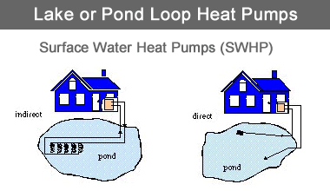
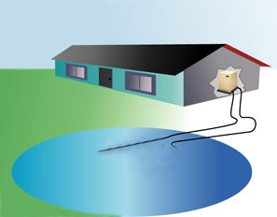
Heat pump revision
GSHP
Purge air / remove debris / check flow rate / discharge correct container
Add anti freeze
GSHP can have open loops from lakes

Slide 13
Heat pump revision
Monovalent single heat pump
Bivalent heat pump with SH (supplementary heating)
GSHP avoid
Dry ground
Stones
Slinky method

Slide 14
ODP Ozone depletion potential
GDP global depletion potential
Boreholes must more than 15m apart
W plan system must be installed “Y” so failure will close priority to hot water

Slide 15
Heat pump typical temperatures and pressures
Bicycle pump
7ºC
7.3
bar
75ºC
22
bar
Low pressure gas
High pressure high temperature gas
Steam
Heating flow
35ºC
Compressor
Plate heat exchanger
Window
Condensation
Compressor
External heat exchanger
Heat from ambient air
7ºC
2ºC
30ºC
Heating return
Expansion device
Boiling Liquid/vapour
High pressure liquid
Aerosol can
1ºC
7.5
bar
33ºC
21.5
bar

Slide 16
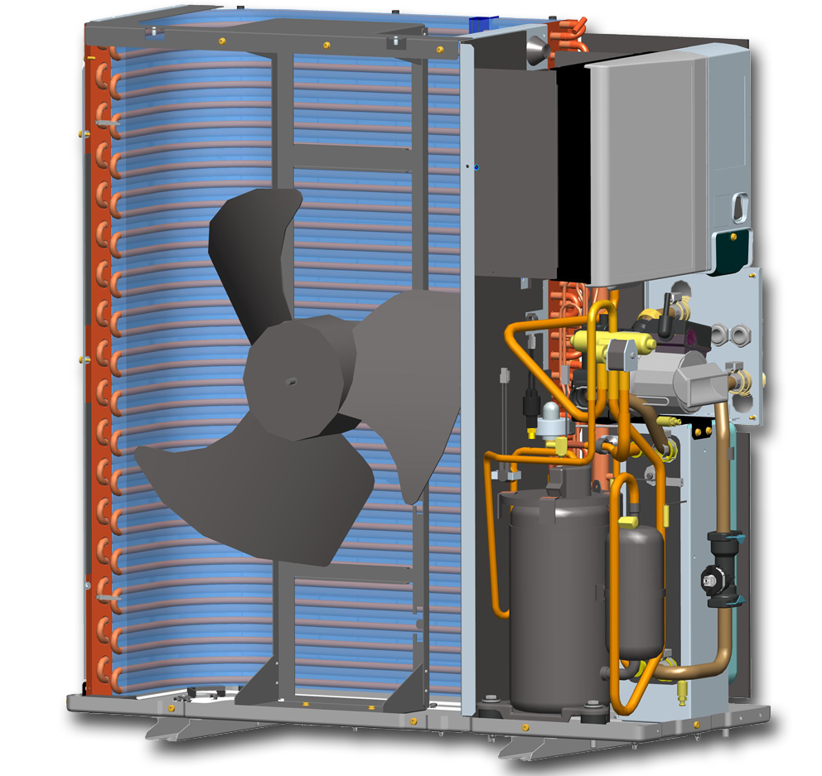
Typical Air to Water Heat Pump components
Air to refrigerant
Heat exchanger (Evaporator coil)
Reversing valve
Accumulator
Electronics box
Fan motor & blade
9
Circulation pump
Refrigerant to water
Plate heat exchanger
Compressor
Expansion device
Flow sensor

Slide 17
Rule of thumb heatloss method (Not MCS)
Not a designed heatloss, but useful to decide whether heatpumps are right for the project.
 | No improvement to insulation | UPVC/wood Double glazing, + loft insulation | UPVC/wood Double glazing, + loft & cavity wall insulation
1970 to 1995 | 100 W/m² | 85 W/m² | 70 W/m²
1996 to 2005 | 80 W/m² | 70 W/m² | 60 W/m²
2006 to 2010 | 50 W/m² | 50 W/m² | 50 W/m²
New build | 40 W/m² | 40 W/m² | 40 W/m²

Slide 18
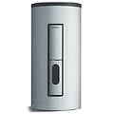
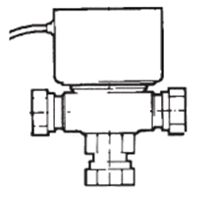



W Plan valve arrangement
B
A
B
A
Honeywell 4044C W plan valve or equivalent
W plan valve connected in central heating priority, wired in DHW priority to satisfy G3

Slide 19
Reducing Noise Impact
Measures to reduce noise impact
Consider carefully the position of the unit do not place near windows or doors
Always ensure the heat pump is fitted to a solid base and use the supplied anti-vibration mounts under the unit
Surround heat pump with plants to deaden noise – always ensuring minimum clearances are met.

Slide 20
Comparing noise ratings
Noise is very much a factor to consider when choosing an air source heat pump
Noise can be quite subjective, what is noisy to one person may be quite acceptable to another
Noise is measured over a wide range of frequencies, an appliance with a low overall rating may have an annoying high peak at a certain frequency
All manufacturers will state the noise levels that their equipment produces however not all measure noise the same way
This can mean that some units appear to be much quieter than others on paper whereas this may not be the case in practice
Some will take measurements directly in front whilst others will measure at 1.5m above floor level
In addition, some manufacturers quote ‘sound power’, whilst others quote ‘sound pressure’ The 2 are totally different measurements, so ensure you compare like-for-like
1m
0.5m
Noise levels are not all measured to the same standard look beyond the ‘headline’ figure

Slide 21
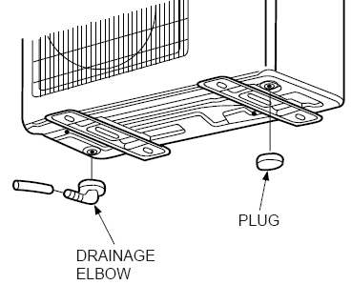
geoTHERM air - Condensate
The geoTHERM air heat pump will produce condensate as part of it’s normal operation
The external coil will frost up particularly in low ambient conditions
The heat pump operates in ‘reverse cycle’ to automatically defrost
The water produced collects in the bottom tray and is discharged via the drain hose adaptor
The adaptor can be fitted in either end of the heat pump to match the fall of the unit
The supplied blank is fitted into the other outlet
This condensate should not be confused with the acidic condensate produced by high efficiency boilers

Slide 22
Connecting heat pump to the system
Flexible hoses must be used to connect heat pump to system
Full bore isolation valves to allow heat pump disconnection from system
Any external pipework must be insulated with UV resistant and peck proof insulation
Consideration should be taken into account when entering the property, entrance hole should be resealed to prevent heat loss
A filter must be fitted on the return internal to the property.

Slide 23
Horizontal depth 0.8-2m
Lakes are the best heat source
DX rare in UK-direct expansion uses refrigerant not glycol in loop
Natural gas is not RHI applicable
PDR-planning development rights

Slide 24
Planning permission issues
Wind turbine fitted
Conservation area (may be visible)
Heat pump housing must be less than 0.6m2
Installing on wall, highway front and 1m of boundary

Slide 25
Heat pumps are designed at 55db
But assessment should be 42db
Boreholes are 180mm wide
85% of renewable are incorrectly installed
GSHP 55-65°
Heat pumps are maintenance free just glycol test

Slide 26
Meter installed for RHI and insulation but no financial gain on hybrids
R410a refrigerant, the higher the number higher the ODP is
Low pressure 7bar high pressure 22bar
GSHP scroll
ASHP inverter

Slide 27
ODP ozone depletion potential
R22 banned
R10 healthier
Scroll traps gas in between metal coil
Dry receiver collects moisture from refrigerant prior to the compressor

Slide 28
4 way reverse valve activates for 90secs to 21minutes
EN 14511 European test standard
Data badge states refrigerant and COP
SPF must be at least 2.5 for RHI

Slide 29
Correction factor formula
Flow + return temperature ÷ 2=
55 – 45= 50
Mean temperature – desired room temp =
50 – 21= 29
30 correction factor 0.5148

Slide 30
Standard design temperature
Underfloor 35
Fan assisted 45
Standard
Radiator 55
Watts= correction factor
m²

Slide 31
15kw Heat pump has two fan coils
Second Heat pump requires planning permission
Balance Point where system heat source changes from
AWHP to gas
FLEQ full load equivalent hours

Slide 32
Temperature difference
Time to heat hot water
135litre x 50 = 76.5 minutes
60 ÷ 4.186
Design hot water temperature
Specific heat capacity of water

Slide 33
Kw required to heat DHW
135litre x 50 x 4.186 = 78.5Kw
3600
Daily demand
3 + 1 x 45 litres = daily demand
Number of rooms

Slide 34
Underfloor heating 35 ͨ
Fan assisted 45 ͨ
Convectional radiators 55 ͨ
AWHP valid positioning allowed in rooms of size to handle F-gas leakage
Refrigerate charge =
Practical limit (kg/m3)
2.2 =5m3
0.44

Slide 35
Buffer vessel sizing
5 x 15 x 60 = 4500 = 215 litres
4.18 x 5 20.935
215 – 100 = 115 litres
Kw of appliance
Time between Heat pump start and stopping
60 seconds
Temperature difference between flow and return
Joules
System content volume

Slide 36
ODP- ozone depletion potential
Electrical 16amp type B
Noise reduction reduces Kw by 0.5Kw
VWL L means Luft which is air
Blank cap blows off under frost expansion
30 watts warms up oil around compressor for an hour

Slide 37
Thawing begins at 3° for 3 – 10 mins
Plate to plate can be used for 18Kw
High pressure sensor switches off at 41.5bar
Schematic settings for 470
1 – 5 boiler 6 – 7 heat pump 8 – 12 hybrid
Always switch on accessories prior to 470

Slide 38
Maximum temperature is 63°
Lowest temperature -15°
Ground loop diameter guidelines
28mm = 100metres
32mm = 200metres
40mm = 400 metres

Slide 39
1m at 8degrees
2m at 12degrees
42db at assessment point
ASHP electrics are designed to be water tight
Casing screws are anti seize material

Slide 40

DNO form A required for 20amp single phrase supply
HEAT METERS must be installed by persons qualified
1.5m between water mains and ground collector

Slide 41
15Kw heat pump, requires planning permission as the cubic area is greater than 0.6m3
Night feature on 15Kw looses 2Kw
Partially parallel bivalent measures both in buffer
8 miles within coast, remove blue coat, then apply Blygold creates durability and more efficiency

Slide 42
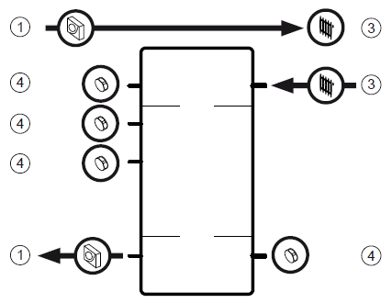
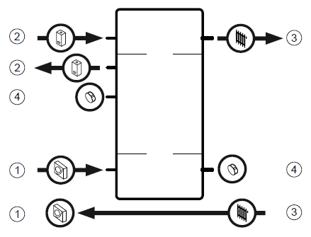
Energy metering
Meter has two valves ready for installation which is installed on return and flow temperature on flow..........any additional supplementary heating must be metered
Good for heated return and defrost
inefficient as the return is too hot by avoiding buffer

Slide 43
40mm only for collector diameter = 1 litre per/meter, 2 parts per 1 glycol sea open water needs titanium components with have an abstract licence ground flows can round together water flow rate must be measured
GSHP system program purge is 50min

Slide 44
Degree minutes from buffer VF1, weather compensator and heat curve
Actual temp
Gives target temperature- calculated temp
DM= calculated flow – actual flow
0
0=demand off -120 Hp begins -600 supplementary heater
but doesn't work till 720
switches off at 480
Positive warmer then target
Negative colder then target
Monitor Dm for direction of target and actual for demand

