Slide 1

Join our cause

Slide 2
Solar revision
Southern roof gives 1500hrs/per/year
Black NTC for external use
Internal grey
Trac pipe connected to pump station to vessel is un-insulated to disperse heat from expansion vessel

Slide 3
Solar revision
1.4kw/per/m2
Should the solar sit further than 200mm from roof line planning permission is required
Operates at 2bar
Releases at 6bar
Glycol-water evaporates leaving sludge and legionella

Slide 4
Solar revision
Pump is sited on return
Single check valve is sited on return
Turn temperature handles for filling/purging
Cooling vessels are installed prior to expansion vessel to prevent heating neoprene diaphragm

Slide 5
Solar revision
Programmer functions on information from cylinder temperature, array NTC difference which can be set 3-11 ͨ
Every 1m2 requires 50litres
Flat roof requires planning permission
Refractometer should read at least -16
PH scale should read above 7

Slide 6
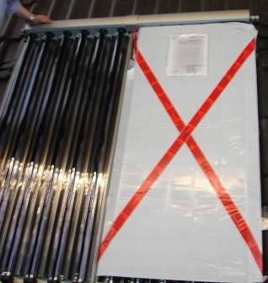
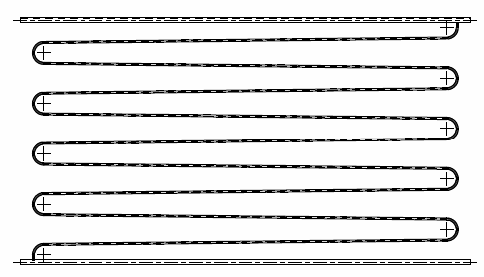
Solar revision
Hydrometer must be above 1.026
Anti-reflection glass increases efficiency by 7% call etching technology
Array must be covered whilst being installed
Serpentine pipe lay-out in Panel
Easier for draining, longer period in sun
Black anodised aluminium against corrosion

Slide 7
Solar revision
Mirosol paint used for anti-reflection
Panels are not allowed when visible from traffic areas in conversation or world heritage zones
Differential controller, switches the pump off when the temperature difference on the collector is small

Slide 8
Solar revision
Note for installation/Surveys
Orientation
Shading
Roof tile
Condition
Conservative area?
Wind exposure
Flat roof
Usage
Tubes are 10-20% more efficient

Slide 9
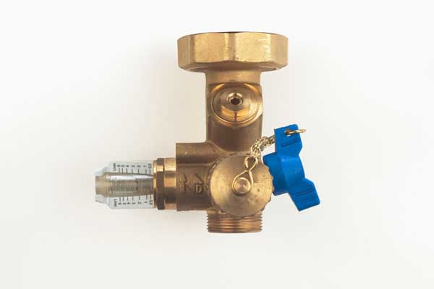
Solar revision
Flush Glycol every five years
Type “O” insulation is vermin and heat proof (150 ͨ)
Pump station must be installed lower than collector
Always set flow rate as per manufacturers instructions
Air separators must be installed on return

Slide 10
Solar revision
1m ² per person
100litre per property + 50 per person
Solar thermal only needs day light not sunshine
Heat exchanger size should be 10% of collector
Solar is always bottom coil

Slide 11
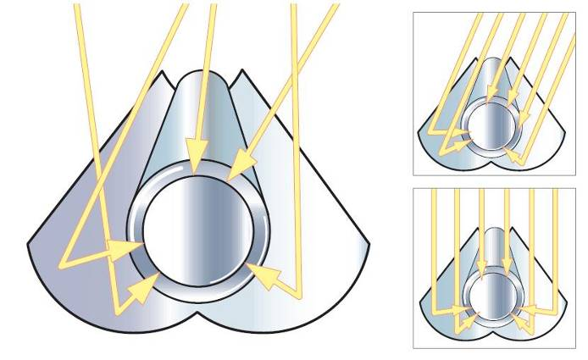
Solar revision
No soldered fittings
No plastic pipe
No PTFE

Slide 12
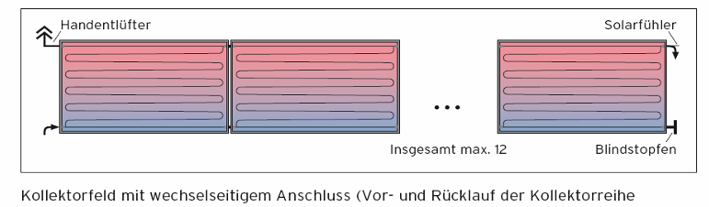
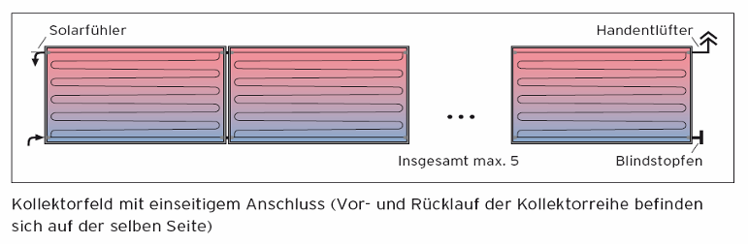
Solar revision
You are able to connect up to 12 collectors in a row (TBOE) horizontal or vertical or up to 5 collectors in a row (TBSE)

Slide 13
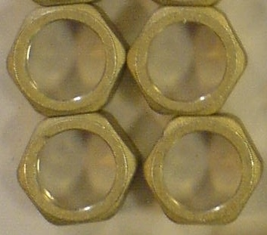
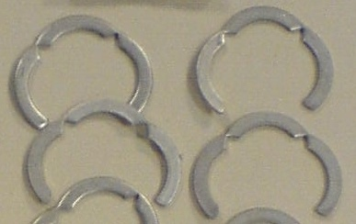
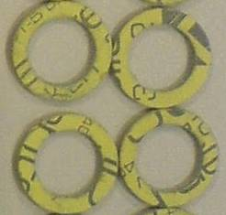
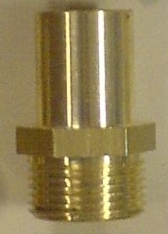
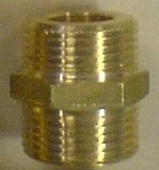
Solar revision
Segment ring/tricorn

Slide 14
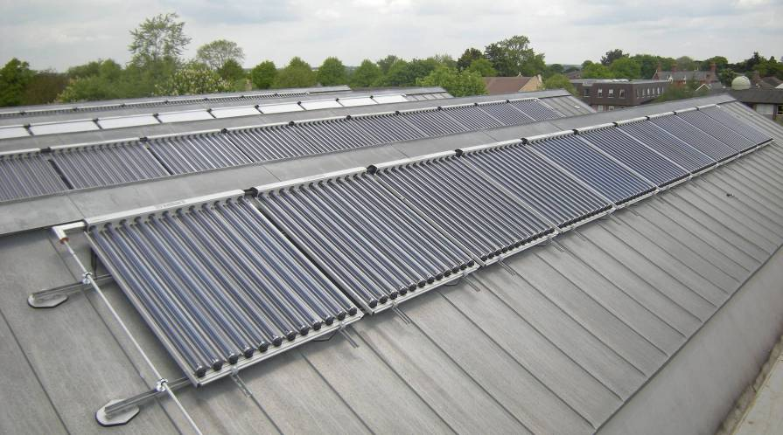
Solar revision
12 maximum panels are allowed in a series

Slide 15
Solar revision
Active solar requires pump
Passive systems gravity
Locate rafters using magnets
More than 9m ² planning permission required
Must be more then 5m from boundary
Planning needed if fitted higher than 4m

Slide 16
Planning required,
If array stands more than 200mm from roof
If panel are highest point on roof except chimney
If fitted within 1m of a flat roof edge

Slide 17
Servicing
Continuity of insulation, leaks, mounts, clean bird mess
Is the cylinder compatible for solar
(handle stress, scale, coil 10% of panel, Boiler interlock fitted)
Check AAV, water softener
Check pump setting, flow rates, temperature differential
Glycol test
Propylene Glycol is used for solar
Ethylene Glycol for external low toxic

Slide 18
Three types of solar panels
Unglazed collectors
Flat plate glazed collectors
Evacuated tubes
Legionella avoid temperatures above 25 ͨ and 60
Under L8

Slide 19
How to calculate flow rate
KW x T
SHC x TD
Kw amount of energy collector can absorb
Time 1sec
SHC specific heat capacity of fluid 3.9
TD temperature different
3.24 x 1 = 3.24 = 0.138L/sec
3.9 x 6 23.4

Slide 20
Pipe diameter up to 40mm must have insulation thicker than the pipe diameter
Flat packs are known to still function after 60years
Defused means cloudy weather
Solar thermal provides a saving of 60%
Glycol is not allowed in drains
Flat roofs installation require planning permission

Slide 21
Cylinder NTC should be 75mm below coil flow
Expansion vessels must be installed upside down
PRV must exit into temperature rated container
Direct systems collector with no coil are ban in UK due to Glycol
Swimming pool solar thermal must have no insulation and unglazed to prevent over heating
Solar systems must have TMV

Slide 22
Solar fraction is efficiency delivering heat from collect to cylinder
Ideal pitch is 30-45 °, winter 50 °
I.A.M Incidence Angle Modifier
Coil surface area should be 10% of panel area 0.1m ²per 1m² of panel
Drain valves must be fitted after isolation and dry to prevent washer melting

Slide 23
Always use metals clips over insulation
Use brass olives and not copper
Or crimping
Use solar designed fibre washers
Expansion vessels prevent vacuuming in cold weather
Prior to adding Glycol flush using sanitizer

Slide 24
Solar fitted higher than the roof line (except chimney) requires planning permission
Vertical collectors require planning permission
Solar water is category 3
Water flow rate through solar should be at least 25l/min
80% of daily usage should be heated by VS coil

Slide 25
The temperature rated discharge container must hold Glycol to cool down heated discharged water
The anaconda must be un insulated to prevent the vessel overheating
Servicing Glycol
Must be above 7ph
1.026 above in density hydrometer
Refractometer -28 (-16 for old systems)

Slide 26
Most pump flow rate are set around 1.33 l/min
Always cover collectors when flushing, filling due to flash back of heat
Silicone pipe work is allowed on direct DHW (pipe can handle freezing and cylinder of hot water will cool system down)
Always test system below PRV setting with water as its cheaper and prevent waste issues
Rubber slates are made from EPDM handles high temperatures
Solar factor is energy used to provide hot water

Slide 27
Solar dedicated water area must be more than 25l/min
Vs, which is cylinder solar volume of the coil must meet 80% of the daily demand
Vb, which is the cylinder boiler volume of the coil can loose 30% for the solar Vd (daily demand)
Rule of thumb
(25 x Np) + 36 = Vd

Slide 28
Pressure test systems to 1.5 times working pressure for 60mins or just below PRV discharge pressure for 30minutes
Varister is lighting protection
Rafters must be at least 50mm thick
Hemp should be used instead of PTFE
Earth cable must be 16mm²

Slide 29
Remove collector cover only when system has been filled and tested
25litres per/min of collector
Direct systems are banned in UK as Glycol is added to water
Evacuated tubes are more efficient than flat plates

Slide 30
Flow rates are usually set between 1.0 - 2.0 (for flat pack)
3 l/m for tubular
When purging and testing PV solar systems always convert electricity to DC
All solar cylinders must have TMV
Collectors must only be installed with compatible combination boilers able to with stand high temperatures
Solar and combination boilers with have TMV and blend valves used

Slide 31
Fire resistance properties when pipes pass through walls
Collectors installed in a series formation is;
Where one panel is disconnected the whole system shuts down
Collector in parallel formation;
Individual supply to each collector

Slide 32
Drain back systems using copper pipe are allowed to use plastic fitting and solder
Drain back does not require glycol
Temperature rated discharge containers must hold at least 25mm of glycol for discharge cooling purposes

Slide 33
15° min 75° max for collection angle
Drain back systems must be installed within 6m from top collector to bottom of drain back station and a minimum of 1m pipe work required
Drain back systems use only flat plate collectors specially designed due to the narrow serpentine design, with a designed flow rate of 2l/min
Pipe work must have a gradient of 4cm/pm

Slide 34
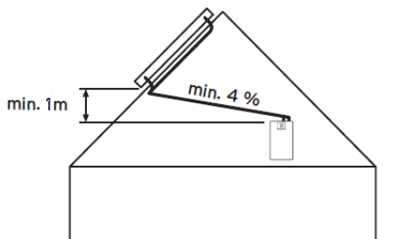
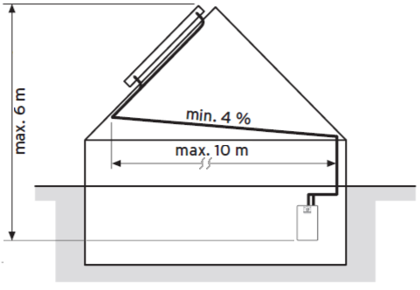

      Sizing
4cm per 1m = 2.3º
General notes
When using the VPM 15 D Basic module, up to 6 collectors can be installed.
The collectors can be installed in series or can be split in 2x2, 2x3 or 3x2 collectors arrays.
When using the VPM 30 D module up to 12 collectors can be installed (7 and 11 not possible).
The collectors can be installed in two rows with 6 collectors or can be split in2x4, 3x3, 2x5 3x4, 4x3 or 6x2 collector arrays.
8

Slide 35
When installing panels be cautious regarding the edge areas
Which is calculating the clearance zone from the edges (including ridge) to prevent wind turbulence and up lift
Arranging from a 1m to 2m

