Slide 1
Electrical revision
Join our cause

Slide 2
Electrical Units
SI Unit | Measure of
Voltage (v) | Electromotive force (emf) | Higher the voltage, greater the force to cause electrons to flow along a conductor (as in water, higher the head of water the greater the pressure) A battery has a positive and negative terminal: potential difference exists between them causes electrons to flow from one to the other
Ampere (I) | Current | Electrical unit of quantity. Volume of current passing through a conductor - similar to volume of water in litres passing through a pipe.
Ohm (Ω) | Resistance | When electrons pass through thin sections they ‘rub’ together in order to pass - they are restricted and there is a drop in emf. Similar to frictional resistance in water pipes
Watt (W) | Power | When electrical energy is used quickly, eg passing through a light bulb, heat energy is produced - referred to as power

Slide 3
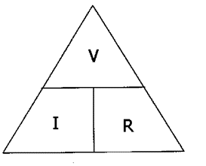
Electrical relationships
Relationship between current (amps), emf (volts) and resistance (ohms)
Expressed on Ohm’s Law:
V = I × R
Ohm’s Law triangle

Slide 4
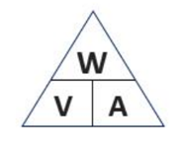
Electrical relationships
Relationship between power, current and voltage
W = V x A

Slide 5
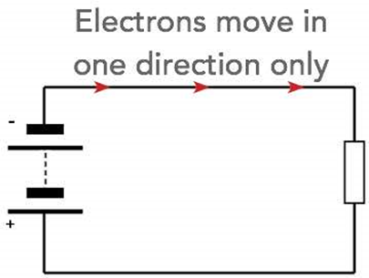
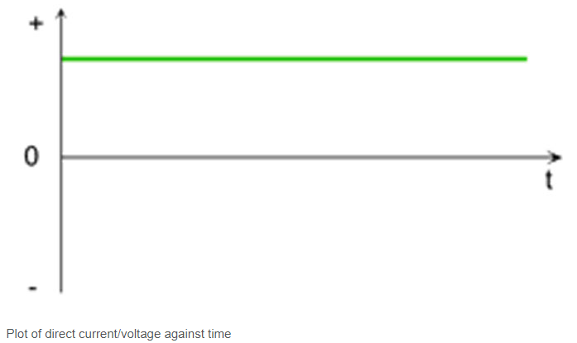
Types of Supply
Direct current (DC)
Sources:
Batteries
Solar panels
Thermocouples
Converters that rectify AC
The characteristic of direct current shown on a graph
Plot of DC current against time

Slide 6
Types of Supply
Applications of DC
Computers
Tablets
Smartphones
TVs
Control of electrical equipment
Automation
Symbol for DC

Slide 7
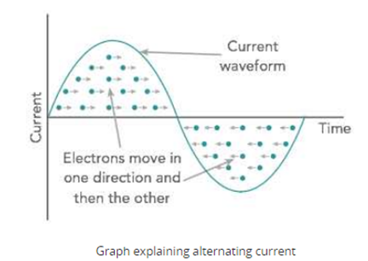
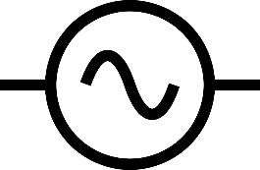
Types of Supply
Alternating current (AC)
Normally provided by electricity generating companies
Direction of flow alternates from positive to negative
AC symbol showing sinusoidal wave form

Slide 8
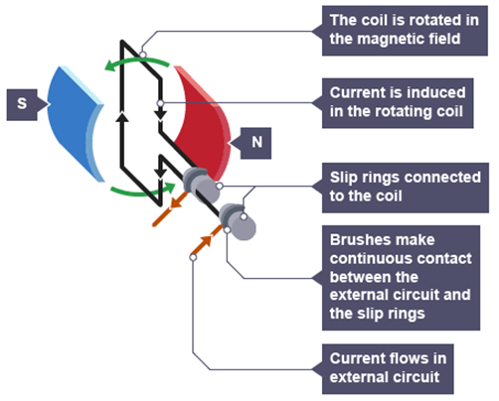
Types of Supply
Alternating current (AC)
The electron flow travels continually back and forth as a result of the way in which the current is produced
AC generator consists of a coil of wire rotating in a magnetic field
One side of the coil moves up through the magnetic field, creating a potential difference in one direction.
As the rotation continues and that side of the coil moves down, the induced potential difference reverses direction

Slide 9
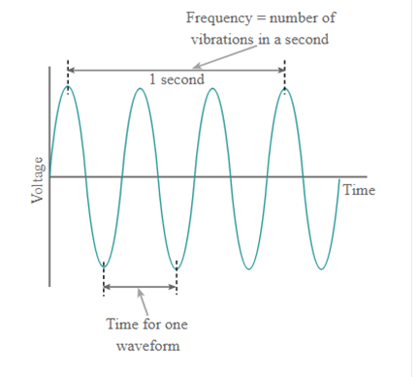
Types of Supply
Alternating current (AC)
The frequency, or number of times it changes direction, has been standardised in this country at 50 Hz (hertz) or cycles per second.

Slide 10
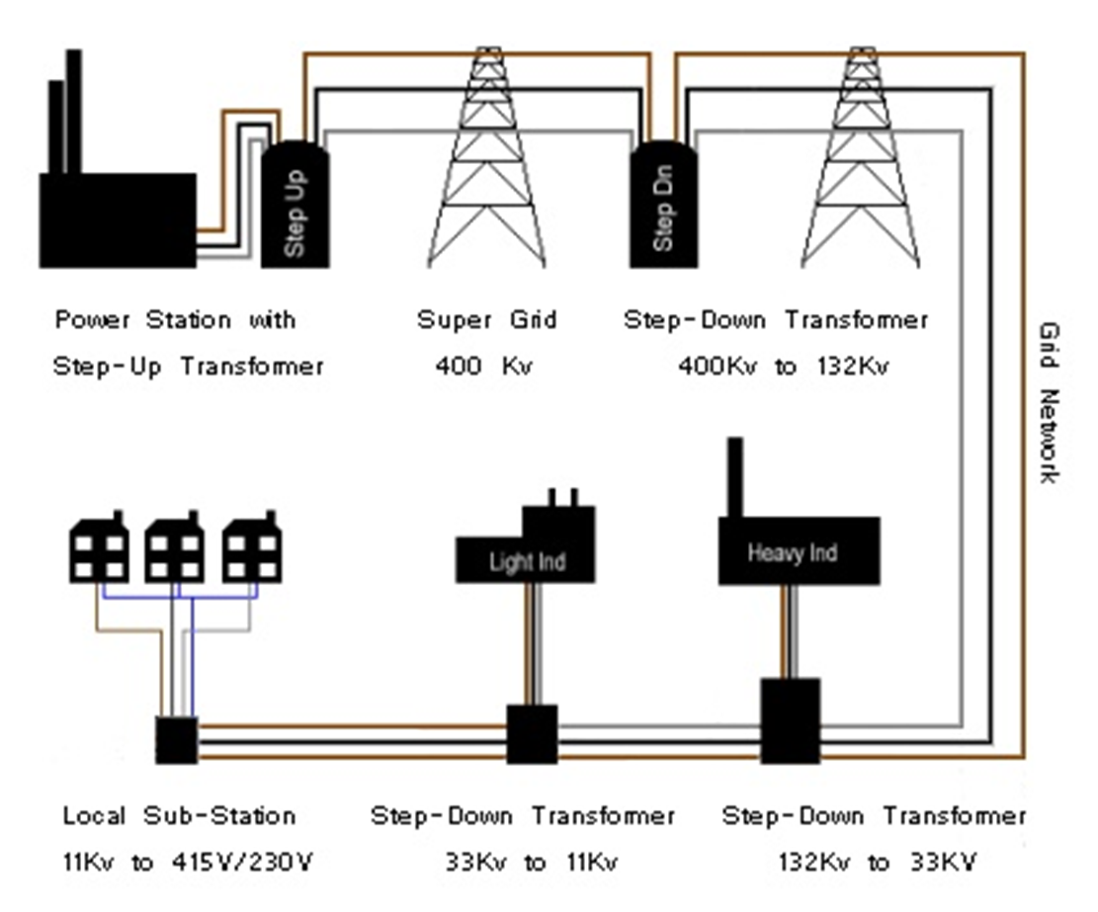
Types of Supply
Electricity from the generators is supplied into the national grid
Voltage transformed down and fed into the regional grids
Substations in the regional grid again reduce the voltage to suit the power requirements of the user.

Slide 11
Types of Supply
Single and three-phase supply
‘Phase’ is live cable
Electricity generated and distributed in 3-phase supply
Large factories/industry use all three phases
Large machines require higher voltages (415v)
Domestic supplies use one phase conductor – ‘single phase’

Slide 12
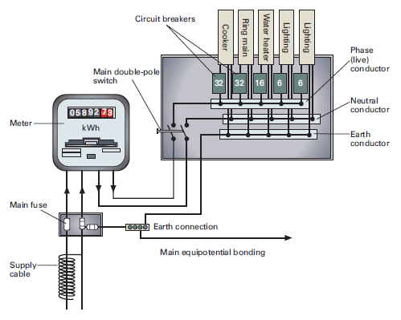
Domestic electrical circuits
Appliances/circuits
Consumer unit
Meter
Suppliers fuse (100A)
In coming supply

Slide 13
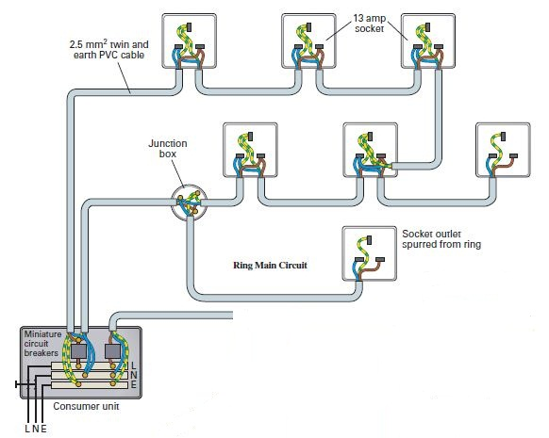
Domestic Electrical Circuits
Ring Main (sockets)
Spur outlets
To Lighting Circuit

Slide 14
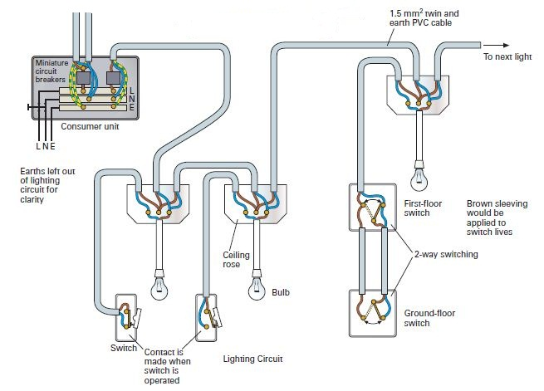
Domestic Electrical Circuits
To Ring Main
Lighting Circuit (Radial)

Slide 15
Domestic electrical circuits
Ring Main:
Ring circuit
Sockets
2.5mm twin and earth
32amp circuit protection (Consumer unit)
13amp appliance protection (Plug)
floor area served must not exceed 100m²
Lighting circuit:
Radial circuit
1.5mm twin and earth
6 amp circuit protection
One circuit upstairs and one downstairs

Slide 16
Domestic electrical circuits
Radial circuits
Often supply dedicated fixed appliances such as shows or immersion heaters
Appliances require a large electrical supply direct from the consumer unit
Typical ratings are:
16A for immersion heaters
32A for cookers
40A for showers rated up to 9kW

Slide 17
Earthing Systems
Earth (where we are standing) is ‘zero potential’
If we touch an electrically charged object current will flow through us to earth
Electrical equipment ‘earthed’ via a circuit protective conductor (CPC)
CPC of every final circuit taken to earth terminal at the consumer unit
Under fault conditions current flows back to the supply transformer
Most common earthing systems are:
TT system
TN-S system
TN-C-S system

Slide 18
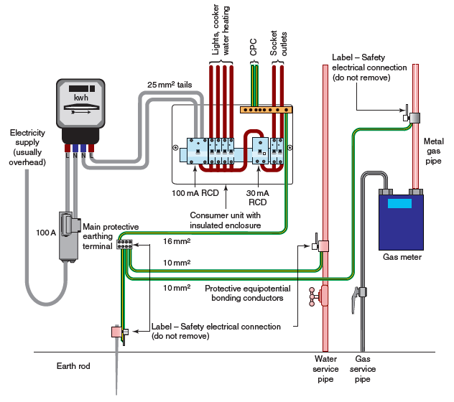
Earthing Systems
TT System
Usually found in rural areas
Overhead cables
Earth rod required (12mm)
Current dissipated and finds its way to supplier’s neutral point

Slide 19
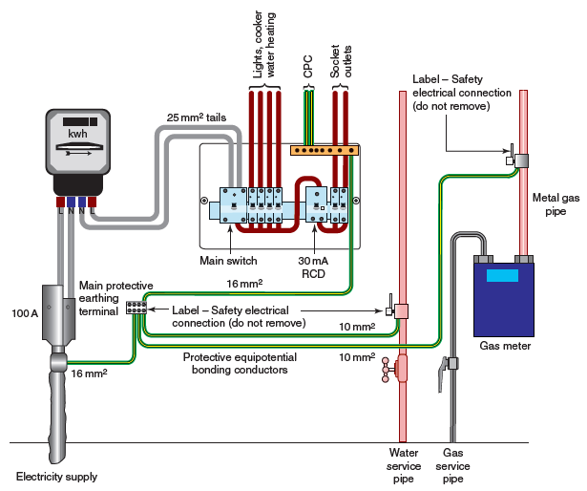
Earthing Systems
TN-S System
Earthing terminal connected to the metallic sheath or armour of the distributor's service cable into the premises
Connects back to the area transformer

Slide 20
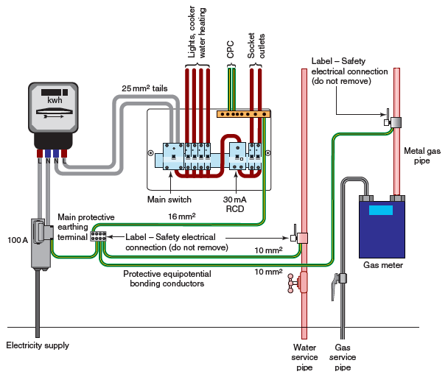
Earthing Systems
TN-C-S System
Sometimes referred to as protective multiple earthing (PME)
The distributor's neutral conductor is used to return earth fault currents arising in the consumer's installation safely to the source
The earthing conductor from the consumer unit to the main earth terminal, and from the main earthing terminal to its connection at the incoming supply, should be 16mm²

Slide 21
Earth continuity
Main equipotential bonding
Extraneous conductive parts:
Metal baths, sinks, taps
Copper pipework in hot water or heating system
Under fault, could become energised and we could suffer electric shock
All exposed metal pipework to be bonded together and connected to main earthing block at consumer unit

Slide 22
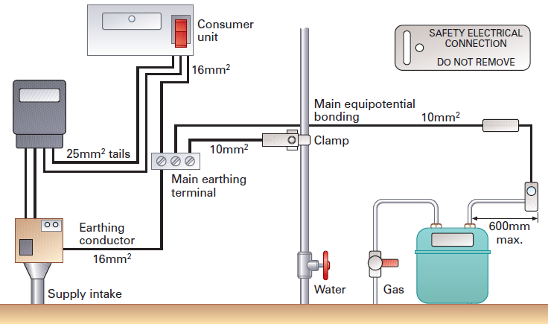
Earth continuity
Equipotential bonding
Supplies bonded together at their point of entry to the building
Gas supply bonded within 600 mm of the gas meter
Bonding conductor to be 10mm² csa

Slide 23
Earth continuity
Supplementary bonding
Main equipotential bonding only connects to one point of metalwork
May be plastic cisterns or fittings – continuity may not be maintained
Supplementary bonding wires join all parts together
Cross-sectional area 6mm²

Slide 24
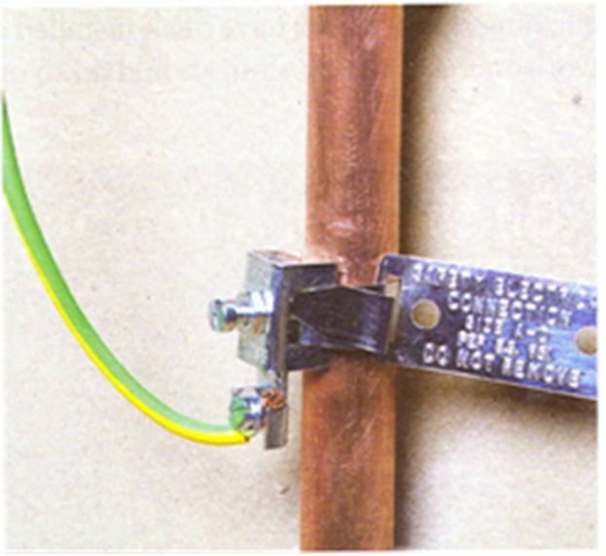
Earth continuity
Supplementary bonding
Earth clamp
Cross-sectional area = 6mm

Slide 25
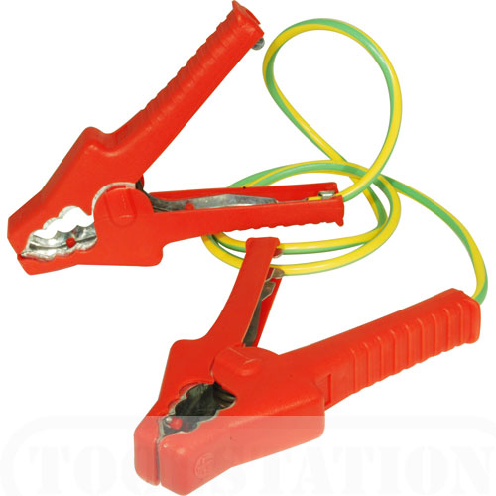
Earth continuity
Temporary bonding wire
When removing sections of pipework earth continuity to be maintained
Sections to be bridged with bonding clip
10mm² conductor
1.2m long

Slide 26
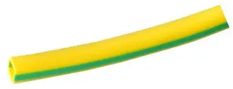
Cables and cords
Twin and earth cable:
Used to hard wire properties, generally behind walls and under floors
Ring main and radial circuits
1.5mm twin and earth = lighting (radial)
2.5mm twin and earth = ring main
6.0mm twin and earth = electric shower up to 7kw (radial)
10.0mm twin and earth = electric showers up to 11kw (radial)
Blue = neutral, Brown = live
Central core is earth which needs sleeving in green & yellow - Circuit Protective Conductor (CPC)

Slide 27
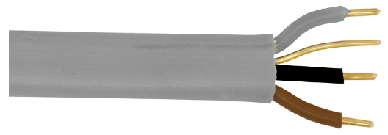
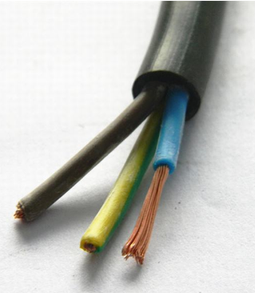
Cables and cords
Three core and earth cable:
Core colours are brown, black and grey plus earth
Used for two-way switching of lights
Multi-strand insulated and sheathed cable:
multiple strands, grouped together to make up a single conductor
Used for meter tails

Slide 28
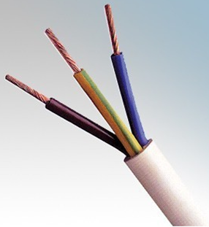
Cables and cords
Single core insulated and sheathed cable:
Used in light industrial and domestic wiring
Core colours are brown or blue with white or grey sheath
Heat-resisting insulated and sheathed flexible cords:
Suitable for use in ambient temperatures up to 85°C
Applications include night storage heaters and immersion heaters, etc.

Slide 29
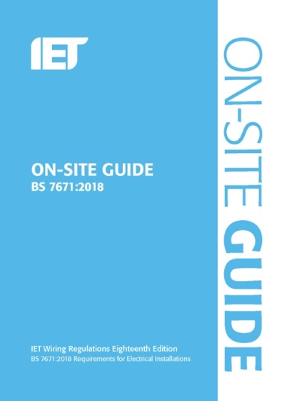
Cables and cords
Selecting cable sizes:
Measured as a cross-sectional area (CSA) and is normally stated in mm²
Guidance in on-site guide
General rule of thumb:
Usage | Fuse (amps) | CSA (mm²)
Lighting | 6 – 10 | 1.5
Ring main | 16 – 20 | 2.5
Shower | 30 – 32 | 6.0
Cooker | 45 | 10

Slide 30
Domestic electrical circuits
Ring Main:
Ring circuit
Sockets
2.5mm twin and earth
32amp circuit protection (Consumer unit)
13amp appliance protection (Plug)
Lighting circuit:
Radial circuit
1.5mm twin and earth
6 amp circuit protection
One circuit upstairs and one downstairs

Slide 31
Circuit protection
Under fault conditions, must be automatic disconnection within 0.4 seconds (BS7671)
Mainly two types of fault:
Residual current (earth leakage)
Accidental break in a circuit – poor wiring, DIY accident
Overcurrent
Overloading a conductor (current exceeds that which conductor is safely capable of carrying)
Short circuit - neutral cable comes into contact with the phase

Slide 32
Circuit protection
All circuits and appliances MUST be protected by the use of a fuse or MCB
Modern regulations also require the use of an RCD.
Every circuit and appliance MUST also have a means of isolation

Slide 33
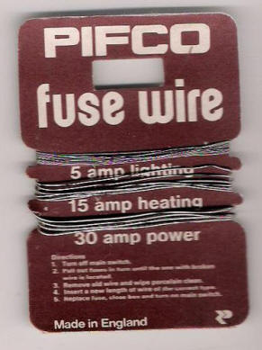
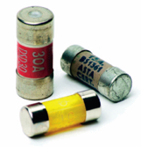
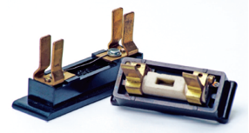
Circuit protection
Fuses
Contain fuse wire that will melt or ‘blow’ if current exceeds a specified level
Re-wirable fuses
Cartridge fuses

Slide 34
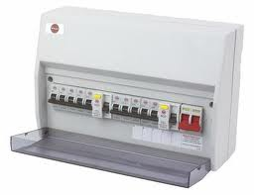
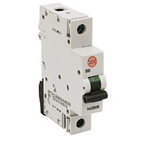
Circuit protection
Miniature circuit breakers (MCB):
Found in the consumer unit and protect one appliance or circuit
Trip out if an overload is detected.
Note –
In this consumer unit there are also two RCDs

Slide 35
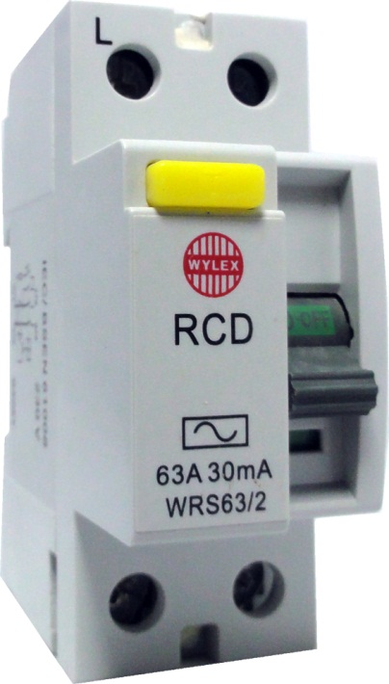
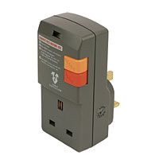
Circuit protection
Residual Circuit Breakers (RCD):
Found in modern consumer units and trip out if there is an earth fault (Test and reset switch)
Detect an imbalance between outgoing and incoming current
Trip at 30mA
Plug in RCD’s should be used with 240v tools.

Slide 36
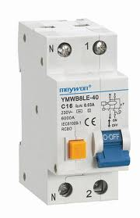
Circuit protection
Residual Current Breaker with Overload (RCBO)
Located in the consumer unit and contains the MCB and RCD for one appliance or circuit

Slide 37
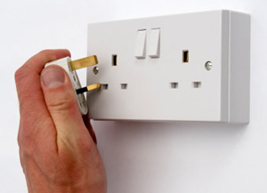
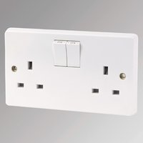
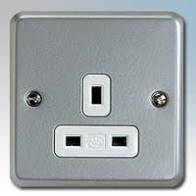
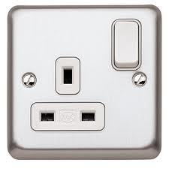
Electrical Components
Plug socket
These accept the domestic 3 pin plug. Any one socket can take up to 3kw, but not on a continuous load.
Can be:
Flush mounted
Surface mounted
Switched
Un-switched
Single gang
Double gang

Slide 38
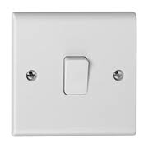
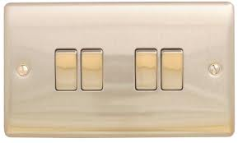
Electrical Components
Light Switches
One way switch:
Allows the live to be switched off in one place. (eg for a single room)
Two way switch:
Allows the live to be switched off in two different places. (eg upstairs and downstairs)
Flush mounted
Surface mounted
Single gang
Multi gang

Slide 39
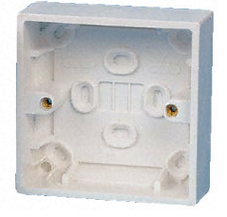
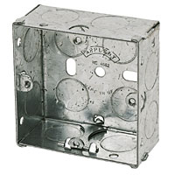
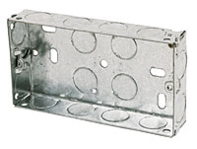
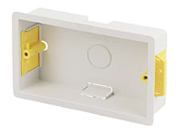
Electrical Components – back boxes
Single or one gang countersunk or flush mounted box
Single or one gang surface mounted back box
Double or two gang countersunk or flush mounted box
Double or two gang countersunk
Dry Wall/Plaster Board box

Slide 40
Electrical Components
Installing a wall socket

Slide 41
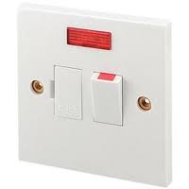
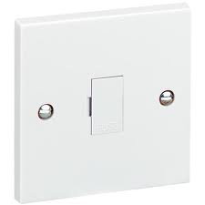
Electrical Components
Fused spurs
Can be:
Flush mounted
Surface mounted
Switched
Un-switched
Illuminated
Used to connect an appliance to the ring main giving a point of isolation

Slide 42
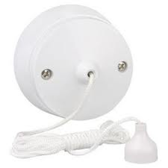
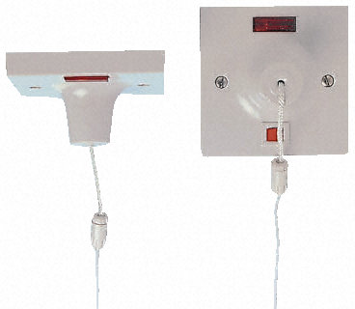
Electrical Components
Pull cords
These are used in danger zones to switch off appliances, so wet fingers do not touch electrical switches.
Lights in a bathroom – single pole isolator
Isolator for electric shower – double pole isolator (these must be illuminated and have a manual indicator)

Slide 43
Part M of the Building Regulations requires switches and socket outlets to be installed so that all persons can easily reach them

Slide 45
Concealed cables at a depth of less than 50mm from the surface of the wall must NOT be routed outside the shaded areas unless protected

Slide 46
To summarise, it is permissible to run unprotected cable within the two zones indicated:
150mm from the ceiling
150mm from an internal corner

Slide 47
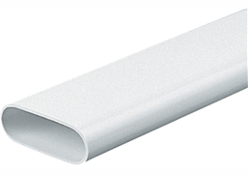
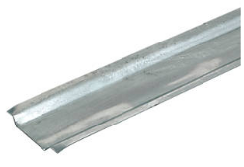
Cables in domestic properties
Protecting cables in walls
PVC oval conduit
Low profile – unobtrusive
Durable material – protection against impact and moisture
Channel section
Normally makes chasing unnecessary
Covered by normal layer of plaster

Slide 48
Cables in domestic properties

Slide 49
Cables in domestic properties

Slide 50
ELV and SELV systems
Extra-low voltage (ELV) systems are commonly used in domestic installations, particularly in the form of recessed downlighting
Safer systems due to:
Low voltages which should never exceed 120 Volts DC and 50 Volts AC, these levels are too low to provide current that would give a lethal electric shock
Very low risk accidental contact with the high voltages
A Separated Extra Low Voltage (SELV) system is an extra low voltage electrical circuit that is electrically separated from other circuits that carry higher voltages. Typical examples are:
CCTV systems
Data and computer cabling
Telephone networks

Slide 51
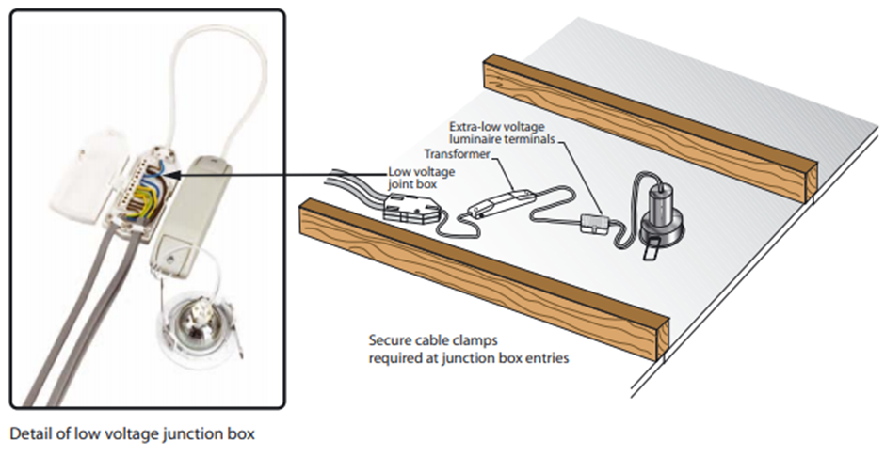
ELV and SELV systems
Example of ELV luminaire
ELV supplies used for lighting should be taken from a system meeting the requirements for the protective measures of SELV

Slide 52
Index of Protection (IP) BS EN 60529
Provides a means of specifying the suitability of equipment for the environmental conditions in which it will be used
Written as IP (Index of Protection) followed by two numbers XX.
The first number gives the degree of protection against the penetration of solid objects into the enclosure.
The second number gives the degree of protection against water penetration.

Slide 53
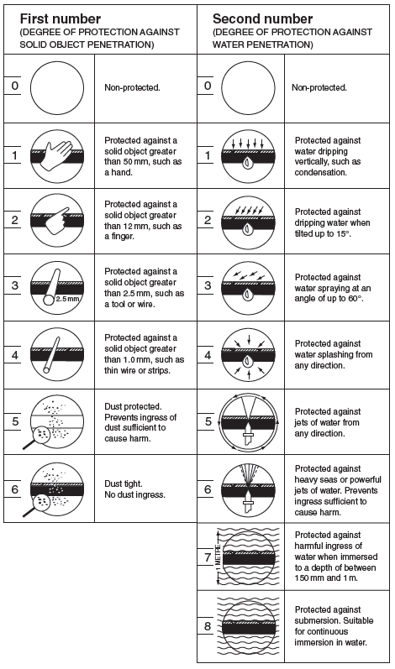
Index of Protection (IP)
A piece of equipment classified as IP45 will prevent a 1mm diameter rigid steel bar from making contact with live parts and be protected against the ingress of water from jets of water applied from any direction
Where a degree of protection is not specified, the number is replaced by an ‘X’
The ‘X’ is used instead of ‘0’, since ‘0’ would indicate that no protection was given

Slide 54
Zones for bath and shower rooms

Slide 55
Zones for bath and shower rooms
Zone 0
Bath tub or shower itself. No electrical equipment to be installed. SELV equipment not exceeding 12V with IPX7 protection permitted
Zone 1
Where people stand in water. Water heaters, showers and shower pumps and SELV fixed equipment may be installed. Must have IPX4 protection
Zone 2
People might be in contact with water. Lights, shavers and fans, plus equipment from zone 1. IPX4 protection
Outside zones
Still potentially dangerous. No sockets unless 3m from zone 1 boundary with additional RCD protection

Slide 56
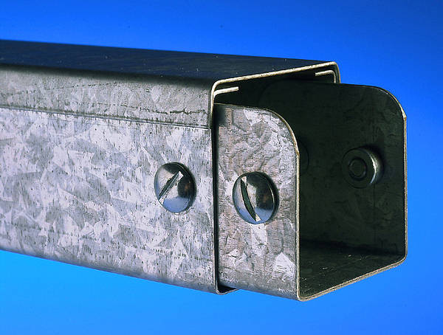
Non domestic installations
Trunking systems
Main purposes:
Support cables
Protect cables from damage
Protect the customer from the cables
Steel trunking
Skirting trunking
Lighting trunking
Dado trunking

Slide 57
Non domestic installations
Conduit:
Can be surface mounted or chased in to a wall and therefore hidden – be careful!

Slide 58
Agricultural and horticultural installations
Adverse conditions
Livestock, vermin, dampness, corrosive substances and mechanical damage
Minimum protection IP44
PVC cables enclosed in heavy-duty PVC conduit are suitable for installations in most agricultural buildings
In many situations, waterproof socket outlets to BS196 must be installed
Cables buried on agricultural or horticultural land should be buried at a depth not less than 600mm, or 1m where the ground may be cultivated

Slide 59
Electrical authority, safety and legislation
All installations have to be carried out by a fully qualified electrician
Under Building Regulations Approved Document P, a plumber does not have to be qualified to replace a like-for-like component, unless it is in a ‘danger zone’ when a competent person must undertake the work
Danger zones are:
in a bathroom
in a kitchen
in an out house
If an airing cupboard door is on the landing that is not a danger zone, but if it’s in the bathroom it is a danger zone!
If the boiler is in the loft, it is okay, but if in the kitchen it is not!!!

Slide 60
Electrical authority, safety and legislation
Part P requires notification of works to the planning department of the local authority before electrical work can be carried out on any domestic premises.
If the work is carried out by a registered competent person, or it is minor work, then it is non-notifiable
Details should be recorded on a minor works certificate
Indicates responsibility for the design, installation, inspection and testing of the work
Should be given to the person ordering the work
Essential tests that a competent person should carry out include:
Insulation resistance, earth loop impedance and polarity

Slide 61
Electrical authority, safety and legislation
Relevant statutory legislation includes:
Health and Safety at Work Act 1974
Building Regulations Approved Document P: Electrical safety
covers electrical safety in dwellings
EAW (Electricity at Work) Regulations
installation, testing and maintenance of commercial electrical systems
requires that the equipment has a current PAT test label
CDM (Construction Design and Management) Regulations
duty of care for all to contribute to the health and safety of a construction site

Slide 62
Electrical authority, safety and legislation
Non-statutory regulations and guidance:
BS 7671:2018 18th Edition IET Wiring Regulations
Covers the design, installation and testing of electrical equipment within domestic, commercial and industrial premises
In 1992, the IET Wiring Regulations became British Standard BS 7671
On-site guide
Handy guide to meeting the requirements of BS 7671
Manufacturers’ instructions
Should always be followed to ensure the correct installation and operation of electrical equipment

Slide 63
Electrical authority, safety and legislation
Summary
Quite simply, a plumber’s responsibility regarding electrical work should not exceed their level of competence.
Do not carry out electrical installations or alterations if you are not confident, capable or deemed competent to do so.
A plumber can replace a like-for-like component such as a shower, pump, fan or zone valve without being Part P registered.
Anyone who installs a new circuit or alters a significant part of an installation must be Part P qualified.
If in doubt – stop! Contact an electrician.

Slide 64
Electrical installation of plumbing appliances
Immersion heaters
Usually rated at 3kW
The overcurrent protection device (MCB) rated at 16amps
Wired directly from the consumer unit to the fixed fused spur (double pole switch) with 2.5mm² twin and earth
Double pole switch max 1m from heater
The cable between the pole switch and the immersion heater is 1.5 mm heat resistant flex, usually butyl

Slide 65
Electrical installation of plumbing appliances
Immersion heaters
Now a requirement to have a thermal cut-out

Slide 66
Electrical installation of plumbing appliances
Macerator-type WCs
Electrical connection to a WC macerator usually via a fused, unswitched spur outlet with a 5 amp fuse.
Cannot be unplugged accidentally thus turning off the supply to a control or appliance
Some macerators may vary – check instruction manuals

Slide 67
Electrical installation of plumbing appliances
Waste disposal units
Electrical connections may be via a 3-pin plug or a fixed fused spur.
Units protected by a 13 amp fuse
Cannot be fitted into a sink with the standard waste hole size

Slide 68
Electrical installation of plumbing appliances
Hot tubs/Jacuzzis
Supply to a hot tub must be suitable for the environment in which it is installed
A hot tub may be designed to take a supply from either a socket-outlet circuit or from a dedicated final circuit
Additional protection must be provided by an RCD having a rated residual operating current not exceeding 30 mA

Slide 69
Electrical installation of plumbing appliances
Hot tubs/Jacuzzis
Where installed outdoors, any equipment such as a socket-outlet or isolator and any associated enclosures should provide a degree of protection of at least IPX5
Water jets might be encountered when filling and/or cleaning the hot tub.
Weatherproof isolation switch

Slide 70
Electrical installation of plumbing appliances
Hot tubs/Jacuzzis
‘13 Amp plug & play’ hot tubs can take a supply from a socket-outlet forming part of a ring final circuit or suitably rated radial socket-outlet circuit
BS 7671 advises that a dedicated radial final circuit should be provided for appliances that have a rated power exceeding 2kW (8.7 A at 230 V).
The use of a factory-fitted in-line RCD is recommended
In-line RCD

Slide 71
Testing Electrical Work
A plumber may need to test for:
Continuity of earthing conductors
Polarity
‘Dead tests’ – electrical power off during testing

Slide 72
Testing Electrical Work
Correct test equipment to be used:
Continuity – low reading ohmmeter
Polarity – low reading ohmmeter
A socket tester is useful to check for polarity at socket outlets
Digital multimeter

Slide 73
Testing Electrical Work
Leads, probes and instruments to be in good condition and function properly
HSE guidance note GS38
Guidance on safe and suitable use of electrical test equipment.
The test probe of any instrument should not in itself be a hazard to the user
Tips to have 2mm minimum, 4mm maximum exposed conductor

Slide 74
Testing Electrical Work
Earth continuity test
To ensure all the metal work, (pipes, boilers, appliances, metal sinks etc) is safely connected to the main earth bar at the consumer unit
Find a known earth source (Screw on cover or earth terminal)
Multi-meter on ohms (or buzzer)
Place one probe on the known earth
Place the second probe on the appliance casing or pipework.
It should show a low reading (or buzz)

Slide 75
Testing Electrical Work
Earth Continuity test
There should be a low resistance reading on the ohmmeter – a satisfactory test result will be 0.05 Ω or less

Slide 76
Testing Electrical Work
Polarity Test
Is live connected to live?
Is neutral connected to neutral?
Is earth connected to earth?
the appliance may still work even though reversed polarity is taking place
A simple way to test polarity in a domestic socket is by using a socket tester
Plug it in and switch the socket on, if all three light come on the socket is okay

Slide 77
Testing Electrical Work
Polarity Test using an ohmmeter or continuity tester
Switch off the supply at the main switch.
Remove all lamps and appliances.
F ix a temporary link between the line and earth connections on the consumer’s side of the main switch.
Test between the ‘common’ terminal and earth at each switch position.
Test between the centre pin of any Edison screw lamp holders and any convenient earth connection.
Test between the live pin (i.e. the pin to the right of earth) and earth at each socket outlet

Slide 78
Electrical components of central heating systems
Wiring central heating components
Isolation point – usually a double pole switch or socket outlet and plug
Over-current protection device (fuse, 3amps)
Located close to programmer
3-core wire, 1.0mm²

Slide 79
Electrical components of central heating systems
Wiring diagram for ‘S-plan’ system

Slide 80
Electrical components of central heating systems
Wiring diagram for ‘Y-plan’ system

Slide 81
System faults on central heating systems
Systems are controlled by the electrical components
At each stage of operation the component can be checked for correct operation
First check – ensure power is available to the system
Then the operation of following components:
programmer, to
thermostat, to
motorised valve, to
pump

Slide 82
System faults on central heating systems
No power to system
Check the fuse. Replace if blown; if it blows again there is either a component or wiring fault. Possible causes:
Sticking pump
Water in one of the electrical components
Cables too close to heating pipes/damage

Slide 83
System faults on central heating systems
Programmer or clock
Switched on, right date and time?
If portable or remote – check batteries
Thermostats
Room stat needs to be on and requesting heat – turn it up to max temperature to check
Cylinder stat should be set at 60°C
The operation of thermostats can be checked when the circuit is isolated by attaching probes of a multimeter set to ohms between the switching terminals and then moving the control dial on and off.

Slide 84
System faults on central heating systems
Motorised valves
Electrical section is the powerhead or actuator. Two parts:
Electric motor (synchron)
Auxiliary switch (microswitch) – powers supply to boiler and pump
If motor fails switch will not be connected
Possible to replace defective motor or actual power head

Slide 85
System faults on central heating systems
Pump
If pump not running
Fuse blown?
Possible wiring issue?
If pump is running but water not flowing
Slight vibration
Shaft or impellor stuck
Gentle tap to free up seized components
Pump motor (extremely hot)

Slide 86
Boiler faults on central heating systems
Sequence of ignition
Current to the boiler control panel (printed circuit board – PCB) from the zone valve
Boiler thermostat calls for heat
Fan operates
Pressure switch detects pressure change caused by movement of the fan
Ignition process begins via control panel (PCB)
Flame rectified
Gas valve solenoid opens
Main burner ignites

Slide 87
Boiler faults on central heating systems
Boiler manufacturers build in many control and safety mechanisms to ensure safe operation of the appliance.
Modern boilers have fault indication panels showing a code, used with manufacturer’s fault-finding flow chart to identify the source of the fault.
Control and safety mechanisms include:
Printed circuit board (PCB)
Thermostats and thermistors
Fan
Air pressure switch
Flame rectification
Solenoid valve/multifunctional gas valve

Slide 88
Boiler faults on central heating systems
Printed circuit boards (PCB)
All electronic components communicate with the PCB
Monitors pressure, temperatures and currents to ensure that the boiler is working in a way that won’t cause damage to the boiler and will not pose any threats to people in a property
Faulty PCBs
Expensive component
Easily misdiagnosed and changed in error
Visual check for scorching or burn marks
Testing limited to continuity test on leads or removable fuses
Use manufacturer’s flow charts

Slide 89
Boiler faults on central heating systems
Thermostats
Boiler thermostat controls temperature of water
Failure will break the supply of current to the gas control valve, stopping the flow of gas and preventing the boiler from operating.
Alternatively, it may not be accurate and turn off the gas at an insufficient operating temperature
Faulty thermostats
Water may overheat or boil
Check for continuity – zero resistance should be displayed
Overheat thermostat should trip out and turn boiler off if thermostat has failed
Again, check for continuity – zero resistance should be displayed

Slide 90
Boiler faults on central heating systems
Thermistors
Variable resistor
Responds to rise and fall of temperature
Offers efficient control
Low current (typically 5v DC) sent from PCB to thermistor
Current passes through and returns to PCB – resistance measured
PCB opens or closes gas valve to increase or decrease heat output
Testing a thermistor
Meter set to the Ω scale
Probes attached to the two terminals
Reading should show resistance, changes if small amount of heat applied

Slide 91
Boiler faults on central heating systems
Fan
increases the velocity of the products of combustion to the outside and pulls in fresh air from the atmosphere
Allows for smaller diameter flues and horizontal runs
Failure of fan would lead to build of products of combustion in the boiler casing and potential carbon monoxide poisoning
Testing a fan motor
Meter set to the Ω scale
Test leads connected across live and neutral connections
If resistance is displayed, fan is operating

Slide 92
Boiler faults on central heating systems
Air pressure switch
Cut-off device if the fan fails
Senses negative pressure to allow boiler to start
Diaphragm responds to pressure applied to its surface
Pulse tubes – must be properly fitted
The usual sign that the air pressure switch is faulty is the fan starts but the boiler firing sequence stops
Checking an air pressure switch
Remove one of the input tubes and gently blow into the end
Microswitch should ‘click’
Attach a multimeter across the terminals

Slide 93
Boiler faults on central heating systems
Flame rectification devices
Utilise a flame as a conductor and pass a current through it.
The chemical reaction in a flame produces ‘ions’, which are electrically charged particles.
These ions rectify the ac current and produce a small dc output, operating a relay which then activates the gas valve.
Sine wave produced by alternating current
The flame works as a rectifier creating a small dc current which is sensed by the electronics of the boiler – allows flow in one direction only

Slide 94
Boiler faults on central heating systems
Flame rectification devices
A ‘flame senor’ is mounted in the path of the flame and an ac current applied to the sensor flows through the flame, which is then rectified to a dc current.
This current tells the control box that a flame is present, allowing the boiler to operate.
If no flame is present there is no ignition, and the shutdown of the gas valve is instantaneous in the event of flame failure.

Slide 95
Boiler faults on central heating systems
Flame rectification devices
Flame rod, flame, and the metal parts of the burner and manifold are all part of a very low power electric circuit
If they become dirty, rusty or corroded, the electrical path becomes corrupted and the flame current can be diminished
Can result in a nuisance shutdown or lockout and a no heat situation
Burner will go through its normal ignition sequence, ignite the flame, and then shut down within seconds
Flame rods can be replaced if physically damaged or broken
Can usually be cleaned with steel wool to correct the fault.

Slide 96
Boiler faults on central heating systems
Solenoid valve/multifunctional gas valve
Solenoid valves translate electrical impulses to open and close, controlling the flow of gas
Usually powered by electromagnetic energy in a coil
Solenoids are fitted on multifunctional gas valves
When the pilot flame is ignited the conductance of the flame enables current to flow from the rectification device to the control panel, which allows the main solenoid to open and the full flow of gas to travel to the burner to ignite
The operation of a solenoid can be tested when in the dead mode by checking the resistance on the coil

Slide 97
Safe Isolation
This is important to ensure before any kind of work starts on electrical appliances
Pumps
Showers
Programmers
Thermostats
Immersion Heaters
Plugs/Spurs
Boilers
Cookers
Valves

Slide 98
Safe Isolation
GS38 The HSE testing equipment standard
Multi meter, test leads and probes
Approved voltage tester with proving unit
Locked off and labelled

Slide 99
Safe Isolation
Before working on any electrical supply, you must ensure that it is completely dead.
An approved voltage indicating device is used to test if circuit is live

Slide 100
Safe Isolation
You will need to confirm that your voltage indicating device is working properly
This is achieved using a ‘proving device’

Slide 101
Safe Isolation
Using a Proving Device

Slide 102
Safe Isolation
Identify the circuit or the equipment you wish to work on.
Make sure that it is convenient to isolate the supply.
Isolate the supply at the consumer unit by switching off the miniature circuit breaker (MCB), residual current device (RCD) or removing the fuse.
Using an approved voltage indicator:
First, check the indicator is working on a known live supply by testing live/neutral, live/earth, neutral/earth.
Then use the indicator to check that the circuit you wish to work on is dead.
Then re-check that the indicator is still working on the known live supply once again.
Lock off the isolator (RCD, MCB) using an approved lock or keep the fuse you have removed in a safe place. To be absolutely sure that no one can put the fuse back in, the safest place is in your pocket!
Place a notice or sign at the consumer unit advising that the circuit is off and must not be turned back on.

Slide 103
Safe Isolation
The correct locations to carry out safe isolation are:
Consumer unit
Fused spur
Switch fused spur
Always lock and label to avoid the supply being switch back on by mistake. (Or retain fuse)

Slide 104
Terminal connections
Screw head and nut & washer terminal
Pillar terminal
Strip connector
Claw washer

Slide 105
Ohm's Law
Volts
Intensity
X R
Amps
Resistance
(Ohms)

Slide 106
Ohm's Law
Find out Amps Volts divide resistance
Volts
X R
Amps
Resistance

Slide 107
Ohm's Law
Find out Volts Amps multiply resistance
Volts
X R
Amps
Resistance

Slide 108
Ohm's Law
Find out resistance Volts divide by Amps
Volts
X R
Amps
Resistance

Slide 109
Power Law
Remember theirs a
Thousand Watts in a Kw
P
Power
I
X V
amps
volts

Slide 110
AC/DC
Anode=Positive
Cathode=Negative

Slide 111
Circuit Breakers
32
Cooker
32
Ring main
16
Water heater
5
Lighting

Slide 112
DC
Direct current is always the same force i.e,
Batteries
Electrical science links
Stable voltage

Slide 113
AC
Alternating current is electrical supply from the mains

Slide 114
All cables should be installed above insulation
In bathrooms there are 3 zones for reference for electrical installations
Bath
1
Basin
2
Toilet
3

Slide 115
A domestic property a classed as a single Phrase
This symbol means double insulated

Slide 116
What is this? Back box for plaster stud walls for light switches or sockets

Slide 117
Where are sockets fitted?
Light switches should be installed 1200mm max from the floor
Floor switches should be fitted 450mm high

Slide 118
Before cables enter brickwork they drop down then up this is to prevent rain entering the cavity
Left is a control panel wiring centre for heating systems

Slide 119
Below is conduit which is used to carry
Electrical cable

Slide 120
Below is a Catenary wire which is used to carry wire between two buildings

Slide 121
Below is a ceiling rose which is used to allow lighting cable through ceiling boards

Slide 122
Permitted cable route must be within 150mm
Cables chased more than 50mm do not need protection

Slide 124
Cables must be hidden 450mm below ground
And cover in clay tiles

Slide 125
Any exposed earth cable should be covered with?
Earth sheathing (yellow and green)

Slide 126
What does a Transformer do?
Reduces voltage from A/C
Step up transformers increase voltage

Slide 127
What connection should be used for Macerator?
Un-switch-able fuse outlet spur

