Slide 1

Domestic fuels

Slide 2
Diploma in Plumbing and Domestic Heating
Phase 3
Domestic Fuel Systems
Selection of fuels
The combustion process
Principles of chimney/flue systems

Slide 3
Hydrocarbon fuels
Non – renewable (high carbon):
finite amounts - will run out one day
energy from fossil fuels (coal, oil, gas) - mainly made up of Carbon
formed over 300 million years ago, when the earth was a lot different in its landscape.
It had swampy forests and very shallow seas - referred to as 'Carboniferous Period'

Slide 4
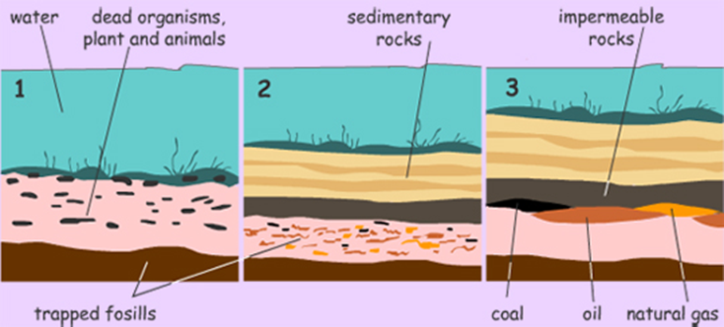
Hydrocarbon fuels
Formed in the ‘carboniferous period’
Dead plants, organisms etc covered by silt – fossil fuels
Dead organisms, plants and animals settled on the ocean floor and in porous rocks. This organic matter had stored energy
Sand, sediments and impermeable rock settled on the organic matter, trapping its energy within the porous rocks. That formed pockets of coal, oil and natural gas.
Earth movements and rock shifts creates spaces that force to collect these energy types into well-defined areas.

Slide 5
Hydrocarbon fuels
Advantages:
relatively less expensive to produce
higher demand as it tends to cost less
Disadvantages:
mainly of carbon - when they are burned (used) they produce a lot of carbon compounds (carbon dioxide and other greenhouse gases) that harm the environment
Air, water and land pollution are all consequences of using fossil fuels.

Slide 6
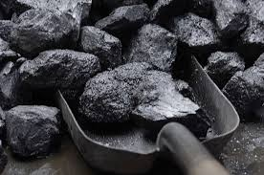
Hydrocarbon fuels
Coal
a combustible black or brownish-black sedimentary rock composed mostly of carbon and hydrocarbons.
made of the remains of ancient trees and plants that grew in great swampy jungles in warm, moist climates hundreds of millions of years ago.
The chemical and organic process these dead organisms undergo to become coal is known as ‘carbonization’
Coal is ranked very high if is has undergone a longer carbonization period, eg anthracite
Coal that has not undergone too much carbonization is ranked low eg lignite.

Slide 7
Hydrocarbon fuels
Coal
Still used for central heating boilers, steam and electricity generation
4 main types – lignite, sub-bituminous, bituminous, anthracite
The higher the carbon content, the higher the calorific value

Slide 8
Hydrocarbon fuels
Coke
Produced by heating coal
Drives off coal gas and coal tar
Smokeless fuel with high calorific value
Still used in some domestic boilers
Peat
Formed in bogs
Poor quality
Can be used in domestic fires, room heaters and peat-burning stoves

Slide 9
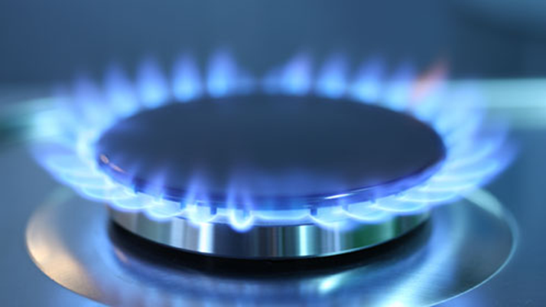
Hydrocarbon fuels
Natural Gas (methane)
Most widely used of the hydrocarbon fuels
Colourless and odourless
Fewer emissions than other fossil fuels
Specific gravity 0.6 (lighter than air)
Calorific value typically 38.76MJ/m³ (but can vary)
most of the world's reserves found in the Middle East (40%) and Eastern Europe (26%)

Slide 10
Hydrocarbon fuels
Liquid Petroleum Gas (LPG)
Most commonly used are propane and butane
Propane used as alternative for natural gas for domestic boilers, cookers etc
Specific gravity 1.5 (heavier than air)
Calorific value 93.1MJ/m³
Butane used for portable equipment eg barbecues, boats, camping
Specific gravity 2.0 (heavier than air)
Calorific value 121.8 MJ/m³
Relatively clean compared to coal or oil

Slide 11
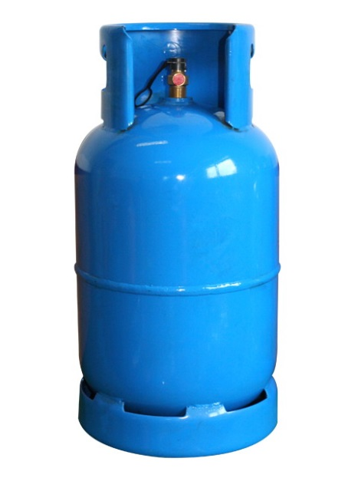
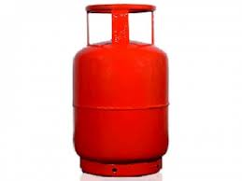
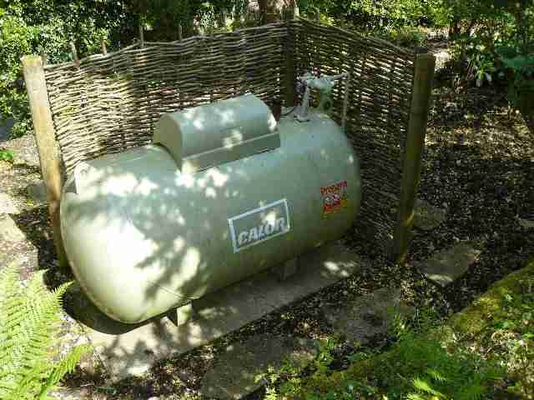
Hydrocarbon fuels
Liquid Petroleum Gas (LPG)
LPG produces no harmful or dangerous waste
LPG, when burned, produces less CO₂ than coal and oil
LPG burns cleanly with no soot and very few Sulphur dioxide and Nitrogen oxide emissions

Slide 12
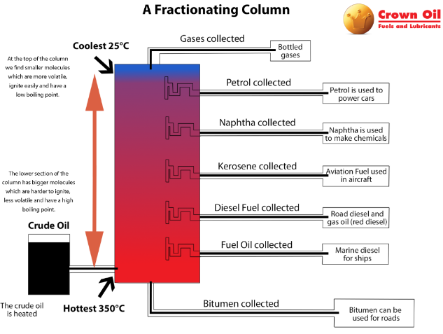
Hydrocarbon fuels
Fuel Oil
Kerosene grade C2
By-product of crude oil
Viscosity is such that a measured amount passes through a measured hole in 28 seconds or less
Used on most domestic oil burning boilers

Slide 13
Renewable energy
Energy sources that exists freely in nature.
Renewable energy resources are always available to be tapped, and will not run out.
When can energy be called 'Renewable'?
When its source cannot run out (like the sun) or can easily be replaced (like wood, as we can plant trees to use for energy)
When their sources are carbon neutral. This means they do not produce Carbon compounds (such as other greenhouse gases).
Renewable energy includes Biomass, Wind, Hydro-power and Solar sources.

Slide 14
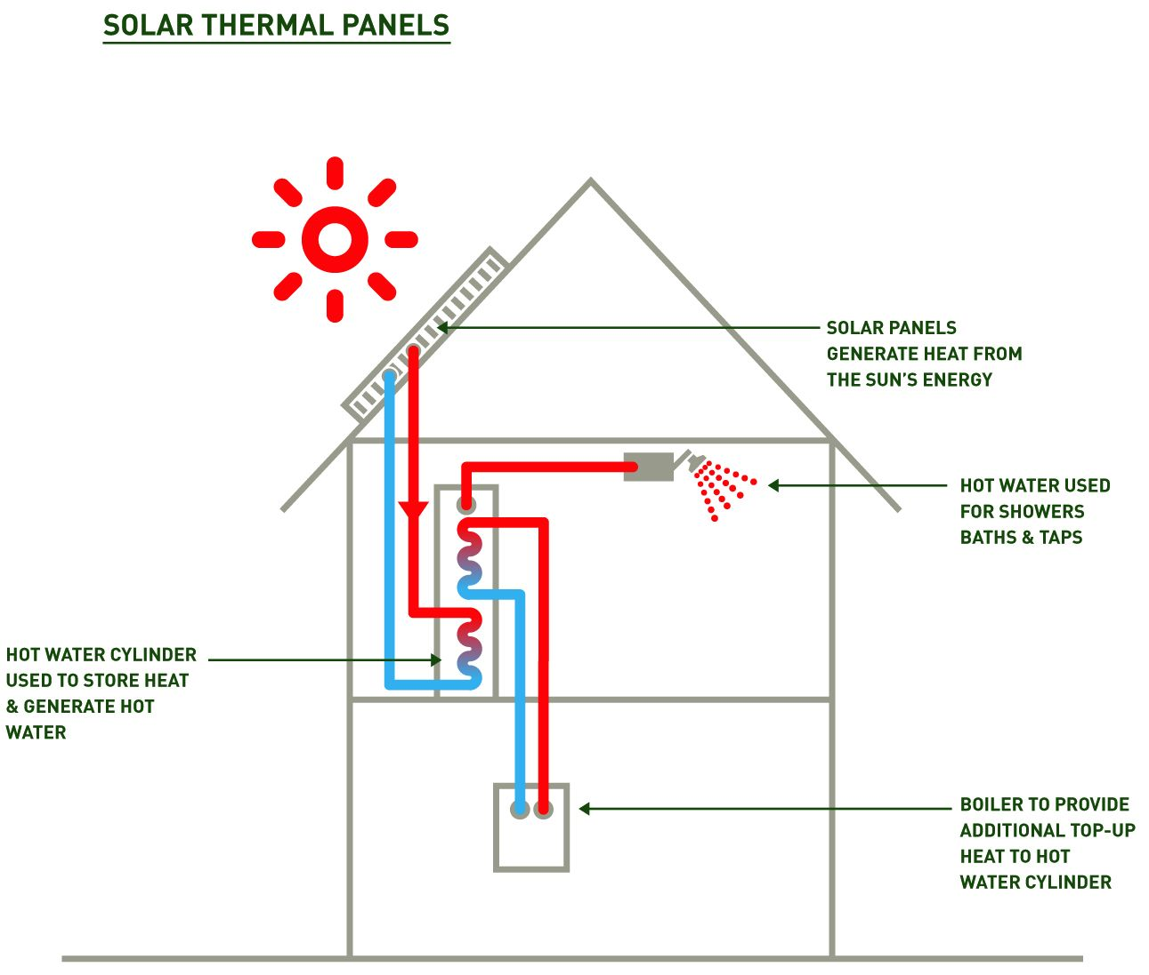
Low Carbon Energy
Solar thermal (water heating)
systems use free heat from the sun to warm domestic hot water
A conventional boiler or immersion heater can be used to make the water hotter, or to provide hot water when solar energy is unavailable.

Slide 15
Low Carbon Energy
Biomass
biological material derived from living, or recently living organisms - usually plant based material
harvested as part of a constantly replenished crop
takes carbon out of the atmosphere while it is growing, and returns it as it is burned
maintains a closed carbon cycle with no net increase in atmospheric CO₂ levels

Slide 16
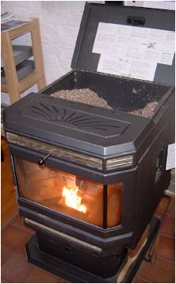
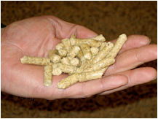
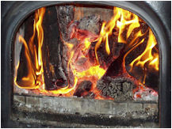
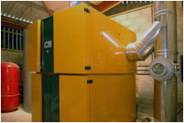
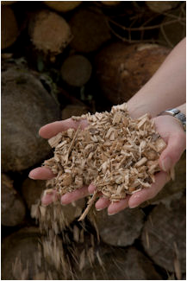
Low Carbon Energy
Log burners
Biomass Stoves & boilers
Pellets
Chip boilers – suitable for large scale installations

Slide 17
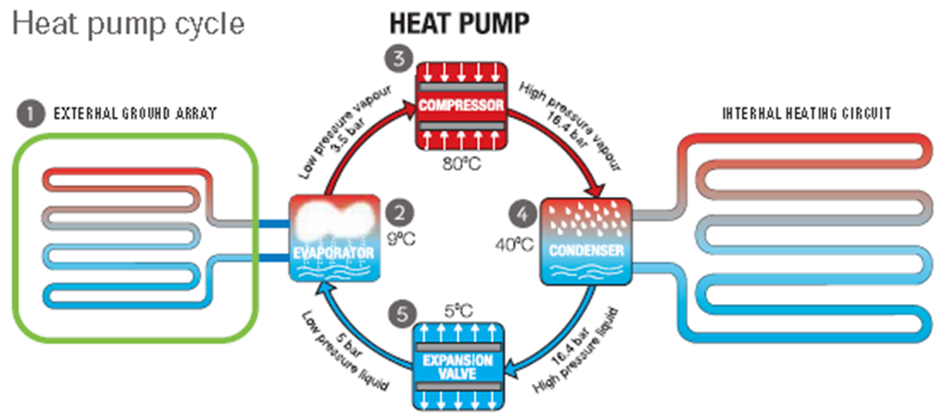
Low Carbon Energy
Heat pumps – extract heat energy from a source and circulates it around a system
External ground array provides the primary heat source from the earth.
Evaporator transfers heat from the ground array and initiates the refrigeration cycle.
Compressor compresses the refrigerant gas to increase the pressure and temperature of the gas within the unit.
Condenser transfers the heat from the refrigerant gas into the heating circuit – ie underfloor heating or low surface temperature (LST) radiators – then condenses the gas back into liquid.
Expansion valve – the liquid refrigerant passes through the expansion valve and reduces its pressure before repeating the whole cycle.

Slide 18
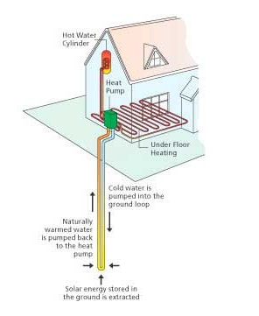
Low Carbon Energy
Ground Source Heat Pump
systems are made up of a ground loop (a network of water pipes buried underground) and a heat pump at ground level

Slide 19
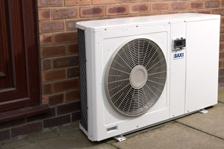
Low Carbon Energy
Air source Heat Pumps
usually placed outside at the side or back of a property
takes heat from the air and boosts it to a higher temperature using a heat pump
heat is then used to heat radiators, underfloor heating systems or warm air convectors and hot water

Slide 20
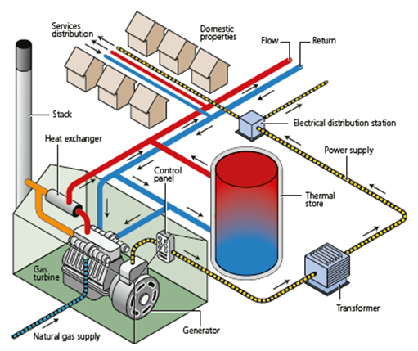
Low Carbon Fuels
Combined heat and power (CHP)
For district heating systems
Captures and utilises the heat that is a by-product of the electricity generation process
Can reduce carbon emissions by up to 30%

Slide 21
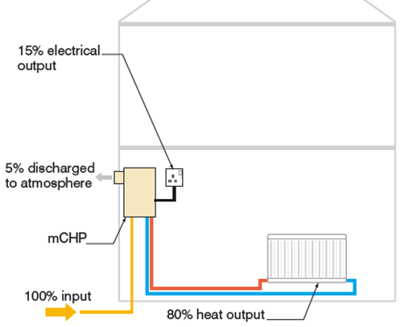
Low Carbon Fuels
Heat-led micro CHP
For domestic properties
Generation of electricity occurs when the unit is providing heat
majority of output from the unit is for heating purposes
Typically up to 95 per cent efficient
80 per cent heat output and 15 per cent electrical output.

Slide 22
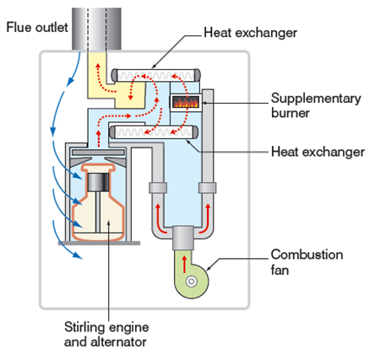
Low Carbon Fuels
Heat-led micro CHP
A Stirling engine micro-CHP unit operates in the following sequence:
When unit provides heat, a gas burner provides heat to the Stirling engine unit causing the Stirling engine to operate.
As the Stirling engine operates, electricity is generated.
Heat output is limited during the operation of the Stirling engine.
When additional heat is needed to meet higher demand, the supplementary burner operates.

Slide 23
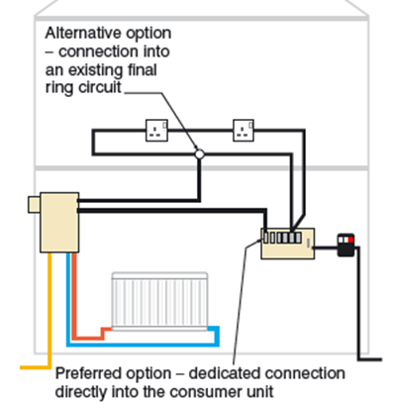
Low Carbon Fuels
Heat-led micro CHP
Electrical output and system connections
A domestic micro-CHP unit will typically generate between 1 kW and 1.5 kW of electricity.
The preferred connection arrangement between the micro-CHP unit and the main electrical installation is to use a dedicated circuit from/to the consumer unit

Slide 24
Advantages/Disadvantages
Include:
Advantages | Disadvantages
relatively less expensive to produce | they produce a lot of carbon compounds (carbon dioxide and other greenhouse gases) that harm the environment and cause climate change
higher demand as it tends to cost less | finite resources – will run out one day
 | Air, water and land pollution are all consequences of using fossil fuels

Slide 25
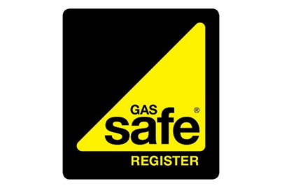


Regulatory Bodies
Natural gas and LPG
All operatives to be registered with Gas Safe
Solid fuel and biomass
HETAS
Register of approved, competent installers
Oil
OFTEC
Voluntary registration
Registered installers can self-certify

Slide 26
Sources of Information
Each fuel has its own requirements and must comply with Regulations:
The Gas Safety (Installation and use) Regulations
Building Regulations Approved Document J (Combustion Appliances and Fuel Storage Systems)
The 18th Edition of the IET Wiring Regulations
Other sources:
British Standards
Manufacturers’ instructions
Guidance notes

Slide 27
Delivery and storage of fuels
Coal and smokeless fuel (coke)
Normally delivered in sealed 25 kg bags and deliveries arranged as required
Should be stored outside of any dwelling in a purpose-made bunker
Should be covered to prevent contamination
A smooth, hard floor to allow easy shovelling of the fuel
A slight slope on the base of a coal bunker prevents water from collecting inside it. Keeping the fuel dry makes it easier to combust.
Good ventilation of the bunker helps to prevent a build-up of moisture, allowing the fuel to stay dry.
The area around the coal bunker should be well lit to ensure safe bagging and shovelling.

Slide 28
Delivery and storage of fuels
Fuel Oil (C2 grade, 28 second viscosity kerosene)
Nationwide distribution
Tankers carry 45m of hose
Storage tanks made of plastic or steel
Size depends on requirements of system
Annual inspection required
Useful working life of 20 years – risk of failure afterwards
Environmental risk if close to watercourse, river or stream

Slide 29
Delivery and storage of fuels
Fuel Oil (C2 grade, 28 second viscosity kerosene)
Secondary containment system (bund) required to counteract the risk of pollution from spillage
Integrally bunded oil tank with secondary oil containment built in
Oil-impermeable containment wall around the tank installation.
The bund must be capable of holding 110 per cent of the oil tank’s contents

Slide 30
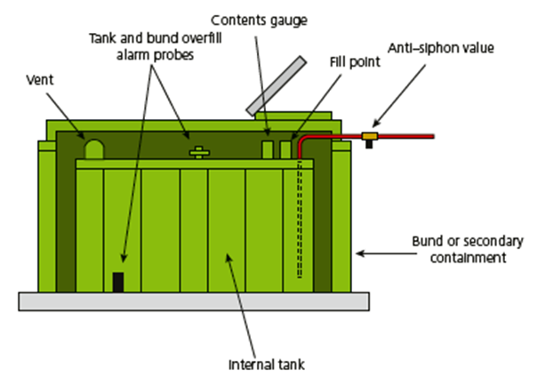
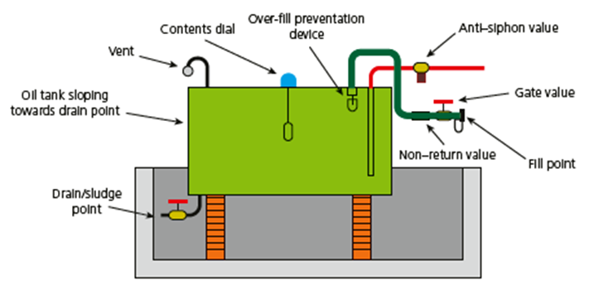
Delivery and storage of fuels
Fuel Oil (C2 grade, 28 second viscosity kerosene)
Integrally bunded oil tank
Oil tank with an oil-proof bund wall

Slide 31
Delivery and storage of fuels
Fuel Oil (C2 grade, 28 second viscosity kerosene)
Siting of fuel oil tanks
Separation from fire or heat source within building
1.8 m from eaves, doors or windows
1.8m away from garden shed or garage
1.8m away from flue terminal
760mm away from wooden boundary fence
600mm away from trellis or foliage not part of a boundary

Slide 32
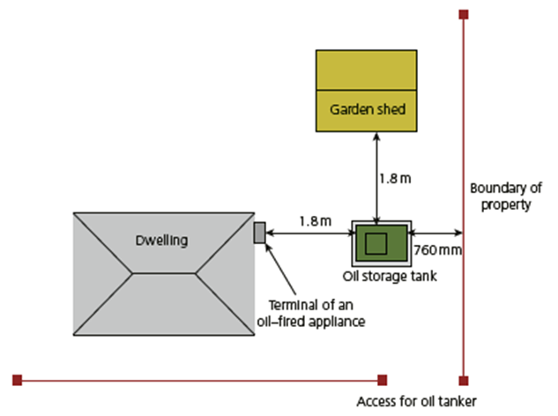
Delivery and storage of fuels
Fuel Oil (C2 grade, 28 second viscosity kerosene)
Siting of fuel oil tanks

Slide 33
Delivery and storage of fuels
LPG
Key points:
LPG is flammable and explosive
LPG is heavier than air (specific gravity of propane 1.5) – will sink to lowest levels
Comprehensive distribution through UK
Can be stored in cylinders or bulk storage tanks
Minimum access road width of 2.75m
Driver must be able to see storage tank during delivery
LPG storage tanks can either be sited above or below ground

Slide 34
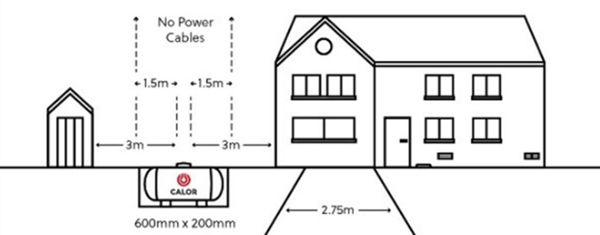
Delivery and storage of fuels
LPG
Below ground LPG storage tank
Turret of tank to be 3m away from building
Excavation 2m away from building

Slide 35
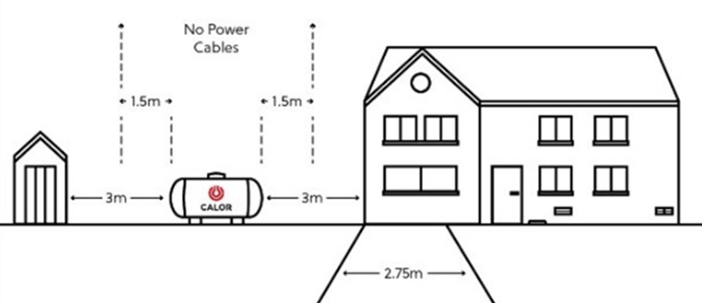
Delivery and storage of fuels
Above ground LPG storage tank
Turret of tank to be 3m away from buildings and boundaries
One side can be reduced to 1.5m with suitable fire wall
3m away from drains and gullies
1.5m away from overhead cables

Slide 36
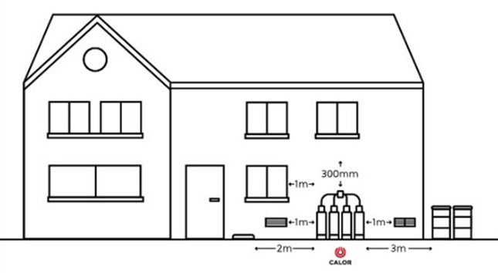
Delivery and storage of fuels
LPG gas bottle storage
Stored outside, and not in cellars or basements or in sunken areas
Sited against a wall or building structure with at least 30 minutes fire resistance
Minimum of 2m horizontally from the nearest gas bottle valve to untrapped drains, unsealed gullies and openings to cellars

Slide 37
Delivery and storage of fuels
Biomass fuels
Many options available for storage – all need to be watertight
Moisture affects fuel quality and operation of boiler
Options include:
  Sheds
  Containers
  Hoppers
  Silos
  Underground bunkers
Selection depends on fuel type, deliveries, space available, costs

Slide 38
Factors affecting selection of fuels
Reasons for choosing fuels for domestic appliances include:
Availability – mains, regular deliveries
Appliance type
Fuel storage requirements – space, dryness, safe distance from property
Environmental considerations
Smoke control legislation – Clean Air Act 1993
Cost
Customer choice

Slide 39
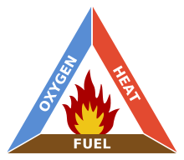
The combustion process
Combustion is a chemical reaction with oxygen
Three elements required:
Fuel + Oxygen + Heat = Fire
Removing any one element will cause the flame to be extinguished

Slide 40
The combustion process
Complete combustion
Around 20% of air is oxygen
Complete combustion need plenty of air to enable the fuel to react fully with the oxygen
When hydrocarbons burn completely:
Carbon oxidises to carbon dioxide
Hydrogen oxidises to water (water is H₂O – an oxide of hydrogen)
Hydrocarbon + oxygen ⇨ carbon dioxide + water

Slide 41
The combustion process
Incomplete combustion
Occurs when the supply of air is poor
Water still produced, but carbon monoxide and carbon produced instead of carbon dioxide
During incomplete combustion:
Hydrocarbon + oxygen ⇨ carbon monoxide + water
Carbon released as soot
Carbon monoxide is a poisonous gas

Slide 42
The combustion process
Causes of incomplete combustion:
Lack of oxygen – air flow restricted
Too much fuel – more than the appliance was designed for, air supply insufficient
Flame impingement – disturbed flame pattern
Vitiation – reduced oxygen levels in the room. Incoming supply insufficient to maintain balance

Slide 43
The combustion process
Visual signs of incomplete combustion:
Yellow flame – larger than normal and ‘floppy’. Will produce sooty deposits and carbon monoxide
Sooting – unburnt carbon (soot) will coat the heat exchanger – affects the burner and reduces air supply further
Staining – seen around the flue or the appliance, may also be spillage of products of combustion to a poor flue

Slide 44
The combustion process
Carbon monoxide poisoning
A concentration of only 0.04 per cent in air can be fatal within a few minutes
Carbon monoxide combines easily with haemoglobin (red cells) in the blood stream
If the haemoglobin become saturated with carbon monoxide then the tissues cannot take oxygen in
Even if death does not occur there may be serious brain damage due to the lack of oxygen

Slide 45
The combustion process
Carbon monoxide detectors
Alarm sounded when they sense a certain amount of carbon monoxide over time. Different sensors set off different types of alerts:
Biomimetic sensor: a gel changes colour which triggers the alarm.
Metal oxide semiconductor: silica chip detects carbon monoxide lowering electrical resistance, which triggers the alarm.
Electrochemical sensor: Electrodes in a chemical solution sense changes in electrical currents when they come into contact with carbon monoxide triggering the alarm.

Slide 46
The combustion process
Ventilation
Combustion appliances require ventilation to supply them with air for combustion.
Ventilation is also required to ensure the proper operation of flues
Flueless gas appliances require a constant supply of fresh air to prevent the air in the room from becoming vitiated
Different flued appliances have different needs for ventilation

Slide 47
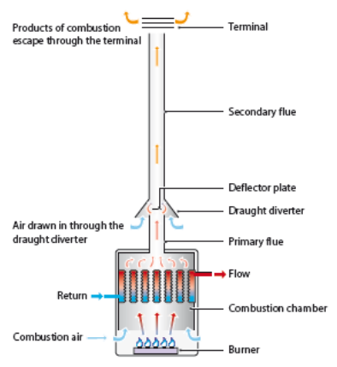
The combustion process
Open flues
Air for combustion at the boiler is drawn from the room in which it situated and the products of combustion are then drawn through the flue by convection
The air needs to be replaced for the appliance to work safely

Slide 48
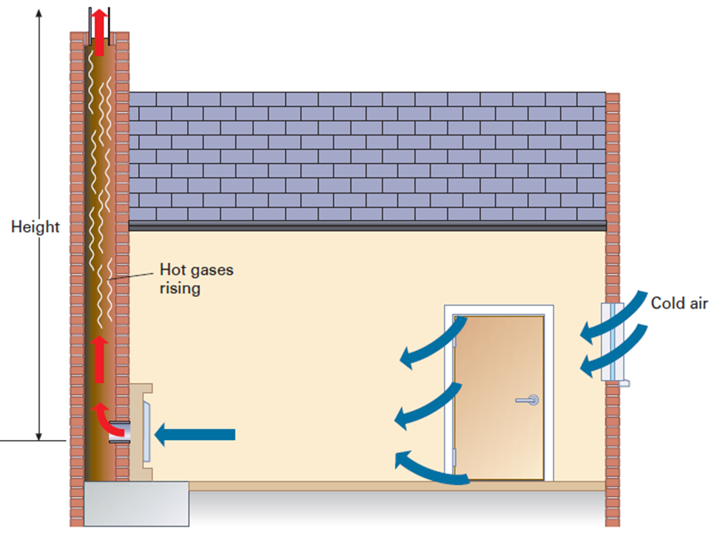
The combustion process
Open flues
A room containing an open-flued appliance may need permanently open air vents.
Infiltration of air through the building fabric (known as adventitious ventilation) may be sufficient but for certain appliance ratings and forms of construction, permanent openings are necessary.

Slide 49
The combustion process
Ventilation for open-flued appliances
Open-flued appliances need sufficient air for combustion
Adventitious ventilation
  Through cracks in floors, windows, doors, etc
Provides enough ventilation for appliances up to 7 kW
Ventilation requirement – 5cm² for every kW heat input in excess of 7kW
Calculation based on net heat input
If input given as gross, divide by 1.11

Slide 50
The combustion process
Ventilation for open-flued appliances
Example:
Calculate the ventilation requirement for a natural gas boiler rated at 15 kW gross heat input.

Slide 51
The combustion process
Ventilation for open-flued appliances
Calculate the ventilation requirement for a natural gas boiler rated at 15 kW gross heat input.
15kW ÷ 1.11 = 13.51kW net heat input
13.51 – 7 = 6.51
6.51 x 5 = 32.55cm²
This means that the boiler requires an air vent of 32.55cm² free area

Slide 52
Principles of chimney/flue systems
Purpose
Enable efficient combustion to take place
Discharge products of combustion to a position that does not cause inconvenience
Maintain flue performance in different wind conditions
Terminology:
Flue – conveys the products of combustion safely to the atmosphere
Chimney – construction that includes the shaft housing the flue
The flue works under negative pressure drawing products of combustion from the appliance

Slide 53
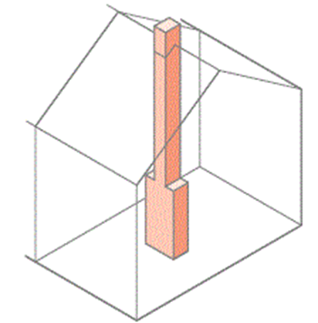
Principles of chimney/flue systems
Chimneys for solid fuel appliances
Requirements in Building Regs Part J
More heat generated than gas appliances; less control
Products of combustion more corrosive
Best position at the centre of a dwelling

Slide 54
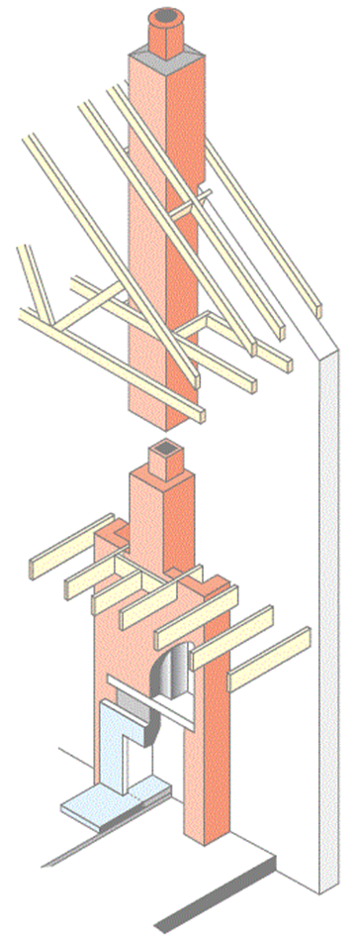
Principles of chimney/flue systems
Masonry chimneys for solid fuel appliances
Flue formed with square or circular liners
Minimum internal dimensions 185mm square or 200mm diameter round
Liners can be vitrified clay, salt glazed ware or precast linings
Installed with sockets uppermost
Gap between liner and masonry to be insulated

Slide 55
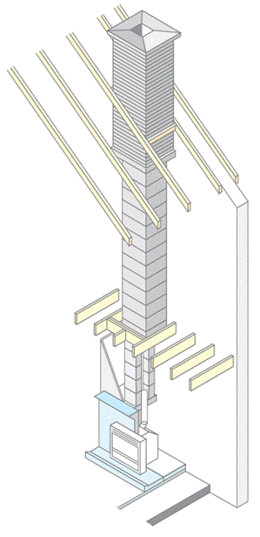
Principles of chimney/flue systems
Factory made precast block chimneys
Built into brick or block walls or can be freestanding
Incorporate a flue way
Lightweight and easy to handle
Can reduce costs
Sections fit together with minimal amount of mortar

Slide 56
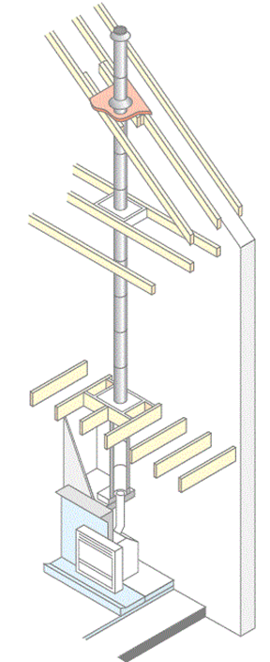
Principles of chimney/flue systems
Factory made insulated chimneys
Easy installation for new and existing housing
Metal or ceramic liners
Fully insulated to ensure even temperatures
Take up less space than brick built chimneys
Can be installed internally or externally

Slide 57
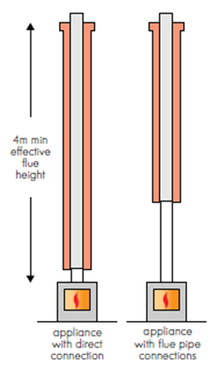
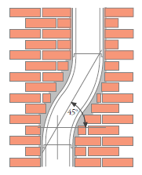
Principles of chimney/flue systems
Chimney construction
Effective flue height not less than 4m from appliance to terminal
Offsets to be minimum of 45° to the horizontal

Slide 58
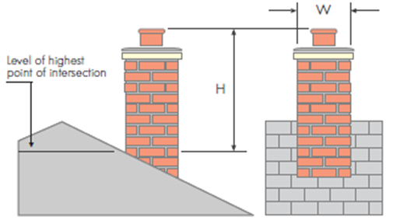
Principles of chimney/flue systems
Chimney construction
Height of the stack above the roof not to exceed 4.5x its minimum horizontal width

Slide 59
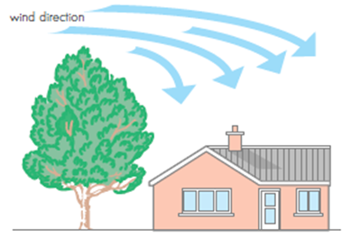
Principles of chimney/flue systems
Effects of wind pressure
Wind blowing over tall building, tree or hill
Causes intermittent puffs of smoke, or fumes in the room

Slide 60
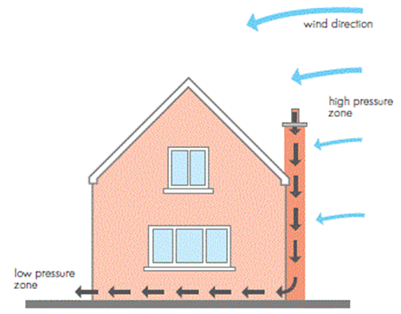
Principles of chimney/flue systems
Effects of wind pressure
Chimney in the line of prevailing wind with taller object behind the terminal
Creates pressure zone causing puffing or fume emission when wind is blowing

Slide 61
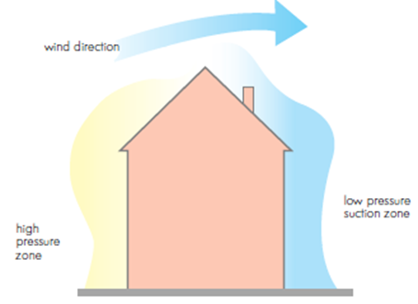
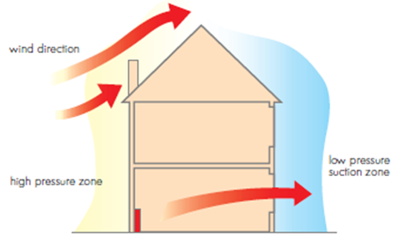
Principles of chimney/flue systems
Effects of wind pressure
High pitched roofs (greater than 30°)
Pressure on the windward side greater than the leeward side
Flue outlet in in high pressure zone may cause fume emission from an appliance unless outlet is placed high pressure zone

Slide 62

Principles of chimney/flue systems
Open flues for gas appliances

Slide 63
Principles of chimney/flue systems
Open flues for gas appliances
An efficient system depends on:
The difference in air pressure between the appliance and the top of the chimney (created by the height of the chimney)
The difference in temperature between the appliance’s exhaust gas and the outside temperature.
The quality of insulation along the length of the chimney
The route of chimney (the straighter and more vertical the chimney the better)
The flue pull or draught is increased when the flue gases are hotter or if the flue height is increased

Slide 64
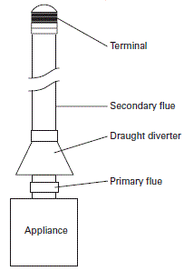
Principles of chimney/flue systems
Open flues for gas appliances
Four main parts:
Primary flue
Draught diverter
  Diverts downdraught
  Breaks excessive pull
Secondary flue
Terminal
  Minimises downdraught
  Stops rain, birds entering flue
Primary flue and draught diverter are normally part of the appliance

Slide 65
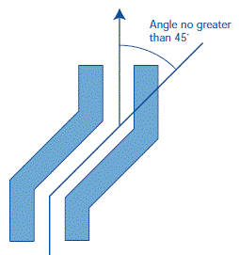
Principles of chimney/flue systems
Open flues for gas appliances
Secondary flue:
Conveys products of combustion to the terminal
Key points:
The angle of the bend should be no greater than 45° from the vertical
Keep flues internal where possible (warm)
A 600 mm vertical rise from the appliance to the first bend should be provided.
The flue size must be at least equal to the appliance outlet and as identified by the manufacturer.

Slide 66
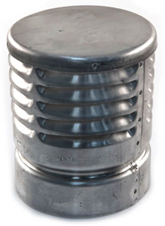
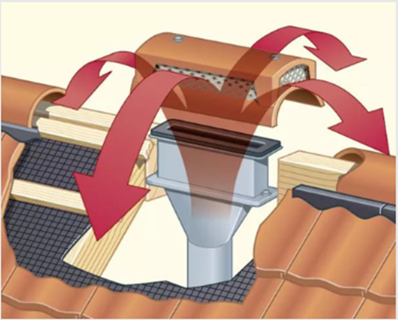
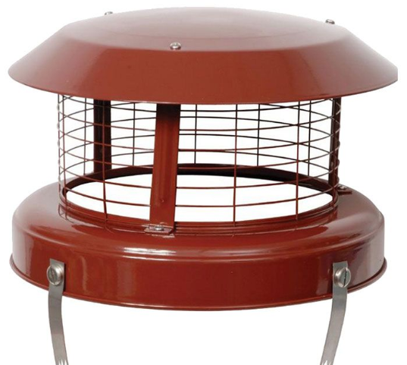
Principles of chimney/flue systems
Open flues for gas appliances
Terminal:
Only approved terminals to be used
Many types:

Slide 67
Principles of chimney/flue systems
Flue construction for gas appliances
Vitreous-enamelled steel flues:
Single skin pipe
Often used as the connection between an appliance and the main flue
Twin-wall metal flues:
with air gap only, only suitable for internal use or externally for lengths less than 3m
fully insulated twin-wall pipe, for use on all other external situations

Slide 68
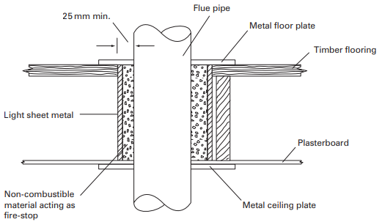
Principles of chimney/flue systems
Flue construction for gas appliances
Pipe passing through a combustible material:
Sleeve to be provided to give an annular space of 25 mm minimum

Slide 69
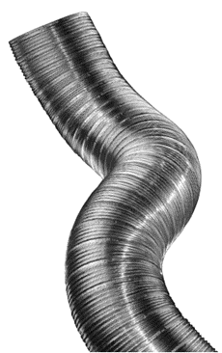
Principles of chimney/flue systems
Flue construction for gas appliances
Flexible stainless steel flue liners:
Line existing chimney that does not have suitable clay lining
Also used where existing chimney is unsatisfactory
Single skin – for use with gas appliances
Twin skin – should be used with wood/multi-fuel appliances

Slide 70
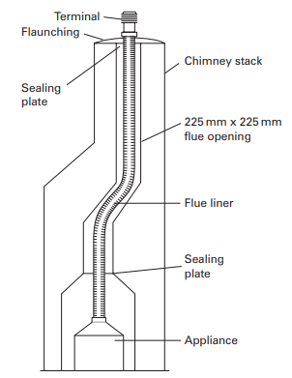
Principles of chimney/flue systems
Flue construction for gas appliances
Flexible stainless steel flue liners:
Top of chimney to be sealed
Sealing plate at the base to prevent debris from falling on to appliance
Liner to be one continuous length
No tight radius bends

Slide 71
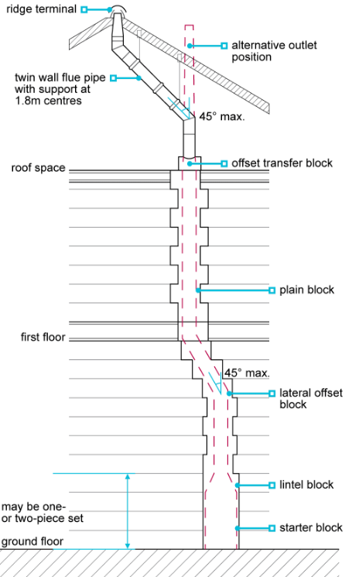
Principles of chimney/flue systems
Flue construction for gas appliances
Pre-cast concrete blocks:
Excess mortar to be carefully removed
No air gaps
Connection from blocks to ridge terminal should be twin-walled, insulated

Slide 72

Principles of chimney/flue systems
Stainless steel system chimneys:
Used on existing buildings with no chimney
Twin walled, insulated flues for external installations
Affected by cold weather – poor updraught and condensation
Ceramic liners for biomass fuels

Slide 73
Principles of chimney/flue systems
Factors affecting performance of chimneys:
For an open-flue, the motive force for the flue is produced by the heat of the products of combustion (POC)
Motive force relies on the warm POC being replaced by cooler fresh air
Adequate ventilation required
Other factors:
Flue route straight as possible, minimum number bends, no greater than 45°
Flue temperature – cold flue can cause spillage of fumes, condensation
Location of terminal
Size – sufficient to remove products of combustion

Slide 74
Principles of chimney/flue systems
Flue sizing for gas appliances
The cross-sectional area will depend on several factors, including:
Heat input of the appliance and its flue loss
Height of the flue
Resistance caused by offsets and bends

Slide 75

Principles of chimney/flue systems
Flue sizing for gas appliances
Heat input of the appliance and its flue loss
Height of the flue
Resistance caused by offsets and bends
Calculate equivalent height
Check against table

Slide 76
Principles of chimney/flue systems
Inspection & testing of chimney/flue systems
Visual inspection:
Condition of external chimney
Design & position of terminal
Obstructions
Continuity of flue
Joints correctly made
Signs of spillage

Slide 77
Principles of chimney/flue systems
Inspection & testing of chimney/flue systems
Flue flow test:
Ensure adequate ventilation
Apply smoke match to opening of flue
If necessary, warm the flue
Position and light a smoke pellet
Check length of flue to ensure no escape of smoke
Smoke to emit from correct terminal only

Slide 78
Principles of chimney/flue systems
Inspection & testing of chimney/flue systems
Spillage test:
Close all doors and windows in room
Turn appliance on full, allow to warm up for 5 mins
Apply lighted smoke match just below draught diverter
All smoke produced to be pulled into the system
If not, leave appliance on for another 10 mins and repeat
Any fault to be rectified and re-test

Slide 79
Principles of chimney/flue systems
Inspection & testing of chimney/flue systems
Flue gas analysis:
Flue gas analyser samples products of combustion to determine efficient/safe operation
Measures concentrations of CO, CO₂ and oxygen
Measurements to be in specification for appliance (manufacturer’s instructions)
Possible faults include integrity of flue, restriction on gas supply, boiler fault or poorly adjusted air/gas supply valve

Slide 80

Principles of chimney/flue systems
Room-sealed (balanced) flues
both the combustion air (fresh air in) and the products of combustion (flue gases out) are situated in the same position outside the building
air for combustion drawn directly from the outside through the flue assembly used to discharge the flue products.

Slide 81

Principles of chimney/flue systems
Room-sealed fan-assisted flues
As with the natural draught flue, the products of the combustion outlet is positioned in the same place (generally) as the combustion air intake. But, there are two distinct differences:
The process is aided by a fan, which ensures the safe evacuation of all combustion products and any unburned gas that may escape.
The flue terminal is circular, much smaller and versatile than a natural draught flue.

