Slide 1
Level 3 Diploma in Plumbing and Domestic Heating
Phase 3
Environmental Technologies
Heat Pumps

Slide 2
What is a heat pump?
A heat pump extracts heat from one area then pumps it to another area
Notes:
A heat pump extracts heat from one area and then pumps it to another area.
Heat flows naturally from a higher to a lower temperature. Heat pumps reverse this natural flow of heat, extracting heat energy from a cool source, such as the ground, and delivering it to a hot system, such as a building’s heating system.

Slide 3
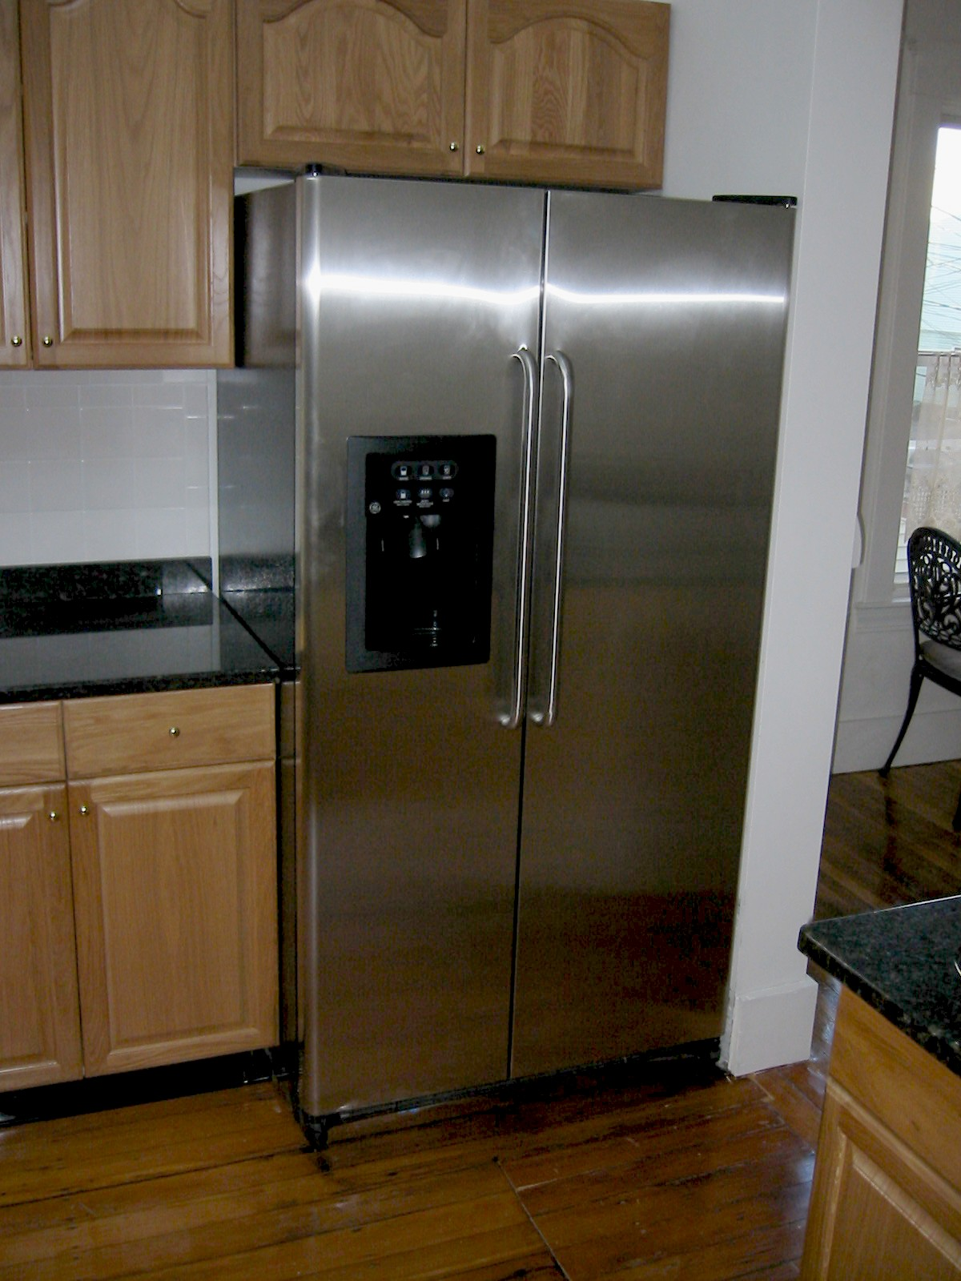
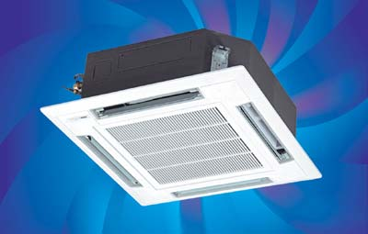
Refrigerators and air-conditioning extract heat and move it elsewhere
Notes:
The heat is extracted from the air inside the fridge and released into the outside air through the grill at the back.
In the same way that a fridge uses refrigerant to extract heat from the inside, keeping your food cool, a heat pump extracts heat from a range for sources, and uses it to heat your home and hot water.
These systems are NOT new technology! Heat Pumps work on the basic principle of heat transfer and refrigeration; which has been around since the 1800’s with the first Heat Pumps developed commercially in the 1930’s. Refrigeration is the process of transferring heat from one area to another; in the domestic refrigerator heat is removed from the body of the refrigerator to make it cooler and the heat is “moved” into the kitchen or utility room in the form of heat energy.

Slide 4
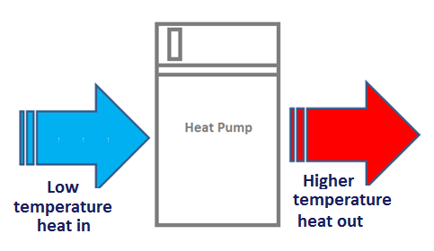
Heat Pump Systems
What is a heat pump?
A heat pump is a device for converting low temperature heat a to higher temperature heat
Some heat pumps can also work in reverse and convert high temperature heat to a lower temperature
So how does a heat pump work? ………………

Slide 5
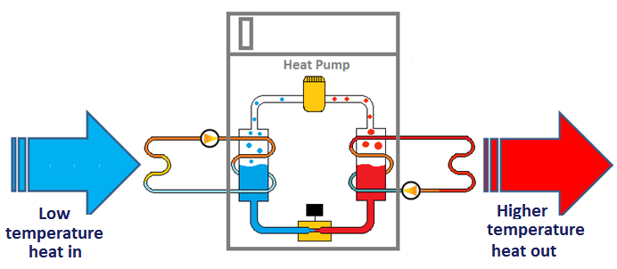
Heat Pump Systems
How does a heat pump work?
Most heat pumps make use of the mechanical vapour compression cycle commonly known as the refrigeration cycle to convert heat form one temperature to another.
The heat pump refrigeration cycle works on a similar principle to a domestic refrigerator but in reverse.
Let’s look at how the heat pump refrigeration cycle works ………………

Slide 6
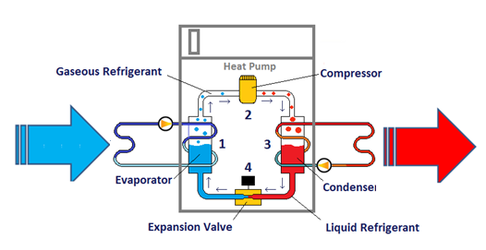
Heat pump refrigeration cycle
The gas in the refrigeration circuit inside the heat pump has an extremely low boiling temperature
When the liquid comes in from the garden circuit, that liquid transfers its heat to the colder liquid refrigerant in the evaporator.
The refrigerant turns to vapour and passes upwards to the compressor.
The now gaseous refrigerant enters the compressor. Electricity is used to drive the compressor, which ‘squashes’ the vapour, increasing its temperature.
The vapour then moves onwards to the condenser heat exchanger.
Water coming from the building’s heat distribution system passes up the other side of the heat exchanger and this water absorbs the heat from the refrigerant coming from the compressor. The refrigerant condenses back to liquid form like steam on a window.
It passes through an extremely small opening in the throttling device and undergoes a large drop in pressure with an associated drop in temperature.
This cold liquid is let into the bottom of the evaporator heat exchanger where the whole process is repeated.
how a heat pump works

Slide 7
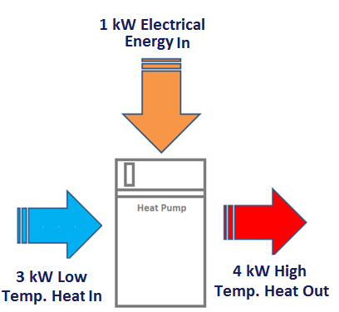
How efficient are heat pumps?
Heat pumps are classified as a ‘low’ carbon technology because they need some electrical energy to operate.
Depending on the application, operating conditions and type of heat pump utilised, heat pump energy output can be 300% to 500% more than the electrical energy input.
Heat Pump efficiency is referred to as Coefficient of Performance (COP)
In its simplest form COP relates to heating output divided by the electrical power input. For this example the COP is 4.0, calculated as follows:
Heating output (4kW) ÷ Electrical power input (1kW) = 4.0

Slide 8
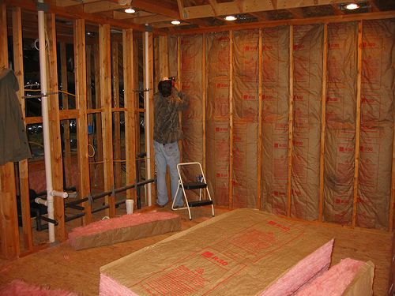
Heating load
All heat pumps are most suitable for homes with a low heat demand
Notes:
A heat pump works best in a home that has a low heat demand. This will, more often than not, be a well insulated home.
For a new build project it makes most sense to design the home with the intended heating source in mind. High levels of insulation and an energy efficient distribution system such as under-floor heating are easiest in a new build project.
In an existing building the starting point is to insulate as much as possible. Bringing down the heating demand will mean less heat needs to be extracted from the ground and will therefore need a smaller ground loop.

Slide 9
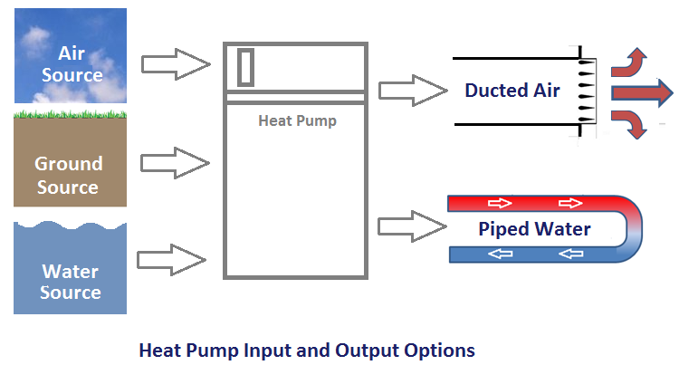
Heat Pump Systems
Heat pump technology can convert low temperature heat from an air, ground or water source to higher temperature heat for use in ducted air or piped water ‘heat sink’ systems.
The type of heat pump unit must be selected in relation to the intended ‘heat source’ and ‘heat sink’ arrangement’
Let’s now look at the options in more detail………….

Slide 10
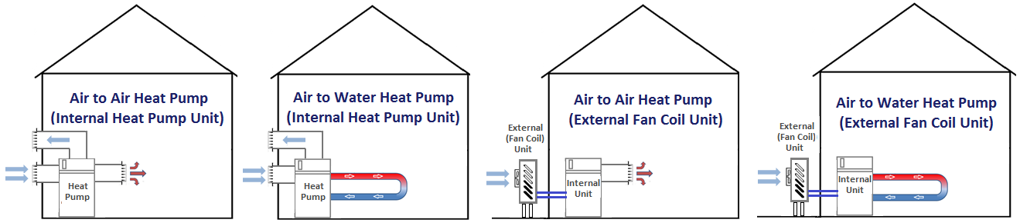
External Air Source Heat Pump System Options
A variety of heat pump system arrangements are possible using the external air as the heat source.
Air source heat pump will typically operate at temperatures up to 20 ºC.
Can be single internal units that receive the incoming air through an inlet duct that passes through the external wall of the building.
A popular alternative is the use of an external fan coil (evaporator) unit that is linked to an internal unit.
Fan coil units can be noisy and this need to be considered at the design stage.
Let’s now look at the ground source options ………….

Slide 11

Ground-source heat pump
(GSHP)
Uses solar heat stored in the ground
Not geothermal energy
Stable ground temperature of 8 - 10ºC
@ 10m the temperature is stable
@ 4m there is a seasonal variation or just 1 - 2ºC
Notes:
How does a GSHP work?
Ground source heat pumps do not tap into geothermal heat (natural nuclear reaction in the earths core) as many people think.
In fact the Earth acts as a huge solar collector. Solar energy is absorbed at the earth’s surface. From there it can warm the air. It is also transported downwards into the earth by conduction and washed downwards by rainfall.
As you dig deeper into the earth the temperature becomes more and more stable until it approaches the temperature of well water, about 8–10ºC year round. This is what is called a solar reservoir.
The temperature of reservoir in the ground is too low for direct use to heat our homes so it is necessary to refine or to upgrade the temperature of the heat. Electricity is used to upgrade it in the heat pump.

Slide 12
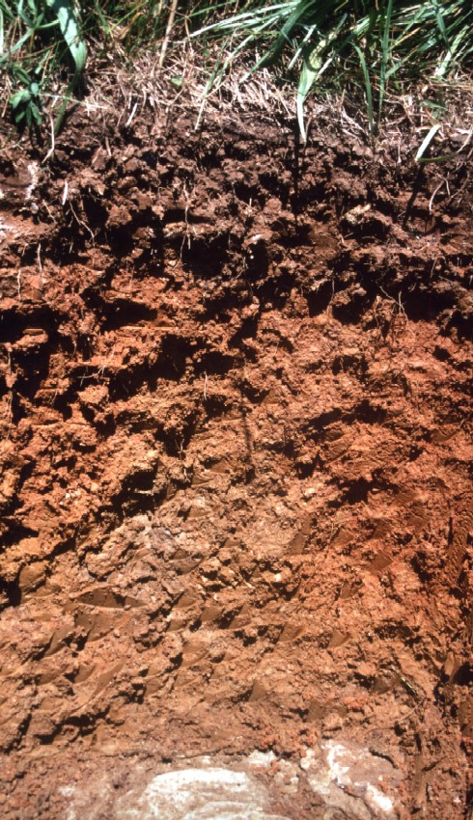
Soil conditions such as particle size and water content determine its thermal properties
Notes:
Soil conditions at a site are important for determining the size of the ground loop.
The thermal properties of soil are related to particle size. Clay soils behave differently to sandy soils and water content is also an issue as it fills the spaces between particles in a saturated soil that would other wise contain air in a dry soil.
Dry loose soil traps air so it has a lower conductivity than moist packed soil. If the soil is dry and loose you may need 50% more ground loop.
There are wide variations in soil type across the UK and therefore it pays to have a site investigation. If you don’t, you may end of paying for it anyway through a ground loop that is over sized or a system that does not operate efficiently.
Water movement across the site also has an impact on the heat transfer through the ground.

Slide 13
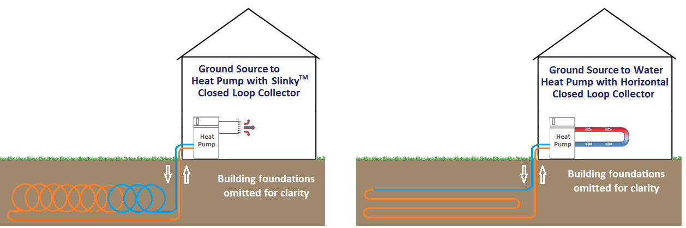
Ground Source Heat Pump System Options
A variety of heat pump system arrangements are possible using ground heat as the heat source. A variety of closed (sealed circuit) collector loop arrangements can be used.
Slinky type collectors (illustrated) are sometimes used where available ground area (m²) is limited.
Let’s now look at some more ground source options ………….

Slide 14
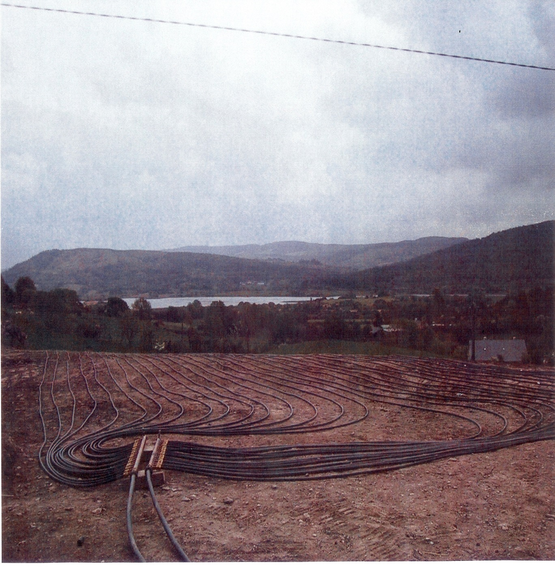
Horizontal ground loops laid and then covered

Slide 15
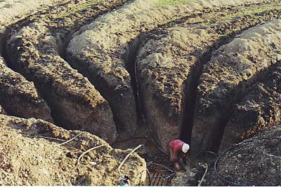
Horizontal ground loops

Slide 16
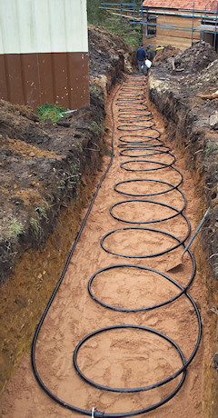
Slinky ground loops in trench
Notes:
Soft sand used to protect piping.

Slide 17
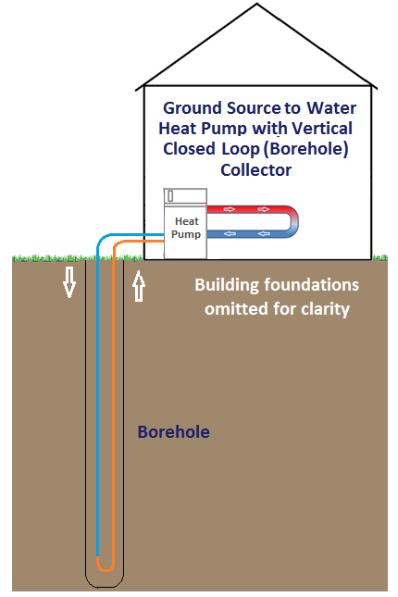
Ground Source Heat Pump System Options
An alternative to horizontal ground collector loops is a vertical collector loop installed in a borehole.
This type of installation requires a specialist drilling rig to be used to create the borehole. A specialist contractor is normally used to undertake the drilling operation.
Vertical borehole collector loops are often used where the geothermal conditions support the use of a ground source heat pump but where the available ground area (m2) is limited.

Slide 18
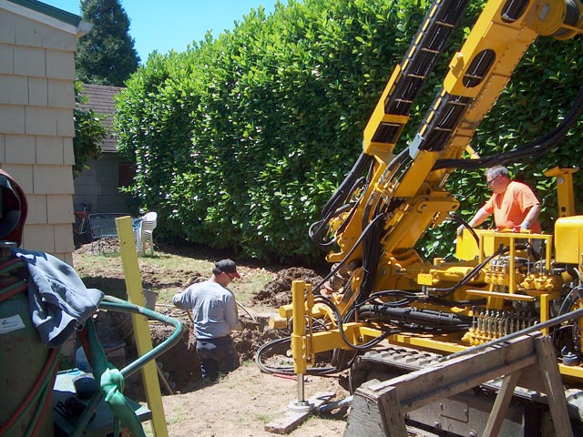
Drilling for vertical ground loop installation

Slide 19
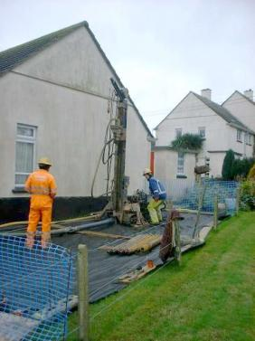
Drilling for vertical ground loop installation

Slide 20
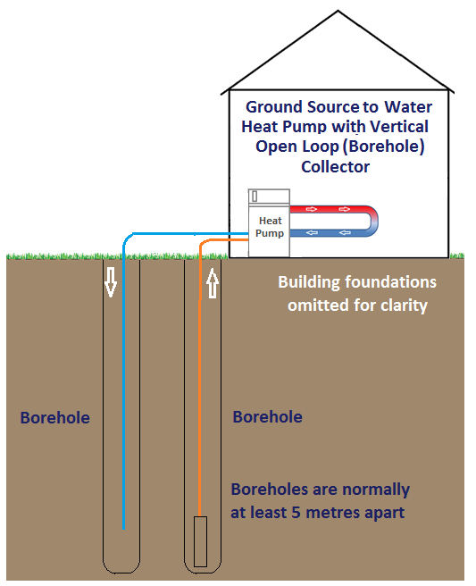
Ground Source Heat Pump System Options
An ‘open’ vertical borehole ground collector loop is an alternative to a ‘closed’ vertical borehole ground collector loop.
With this arrangement , two boreholes are used and the collector circuit is open and the collector circuit fluid flows naturally from the open ended return pipe to the open ended flow pipe.
This type of arrangement requires the availability of a suitable ground water source.

Slide 21
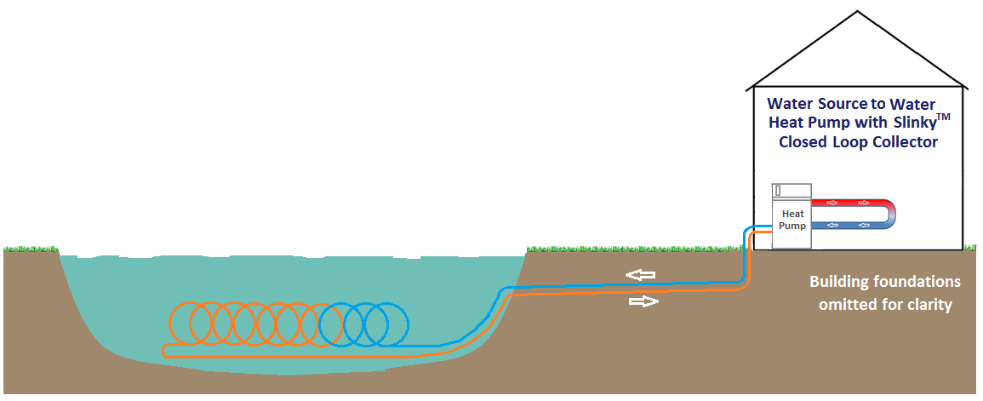
Water Source Heat Pump System Options
Where a suitable water source exists such as a lake or a pond, this can be a very effective alternative to a ground source collector circuit.
Water source collectors are simply laid on the bottom of the lake or a pond and weighted as necessary to keep them in place.
‘Open’ water source collector circuits (not illustrated) are also an option.

Slide 22
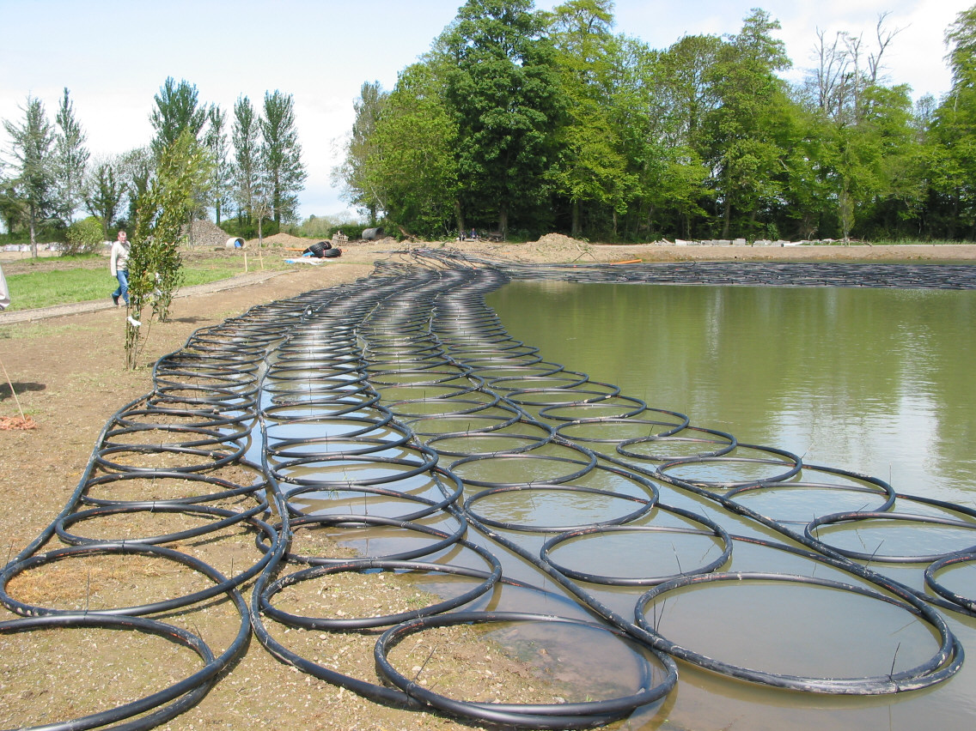
Water Source

Slide 23
✓ Learning Check
Quick Questions
What type of heat conversion process does a heat pump use?
Refrigeration Circuit
What types of heat source options exist?
Ground, air & water
What types of heat sink circuit exist?
Air and piped water
What is the typical % increase in energy output from a heat pump in relation to the electrical energy input?
300% - 500%
What does Coefficient of Performance relate to?
Heat Pump Efficiency
How do we measure efficiency?
Heating output/electrical power input

Slide 24
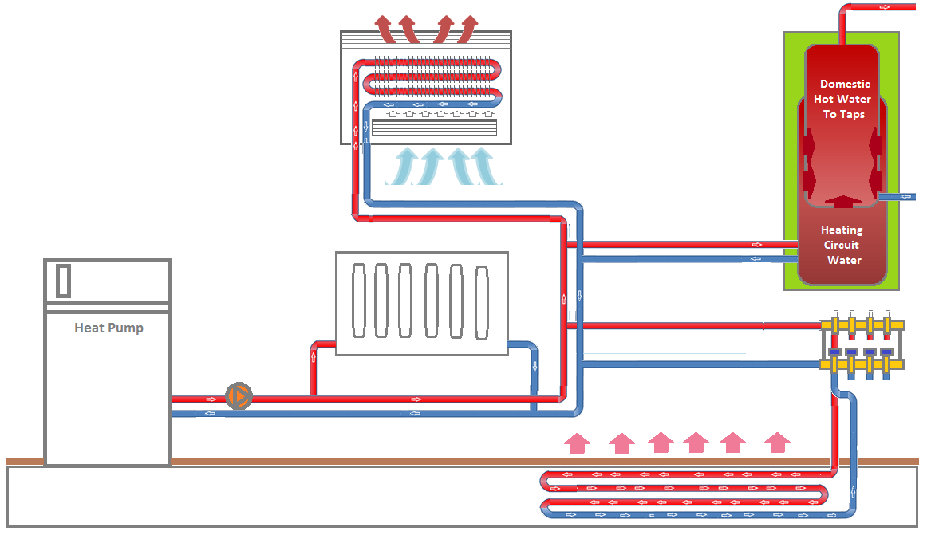
Heat Pump System Piped Water ‘Heat Sink’ (Emitter) Circuit Options
4
1
3
2
Heat pumps using a piped Water ‘Heat Sink’ Circuit can be used to heat domestic hot water storage vessels (1), underfloor heating circuits (2), radiators (3) and fan convector heaters (4). However, some of these are more suitable than others.

Slide 25
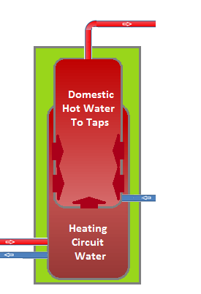
Heat Pump System Piped Water ‘Heat Sink’ Options
Domestic Hot Water Storage
Standard type indirect hot water storage cylinders are not suitable for heat pump system due to the size of the heat transfer coil.
A ‘tank-in-tank’ hot water cylinder is the most appropriate for use with heat pumps. Some heat pump units have an integrated ‘tank-in-tank’ cylinder.
The ‘tank-in-tank’ design provides a large surface to surface contact between the heating circuit water and the stored domestic hot water.
This design is very suitable due to the lower temperature of the heating circuit water in a heat pump system
A ‘boost’ or auxillary heater is required to boost the stored water temperature to standard 60ºC domestic hot water storage temperature
‘Tank-in-Tank’ Hot Water Cylinder

Slide 26
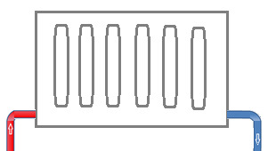
Heat Pump System Piped Water ‘Heat Sink’ Options
Panel Radiators
Standard type panel radiators are designed to work at a mean (average) water temperature of approximately 70ºC.
A heat pump system mean water temperature will typically be between 30ºC and 40ºC
To be effectively and efficiently used with a heat pump system, standard type panel radiators would need to be significantly over-sized to enable the required heat output to be achieved using a lower mean water temperature .
This means that heat pump units are typically not suitable for use with existing radiator circuits that have been sized for a mean water temperature of 70ºC.
Low temperature, high efficiency panel radiators are available and these are more suitable for use in a heat pump heat sink circuit.

Slide 27
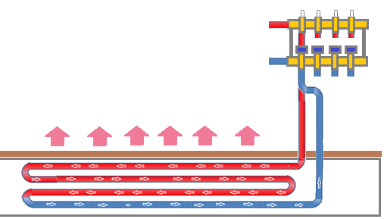
Heat Pump System Piped Water ‘Heat Sink’ Options
Underfloor Heating
Underfloor heating systems operate at a lower mean (average) water temperature than a heating system with radiators.
Therefore, underfloor heating is very suitable for use with heat pumps.

Slide 28
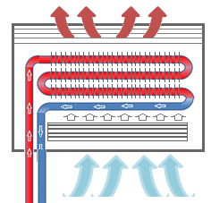
Heat Pump System Piped Water ‘Heat Sink’ Options
Convector Heaters
Natural and fanned convector heaters are suitable for use with heat pumps.
As is the case with low temperature, high efficiency panel radiators, where natural and/or fanned convector heaters used, the Coefficient of Performance will typically be lower than if underfloor heating is used.
Fanned Convector Heater

Slide 29
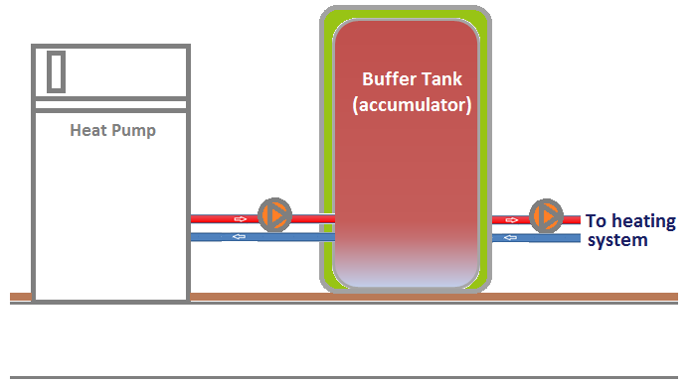
Heat Pump System Piped Water ‘Heat Sink’ (Emitter) Circuits
Buffer Tanks
Some heat sink circuits make use of a component called a buffer tank. In basic terms, a buffer tank is a vessel that accumulates and stores heating circuit water ready for use when needed.
Heat pumps are not designed or sized to meet short-term heat loads.
For efficient operation a heat pump needs to be able to start-up and run for a period of time. Stop-start operation can also shorten the life of the heat pump compressor.
Buffer tanks are also useful where an auxilliary heat source such as a boiler is being used with a heat pump.
This type of system is known as a bivalent system.
Most air source heat pumps, particularly those with an external fan coil unit need to defrost regularly. Buffer tanks are also useful to provide heat for the defrost cycle.

Slide 30
Heat Pump System Piped Water ‘Heat Sink’ (Emitter) Circuits
Mean Operating temperatures:
Under-floor heating 30–45ºC
Low temperature radiators 45–55ºC
Conventional radiators 60–80ºC
Air ducts 30–50ºC

Slide 31
Is the building suitable?
Activity
List all the features you think need to be considered before installing a heat pump
Notes:
The most important consideration in the decision to install a heat pump is the design of the building.
Some argue that because the heat pump uses electricity to operate then they are not really a renewable technology. However, as long as the CoP is greater than 2 (and well designed systems achieve far better than this) then a GSHP will produce less CO₂ than a condensing boiler.
The system can be made greener if you use electricity from a renewable energy source (on site PV, wind, hydro) or sign up to a green tariff. They are also eligible for grants under the Low Carbon Buildings Programme.

Slide 32
Is the building suitable?
Low heat demand – high insulation
Appropriate heat source (air, ground or water)
Ground space for trench or borehole
Suitability of ground type
1.5m min soil depth
Moist packed soil
or
the availability of a suitable location to mount the components - particularly the potential for noise issues if an air source heat pump is being considered
Type of heat distribution system
Under-floor heating
Air heating
Low-temperature radiators
Desire to be 100% renewable
Notes:
The most important consideration in the decision to install a heat pump is the design of the building.
Some argue that because the heat pump uses electricity to operate then they are not really a renewable technology. However, as long as the CoP is greater than 2 (and well designed systems achieve far better than this) then a GSHP will produce less CO₂ than a condensing boiler.
The system can be made greener if you use electricity from a renewable energy source (on site PV, wind, hydro) or sign up to a green tariff. They are also eligible for grants under the Low Carbon Buildings Programme.

Slide 33
✓ Learning Check
Quick Questions
What is the mean water temperature used in a heating system connected to a heat pump ?
30°C - 40°C
What type of domestic hot water cylinder is most suitable for use in a heat pump system?
A ‘tank-in-tank’ cylinder
What component can be used to prevent the heat pump cycling on and off during short-term heat demand periods?
A buffer tank

Slide 34
Regulatory Requirements
Town & Country Planning
Installing a ground source or water source heat pump system does not usually need planning permission and should fall within permitted development rights.
Due to potential noise issues, most air source heat pump installation currently require planning permission. However, this is currently being reviewed and as soon as relevant standards and safeguards to deal with noise have been established air source heat pumps are likely to be classified as permitted development.
The Local Planning Authority should be consulted for clarification, particularly for installations in conservation areas and installations to non-dwelling building types.

Slide 35
Regulatory Requirements –
Building Regulations
Part | Topic | Relevance to Solar Hot Water Installations
A | Structure | Heat pumps and components putting load on structure
B | Fire Safety | Holes for pipes reducing fire resistance of building
C | Site preparation and resistance to moisture | Holes for pipes reducing moisture resistance of building
E | Resistance to the passage of sound | Holes for pipes reducing sound proof integrity of building
G | Sanitation, hot water safety and water efficiency | Safety and water efficiency of hot water system
L | Conservation of fuel and power | Efficiency of system and building
P | Electrical safety in dwellings | Safe installation of controls and components

Slide 36
Advantages/Disadvantages
Include:
Advantages | Disadvantages
Reduces carbon dioxide emissions | Not usually suitable for connection to existing heating systems using panel radiators
Efficiencies between 300% to 500% are typical. | Initial installation costs can be off-putting
Relatively low maintenance is needed | Air source installations can present a noise issue
Improves Energy Performance Certificate ratings | Ground source installations require a large ground area or a borehole

Slide 37
Level 3 Diploma in Plumbing and Domestic Heating
Phase 3
Environmental Technologies
Micro Combined Heat and Power

Slide 38
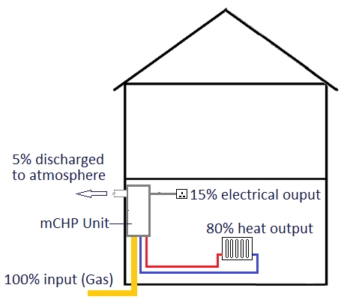
Micro-Combined Heat and Power Systems (Heat Led)
A heat-led micro-combined heat and power (mCHP) system includes a mCHP unit, similar in appearance to a heating system boiler, that generates some electricity as well as generating heat for domestic hot water and space heating purposes.
The term ‘heat-led’ means that the generation of the electricity occurs when the unit is responding to a system demand for heat and that the majority of output from the unit is for heating purposes.
Although mCHP units have existed for some time, units suitable for domestic installations have only recently become available. The currently available domestic units are gas-fired only. Other fuels options may be available for non-domestic units.
MCHP is a low carbon technology and the units are typically up to 95% efficient.
Typical mCHP System
Energy Flows

Slide 39
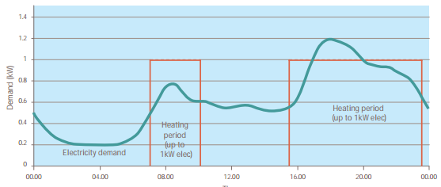
Micro-Combined Heat and Power Systems (Heat Led)
Typical household electricity demand and heating periods

Slide 40
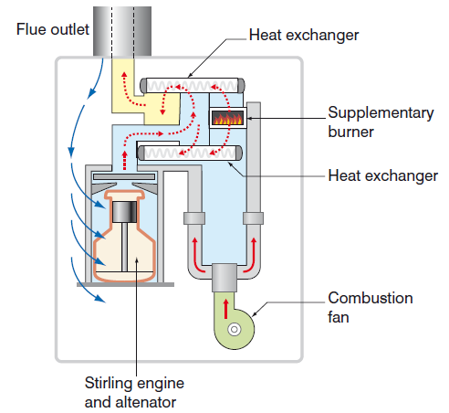
Micro-Combined Heat and Power Unit Components
The key mCHP unit internal components are:
an engine or gas turbine
an alternator
two heat exchangers
a supplementary burner
a combustion fan
electrical controls (not illustrated)
mCHP units can contain any of the following engine types
External combustion (Stirling type illustrated )
Internal combustion
Organic rankine cycle
Example mCHP Unit

Slide 41
Micro-Combined Heat and Power Unit Operation (Stirling Engine Unit)
When demand for heat occurs, a gas burner provides heat to the Stirling engine unit causing the Stirling engine to operate.
The Stirling engine unit includes a generator comprising a piston that moves between a copper coil. As the Stirling engine operates electricity is generated providing the engine runs for a minimum period of time and does not cycle on and off.
There is a limit (typically 25% of total unit output) to the amount of heat that can be provided during the operation of the Stirling engine.
When additional heat is needed to meet higher demand, the supplementary burner operates.

Slide 42
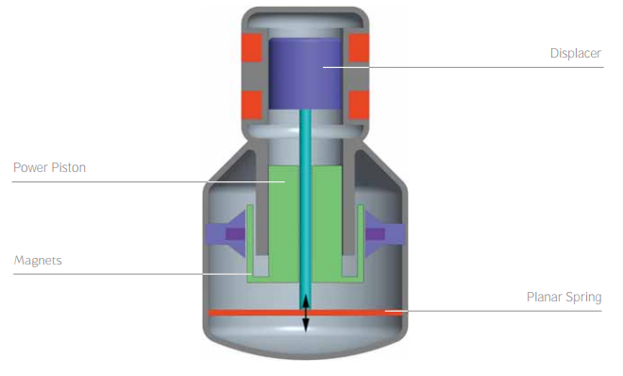
Micro-Combined Heat and Power Unit Operation (Stirling Engine Unit)
For electricity generation, the Baxi Ecogen uses a free piston Stirling engine
This engine is heated by burning gas. The helium working fluid expands and contracts to move a piston up and down
This piston travels between a copper coil, generating up to 1kW of electricity at 50Hz single phase
how the baxi ecogen works

Slide 43
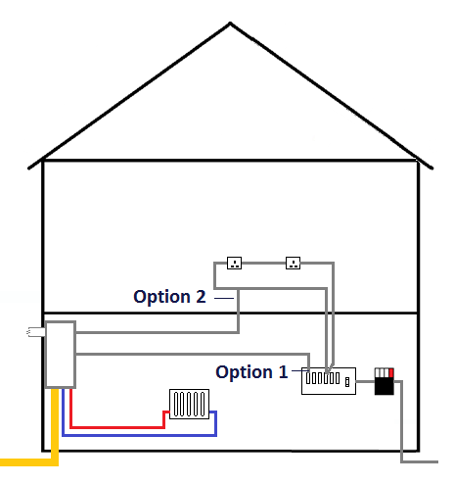
Micro-Combined Heat and Power Unit – Electrical Output and System Connections
A domestic mCHP unit will typically generate between 1kW and 1.5kW of electricity. Larger mCHP units typically generate up to 5-6 kW of electricity.
The preferred connection arrangement between the mCHP unit and the main electricity system is using a dedicated circuit from/to the consumer unit (Option 1).
Where this is difficult, it is possible to connect the unit to an existing final circuit (Option 2).
Any surplus electricity can be exported to the distribution grid.
mCHP installations are eligible for Feed-In Tariff payments providing the installation is carried out by a Microgeneration Certification Scheme MCS) certified contractor using an MCS approved unit.
All electrical work must be designed, installed and tested by a competent person

Slide 44
✓ Learning Check
Quick Questions
How does a mCHP unit generate electricity?
Using a generator connected to an engine or turbine
Approximately, what percentage of the energy produced by a mCHP unit is electrical energy ?
15%
What is the maximum efficiency of a mCHP unit?
95%
Are mCHP installations eligible for Feed-in Tariff payments?
Yes, provided the installation is carried out by a Microgeneration certification Scheme (MCS) certified contractor installing am MCS approved unit

Slide 45

Micro-combined Heat and Power Systems – Regulatory Requirements
The installation of a micro-combined heat and power system will require compliance with a number of regulatory requirements including health and safety, electrical regulations and regulations relating to the connection of ‘on-grid’ micro-hydropower systems.
A competent installation contractor will have a detailed knowledge of these regulations and will ensure compliance.
Within this section we consider three primary regulatory requirements in relation to micro-combined heat and power systems:
Building Regulations
Town and Country Planning Regulations
Note: The requirements stated in this section relate to England and Wales only. The requirements for Scotland and Northern Ireland may differ.

Slide 46
Regulatory Requirements –
Building Regulations
Part | Topic | Relevance to Solar Hot Water Installations
A | Structure | Where any part of the mCHP unit and other components impose load on a structure
B | Fire Safety | Holes for wires reducing fire resistance of building
C | Site preparation and resistance to moisture | Holes for wires reducing moisture resistance of building
E | Resistance to the passage of sound | Holes for wires reducing sound proof integrity of building
G | Sanitation, hot water safety and water efficiency | Hot water safety and water efficiency
J | Combustion appliances and Fuel Storage system | mCHP units are heat producing combustion appliances and must be installed safely
L | Conservation of fuel and power | Energy efficiency of system and the building
P | Electrical safety in dwellings | Safe installation of controls and components

Slide 47

Micro-Combined Heat and Power Systems – Regulatory Requirements
Town and Country Planning Regulations
Planning permission is not normally needed when installing a micro-combined heat and power system in a house if the work is all internal
If the installation requires a flue outside, however, it will normally be permitted development if the conditions outlined below are met:
Flues on the rear or side elevation of the building project to a maximum of one metre above the highest part of the roof.
If the building is listed or in a designated area even if the building has permitted development rights it is advisable to check with the local planning authority before a flue is fitted. Consent is also likely to be needed for internal alterations.
In a conservation area or in a World Heritage site the flue should not be fitted on the principal or side elevation if it would be visible from a highway.
If the project also requires an outside building to store fuel or related
equipment the same rules apply to that building as for other extensions
and garden outbuildings

Slide 48

Micro-Combined Heat and Power Systems - Building location and feature requirements
For the potential to install to a micro-combined heat and power system to exist, as a minimum some or all of the following building and location factors will need to be considered:
A suitable route and termination point for the mCHP unit flue system
A suitable heat-demand – heat-led mCHP units only generate electricity when the unit engine is able to run for a minimum period of time
Additionally, the unit will not be as efficient if the unit cycles ‘on and ‘off’
Small dwellings and dwelling with low heat demand are not suitable for heat-led mCHP.

Slide 49
✓ Learning Check
Quick Questions
Is the installation of a mCHP unit in a house classified as ‘permitted development’ under the Town and Country Planning Regulations?
Yes, providing:
Flues on the rear or side elevation of the house project no more than 1m above the highest part of the roof
The house is not listed, not in a designated area, not in a conservation area or in a World Heritage site
What effect does ‘on’ – ‘off’ cycling operation have on a mCHP unit?
The operation is inefficient and it is unlikely that the unit will produce electricity
What type of heat-demand is most suitable for a mCHP system?
A high heat demand

Slide 50
Advantages/Disadvantages
Include:
Advantages | Disadvantages
Domestic mCHP units are now similar in size to a central heating boiler | The cost of domestic mCHP units do not compare favourably to central heating boilers
Heat-led mCHP units produce free electricity whilst generating heat | Heat-led mCHP units are not suitable for property with low heat demand
Eligible for Feed-in Tariff payments (subject to conditions) | Heat-led mCHP units have a limited electrical generation capacity
Does not rely on building orientation or weather conditions to generate renewable electricity | Unlike other renewable electricity producing technologies, mCHP is a low carbon rather than zero carbon technology

Slide 51
Level 3 Diploma in Plumbing and Domestic Heating
Phase 3
Environmental Technologies
Grey Water Re-Use Systems

Slide 52
Greywater reuse systems
At the end of this section you will:
Describe the fundamental working principles of grey water reuse systems
Identify the top level regulatory requirements that apply in relation to grey water reuse systems installation work
Explain the fundamental requirements of building location and building features for the potential to install a grey water reuse system
State the typical advantages and disadvantages of grey water reuse systems

Slide 53
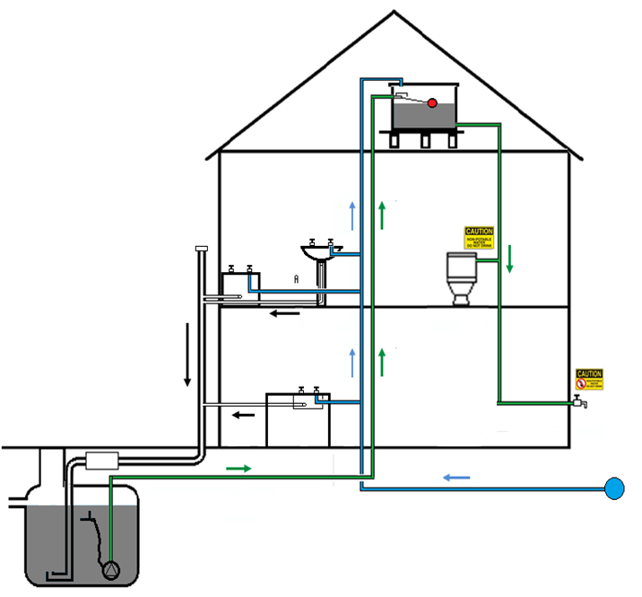
Introduction
A greywater re-use system captures and stores ‘grey’ waste water that is discharged from washbasins, baths, showers washing machines and kitchen sinks for permitted non-wholesome usage
Reduces ‘wholesome’ mains water usage
To become ‘wholesome’, water is treated by the water supply company before it is supplied
Any reduction in usage of wholesome water will also lead to energy savings and a carbon emission reduction

Slide 54
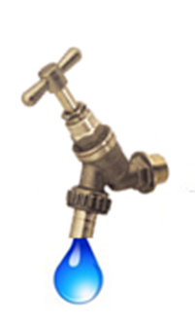

Permitted use of harvested rainwater
Grey water is classified as Class 5 Risk under the Water Regulations
Permitted for use for the following purposes:
Supplying a clothes washing machine
Flushing WCs
Garden watering/irrigation
Car washing
Not permitted for use for the following purposes:
Drinking water
Dishwashing (hand or machine)
Food preparation
Personal washing, showering bathing

Slide 55
Greywater Re-use Systems
Types of system
System Type | Description
Direct re-use system | A system that collects greywater from appliances and delivers it directly to the points of use with no treatment and minimal, or no storage.
Short retention system | A system that includes a basic filtration or treatment technique such as surface skimming and allow for natural particle settlement.
Basic physical/chemical system | A system that filters greywater prior to storage and uses chemical disinfectants such as chlorine or bromine to stop bacterial growth during storage
Biological system | A system that introduces an agent, such as oxygen, into the stored greywater to allow bacteria to digest any unwater organic mater. Pumps or plants can be used to aerate the stored water.
Bio-mechanical system | A system that combines both physical and biological treatment.
Hybrid system | A combination of any of the above systems or a combiner rainwater harvesting and greywater re-use system.

Slide 56
Storage, Treatment and Use Considerations
Greywater from showers, baths and washbasins is often contaminated with human intestinal bacteria and viruses as well as organic debris such as skin particles and hair.
Greywater will also contain residues of soaps, detergents and other cosmetic products; these often contain nutrients that help bacteria develop. The relatively high temperature of greywater can also encourage the growth of bacteria further.
For these reasons untreated greywater should never be stored for more than a few hours.
If greywater is to be used for irrigation, it should be directly applied to soil and not through a sprinkler or method that would allow contact with above ground portions of plants.
Greywater should not be used to water crops, which are eaten uncooked.

Slide 57
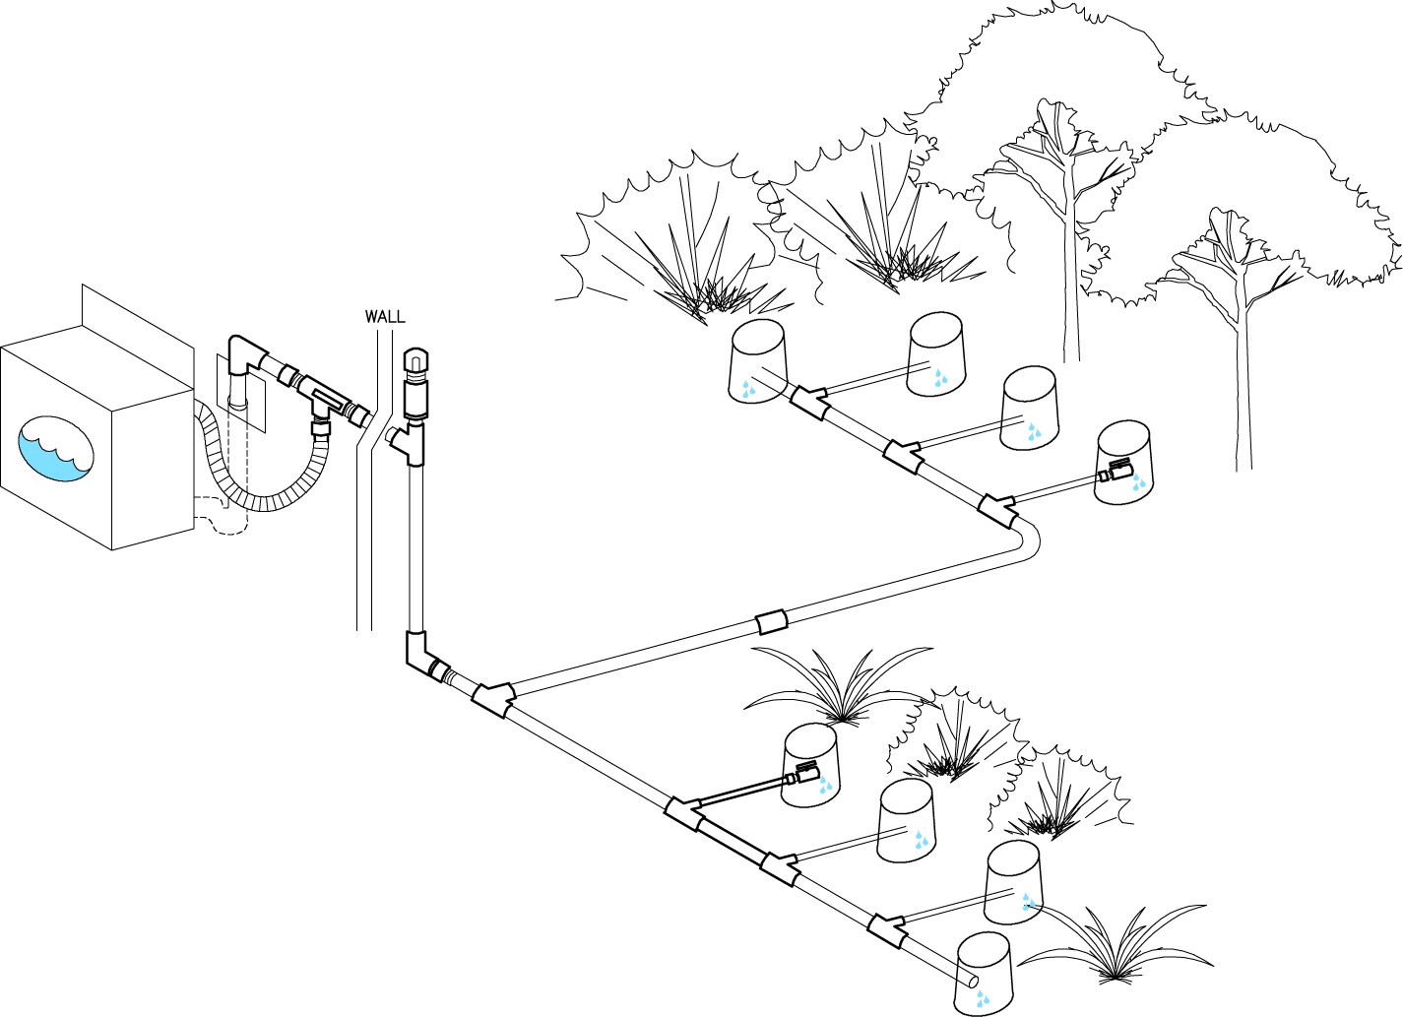
Greywater Re-use Systems
Direct re-use
laundry-to-landscape
  (not recommended for vegetables likely to be eaten without cooking)

Slide 58
Layout Options
A wide range of other system layout options exist including a number of options for an internal greywater storage tank and treatment unit.
The internal units come in a variety of shapes and sizes and offer a lot of flexibility in system design.
As with rainwater harvesting systems, all greywater re-use system supply points and pipework must be marked and labelled to minimise the risk of incorrect use of reclaimed greywater and/or the possibility of cross-connections between wholesome water systems and greywater re-use systems.

Slide 59
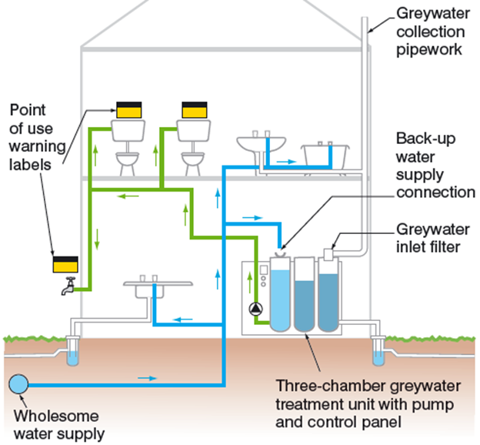
Example Greywater System
- Layout and Key Components
System using physical, biological and UV disinfection to treat and prepare the greywater for reuse

Slide 60
Grey Water Re-use Systems
Domestic-size grey water recycling system that utilises biological treatment:
The following processes are utilised:
Pre-filtration
Biological treatment
Sedimentation
UV disinfection

Slide 61
✓ Learning Check
Quick Questions
Is reclaimed greywater suitable for use to supply a clothes washing machine?
Yes, if it is appropriately treated (appropriate treatment is likely to be a combination of membrane filtration, anaerobic bacteria and ultra-violet disinfection)
What is a direct reuse greywater system?
A system that collects grey water from appliances and delivers it directly to the points of use with no treatment and minimal, if any, storage
Is reclaimed greywater suitable for use to water vegetables that will be eaten uncooked?
No – not recommended

Slide 62

Regulatory requirements
The installation of grey water reuse systems will require compliance with a number of regulatory requirements including health and safety, water regulations
Two primary regulatory requirements in relation to rainwater harvesting systems :
Building Regulations
Town and Country Planning Regulations
Note: The requirements stated in this section relate to England and Wales only.

Slide 63
Regulatory Requirements
The Building Regulations (England and Wales) comprise of 14 parts.
In pairs, identify which of these parts have relevance to solar hot water systems installation.
(5 mins)

Slide 64
Regulatory Requirements –
Building Regulations
Part | Topic | Relevance to Grey water re-use Installations
A | Structure | Where grey water re-use system components put load on the structure and/or where excavations are made close to the structure
B | Fire Safety | Holes for pipes reducing fire resistance of building
C | Site preparation and resistance to moisture | Holes for pipes reducing moisture resistance of building
E | Resistance to the passage of sound | Holes for pipes reducing sound proof integrity of building
G | Sanitation, hot water safety and water efficiency | Water efficiency
H | Drainage and Waste Disposal | Sanitary pipework connected to greywater reuse systems
P | Electrical safety in dwellings | Safe installation of controls and components

Slide 65
Regulatory Requirements
Town and Country Planning Regulations
Planning permission not normally needed if the finished installation does not alter the outside appearance of the property
Where above ground grey water reuse storage tanks are to be included, planning permission may be required.
If the building is listed or in a designated area it is advisable to check with the local planning authority
Consent is also likely to be needed for internal alterations to listed buildings.

Slide 66
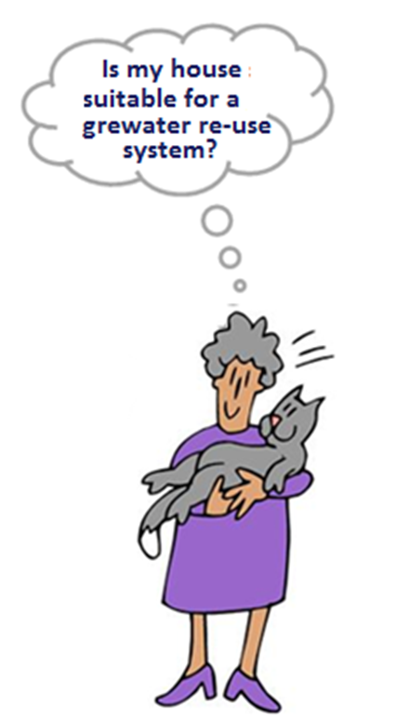
Building location and feature requirements
The following building and location factors will need to be considered:
A suitable location and space for a storage tank of a suitable size to meet the demand
A suitable location to minimize the potential for freezing, warming and algal blooms
A suitable supply (yield) of rainwater in relation to the demand on the system.
A wholesome back-up water supply

Slide 67
✓ Learning Check
Quick Questions
Why is Part H of the Building Regulations relevant to the installation of a greywater re-use system?
This part of the Building Regulations states the requirements relating to design, installation and testing of sanitary appliances connected to greywater re-use systems
Is planning permission normally required for a rainwater harvesting system installation?
Not normally, unless:
The storage tank is above ground, or the building is listed or located in a conservation area or similar type of area
Is a greywater re-use system likely to be suitable for a property with two occupants who prefer to take sort showers instead of baths?
Not typically, because the volume of available greywater (yield) isn’t likely to be sufficient to make the system viable. However, some small systems may be suitable

Slide 68
Level 3 Diploma in Plumbing and Domestic Heating
Phase 3
Environmental Technologies
Solar Thermal

Slide 69
What is Solar Thermal?
Systems gather energy radiated by the sun and convert it into useful heat in the form of hot water
Has been available since the 1970s and the technology is now well developed with a large choice of equipment
Represents the most cost-effective use of solar energy
Systems are the most common domestic renewable energy installation in the UK

Slide 70
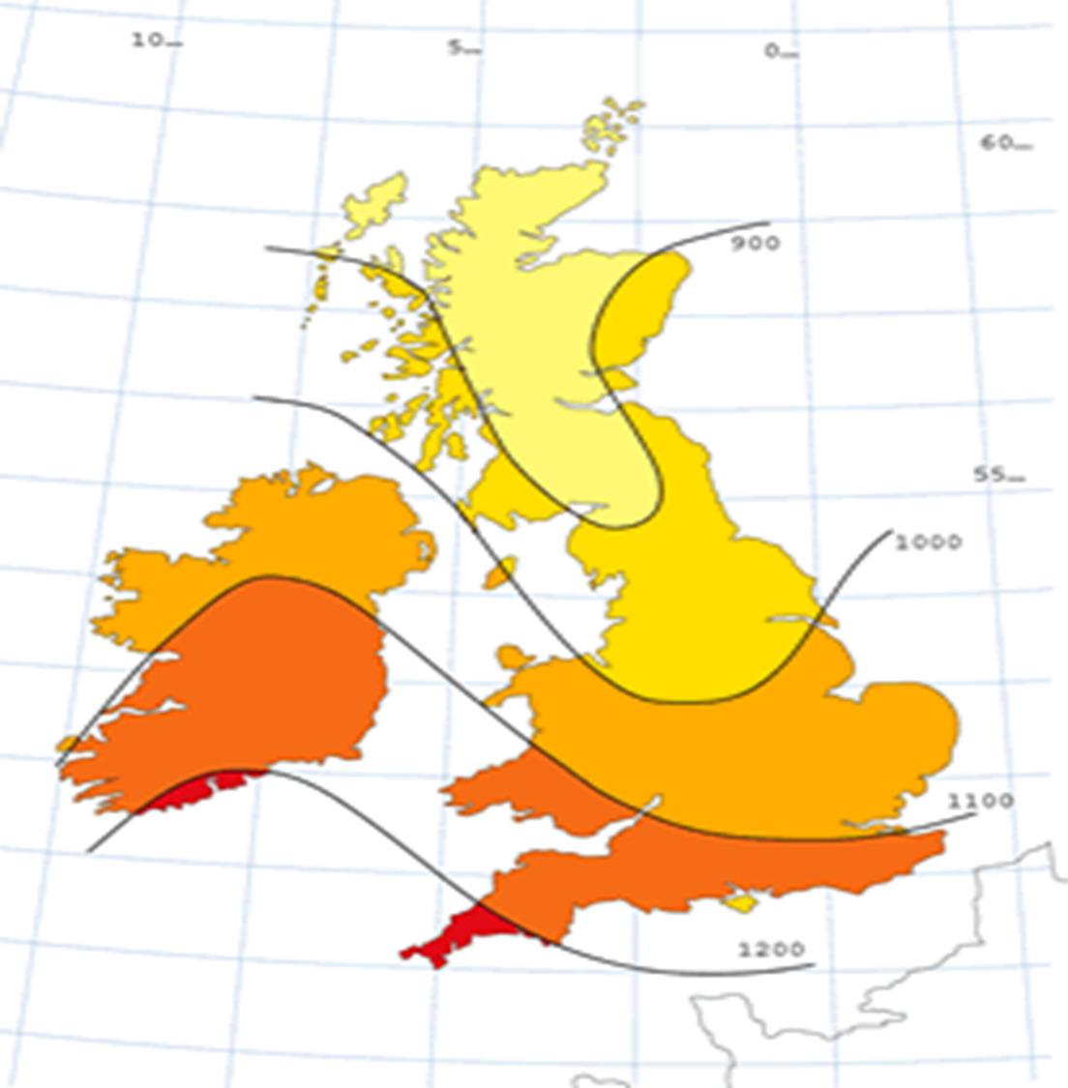
How well does it work in the UK?
Available annual solar energy in kWh per m²
Active solar heating systems will typically convert 30–60% of the solar energy falling on the solar collectors into useful heated water.
Could expect to harvest 1000–2000 kWh per year depending on the size and type of system

Slide 71
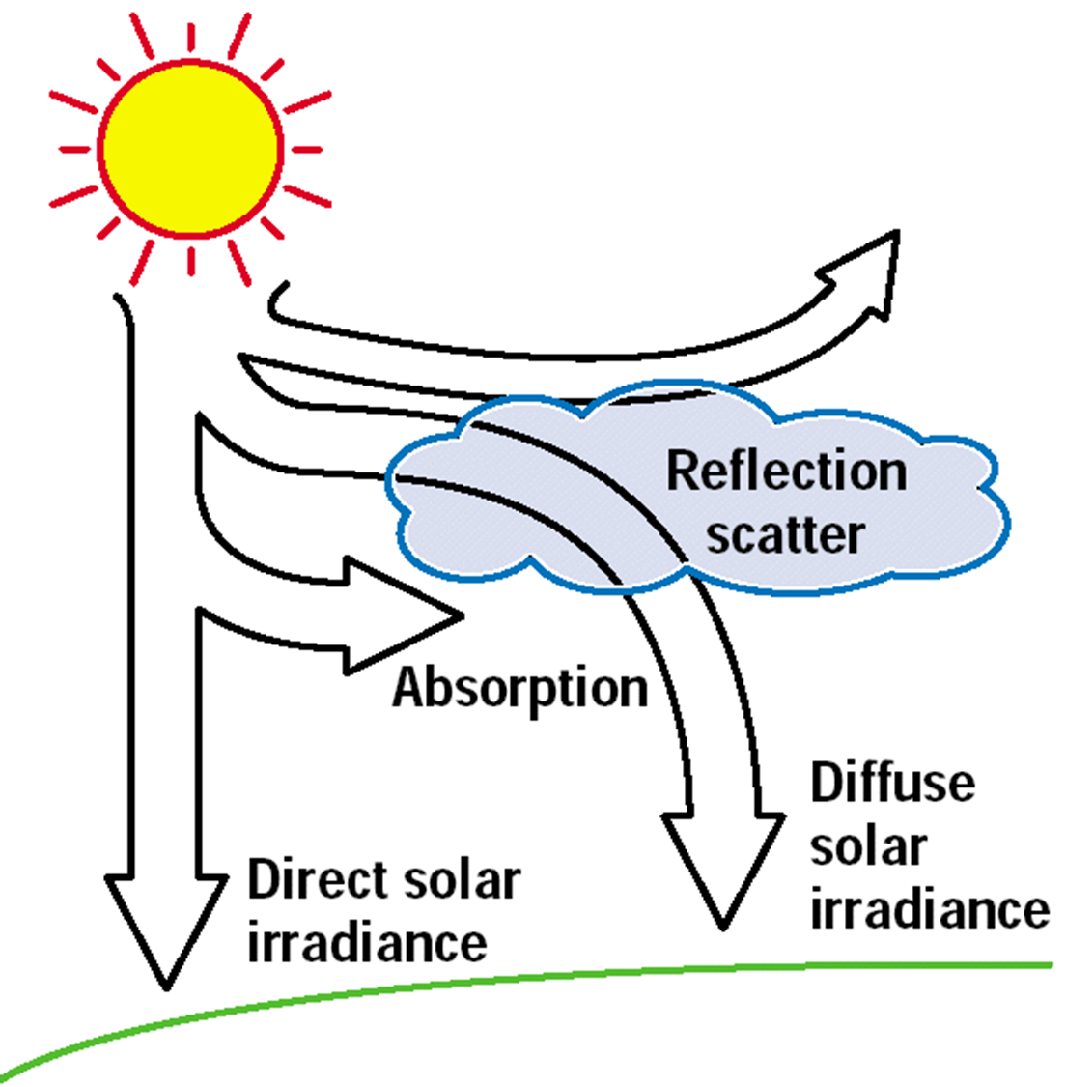
Solar Irradiance
A solar panel does not need direct sunlight to work
It uses about 50/50 defuse and direct sunlight
Even in the spring and autumn, and on clear winter days we receive very useful amounts of solar energy.

Slide 72
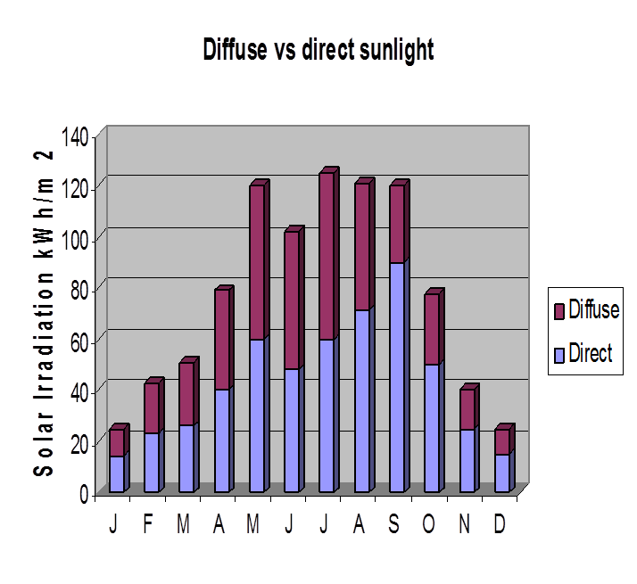
Direct & Diffuse Sunlight
Intensity of the sun’s rays varies from season to season
However there is a fairly stable 50/50 proportion of defuse and direct light
Overall solar energy could meet 40–60% of a household’s annual needs
In summer it could meet 80–100% of need

Slide 73
Heating Requirements V available energy
Heating requirement for house (1984)
Heating requirement for low energy house
Hot water requirement
Solar input – 5 sq m
Solar input – 15 sq m

Slide 74
Basic System Categories
Although there are a number of system types, variations and configurations, solar thermal hot water systems fall into two basic system categories:
passive systems
active Systems

Slide 75
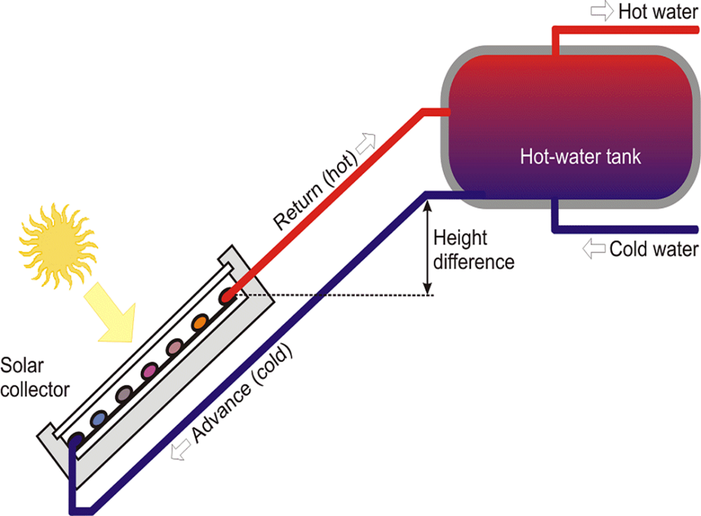
Passive Systems (thermosiphon)
A thermosiphon system makes use of gravity
The collector is always mounted below the tank.
Cold water from the bottom of the tank flows to the solar collector through a descending water pipe. When the panel heats up the hot water rises and flows back to the tank.
The weight of the water filled tank can sometimes cause structural problems in the roof space and can be difficult to integrate with a conventional heating system.
There is no heat exchanger/coil. The water flows directly through the collector. Therefore, it has no freeze protection.

Slide 76
Active Systems
System overview:
Solar panel / collector
Hot water storage cylinder
Plumbing system
Notes:
How does it work?
A solar water heating system for domestic hot water comprises three main components:
Solar panels/collector
Hot water cylinder
A plumbing system.

Slide 77
System overview
Solar Panel
Notes:
This represents a solar panel…..
Solar panels are fitted to your roof and retain heat from the sun’s rays and transfer this heat to the fluid contained within the system.

Slide 78
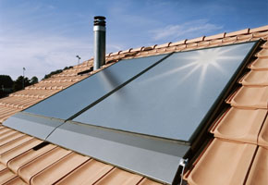
Solar Panels
Flat plate:
30–40% efficient at converting sunshine into usable hot water
Source: SPF
Notes:
Flat plate systems have an efficiency of around 30% and are cheaper to install. They will convert 30-40% of the 1200KWh falling on each m² panel into usable hot water.
Flat plate panels typically look like a Velux window. They can be set flush with the roof or on a frame.
Solar water heating is one of the cheapest forms of domestic renewable energy. It is most cost effective to install a system to coincide with other work – for instance installing a system when you are re-roofing your property will save on scaffolding costs. Similarly, if you are putting on an extension.
If you are putting it in when the house is being built you can save on the materials that would have been used i.e. the slates and tiles. The scaffolding costs will be reduced if the systems goes on at the same time as the roof. In addition, you would probably have been putting in a hot water cylinder anyway so savings can be made here too.
Flat plate collectors can be mounted in two ways:
In roof – the collector is mounted on felted batons fixed into rafters and flashed around. They are often used in this way in new build projects.
On roof – collectors are mounted on rails on the roof covering. Fixings are drilled through the roof covering into the rafters and weather proofed. Suitable for retro fitting.

Slide 79
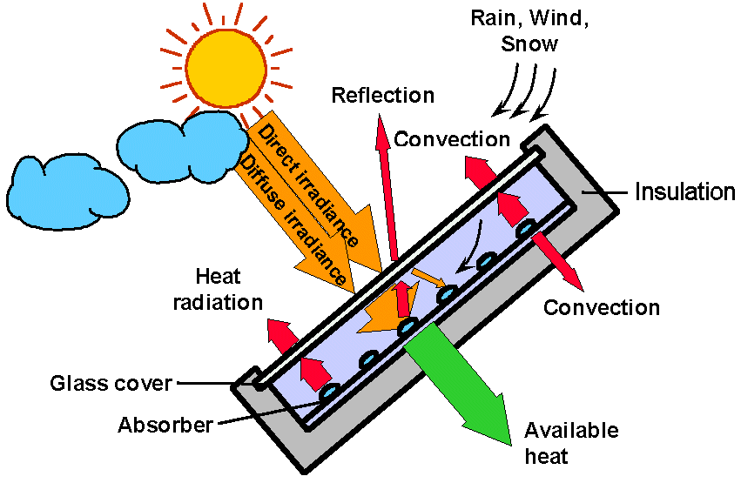
Flat plate
Box
Notes:
Flat plate
It is basically a well-insulated box with a transparent cover and an absorber surface. The absorber converts sunlight to heat and transfers it to water/fluid in tubes, which passes through the system.
A pane of glass covers the box. This reduces loss of heat from air movement /convection. It works a bit like a green house to let light in and stop heat getting out.
The glass does stop some of the light energy getting in as it reflects a small part of the sunlight spectrum. However, the majority passes through. Double glazed models can reduce heat loss but also reduce transmitted solar power and increased costs.
Some models have a vacuum between the front glass clover and the absorber. This can significantly reduce the convection heat loss due to air movements inside the collector. However, it is difficult to maintain the vacuum over long periods. Air nearly always gets in. So they must be evacuated from time to time.

Slide 80
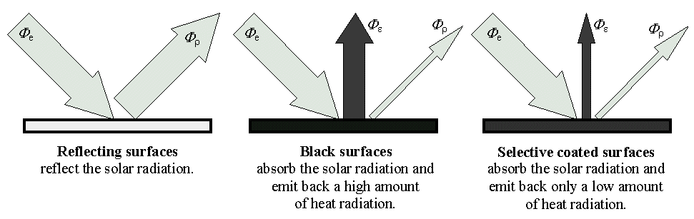
Selective coatings improve absorption
Notes:
Selective coatings
It is well known that black materials absorb sunlight well and warm up to high temperatures. However, the metallic materials use for the absorber do not naturally have a black surface and need to be coated. Selective coated surfaces emit back only low amounts of heat.

Slide 81
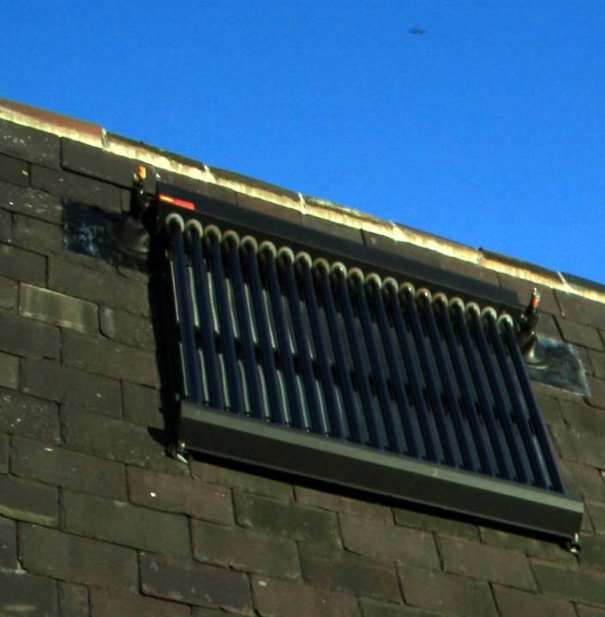
Evacuated tubes: 40–60% efficient at converting sunshine into usable hot water
Notes:
Evacuated tubes look like this on a roof. They are set on the roof rather than integrated into it because of the way they work. This can reduce the architectural possibilities.
Evacuated tube systems occupy a smaller area and have an efficiency of approximately 40–60% but are generally more expensive to install.
If you have a limited amount of space on your south-facing roof then an evacuated tube system may be best.

Slide 82
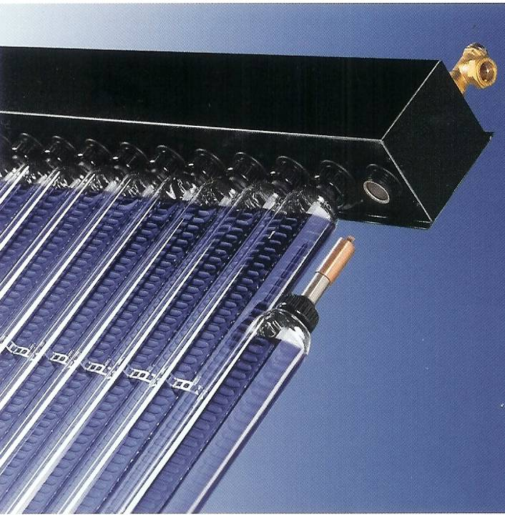
Tube collector
Source: Thermomax
Notes:
Systems will often have 20 or 30 tubes that connect into a manifold. Their modular nature means that if one breaks you can replace it rather than replacing the whole panel.
The high vacuum inside the closed glass tube of the evacuated tube collector is easer to maintain over a long period. Their shape makes it easer to prevent air getting in.
The vacuum is beneficial because it significantly reduces convection heat losses due to air movements. This makes the evacuated tubes more efficient.

Slide 83
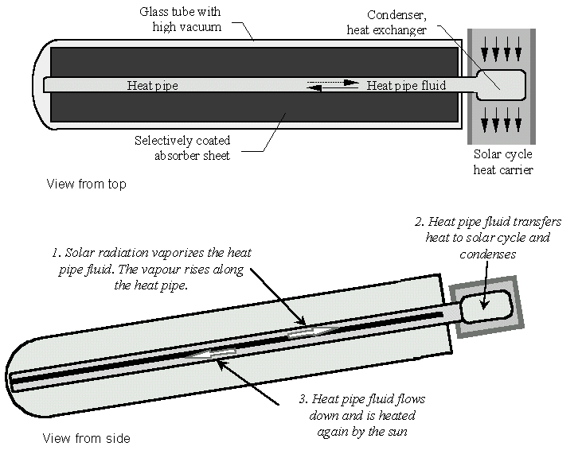
Tube collector
Notes:
Inside the tube collector is an absorber sheet with a selective coating and a heat pipe in the middle.
The heat pipe contains a temperature-sensitive fluid (the fluid is often an alcohol – methanol).
The sun heats up and vaporises the fluid. The vapour raises to the condenser and heat exchanger.
Here the vapour condenses and transfers heat to the heat carrier of the solar cycle (the fluid in the pipes going to the hot-water tank).
The condensed fluid flows back to the bottom of the heat pipe where the sun starts to heat it again.
Some models need a slight tilt to encourage the fluid flow back down.
Evacuated tube collectors can obtain significantly higher energy gains especially in the cooler months of the year.
Therefore a solar collector with evacuated tubes needs a smaller area for the same energy harvesting compared with standard flat plate collectors.

Slide 84
System overview
Hot Water Cylinder
Recommended storage for one family with 4–6 people is about 300 litres
Hot water storage
Notes:
A hot water cylinder stores the hot water that is heated during the day and supplies it for use later. It is an often under-rated component of the solar system but should be big enough to exceed the daily hot water demand by a factor of 1.5 to 2.
For most people their need for hot water does not coincide with daylight hours. Hence the cylinder’s function is two-fold. Firstly it must effectively transfer heat from the solar collector to the stored water, and secondly it needs to have a large enough capacity to smooth the light energy fluctuations not just throughout the day but from day to night and from bright through dull days.
The recommended storage size for a one-family house with four to six people is about 300 litres. This is a good bit bigger than a normal hot water tank. However, size depends on whether residents are in or out most of the day, prefer a shower to a bath, use a washing machine regularly and so on.
If the cylinder is too small it may result in the system shutting down too often on sunny days because there is no more room to store hot water.

Slide 85
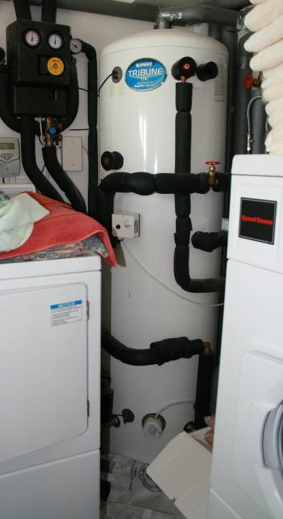
Hot-water storage cylinder
Notes:
The disadvantages of a big tank are that it may be too big for some airing cupboards, and it is more expensive.
A well-insulated cylinder will show as little as a 3ºC drop in water temperature in 24 hours.

Slide 86
System overview
Solar cylinders have two heat exchanger coils
Hot water storage
Notes:
Solar cylinders have two heat exchanger coils. These transfer heat into the water in the tank.

Slide 87
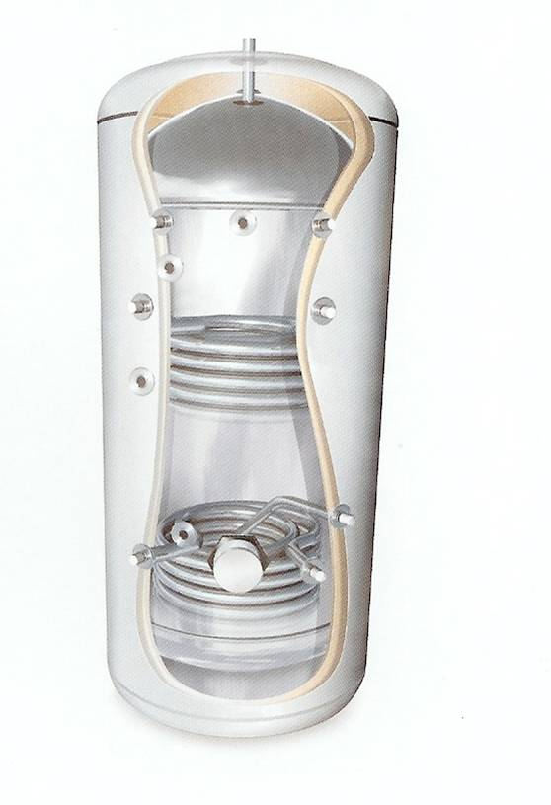
Twin-coil cylinder
Notes:
This shows the two-coil hot-water cylinder. It is important to have a good quality cylinder designed for use with a solar system.
Manufactures will often produce a bundle of components that all go together. This is often the best way to install a systems as they will be designed top work together efficiently.

Slide 88
System overview
Boiler
Solar thermal hot water systems require an auxiliary heat source to heat the stored domestic hot water when there is either:
insufficient solar energy to heat the water fully; or
no solar energy to heat the water
Hot water storage
Notes:
The first coil connects into the existing boiler. Water is heated by the boiler and pumped to the hot water tank where the heat is transferred to the water in the tank. There is no direct contact. The water heated in the boiler is in a closed system and does not fill up in the tank. Rather it is used to heat cold water in the tank by heat exchanging through the coil.

Slide 89
System overview
Fluid is circulated to the heat exchanger by means of a pump
Boiler
The fluid in the coil then cools down and is pumped back to the collector.
The boiler can top up the temperature if needed
Pump
Hot water storage
Notes:
The hot fluid coming from the solar panel heats water in the storage tank in the same way. This fluid can contain an anti-freeze to help protect the system in winter.
The fluid is circulated through a closed loop system by means of a pump. A pipe carries the hot fluid to the domestic hot water cylinder, where a coiled pipe (inside the cylinder) gives up the heat to the water. The fluid in the coil then cools down and is pumped back, through another pipe, to the collector.
Basically, the system forms a continuous loop that brings heat to the cylinder and returns cold fluid to the collector for re-heating by the sun.
The hot water in the tank rises and is drawn off for use in showers and taps.
The boiler can top up the temperature if needed as indicated by the tank thermostat.
The pipes running to and from the panel need to be well insulated and the distances they covers should be kept as short as possible.

Slide 90
System Overview
Differential Temperature Controller (DTC)
the heart and brains of the system
linked to high level and low level temperature sensors the DTC only allows the system circulating pump to operate when there is:
solar energy available
a demand for water to be heated

Slide 91
System overview
Boiler
Controller
Pump
Hot water storage
Notes:
The controller compares the temperature of the water in the tank with that produced in the panel and turns on the pump when the water produced by the panel is warmer than the water in the tank.
The pump only circulates when there is adequate solar energy and so minimises electricity consumption. It also maximises energy capture by responding quickly when there is sufficient sunshine.
Some models will have a display panel that can tell you various bits of information such as how much energy has been collected that day or since the panel was first installed.
It is important to note that if the hot water is not being used, the solar panel will not be able to release its captured energy into the tank. Equally so, if your boiler or immersion has heated the water in the morning and there is a full tank of hot water you will not be able to benefit from the energy the panel can capture.
Therefore it is important to make slight behavioural changes to maximise the benefits of the system. Having showers in the evening when there is a full tank of water is one way to use the hot water produced by the system. Shutting of your backup heating in the summer can also help.

Slide 92
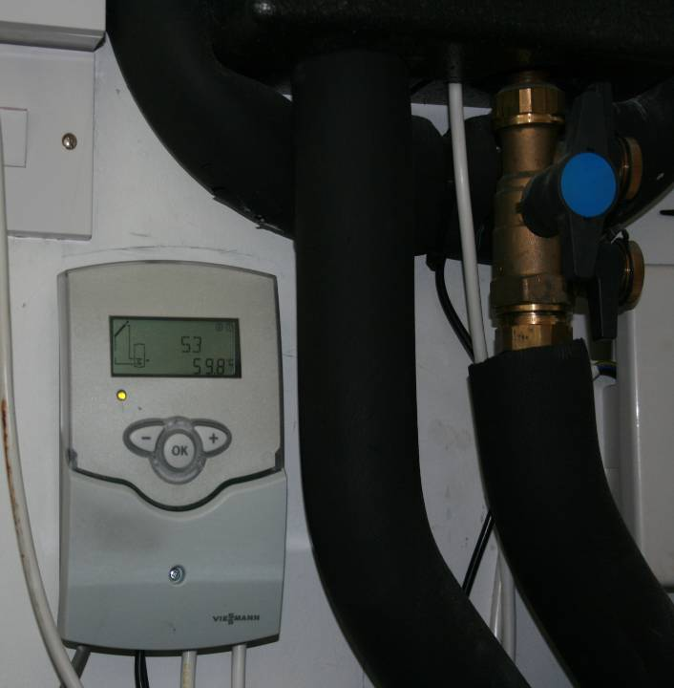
Differential Temperature Controller
Notes:
The controller

Slide 93
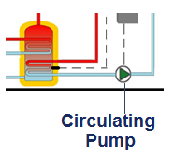
System Overview
Circulating Pump
Circulates the system heat transfer fluid which is either water or glycol depending upon the type of system, around the solar hot water circuit.
The operation of the circulating pump is controlled by the Differential Temperature Controller

Slide 94

System Overview
One of a number of alternative arrangements is to use a separate solar pre-heat cylinder:

Slide 95
✓ Learning Check
Quick Questions
Most Solar Hot Water Systems in the UK fall into which category?
Active or Pumped Systems
What types of Solar Collector are available?
Flat plate and Evacuated Tube
What is the function of the Temperature Differential Controller?
Allows the system circulating pump to operate when there is:
solar energy available
a demand for water to be heated
What is the purpose of the auxiliary heat source?
To provide back up heat when there is no or insufficient solar energy available to heat the water

Slide 96
Is the building suitable?
Roof orientation
Angle of roof
Shading
Size of roof
Weight loading of roof
Type of heating system/water storage
Space for a large hot-water storage tank
Economics – fuel to be replaced
Notes:
The system which best suits your needs depends on a range of factors, including:
Roof orientation
Size of roof
Angle of roof
Weight loading of roof
Shading
Type of heating system/water storage
Space available for a large hot-water storage tank
Economics – fuel to be replaced
If you are talking to an installer these are the first things he/she will want to know .

Slide 97

Roof Orientation
The ideal orientation is south facing due to the availability of the sunshine throughout the day.
Orientations between south east and south west will also provide good results.
For buildings with suitable east and west facing roof areas, a split collector system is possible with solar collectors mounted on both east and west facing roof slopes.

Slide 98

Solar Collector Tilt
Also a key factor that determines the amount of solar energy that is transferred from the sun to the solar hot water system
Collector ‘tilt’ is the angle that the solar collector is mounted from the horizontal plane
Where a pitched roof already exists, the tilt is typically determined by the roof pitch.
It is possible to mount solar collectors on vertical and horizontal surfaces.
Solar collectors may also be mounted on purpose built support frames to provide the required tilt

Slide 99
Orientation and tilt
Tilt of Collector | Orientation of collector
 | South | SE/SW | E/W | NE/NW | North
Horizontal | 961
30⁰ | 1073 | 1027 | 913 | 785 | 730
45⁰ | 1054 | 997 | 854 | 686 | 640
60⁰ | 989 | 927 | 776 | 597 | 500
Vertical | 746 | 705 | 582 | 440 | 371
Annual solar radiation kWh/m2 (Source: Table H2, SAP, 2009)
Learning Check
What is the optimum orientation and tilt given in the table above?

Slide 100
Orientation and tilt
Tilt of Collector | Orientation of collector
 | South | SE/SW | E/W | NE/NW | North
Horizontal | 961
30⁰ | 1073 | 1027 | 913 | 785 | 730
45⁰ | 1054 | 997 | 854 | 686 | 640
60⁰ | 989 | 927 | 776 | 597 | 500
Vertical | 746 | 705 | 582 | 440 | 371
The optimum orientation and tilt given in the table above is south facing at a 30º tilt.
Typically, a collector tilt of between 30º and 40º from horizontal is considered to be very close to optimum with 35º being optimum.

Slide 101

Overshading
Any overshading of the solar collector(s) will have an impact on how much available solar energy that is transferred from the sun to the solar hot water system
Overshading | % of sky blocked by obstacles | Impact of overshading (% reduction in potential system performance)
Heavy | ˃ 80% | 50%
Significant | ˃ 60 - 80% | 35%
Modest | 20% - 60% | 20%
None or very little | ˂ 20% | none
Based upon Table H4, SAP, 2009

Slide 102


Roof
Sufficient size (m²)
typically a minimum of 3- 4m² of suitable collector mounting area is needed with approximately 0.75m² to 1m² of collector area being required per person
Strong enough
to support the collectors
wind uplift loads must also be considered and assessed.
In good condition
Any repairs or refurbishment should be carried out prior to installing the solar collector(s)

Slide 103
✓ Learning Check
Quick Questions
What type of solar hot water system is typically suitable for a property with and East/West roof orientation?
A split system with solar collectors mounted on both East and West facing slopes
What effect will heavy overshading of solar collectors have on system performance?
A potential reduction in system performance of approximately 50%
What are the essential requirements for a structure to be suitable for the mounting solar collectors?
Sufficient size; strong enough; in good enough condition
Which type of hot water system is most compatible with a solar hot water system?
A centralised storage system

Slide 104
Regulatory Requirements
Town & Country Planning
  The installation of a building mounted collector array is typically classed as permitted development for houses and bungalows providing :
the solar collectors are not installed above the ridgeline and do not project more than 200mm from the roof or wall surface.
the solar collectors are sited, so far as is practicable, to minimise the effect on the appearance of the building
the solar collectors are sited, so far as is practicable, to minimise the effect on the amenity of the area.
the property is not a listed building
the property is not in a conservation area or in a World Heritage Site

Slide 105
Regulatory Requirements
Town & Country Planning
  The installation of a stand-alone collector array is typically classed as permitted development for houses and bungalows providing :
The array is no higher than four metres
The array is sited at least 5m from boundaries
The size of array is limited to 9m² or 3m wide and 3m deep
The array is not being installed within boundary of a listed building
In the case of land in a conservation area or in a World Heritage Site the array will not be visible from the highway.
Only one stand-alone solar installation is being installed.

Slide 106
Regulatory Requirements –
Building Regulations
Part | Topic | Relevance to Solar Hot Water Installations
A | Structure | Load on structure including wind uplift loads
B | Fire Safety | Holes for pipes reducing fire resistance of building
C | Site preparation and resistance to moisture | Holes for pipes reducing moisture resistance of building
E | Resistance to the passage of sound | Holes for pipes reducing sound proof integrity of building
G | Sanitation, hot water safety and water efficiency | Safety and water efficiency of hot water system
L | Conservation of fuel and power | Efficiency of system and building
P | Electrical safety in dwellings | Safe installation of controls and components

Slide 107
Advantages/Disadvantages
Include:
Advantages | Disadvantages
Reduces carbon dioxide emissions | Not compatible will all existing hot water systems
Solar energy is free, energy costs will be reduced | Less solar energy is available in the winter months
Relatively low maintenance is needed | Initial installation costs can be off-putting
Improves Energy Performance Certificate ratings | Needs a linked auxillary heat source

Slide 108
Level 3 Diploma in Plumbing and Domestic Heating
Phase 3
Environmental Technologies
Rainwater Harvesting Systems

Slide 109

Introduction
A rainwater harvesting system captures and stores rainwater for permitted non-wholesome usage
Reduces ‘wholesome’ mains water usage
To become ‘wholesome’, water is treated by the water supply company before it is supplied
Any reduction in usage of wholesome water will also lead to energy savings and a carbon emission reduction

Slide 110
Permitted use of harvested rainwater
Harvested rainwater is classified as Class 5 Risk under the Water Regulations
Permitted for use for the following purposes:
Supplying a clothes washing machine
Flushing WCs
Garden watering/irrigation
Car washing
Not permitted for use for the following purposes:
Drinking water
Dishwashing (hand or machine)
Food preparation
Personal washing, showering bathing

Slide 111

System Layout and Key Components
Indirect distribution with below ground tank
3
2
4
1
In pairs, identify features 1 – 4

Slide 112

Rainwater Harvesting System Components
1. Below Ground Storage Tank
Can be located above or below ground providing the stored water is protected from freezing, warming and bacterial contamination.
Water enters the storage tank via the calmed inlet
Harvested rainwater is then pumped away to the outlet points using a submersible pump.

Slide 113

Rainwater Harvesting System Components
2. Inlet filter
Before the harvested rainwater enters the storage tank it must pass through an approved type inlet filter
Can be located anywhere in the collection pipework but must be accessible for maintenance purposes

Slide 114

Rainwater Harvesting System Components
3. Intermediate Storage Cistern
A key requirement is the inclusion a back-up wholesome water supply.
The required backflow prevention arrangement is a Type AA air gap.

Slide 115


Rainwater Harvesting System Components
4. Signage and Labelling
Appropriate signage and labelling must be provided to minimise the risk of incorrect use of harvested rainwater and/or the possibility of cross-connections between wholesome water systems and harvested rainwater systems

Slide 116

System layout example
Direct distribution system with above ground tank

Slide 117
System layout options
Storage tank and distribution system arrangements include:
Below ground rainwater harvesting storage tank with indirect distribution system via an intermediate system
Above ground rainwater harvesting storage tank with direct distribution system
Below ground rainwater harvesting storage tank with direct distribution system
Above ground rainwater harvesting storage tank with indirect distribution system via an intermediate system
Above ground high-level storage tank (usually internal) with gravity distribution to outlets.

Slide 118
✓ Learning Check
Quick Questions
Is harvested rainwater suitable for use to supply a bath or shower?
No
What is the purpose of a Type AA air gap arrangement in a rainwater harvesting system?
To prevent the backflow of stored water into the wholesome water supply
Why is labelling and marking of rainwater harvesting pipework and outlets important?
To minimise the risk of the incorrect use of harvested rainwater supply
To eliminate the possibility of cross connections between wholesome water systems and harvested rainwater systems
Which component is a floated extraction connected to?
Submersible pump

Slide 119
Regulatory requirements
The installation of rainwater harvesting systems will require compliance with a number of regulatory requirements including health and safety, water regulations
Two primary regulatory requirements in relation to rainwater harvesting systems :
Building Regulations
Town and Country Planning Regulations
Note: The requirements stated in this section relate to England and Wales only.

Slide 120
Regulatory Requirements –
Building Regulations
Part | Topic | Relevance to Rainwater Harvesting Installations
A | Structure | Where rainwater harvesting system components put load on the structure and/or where excavations are made close to the structure
B | Fire Safety | Holes for pipes reducing fire resistance of building
C | Site preparation and resistance to moisture | Holes for pipes reducing moisture resistance of building
E | Resistance to the passage of sound | Holes for wires reducing sound proof integrity of building
G | Sanitation, hot water safety and water efficiency | Water efficiency
H | Drainage and Waste Disposal | Rainwater gutters and rainwater pipework connected to rainwater harvesting systems
P | Electrical safety in dwellings | Safe installation of controls and components

Slide 121
Regulatory Requirements
Town and Country Planning Regulations
Planning permission not normally needed if the finished installation does not alter the outside appearance of the property
Where above ground rainwater harvesting storage tanks are to be included, planning permission may be required.
If the building is listed or in a designated area it is advisable to check with the local planning authority
Consent is also likely to be needed for internal alterations to listed buildings.

Slide 122

Building location and feature requirements
The following building and location factors will need to be considered:
A suitable location and space for a storage tank of a suitable size to meet the demand
A suitable location to minimize the potential for freezing, warming and algal blooms
A suitable supply (yield) of rainwater in relation to the demand on the system.
A wholesome back-up water supply

Slide 123
✓ Learning Check
Quick Questions
Why is Part A of the Building Regulations relevant to the installation of a rainwater harvesting system?
The load imposed by system components (storage cisterns) may affect the structure of the building
Any excavation work may have an effect on the structural stability of the building
Is planning permission normally required for a rainwater harvesting system installation?
Not normally, unless:
The storage tank is above ground, or the building is listed or located in a conservation area or similar type of area
Is a rainwater harvesting system suitable for a building that is located in an area with low rainfall intensity?
No

Slide 124
Advantages/Disadvantages
Include:
Advantages | Disadvantages
Conserves wholesome water | Payback periods can be long.
Indirectly reduces energy consumption and reduces carbon emissions | Not always straightforward to install to existing building
A wide range of system options exist | There is a risk of contamination or cross-connection
Rainwater is free so for buildings where a water meter is fitted the annual cost of water will reduce | Only certain types of outlet and appliance can be supplied using harvested rainwater

