Slide 1
Synodality and Saint Augustine
Session 1:
Organization of Augustinians of Europe
Valladolid, Spain
June 2024

Slide 2
An Augustinian Prayer
Teach me, Lord, my only Teacher,
what I have to teach
and what I still have to learn.
Teach me the art of listening,
more exceptional than eloquent words.
Teach me to place the journey to the inner world
in the plan for the journey.
There I can hear the murmur of truth.
Give me the gift of silence,
of joy and mercy
so that I may know how to wait
just as the farmer contemplates the furrow
with his eyes open to admiration and surprise.

Slide 3
An Augustinian Prayer
May my heart not be an empty square, a private territory,
but the sunny corner
where those hungry for friendship can feel comfortable and
that in seeking to learn, hoping to know myself,
and knowing myself to know you,
like the ray of the light that comes through the window
helps me discover the immense sun.
God of Unity, God of Peace,
you inspired Augustine to gather friends
around him in community.
May we always live together in harmony
and be of one mind and one heart.
Amen.

Slide 4
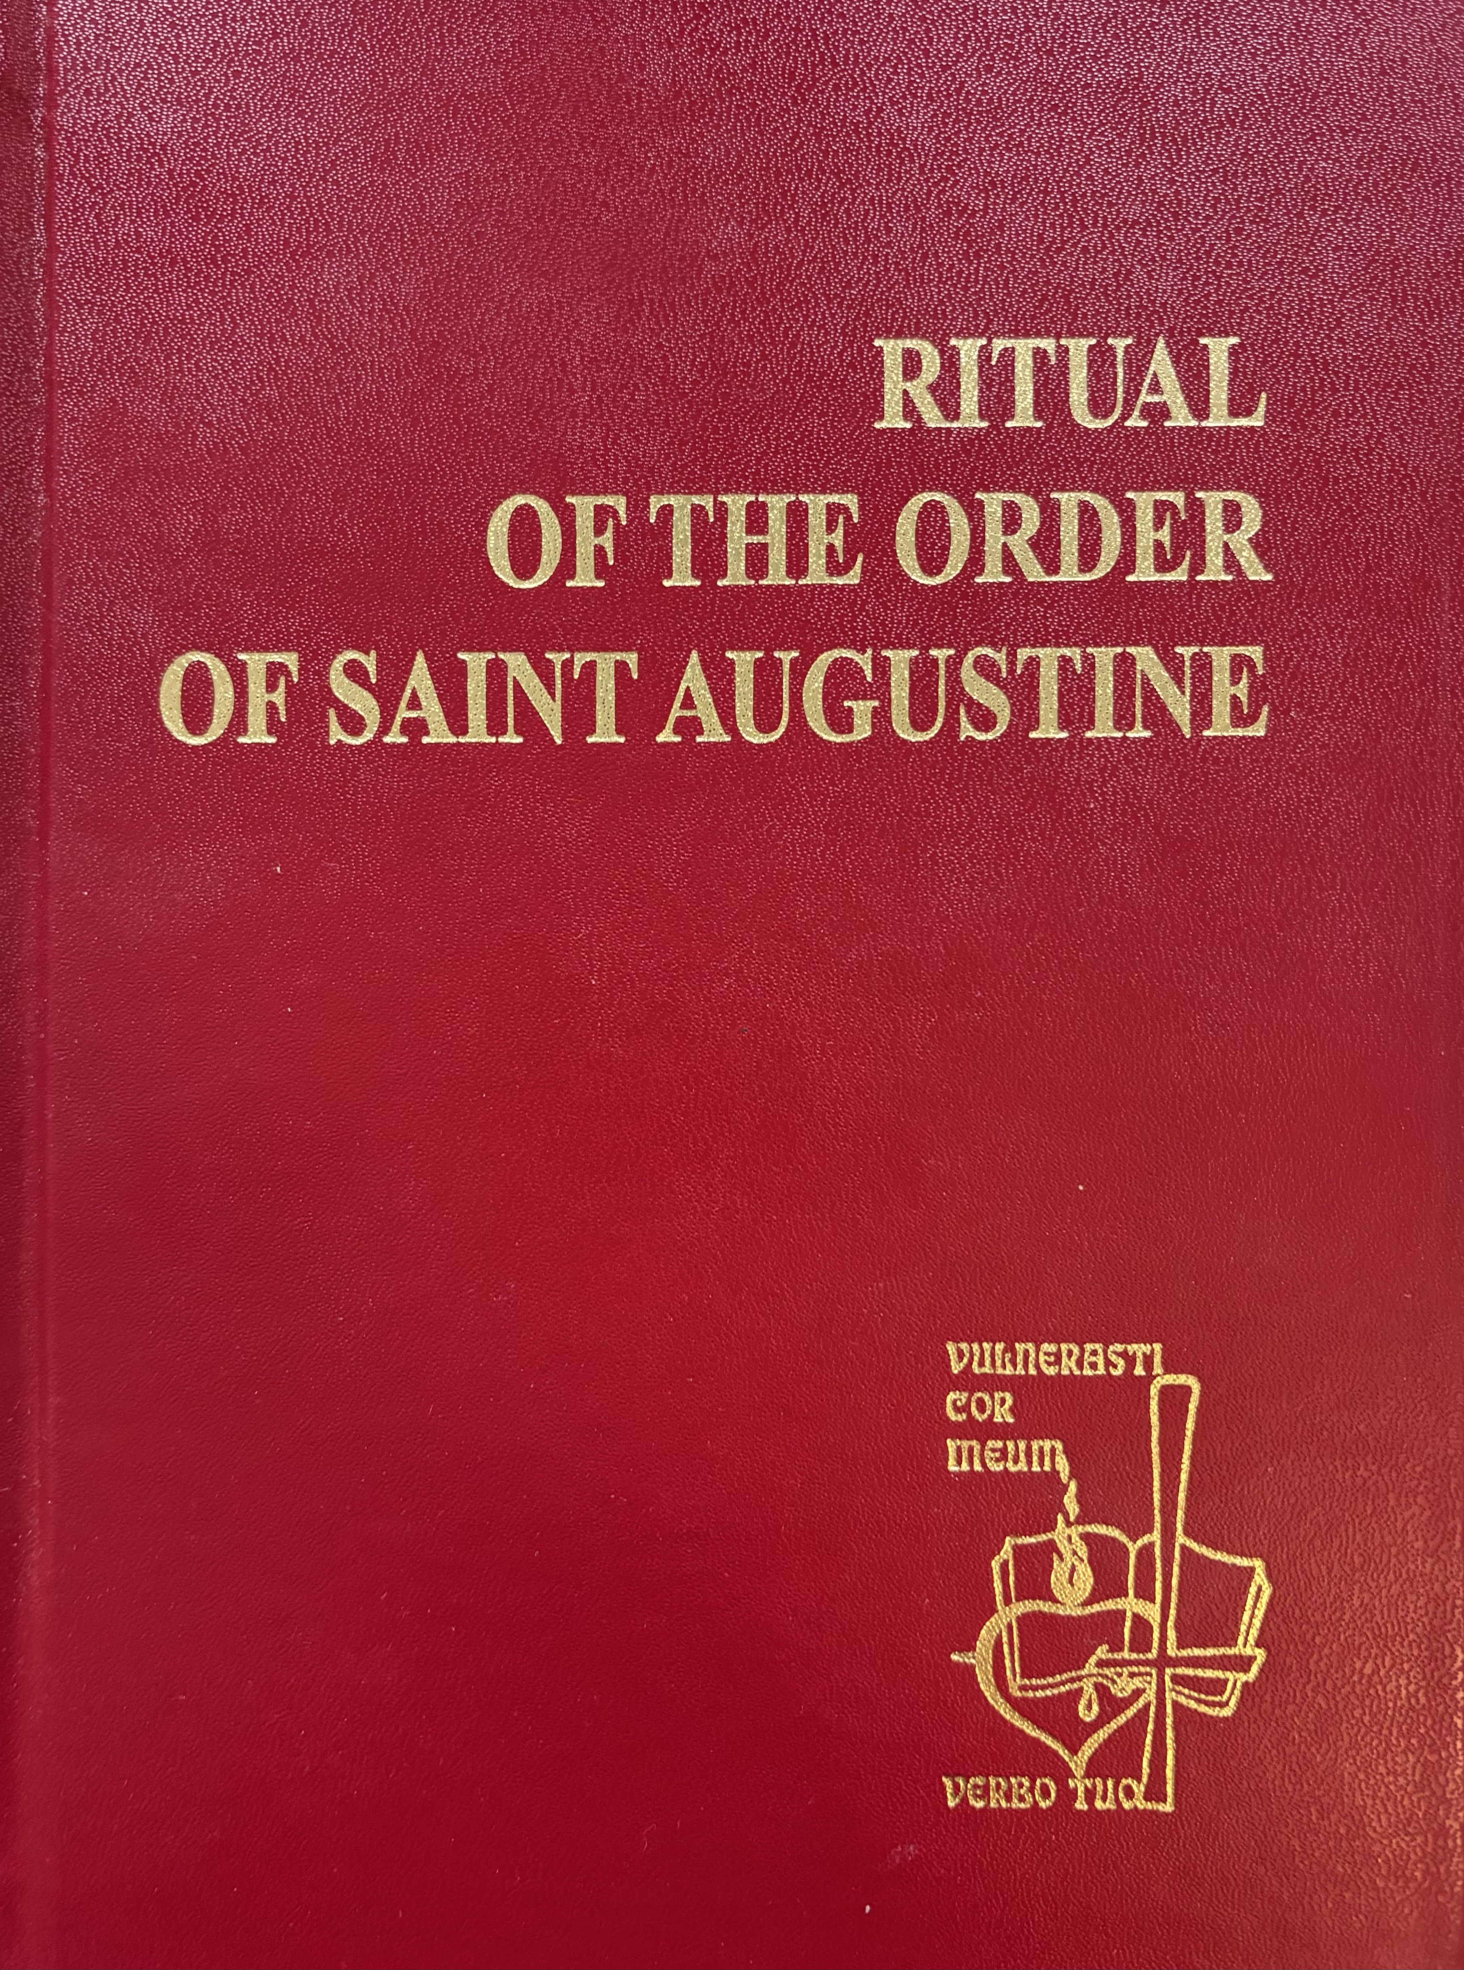
Chapter of Renewal
Dialogue Process

Slide 5
Synodal Aspect Walking Together
Always be dissatisfied with what you are, if you want to arrive at what you are not yet. Wherever you are satisfied with yourself, there you are stuck. …. Always add some more. Always keep on walking. Always forge ahead. (Sermon 169, 18)
While we are walking, one walks more slowly. another more quickly; still, both are walking. So the ones who are sticking are to be rallied, those who are turning and are going back to be called back. Those who go astray to be led back to the road; slow walkers are to be urged on, the fast walkers to be imitated. … Let us be counted with the slow ones, a long way behind the faster walkers, but still with those who are walking. (Sermon 306B, 1)

Slide 6
Synodal Aspect Walking Together
?
?
?
?
?
?
?
?
?
?
What Difficulties Do We Need
to Face to Forge Ahead?
How Can We Help Each Other
To Walk Together?

Slide 7
Synodal Finding Walking Together
Synodal Finding Walking Together
!
! !
!
!
!
! !
!
!
What Have We
Learned?

Slide 8
Synodal Finding Walking Together
My place as your head frightens me, but what I share with you comforts me. I am a bishop set over you, but together with you, I am a Christian. The first is the title of the office I have assumed, the second is a grace; the first is a danger, the second is salvation. The office seems like a storm tossing us about in a raging sea. But when we remember who redeemed us by His blood, it seems we enter the safety of a harbor in the stillness of that thought. Even though this office is personally hard work, the common benefit gives me rest. (Sermon 340, 1)

Slide 9
Synodal Finding Walking Together
With before For – Distinctive Augustinian Leadership Characteristic
Not Jesuit – Men and Women for [and with] Others*
Kinship (Greg Boyle* ) not Kingship - Reciprocal Love
If kinship with other souls appeals to you, let them be loved in God…. Let them be loved in him, and carry off to God as many as possible with you. (Confessions IV, 12, 18)
Samuel Wells
“With is the most fundamental thing about God.”**
“The most important word in the Bible … is with.”***
Being “with” unmoved hearers of our Catechesis/Preaching (Instructing Beginners in the Faith)
*Arrupe, P., S.J., Men and Women for Others in Essential Writings, Selected by Kevin Burke. Maryknoll, NY: Orbis Books, 2004, pp. 171-187.
*Boyle, Gregory, Tattoos on the Heart: The Power of Boundless Compassion. New York: Free Press, 2010.
**Wells, Samuel, A Nazareth Manifesto: Being with God. Oxford: Wiley Blackwell, 2016, p. 3.
***Ibid.

Slide 10
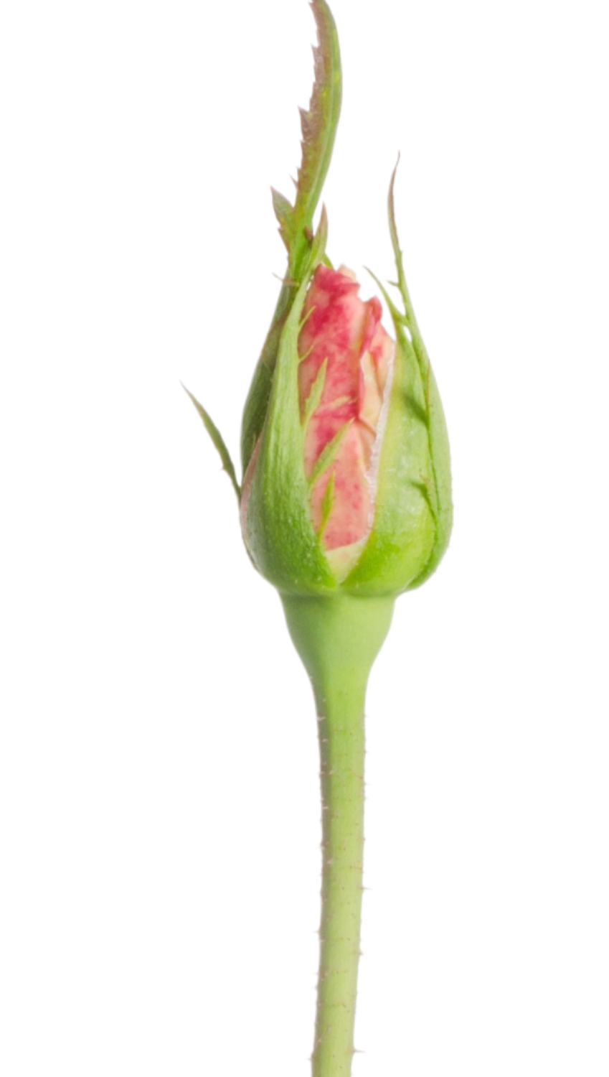
Rose Flower
Synodal Finding Walking Together
Rose Bud
Thorn

Slide 11
Synodal Aspect Listening
Inductive NOT Deductive Attitudes
Accepting NOT Approving
Accommodating NOT Acquiescing or Accosting
Asking NOT Demanding
Beckoning NOT Badgering or Demeaning
Compassionate NOT Compromising
Cooperating NOT Coercing
Courageous NOT Conflicting
Dialoguing NOT Dictating
Directing NOT Driving
Encouraging NOT Insulting
Engaging NOT Opposing
Humble NOT Hard
Inquiring NOT Insisting
Investigating NOT Imposing
Involving NOT Evading
Probing NOT “Preaching At”
Respecting NOT Renouncing

Slide 12
Synodal Aspect Listening
Let’s generously allow something also to silence. Return to yourself, withdraw from all the din. Look inside yourself and see if you have there any pleasant private nook in your consciousness …. Be gentle in hearing the word to understand. (Sermon 52, 22)
Those who hear are more fortunate than those who speak. The learner is humble, but the teacher has to work hard not to be proud. (Exposition of Psalm 50(51) 13)
God … may I know myself, may I know you. (Soliloquies II, 1,1)

Slide 13
Synodal Aspect Listening
?
?
?
?
?
?
?
?
?
?
What Difficulties Do We Need
to Face to Forge Ahead?
How Can We Help Each Other
To Walk Together?

Slide 14
Synodal Aspect Listening
Finding the Inner Teacher
Now see a great sacrament here, brothers: the sound of our words strikes the ears; the teacher is within. Don’t think that a person learns anything from a human being. We can offer a suggestion by the sound of our voice, but if he who teaches isn’t within, our voice is of no avail. (Homily 3 on the First letter of John 13.)
What foolish curiosity could ever prompt a man to send his child to school in order to have him learn what the teacher thinks? (The Teacher, 14, 45).
Galende – Augustine’s interior life is not a theoretical construct - it flows from his personal experience in life.*
*Galende, F. Augustinian Interiority in Our journey back to God: Reflections on Augustinian Spirituality. Rome: Pubblicazione Agostiniane, 2006, p.301.

Slide 15
Synodal Finding Walking Together
Synodal Finding Listening
!
! !
!
!
!
! !
!
!
What Have We
Learned?

