Slide 1


Augustinian Pedagogy
and a Changing Cultural Context
Building the City of God
Augustinian Secondary Education Association (ASEA)
October 25, 2025

Slide 2
An Augustinian Prayer
for a Student or Teacher
Let us Pray:
God of Truth and Beauty,
you give each one of us the desire to seek the Truth.
Fire me with a thirst for knowledge and Truth.
Let me use that knowledge to build a community of justice and love.
God of Splendor and Glory,
you show us your splendor in the heavens,
the earth and the mystery of each person.
May I see your presence and warming love in the gifts of this earth.
May I reverence this presence.

Slide 3
An Augustinian Prayer
for a Student or Teacher*
God, companion on the journey,
you touched the restless heart of Augustine as he searched for you.
Help me to support my friends, mentors, and companions in their quests
and seek their help in mine.
Remind me that you are within me and them as teacher and friend.
Be present to us in the struggles of life as we journey together.
God of Unity, God of Peace,
you inspired Augustine to gather friends around him in community.
May we always live together in harmony
and be of one mind and one heart.
Amen.
*Rubio Bardon, Pedro, O.S.A. Education – An Augustinian Approach. Adapted and edited by Michael Morahan, O.S.A. Coorparoo, Australia: Villanova College, 2001, p. 31.

Slide 4
What is Augustinian Pedagogy?
Augustinian Pedagogy - comprised of 3 categories
1 - Seeking Truth - Reflection (Interiority)
2 - Forming Community - Togetherness (Mutual (Common) Benefit), and
3 - Reaching Out in Service with Neighbor (Mutual (Common) Benefit).

Slide 5
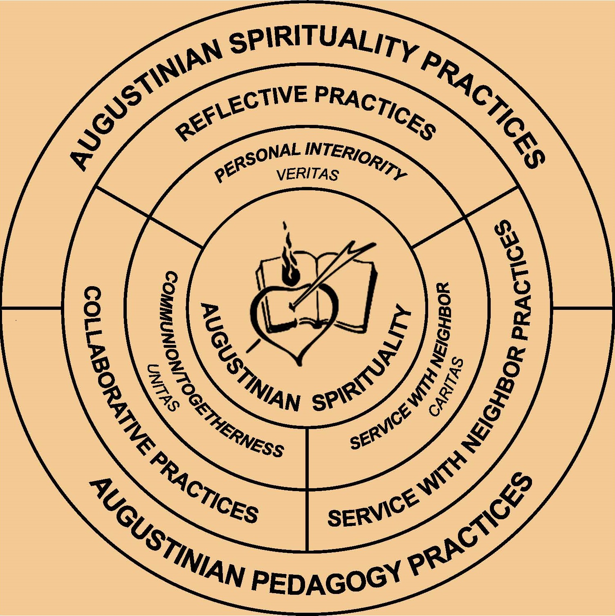
Co-learners of Augustinian Pedagogy

Slide 6
Co-learners of Augustinian Pedagogy
Seeking Truth-Reflection (Veritas)
Forming Community-Togetherness (Unitas)
Reaching Out in Service with Neighbor (Caritas)
Actions - Seeking, Forming, and Reaching Out
Frame Education as a Journey with Restlessness
Crucial Augustinian Importance of “With”

Slide 7
Mutual (Common) Benefit as Preparing Learners
Sermon 340, 1 – “With” Before “For”
Constructive Reciprocity and Fruitful Interaction
Reciprocal Love
Catholic Social Teaching (CST) Principals of Solidarity and Common Good
Need of “With” in AI reality

Slide 8
“Putting On” Our Knowledge
Putting on the Lord Jesus Christ – Romans 13:14
Culture of Encounter – Pope Leo
Encounter = Tolle Lege-like Invitations
Intellectus (Understanding) not just Scientia (Knowledge)
De Doctrina Christiana – Putting on Love –
True Instruction is Perfected with Love
Formulated in Communities of Practice
Real Encounter in Face of AI

Slide 9
Forming Community-Togetherness (Mutual (Common) Benefit) Encounter Points
All Participants Sharing the Truth
(Confessions XII, 25, 34 and Exposition of Psalm 75, 17)
A Spirit of Togetherness/Personal Relationship
(Exposition of Psalm 131, 5)
Invitations to Companionship/Encounter
(Sermon 236A, 4, Sermon 340, 1, Homily 3 on the Gospel of John, 12, Homily 21 on the Gospel of John, 8, Letter 110, 4-6, and Letter 243)

Slide 10
Reaching Out in Service with Neighbor (Mutual (Common) Benefit) Encounter Points
Service through Immersion to Avoid Volunteerism, Voluntourism, and the Savior Complex
(City of God XIX, 7, Sermon 299D, 1,)
Service with Mutual Support of One Another and Bearing One Another’s Burdens.
(On Music I, 4,6, Eighty-three Diverse Questions, 71, 1, and De Catechizandis Rudibus, 4, 8)

Slide 11
Seeking Truth-Reflection (Interiority) Encounter Points
Always be thinking, the whole time, that one must love God and neighbor – God with the whole heart, with the whole soul, and with the whole mind; and one’s neighbor as oneself. Always think about them, reflect on them, observe them, practice them, fulfill them. (Homily 17 on the Gospel of John, 8)

Slide 12
Seeking Truth-Reflection (Interiority) Encounter Points
Seeking Truth
(De Vera Religione 36, 66, Exposition of Psalm 50, 13, and Sermon 261, 2)
Self-criticism
(Retractationes, Prologue, The Gift of Perseverance, 21, 55)
Development
(Know Yourself (Soliloquies, II, 1, 1), Accept Yourself (Sermon 142, 14) , and Surpass Yourself (Sermon 169, 18)
Harnessing the Power of Humility
(Confessions X 9,16, Homily 55 on the Gospel of John, Sermon 198, 44, and Letter 118, 3, 22)

Slide 13
Assessing Effectiveness in Augustinian Pedagogy
It is the task of Christians daily to make progress toward God, and always to rejoice in God or his gifts. For the time of our pilgrimage, our wandering in exile, is extremely short, and in our home country time does not exist…. Here devotion is required of you, there you take your rest. For that reason, like good traders, let us note every day how we have got on, what profit we have made. You see, we have to be not only attentive at listening, but vigilantly active as well. This is a school in which God is the only teacher, and it demands good students, ones who are keen in attendance, not ones who play truant. (Sermon 16A, 1)
Need to Assess Encounters with Co-Learners which AI Cannot Replace.

Slide 14
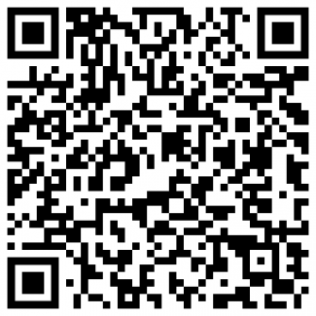
https://augustinianpedagogy.org/
gary.mccloskey@augustinian.org

