Slide 1
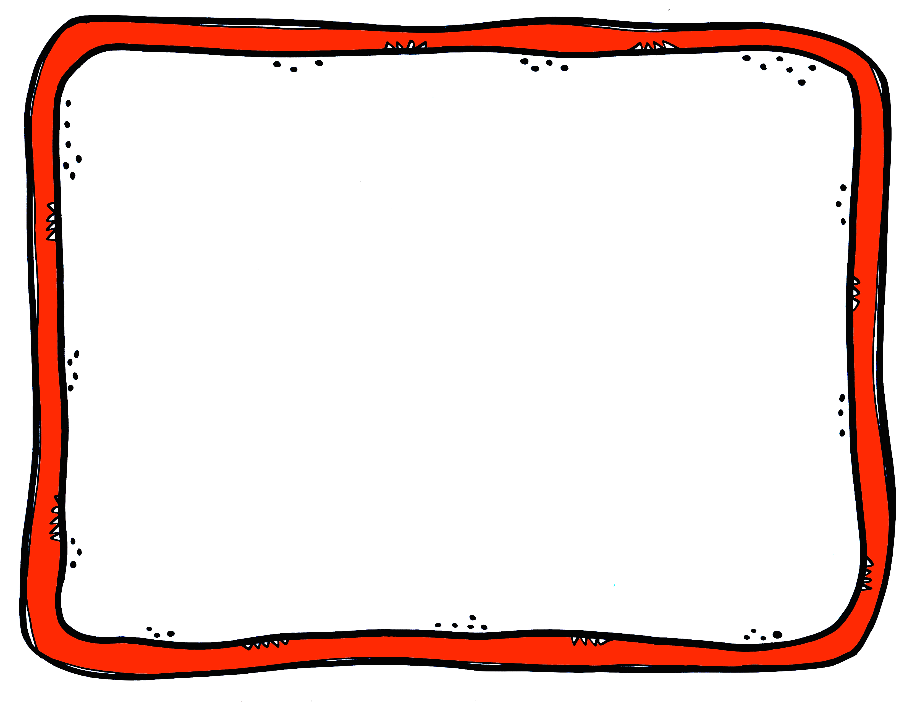
I am OK.

Slide 2
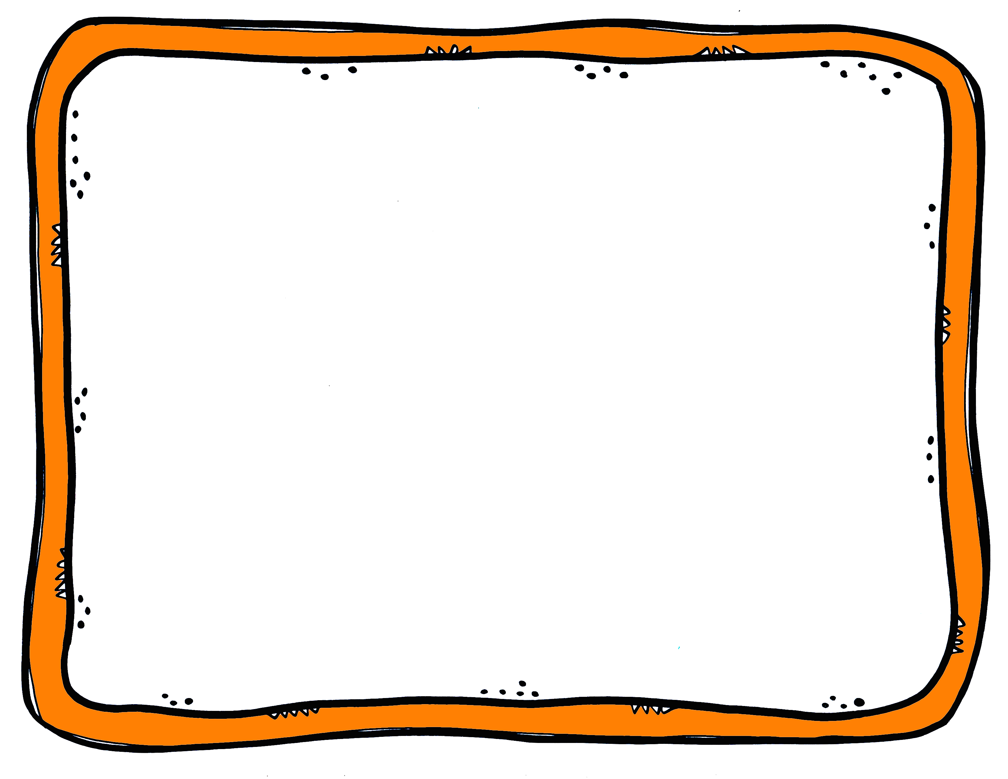
I am loved.

Slide 3
I am peaceful.

Slide 4
I am ready and steady.

Slide 5
I am OK.
I am loved.
I am peaceful.
I am ready and steady.

