Slide 1
1.3 Software process models :-
SDLC Models :-
Software Development life cycle (SDLC) is a spiritual model used in project management that defines the stages include in an information system development project, from an initial feasibility study to the maintenance of the completed application.
There are different software development life cycle models specify and design, which are followed during the software development phase. These models are also called "Software Development Process Models." Each process model follows a series of phase unique to its type to ensure success in the step of software development.
Here, are some important phases of SDLC life cycle:

Slide 2
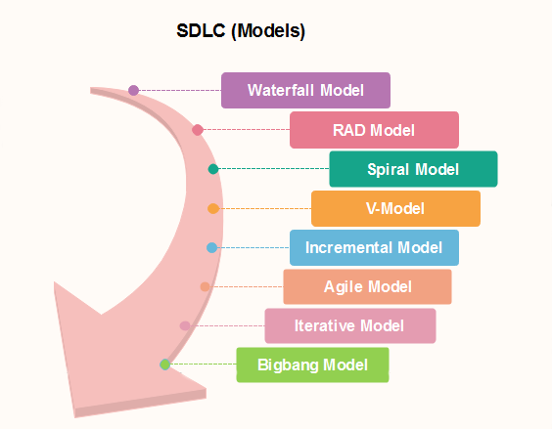

Slide 3
Linear sequential / waterfall model :-
The Waterfall Model was the first Process Model to be introduced. It is also referred to as a linear-sequential life cycle model. It is very simple to understand and use. In a waterfall model, each phase must be completed before the next phase can begin and there is no overlapping in the phases.
The Waterfall model is the earliest SDLC approach that was used for software development.
The waterfall Model illustrates the software development process in a linear sequential flow. This means that any phase in the development process begins only if the previous phase is complete. In this waterfall model, the phases do not overlap.

Slide 4
Waterfall Model – Design :-
Waterfall approach was first SDLC Model to be used widely in Software Engineering to ensure success of the project.
In "The Waterfall" approach, the whole process of software development is divided into separate phases. In this Waterfall model, typically, the outcome of one phase acts as the input for the next phase sequentially.
The following illustration is a representation of the different phases of the Waterfall Model.

Slide 6
Waterfall Model – Application :-
Every software developed is different and requires a suitable SDLC approach to be followed based on the internal and external factors. Some situations where the use of Waterfall model is most appropriate are −
Requirements are very well documented, clear and fixed.
Product definition is stable.
Technology is understood and is not dynamic.
There are no ambiguous requirements.
Ample resources with required expertise are available to support the product.
The project is short.

Slide 7
Waterfall Model – Advantages :-
The advantages of waterfall development are that it allows for departmentalization and control. A schedule can be set with deadlines for each stage of development and a product can proceed through the development process model phases one by one.
Development moves from concept, through design, implementation, testing, installation, troubleshooting, and ends up at operation and maintenance. Each phase of development proceeds in strict order.
Some of the major advantages of the Waterfall Model are as follows −
Simple and easy to understand and use
Easy to manage due to the rigidity of the model. Each phase has specific deliverables and a
review process.
Phases are processed and completed one at a time.
Works well for smaller projects where requirements are very well understood.
Clearly defined stages.
Well understood milestones.
Easy to arrange tasks.
Process and results are well documented.

Slide 8
Waterfall Model – Disadvantages :-
The disadvantage of waterfall development is that it does not allow much reflection or revision. Once an application is in the testing stage, it is very difficult to go back and change something that was not well-documented or thought upon in the concept stage.
The major disadvantages of the Waterfall Model are as follows −
No working software is produced until late during the life cycle.
High amounts of risk and uncertainty.
Not a good model for complex and object-oriented projects.
Poor model for long and ongoing projects.
Not suitable for the projects where requirements are at a moderate to high risk of changing. So, risk and uncertainty is high with this process model.
It is difficult to measure progress within stages.
Cannot accommodate changing requirements.
Adjusting scope during the life cycle can end a project.
Integration is done as a "big-bang. at the very end, which doesn't allow identifying any technological or business bottleneck or challenges early.

Slide 9
Prototype model :-
The prototype model requires that before carrying out the development of actual software, a working prototype of the system should be built.
An original model on which something is patterned
A prototype usually turns out to be a very crude version of the actual system, possible exhibiting limited functional capabilities, low reliability, and inefficient performance as compared to actual software.
In many instances, the client only has a general view of what is expected from the software product.
In such a scenario where there is an absence of detailed information regarding the input to the system, the processing needs, and the output requirement, the prototyping model may be employed.

Slide 11
Steps of Prototype Model :-
Requirement Gathering and Analyst
Quick Decision
Build a Prototype
Assessment or User Evaluation
Prototype Refinement
Engineer Product
Advantage of Prototype Model :-
Reduce the risk of incorrect user requirement
Good where requirement are changing/uncommitted
Regular visible process aids management
Support early product marketing
Reduce Maintenance cost.
Errors can be detected much earlier as the system is made side by side.

Slide 12
Disadvantage of Prototype Model :-
An unstable/badly implemented prototype often becomes the final product.
Require extensive customer collaboration
Costs customer money
Needs committed customer
Difficult to finish if customer withdraw
May be too customer specific, no broad market
Difficult to know how long the project will last.
Easy to fall back into the code and fix without proper requirement analysis, design, customer evaluation, and feedback.
Prototyping tools are expensive.
Special tools & techniques are required to build a prototype.
It is a time-consuming process.

Slide 13
Incremental Model
The incremental process model is also known as the Successive version model.
Incremental Model is a process of software development where requirements divided into multiple standalone modules of the software development cycle.
In this model, each module goes through the requirements, design, implementation and testing phases. Every subsequent release of the module adds function to the previous release. The process continues until the complete system achieved.
First, a simple working system implementing only a few basic features is built and then that is delivered to the customer. Then thereafter many successive iterations/ versions are implemented and delivered to the customer until the desired system is released.

Slide 15
The various phases of incremental model are as follows:
Requirement analysis: In the first phase of the incremental model, the product analysis expertise identifies the requirements. And the system functional requirements are understood by the requirement analysis team. To develop the software under the incremental model, this phase performs a crucial role.
2. Design & Development: In this phase of the Incremental model of SDLC, the design of the system functionality and the development method are finished with success. When software develops new practicality, the incremental model uses style and development phase.

Slide 16
3. Testing: In the incremental model, the testing phase checks the performance of each existing function as well as additional functionality. In the testing phase, the various methods are used to test the behavior of each task.
4. Implementation: Implementation phase enables the coding phase of the development system. It involves the final coding that design in the designing and development phase and tests the functionality in the testing phase. After completion of this phase, the number of the product working is enhanced and upgraded up to the final system product

Slide 17
When we use the Incremental Model?
When the requirements are superior.
A project has a lengthy development schedule.
When Software team are not very well skilled or trained.
When the customer demands a quick release of the product.
You can develop prioritized requirements first.
Advantage of Incremental Model
Errors are easy to be recognized.
Easier to test and debug
More flexible.
Simple to manage risk because it handled during its iteration.
The Client gets important functionality early.

Slide 18
Disadvantage of Incremental Model Need for good planning Total Cost is high. Well defined module interfaces are needed.

Slide 19
Spiral Model :-
The spiral model combines the idea of iterative development with the systematic, controlled aspects of the waterfall model.
This Spiral model is a combination of iterative development process model and sequential linear development model i.e. the waterfall model with a very high emphasis on risk analysis.
It allows incremental releases of the product or incremental refinement through each iteration around the spiral.
The spiral model has four phases. A software project repeatedly passes through these phases in iterations called Spirals.
Identification -
This phase starts with gathering the business requirements in the baseline spiral. In the subsequent spirals as the product matures, identification of system requirements, subsystem requirements and unit requirements are all done in this phase.
This phase also includes understanding the system requirements by continuous communication between the customer and the system analyst. At the end of the spiral, the product is deployed in the identified market.

Slide 20
Design :-
The Design phase starts with the conceptual design in the baseline spiral and involves architectural design, logical design of modules, physical product design and the final design in the subsequent spirals.
Construct or Build :-
The Construct phase refers to production of the actual software product at every spiral. In the baseline spiral, when the product is just thought of and the design is being developed a POC (Proof of Concept) is developed in this phase to get customer feedback.
Then in the subsequent spirals with higher clarity on requirements and design details a working model of the software called build is produced with a version number. These builds are sent to the customer for feedback.

Slide 21
Evaluation and Risk Analysis :-
Risk Analysis includes identifying, estimating and monitoring the technical feasibility and management risks, such as schedule slippage and cost overrun. After testing the build, at the end of first iteration, the customer evaluates the software and provides feedback.
The following illustration is a representation of the Spiral Model, listing the activities in each phase.

Slide 24
Spiral Model Application:-
The Spiral Model is widely used in the software industry as it is in sync with the natural development process of any product, i.e. learning with maturity which involves minimum risk for the customer as well as the development firms.
The following pointers explain the typical uses of a Spiral Model −
When there is a budget constraint and risk evaluation is important.
For medium to high-risk projects.
Long-term project commitment because of potential changes to economic priorities as the requirements change with time.
Customer is not sure of their requirements which is usually the case.
Requirements are complex and need evaluation to get clarity.
New product line which should be released in phases to get enough customer feedback.
Significant changes are expected in the product during the development cycle.

Slide 25
When to use Spiral Model?
When deliverance is required to be frequent.
When the project is large
When requirements are unclear and complex
When changes may require at any time
Large and high budget projects
Advantages
High amount of risk analysis
Useful for large and mission-critical projects.
Disadvantages
Can be a costly model to use.
Risk analysis needed highly particular expertise
Doesn't work well for smaller projects.

Slide 26
RAD Model :-
The RAD (Rapid Application Development) model is based on prototyping and iterative development with no specific planning involved.
The process of writing the software itself involves the planning required for developing the product.
Rapid Application Development focuses on gathering customer requirements through workshops or focus groups, early testing of the prototypes by the customer using iterative concept, reuse of the existing prototypes (components), continuous integration and rapid delivery.

Slide 27
What is RAD? :-
Rapid application development is a software development methodology that uses minimal planning in favor of rapid prototyping.
A prototype is a working model that is functionally equivalent to a component of the product.
In the RAD model, the functional modules are developed in parallel as prototypes and are integrated to make the complete product for faster product delivery.
There is no detailed preplanning, it makes it easier to incorporate the changes within the development process.
RAD projects follow iterative and incremental model and have small teams comprising of developers, domain experts, customer representatives and other IT resources working progressively on their component or prototype.
The most important aspect for this model to be successful is to make sure that the prototypes developed are reusable.

Slide 29
RAD Model Design :-
RAD model distributes the analysis, design, build and test phases into a series of short, iterative development cycles.
Following are the various phases of the RAD Model −

Slide 30
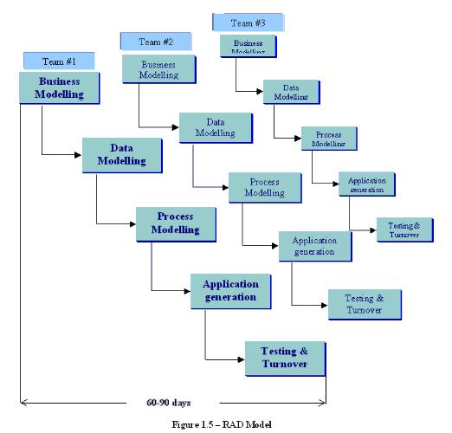

Slide 31
Business Modelling
The business model for the product under development is designed in terms of flow of information and the distribution of information between various business channels.
A complete business analysis is performed to find the vital information for business, how it can be obtained, how and when is the information processed and what are the factors driving successful flow of information.
Data Modelling
The information gathered in the Business Modelling phase is reviewed and analyzed to form sets of data objects vital for the business.
The attributes of all data sets is identified and defined. The relation between these data objects are established and defined in detail in relevance to the business model.

Slide 32
Process Modelling :-
The data object sets defined in the Data Modelling phase are converted to establish the business information flow needed to achieve specific business objectives as per the business model.
The process model for any changes or enhancements to the data object sets is defined in this phase. Process descriptions for adding, deleting, retrieving or modifying a data object are given.
Application Generation :-
The actual system is built and coding is done by using automation tools to convert process and data models into actual prototypes.

Slide 33
Testing and Turnover
The overall testing time is reduced in the RAD model as the prototypes are independently tested during every iteration.
However, the data flow and the interfaces between all the components need to be thoroughly tested with complete test coverage.
Since most of the programming components have already been tested, it reduces the risk of any major issues.

Slide 34
RAD Model - Application
RAD model can be applied successfully to the projects in which clear modularization is possible. If the project cannot be broken into modules, RAD may fail.
RAD should be used only when a system can be modularized to be delivered in an incremental manner.
It should be used if there is a high availability of designers for Modelling.
It should be used only if the budget permits use of automated code generating tools.
RAD SDLC model should be chosen only if domain experts are available with relevant business knowledge.
Should be used where the requirements change during the project and working prototypes are to be presented to customer in small iterations of 2-3 months.

Slide 35
RAD Model - Pros and Cons
RAD model enables rapid delivery as it reduces the overall development time due to the reusability of the components and parallel development. RAD works well only if high skilled engineers are available and the customer is also committed to achieve the targeted prototype in the given time frame. If there is commitment lacking on either side the model may fail.
The advantages of the RAD Model are as follows −
Changing requirements can be accommodated.
Progress can be measured.
Iteration time can be short with use of powerful RAD tools.
Productivity with fewer people in a short time.

Slide 36
Reduced development time.
Increases reusability of components.
Quick initial reviews occur.
Encourages customer feedback.
Integration from very beginning solves a lot of integration issues.

Slide 37
The disadvantages of the RAD Model are as follows −
Dependency on technically strong team members for identifying business requirements.
Only system that can be modularized can be built using RAD.
Requires highly skilled developers/designers.
High dependency on Modelling skills.
Inapplicable to cheaper projects as cost of Modelling and automated code generation is very high.
Management complexity is more.
Suitable for systems that are component based and scalable.
Requires user involvement throughout the life cycle.
Suitable for project requiring shorter development times.

