Slide 1
Agile Model
The meaning of Agile is versatile. "Agile process model" refers to a software development approach based on iterative development.
Agile methods break tasks into smaller iterations, or parts do not directly involve long term planning.
The project scope and requirements are laid down at the beginning of the development process.
Plans regarding the number of iterations, the duration and the scope of each iteration are clearly defined in advance.
Each iteration is considered as a short time "frame" in the Agile process model, which typically lasts from one to four weeks.
The division of the entire project into smaller parts helps to minimize the project risk and to reduce the overall project delivery time requirements.
Each iteration involves a team working through a full software development life cycle including planning, requirements analysis, design, coding, and testing before a working product is demonstrated to the client.

Slide 2
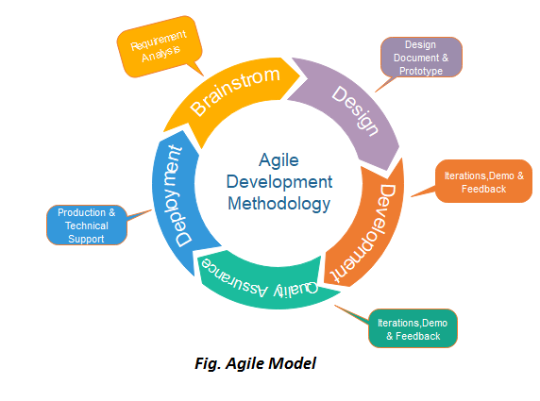

Slide 3
Phases of Agile Model:
Following are the phases in the Agile model are as follows:
Requirements gathering
Design the requirements
Construction/ iteration
Testing/ Quality assurance
Deployment
Feedback

Slide 4
Agile Testing Methods:
Scrum
Crystal
Dynamic Software Development Method(DSDM)
Feature Driven Development(FDD)
Lean Software Development
eXtreme Programming(XP)

Slide 5
Scrum
SCRUM is an agile development process focused primarily on ways to manage tasks in team-based development conditions.
There are three roles in it, and their responsibilities are:
Scrum Master: The scrum can set up the master team, arrange the
meeting and remove obstacles for the process
Product owner: The product owner makes the product backlog,
prioritizes the delay and is responsible for the
distribution of functionality on each repetition.
Scrum Team: The team manages its work and organizes the work to
complete the sprint or cycle.

Slide 6
Crystal:
There are three concepts of this method-
Chartering: Multi activities are involved in this phase such as
making a development team, performing feasibility
analysis, developing plans, etc.
2. Cyclic delivery: Under this, two more cycles consist, these are:
            Team updates the release plan.
            Integrated product delivers to the users.
3. Wrap up: According to the user environment, this phase performs
deployment, post-deployment.

Slide 7
Dynamic Software Development Method(DSDM):
DSDM is a rapid application development strategy for software development and gives an agile project distribution structure.
The essential features of DSDM are that users must be actively connected, and teams have been given the right to make decisions.
The techniques used in DSDM are:
Time Boxing
MoSCoW Rules
Prototyping

Slide 8
The DSDM project contains seven stages:
Pre-project
Feasibility Study
Business Study
Functional Model Iteration
Design and build Iteration
Implementation
Post-project

Slide 9
Feature Driven Development(FDD):
This method focuses on "Designing and Building" features.
In contrast to other smart methods, FDD describes the small steps of the work that should be obtained separately per function.

Slide 10
Lean Software Development:
Lean software development methodology follows the principle "just in time production." The lean method indicates the increasing speed of software development and reducing costs.
Lean development can be summarized in seven phases.
Eliminating Waste
Amplifying learning
Defer commitment (deciding as late as possible)
Early delivery
Empowering the team
Building Integrity
Optimize the whole

Slide 11
When to use the Agile Model?
When frequent changes are required.
When a highly qualified and experienced team is available.
When a customer is ready to have a meeting with a software team all the time.
When project size is small.

Slide 12
Advantage(Pros) of Agile Method:
Frequent Delivery
Face-to-Face Communication with clients.
Efficient design and fulfils the business requirement.
Anytime changes are acceptable.
It reduces total development time.

Slide 13
Disadvantages(Cons) of Agile Model:
Due to the shortage of formal documents, it creates confusion and crucial decisions taken throughout various phases can be misinterpreted at any time by different team members.
Due to the lack of proper documentation, once the project completes and the developers allotted to another project, maintenance of the finished project can become a difficulty.

