Slide 1
Major-4:
Software Engineering
Credit - 4
Prof. Shruti S. Revdiwala

Slide 2
Unit 1 Introduction to Software Engineering 8 hr
1.1 | Software, Software characteristics, Software Engineering
1.2 | Software engineering approach 1.2.1 Introduction to phased development approach 1.2.2 Introduction to effort distribution
1.3 | Software process models - Linear sequential / waterfall Model, Prototype model, RAD model, Incremental model, Spiral mode
1.4 | Agile Development Models
1.5 | Software quality Assurance

Slide 3
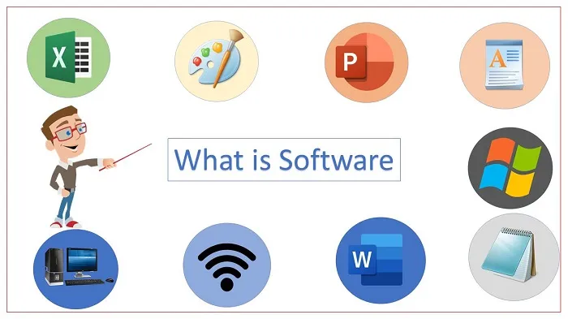
1.1 Software, Software characteristics, Software Engineering
1) Define Software
Software is a set of instructions (computer programs) that when executed provide desired function and performance, data structures that enable the programs to adequately manipulate information, and documents that describe the operation and use of the programs.
Or
IEEE i.e Institute of Electrical and Electronics Engineers defines software as the collection of
computer programs, procedures, rules, and associated documentation and data, i.e. software is not just programs, but also includes all the associated documentation.

Slide 4
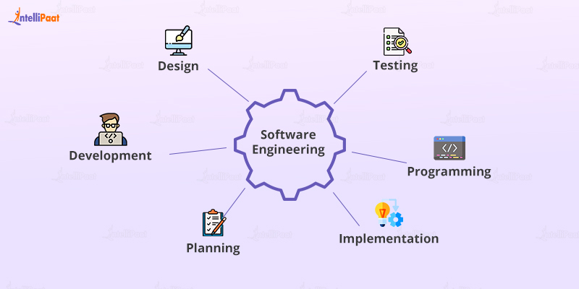
1.1 Software, Software characteristics, Software Engineering
Software engineering is an engineering branch associated with development of software product using well-defined scientific principles, methods and procedures. The outcome of software engineering is an efficient and reliable software product.
It is one kind of Application/Engineering to develop software.

Slide 5
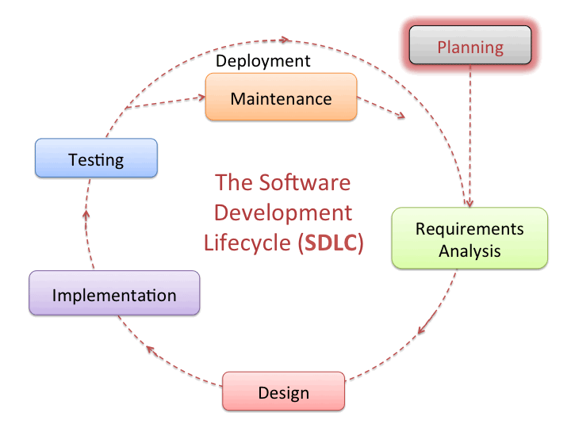

Slide 6

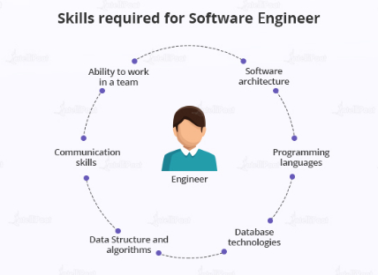

Slide 7
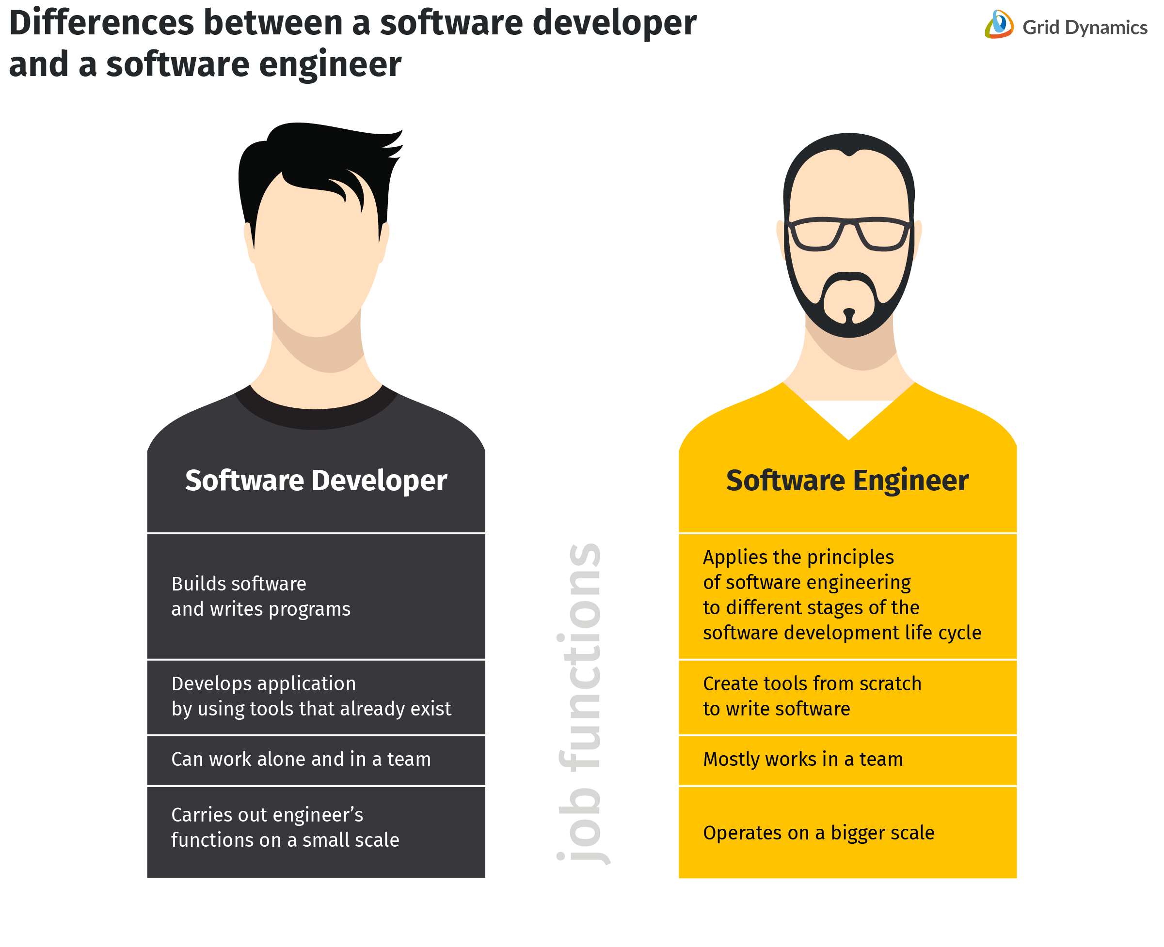

Slide 8
2) Software Characteristics :-
1. Software is developed or engineered; it is not manufactured in the classical sense: Software is not manufactured but is developed. So, it does not require any raw material for its development.
2. Software doesn't "wear out.": Different things like clothes, shoes, ornaments do wear out after some time. But, software once created never wears out. It can be used for as long as needed and in case of need for any updating, required changes can be made in the same software and then it can be used further with updated features.

Slide 9
Above Fig 1 show failure rates for hardware is also known as bathtub curve that indicates there are high failure rates in hardware life which are corrected failure rates goes down as hardware component suffer from effect of dust, vibration and many other environmental problem so the hardware begins to wear out.
In case of software it is not affected by the environmental problems therefore software does not wear out and above Fig 2 shows the idealized curve for software.

Slide 10
3. Although the industry is moving toward component-based assembly, most software continues to be custom built: Requirements of many users are different so it is not possible for developers to accommodate all functionalities in the single software. Therefore, there is need for the customization in the software and hence, software industry is expanding day by day.
4. Usability of Software: The usability of the software is the simplicity of the software in terms of the user. The easier the software is to use for the user, the more is the usability of the software as more number of people will now be able to use it and also due to the ease will use it more willingly.
5. Reusability of components: As the software never wears out, neither do its components, i.e. code segments. So, if any particular segment of code is required in some other software, we can reuse the existing code form the software in which it is already present. This reduced our work and also saves time and money.

Slide 11
6. Flexibility of software: A software is flexible. What this means is that we can make necessary changes in our software in the future according to the need of that time and then can use the same software then also.
7. Maintainability of software: Every software is maintainable. This means that if any errors or bugs appear in the software, then they can be fixed.
8. Portability of software: Portability of the software means that we can transfer our software from one platform to another that too with ease. Due to this, the sharing of the software among the developers and other members can be done flexibly.
9. Reliability of Software: This is the ability of the software to provide the desired functionalities under every condition. This means that our software should work properly in each condition.

Slide 12
1.2 Software engineering approach
Basic Principles of Good Software Engineering approach :-
Software Engineering is the systems engineering approach for software product/application development. It is an engineering branch associated with analyzing user requirements, design, development, testing, and maintenance of software products.
Some basic principles of good software engineering are –
One of the basic software Engineering principles is Better Requirement analysis which gives a clear vision of the project. At last, a good understanding of user requirements provides value to its users by delivering a good software product that meets users’ requirements.
All designs and implementations should be as simple as possible principle should be followed. It makes code so simple as a result debugging and further maintenance become simple.
Maintaining the vision of the project is the most important thing throughout complete development process for the success of a software project. A clear vision of the project leads to the development of the project in the right way.

Slide 13
Software projects include a number of functionalities, all functionalities should be developed in a modular approach so that development will be faster and easier. This modularity makes functions or system components independent.
Another specialization of the principle of separation of concerns is Abstraction for suppressing complex things and delivering simplicity to the customer/user means it gives what the actual user needs and hides unnecessary things.
Think then Act is a must-required principle for software engineering means before starting developing functionality first it requires to think about application architecture, as good planning on the flow of project development produces better results.
Sometimes developer adds up all functionalities together but later find no use of that. So following the Never add extra principle is important as it implements what actually needed and later implements what are required which saves effort and time.
When other developers work with another’s code they should not be surprised and should not waste their time in getting code. So providing better Documentation at required steps is a good way of developing software projects.

Slide 14
There are several basic principles of good software engineering approach that are commonly followed by software developers and engineers to produce high-quality software. Some of these principles include:
Modularity: Breaking down the software into smaller, independent, and reusable components or modules. This makes the software easier to understand, test, and maintain.
Abstraction: Hiding the implementation details of a module or component and exposing only the necessary information. This makes the software more flexible and easier to change.
Encapsulation: Wrapping the data and functions of a module or component into a single unit, and providing controlled access to that unit. This helps to protect the data and functions from unauthorized access and modification.
DRY principle (Don’t Repeat Yourself): Avoiding duplication of code and data in the software. This makes the software more maintainable and less error-prone.
KISS principle (Keep It Simple, Stupid): Keeping the software design and implementation as simple as possible. This makes the software more understandable, testable, and maintainable.
YAGNI (You Ain’t Gonna Need It): Avoiding adding unnecessary features or functionality to the software. This helps to keep the software focused on the essential requirements and makes it more maintainable.
SOLID principles: A set of principles that guide the design of software to make it more maintainable, reusable, and extensible. This includes the Single Responsibility Principle, Open/Closed Principle, Liskov Substitution Principle, Interface Segregation Principle, and Dependency Inversion Principle.
Test-driven development: Writing automated tests before writing the code, and ensuring that the code passes all tests before it is considered complete. This helps to ensure that the software meets the requirements and specifications.
By following these principles, software engineers can develop software that is more reliable, maintainable, and extensible.
It’s also important to note that these principles are not mutually exclusive, and often work together to improve the overall quality of the software.

Slide 15
A Phased Approach to Software Development :-
In general, any problem solving in software must consist of these activities during the development process;
Requirement Specifications: defines the objectives of new or modified system and lists a detailed statement of the functions that new system must perform.
Analysis: during analysis, the focus is on building models that unambiguously determine the problem for which a software solution is being constructed. At this stage the limitations of the target environment is not given a priority.
Design: the analysis model is adapted such that it serves as the basis for implementation in the target environment. Hence, the design deals with transforming or refining the analysis model into a design model that determines how to eventually obtain a working system.
Implementation: at this stage, the coding of the system is performed
Testing: testing deals with the validation of software at various levels. Testing can be categorized as follows:

Slide 16
Unit: deals with testing the smallest units of the designed software.
Integration: integration testing deals with testing the application that has been (partially) put together by integrating the smallest software units. Basically it involves testing individual software modules as a group.
Validation: this involve in testing whether the software functions in a manner expected by the user.
System: this is carried out at the after the integration and validation testing, system testing deals with different test whose primary purpose is to fully exercise the computer-based system. Although each test has a different purpose, all work should verify that all system elements have been properly integrated and perform allocated functions.
Recovery: recovery testing involves system tests that force the software to fail in a variety of ways and verifies that recovery is properly performed.
Security: this testing verifies that protection mechanisms built into a system will, in fact, protect it from improper usage and unauthorized access. It ensures adherence to restrictions on command usage, access to data, and access requirement according to associated privileges.
Stress: the stress testing involves executing a system in a manner that demands resources in abnormal quantity, frequency, or volume. In other words, stress testing helps find out the level of robustness and consistent or satisfactory performance even when the limits for normal operation for the system software is crossed.

Slide 17
1.2.2 Introduction to effort distribution :-
Effort distribution in software engineering is a well-known term used to measure cost and effort estimation for each and every phase or activity in software development.
Effort distribution in software engineering is a well-known term used to measure cost and effort estimation for each and every phase or activity in software development.

Slide 18
40-20-40 Distribution of Effort
A recommended distribution of effort across the software process is 40% (analysis and design), 20% (coding), and 40% (testing)‏
Work expended on project planning rarely accounts for more than 2 - 3% of the total effort
Requirements analysis may comprise 10 - 25%
  Effort spent on prototyping and project complexity may increase this
Software design normally needs 20 – 25%
Coding should need only 15 - 20% based on the effort applied to software design
Testing and subsequent debugging can account for 30 - 40%
  Safety or security-related software requires more time for testing

Slide 19
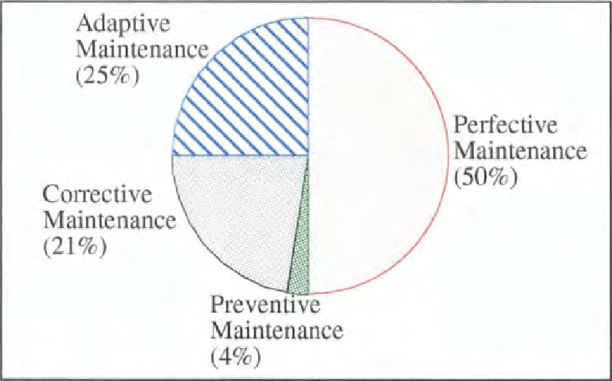

Slide 20
