Slide 1
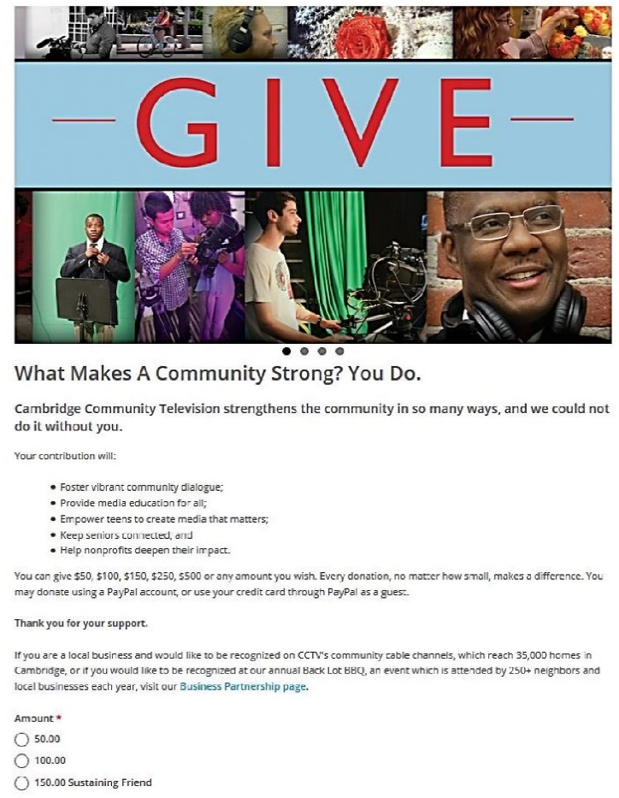
Going Beyond Cable Funding
Options, Opportunities, Success Stories

Slide 2
Going Beyond Cable Funding
Options, Opportunities, Success Stories
Community Media Center approach is essential
Not just TV -- A community media services organization
Technology experts assisting local organizations and governments, libraries and schools
Strong partnerships and collaborations
Local government, community organizations, local businesses
Clear and positively identified brand
Regularly seeking input from the community
Staying current with technology

Slide 3
Going Beyond Cable Funding
Options, Opportunities, Success Stories
Revenue development opportunities
Production services and equipment/facility rentals
Government departments and public agencies
Special Districts, School Districts
Local government search for transparency
Meeting coverage, video “explainers”
Community organizations
Videos and websites for NPO’s
Other media services
Serving as the “communication department” for small towns/cities/nonprofits
Facility rental income (e.g., Longview, WA and Maui, HI)

Slide 4
Going Beyond Cable Funding
Options, Opportunities, Success Stories
Revenue development opportunities (continued)
Classes, training
Video and audio training
Smartphone making media, Podcasting, film screenings
Beyond traditional training
Branding, social media
Media Literacy
Representation in media
Confronting bias
Recognizing propaganda
Schools and universities
Classes to supplement their curriculum
Hands-on opportunities for students

Slide 5
Going Beyond Cable Funding
Options, Opportunities, Success Stories
Revenue development opportunities (continued)
Sponsorships and program underwriting
Sports, events, etc.
Identify what you do well
Develop policies
Who solicits sponsorships/underwriting/sales?
Are you generating revenue over and above your cost to market / sell?
What about follow-up with sponsors?

Slide 6
Going Beyond Cable Funding
Options, Opportunities, Success Stories
Revenue development opportunities (continued)
Collaborations, partnerships, and service projects
Social entrepreneurship
Lots of opportunities
Creativity in structuring relationships
Grants
One time income sources
Don’t rely on grants to sustain your organization long-term
Good opportunity for starting a new program
Plan for ongoing support

Slide 7
Going Beyond Cable Funding
Options, Opportunities, Success Stories
Revenue development opportunities (continued)
Fundraising
Special events or activities
Individual “asks”
Donations and contributions
Facility rental income (e.g., Longview, WA and Maui, HI)
Facility and resource sharing (to reduce expenses)
Memberships
Typically a very small percentage of overall income

