Slide 1
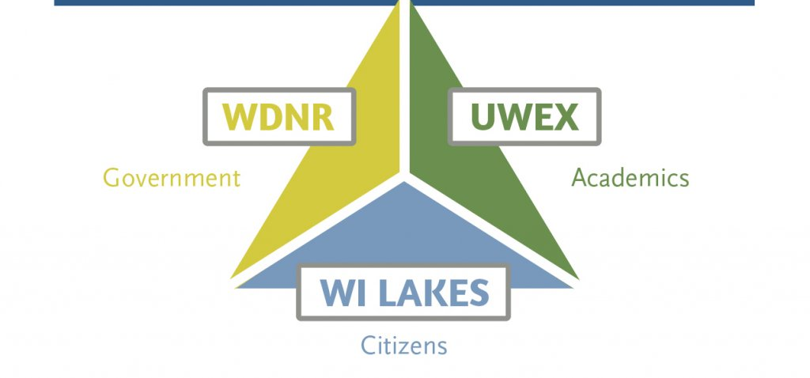
Wisconsin statewide organizations
working together in managing and protecting Wisconsin Lakes & Rivers
Notes:
I want to share with you the three organizations that work together to manage and protect all of Wisconsin Lakes & Rivers.
These three organizations partner with each other so they don’t duplicate efforts.
The Wisconsin Department of Natural Resources – they are the regulatory government organization
Wisconsin Lakes – they are the member organization for lakes and rivers that works on legislative issues
AND
The University of Wisconsin Extension Lakes – the educational resource for Lake Organizations and Districts
NEXT SLIDE

Slide 2



WDNR:
Wisconsin Department of Natural Resources
Manages fish, wildlife, forests, parks, air and water resources
Government regulatory organization
WI LAKES: Wisconsin Lakes
(formerly Wisconsin Association of Lakes)
Works to develop statewide solutions for
the challenges faced by our lakes while supporting strong
local protection efforts - legislative
Member-based organization
UWEX: University of Wisconsin Extension Lakes
Provides statewide education and outreach for Lake Organizations/Districts
Funded primarily through the DNR
Notes:
The DNR - regulates the river and the dam.
Wisconsin Lakes is member organization that works at the legislative level.
Extension Lakes is the organization that provides statewide education for Lake Organizations and Lake Districts.
There are other organizations that we hear about such as the
Clean Lakes Alliance in Madison. They concentrate on the Yahara Watershed which they consider ends at the south-end of Lake Kegonsa.
We also hear about the Rock River Alliance. As their name implies, they cover the area south of us.

Slide 3
Extension Lakes:
Resource to Lake Organizations & Districts – over 500 lake associations and over 250 lake districts
Citizen Lake Monitoring Network
Clean Boats Clean Water: Train inspectors to provide education and conduct boat and trailer checks
Wisconsin Lakes Leadership Institute – 20+ people trained ea yr
Quarterly Newsletter
Printed How-To Manual:
“People of the Lakes: A Guide for Wisconsin Lake Organizations”
Notes:
Extension Lakes is based out of the University of Wisconsin in Stephens Point.
We have found them to be extremely helpful and have contacted them numerous times with questions of all sorts.
They are the experts when it comes to Chapter 33 of the Wisconsin State Statute that defines Lake Districts.
They help Lake Districts and Organizations get started and lend assistance along the way.
Each year they have an annual conference for Lake Districts and Organizations.
NEXT SLIDE

Slide 4
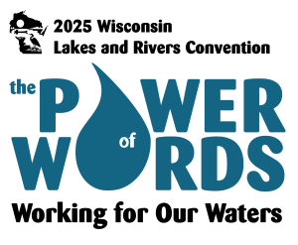
THE WISCONSIN LAKES & RIVERS CONVENTION:
March 26-28, 2025
Holiday Inn Convention Center
Stevens Point
Full Registration: $225
Early Bird: $180
Wed: Pre-convention Workshops
Th & Fri: In-person/Virtual
Fri afternoon: In-person interactive workshops
“Do You Own or Manage a Dam? Let’s Talk!”
wisconsinwaterweek.org
Notes:
This year’s conference is in March in Stevens Point.
Ted and I will be attending this year. Each of you are invited to attend as well.
I’ll be involved in one of the sessions on Friday afternoon where we’re inviting attendees and the public to come and
share what they’ve learned about owning and managing a dam.
The full agenda and details can be found at the conference website: wisconsinwaterweek.org
I also easily found the conference when I googled “Lakes conference in Wisconsin.”
If you run into other resources that might be helpful to the DDLD, be sure to let me know. Thanks

