Slide 1
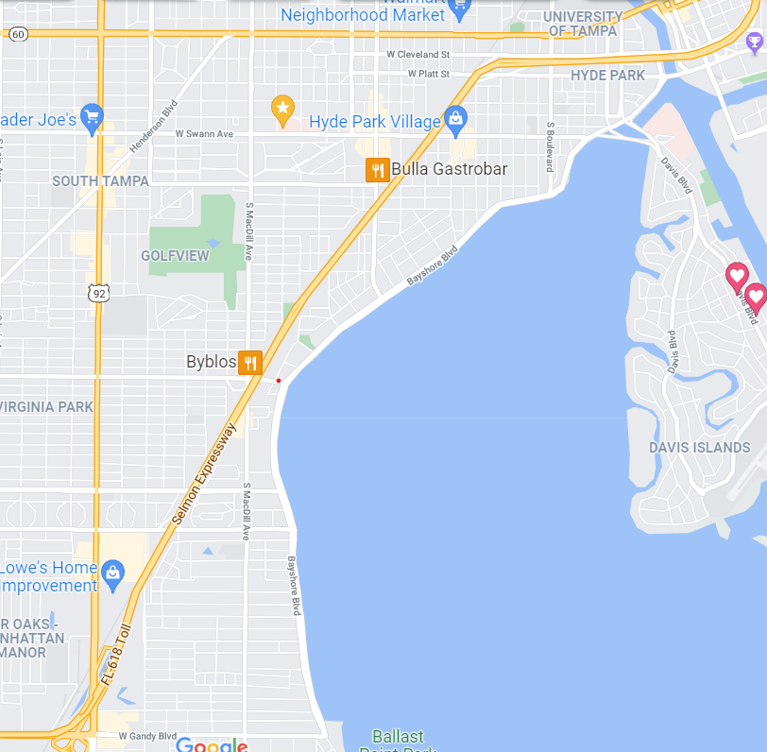
End at Edison
Start at Bay to Bay
Staging Area

