Slide 1

DMIST Verbal Report for Transition of Care

Slide 2
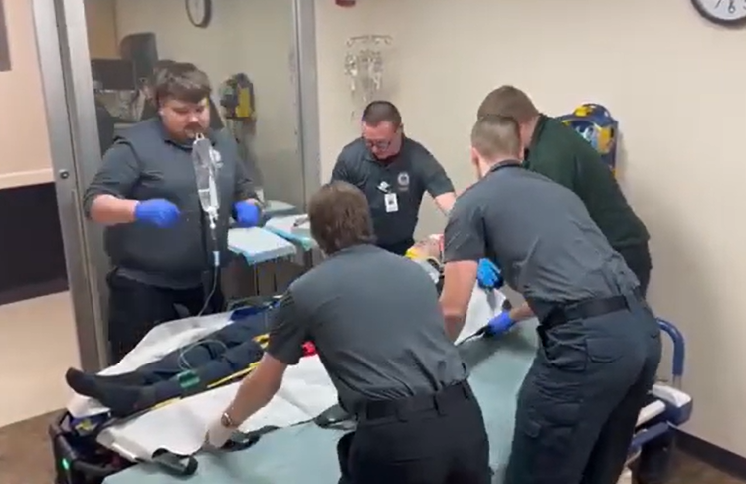

The power of communication
Notes:
Did you know that patient hand off is an extremely important time in patient care transition and one of the times most at risk for errors that can lead to patient care mistakes and poor outcomes? One recent study noted that poor communication was the sole cause of patient-safety incidents in over one in ten cases and contributed to causing incidents in one in four cases.
(https://doi.org/10.7326/ANNALS-24-02904)

Slide 3



DMIST Can be used for all patient care hand-offs:
First responders to ambulance crews
BLS ambulance crews to ALS intercepts
Ambulance crews to helicopter flight crews
When delivering a patient to the hospital and giving bedside report to the ED staff or a trauma team
Notes:
Recently the Wisconsin State Trauma Advisory Council and the EMS Advisory Board approved a joint position statement on verbal reports for transition of patient care. The position statement recommends that a standardized format of hand-off report be adopted across the state to make it easier for services that transport to multiple hospitals or hand-off to different ALS intercept or helicopters.
DMIST can be used for face-to-face communication or reports via radio or phone. The situations where is should be used include:
First responders to ambulance crew hand-offs
BLS ambulance crew to ALS intercept reports
Ambulance crew to helicopter flight crew transitions
And when delivering a patient to the hospital and giving bedside report to the ED staff or a trauma team

Slide 4
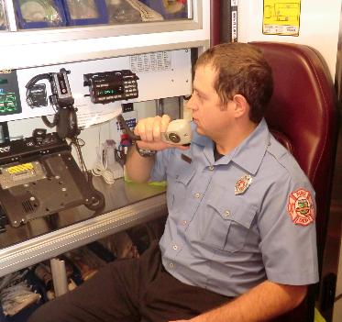
D – Demographics M - Mechanism of injury or illness I - Injuries or illness S - Signs and symptoms T - Treatments
Notes:
The position statement recommends that a standardized format of hand-off report be adopted across the state to make it easier for services that transport to multiple hospitals or hand-off to different ALS intercept or helicopters. DMIST (DEE-mist) is a recommended acronym that outlines five important parts of an effective and efficient hand-off report. The next few slides will break down each of the five components.

Slide 5

D – Demographics M - Mechanism of injury or illness I - Injuries or illness S - Signs and symptoms T - Treatments
Name
Age
Date of birth
Medical history
Medications
Blood thinners
Allergies
Notes:
Demographics should include pertinent information about the patient including their name, or what they want to be called, their age or date of birth, and any pertinent medical history such as use of blood thinners. Significant allergies to medications could also be included here.

Slide 6
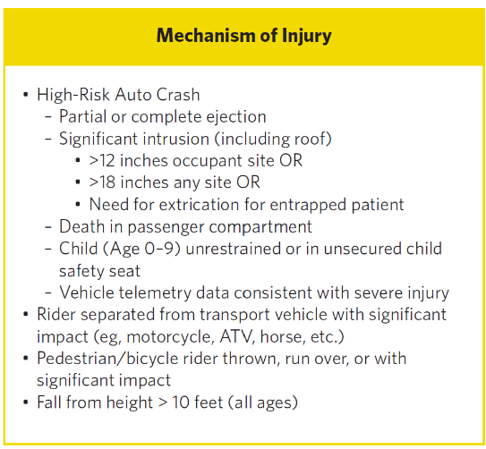
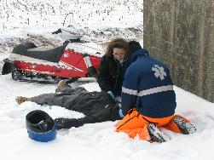
D – Demographics M - Mechanism of injury or illness I - Injuries or illness S - Signs and symptoms T - Treatments
Notes:
Mechanism of injury or illness should be brief information about how the patient was injured or for medical patients, the history of present illness. You don’t need to paint the entire picture here, just enough to give an idea if it was a significant injury or not. Inclusion of any MOI points from the National Guidelines for the Field Triage of Injured patients would be appropriate.

Slide 7
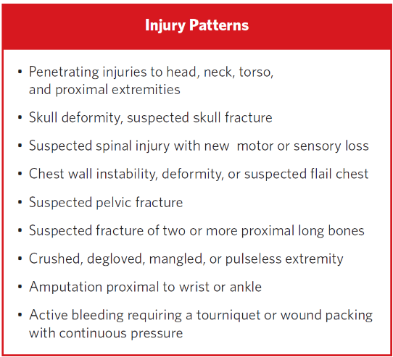
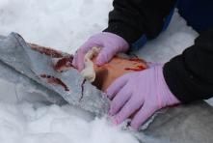
D – Demographics M - Mechanism of injury or illness I - Injuries or illness S - Signs and symptoms T - Treatments
Notes:
The Injury or illness section includes any injuries you have identified in your primary or secondary assessments. It would be especially important to highlight any of these critical injuries Significant pertinent negatives, such as no loss of consciousness, may also be listed here. The list of significant injury patterns from the National Guidelines for the Field Triage of Injured Patients is a great place to start but other significant injuries identified should also be reported. For medical cases this might be the illness that you are treating them for. Be sure to announce if they meet STEMI or stroke alert criteria.

Slide 8
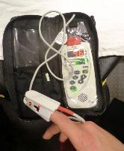
D – Demographics M - Mechanism of injury or illness I - Injuries or illness S - Signs and symptoms T - Treatments
Glasgow coma score
Blood pressure – report the lowest one you recorded if the patient is at all hypotensive
Heart rate
Respiratory rate
Pulse oximetry
Pain scale
End tidal CO2 data if pertinent
Blood glucose if there is an altered level of consciousness
Notes:
Report any symptoms the patient is complaining of as well as their most recent set of vital signs. Be sure to highlight any abnormal findings even if they have improved.

Slide 9
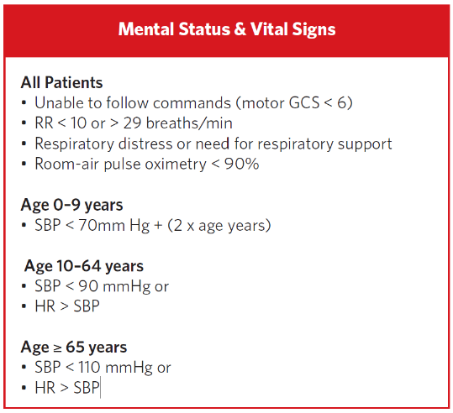
D – Demographics M - Mechanism of injury or illness I - Injuries or illness S - Signs and symptoms T - Treatments
Notes:
Report any symptoms the patient is complaining of as well as their most recent set of vital signs. Be sure to highlight any abnormal findings even if they have improved. For trauma patients, keep the mental status and vital sign criteria from the trauma triage guidelines in mind.

Slide 10
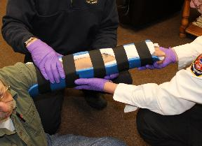
D – Demographics M - Mechanism of injury or illness I - Injuries or illness S - Signs and symptoms T - Treatments
Airway and breathing interventions
Circulation and hemorrhage control
IVs and IV fluids
Medications given
Splinting and spinal immobilization
Pelvic stabilization
Notes:
The treatment section is your time to report the key interventions you did during your time with the patient. If the treatment led to a significant change in the patient’s condition, make note of it here.
Examples of interventions to report include:
Airway and breathing interventions
Bleeding control, especially tourniquets
IVs started
Medications given
Spinal motion restriction
And pelvic stabilization

Slide 11
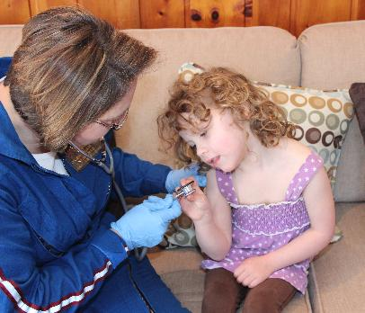
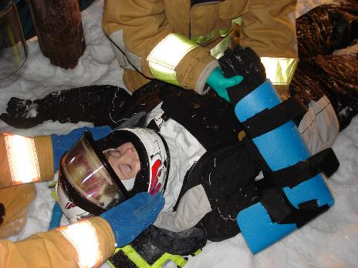
Practice makes perfect
Use the DMIST format for all your patient care hand-offs, not just the serious calls.
Notes:
Use the DMIST format to guide all of your patient care hand-offs, not just the critical calls. Using it everyday will make it second nature and easier to remember when you need it most.

Slide 12

Putting it all together
DMIST video created by the Wisconsin RTAC Coordinators
https://www.youtube.com/watch?v=_dUTTJA1OIA
Notes:
{ Consider showing this video to reinforce the learning points of this Power Point presentation. }

