Slide 1
A PATH TO EMPLOYEE WELLNESS
A journey to learn how you can control and maintain your health with easy to understand methods.
Notes:
Welcome – sign in- We will be talking about something radical yet so simple and easy. Explain the 3 parts of the series.

Slide 2
This program is for educational purposes only.
Nothing on this site is medical advice. Talk to your doctor before making any lifestyle or diet changes. My opinions are not intended as medical advice and should not be taken as medical advice. They are based on my personal experience and preferences.
Be aware that diet changes may affect your health. Please ensure you are under appropriate medical care and have regular check ups with your physician/dietician to monitor any biological markers such as weight, blood pressure, etc. . Ensure these results are explained to you and understood with regular visits with your doctor.
The program is to inspire those following a low carb lifestyle and share my personal journey and experiences. It is not meant as a substitute for medical advice or medical treatment or to persuade individuals to follow this lifestyle.
I disclaim any and all liability of any kind with respect to any act or omission wholly or in part in reliance on anything contained in this program

Slide 3
WHAT TO LOOK FOR Color guides:
(RED) IMPORTANT PAY ATTENTION
(BLACK) GENERAL INFORMATION
(bluelink) helpful-link
Notes:
You will be sending the information to the email provided in the sign in sheet.

Slide 4
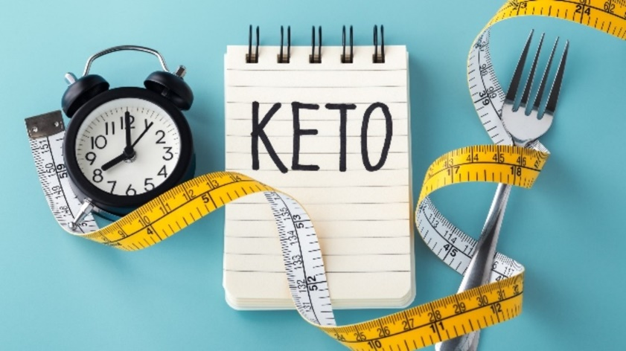
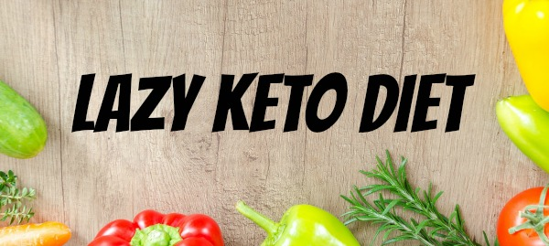
The ketogenic diet originated in the 1920s as a medical approach to treating epilepsy. Traditional keto diets require you to closely track your macronutrient intake and follow a strict, very-low-carb, high-fat eating pattern that includes only moderate amounts of protein.
Recently, variations of this diet, including lazy keto, have become mainstream strategies for weight loss.
The intention is to induce ketosis, a metabolic state in which your body burns fat as its primary source of fuel.
The goal of lazy keto is to induce a metabolic state called ketosis, in which your body mainly burns fat for fuel. Researchers attribute many of the potential health benefits of ketogenic diets to this metabolic state.
Notes:
Tell your story – Nutritionist house call by accident (only 15#) Hailee Barry diabetic article in Woman’s day. Magic Pill Netflix. Dr. Villanueva. Explain the 2 factions. (how bad people say it is although we’ve been doing it 1000s yrs.)
Follow the Dr.’s who promote the lifestyle - watch the Dr. Ken Berry YouTube video at the end of this presentation. SET A GOAL.

Slide 5
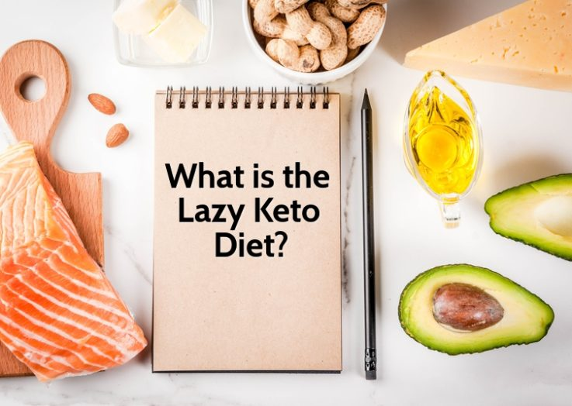
Lazy keto is a simple variation of the ketogenic diet.
No tracking.
It restricts carbs, but there are no rules regarding your intake of calories, fat, or protein.
Though research on lazy keto is limited, it may offer the same potential benefits as the traditional keto diet, including weight loss, decreased hunger, improved blood sugar control, and possibly a reduced risk of heart disease.
Minimal exercise required.
Very important to stay fit - but you will not lose weight.
Notes:
Talk a little about the importance of exercise especially weight resistance – daily walking – 15 minutes of increased BPM ONLY!

Slide 6
DOWNSIDES
(You may or may not get this)
Keto Flu – nausea, headaches, fatigue (Temporary 1-2 weeks).
Withdrawals – (Sugar/Gluten).
Dehydration – this is your gut working out (More Water & Salt).
Constipation – comes from dehydration (Magnesium Citrate & Fermented Probiotics).
Stalls – shock your system (Marginally).
Eating too much protein on lazy keto could prevent ketosis altogether. (You need to consume fats).
Notes:
Like drug addicts Sugar withdrawals. ANY QUESTIONS ON KETO ? Discuss metabolism.

Slide 7
What Is Gluten?
Gluten is a protein found in many grains, including wheat, barley and rye. It's common in foods such as bread, pasta, pizza and cereal. Gluten provides no essential nutrients.
Some people have an immune reaction that is triggered by eating gluten. They develop inflammation and damage in their intestinal tracts and other parts of the body when they eat foods containing gluten.
When we swallow a food antigen (like gluten) the body goes to work fighting it. White cells recognize the antigens and destroy them. When the white cells* are overwhelmed, inflammation results.
https://www.precisionnutrition.com/all-about-gluten
https://www.health.harvard.edu/staying-healthy/ditch-the-gluten-improve-your-health
Dictionary
an·ti·gen
/ˈan(t)əjən/
Learn to pronounce
noun
pluralnoun: antigens
a toxin or other foreign substance which induces an immune response in the body, especially the production of antibodies.
*White blood cells are the cells of the immune system that are involved in protecting the body against both infectious disease and foreign invaders.
Notes:
Discuss Antigens. Emphasize the importance of white blood cells. Explain why more and more people are getting sick + obese.

Slide 8
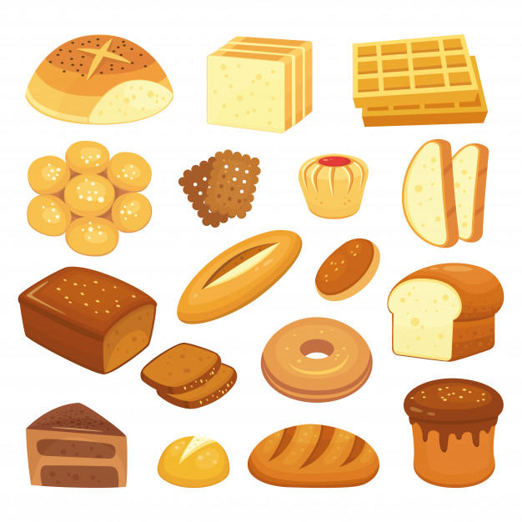
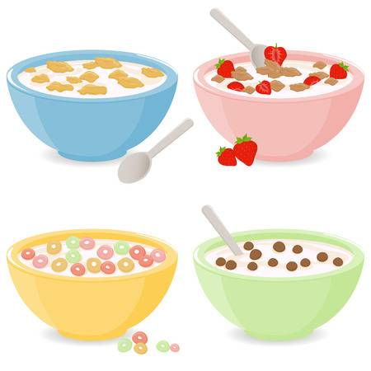
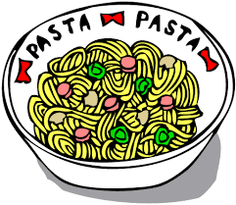
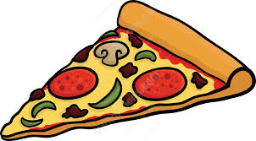
For example, people with celiac disease, for them, a gluten-free diet is nothing short of essential.
And then there are people described as "gluten-sensitive." Their tests for celiac disease are negative (normal) and yet they get symptoms (including bloating, diarrhea or crampy abdominal pain) whenever they eat foods that contain gluten.
Avoiding gluten makes sense for people with celiac disease, wheat allergy or those who feel unwell when they consume gluten.
Notes:
ANY QUESTIONS ON GLUTEN? Discuss the importance of gluten/wheat sensitivity in the keto diet. Give examples. More home-made foods. Bun-less burgers. Zero Soft Drinks. MOST IMPORTANT. Find what works for you!

Slide 9
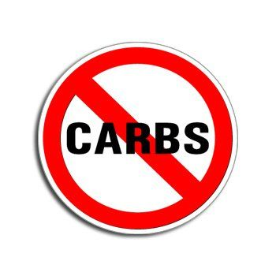
EATING
Think of it as a new lifestyle.
We eat to fuel our body.
CARBOHYDRATES(Carbs) and FATS
Restrict carbohydrates and increase fats and proteins.
Notes:
A carb restriction Lifestyle. Need to have a “Food is Fuel Mindset.” Taste/Smell triggers will eventually go away. Fat has had a bad rap. Need to change our perception about fats as fuel. YOU DON’T GET FAT WITH FAT! Saiety Appitite Suppressant.

Slide 10
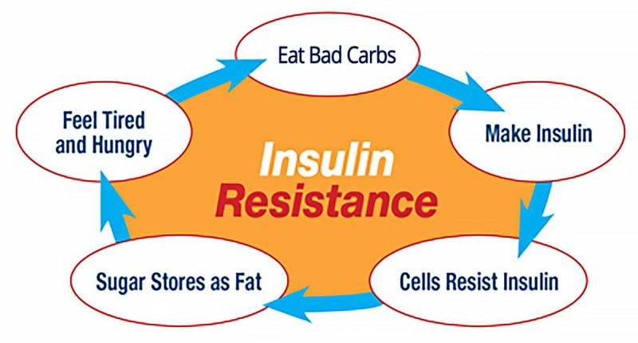
CARBS – Turn into sugar (glucose). Sugar is fuel burned by the body for energy.
Flours, grains, cereals (gluten) are carbs – they turn into sugar then
they create inflammation causing cardio vascular (heart) disease and diabetes.
Sugars (glucose) triggers insulin to lower blood sugar level, too much sugar creates insulin spikes in the blood. The body then counteracts the spikes by restricting the insulin called “Insulin Resistance”.
Insulin resistance is a sure cause of diabetes.
With insulin resistance the body only burns sugars - fat is then stored and will never get burned if sugar is always the primary source of fuel burned by the body for energy.
Source
Notes:
STOP HERE ! Emphasize that is the most important information of their life to be learned today.

Slide 11
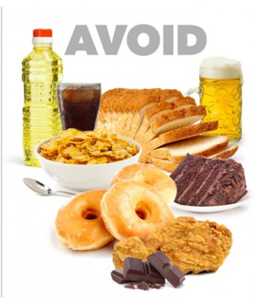
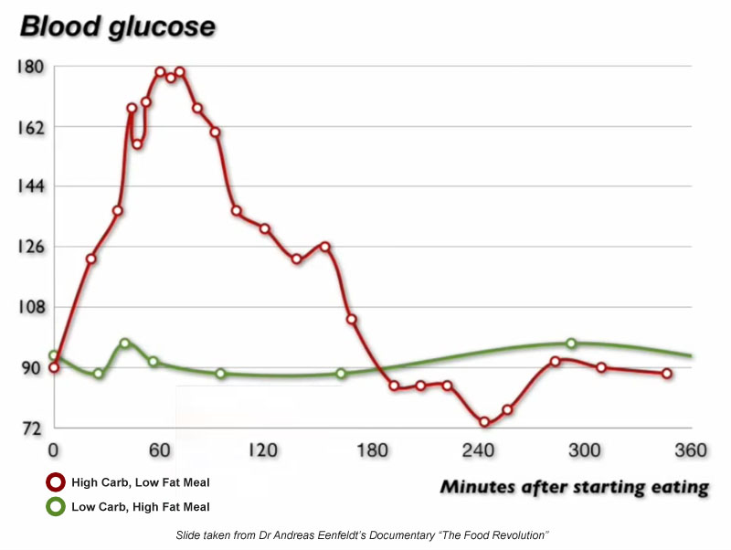
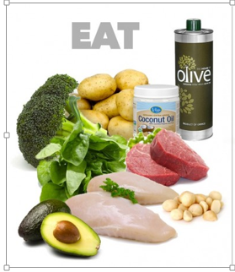
Notes:
Explain the correlation between a high carb & low carb on your sugar levels. How Insulin is produced and how Insulin resistance then ensues.

Slide 12
Glycemic literally means "causing glucose (sugar) in the blood." Blood glucose levels are closely related to the amount and type of carbohydrates consumed.
Carbohydrates with a low GI value (55 or less) are more slowly digested, absorbed and metabolized and cause a lower and slower rise in blood glucose and, therefore insulin levels.
Notes:
Explain Glycemic use Eye Glass. Take time to review the highs & lows. Compare different carb Glycemic levels as sugar monitor. Not telling people what to eat just informing them how these are hidden sugars that we think are good but will spike your GL’s and make you fat.

Slide 13
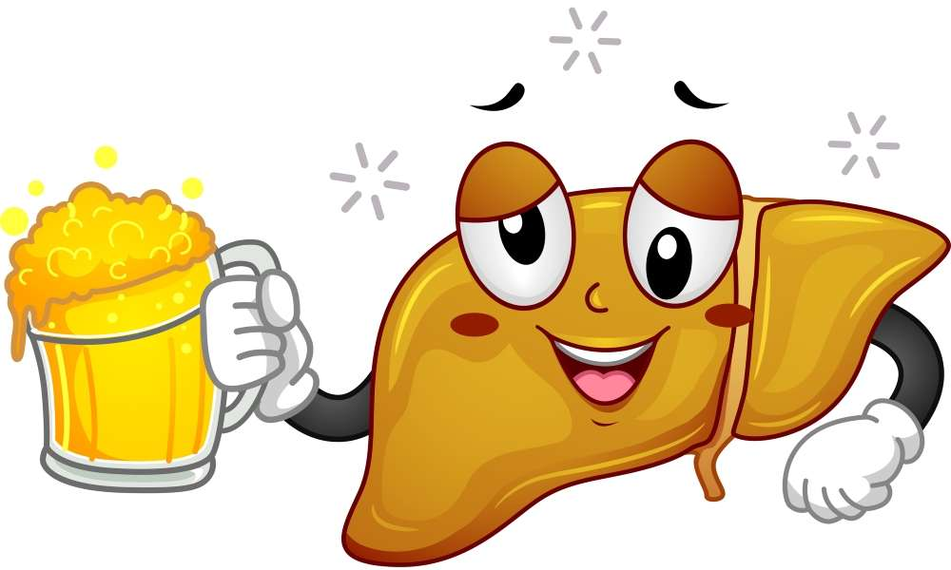
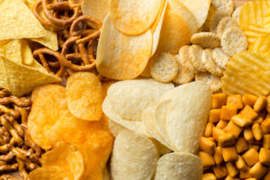
AVIOD BEER & ALCOHOL
Beer and alcohol is a carb. Its basically liquid grains.
It turns into sugar.
This sugar is filtered then through the liver.
The liver is very important in order to lose weight.
Alcohol takes at least 3 days to leave your system through the liver.
No other carb or fat can be burned in the liver while the alcohol is processing.
You’re probably consuming other carbs, overloading the liver, further compounding the vicious cycle of insulin resistance and possible liver disease.
https://www.cleaneatingmag.com/.amp/clean-diet/whats-your-liver-got-to-do-with-losing-weight
https://www.thedailymeal.com/healthy-eating/reasons-drink-shot-tequila
Notes:
Straight Tequila because its made from a cactus not grains. Good for metabolism also. LOL STOP HERE ! Ask if they have any questions. That we've just went over two of the very important reasons : GLUTEN & INSULIN/RESISTANCE this is why people are obese. You just want to make sure that everybody understands this part before moving forward – to please ask question or comments.

Slide 14
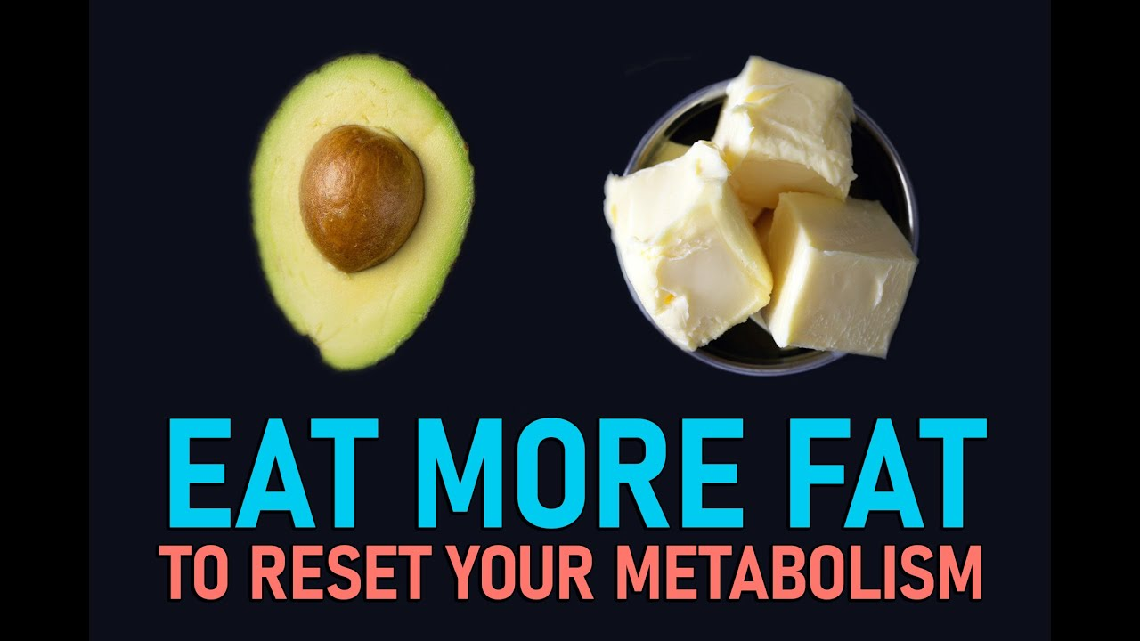
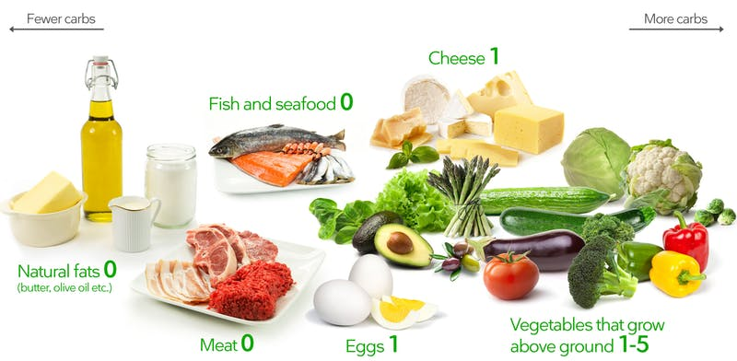
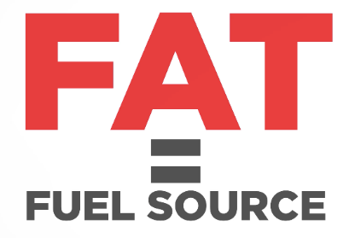
Dietary fat does not induce the high levels of insulin secretion seen with a very high-carb meal.
When the body is relying less on glucose and more on fat for energy insulin secretion is decreased and insulin sensitivity actually increase.
This allows the body to continue efficiently accessing fat stores for energy.
To be successful with the ketogenic diet, the majority of your calories should come from fat—not protein, not carbohydrates.

Slide 16
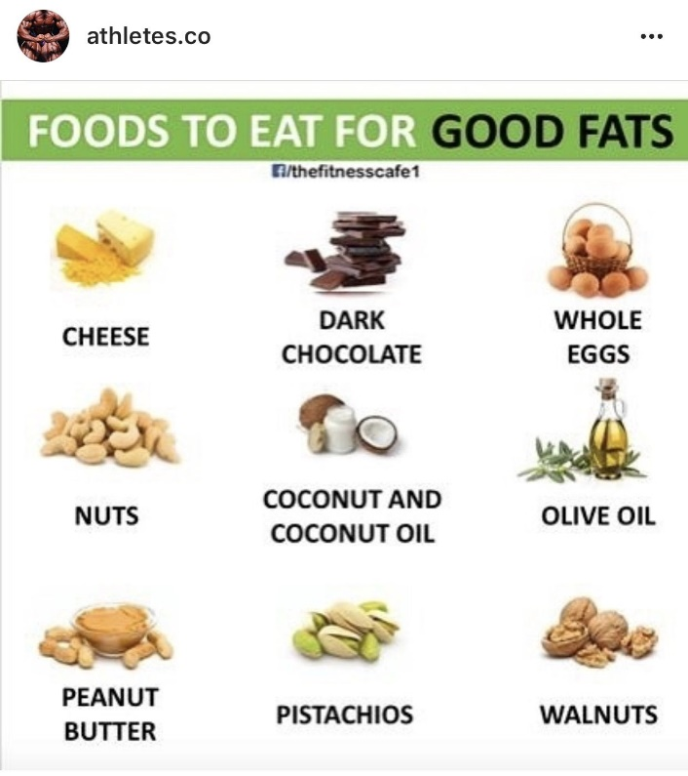
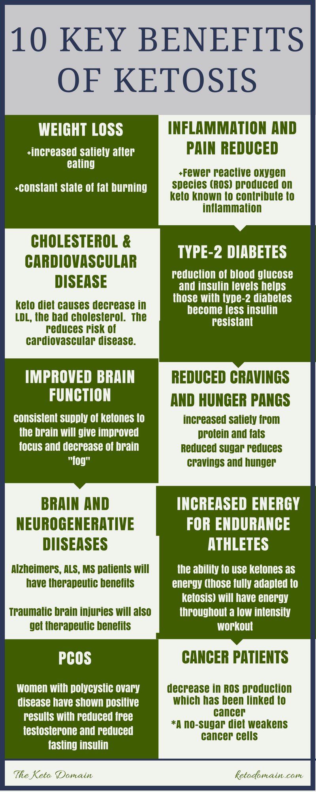
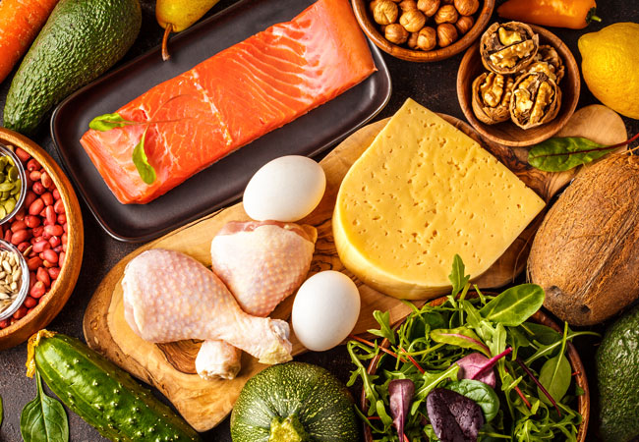
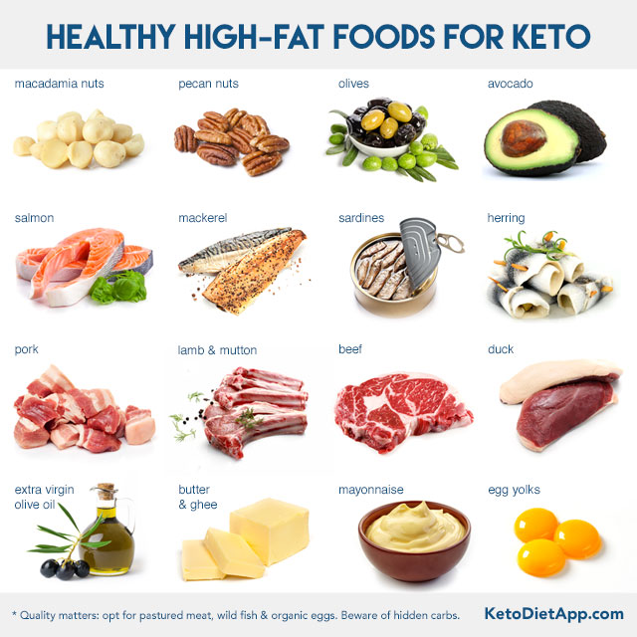
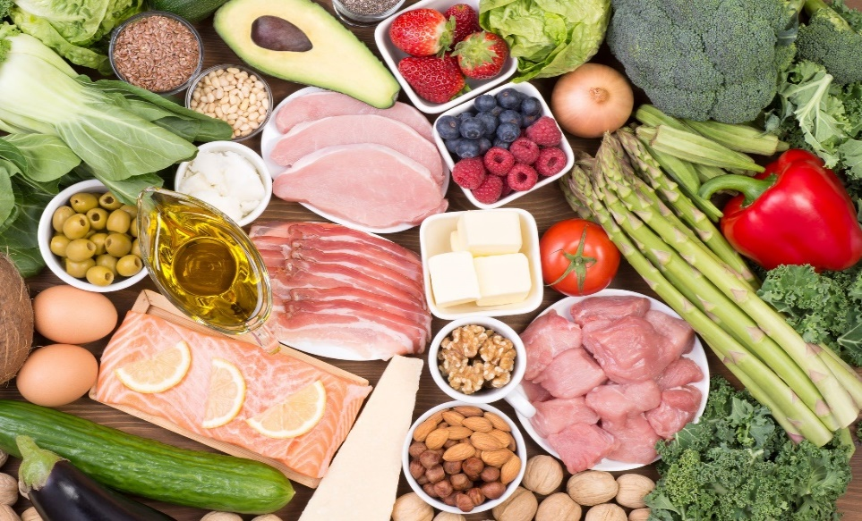

Slide 17
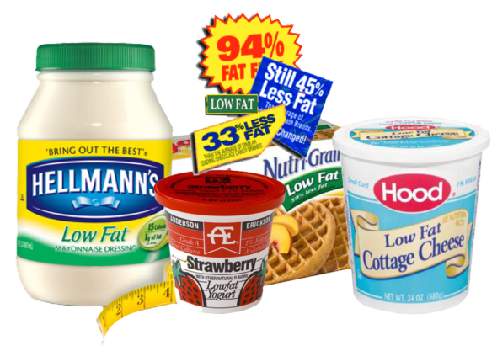
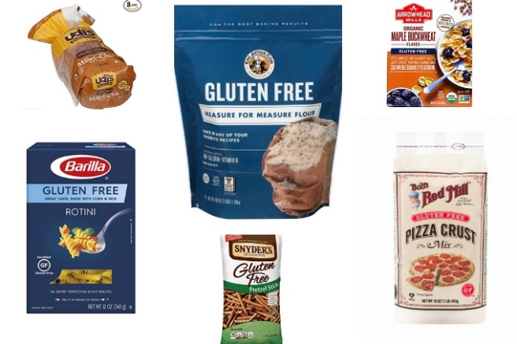
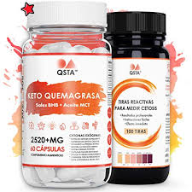
Don’t fall for the hype either.
DO NOT BUY “GLUTEN FREE” or “LOW FAT” PROCESSED FOODS!
(very expensive & too many carbs)

Slide 18
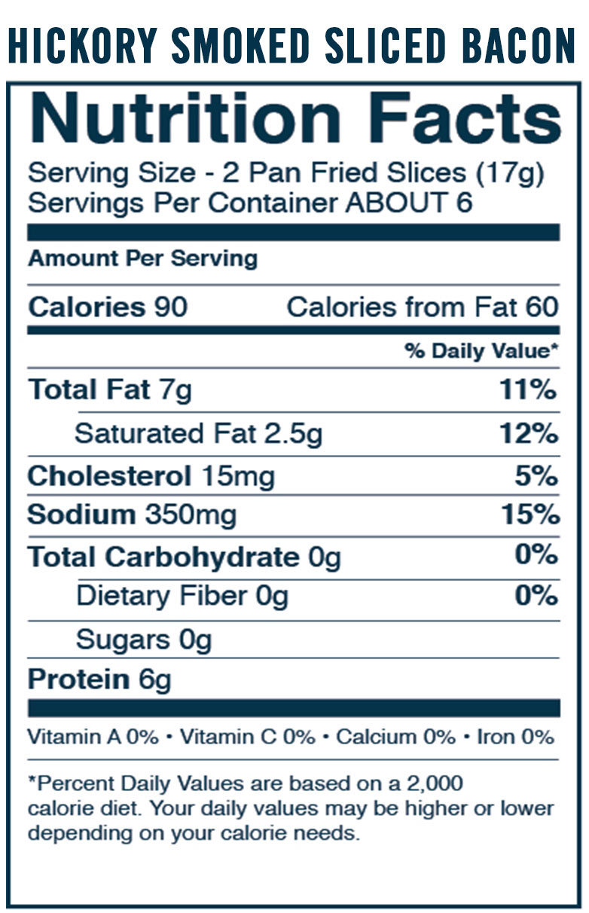
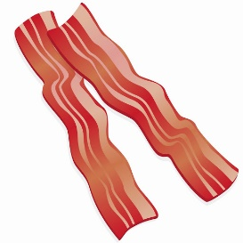
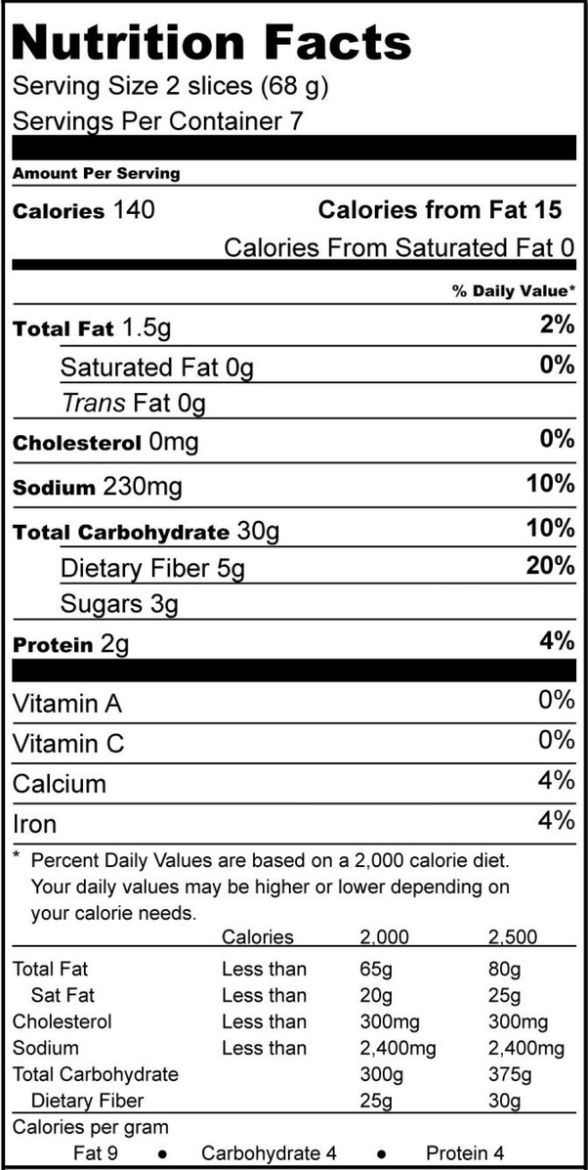
WHITE BREAD
Notes:
Look for single digit carbs. Check the ingredients for seed oils and sugars.

Slide 19
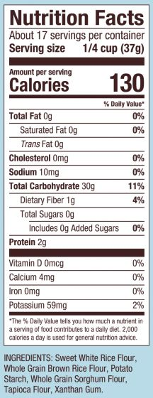
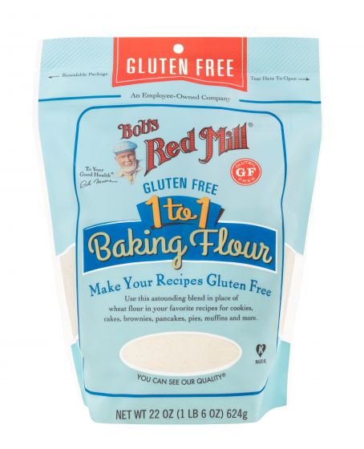

Slide 20
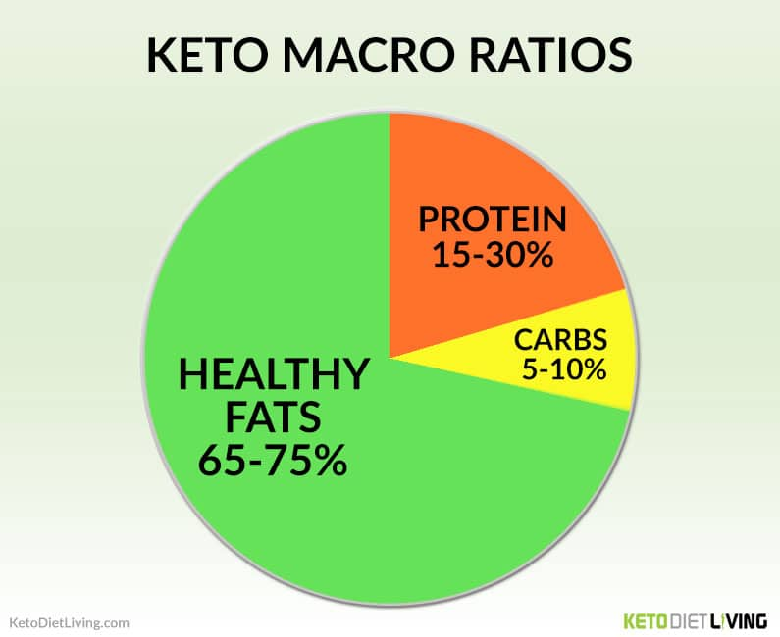
Like most variations of the ketogenic diet, lazy keto dramatically restricts your carb intake. Typically, carbs are restricted to around 5–10% of your total daily calories — or around 20–50 CARBS grams per day
for most people

Slide 21
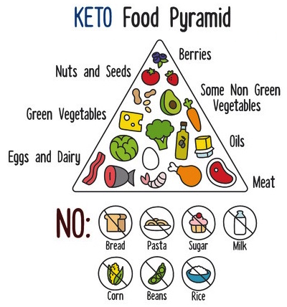

Slide 22
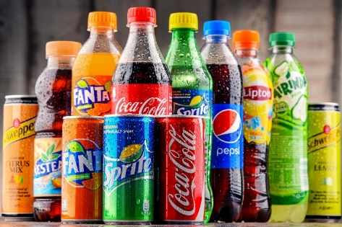
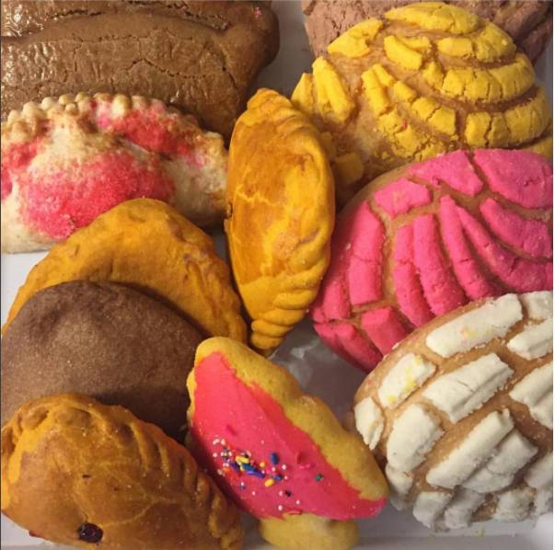
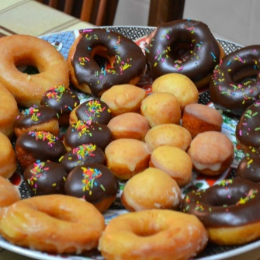
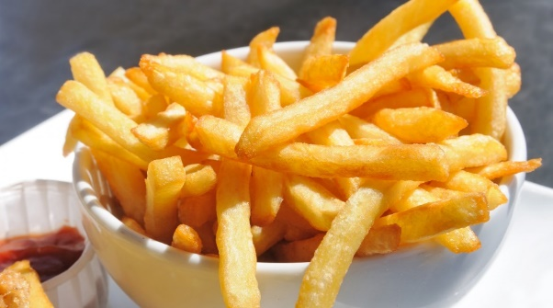
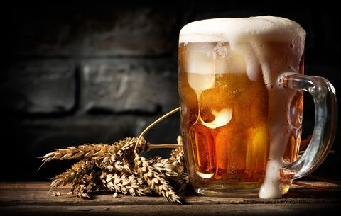
NEXT TIME
WHAT - WHERE - AND HOW TO EAT DIRTY KETO
Which carbs are you going to give up now to see if you are ready to start?
Notes:
Now do you know what CARBS are?

Slide 23
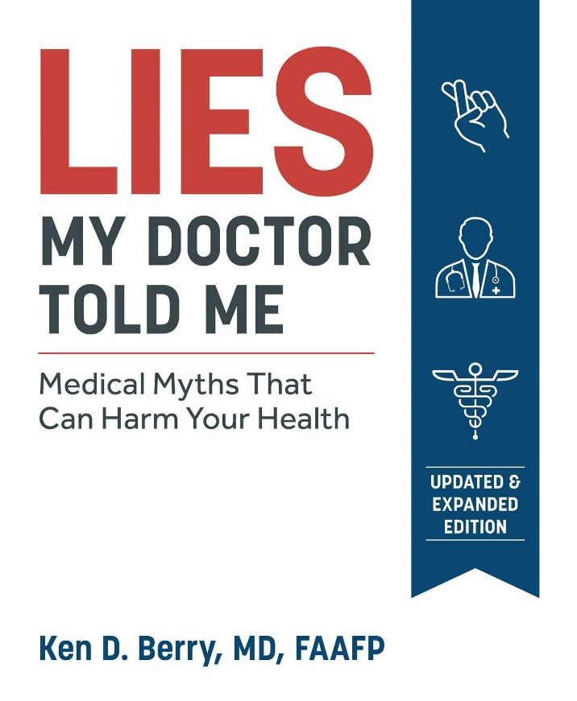
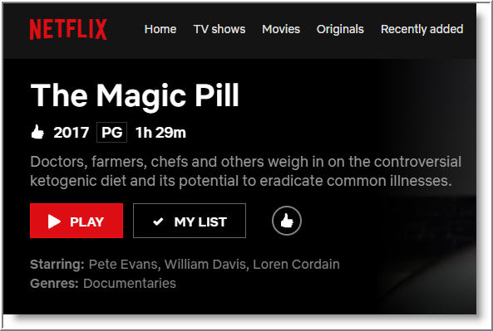
Please make sure to click on the following before continuing to the next session.
Dr. Ken Berry on YouTube
Netflix The Magic Pill

Slide 24
https://www.menshealth.com/nutrition/a19536669/fatty-foods-with-health-benefits
https://www.healthline.com/nutrition/foods/beef#vitamins-and-minerals

