Slide 1
Chapter 2 - Cryptographic Tools
Information Security
www.faisalak.info
Dr. Faisal Khan
faisal.khan@buitms.edu.pk
Office: Room no. 01, SS Block

Slide 2
Cryptography
(the art of secret writing)
plaintext (data file or message)
encryption
ciphertext (stored or transmitted safely)
decryption
plaintext (original data or message)
2

Slide 3
Cryptographers - Invent cryptographic algorithms (secret codes).
Cryptoanalysts - Find ways to break codes.
Decrypt a message - find the plaintext knowing the key.
Decipher a message - find the plaintext without knowing the key or secret algorithm.
Break a code- find a systematic way to decipher ciphertext created using the code with affordable resources (<< brute force attack)
(code, short for encryption algorithm).
- If you decipher a message with a brute force attack, you have not broken the code.
3

Slide 4
Fundamental Tenet
Cryptographic algorithms are probably reliable if they are not broken after many bright cryptoanalysts try to break them.
This implies that standard algorithms should be published.
Keeping a cryptographic algorithm secret makes deciphering messages much harder; but since the algorithm's code must be at every location that uses it, this is usually impossible.
Exceptions - where one organization implements a proprietary algorithm in an integrated circuit that is designed to foil reverse engineering.
Examples: Smart Cards, CATV Boxes.
4

Slide 5
Computational Difficulty
Most common codes have algorithms that are well known and the key for a particular ciphertext can be found by exhaustive search* (but not in a reasonable amount of time on affordable computers for Triple-DES, RSA, IDEA, AES).
Combination lock, 40 positions, sequence of 4 ->
40*40*40*40 = 2,560,000 possible combinations
One combination each 13 seconds -> one year for all
(only 3 positions, it takes 9 days).
DES - 56 bit key, 2^56 = 7E16 combinations
1E6 tries per second -> 1,000 years
1E10 tries per second -> 5 weeks .
*”Brute Force” attack - try all possible keys.
The number of keys tried before finding the right one will vary from 1 to N, but on the average will be N/2.
5

Slide 6
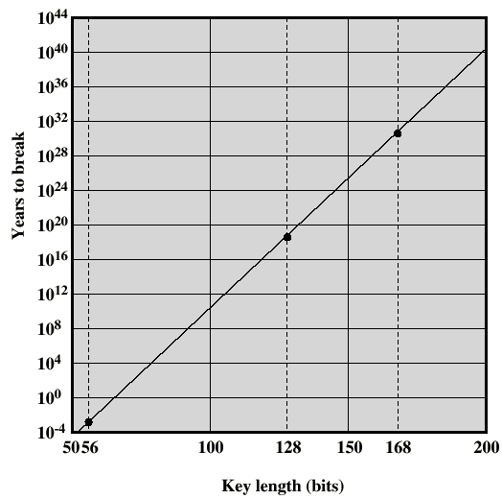
With 1E12
Tries / sec
No. of
Binary keys
= 2^(No. bits)
~10^(0.3 N)
2^10 ~ 10^3
Age of the Universe
Last Ice Age
6

Slide 7
Caesar Cipher
In: ABCDEFGHIJKLMNOPQRSTUVWXYZ1234567890_
Out: DEFGHIJKLMNOPQRSTUVWXYZ1234567890_ABC
The quick red fox jumped over the lazy brown dog
WKHCTXLFNCUHGCIR1CMXPSHGCRYHUCWKHCOD32CEURZQCGRJ
This code is easily broken when the plaintext is English (the value of n is obvious from viewing the ciphertext only).
Even if the substitution string is "scrambled," known redundancies in English show up in the ciphertext ("e" is 2nd most common, "i" is third, "th" is most common diad, ... . (General Substitution Code)
7

Slide 8
Number of Possible Keys
With a Caesar code of N characters C(i), there are N possible keys.
Encryption: j -> (i + K) modulo N
Decryption: i -> (j + N-K) modulo N
The key K=0 is considered a “weak key,” and should be avoided.
A more general “Substitution Code” uses a table for translating “i” to “j”. A reverse lookup is used to go back from “j” to “i”.
To make up the table, for the first entry we have a choice on N characters. For the second spot we only have (N-1) choices, since we can not reuse characters. For the third spot, (N-2), and so forth until only 1 choice can be made for the last spot. The number of possible tables is then:
Possible Tables (keys) = N * (N-1) * (N-2) * . . . * 3 * 2 * 1 = N!
For N > 10, Stirling’s Approximation is accurate to < 1%
N! = sqrt( 2 ∏ N ) * ( N / e )^N where e = exp(1)
For N = 128 (ascii text), N! = 3.8e125. A Brute-Force attack is not feasible, but if the plaintext is English, a simple substitution code is easily deciphered by using character-frequency tables (thus, this code is “broken”).

Slide 9
Types of Attacks
Ciphertext only (hardest)
• Try different keys, see if result is recognizable.
• Having more available ciphertext is better.
Ciphertext and corresponding Plaintext
• For a Substitution Code: the table known for every character in the plaintext.
Chosen Plaintext or Chosen Ciphertext
• Slight variations can be used to determine key being used.
Chosen Key, Plaintext, observe many ciphertext variations. (easiest)
9

Slide 10
Types of Cryptographic Functions
Secret Key (also "Conventional" or"Symmetric")
• Identical keys used to encrypt and decrypt data
• Ciphertext is same length as plaintext (+ padding)
• Used for transmission and storage for privacy
• Can be used for authentication
• Message integrity check (MIC) (encrypt hash of message)
Public Key Cryptography ("Public-Private", "Asymmetric")
• Invented in 1975
• Public Key can be used by anyone to send a message
• Private Key can be used for a "Digital Signature”
• Message shorter than the key length - usually it’s a “session key”
Hash Algorithms ("Message Digest" or "1-Way Transform")
• Password hashing
10

Slide 11
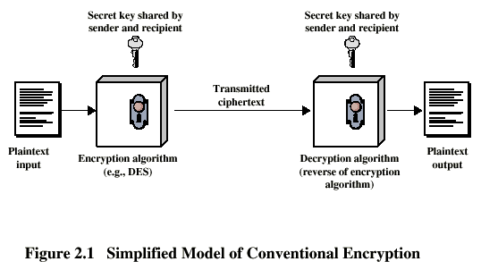
11

Slide 12
One-Time Pad
The Key (Pad) is as long as the message. It should be random
(e.g., bits chosen by a coin toss). Should be used only once.
XOR: 0 (+) 0 = 1 (+) 1 = 0 0 (+) 1 = 1 (+) 0 = 1
X(+)X = Y(+)Y = 0
X (+ )0 = X
X (+) Y (+) Y = X (+) 0 = X
Plaintext: 1 0 0 1 1 1 0 1 0 0 1 0 . . .
XOR-Pad: 1 1 0 1 1 0 0 0 1 1 0 0 . . .
Ciphertext: 0 1 0 0 0 1 0 1 1 1 1 0 . . .
XOR-Pad: 1 1 0 1 1 0 0 0 1 1 0 0 . . .
Plaintext: 1 0 0 1 1 1 0 1 0 0 1 0 . . .
If you know M and C, then Pad = C (+) M
Pad may be algorithmically generated from a key.
12

Slide 13
Block Codes
Block codes used fixed-length chunks of binary data as "symbols" or "code points."
DES and IDEA treat 64-bit strings (blocks) of binary data as input values.
• There are 2^64 = 7E12 =7,000,000,000,000 values
• Each is mapped into a unique ciphertext value.
> Uniqueness assured by a series of "reversible" steps.
• The mapping appears to be random
> Changing any bit in the input changes about half of the output bits.
13

Slide 14
Block Operations, B()
b_{i} must be recoverable from B(b_{i})
Substitutions
- Substitute each n-bit block, b_{i}, with B(b_{i}),
• Table: b_{i} -> B(b_{i}) requires 2^n vectors with n bits.
n=8 bits easy, n= 64 bits too large (10^19 elements).
• Algorithmic - reversible (1-to-1) operations:
  Number Theory (RSA Asymmetric Encryption):
  B(b_{i}) = (b_{i} * c) mod 2^n where c is an odd number.
  If 2^n and c have no common factors, there is a u such that
  b_{i} = B(b_{i}) * u mod 2^n.
  Note the different keys for encryption (c) and decryption (u).
Permutations (special case where bits shuffled)
• Easy to implement in hardware, difficult in software
14

Slide 15
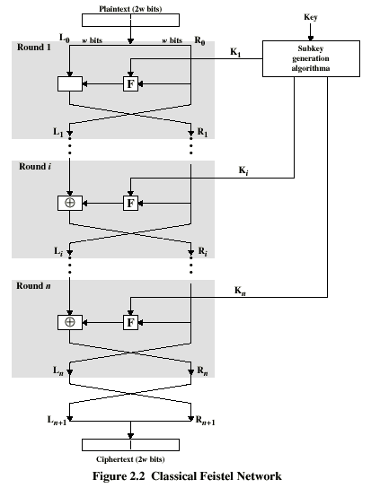
Plaintext
Round 1
(+)
Round i
Classical
Feistel
Network
(Algorithm)
Round n
Ciphertext
15

Slide 16
DES Round n, Encryption
64-bit input from last round
32-bit Ln
32-bit Rn
Mangler <- K_{n}
(+)
32-bit Ln+1
32-bit Rn+1
64-bit output for next round
16
Why is this reversible for any Mangler function?

Slide 17
DES Round n, Decryption
64-bit input from last round
32-bit Ln
32-bit Rn
Mangler <- K_{n}
L (+) M = R
(+)
then
L = M (+) R
32-bit Ln+1
32-bit Rn+1
64-bit output for next round
All steps in reverse order (except Mangler, or “Round Function”).
17

Slide 18
DES (Data Encryption Standard)
56-bit key
64-bit key
48-bit key ->
...
48-bit key ->
(inverse of initial)
Initial Permutation
Round 1
...
Round 16
Final Permutation
18

Slide 19
DES Mangler Function
32-bit input
6-bits
6-bits
6-bits
6-bits
6-bits
6-bits
6-bits
6-bits
Kn (+)
S Box1
S Box2
S Box3
S Box4
S Box5
S Box6
S Box7
S Box8
4-bits
4-bits
4-bits
4-bits
4-bits
4-bits
4-bits
4-bits
32-bit permutation
32-bit output
19

Slide 20
DES S-Boxes
S-Boxes 0 to 15 map a 6-bit input (64 possible values) into a 4-bit output.
Each 4-bit output value could result from any of 4 different input values.
This is not a reversible function, but it does not have to be for decryption (using the Feistel technique).
Paranoids worry that a secret way exists to break DES messages.
20

Slide 21
Concerns about DES
A “DES Cracker” was designed by the EFF for less than $250,000 that will try 2E11 56-bit keys per second (200 per nanosecond). This will find the right key in about 2 days (if the plaintext is recognized as such when it appears).
The answer is to use longer keys, such as a 128-bit key. Time increased by a factor of 2^(128-56) ~ 10^22
Triple-DES effectively uses a 112-bit key.
21

Slide 22
Triple DES
Encryption
There are
112 unique
bits in key
Decryption
m1
c1
E
Key1
D
Key1
D
Key2
E
Key2
E
Key1
D
Key1
c1
m1
22

Slide 23
IDEA vs DES
• 128-bit key vs 56-bit key. 3.4E38 vs 7E16 possible values, or 4,194,304 times as many.
• If an exhaustive key search for DES takes an hour, the same for IDEA would take 500 years.
Better suited for implementation in software
• No large bit-wise (e.g., 64-bit) permutations.
Newer algorithms: Blowfish, RC5, CAST-128, AES.
23

Slide 24
24

Slide 25
Cipher Block Chaining (CBC)
m1
m2
m3
IV
(+)
(+)
(+)
E
E
E
Key
c1
c2
c3
The first 64-bit message segment is XOR'ed
with an initial vector (IV). Each following
message segment is XOR'ed with the
preceding ciphertext segment.
25

Slide 26
Cipher Block Chaining (CBC)
m1
m2
m3
x no effect
randomized
(self-synchronized)
IV
(+)
(+)
(+)
randomized
D
D
D
Key
c1
c2
x
c3
For decryption, the processing flow is
reversed.
“x” is a one-bit error
26

Slide 27
Cipher Block Chaining (CBC)
Encryption
C1 = E(IV+M1)
C2 = E(C1+M2) = E(E(IV+M1)+M2)
C3 = E(C2+M3) = E(E(E(IV+M1)+M2) +M3)
Decryption
M1 = D(C1) + IV
M2 = D(C2) + C1
M3 = D(C3) + C2
M4 = D(C4) + C3
If a bit in C2 is changed:
a. M2 (decoded) becomes random bits
b. The corresponding bit in M3 is reversed.
c. Later (n>3) message blocks are unaffected (self-synchronizing).
Note: “+” represents the XOR bitwise operation.
27

Slide 28
k-bit Cipher Feedback Mode (CFB)
k-bit shift
shift
shift
IV
E
E
E
Key
k
k
k
k
k
k bits
m1->(+)
m2->(+)
m3->(+)
mi and ci are
only k-bits wide
k
k
c1
c2
c3
Streaming Encryption: the plaintext (m1, m2, m3, …) is XORed with a stream of bits generated algorithmically from the key.
28

Slide 29
k-bit Output Feedback Mode (OFB)
k-bit shift
shift
shift
IV
k
k
k
E
E
E
Key
use k-bits
k
k
k
m1->(+)
m2->(+)
m3->(+)
mi and ci are
only k-bits wide
k
k
k
IV
c1
c2
c3
-> Output
Self Synchronizing, but a bit change in Ci only changes that bit in Mi
Should not restart with the same key, unless a
different Initial Vector, IV, is used, perhaps for each connection.
29

Slide 30
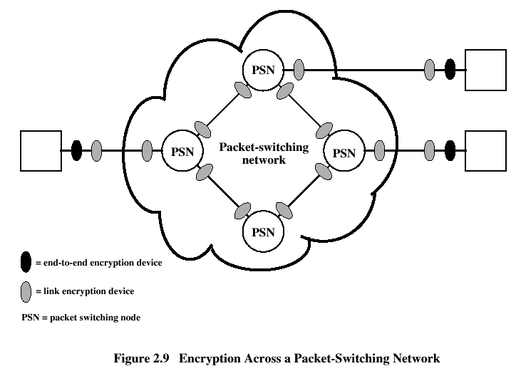
End-to-end Encryption
Link Encryption
End-to-End Device
Link Encryption Device
PSN = Packet Switching Node
30

Slide 31
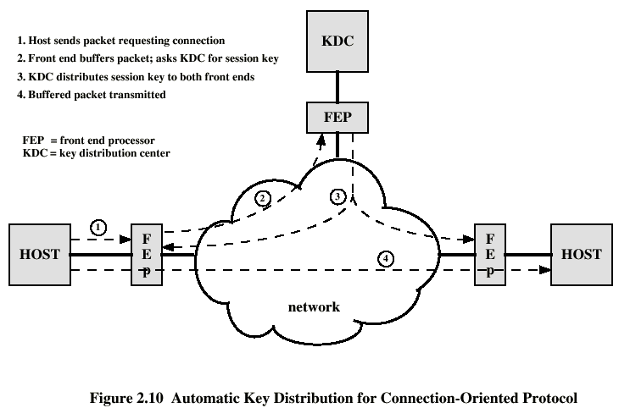
Key Distribution Center
KDC
31

Slide 32
Entropy of Data, H
H = sum[i=1 to k]{P_{i} * log₂(1/P_{i})}
(bits of information per symbol)
Where:
k = number of states (or symbols)
P_{i} = probability of the i’th state (n_{i}/N)
If the symbols are binary numbers with 8 bits:
H = 8 -> complete disorder or randomness
H < 8 -> some order (ASCII text, H = 4 - 5 bits)
32

Slide 33
Entropy. Example - equal states
Example - 1 of 4 code
State(i) Probability Pi
0001 0.25
0010 0.25
0100 0.25
1000 0.25
other 12 0
Entropy = sum[i=1 to k]{P_{i} * log₂(1/P_{i})}
= 0.25*2 + 0.25*2 + 0.25*2 + 0.25*2 +0+0+0…
= 2 bits of entropy (information)
33

Slide 34
Entropy. Example - Unequal States
State(i) Probability Pi log₂(1/P_{i})})
a 0.25 2
b 0.25 2
c 0.50 1
Entropy = sum[i=1 to k]{P_{i} * log₂(1/P_{i})}
= 0.25*2 + 0.25*2 + 0.5*1
= 1.5 bits of information
• Good ciphertext and good compressed data:
Entropy -> number of bits (as data length -> infinity)
Encrypted data can not be compressed.
Which should be done first?
34

Slide 35
Entropy Adds Up
If one password character has 64 possibilities, the entropy per character is log2(64) = 6 bits.
A 10 character password has 10 * 6 = 60 bits of entropy.
The number of possible combinations is 2^60
A handy rule of thumb for converting 2^x to 10^y:
Since 2^10 is approximately 10^3: 2^x = 10^((3/10)*x)
so 2^60 = 10^((3/10)*60) = 10^18
= 1e18

Slide 36
SSH Software to Install on Your PC
Linux, Mac, UNIX: Default installs include software for SSH client and server. Use “man ssh”, “man sshd”, and “man ssh-keygen” to learn how to use them. Wikipedia has good articles.
Microsoft Windows: Install Cygwin: http://www.cygwin.com/ or
WinSCP: SFTP and SCP client for Windows using SSH. for secure copying of files between a local and a remote computer - http://sourceforge.net/projects/winscp/
PuTTY - a telnet and ssh client for Windows - http://www.chiark.greenend.org.uk/~sgtatham/putty/
36

Slide 37
Summary - Problems and Solutions
64-bit Keys can be found by a Brute-Force Attack
Use a 128-bit or larger key.
Code-book encrypting allows interchange and duplication of blocks
Use Cipher-Block Chaining (Crypto-Feedback).
The same Plaintext encrypted with the same key = same Ciphertext
Use a random, non-repeating Initial Vector.
Later Chapters
How do you know the Ciphertext was not altered?
Include a Message Digest (Hash of Plaintext ).
How do you know the authenticity of the sender?
Encrypt the Message Digest with the sender’s Private Key (3).
How do you manage encryption keys securely and efficiently?
Key Management System (Kerberos) (4a)
X.509 Certificates (SSL) (4b, 7)
PGP Email (5a)
PKI (Public Key Infrastructure) (3)
How do you authenticate passwords without storing them on the computer?
Store crypto-hashes of the passwords (with “Salt”)
37

