Slide 1
Chapter 07 – Denial-of-Service Attacks
Dr. Faisal Khan
faisal.khan@buitms.edu.pk

Slide 2
A denial of service (DoS) is an action that prevents or impairs the authorized use of networks, systems, or applications by exhausting resources such as central processing units (CPU), memory, bandwidth, and disk space.

Slide 3
Targets limited resources
Specific types of packets are sent that consume the limited resources available on the system. These include temporary buffers used to hold arriving packets, tables of open connections, and similar memory data structures.

Slide 4
Classic Denial-of-Service Attacks
Ping Flooding:
Aims to overwhelm network capacity of the target organization
Hacker has higher capacity network than the target organization
Ping requests at the target; server bandwidth is consumed twice by ICMP request and response
Employs source address spoofing exploiting raw socket interface in OS

Slide 5
Classic Denial-of-Service Attacks
Just inspecting the header is not enough
Rather the flow of packets of some specific form through the routers along the path from the source to the target system must be identified
SYN Spoofing:
Uses TCP protocol’s SYN requests and targets overflow of the connection table at the target

Slide 6
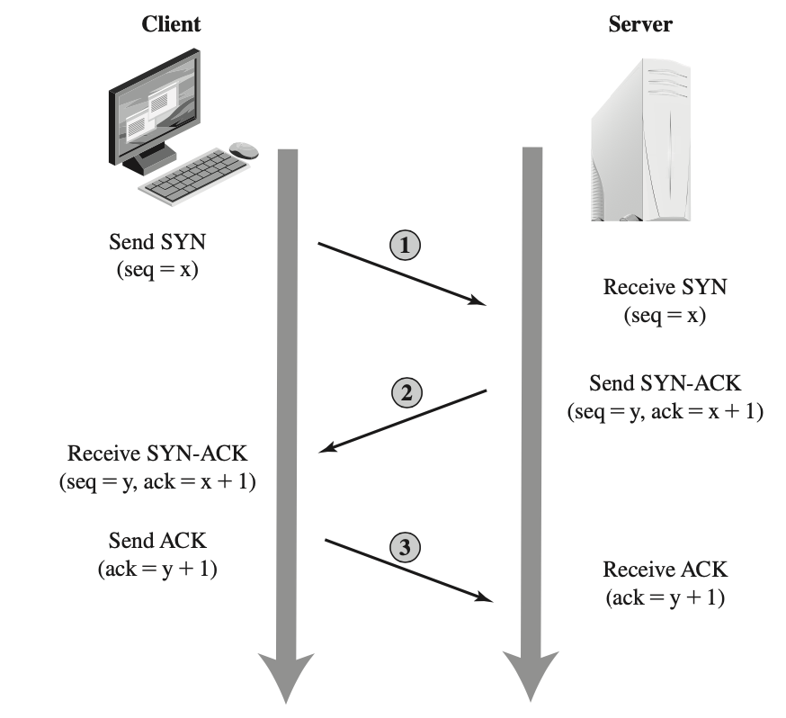
Classic Denial-of-Service Attacks
SYN Flooding
TCP Three-Way Connection Handshake

Slide 7
Classic Denial-of-Service Attacks
UDP Flood
Uses UDP packets targeted to some port number on the target system
Common choice is diagnostic echo port, open in most servers
Spoofed source addresses are used to avoid detection
All these attacks use a single hacker system with address spoofing.

Slide 8
Distributed Denial-of-Service Attacks
Attacker uses multiple compromised systems (zombies or bots) to generate attack
Attacker uses malware to subvert the system and installs an attack agent to control the system for future use
While attacker can command each bot individually, more generally a hierarchy is used.
A small number of systems act as handlers controlling a much larger number of agent systems
Makes it more robust against identification

Slide 9
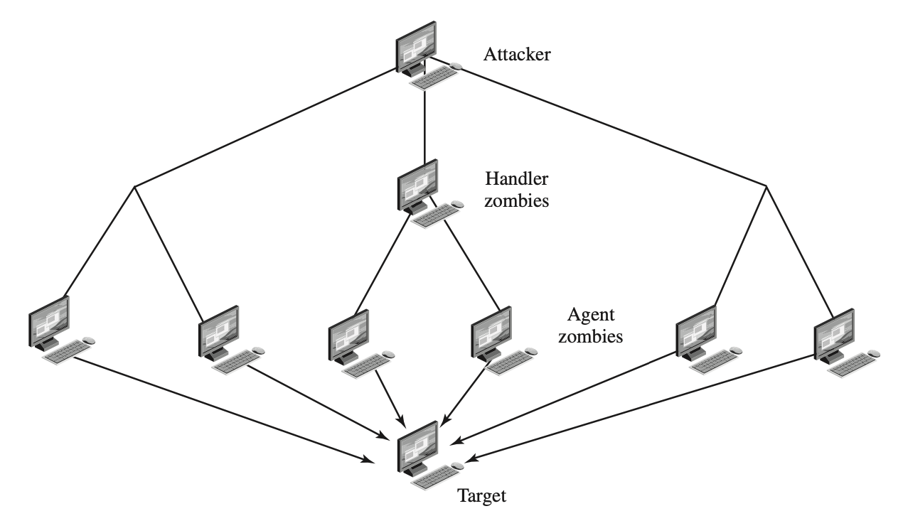
Distributed Denial-of-Service Attacks
DDoS Attack Architecture

Slide 10
Reflector and Amplifier Attacks
In contrast to DDoS attacks, where the intermediaries are compromised systems running the attacker’s programs, reflector and amplifier attacks use network systems functioning normally
  The attacker sends a network packet with a spoofed source address to a service running on some network server
  The server responds to this packet, sending it to the spoofed source address that belongs to the actual attack target
  If the attacker sends a number of requests to a number of servers, all with the same spoofed source address, the resulting flood of responses can overwhelm the target’s network link

Slide 11
Reflector and Amplifier Attacks
Two basic variants, simple reflection attack and amplification attack
Reflection Attack
Attacker sends packets to a known intermediary with spoofed source address of the target system
When the intermediary responds, the response is sent to the target
Effectively this reflects the attack off the intermediary, which is termed the reflector, and that’s why this is called a reflection attack

Slide 12
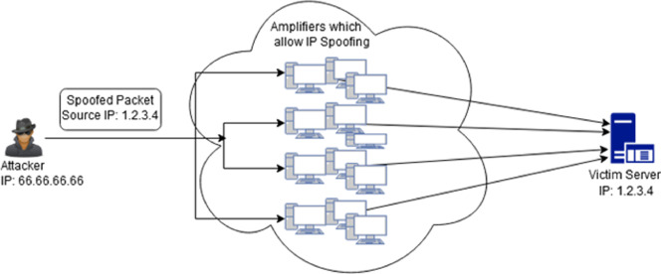
Reflector and Amplifier Attacks
Reflection Attack

Slide 13
Reflector and Amplifier Attacks
Reflection Attack..
Intermediaries are chosen to be high-capacity network servers or routers so that they can generate big volume of traffic
Attackers use a service e.g. UDP with which they can generate large volume of traffic with small queries
Prevention is to filter spoofed packed

Slide 14
Reflector and Amplifier Attacks
Amplification Attack
Directs the original request to the broadcast address for some network
As a result, all hosts on that network can potentially respond to the request, generating a flood of responses
Prevention is to filter broadcast requests from outside

Slide 15
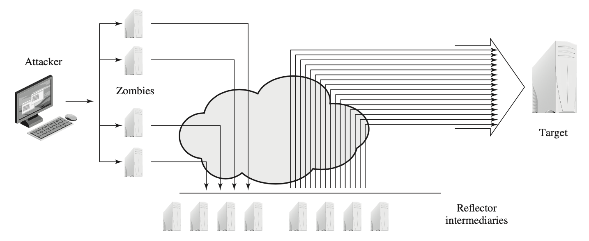
Reflector and Amplifier Attacks
Amplification Attack

Slide 16
Defenses Against Denial-of-Service Attacks
There are steps that can be taken to limit the consequences of the DoS attack from your system to become the target or a compromised intermediary. However, these attacks cannot be prevented entirely.
There are four lines of defense against DoS Attacks

Slide 17
Defenses Against Denial-of-Service Attacks
1. Attack prevention and preemption (before the attack): These mechanisms enable the victim to endure attack attempts without denying service to legitimate clients. Techniques include enforcing policies for resource consumption and providing backup resources available on demand. In addition, prevention mechanisms modify systems and protocols on the Internet to reduce the possibility of DDoS attacks.
2. Attack detection and filtering (during the attack): These mechanisms attempt to detect the attack as it begins and respond immediately. This minimizes the impact of the attack on the target. Detection involves looking for suspicious patterns of behavior. Response involves filtering out packets likely to be part of the attack.
3. Attack source traceback and identification (during and after the attack): This is an attempt to identify the source of the attack as a first step in preventing future attacks. However, this method typically does not yield results fast enough, if at all, to mitigate an ongoing attack.
4. Attack reaction (after the attack):This is an attempt to eliminate or curtail the effects of an attack.

Slide 18
Defenses Against Denial-of-Service Attacks
Traffic pattern monitoring: an organization should know its normal traffic pattern so that it has a baseline to compare with.
When an attack is detected, it is important to study the attack after the event to identify vulnerabilities and the attacker (and their intent)
Limit the rate at which ICMP or UDP diagnostic packets (ping, echo packets etc)
ISPs are contributing to spoofing by not using anti-spoofing filter
Contingency plan: either to switch to backup servers or to rapidly commission new servers at a new site

