Slide 1
Entrepreneurship & Leadership
Chapter 1: Introduction to Entrepreneurship
Fall 2022
Dr. Faisal Khan
www.faisalak.info
faisal.khan@buitms.edu.pk

Slide 2
What is a Startup?
A Startup is not a smaller version of a large company.
A Startup is a temporary organization in search of a scalable, repeatable, profitable business model.
Majority of businesses are small scale. We are talking about something else – Scalable startups.

Slide 3
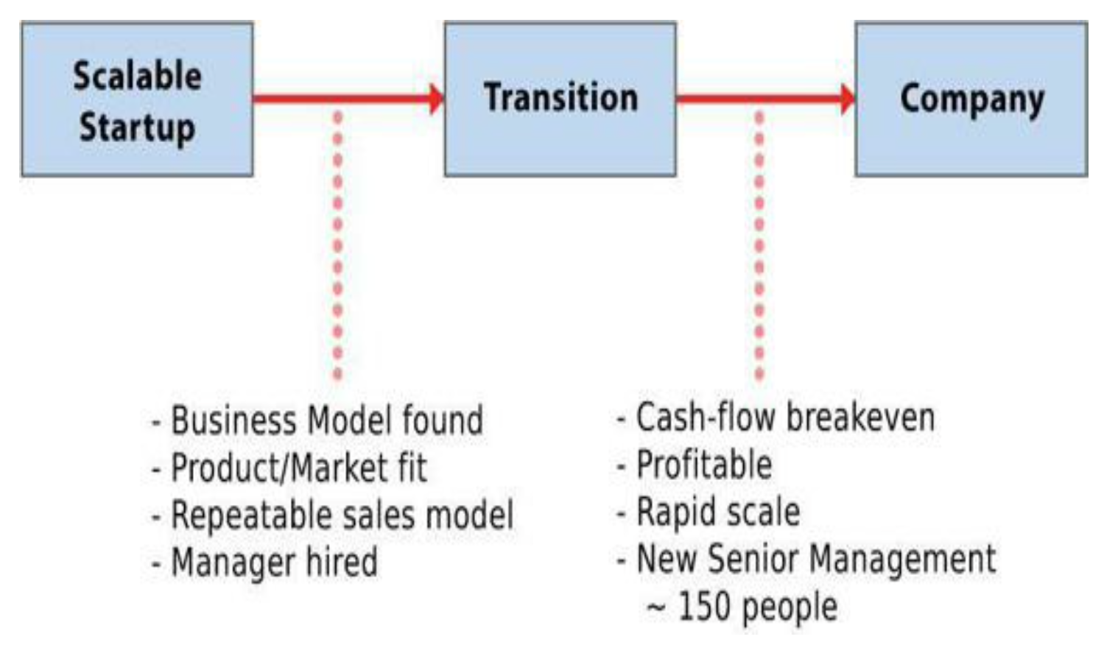
Scalable startups
Work of tech entrepreneurs
They believe their vision will change the world and their company with hundreds of millions of dollars in sales.

Slide 4
Buyable startups
A new phenomenon.
With low cost of development, they can fund themselves or raise less than a 1M USD investment.
Happy to be acquired, usually at a cost of $5 million to $50 million. Purchased by large companies.

Slide 5
Social entrepreneurs
Build innovative nonprofits to change the world.
They seek solutions rather than profits and happen in areas like water, agriculture, health, and microfinance.
Khan Academy
Groundswell
Aresenic Absorbent

Slide 6
A Legendary Hero
A legendary hero is usually the founder of something—the founder of a new age, the founder of a new city, the founder of a new way of life. In order to found something new, one has to leave the old and go on a quest of the seed idea, a germinal idea that will have the potential of bringing forth that new thing.
Joseph Campbell, The Hero with a Thousand Faces.

Slide 7
A typical entrepreneurial failure
Excellent idea
Brilliant team
Amazing technology
Right idea at the right time
E.g. Profile sharing for university graduates
  But it failed. All stories of perseverence and hard work were lies.
  Grim reality, most new products are not successful!
  The mundane details, boring stuff and individual details do not matter.

Slide 8
Eric Ries and His Story..continued
More than 10 years as entrepreneur, he suggests that
  It’s the boring stuff that matters!
Startup success can be engineered by following the right process, it can be learned, it can be taught
E.g., a company called IMVU ( a meta verse concept)
Shipped minimum viable product and rapidly kept improving it based on customer input
The Lean Startup
Notes:
Lean startup: It builds on many previous management and product development ideas, including lean manufacturing, design thinking, customer development, and agile development. It represents a new approach to creating continuous innovation.

Slide 9
The Unorthodox Way
Business and marketing functions of a startup as important as engineering & product development
Build-Measure-Learn
A good plan, a solid strategy, and thorough market research
Its not a “Just Do It” concept
Notes:
Startups fail because they have no good plan, a solid strategy, and thorough market research

Slide 10
The Unorthodox Way
Vision: who is entrepreneur, define startup and guage progress. Systematic experimentation to build a sustainable business
Steer: the details. Build-Measure-learn loop. Building a minimum viable product. Pivot or persevere.
Accelerate: Speed through the loop as quickly as possible. Lean manufacturing concepts.
Notes:
Startups fail because they have no good plan, a solid strategy, and thorough market research

Slide 11
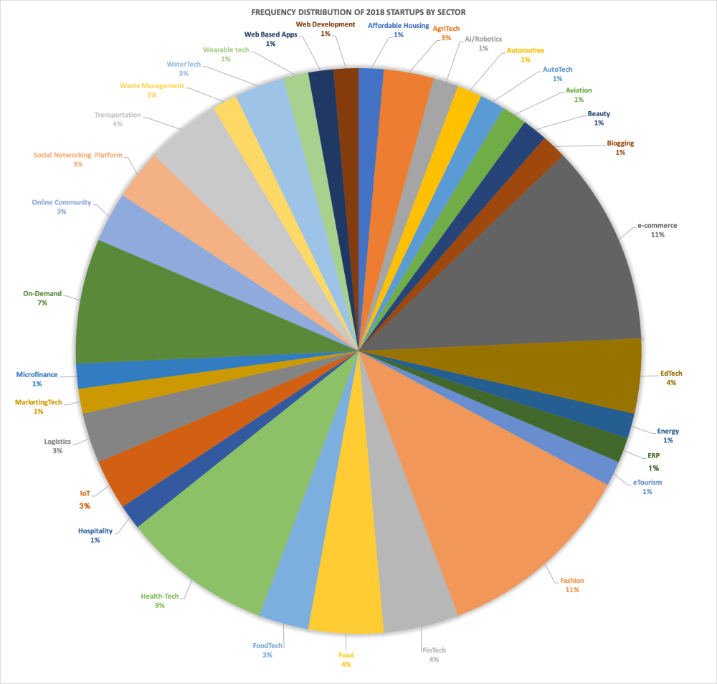
Pakistani Startups by Sector
Src: Menabytes (KPMG study)
Sector-wiseDistribution of Pakistani Startups
Notes:
Total number of startups used here = 70

Slide 12
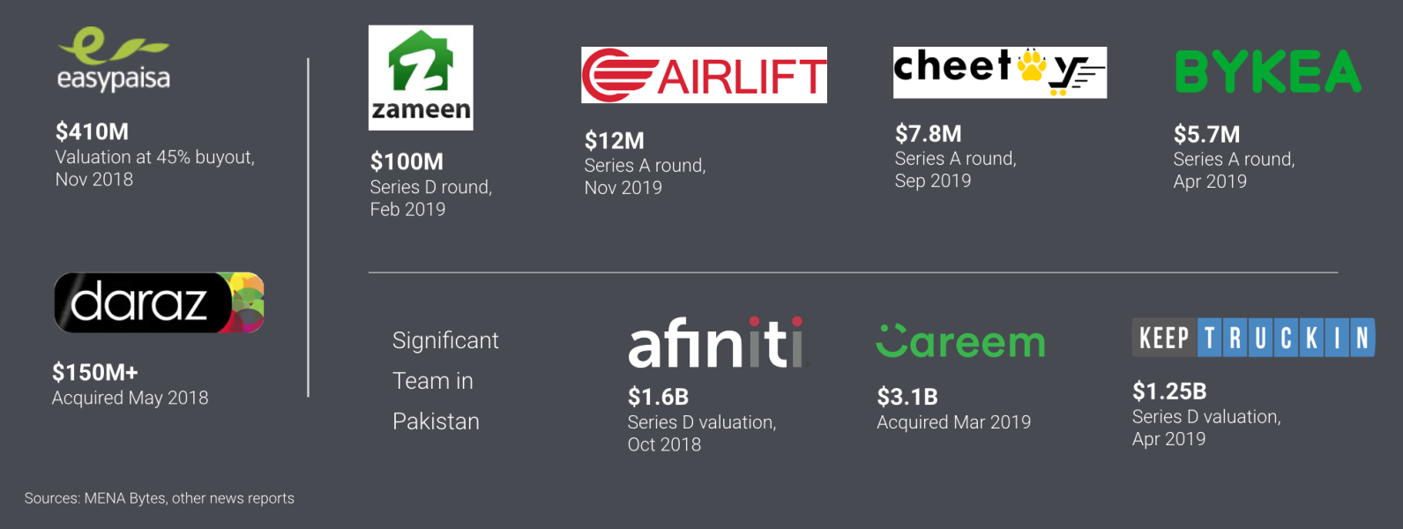
Pakistani Startups
- Notable fundings
Src: Menabytes
Notes:
Total number of startups used here = 70

Slide 13
The Roots of the Lean Startup
From Lean Manufacturing
  Drawing on individual worker knowledge & creativity
  Shrinking batch-sizes
  Just-in-time production
  Acceleration of cycle times
Address all the functions of an early-stage venture: vision and concept, product development, marketing and sales, scaling up, partnerships and distribution, and structure and organizational design.
Learning milestones (what is a good productive day?)
Notes:
Taiichi Ohno and Shigeo Shingo are credited with developing at Toyota

Slide 14
The Snaptax story
In 2009, the team tried to assist taxpayers
Many users were unable to use scanners
Team allowed to use phone cameras instead
Later evolved into filing the entire tax return filing on phone
Now one of the most downloaded tax app
  Interestingly, it happened within a large company called Intuit (one of America’s largest finance and accounting tool producer)
  Entrepreneurship can happen within large established organizations

Slide 15
Startup’s 3 Elements
Engine of growth (like an automobile engine): every new version of a product, every new feature, every new marketing program is an attempt to to improve enginer of growth
Driving a car vs. a rocket launch: too many startups business plans are more like they are planning to launch a rocket
Often-times companies achieve failure by rigorously and faithfully execute a flawed plan
The new Build-measure-learn feedback is like a steering wheel instead
Notes:
Always destination in mind (a true north), but you still adapt

Slide 16
Startup’s 3 Elements
You don’t give up because there is a diversion in the road or you took a wrong turn, you remain focused
Creating a thriving, world-changing business
Employ a strategy to achieve the vision
  Business model
  Product road map
  Partners and competitors
  Ideas about who are the customers
Product is the end-result of strategy
Notes:
Always destination in mind (a true north), but you still adapt

Slide 17
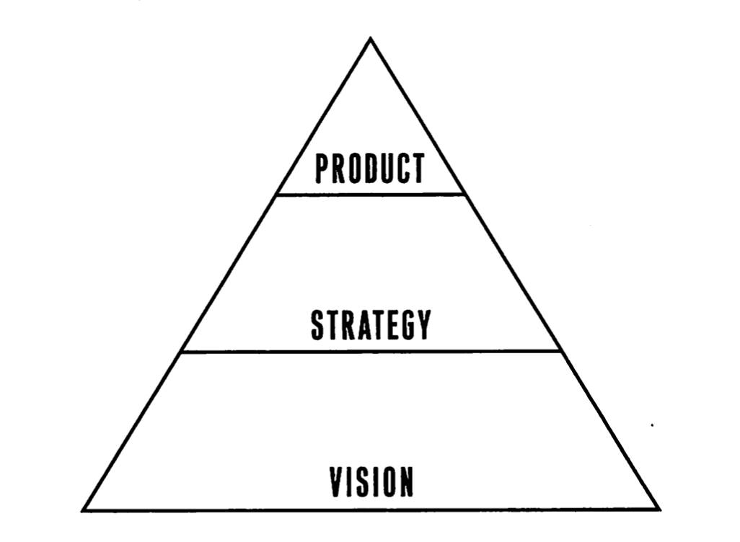
Startup’s 3 Elements

Slide 18
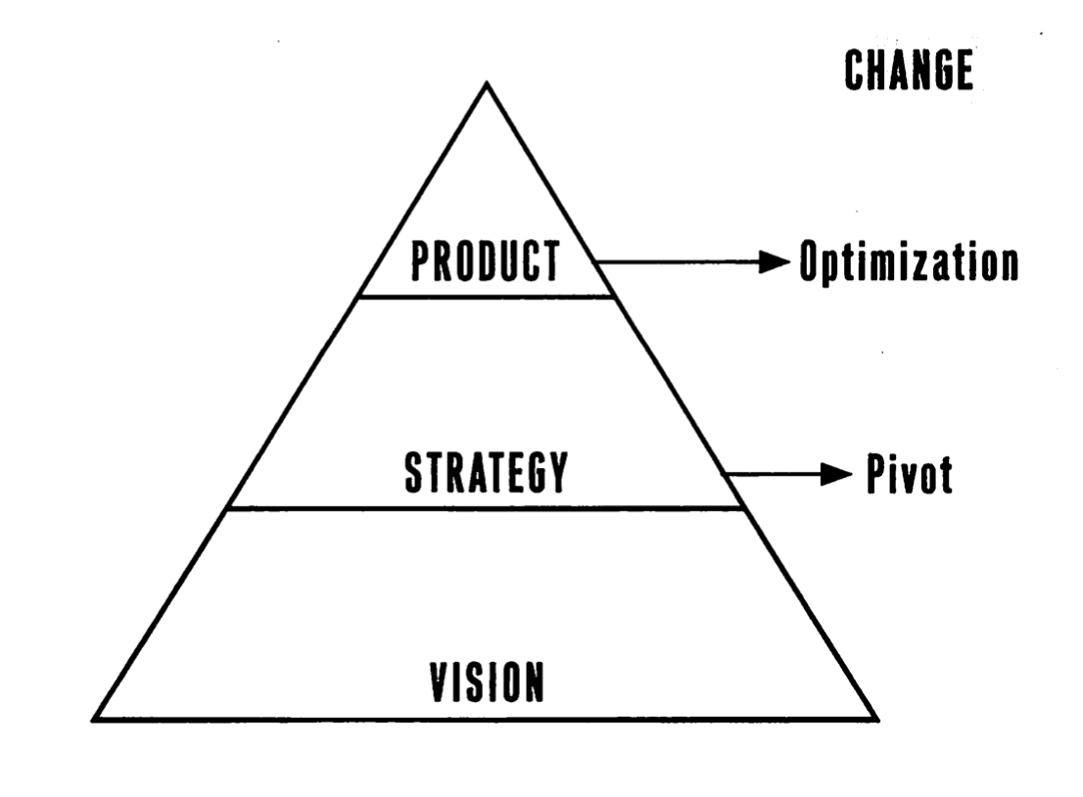
Startup’s 3 Elements

Slide 19
Startup (defining it one more time)
A startup is a human institution designed to create a new product or service under conditions of extreme uncertainty.
Its an acutely human enterprise
Innovative product
The context
Notes:
Doesn’t matter with the size of a company. Innovation. Context: situations of extreme uncertainty

Slide 20
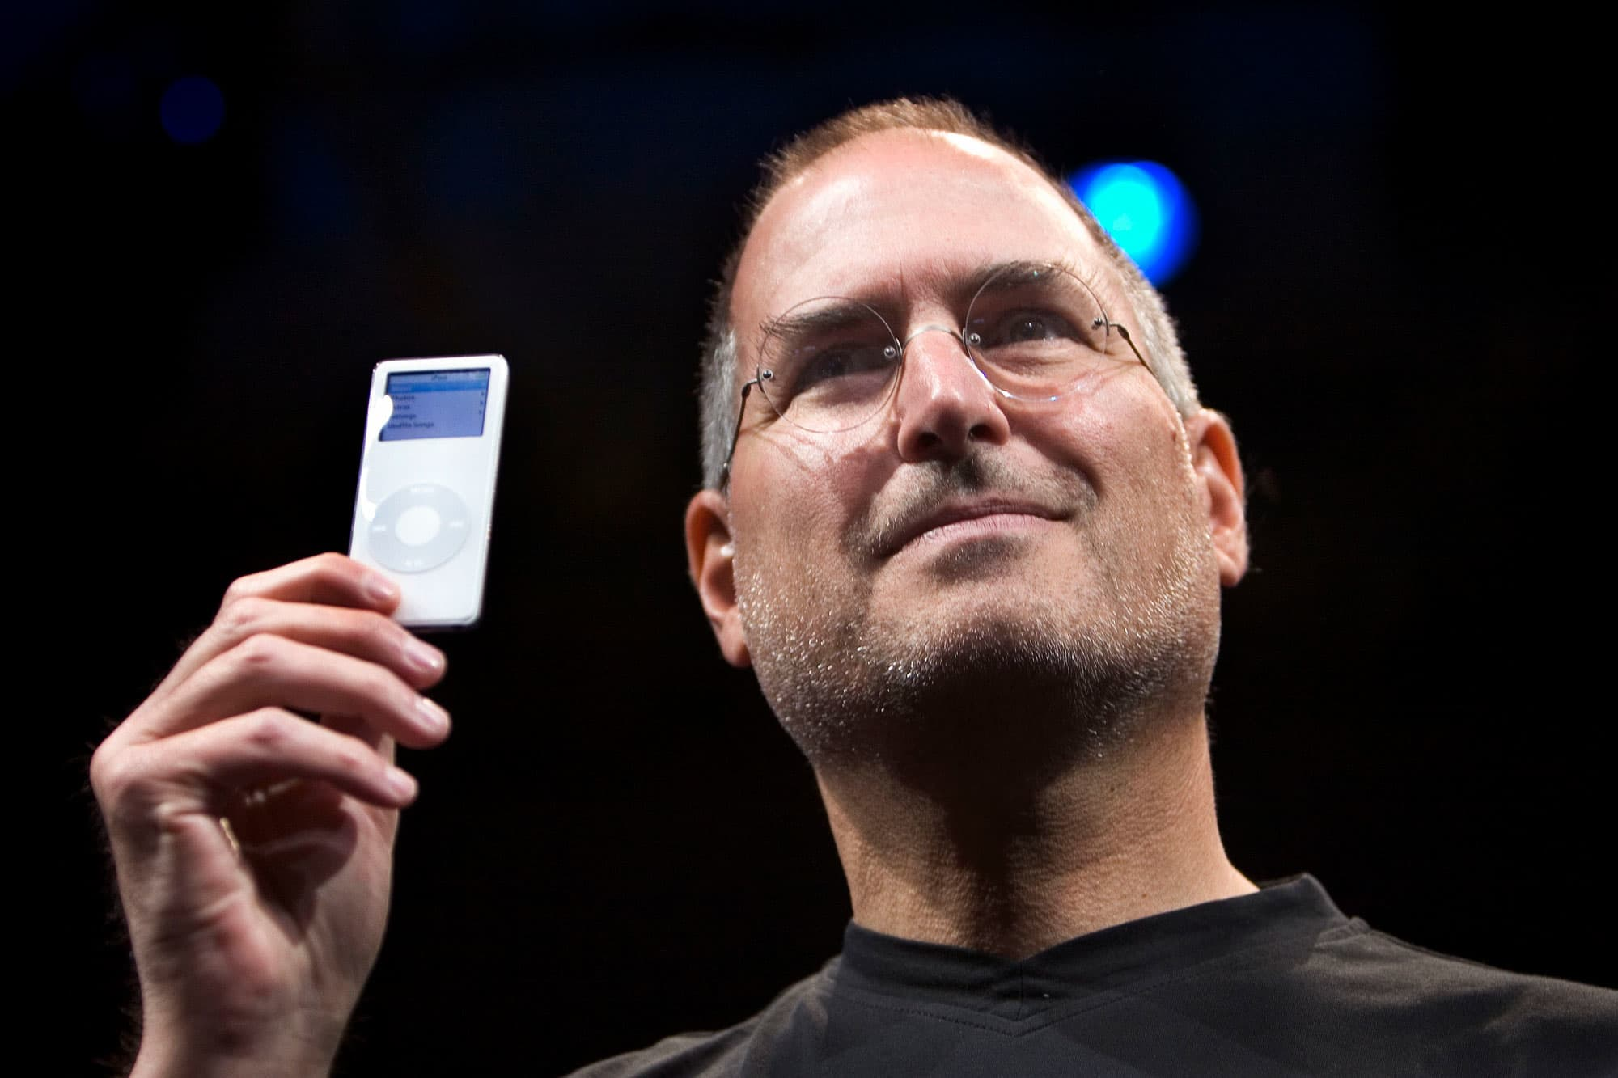
Why Become an Entrepreneur?
Be their own boss
-Put into action what you suggested everyone
-No confines of the corporate sector
Pursue their own ideas
  -No need to convince hierarchy
  in making a change or initiating
  something new
Pursue financial rewards
  -Usually secondary but it often doesn’t
  meet its hype
Notes:
Doesn’t matter with the size of a company. Innovation. Context: situations of extreme uncertainty

Slide 21
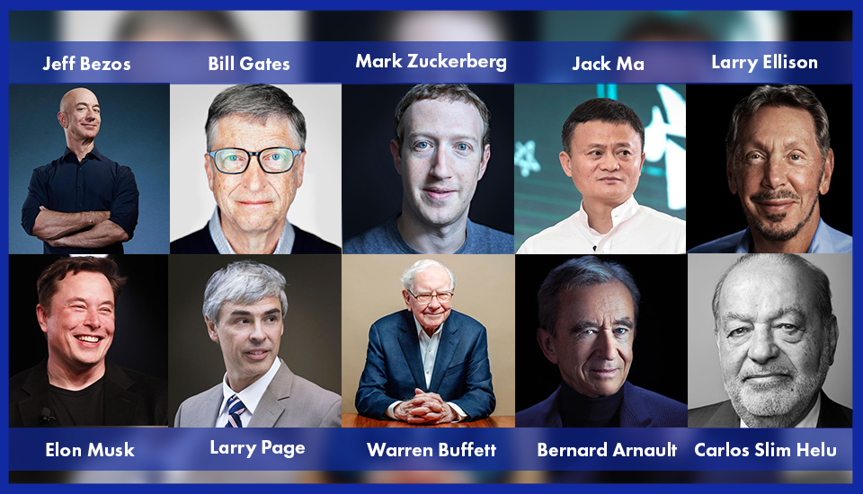
Characteristics of Successful Entrepreneurs
Passion for the business
-The number one characteristic
-A belief to positively influence
people’s lives (e.g., Room to Read)
Product/Customer Focus
  -”Computer is the most remarkable tool..
  but the goal is to get them in the hands of
  as people as possible”, Steve Jobs
3. Tenacity (perseverance) despite failure
  -Its like a scientific experience, build-measure-learn loop
Notes:
John Wood who left Microsoft and founded Room to Read in developing world. 1,440 schools in diff countries. Mac GUI from Xerox brought computer to mainstream

Slide 22
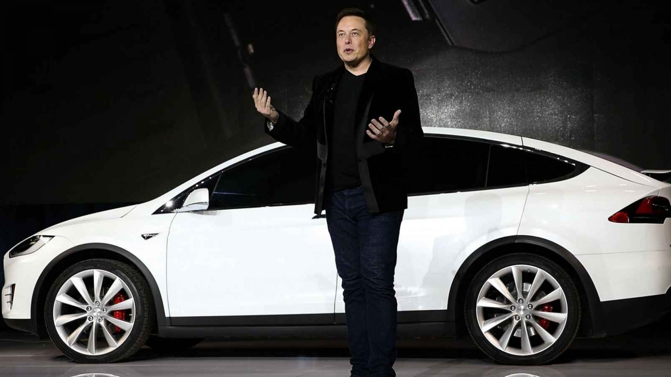
Characteristics of Successful Entrepreneurs contd..
4. Execution Intelligence
-Ability to change a solid idea into a
viable business
-Putting together a team, managing
finances
Notes:
Putting together a team, building the working model, managing finances.

Slide 23
Case Studies
What Went Wrong?
Savvy Entrepreneurial Firm
Notes:
Putting together a team, building the working model, managing finances.

