Slide 1
Entrepreneurship & Leadership
Chapter 3: Feasibility Analysis
Fall 2022
Dr. Faisal Khan
www.faisalak.info
faisal.khan@buitms.edu.pk

Slide 2
What is Feasiblity Analysis?
Feasibility analysis is the process of determining whether a business idea is viable.
It is the preliminary evaluation of a business idea, conducted for the purpose of determining whether the idea is worth pursuing.

Slide 3
When To Conduct a Feasibility Analysis
Timing of Feasibility Analysis
  The proper time to conduct a feasibility analysis is early in thinking through the prospects for a new business.
  The thought is to screen ideas before a lot of resources are spent on them.
Components of a Properly Conducted Feasibility Analysis
  A properly conducted feasibility analysis includes four separate components, as discussed in the following slides.
Notes:
Something people need and willing to buy, not what entrepreneur wants to sell. Window of opportunity (yahoo in 1995 and others),

Slide 4
Feasbility Analysis

Slide 5
Forms of Feasiblity Analysis
Product/Service Feasibility
Industry/Target Market
Feasibility
Organizational Feasibility
Financial Feasibility

Slide 6
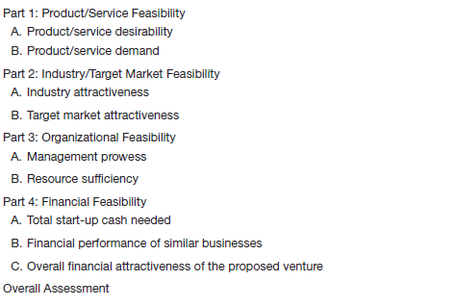
Outline for a Comprehensive Feasibility Analysis

Slide 7
Product/Service Feasibility Analysis
Purpose
Is an assessment of the overall
appeal of the product or service
being proposed.
Before a prospective firm rushes
a new product or service into
development, it should be sure
that the product or service is what
prospective customers want.
Product/Service Feasibility Analysis

Slide 8
Product/Service Feasibility Analysis
Components of product/service
feasibility analysis
Product/Service
Desirability
Product/Service
Demand

Slide 9
Product/Service Desirability
First, ask the following questions to determine the basic appeal of the product or service.
Does it make sense? Is it reasonable? Is it something consumers
will get excited about?
Does it take advantage of an environmental trend, solve a
problem, or take advantage of a gap in the marketplace?
Is this a good time to introduce the product or service to the
market?
Are there any fatal flaws in the product or service’s basic design
or concept?

Slide 10
Product/Service Desirability
Second, Administer a Concept Test
  A concept statement should be developed.
  A concept statement is a one-page description of a business that is distributed to people who are asked to provide feedback on the potential of the business idea.
  The feedback will hopefully provide the entrepreneur:
    A sense of the viability of the product or service idea.
    Suggestions for how the idea can be strengthened or “tweaked” before proceeding further.

Slide 11
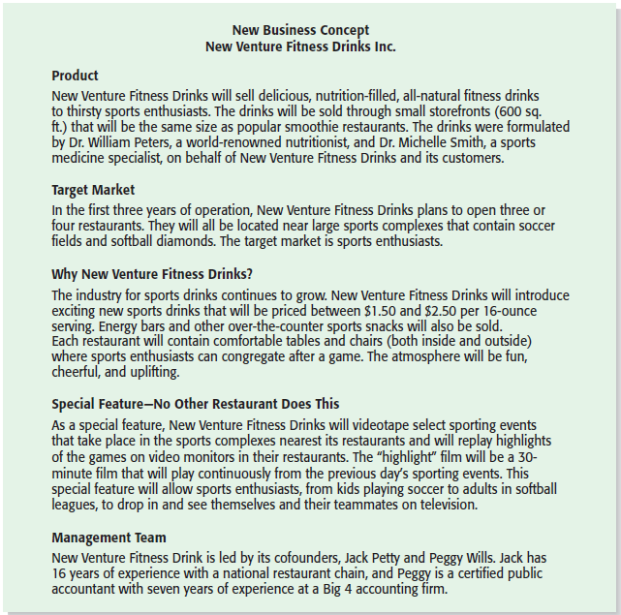
Product/Service Desirability
New Venture Fitness Drink’s Concept Statement

Slide 12
Product/Service Demand
Product/Service Demand
  There are two steps to assessing product/service demand.
  Step 1: Talking Face-to-Face with Potential Customers.
  Step 2: Using Online Tools, Such as Google AdWords and Landing Pages, To Assess Demand.

Slide 13
Product/Service Demand
Talking Face-to-Face with Potential Customers
  The only way to know if your product or service is what people want is by talking to them.
  The idea is to gauge customer reaction to the general concept of what you want to sell, and tweak, revise, and improve on the idea based on the feedback.
  In some cases, talking with potential customers will cause an entrepreneur to abandon an idea.
    Entrepreneurs are often surprised to find that a product idea they think solves a problem gets lukewarm reception when they talk to actual customers.

Slide 14
Product/Service Demand
Utilizing Online Tools, Such as Google AdWords and Landing Pages, to Assess Demand
  The second way to assess demand is to utilize online tools to gauge reaction from potential customers.
  Some entrepreneurs purchase text ads on search engines that show up when a user is searching for a product that is close to their idea. If the searcher clicks on the text ad, they are directed to a landing page that describes the idea. There may be a link on the landing page that says “For future updates please enter your e-mail address.” Demand for the idea can be assessed by how many people click on the text ad and enter their e-mail address.

Slide 15
Product/Service Demand
Utilizing Online Tools, Such as Google AdWords and Landing Pages, to Assess Demand (continued)
  A variety of additional online tools are available to help assess the demand for a new product or service.
  Examples include:
    Sites that provide feedback on business ideas (Foundersuite, Quirky).
    Market Research (CrowdPicker, Google Trends).
    Online Surveys (Survey Monkey, Google Consumer Surveys).
    Q&A Sites (Quora, Stack Overflow).

Slide 16
Industry/Target Market Feasibility Analysis
Purpose
Is an assessment of the overall
appeal of the industry and the
target market for the proposed
business.
An industry is a group of firms
producing a similar product or
service.
A firm’s target market is the
limited portion of the industry it
plans to go after.
Industry/Target Market Feasibility Analysis

Slide 17
Industry/Target Market Feasibility Analysis
Components of industry/target market
feasibility analysis
Industry Attractiveness
Target Market
Attractiveness

Slide 18
Industry Attractiveness
Industry Attractiveness
  Industries vary in terms of their overall attractiveness.
  In general, the most attractive industries have the characteristics depicted on the next slide.
  Particularly important—the degree to which environmental and business trends are moving in favor rather than against the industry.

Slide 19
Industry Attractiveness
Characteristics of Attractive Industries
Are young rather than old.
Are early rather than late in their life cycle.
Are fragmented rather than concentrated.
Are growing rather than shrinking.
Are selling products and services that customers “must have” rather than
“want to have.”
Are not crowded.
Have high rather than low operating margins.
Are not highly dependent on the historically low price of key raw materials.

Slide 20
Organizational Feasibility Analysis
Purpose
Is conducted to determine
whether a proposed business has
sufficient management expertise,
organizational competence, and
resources to successfully launch
a business.
Focuses on non-financial resources.
Organizational Feasibility Analysis

Slide 21
Organizational Feasibility Analysis
Components of organizational
feasibility analysis
Management Prowess
Resource Sufficiency

Slide 22
Management Prowess
Management Prowess
  A proposed business should candidly evaluate the prowess, or ability, of its management team to satisfy itself that management has the requisite passion and expertise to launch the venture.
  Two of the most important factors in this area are:
    The passion that the sole entrepreneur or the founding team has for the business idea.
    The extent to which the sole entrepreneur or the founding team understands the markets in which the firm will participate.

Slide 23
Resource Sufficiency
Resource Sufficiency
  This topic pertains to an assessment of whether an entrepreneur has sufficient resources to launch the proposed venture.
  To test resource sufficiency, a firm should list the 6 to 12 most critical nonfinancial resources that will be needed to move the business idea forward successfully.
    If critical resources are not available in certain areas, it may be impractical to proceed with the business idea.

Slide 24
Resource Sufficiency
Examples of nonfinancial resources that may be critical to the successful launch of a new business
Affordable office space.
Lab space, manufacturing space, or space to launch a service business.
Availability of contract manufacturers or service providers.
Key management employees (now and in the future).
Key support personnel (now and in the future).
Ability to obtain intellectual property protection.
Ability to form favorable business partnerships.

Slide 25
Financial Feasibility Analysis
Purpose
Is the final component of a
comprehensive feasibility analysis.
A preliminary financial assessment
is sufficient.
Financial Feasibility Analysis

Slide 26
Financial Feasibility Analysis
Components of financial
feasibility analysis
Total Start-Up Cash
Needed
Financial Performance of
Similar Businesses
Overall Financial
Attractiveness of the
Proposed Venture

Slide 27
Total Start-Up Cash Needed
Total Start-Up Cash Needed
  The first issue refers to the total cash needed to prepare the business to make its first sale.
  An actual budget should be prepared that lists all the anticipated capital purchases and operating expenses needed to generate the first $1 in revenues.
  The point of this exercise is to determine if the proposed venture is realistic given the total start-up cash needed.

Slide 28
Financial Performance of Similar Businesses
Financial Performance of Similar Businesses
  Estimate the proposed start-up’s financial performance by comparing it to similar, already established businesses.
  There are several ways to doing this, all of which involve a little ethical detective work.
    First, there are many reports available, some for free and some that require a fee, offering detailed industry trend analysis and reports on thousands of individual firms.
    Second, simple observational research may be needed. For example, the owners of New Venture Fitness Drinks could estimate their sales by tracking the number of people who patronize similar restaurants and estimating the average amount each customer spends.

Slide 29
Overall Financial Attractiveness of the Proposed Venture
Overall Financial Attractiveness of the Proposed Investment
  A number of other financial factors are associated with promising business start-ups.
  In the feasibility analysis stage, the extent to which a business opportunity is positive relative to each factor is based on an estimate rather than actual performance.
  The table on the next slide lists the factors that pertain to the overall attractiveness of the financial feasibility of the business idea.

Slide 30
Overall Financial Attractiveness of the Proposed Venture
Financial Factors Associated With Promising Business Opportunities
Steady and rapid growth in sales during the first 5 to 7 years in a clearly
defined market niche.
High percentage of recurring revenue—meaning that once a firm wins a
client, the client will provide recurring sources of revenue.
Ability to forecast income and expenses with a reasonable degree of
certainty.
Internally generated funds to finance and sustain growth.
Availability of an exit opportunity for investors to convert equity to cash.

Slide 31
First Screen
First Screen
  Shown in Appendix 3.1 is a template for completing a feasibility analysis.
  It’s called “First Screen” because it’s a tool that can be used in the initial pass at determining the feasibility of a business idea.
  If a business idea cuts muster at this stage, the next step is to complete a business plan.

