Slide 1
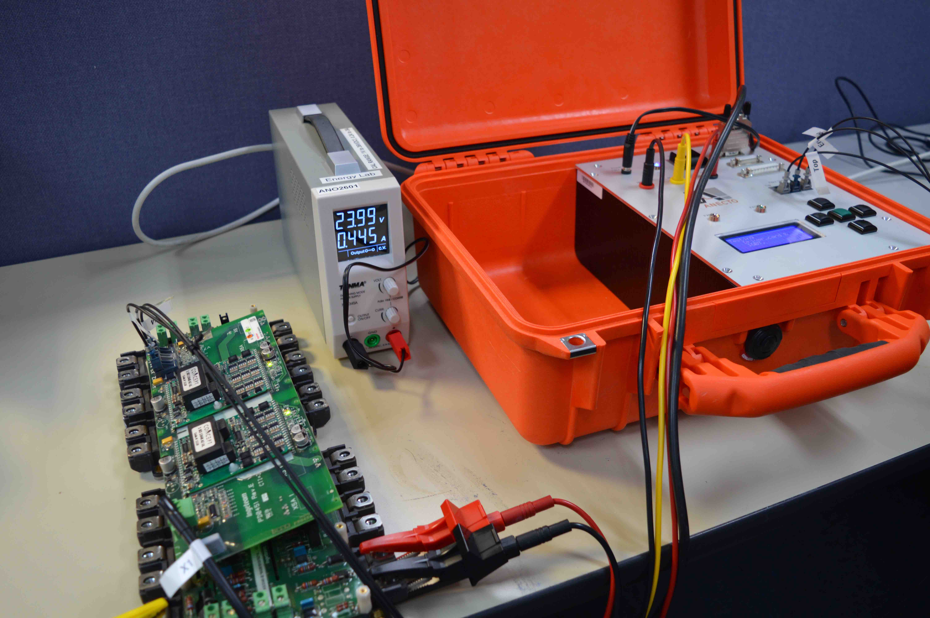
Anecto Design - Ingeteam Diagnostics tester
- Warehouse and In Turbine test capability
- Test Coverage across 8 product iterations
- Ability to test units for 100 % Functionality
- Ability to validate non OEM product
- Preventative maintenance add on – Fiber Optics and Cap Bank
Customized Options based on Customer preference
- Firmware Updates Remotely
- Test Results and Data Storage
- Converter Integration to develop efficiencies in Maintenance
- ………………………………….

