Slide 1
Who is the TOUGHEST person you have ever known?
What did they DO that made them tough?
What did they BELIEVE that made them tough?

Slide 2
Toughness is:
Learning to tolerate psychological uncomfortable-ness
(otherwise known as anxiety)

Slide 3
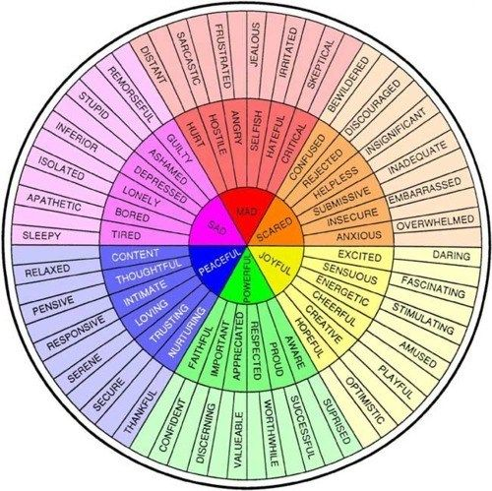

Slide 4
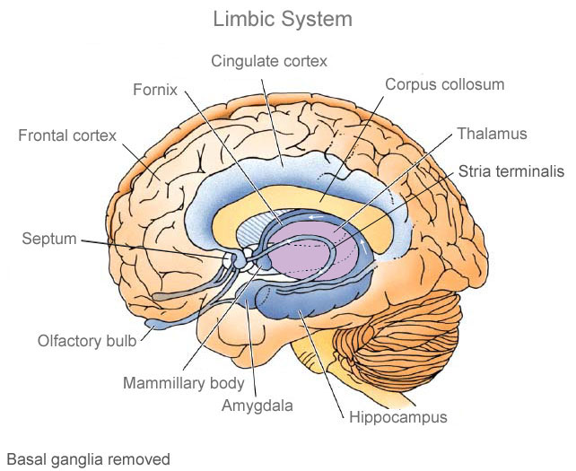
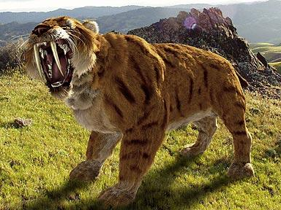
Why are emotions critical?
“First” emotions were a neural response mechanism that helped us avoid danger.
Emotions are instant plans for dealing with life events!
PROBLEM: neural alarms were meant to be SHORT AND SWIFT…

Slide 5
OH NO! PROBLEMS ARE:
Permanent
Pervasive
Out of your control

Slide 6
Most “Problems” Actually are:
Temporary
Local
Changeable

Slide 7
When emotions drive the train…it tends to be a cluster

Slide 8
feeling
mood
temperament
disorder

Slide 9
Generational Differences in approaches to EMOTIONS and what is thought of as “THREAT”
BB=1946-1964
X=1965-1980
M=1981-1996
YOU
WE
ME

Slide 10
Anxiety KILLS empathy

Slide 11
Mental Toughness Is 21st Century Emotional Intelligence 2.0
1. Self-Awareness
Knowing what you feel is only the starting block!
2. Self-Management
Knowing how to self sooth, manage behavior in spite of mood, execute strategically
3. Other-Awareness
Empathy
4. Management of the interaction of Self/Other (i.e, relationships) with thoughtfulness and strategy
Conflict resolution, giving feedback, maintaining a marriage, making a sale

Slide 12
Defense Mechanisms
Repression
Denial
Displacement
Sublimation
Projection
Intellectualization
Avoidance
Compensation
Humor
Passive Aggression
Undoing
Introjection
Turning Against Self
Splitting
Devaluation
Dissociation
Isolation
Acting out
Regression
Affiliation
Reaction Formation
Altruism
Rationalization
Reversal
Compartmentalization

Slide 13
10 Point Mental Toughness Bootcamp
Before vs NOW
Blame vs Ownership
Control vs Acceptance
Peanut Gallery vs Internal Tuning Fork
Blind Spot vs Common Denominator
Envy vs Celebration
Lonely vs Alone
Entitlement vs Commission
Now vs Later
Ability vs Effort

Slide 14
BEFORE vs. NOW
If you say things like: No one else had to deal with what I had to deal with, I got screwed over, There was nothing I could do about it, I was stuck there because it was not fair…
PITY PARTY=NOT mentally tough
Answer this question:
What do I know about myself now, I did not know then?

Slide 15
Ownership vs. BLAME
If you say things like: He makes me feel bad about myself, My kids make me feel unimportant, My in-laws make me furious…
GIVE AWAY YOUR MOOD= NOT mentally tough
Answer this question:
What am I avoiding having to decide or do for myself by blaming this person for my feelings?

Slide 16
ACCEPTANCE vs. CONTROL
If you say things like: What if he stops loving me, What if she gets sicker, What if the storm is huge, What if the buyout leads to a layoff, What if his family hates me?
RUMINATE ABOUT WHAT YOU CANNOT CONTROL=NOT mentally tough
Answer this question:
What is the one thing I CAN DO right now to alleviate my anxiety?
STOP making movies!

Slide 17
INTERNAL TUNING FORK vs. PEANUT GALLERY
If you say thing like: I really hope they don’t make fun of me, I bet they will judge me for this, I better ask 67 people what they think I should do…
OBSESSION WITH APPROVAL=NOT mentally tough
Answer this question:
When I imagine bleacher seats populated with people who are evaluating and judging my choices, who is sitting there? What is stopping you from asking them to leave?

Slide 18
COMMON DENOMINATOR vs. BLIND SPOT
If you say things like: I keep dating the same person in another body over and over again! I keep getting fired from stupid companies for no reason, I am always bored at my jobs, people are all such morons, this system is full of idiots…
AVOIDING THE MIRROR AND SHORT TERM MEMORY=NOT mentally tough
Answer these questions:
Why do I keep ignoring signs that something is “off” until it is too late?
What am I accusing other people of on a routine basis?
What mistakes have I made in my life, do I spend a lot of time hiding from others?
What do I demonstrate, when I feel I have not been heard?

Slide 19
ENVY vs. CELEBRATION
If you say things like: Why should she get that promotion and not me? How does good stuff always seem to happen for them and not me? I cannot talk to you right now because I am too angry I lost
RESENTMENT OF OTHERS SUCCESS=NOT mentally tough
Answer this question:
What is your first memory of coveting something a friend had in childhood that you desperately wanted? (Atari, Jordache Jeans, Flintstone Vitamins are on my list)
What did you do with that then? Have you matured in how you handle this experience as an adult?

Slide 20
ALONE vs. LONELY
If you say things like: I am sooooooo bored, I cannot sit still, I need to find something to do, I always have Instagram/Twitter/FB open
AVOIDANCE OF SOLITUDE=NOT mentally tough
Answer this question:
What are the first three things that happen to your body and what are the first three thoughts that pop into your head when you are in silence?
Practice embodiment meditations, 3 times a day, 2 minutes each time.

Slide 21
ENTITLEMENT vs. COMMISSION
If you say things like: Well, I work hard, I deserve this (fill in the blank); It’s not fair! People hurt me, I should be taken care of, How dare you!
DETERMINING THE WORLD OWES YOU=NOT mentally tough
Answer this question:
Do you routinely tell stories about loss and getting an “unfair” deal in the past to justify bad behavior in the present?
Read about the “just world hypothesis” and write out what you think.

Slide 22
NOW vs. LATER
If you say things like: I will never be able to wear a size 8 again, I will never be able to graduate, I want these shoes/chips/beach vacation NOW
INABILITY TO DELAY GRATIFICATION= NOT mentally tough
Answer this question:
The last time I remember sacrificing and waiting to purchase/eat/say something I wanted was…

Slide 23
EFFORT vs. ABILITY
If you say things like: I just wasn’t born with a silver spoon, I am unlucky, I am not smart enough, I do not have the right background for that
LACK OF PERSISTENCE=NOT mentally tough
Answer this question:
When is the last time I solved a complicated problem or puzzle in my life? What did it take? When do I tend to give up when facing challenges?

Slide 24
NO ONE CARES HOW YOU FEEL

Slide 25
BEHAVIOR is HUMAN CURRENCY
All but about 9% of the population can learn to BEHAVE in spite of their emotions
Behaving strategically is not being FAKE

Slide 26
TOUGHNESS is:
backspace, backspace, backspace….delete.

Slide 27
Change your BRAIN with G.R.I.T.
GRATITUDE
RESPONSIBILITY
INTENTION
TOUGHNESS

Slide 28
G.R.I.T.=The willingness and capacity to BEHAVE FORWARD

Slide 29
CBT for free…

Slide 30
Thank you!!
drmelissa@behaveforward.com
behaveforward.com
800 570 1509
@drmlbp

