Slide 1
Time for R & R
Teacher Recruitment and Retention
WVPEC Hot Topics Conference
June 21, 2022
Brenda Tanner, Ed.D
Head of Leadership Coaching
brenda@teachupbeat.com
Notes:
Brenda welcome
Brenda’s intro
Yanique’s intros

Slide 2
Agenda
Welcome and Introductions (Time to Build Your Network)
Teacher Retention: A Challenge for All
Research on Teacher Retention
Upbeat and the Work We Do
Opportunities for Partnerships
Next Steps
Q&A and Sharing

Slide 3
Who We Are and What We Do
Your Name
Your Title
One Word That Best Describes You
Our mission is to elevate teacher engagement and retention by fostering strong school environments.

Slide 4
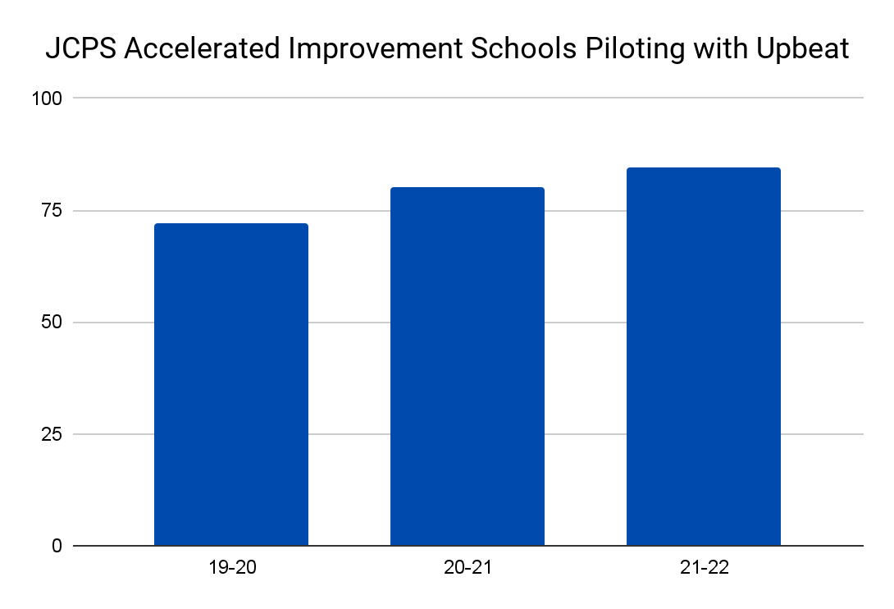
Upbeat’s Teacher Retention Improvement Process
Expert designed, research-based surveys
Coaching from industry leaders
Improved teacher satisfaction and retention
94%
80%
84.7%
72%
of principals and district leaders said that meeting with an Upbeat leadership coach helped them accomplish their goals as leaders
Notes:
Yanique
All of our surveys are grounded in teacher retention research.
One of our priorities is providing clear actionable data thats anonymous.
After completing the engagement survey we pride ourselves on getting the data back to districts within two weeks of completion. They are then partnered with one of our leadership Coach who are former superintendent, former principals, and or Chief Human Resource Officers . We’ve seen this process improve teacher engagement and retention in suburban Atlanta, Texas, Chicago, New York, South Carolina and rural Virginia

Slide 5
Teacher Retention
Last year what were the top 3 reasons you believe teachers in your district left the district?
Did this change from previous years? If so, how?

Slide 6
What is Your Role in Recruitment and Retention
Discuss the following with a partner:
What role do you play in recruiting and retaining teachers and other staff members?
What are the greatest challenges you face/see in recruiting and retaining teachers?
WE WANT YOU TO JOIN OUR TEAM… AND TO STAY.

Slide 7
Research on Retention – Did You Know?
Do you know the impact each of the these can have on teacher retention?
Appreciation
Autonomy
Principal/Teacher Trust
Instructional Leadership
Professional Development
Collaboration
Teacher Voice & Leadership
School Safety and Order
Belonging and Wellbeing
Parent/Teacher Communication
Evaluation
Other?
For More Information on the Research on Teacher Retention go to teachupbeat.com and download the research document: Teacher Retention in Public Schools

Slide 9
The Challenge:
Inadequate Data
Difficult for leaders to gauge significance of feedback from individual teachers
Challenging to understand the factors influencing turnover for different types of teachers
Teacher survey data is unreliable if not anonymous (Murdoch, 2014)

Slide 10
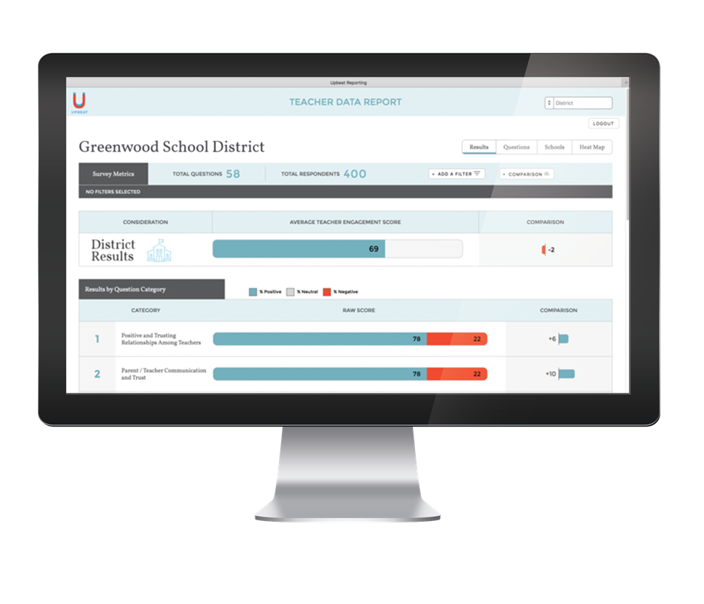
Upbeat
Expert-designed survey
Research-based algorithm
Clear, actionable data
Protects anonymity of teachers

Slide 11
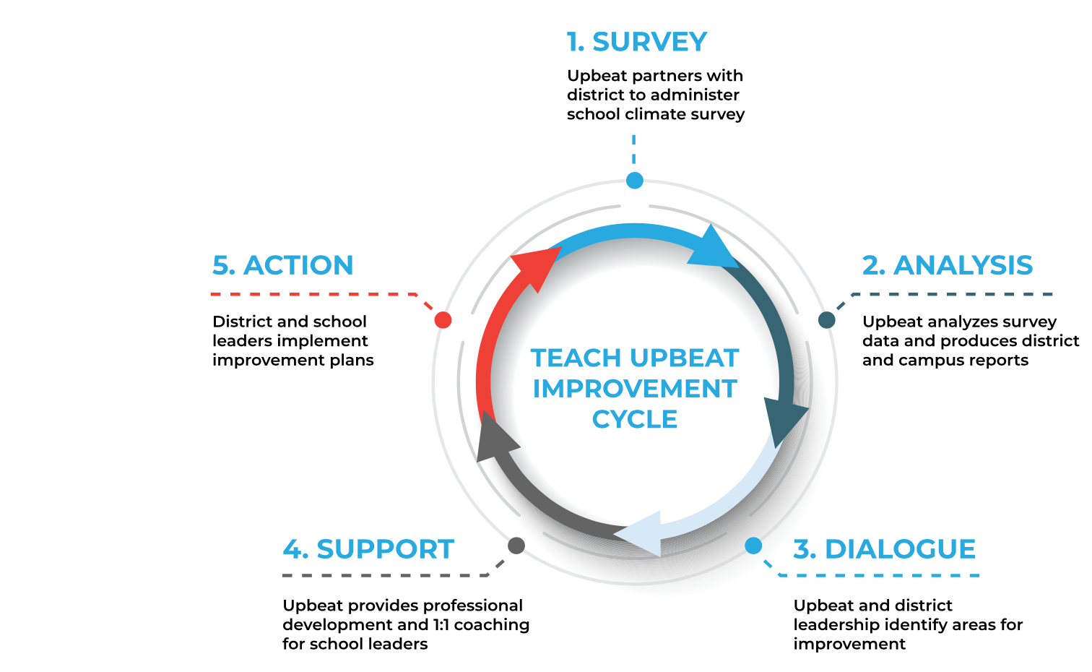
Upbeat Leadership Coaching Improvement Cycle
Notes:
Yanique steps 1-2
Brenda steps 3-5

Slide 12
Next Steps
Contact Brenda for more information or to set up a meeting that will include a survey demo
brenda@teachupbeat.com
Cell: 540-718-2617
Check on status of WVPEC partnership
For more information about the survey and services Upbeat provides go to teachupbeat.com
Questions?
Notes:
Kylie

