Slide 1
The good in evil deeds: Exploring moral ambiguity and developmental contexts in adolescent behavior
Southern Society for Philosophy and Psychology
Michael Paskaru, MA
April 3, 2025

Slide 2
Take home
By the end of this presentation, the psychologist and philosopher alike:
Will better understand moral ambiguity generally, in relation to youth, and to a personally experienced case study.
Will become familiar with moral psychology in the context of moral ambiguity for the purpose of doing and achieving good.
Will see what future research may look like.

Slide 3
Contents
Moral ambiguity (General).
Moral ambiguity (Youth).
Moral ambiguity (Personal Case Study).
Doing good – Virtue Ethics (Situationism).
Future research.

Slide 4

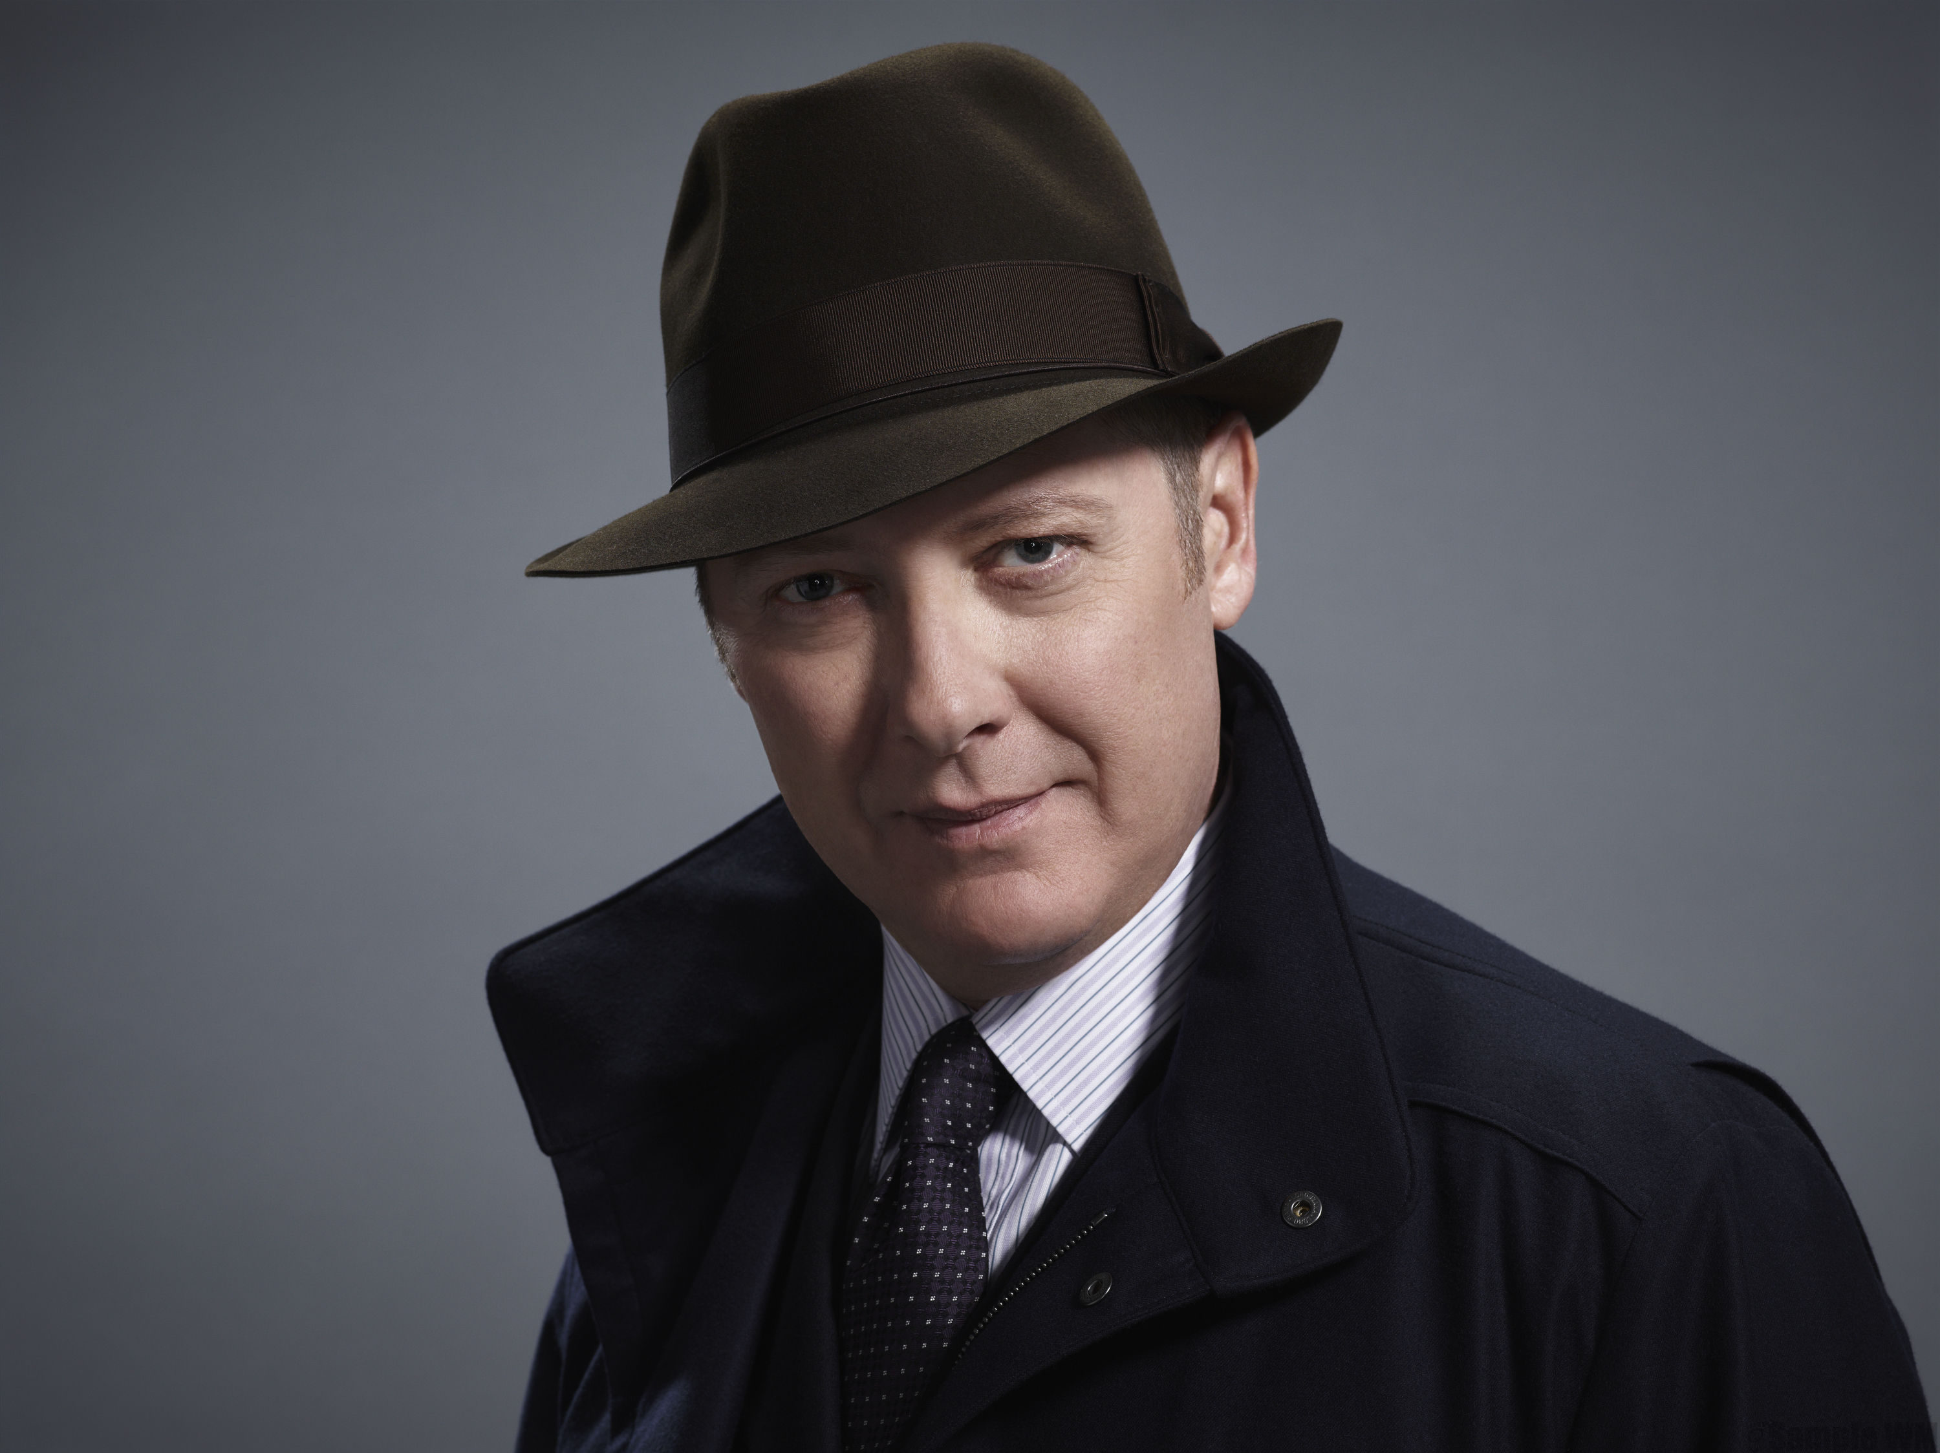
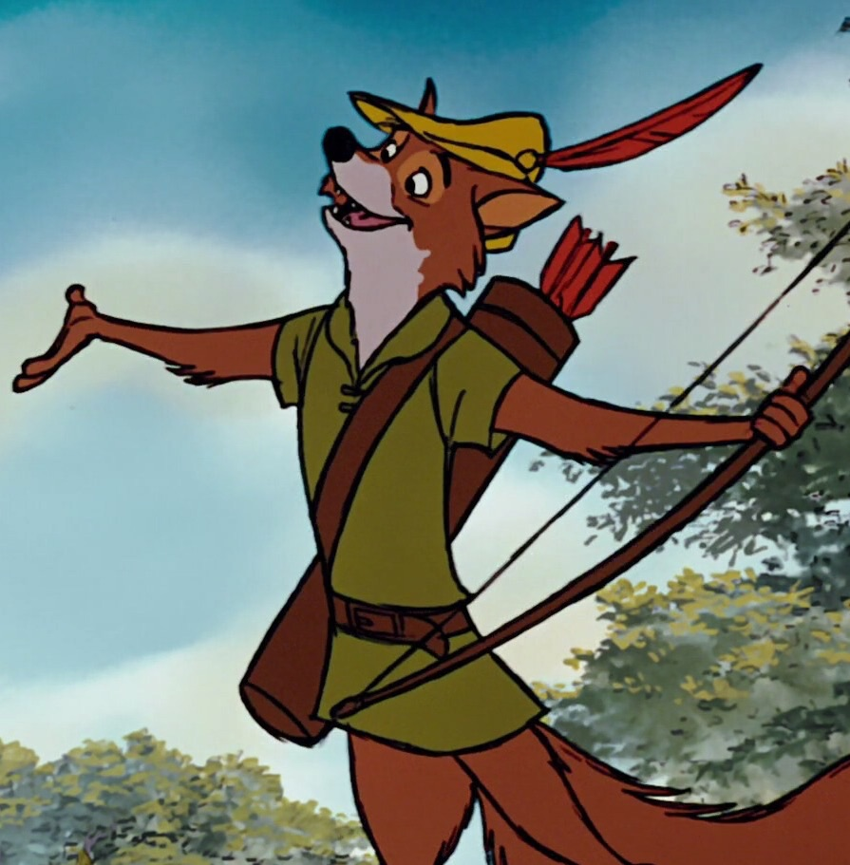
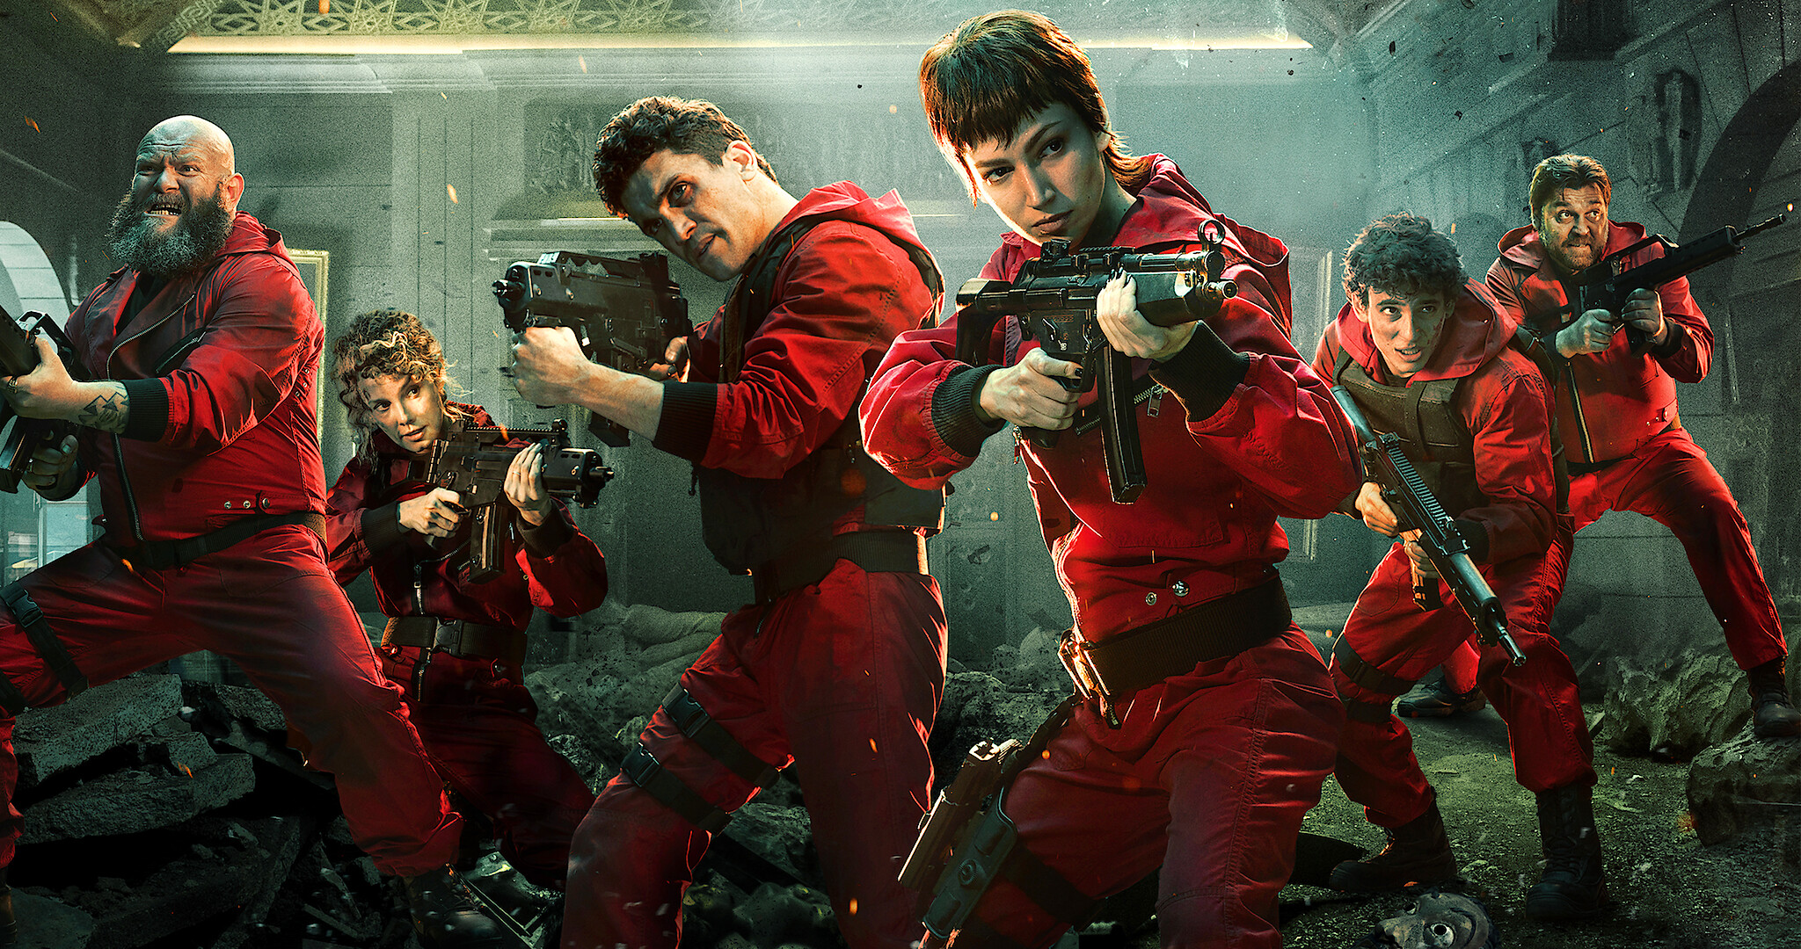


Slide 5
Moral Ambiguity (General)
Moral ambiguity isn't defined exactly in the literature.
For the purposes here, let's define it as: "Any internal or external position that a moral subject faces where clear action-guidance isn't provided in order to help navigate either a belief, situation, or experience."
Internal positions can be: a) Speaking to a friend about a relationship you know that's bad for them, b) Not knowing when to pass or fail a student.
External positions can be: a) Being the sole jury member to disagree, b) A doctor lying to a patient to preserve quality of life.
The dichotomy isn't as clear here. Although both involve the moral subject, the internal one is part of a smaller group compared to external larger ones.

Slide 6
Moral Ambiguity (General)
Krakowiak and Beth Oliver (2012) found in a sample of n = 133 adults that morally ambiguous characters (like those present in literature, television, and films) are less liked than good characters but are equally engaging and suspenseful, making them as enjoyable as good characters despite their lower likability.

Slide 7
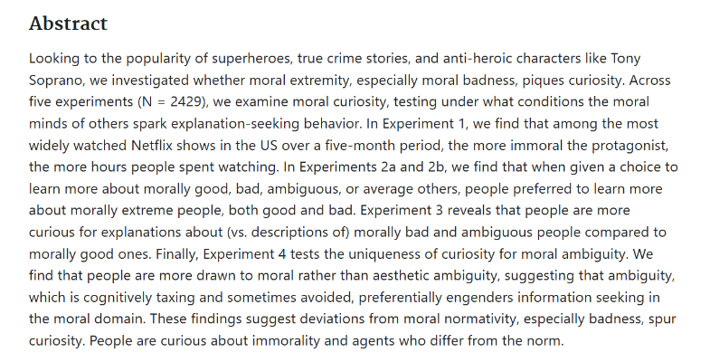
Wylie and Gantman's experiment (2023)

Slide 8
Moral Ambiguity (Youth)
Provins (2021) conducted an online study in a sample of n=95 youth 11-14.
The study found that while not all results were statistically significant, adolescents exposed to morally ambiguous role models were more likely to lie for their own benefit, while those exposed to immoral role models were less likely to lie for the benefit of others

Slide 9
Moral Ambiguity (CASE STUDY)

Slide 10
13-year-old boy, Jones, gave a bad feeling in my stomach.
Hung out with younger boys, stealing their ball, gave cold and detached attitudes. Overall angry vibes.
Additionally, he had, in my opinion, a very mean and detached homeroom teacher.
Working with him independently one day, he read my notebook.
Was put in a morally ambiguous situation of whether to keep it to himself, whether to tell the teacher, or whether to tell the whole class. And he...
Told the whole class.
Despite initial discomfort, this resulted overall in the teacher improving and the students being happier! (e.g., lights, door).
Not all kids would've even looked into the notebook, let alone told everyone about it.
My theory is that being the 'class hero' taught him about the good in evil deeds, thus preventing future acts of bad that’s truly bad.
The question now becomes: how can we apply this?

Slide 11
Moral Psychology
Situationism is a perspective in moral psychology that says people lack cross-consistent character traits across situations, thus not making them stable enough for the habit and practice required by traditional virtue (e.g., Isen & Levin, 1972; Darley and Batson, 1973).
The experiments, however, do not involve any aspects of moral ambiguity.
An interesting question can therefore be as follows:
If people really do lack cross-consistent character traits across situations, shouldn't these also include those situations that are morally ambiguous?

Slide 12

"What would you do?"
"What Would You Do?" is an American hidden-camera reality TV show where the public is put into morally ambiguous situations to see how they would react.
Of course, the show only includes those who help, but these are still quite a lot of people.

Slide 13
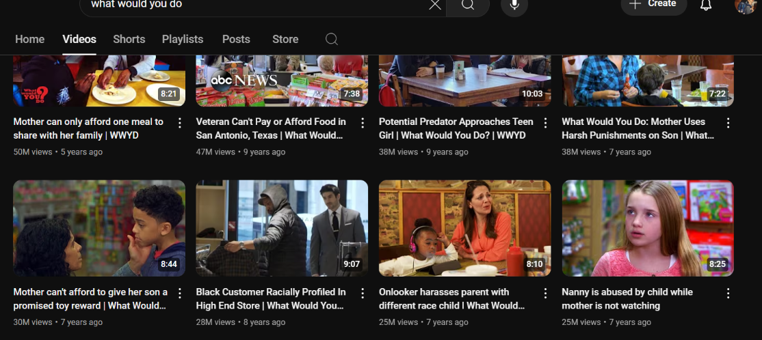

Slide 14
Many People Help!

Slide 15
Research
Does this mean, however, that those who step in to help would also help in other morally ambiguous situations?
Research says that it's quite likely.

Slide 16
Research
Funder and Colvin (1991), in a sample of n = 140 undergraduates, found that behavior can exhibit impressive consistency at the level of psychological meaning, suggesting that individuals who display helping behavior in one context are likely to do so in others.
On 3,512 occasions randomly sampled from the lives of 42 subjects, Diener and Larsen (1984) found that "persons who were more consistent across one pair of situations tended to be more consistent across other situational pairs."

Slide 17
Research
However, Lefevor and Fowers (2016) found that, in a sample of 121 undergraduate students, the character trait of kindness significantly predicted helping behavior more than agreeableness and situational factors.

Slide 18
Future Research
How can we relate moral amibiguty to situationism positions while incorperating the idea of the good in evil deeds?
Could studies inform us more about this to help mitigate possbile behavioural concerns in youth and adolecesent populations?
One example: A pre-screening assessment could involve presenting adolescents with interactive digital narratives where they face decisions with both positive and negative consequences. For youth with behavioral concerns, psychologists could analyze whether they choose actions that offer short-term social gain or long-term moral growth. Follow-up interventions could then simulate situations where they act as a ‘class hero’ or constructive leader, reinforcing prosocial behavior through experiential learning and reflection.

Slide 19
Recap
I talked about what moral abmiguity is generally through popular-media and the few research studies out there that test this; offering my own interm defintion as: "Any internal or external position that a moral subject faces where clear action-guidance isn't provided in order to help naviagte either a belifef, situaiton, or experince."
I spoke about the case study of the 13-year old boy, Jones.
I linked the idea of moral ambiguity to moral psychology's seminal situationism postioin, providing the 'What would you do?" Example.
Discussed what future research may look like.

Slide 20
References
Diener, E., & Larsen, R. J. (1984). Temporal stability and cross-situational consistency of affective, behavioral, and cognitive responses. Journal of Personality and Social Psychology, 47(4), 871.
Funder, D. C., & Colvin, C. R. (1991). Explorations in behavioral consistency: Properties of persons, situations, and behaviors. Journal of Personality and Social Psychology, 60(5), 773.
Krakowiak, K. M., & Oliver, M. B. (2012). When good characters do bad things: Examining the effect of moral ambiguity on enjoyment. Journal of Communication, 62(1), 117-135.
Lefevor, G. T., & Fowers, B. J. (2016). Traits, situational factors, and their interactions as explanations of helping behavior. Personality and Individual Differences, 92, 159-163.
Provins, A. (2021). Role models and moral ambiguity: Impacts on adolescent moral decision-making (Master's thesis, Harvard University).
Wylie, J., & Gantman, A. (2022). What is moral ambiguity and when does it trigger curiosity? In Proceedings of the Annual Meeting of the Cognitive Science Society (Vol. 44, No. 44).

Slide 21

Thank you

