Slide 1
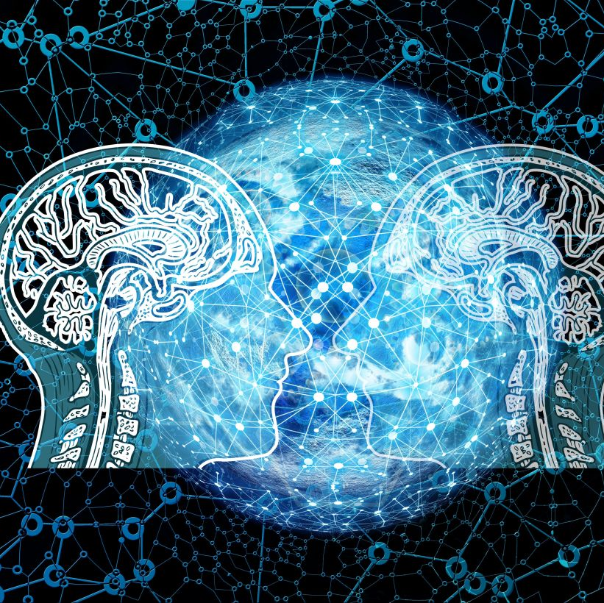
Intuitive Judgements of Awareness in AI Systems
A Vignette Survey Study

Slide 2
Contents
1) Introduction
2) Research Question
3) Method
4) Results
5) Conclusion

Slide 3
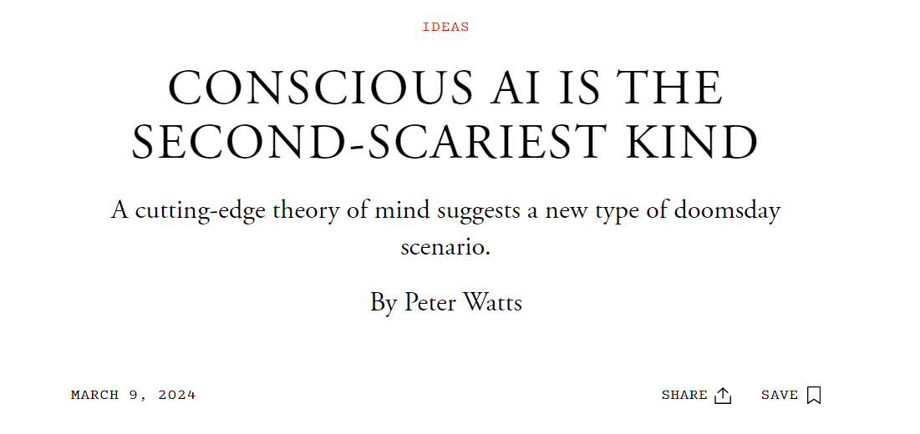
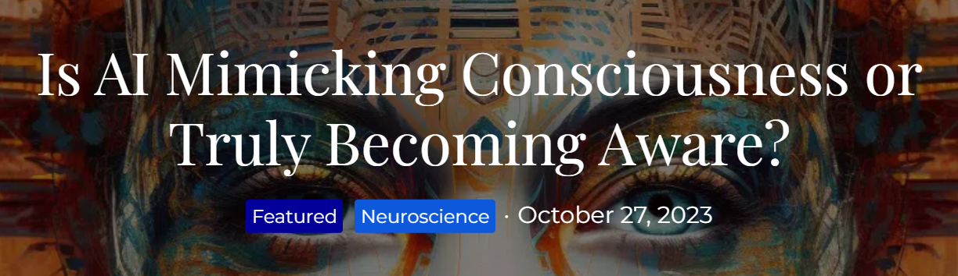
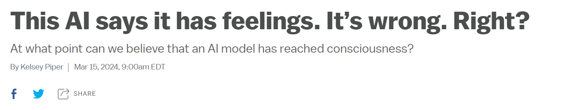
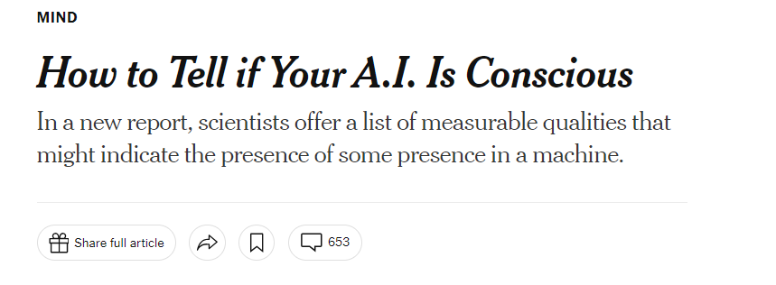
Introduction
Recent headlines in popular media suggest AI is conscious. >>
But is this true? Should we be skeptical of these headlines?

Slide 4
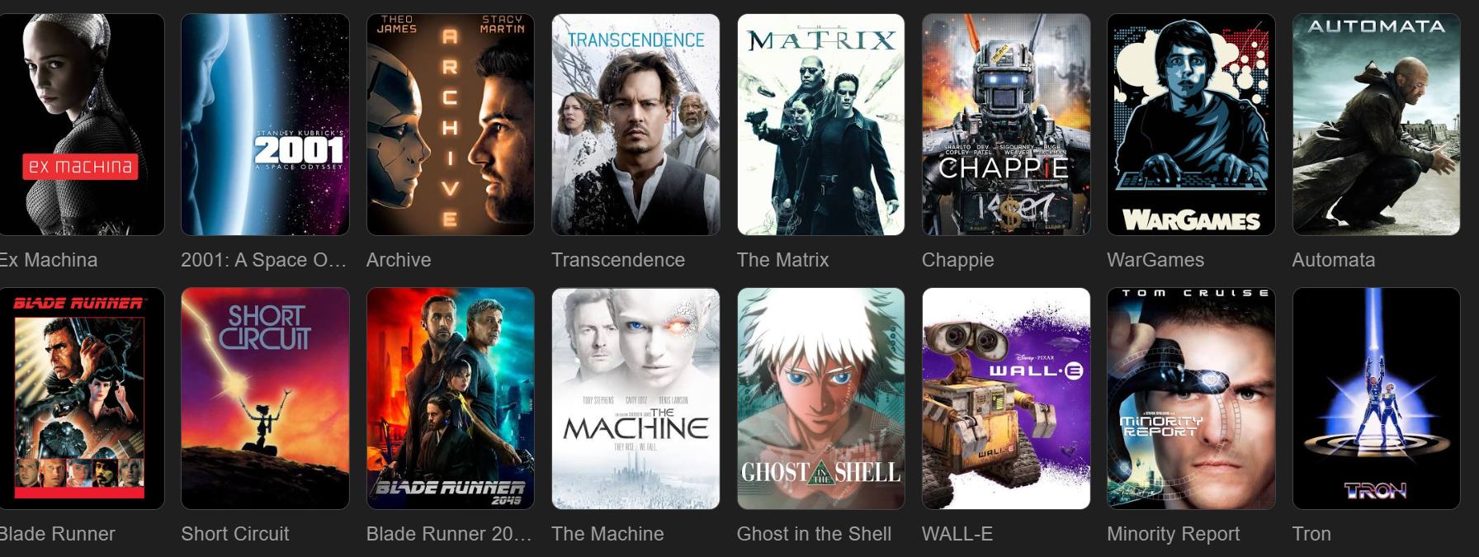
Fears Associated to AI Often draw to film

Slide 5

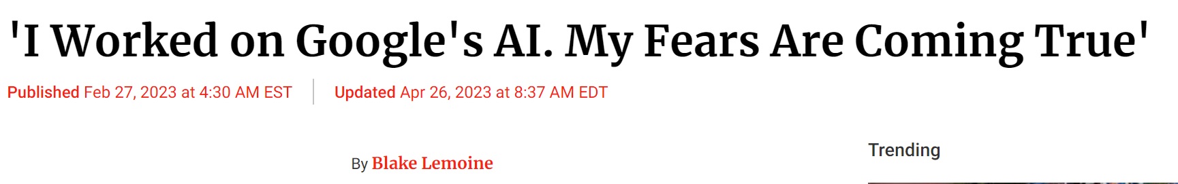
The case of Blake Lemoine who in 2022 argued Google’s chat was conscious, although many disagreed with him.

Slide 6

David Chalmers
Chalmers concludes in his talk at New York University (2022) titled “Are Large Language Models Sentient?” three main points that can be summarized as follows:
We need a better understanding of AI and sentience because questions about AI sentience aren’t going away so much so that within the next ten years or so we’ll have systems close to artificial general intelligence.

Slide 7

Recent Scholarly Research (1)
Meissner’s paper (2019) Artificial intelligence: consciousness and conscience, argues that:
Our society is experiencing the AI revolution… while also debating the implications of imbuing AI robots with virtual consciousness and conscience.

Slide 8
Recent Scholarly Research (2)
Li, He, and Guo’s paper Why AI still doesn’t have consciousness argues (2021)
“The development of AI shows that intelligence can exist without consciousness. When human beings enter into the era of life intelligence from AI, it is not the AI becomes conscious, but that conscious lives will have strong AI.”

Slide 9
(2) Research Question
How do students reading short vignettes of various AI conditions judge such AI based on moral responsibility and consciousness?
We defined “intuitive judgements of awareness” as one factor being moral responsibility and the other factor consciousness.
The independent variables were how the AI looks and acts.
The dependent variables were measures of moral responsibility and consciousness.

Slide 10
Disclaimer
This project was conducted as part of the requirements for Tilburg University’s Philosophy Master’s program.
It was done as a project for the AI course taught by Dr. Michael Cohen.
Accordingly, we didn’t pre-register the study nor had it approved by an ethics board before.
We made sure to include all ethical parameters in the actual survey on the front page, collecting responses of consent to record the data, and the option for them to stop taking the survey at any time.

Slide 11
Method (I)
An initial G-Power test (informs about the required sample size to get a result) informed 128. Our sample at the end was less than this: N = 116.
Participants were asked to read four vignettes which displayed four cases: A) looks human, acts human, B) looks human but doesn’t act human, C) acts human but doesn’t look human, D) purely mechanical AI systems.
The null hypothesis was that no correlation between moral responsibility and conscious ratings exist between conditions.
The alternative hypothesis was that a correlation does exist between the groups of moral responsibility and conscious ratings.

Slide 12
Method (II)
The first two conditions had negative outcomes like the AI resulting in job lose and failing students. The second two conditions had positive outcomes like teams winning games and wood mills completing orders on time.
Responses were collected on a 7-point Likert scale.
Collected results underwent a paired sample t-tests to compare the scores of responsibility and consciousness between each of the two groups of the independent variable.
Four vignettes were made available in English and Dutch.

Slide 13
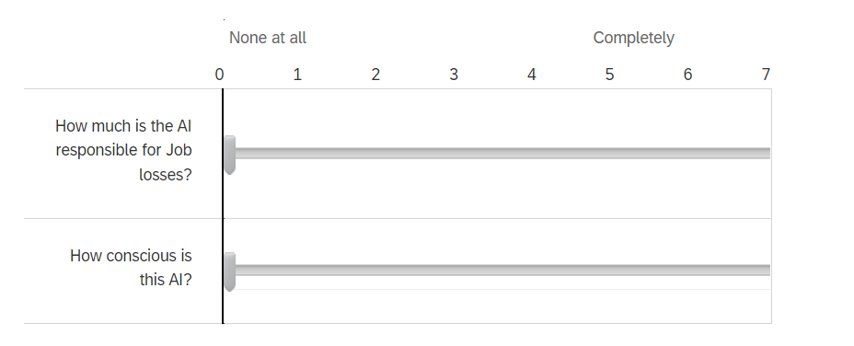
Vignette I: Looks Human, Acts Human (-)

Slide 14
Vignette I: Looks Human, Acts Human (-)
The Chief AI officer of a technology company went to their CEO and said: ‘We are thinking of implementing a new AI system to automate our customer service. It will improve efficiency because it looks and acts just like a human’. The CEO answered, ‘I understand that this AI looks and acts like a human, but I also want to ensure that our employees are treated fairly. Let’s explore alternative solutions that minimize job losses.’ Despite their efforts, the implementation of the AI system led to significant job losses in the customer service department, but the customer service ratings increased in satisfaction ten-fold.

Slide 15
Vignette II: Looks Human, DOES not act HUMAN (-)
A high school teacher went to the school principal and said: ‘I am thinking about adding a tutor AI bot that looks human but does not act human. It will help the students learn because it looks human, helps them build connections, but does not act human.' The principal responded, 'I understand that this AI looks human but does not act human, but I want to ensure that students have a chance to talk to someone that is real. Let’s explore alternative solutions that minimize student risk.’ Despite their efforts, the school board decided to implement the AI system which led to the students relying on it so much that the majority of them failed.

Slide 16
Vignette III: Acts human but doesn’t look human (+)
A sports manager went to the hockey coach and said, ‘There’s a new AI that acts human but does not look like a human. Its purely robotic, and our players can play against it, train, and do better overall.’ The hockey coach responded, ‘I understand that this AI acts human-like but does not look human, but I want to ensure that our players have a good understanding of how humans look like because this relates to how they play. Let’s explore alternative solution that minimize players getting the wrong impression.’ Despite their efforts, the hockey board decided to implement the AI system which led to the players training with it, and winning every single game.

Slide 17
Vignette IV: Acts purely Mechanical (+)
A worker at the wood mill went to the operator and said,
‘There’s a new machine on the market that they say is AI because it can tell which logs it cuts. It looks and acts in a purely mechanical way, and it will help us fill the hundreds of orders we have to do.’
The operator said, ‘I get this AI machine can tell which logs it cuts and how to cut them, but we must do this process manually because the human-eye is better at knowing which logs to cut and how.
Let’s explore alternative solution that minimize the risk of getting all our orders wrong.’
Despite their efforts, the owner of the mill decided to buy this new AI machine which led to the hundreds of orders being processed and complete on time.

Slide 18
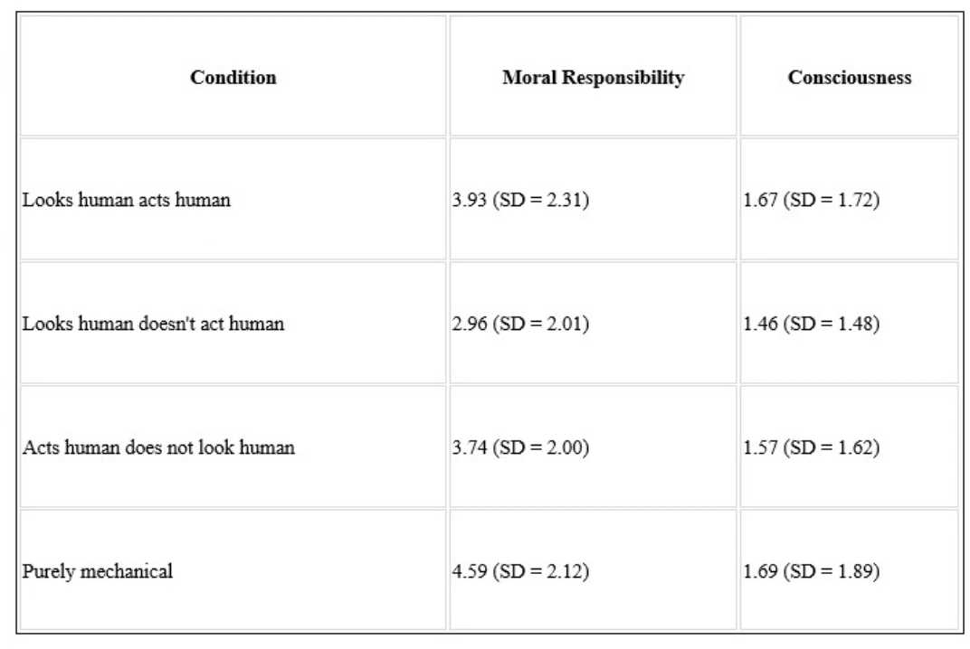
Means and Standard Deviation
1 = Low, 7 = High
AI at Tech Company resulting in job loss
AI Tutor Bot resulting in students failing
AI Coach resulting in winning.
AI wood mill machine resulting on-time orders
Leaves one to question: Does one’s perception itself qualify as a sufficient rating of consciousness?

Slide 19
6-paired sample t-tests
Once the results were collected, 6-paired sample t-tests compared the scores of moral responsibility (MR) and consciousness (C) between each two groups of the independent variable.
A paired t-test is used to determine whether the mean difference between two related groups is statistically significant or not.
6-tests were performed comparing conditions: case 1 with 2, 1 with 3, 1 with 4, and so on, for both MR and C.

Slide 20
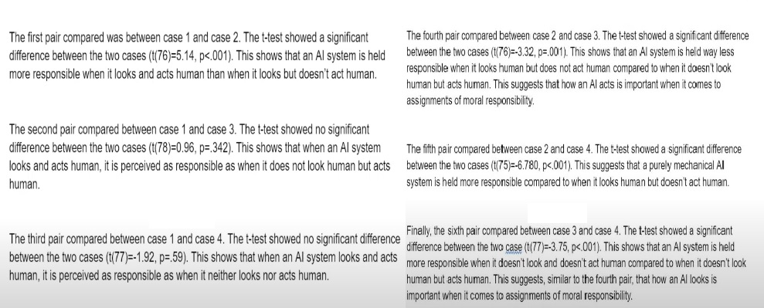
Comparing means of mR

Slide 21
Results: Comparing means of mR
Results show that an AI system is perceived as the most morally responsible when it doesn’t look human but acts human (i.e., hockey training bot winning games).
And perceived as the least morally responsible when it looks human but does not act human (tutor bot failing students).
AI systems are therefore judged to be more morally responsible not as a function of how they look, but how they act.

Slide 22
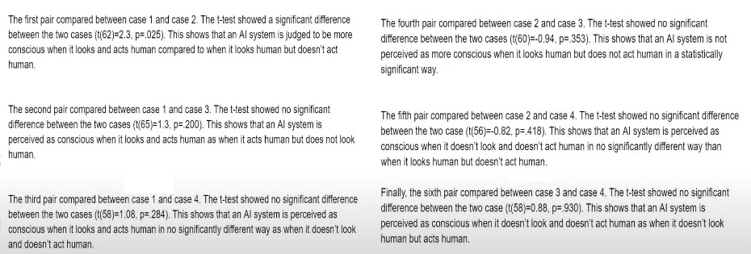
Comparing means of Consciousness

Slide 23
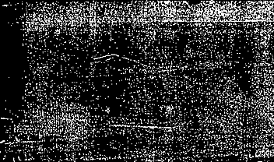

Results: Comparing means of C
Although the first paired t-test comparison showed significantly higher perception of consciousness between case 1 and case 2, the results show that overall, AI systems are not perceived/judged to be conscious.

Slide 24
Results: Conclusion
We were able to successfully reject the null hypothesis for the moral responsibly condition.
We were unable to successfully reject the null hypothesis for the consciousness condition.
Results show that an AI system is perceived as the most responsible when it doesn’t look human but acts human (i.e, AI hockey coach winning), and is perceived as the least morally responsible when it looks human but does not act human (i.e, tutor AI Bot failing students).

Slide 25
Results: Limitations
The sample size was educated. As this was a school assignment for an AI class, a portion of the sample was from this class.
Some students completed the survey on time pressures before class.
The degrees of freedom are different for every pair wise analysis meaning that the survey didn’t count responses of 0 on the Likert as a response.

Slide 26
Importance and Future Research
Informs AI creators of the public’s perception of AI systems.
Informs educators that people despite the media outlets and scholarly arguments, do not perceive AI as conscious.
Informs both creators, researchers, and the public that moral responsibility is judged in AI systems differently as a function of how it looks and acts.
Future research can seek to replicate this study with a more random and larger sample size using the same conditions (perhaps with pictured aided vignettes) with a more robust statistical analysis.

Slide 27
Thank you for listening

