Slide 1
The Detail in Cognitive Architecture
5th International Conference on Philosophy of Mind
Michael Paskaru

Slide 2
Contents
Theoretically picture the detail in cognitive architecture via a virtual reality analogy.
How paradigms in cognitive science do not consider both the amount and the specific qualities of representations.
Criticisms about mind-uploading and whether an updated RTM could help overcome concerns.

Slide 3
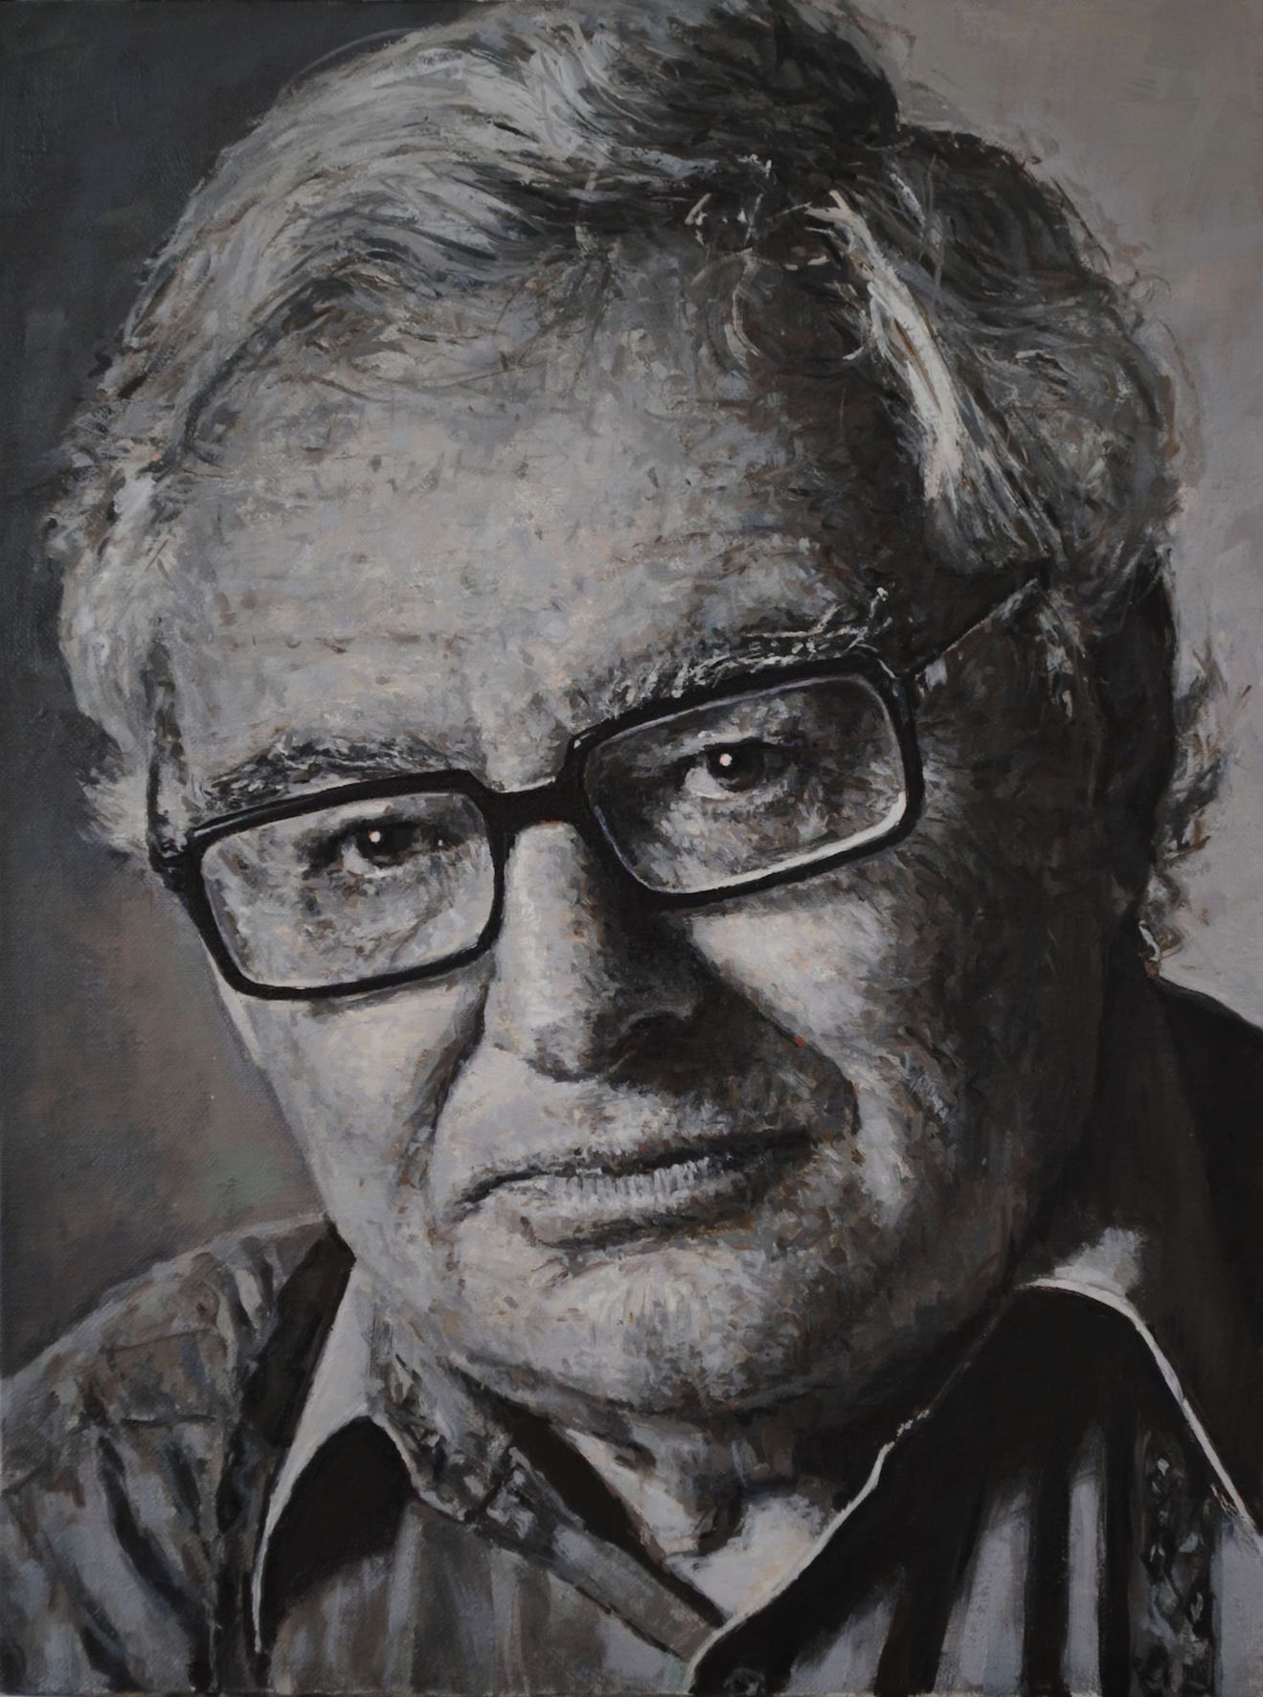
Operating Paradigms
That the mind is an information-processor.
Within the representational theory of mind, the view that thinking occurs through the manipulation of mental representations—structured symbols in a "language of thought"—that correspond to real-world entities and states.

Slide 4
What do we think about when it comes to virtual reality?

Slide 5
1. Analogy from Cryptography
Grant Sanderson of 3Blue1Brown posted a video in 2017.
His main claim was that solving a cryptographic hash function, called SHA-256, while being very difficult, is nonetheless possible to visualize regarding how many guesses it would take. (I claim we can use this analogy to think about how many representations we should account for when thinking about the detail in cognitive architecture).
A SHA-256 hash function is a cryptographic algorithm that generates a fixed-length unique string of characters, known as a hash, from input data, providing a secure and irreversible way to represent the original data. It is used most often to secure digital transactions.

Slide 6
Analogy from Cryptography
To solve a SHA-256 hash function, would take 2^256 guesses.
To visualize a number as big as this one, Sanderson breaks it down into multiplying 4 billion (2^23) times itself eight times.

Slide 7
Graphic processing units (GPU’s)
(4 Billion) (4 Billion) (4 Billion) (4 Billion) (4 Billion) (4 Billion) (4 Billion) (4 Billion)
If one programmed a GPU to run a cryptographic hash function over and over, a really good one can likely achieve around less than a billion hashes per second.
Then, if we take 4 of these GPU’s, our first 4 billion here is going to represent “the number of hashes per second per computer”.

Slide 8
GPU packed computer
(4 Billion) (4 Billion) (4 Billion) (4 Billion) (4 Billion) (4 Billion) (4 Billion) (4 Billion)
Now, picture 4 billion of these GPU packed computers.
Google’s servers are around in the single digit millions.
4 billion machines of these can be called one kilo-Google worth of computing power.

Slide 9
½ Earth’s pop. having 1 kilo-Google
(4 Billion) (4 Billion) (4 Billion) (4 Billion) (4 Billion) (4 Billion) (4 Billion) (4 Billion)
Next, imagine giving a little over half of every person on Earth their own personal kilo-Google.
This means that around 4 billion people on Earth have this kilo-Google computer.

Slide 10
4 billion copies of Earth
(4 Billion) (4 Billion) (4 Billion) (4 Billion) (4 Billion) (4 Billion) (4 Billion) (4 Billion)
Now, imagine 4 billion copies of this Earth…
Akin to around 1% of every star in the Milky Way galaxy which has around 100-400 billion stars.

Slide 11
4 billion copies of the Milky Way
(4 Billion) (4 Billion) (4 Billion) (4 Billion) (4 Billion) (4 Billion) (4 Billion) (4 Billion)
Now, try and imagine 4 billion copies of the Milky Way.
Sanderson calls this our ‘Giga-Galactic Supercomputer” running about 2^160 hashes/sec.

Slide 12
4 billion seconds
(4 Billion) (4 Billion) (4 Billion) (4 Billion) (4 Billion) (4 Billion) (4 Billion) (4 Billion)
4 billions seconds is about 126.8 years.

Slide 13
4 billion years
(4 Billion) (4 Billion) (4 Billion) (4 Billion) (4 Billion) (4 Billion) (4 Billion) (4 Billion)
4 billion of those seconds is 507 billion years, about 37x the age of the universe.

Slide 14
1 in 4 billion chance…
(4 Billion) (4 Billion) (4 Billion) (4 Billion) (4 Billion) (4 Billion) (4 Billion) (4 Billion)
“So even if you were to have your GPU-packed kilo-Google-per-person multiplanetary GigaGalactic computer guessing numbers for 37 times the age of the universe, it would still only have a 1 in 4 billion chance of finding the correct guess” (Sanderson, 2017).

Slide 15
Now… this is a lot of guesses, what I claim can be thought of as representations.
It is my guess that when thinking about cognitive architecture and the role of detail in computation, and creating minds so that they are virtually indistinguishable from our own… we would have to account for so much stuff that it would be close to a number like this. Which itself isn’t so far from reality.
Neurons: Around 86 billion in the brain with hundreds of billions of signals sent to other neurons in the brain and body every second.
(4 Billion) (4 Billion) (4 Billion) (4 Billion) (4 Billion) (4 Billion) (4 Billion) (4 Billion)

Slide 16
2. Amount of Representations
Current paradigms in cognitive science do not account for both the number of representations and their specific qualities in the way I am discussing here.
What I mean by amount is simply the number of possible representations that do and could exist.
What I mean by specific quality is the direct link between one representation (e.g., yellow) the neurons responsible for its activation.
To create a computational philosophy of mind, my claim is that both paradigms should focus on these two: the amount & specific quality.
Let’s explore this in more detail…

Slide 17
Updated RTM
Updated RTM focuses on both the amount and the specific qualities of representations. It requires a new metaphysics to organize the amount.
How could an updated RTM handle criticism about mind-uploading?

Slide 18
3. Criticisms against mind-uploading
Mind-uploading is a common topic within the last decade or so, and it concerns the idea that the mind can be uploaded to a computer.

Slide 19
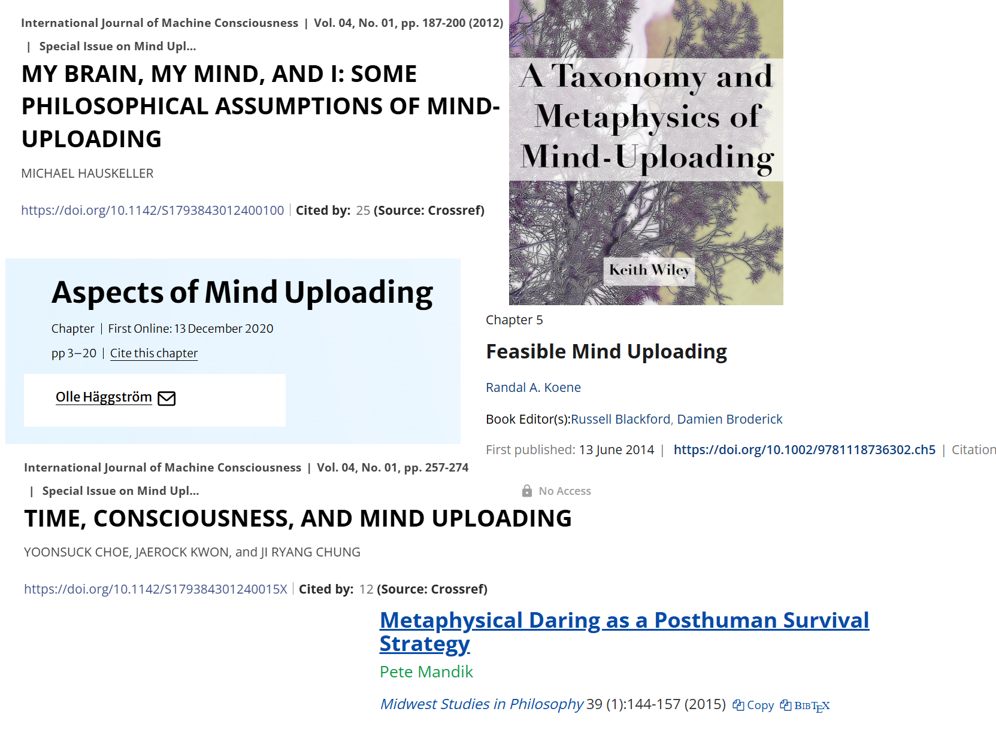

Slide 20

3. Criticisms against mind-uploading
One counter-proponent is Gualtiero Piccinini who in 2021 argued that are several limitations to mind-uploading.
1) Loss of information about dynamical systems.
2) Measurement errors.
3) Ignorance against complex systems.
4) Ignorance about human brains.
5) Idealization and specification.
6) Numerical approximation.
7) Unpredictability of nonlinear dynamical systems.
8) Finiteness of computational resources.

Slide 21
How can picturing the amount and specific qualities of representations (or the detail in cognitive architecture), mitigate these concerns?

Slide 22
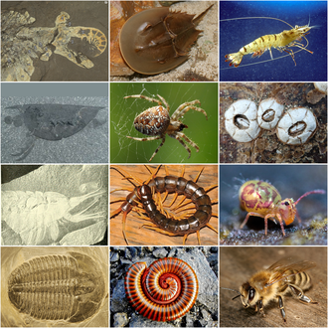
1) Loss of information about dynamical systems.
Piccinini claim is that the same neurobiological structures differ widely in terms of performed function, which isn’t really a loss of information.
Piccinini discusses this from the perspective of the stomatogastric ganglion (STG) which is a much-studied ganglion (collection of neurons) found in arthropods and studied extensively in decapod crustaceans.
He then assumes that this lack of correspondence between structure and function is also the case with humans and their hundreds of billions of neurons.
But, while the amount of human neurons in the brain can be large, their specific qualities can still, nonetheless, be the same (e.g., brain function localization).

Slide 23


2) Measurement errors
Piccinini claim is that we can’t get exact measurements of specific neurons, and if we were to zoom in for this data, we’d inevitably alter the system and have measurement errors, thus leaving behind critical data.
Although, while the specific qualities are hard to obtain in terms of clusters of neurons, we should be able to isolate the amount of them (e.g., the first 4 billion). Doing this can be used via an EEG to see how these two ‘yellows’ differ in terms of neurological pathways:

Slide 24
3) Ignorance against complex systems
Piccinini claim is that the brain is too complex and intricate to fully understand.
A potential solution could be to form an aggregated metaphysics that divides and organizes our representations into specific kinds.

Slide 25
4) Ignorance about human brains
Piccinini claim is that the mind and cognition are also too complex, and that ethical parameters prevent its direct study through various means of intervention in contrast to studies done to rats and monkeys.
The potential way around this is to see to what extent paradigms in neuroscience can help explain each cluster of organization differently: (e.g., the complex cluster to do with decision making can use Bayesian probability, while the input systems cluster can be a mix of embodied and representational cognition).
In other words, playing around with the paradigms to see which combinations of them best describes what.

Slide 26
5) Idealization and specification.
Piccinini claim is that mathematical and computational models will be unable to capture the nuances of specificity.
A potential way around this is instead of using X (math) to describe Y (possible computations), to let Y (possible computations) define X (what specific kind of math). In other words, letting specification set the limits opposed to imposing the limitations from the get-go (e.g., theoretical physics for the specific and engineering for the structural).

Slide 27
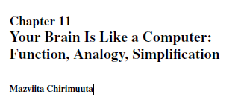
6) Numerical approximations
Piccinini claim is that “Scientists build computational simulations because the underlying mathematical models are analytically unsolvable”.
In other words, we want to build supercomputers (X) to solve complex math problems (Y), and the same idea may apply to cognition, but how can we go backwards?
Possible way around this is to let the amount and specific qualities of representations each be defined differently by relying not on just mathematics, but on the different principles of it: (e.g., engineering vs. physics).

Slide 28
7) Unpredictability of nonlinear dynamical systems
Piccinini assumes a non-linear dynamical system, but it isn’t clear exactly what its unpredictability will constitute.
Does nonlinear imply that cognitive penetration is true? If not, then what’s so unpredictable about it, and to what extent can Bayesian theories overcome this?

Slide 29
8) Finiteness of computational resources
Piccinini claim is that there’s not enough computational resources: “transistors cannot shrink forever”.
I do agree with Piccinini on this claim but am inclined to believe that there could be an interesting way around this.
240p, 480p, 720p, 1080p.

Slide 30
Summary
Discussed the amount of representations needed to understand the detail in cognitive architecture through the cryptographic hash function analogy. This was meant to fill in RTM’s gap on the amount of representations.
Talked about paradigms in cognitive science not focusing on both the amount and specific quality, thus needing either a combination of these or an entirely new metaphysics.
Discussed how this can help mitigate some the concerns regarding mind-uploading and the limits of it imposed by Piccinini (2021).

Slide 31
Thank you for listening

