Slide 1
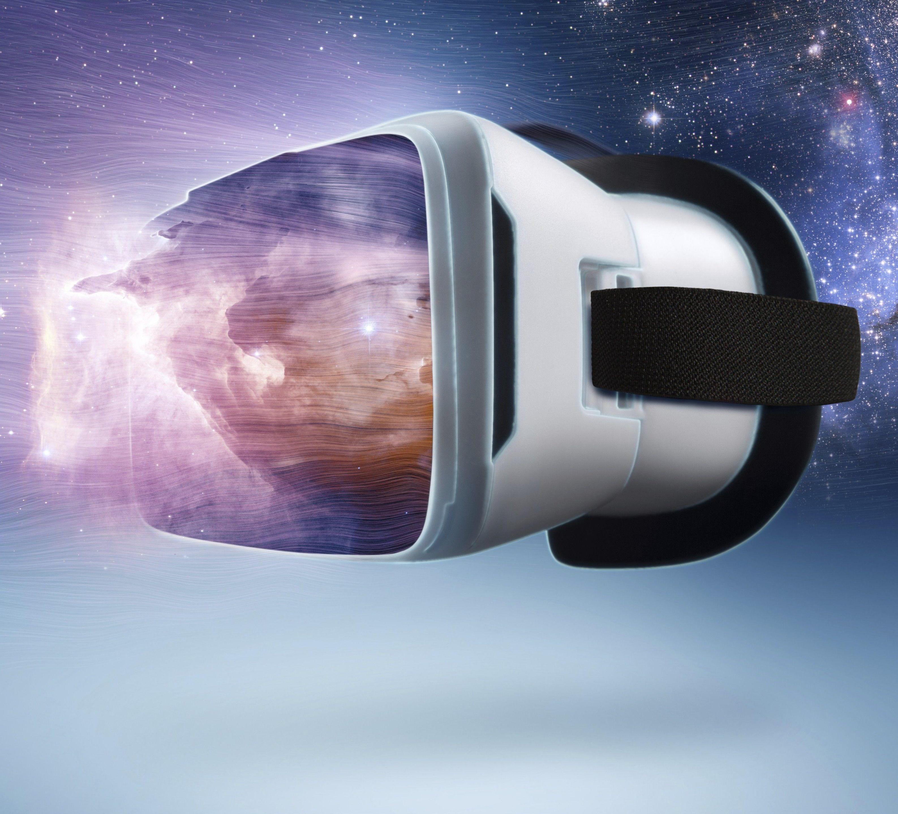
Picturing Virtual Reality
Social cognition in Virtual Reality

Slide 2

How many particles are in the universe?
A) 550 billion
B) 10^80
C) 2^256
D) Unknown

Slide 3
Background
Alimi, J.-M., et al. "First-ever full observable universe simulation." In SC '12: Proceedings of the International Conference on High Performance Computing, Networking, Storage and Analysis, Salt Lake City, UT, USA, 2012, pp. 1-11. doi: 10.1109/SC.2012.58.
> > 550 billion particles simulation.
Zwart, S. P., and Bedorf, J. "Creating the Virtual Universe." IEEE Software 33, no. 5 (September-October 2016): 25-29. doi: 10.1109/MS.2016.113.
>> 220 billion particles

Slide 4
Research Question
What specifically should we think about when it comes to creating a perfect virtual reality?

Slide 5
Main Claim
Philosophers studying virtual reality through the concept of representation can utilize an analogue from cryptography to consider the amount of stuff needed for a virtual world to be indistinguishable from our own, with further thoughts on how to go about its organization.

Slide 6
Argumentative Structure
1) The Concept of Representation.
2) What does it mean for VR to be undistinguishable?
3) Analogy from cryptography.
4) How to go about its organization.

Slide 7
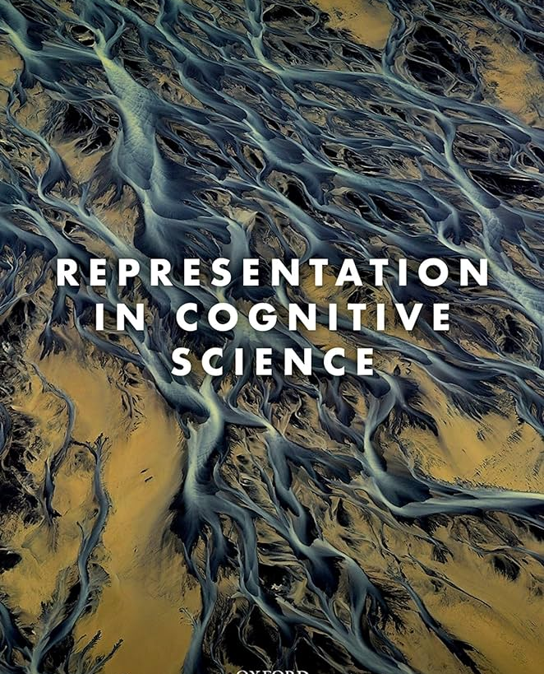

The Concept of Representation
Philosopher Nicholas Shea, describes the concept of mental representation as the solution to the enigma of thinking. Shea describes mental representation as “one of the most significant discoveries of the twentieth century—perhaps the most significant” (Shea 2018, 4).

Slide 8
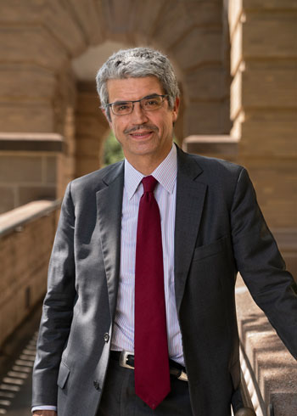
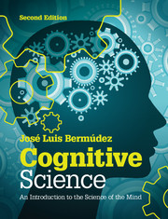
The Concept of Representation
For José Luis Bermúdez, “Representations are one of the fundamental explanatory tools of cognitive science” (2014, p. 11)
“Hand in hand with the concept of information goes the concept of representation… representation will turn out to be the basic currency of cognitive science” (ibid, 24).

Slide 9
The Concept of Representation
Difficult to determine what counts as “one representation” as opposed to “many.”
For example, is one byte a representation?
Could this be an epistemic problem regarding what counts as knowledge?
Could it be a metaphysical problem: (i.e., set theory which posits whether a set is grounded in its members; emotions to a mood).
We’re not sure…

Slide 10
The Concept of Representation
For this presentation, let’s define one representation as one of anything.
This anything could be a letter, a number, a decimal point.
It can be a certain emotion, personality, thought, or mood.
A representation therefore can be anything and everything except for nothing.

Slide 11
What is indistinguishable VR?
Who is familiar with Black Mirror’s episode called San Junipero?
Written by Charlie Brooker, this episode consists of two woman who fall in love in a makeshift hospice.
For those who don’t know, a spoiler alert.. It takes place in VR.
Therefore, indistinguishable VR is one where ourself and the world around us is exactly as it is now. Sits at the same dinner table with the simulation hypothesis.

Slide 12
Quick Review
So far, we’ve answered the one question on the Strawpoll which we’ll get back to.
Second, the concept of representation was defined as a concept of central currency in the world of cognitive science.
Third, we briefly discussed what counts as one representation opposed to many, and how it is difficult to determine whether it’s an epistemic problem or a metaphysical one (i.e., set theory).
Forth: Main claim – we can think

Slide 13
Analogy from Cryptography
Grant Sanderson of the YouTube channel 3Blue1Brown posted a video in 2017.
His main claim was that solving a cryptographic hash function, called SHA-256, while being very difficult, is nonetheless possible to visualize regarding how many guesses it would take. (I claim we can use this analogy to think about how many representations we should account for when creating VR).
A SHA-256 hash function is a cryptographic algorithm that generates a fixed-length unique string of characters, known as a hash, from input data, providing a secure and irreversible way to represent the original data. It is used most often to secure digital transactions.

Slide 14
Analogy from Cryptography
To solve a SHA-256 hash function, it would take 2^256 guesses.
To visualize this immense number, Sanderson breaks it down into multiplying 4 billion (2^23) multiplied by itself eight times.
(4 Billion) (4 Billion) (4 Billion) (4 Billion) (4 Billion) (4 Billion) (4 Billion) (4 Billion)

Slide 15
Graphic processing units (GPU’s)
(4 Billion) (4 Billion) (4 Billion) (4 Billion) (4 Billion) (4 Billion) (4 Billion) (4 Billion)
If one programmed a GPU to run a cryptographic hash function over and over, a really good one can likely achieve around less than a billion hashes per second.
If we then take 4 of these GPU’s, our first 4 billion here is going to represent “the number of hashes per second per computer”.

Slide 16
GPU packed computer
(4 Billion) (4 Billion) (4 Billion) (4 Billion) (4 Billion) (4 Billion) (4 Billion) (4 Billion)
Now, picture 4 billion of these GPU packed computers.
Google’s servers are around in the single digit millions.
4 billion machines of these can be called one kilo-Google worth of computing power.

Slide 17
½ Earth’s pop. having 1 kilo-Google
(4 Billion) (4 Billion) (4 Billion) (4 Billion) (4 Billion) (4 Billion) (4 Billion) (4 Billion)
Next, imagine giving a little over half of every person on earth their own personal kilo-Google.
This means that around 4 billion people on Earth have this kilo-Google computer.

Slide 18
4 billion copies of Earth
(4 Billion) (4 Billion) (4 Billion) (4 Billion) (4 Billion) (4 Billion) (4 Billion) (4 Billion)
Now, imagine 4 billion copies of this Earth…
Akin to around 1% of every star in the Milky Way galaxy which has around 100-400 billion stars.

Slide 19
4 billion copies of the Milky Way
(4 Billion) (4 Billion) (4 Billion) (4 Billion) (4 Billion) (4 Billion) (4 Billion) (4 Billion)
Now, try and imagine 4 billion copies of the Milky Way.
Sanderson calls this our ‘Giga-Galactic Supercomputer” running about 2^160 hashes/sec.

Slide 20
4 billion seconds
(4 Billion) (4 Billion) (4 Billion) (4 Billion) (4 Billion) (4 Billion) (4 Billion) (4 Billion)
4 billions seconds is about 126.8 years.

Slide 21
4 billion years
(4 Billion) (4 Billion) (4 Billion) (4 Billion) (4 Billion) (4 Billion) (4 Billion) (4 Billion)
4 billion of those seconds is 507 billion years, about 37x the age of the universe.

Slide 22
1 in 4 billion chance…
(4 Billion) (4 Billion) (4 Billion) (4 Billion) (4 Billion) (4 Billion) (4 Billion) (4 Billion)
“So even if you were to have your GPU-packed kilo-Google-per-person multiplanetary GigaGalactic computer guessing numbers for 37 times the age of the universe, it would still only have a 1 in 4 billion chance of finding the correct guess” (Sanderson, 2017).

Slide 23
Now… this is a lot of representations.
(4 Billion) (4 Billion) (4 Billion) (4 Billion) (4 Billion) (4 Billion) (4 Billion) (4 Billion)
It is my guess that when creating a potential VR world indistinguishable from our own, we would have to account for so much stuff that it would be close to this number.

Slide 24
Thoughts about organization
(4 Billion) (4 Billion) (4 Billion) (4 Billion) (4 Billion) (4 Billion) (4 Billion) (4 Billion)
It is also my guess that a potential theoretical model to think about how to deal with this immense number lies in the philosophy of Arthur Schopenhauer.
His metaphysical system encompasses Becoming, Knowing, Being, and Willing. It’s possible that the first 8 billion can be becoming, the next 8 can be knowing, and so on.

Slide 25
Concluding Review
We went through one Strawpoll question regarding how many particles in the universe.
Discussed how although representation is a central concept in cognitive science, it’s not easy to demarcate what counts as one “representation” as opposed to many.
We talked about indistinguishable VR through the example of Black Mirror.
And we unpacked Sanderson’s analogy from cryptography to provide insight into how many representations we might have to account for.
Lastly, I touched briefly on a philosopher whose metaphysical system may help.

Slide 26
Thank you for listening

