Slide 1
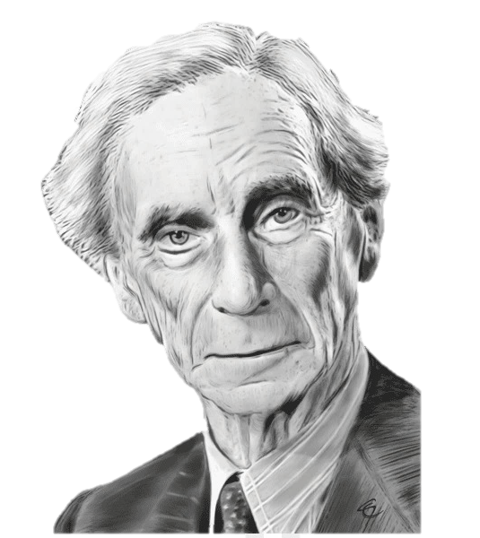
Russell Style Questions
50th annual Bertrand Russell Society Annual Meeting
By: Michael Paskaru, MA

Slide 2

Contents
Introduction
Background
Three Examples Of Russell Style Questions
Conclusion

Slide 3
About Me:
I obtained my Undergraduate degree in Psychology with honors from York University, Toronto.
Then I did my Master’s degree in Philosophy of Mind and Psychology at Tilburg University, Netherlands.
I’m applying to Ph.D. programs focused on the Philosophy of Psychology, Virtue Ethics, and Development Education.

Slide 4
Introduction
Philosophy and Psychology alike are in the business of asking questions about the world.
As a result, both disciplines look to different literature for inquiry about what it means to ask good questions.
In this introduction, I discuss who psychologists look at to ask better questions followed by who philosophers look at to ask better questions.

Slide 5
Why is asking better questions important?
Before doing this, however, we must ask: “Why is it important to ask better questions? What’s wrong with the current way of asking them now? And can this way be improved?”
I claim that Russell’s philosophy can help the philosopher and psychologist alike ask better questions by establishing a correlation between the behaviour and the phenomenon. This point will be returned to.

Slide 6
Who Psychology Looks At:
Schaeffer & Presser (2003) argued that different kinds of questions require different theoretical approaches.
Their claims is that: Questions have two domains- Events & Behaviours and Subjective Phenomena- with each requiring their own sine qua non.
Meanwhile, Coenen and collaborators (2018) claim we need to ask questions about asking questions, but quickly think about what makes a good answer and the developmental trajectory of a question with respect to youth.

Slide 7
Who Psychology Looks At:
Ruggeri and collaborators (2021) speak of such developmental trajectory, finding that kids ages 4-6 ask better questions with age and scaffolding, which is helping their questions to be more specific.
The point here is that not much literature exists in psychology on what it means to ask better questions.

Slide 8
Who Philosophy Looks At:
To find out more about what a philosophical question is, Floridi (2013) writes that philopsohical questions share various characteristics such as rationality with certain empirical constraints.
When thinking about questions in Philosophy, however, one often looks more toward the Philosophy of Science.
Here, Popper reminds us that theories built on questions must be falsifiable.
Kuhn reminds us that questions range from normal to potentially revolutionary.

Slide 9
Who Philosophy Looks At:
Ruse (1982) reminds us that “Testability is a two-way process” with limitations toward certain unempirical tested claims.
Duhem reminds us that questions require different levels of testing as a function of logical simplicity (i.e., in physics vs. physiology).
Quine reminds us that questions for analytical philosophers must first have a clear idea of the relationship between definition and meaning.

Slide 10
Who Philosophy Looks At:
Laudan reminds us that questions as they pertain to theory have various grades of underdetermination that are separate from not only the scientists' beliefs, but also from any other questions or claims that can prove or disprove it from being testable or true.
Feyerabend reminds us that empirical researchers asking questions create their own domain-specific metaphysics.
Fodor reminds us that questions may be bridged between special sciences like psychology and the physical sciences.

Slide 11
Background
So, while psychology has limited literature concerning what asking better questions means that’re beyond the notion of operationalization, specification, replication, and validity…
... Philosophical literature concerns various methods and pieces of advice, that while not focusing on questions directly, informs us overall that the amount of detail an answer requires often depends on the nature of the question.

Slide 12
Background
Both disciplines, however, have yet to think about a way to take the questions they are asking already and how to make them better; how to make them more robust.
I argue that there exists a method inspired by one of Russell’s less well-known papers: The Relation of Sense-Data to Physics.
The background section explores this paper to find a unique, simple, and sharp way to ask better questions for both disciplines.

Slide 13
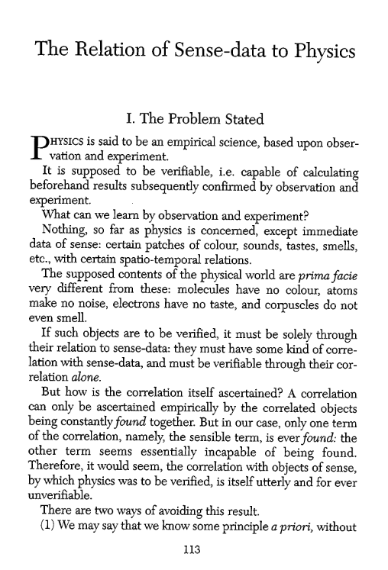
The Relation of Sense-data to Physics
Russell wrote this paper in 1914 while writing Principia Mathematic with Whitehead between 1910 and 1913.
1914 also marked the start of WW1, where Russell was not only dismissed from Trinity College in 1916 due to being against the Defense of the Realm Act (DORA) of 1914 (an act which granted the UK powers of a military state) but was also sent to prison for being against this act.

Slide 14


Russell’s 1914 paper
Russell’s main claim in this paper is that for a phenomenon in physics to be verifiable, a correlation must exist between our senses and the object itself.
A two-way road must exist between the object and our sense-data: to see, feel, touch, smell, etc.
But the problem is that objects studied in physics aren’t always seen.

Slide 15
Russell’s 1914 paper
“Physics is said to be an empirical science, based upon observation and experiment. It is supposed to be verifiable, i.e. capable of calculating beforehand results subsequently confirmed by observation and experiment. What can we learn by observation and experiment? Nothing, so far as physics is concerned, except immediate data of sense: certain patches of colour, sounds, tastes, smells, etc., with certain spatio-temporal relations. The supposed contents of the physical world are prima facie very different from these: molecules have no colour, atoms make no noise, electrons have no taste, and corpuscles do not even smell.”

Slide 16
Russell’s 1914 paper
Russell claims Physics cannot be verified if the contents of the objects aren’t seen.
Sense-data, in physics, is seen as products of the phenomenon that comes first (i.e., this or that electron spins and we see its effects).
But physics can only be verified if these physical objects themselves are seen as products of the sense-data that comes first.
Finding examples for what this may mean, is a little more difficult but possible.

Slide 17
Russell’s 1914 paper
I do not wish to explore Russell’s solution to this problem here, insofar as I want to highlight how these two separate roads are understood, and how they translate into psychology.
Paradigm A: Sense-data as functions of physical objects; and Physical objects as functions of sense-data.
Paradigm B: Can paradigm A be translated to concepts that make sense with psychology?

Slide 18
Making sense w/ Psychology
Picture sense-data as behaviour.
Picture physical objects as phenomena.
I define Behaviour as any specific adjective that describes a person’s characteristics or attitudes: (i.e., the behaviour of hypocrisy, hostility, affection, avoidance, and resentment).
I define Phenomena as any overarching emotional or psychological state or experience that gives rise to specific behaviors: (i.e., the phenomena of love, hate, fear, and envy).

Slide 19
Behaviour & Phenomena
Behaviour | Phenomenon
Hate | Hostility
Love | Affection
Fear | Avoidance
Envy | Resentment
Insincerity | Hypocrisy

Slide 20
Behaviour & Phenomena
Hostility (or the sense of it) when seen as function of the phenomenon of hate, sees the phenomenon of hate come first. People hate before they’re hostile.
Behaviour | Phenomenon
Hostility | Hate
Affection | Love
Avoidance | Fear
Resentment | Envy
Hypocrisy | Insincerity

Slide 21
Behaviour & Phenomena
Now, many psychological studies study the phenomenon coming first and the behaviour that follows. For example, the phenomenon of being in prison to see behaviours; the phenomenon of ringing a bell to see the dog salivate; the phenomenon of shocking a victim to see how people react to this).
Behaviour | Phenomenon
Hostility | Hate
Affection | Love
Avoidance | Fear
Resentment | Envy
Hypocrisy | Insincerity

Slide 22
Behaviour & Phenomena
Now, what I’m proposing is similar to what Russell did with physics, is to express PHENOMENA as FUNCTIONS OF BEAHAVIOUR. This is for the main idea that if the behaviour comes first, we can better understand the phenomenon and how it relates to the behaviour.
Behaviour | Phenomenon
Hostility | Hate
Affection | Love
Avoidance | Fear
Resentment | Envy
Hypocrisy | Insincerity

Slide 23
Example 1
Instead of asking “Is the behaviour of hostility a function of hate?” where the phenomenon of hate comes first, we should also ask “Is the phenomenon of hate a function of hostility?”
Here, people who are hostile are assigned various hateful conditions in order to study the correlation between them better.
This is similar to the idea: “Is the behaviour of prisoners a function of being in a makeshift prison?” to “Is the phenomenon of being in a makeshift prison a function of prisoner behaviour?”

Slide 24
Example 2
Instead of asking “Is the behaviour of affection a function of love?” where the phenomenon of love comes first, we should also ask “Is the phenomenon of love a function of affection?”
Here, people who are affectionate are assigned various love-like conditions to study the correlation between them better.
This is similar to the idea: “Is the behaviour of shocking a victim a function of being told to do so?” to “Is the phenomenon of being told to do so a function of shocking a victim?”

Slide 25
Example 3
Instead of asking “Is the behaviour of avoidance a function of fear?” where the phenomenon of fear comes first, we should also ask “Is the phenomenon of fear a function of avoidance?”
Here, people who are avoidant are assigned various fearful conditions to study the correlation between them better.
This is similar to the idea: “Is the behaviour of hitting a Bobo doll a function of seeing adults hitting it also?” to “Is the phenomenon of seeing adults hitting it also a function of hitting a Bobo doll?”

Slide 26
Conclusion
These three examples demonstrate the ability to translate Russell’s problem with physics to psychology.
I claim that these questions when translated to psychology under Russell’s framework make it possible for questions to become more robust.
By asking questions through both paradigms, various phenomena can be understood based on the principles of a two-way road existing between the behaviour and the phenomenon to form a verifiable correlation between them.

Slide 27
Thank you for listening

Slide 28
References
Coenen, Anna, Jonathan D. Nelson, and Todd M. Gureckis. "Asking the Right Questions about the Psychology of Human Inquiry: Nine Open Challenges." Psychonomic Bulletin & Review 26, no. 5 (2019): 1548-1587.
Floridi, Luciano. "What Is a Philosophical Question?" Metaphilosophy 44, no. 3 (2013): 195-221.
Ruggeri, Azzurra, Caren M. Walker, Tania Lombrozo, and Alison Gopnik. "How to Help Young Children Ask Better Questions?" Frontiers in Psychology 11 (2021): 586819.
Schaeffer, Nora Cate, and Stanley Presser. "The Science of Asking Questions." Annual Review of Sociology 29, no. 1 (2003): 65-88.

