Slide 1

Rental Catalog
Partyperfection_llc@yahoo.com

Slide 2
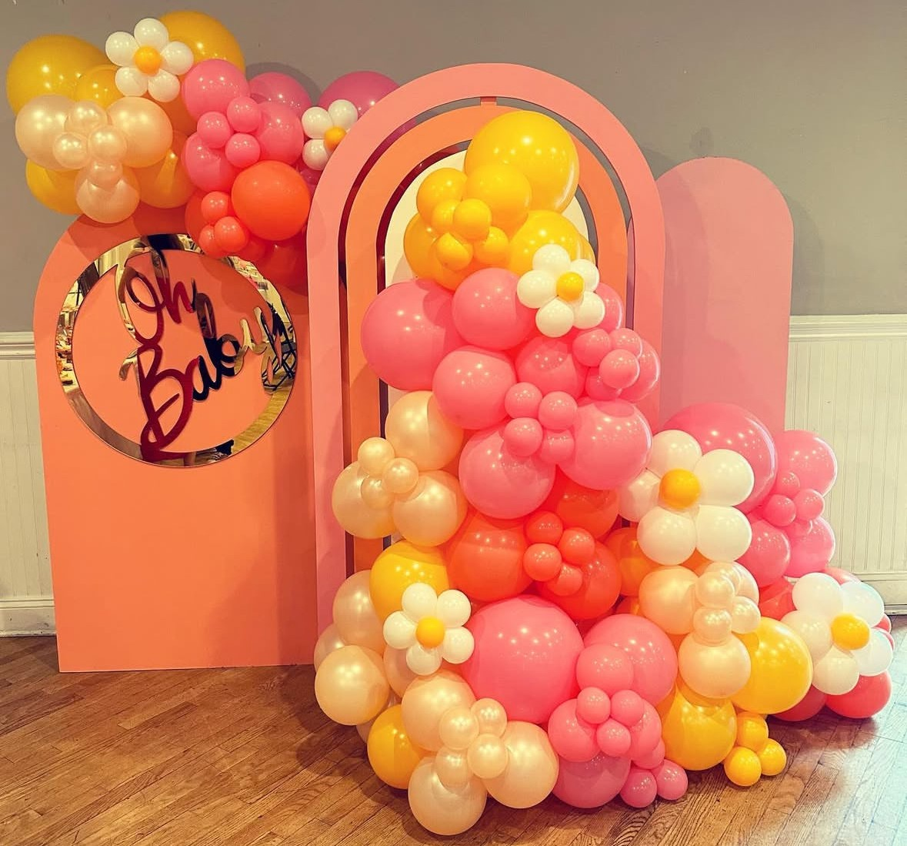
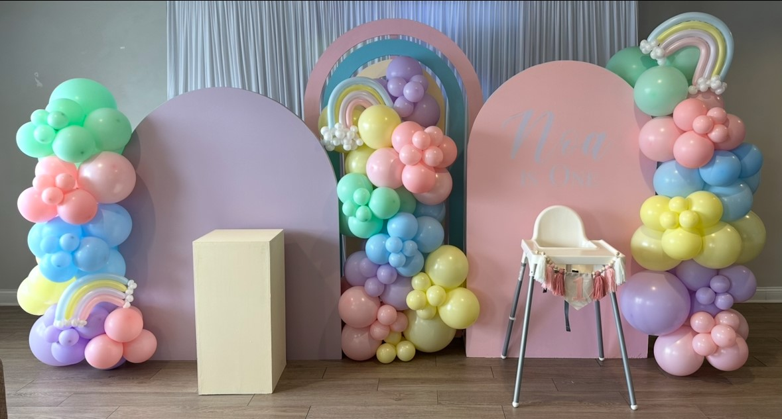
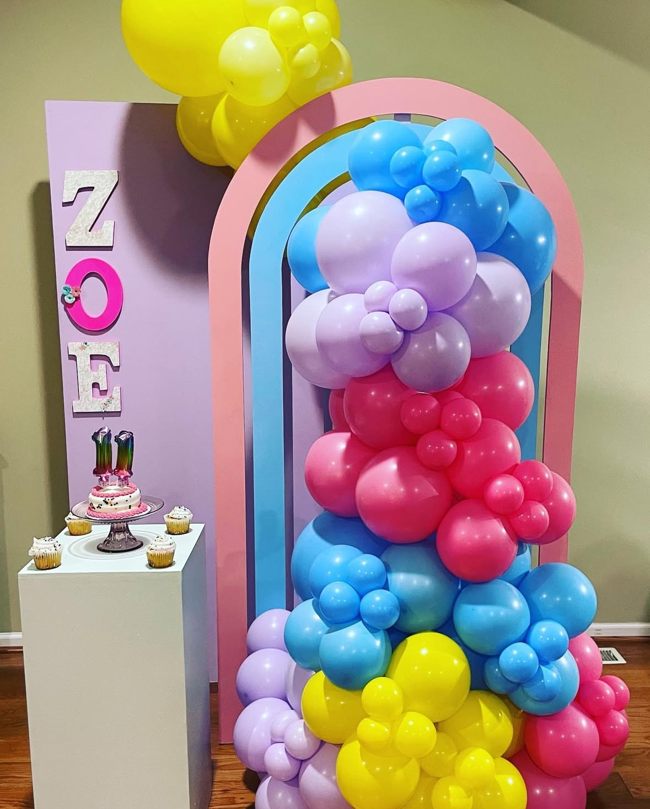
Rainbow Wall $150
**Rental Prices Do Not Include Decor**

Slide 3
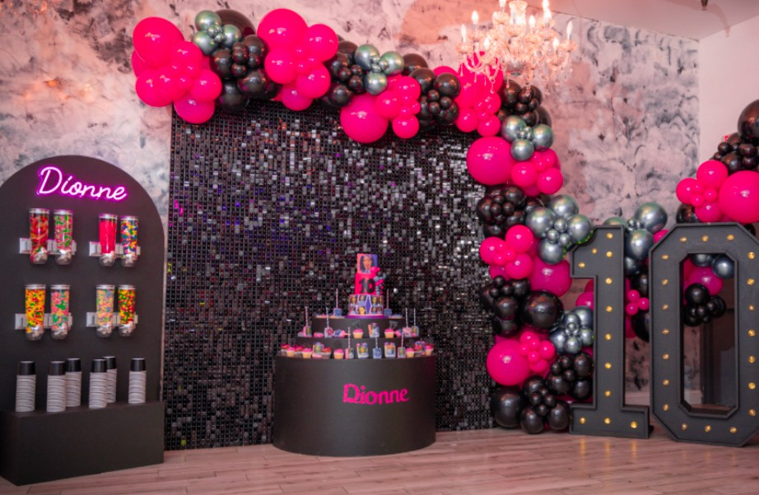
Candy Wall $175
(not filled)
Tri Table $150

Slide 4
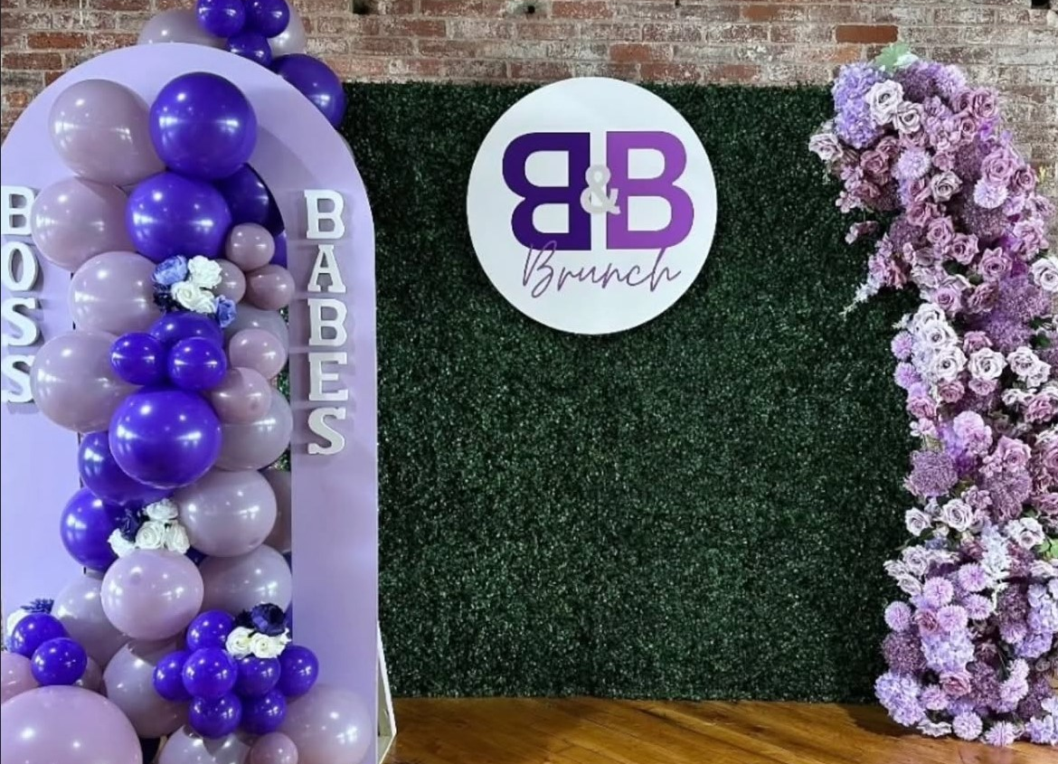
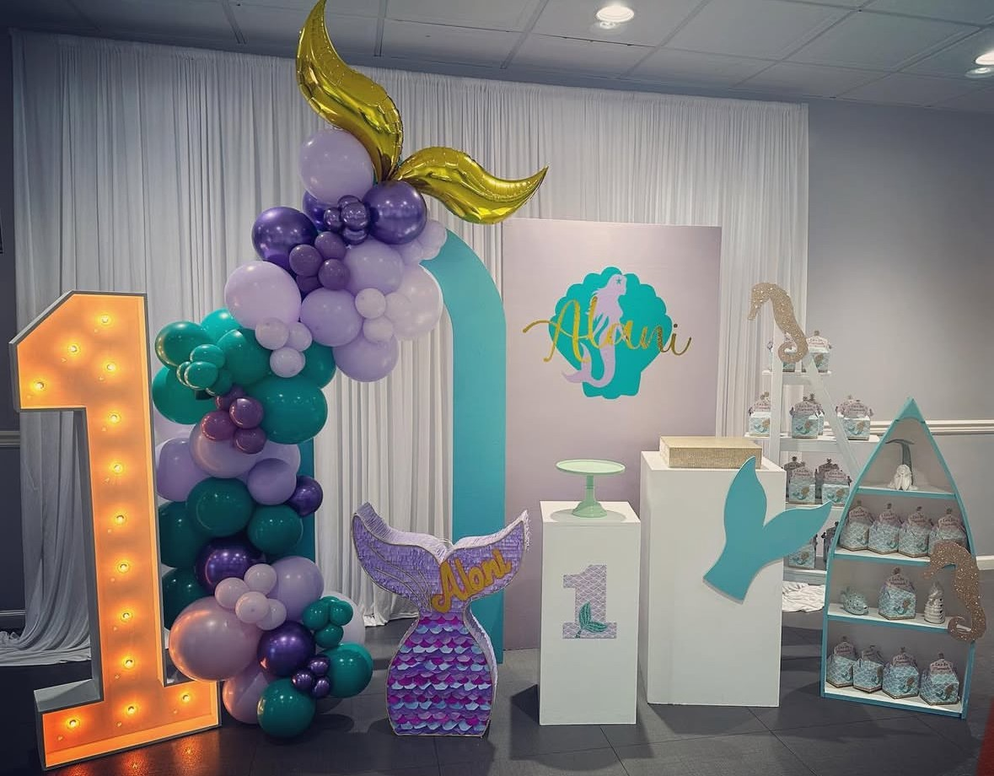
Open Arch Wall $100
Grass Wall $250

Slide 5
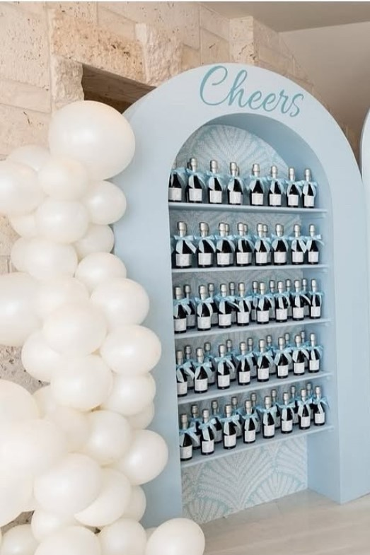
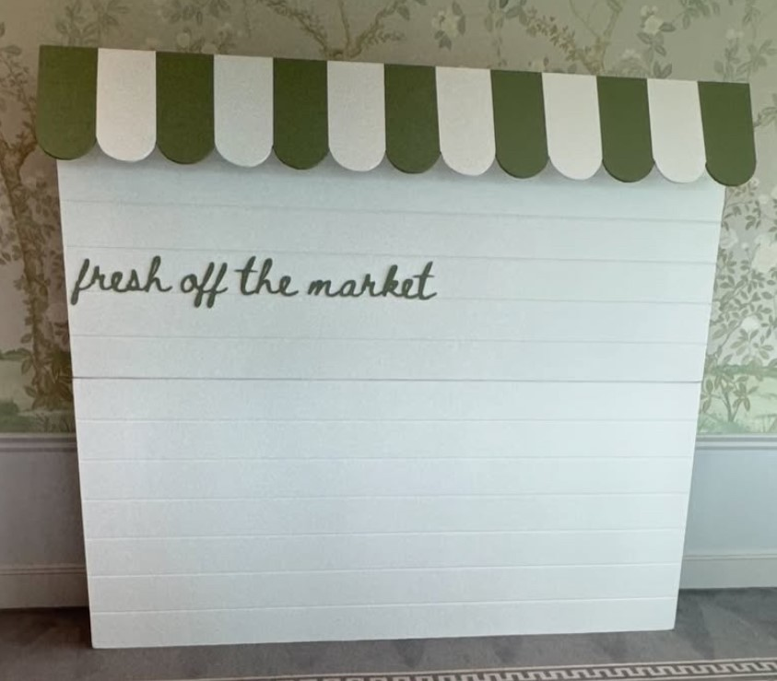
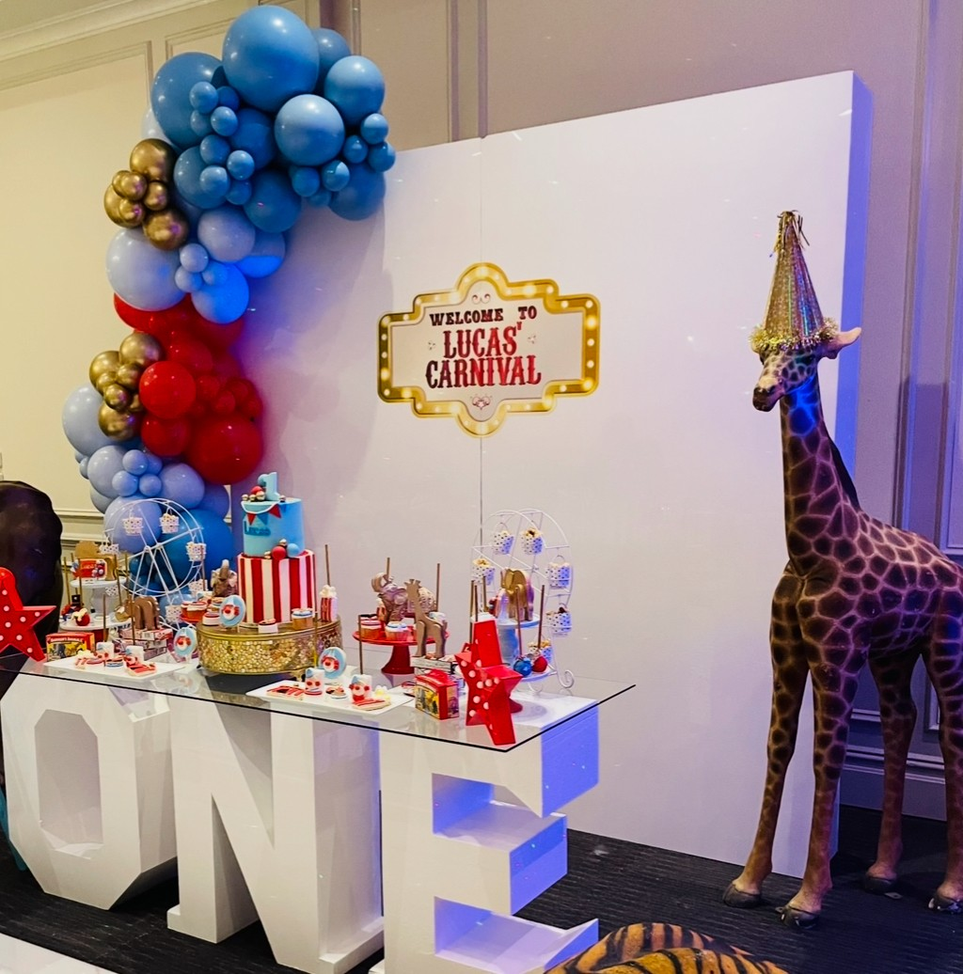
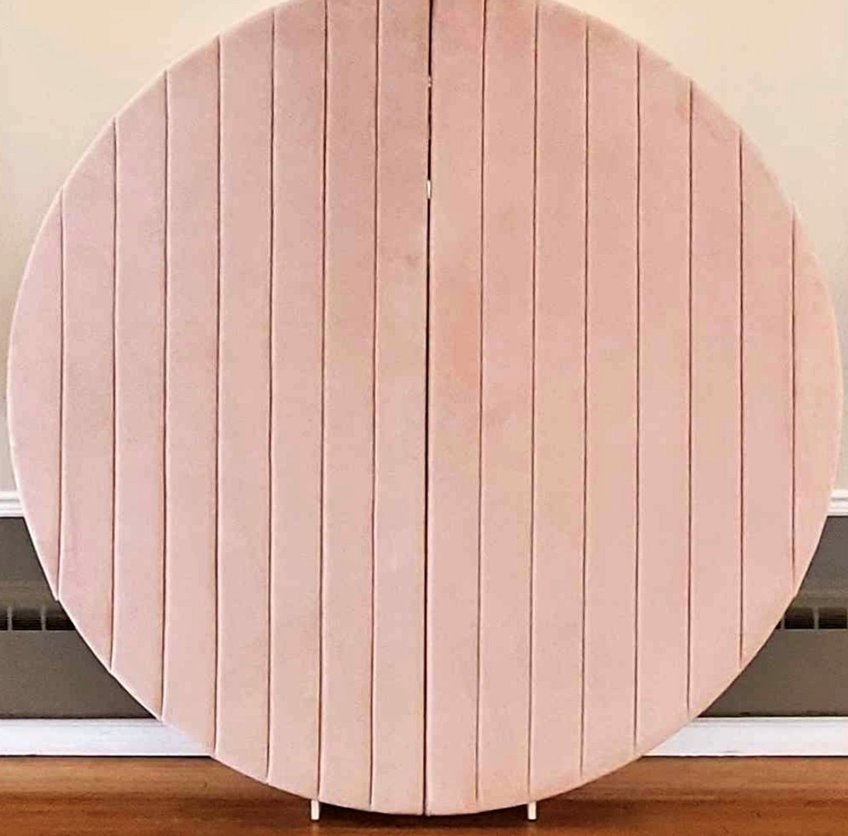
Specialty Backdrops
Acrylic 8x8 Wall $275
Pink Velvet 7ft Wall $250
Market 8x8 Wall $300
8x8 Shelf Wall $250

Slide 6
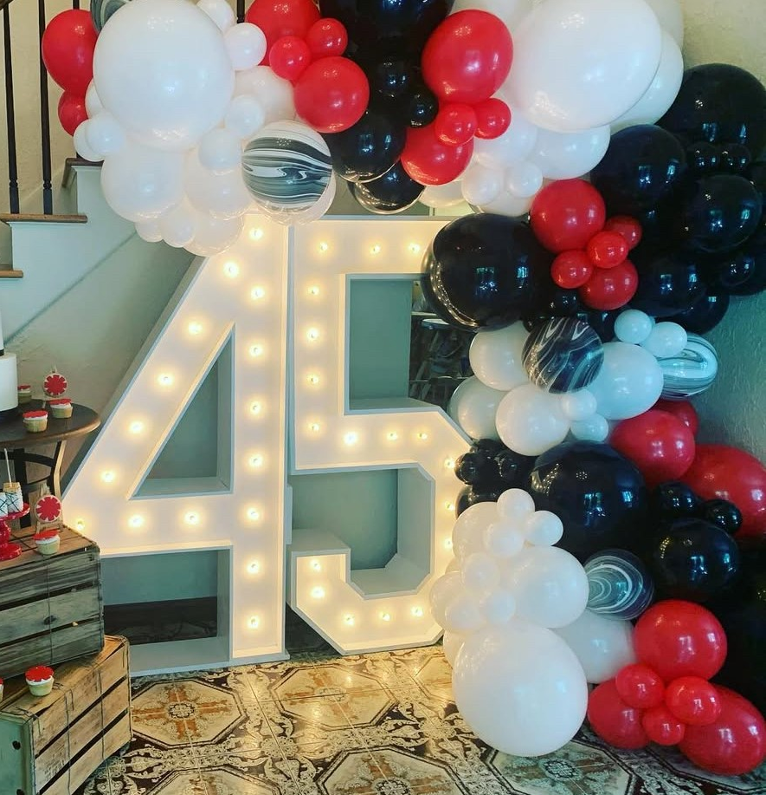
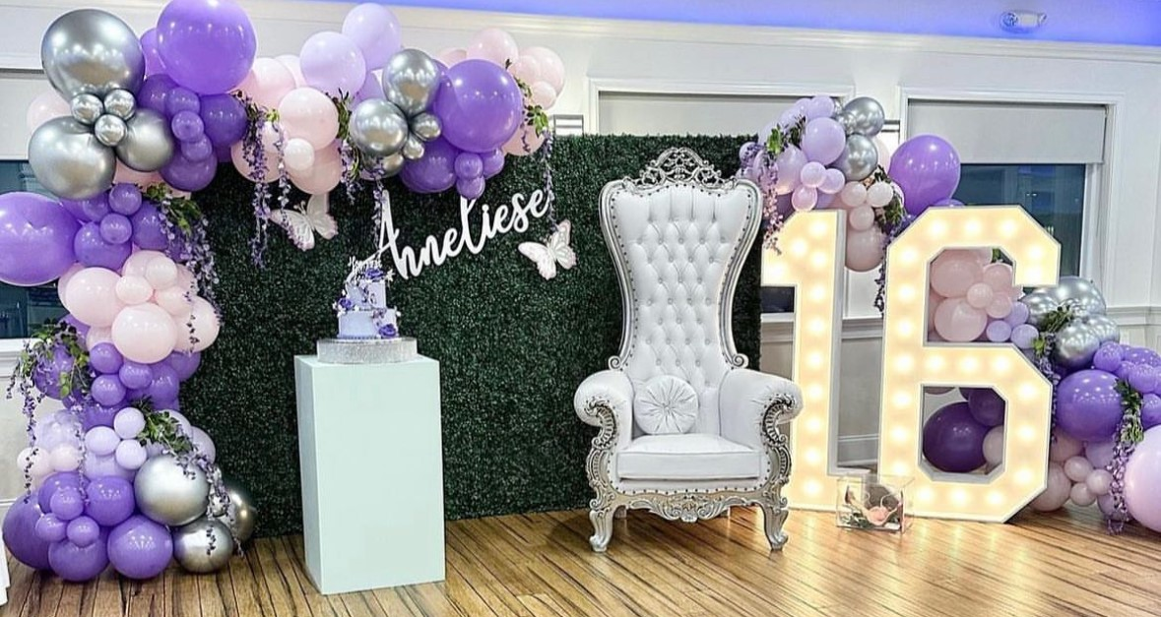
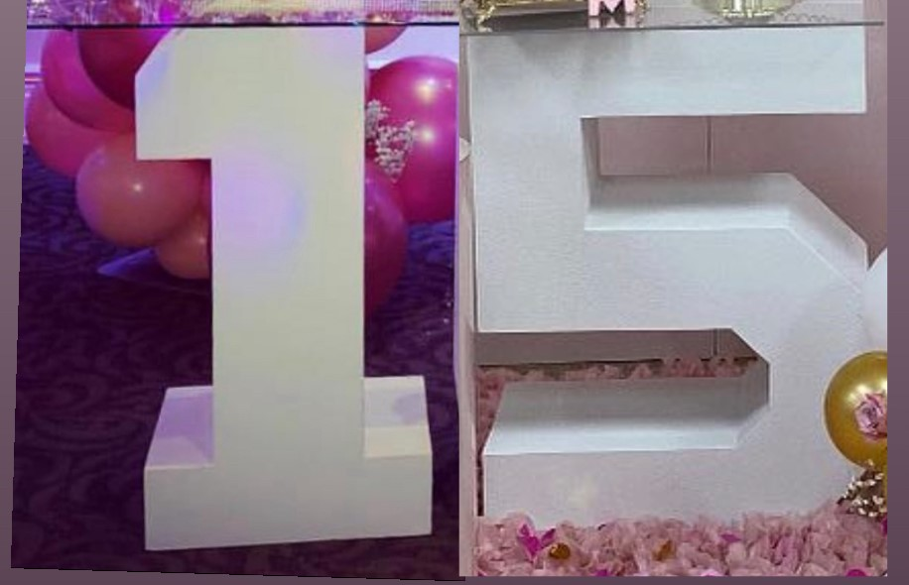
5 Ft Lighted Marquees $100 each
0,1,2,3,4,5,6 available
Block Table $50 each
1, 2, 5, 8 available

Slide 7
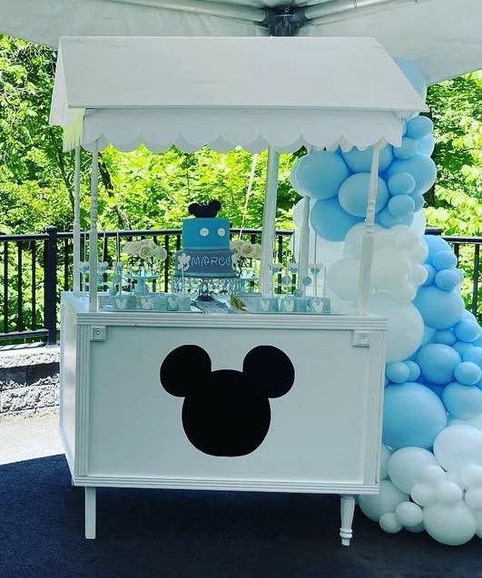
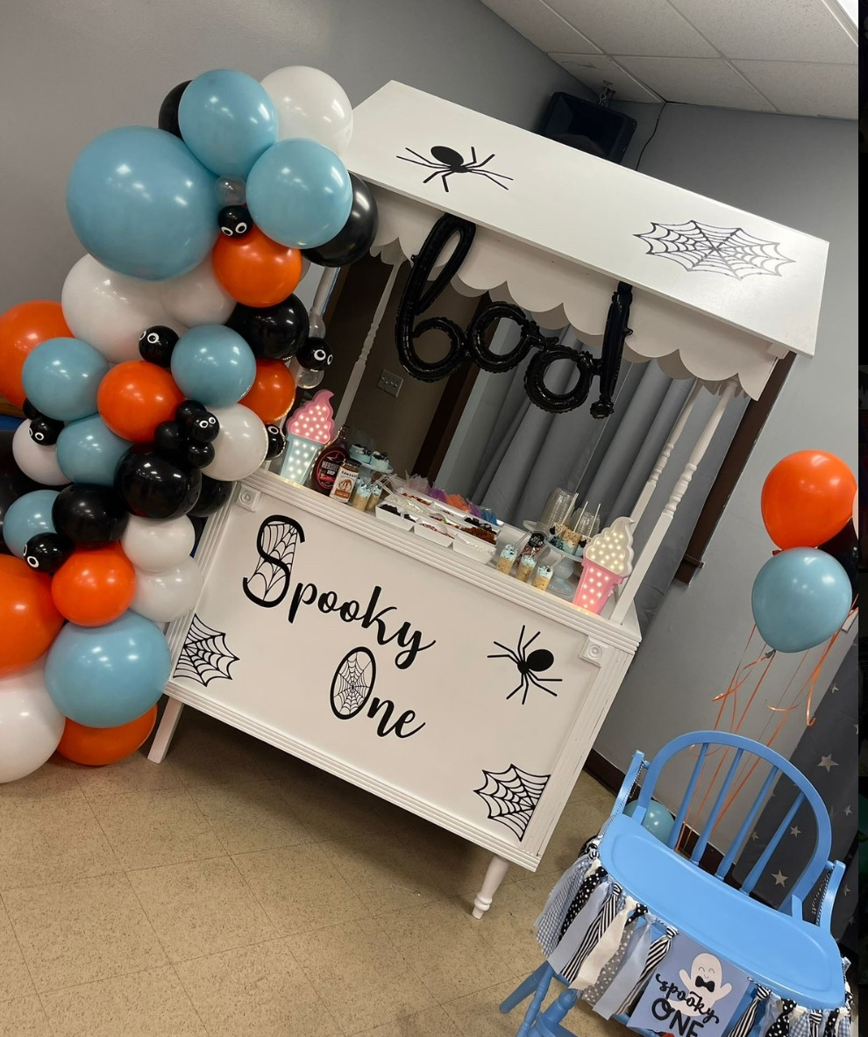
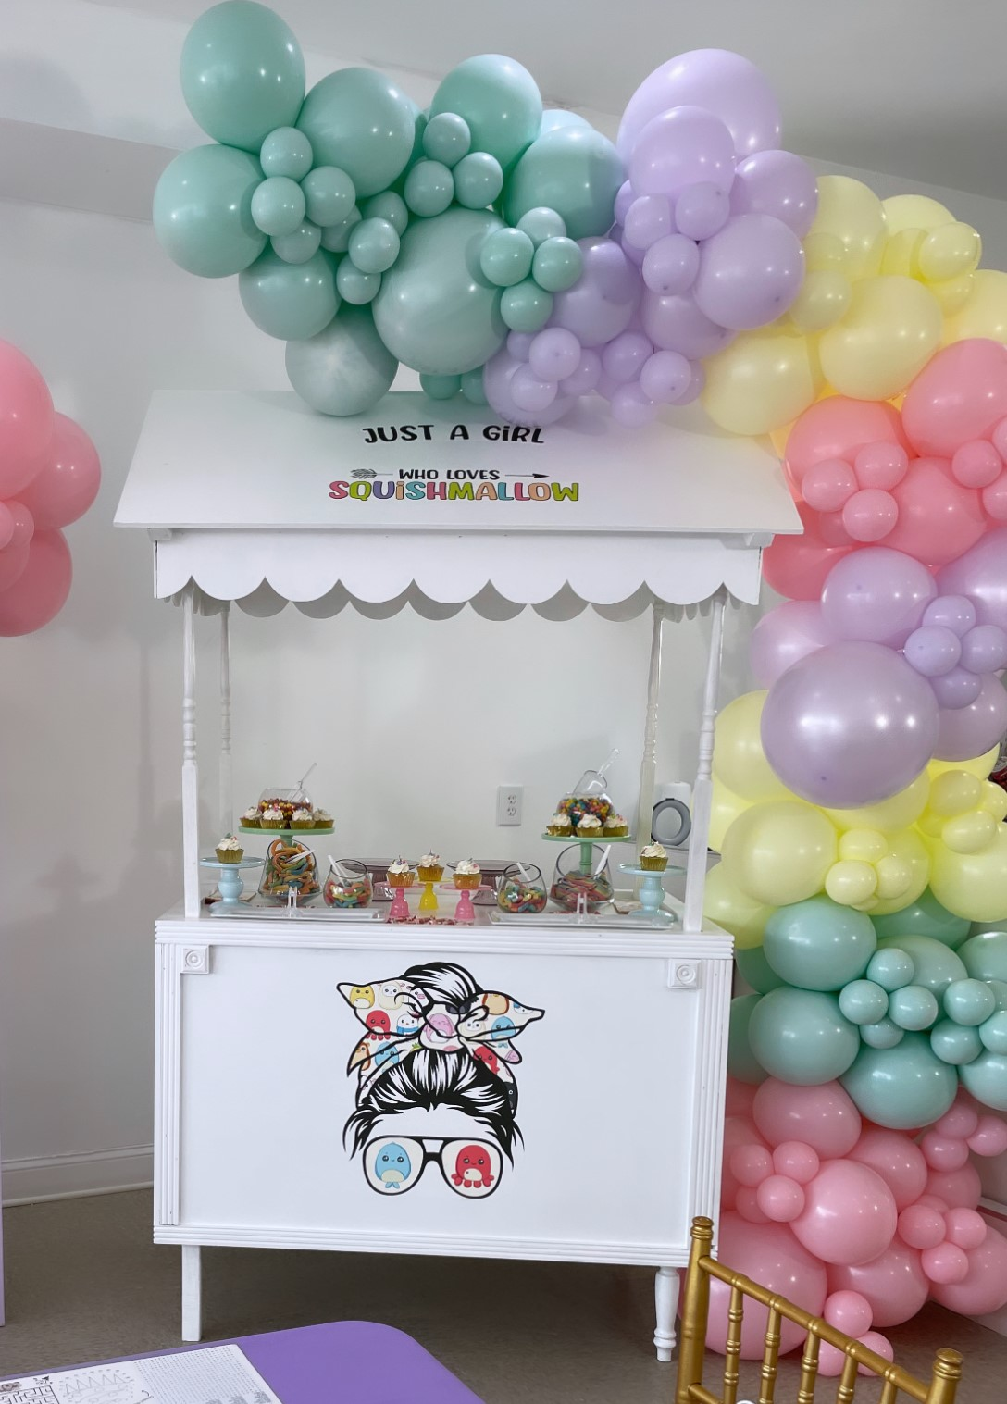
Candy Cart $250
(Customization Extra)

Slide 8
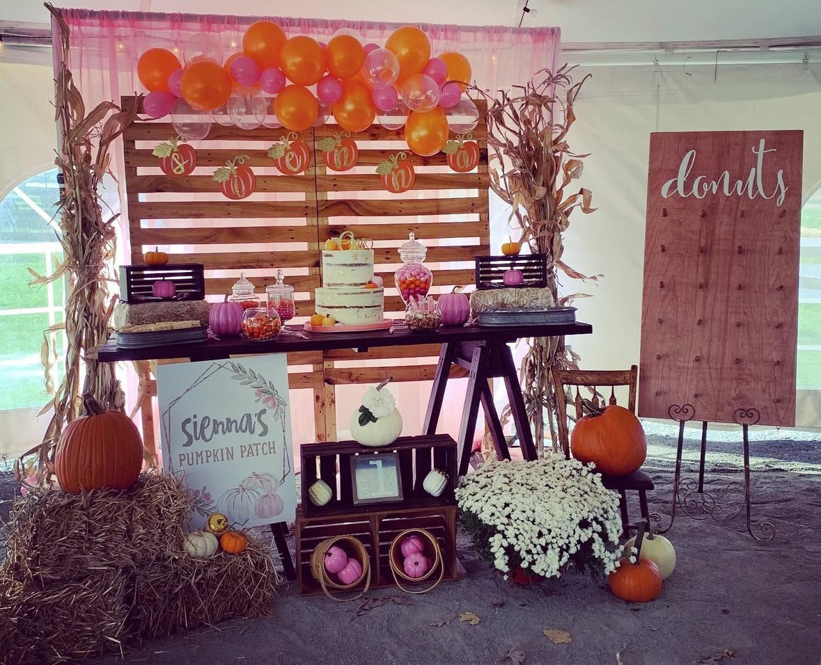
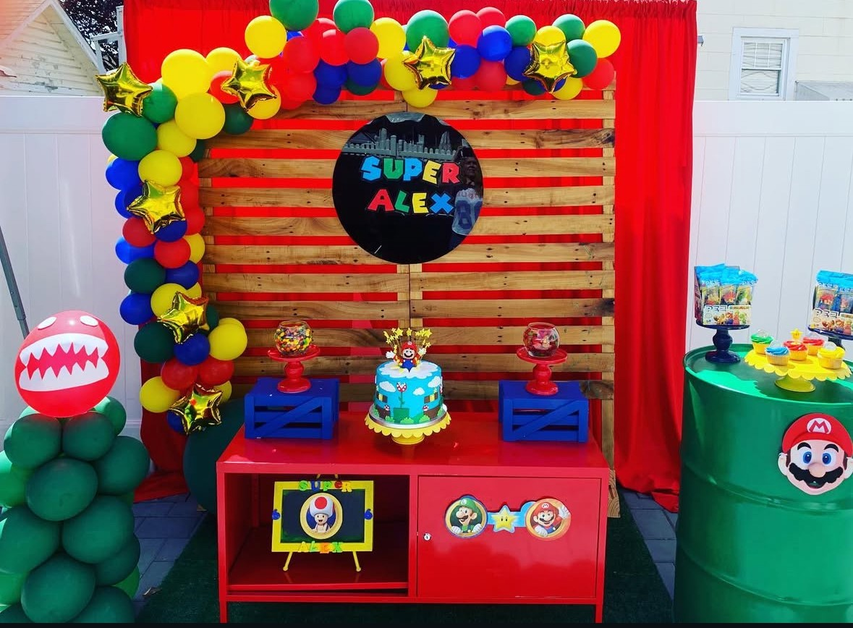
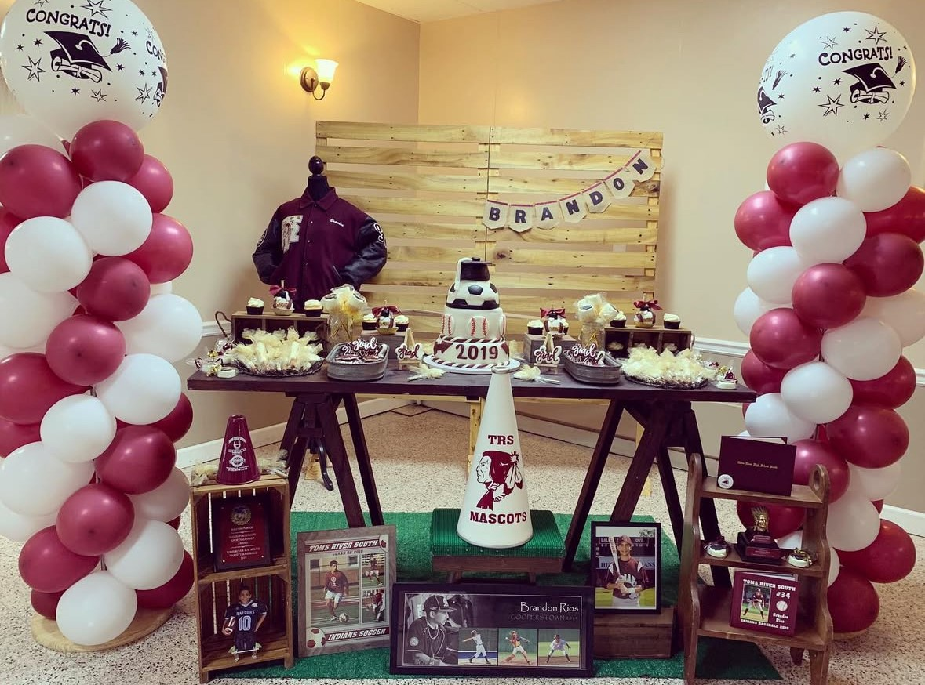
Wooden Wall $100
Wooden Table $75
Donut Wall $50

Slide 9
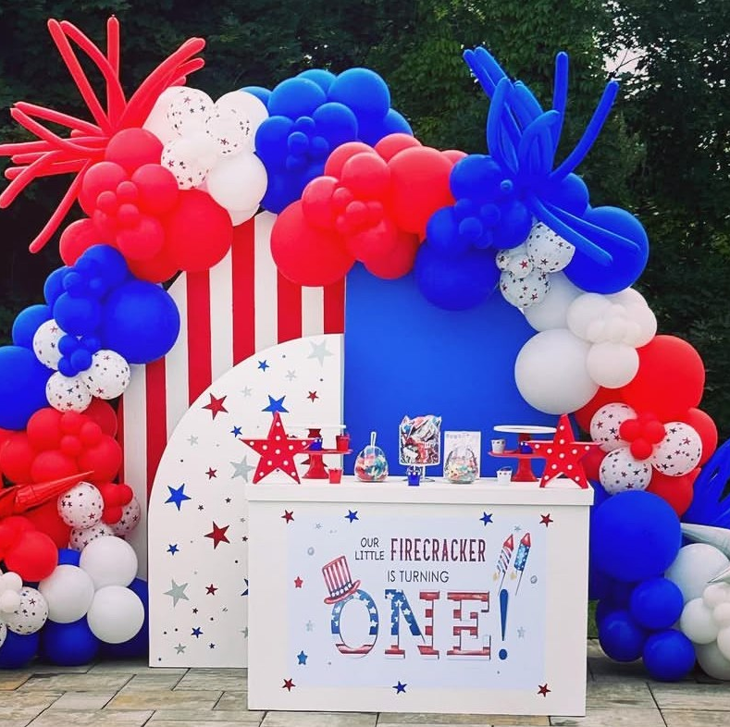
Half Arch Wall Set of 3 $200
4 ft Table $75
Customization Extra

Slide 10
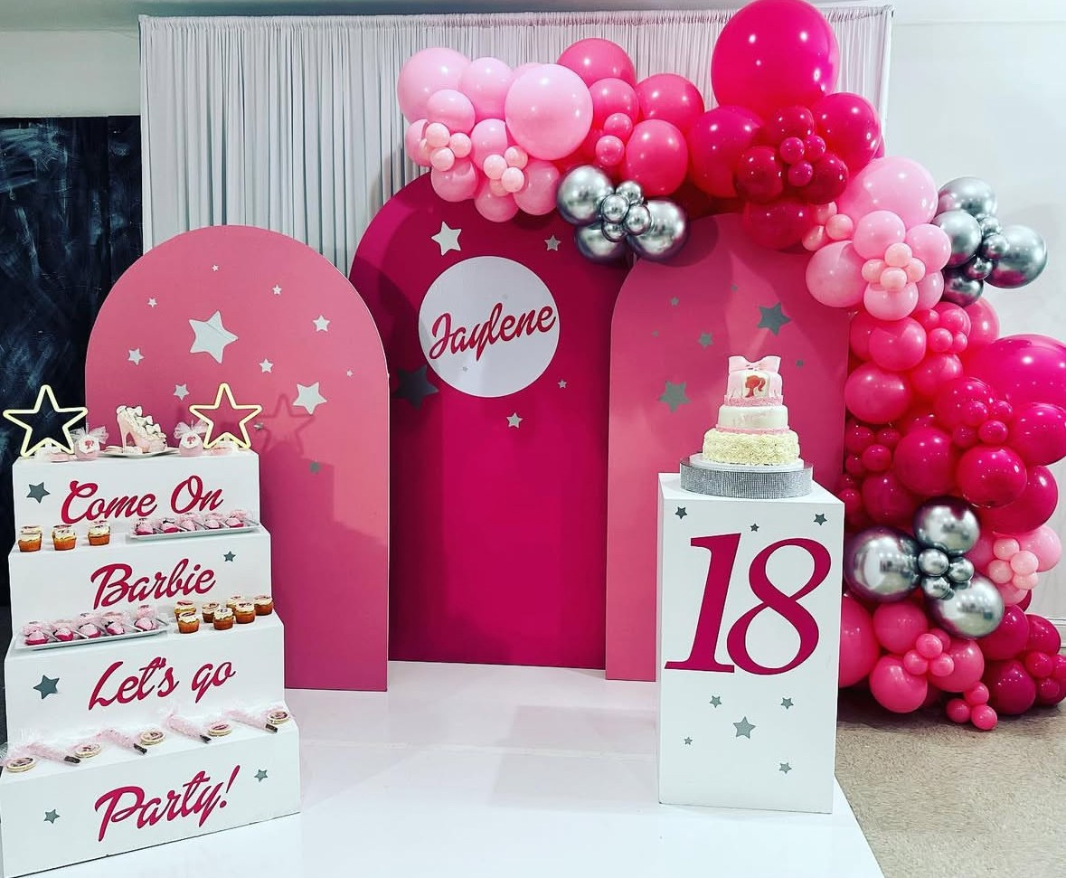
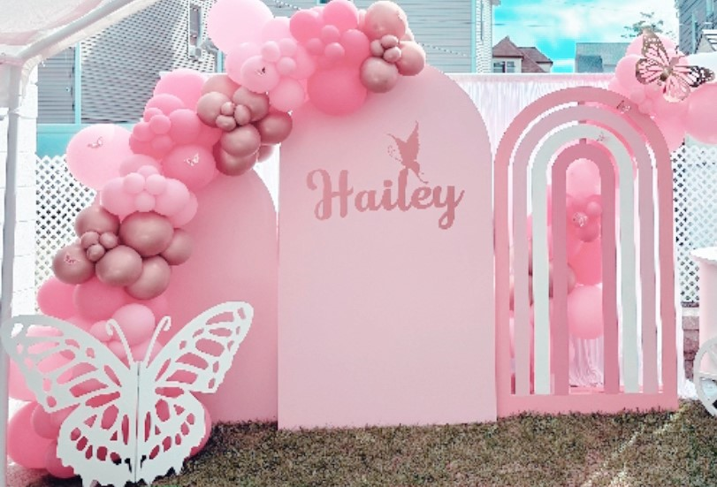
Round Top Wall Set of 2 $150
Step Display $100

Slide 11
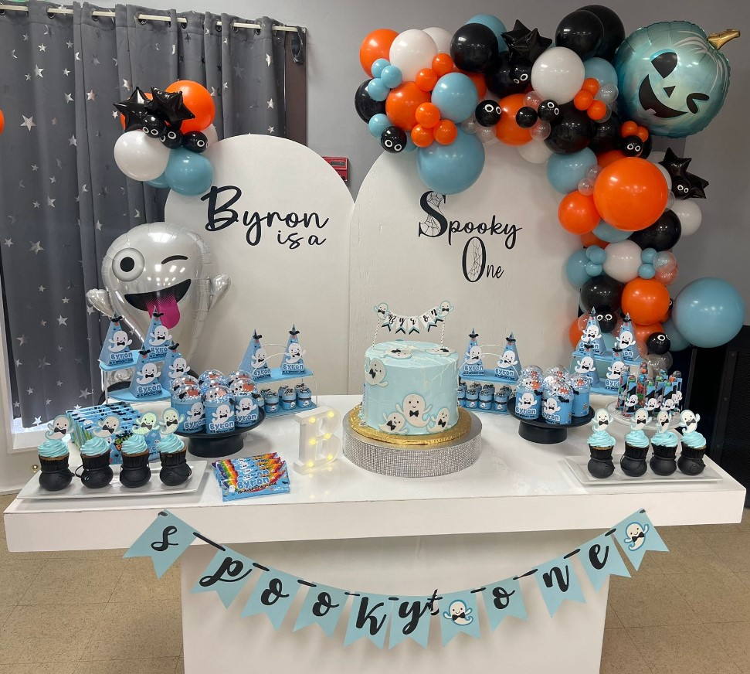
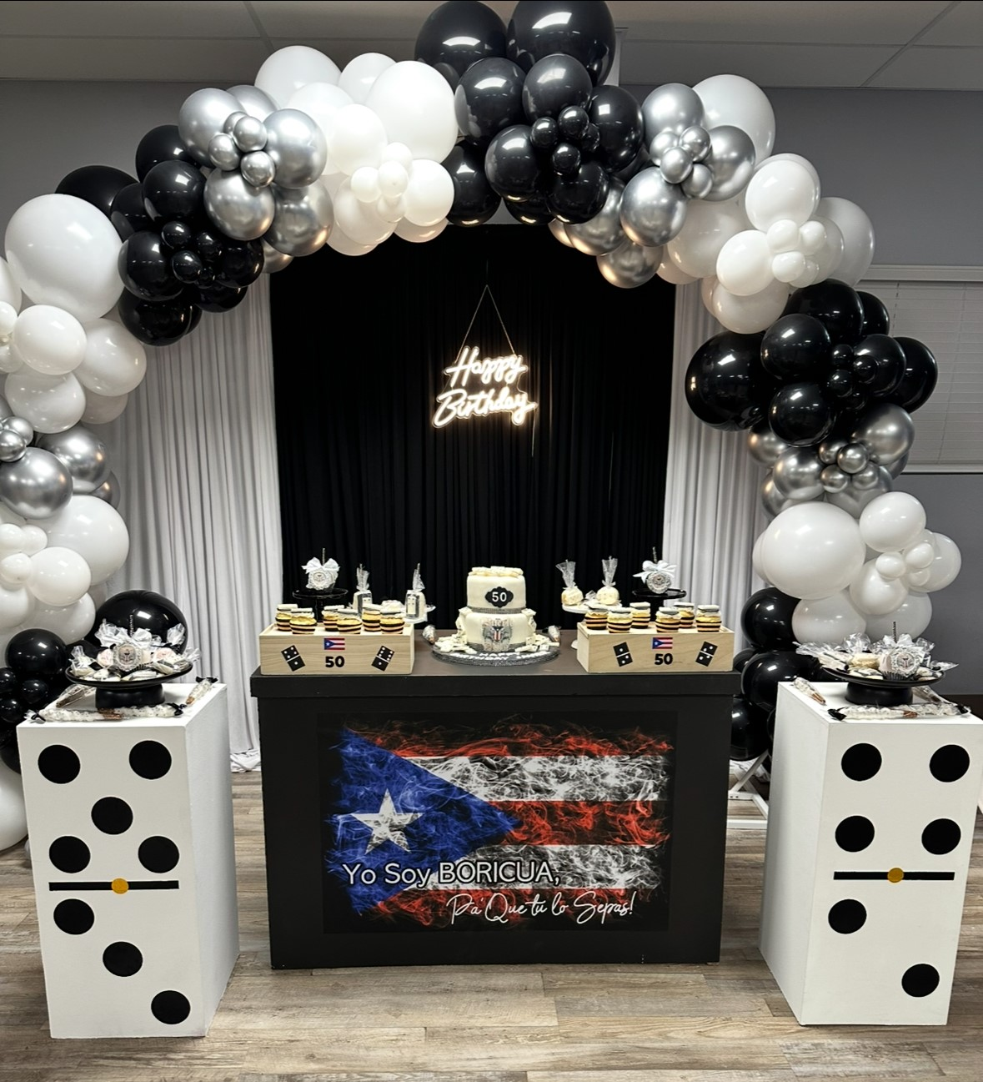
4 ft Table$75
6 ft Table $125
Pedestal Set $80
(Customization Extra)

Slide 12
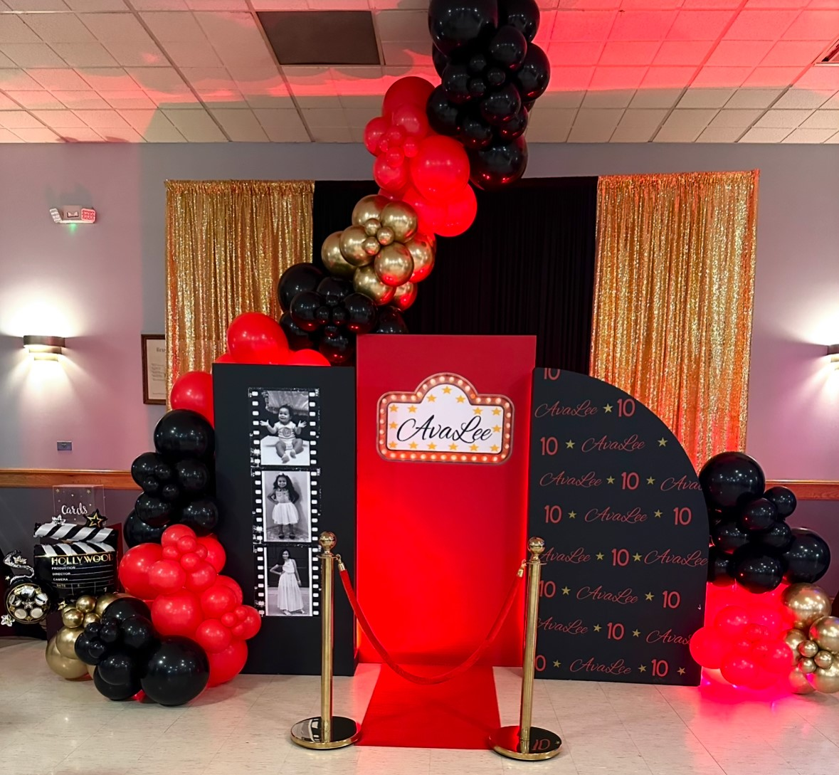
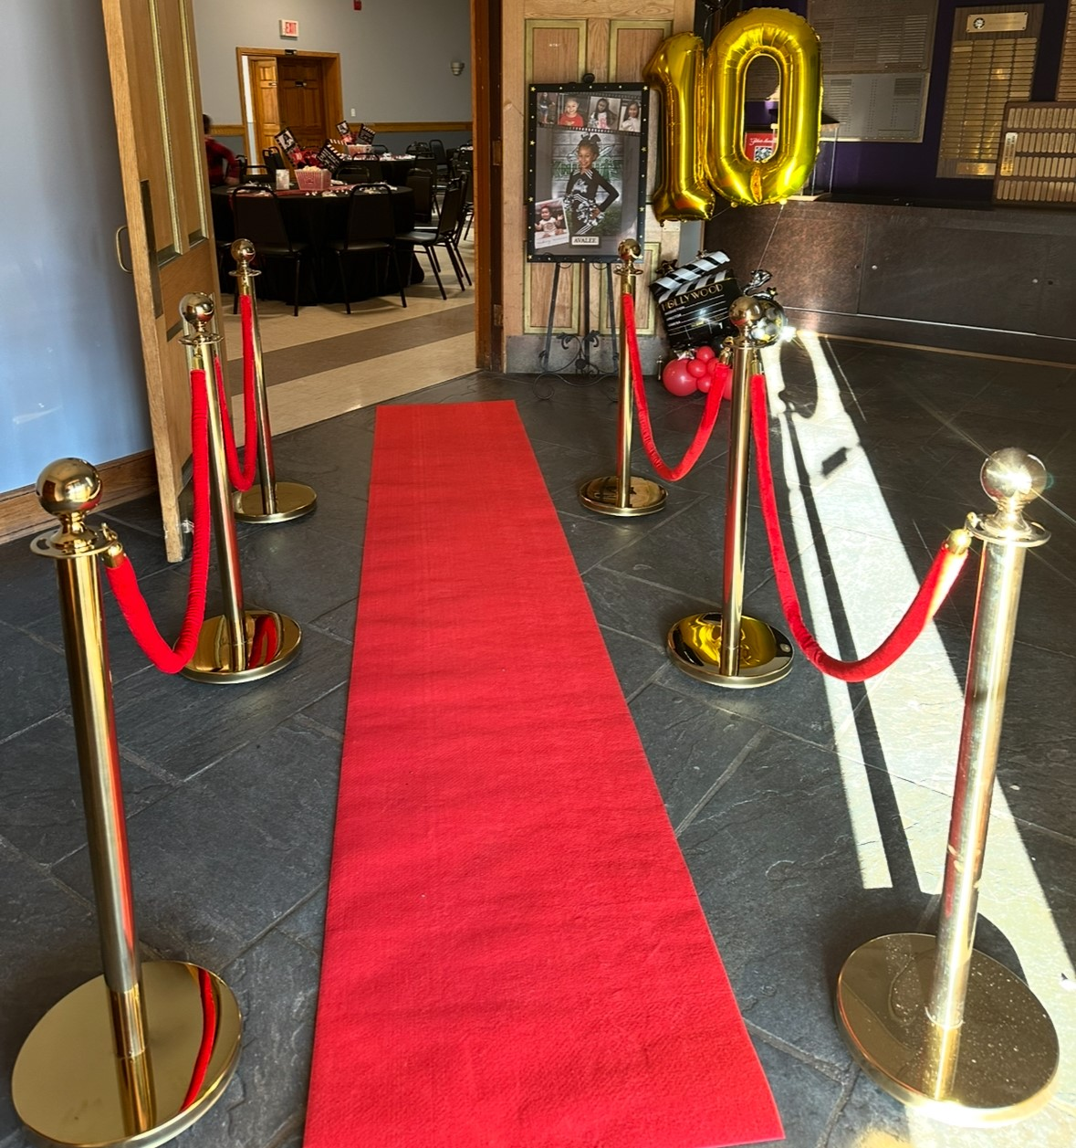
Stanchions $75
(Red Carpet Additional)

Slide 13
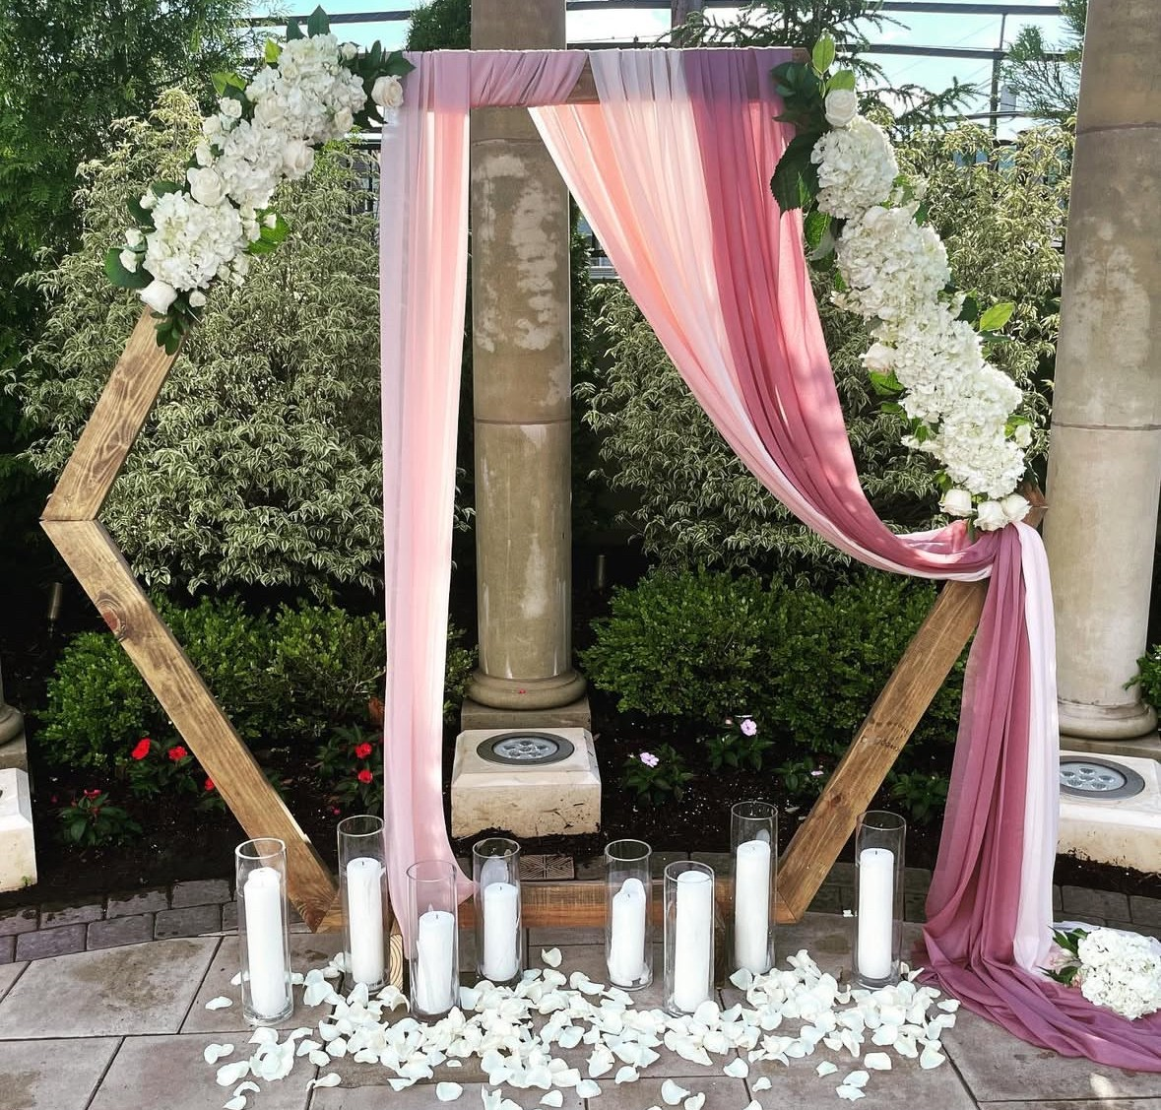
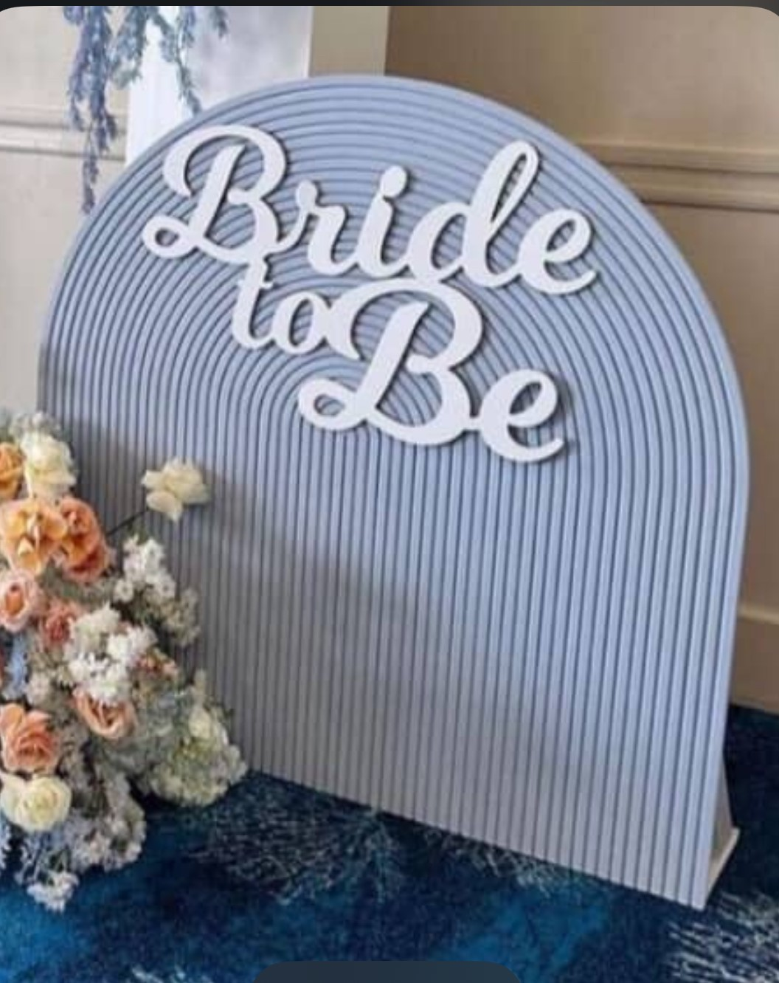
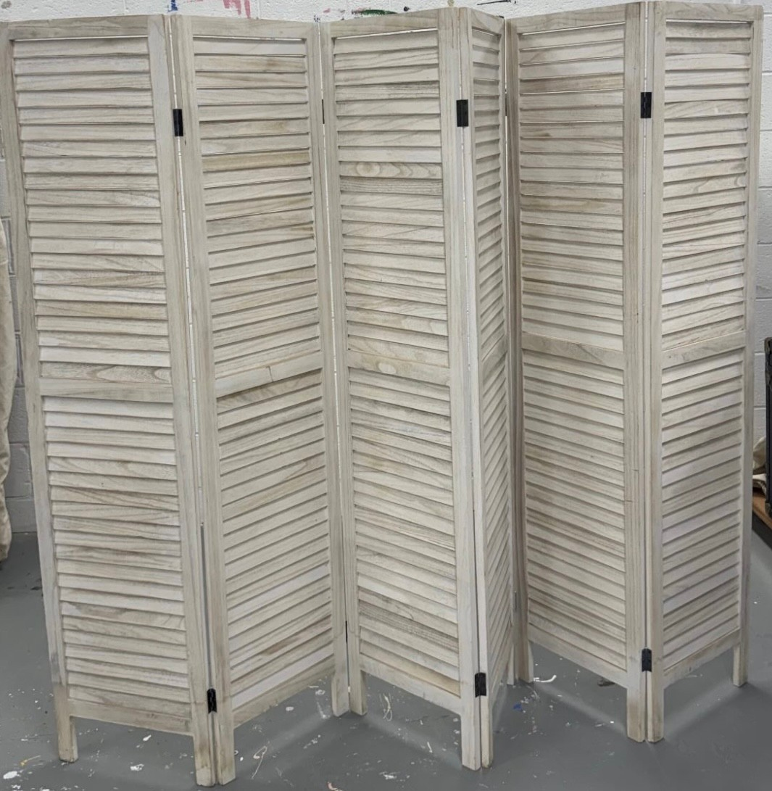
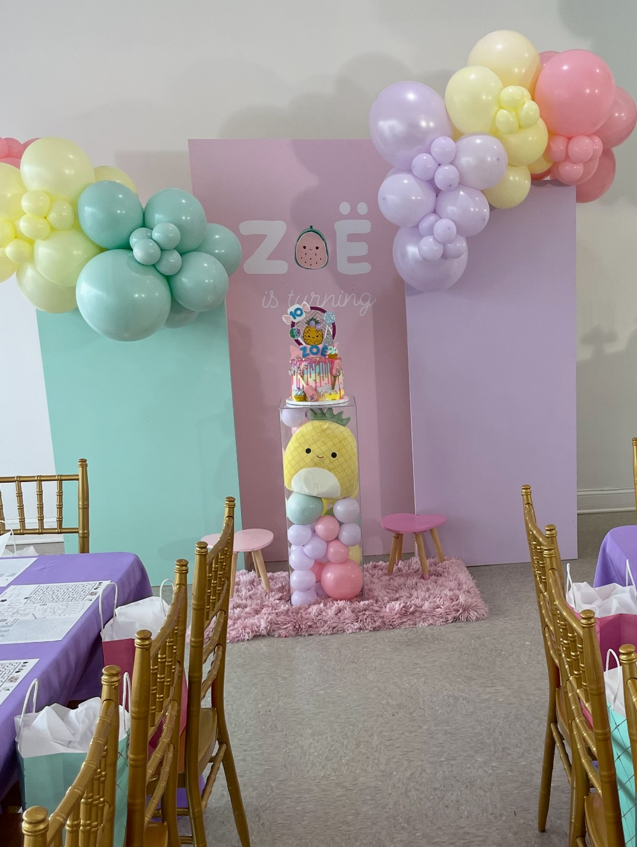
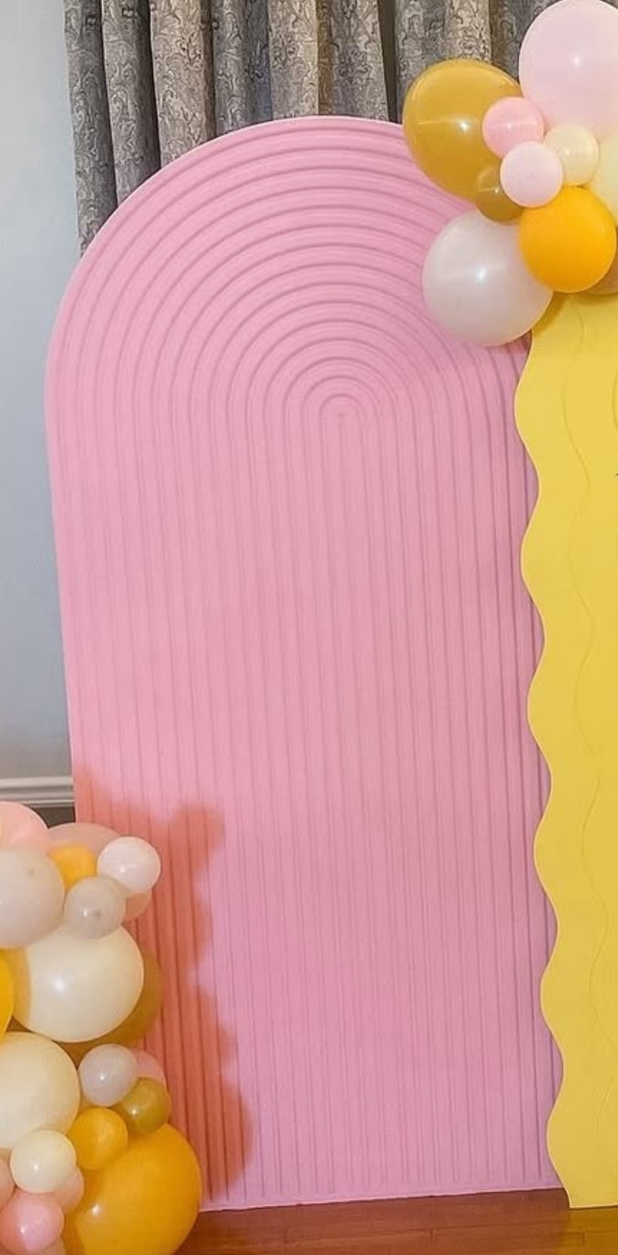
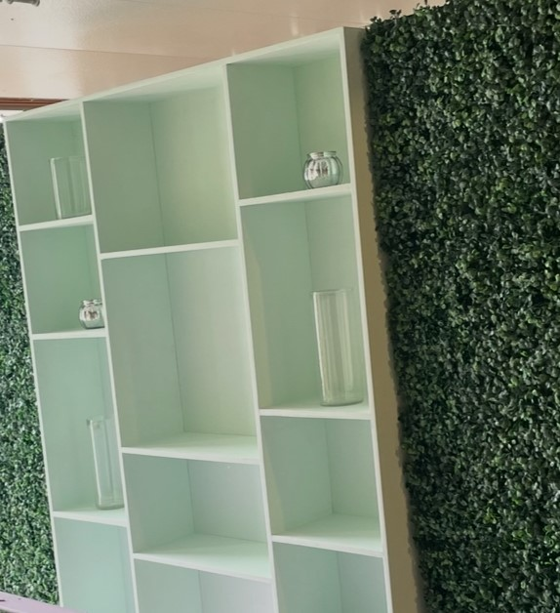
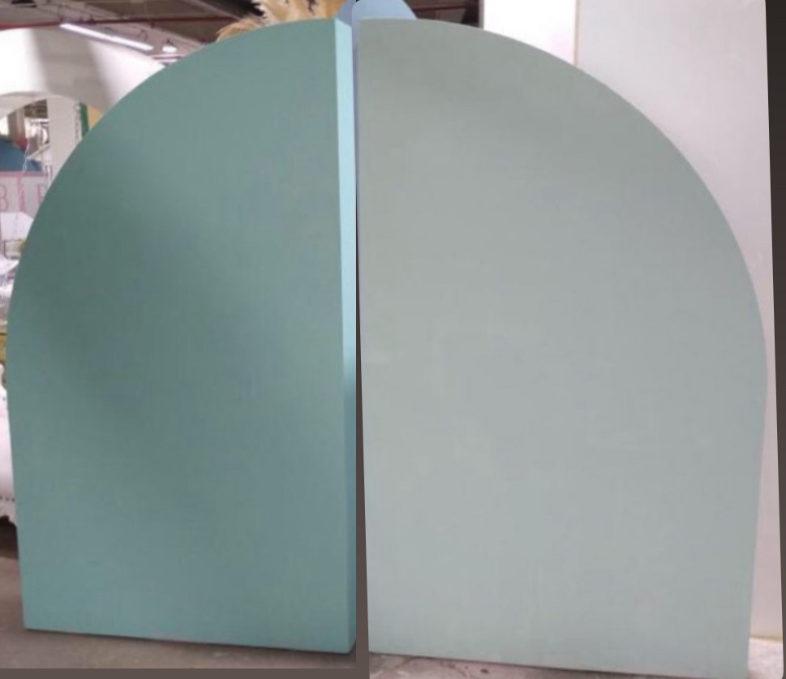
Wooden Hexagon $125
Small Ripple Wall $100
Folding Door(5.7ft x 8ft) $100
Rectangular Wall Set of 3 $175
Big Ripple Wall $200
Display Wall $150
Double Arch Wall Set $175

Slide 14
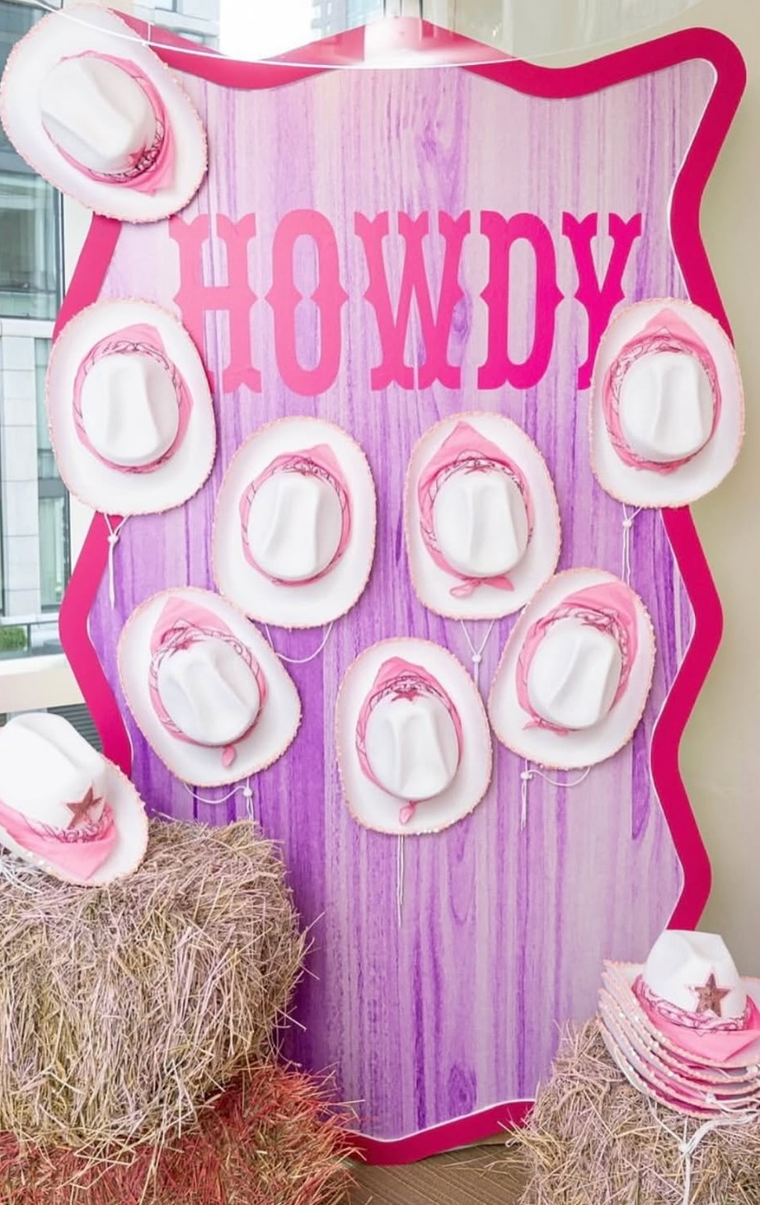
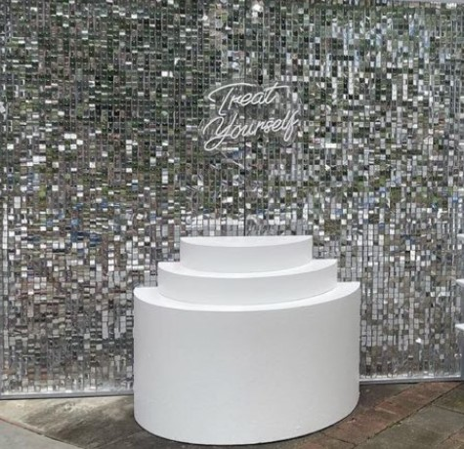

Silver Shimmer Wall $300
Wavy Wall $200
Round Acrylic Wall $250

Slide 15
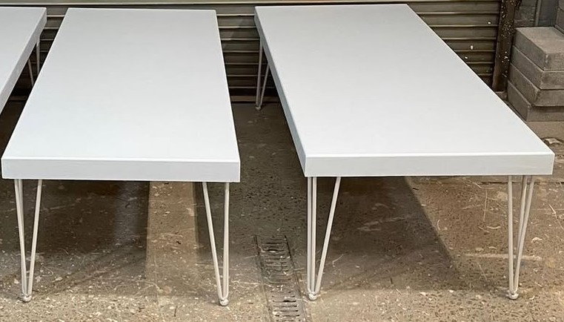
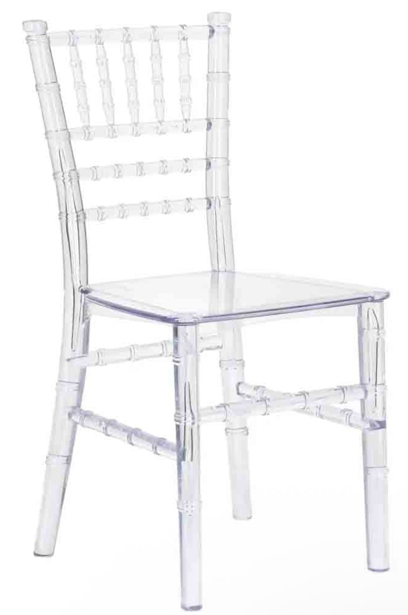
Kids Chivari Chair $5 each
(20 available)
Kids Table $75 each
(2 available)

Slide 16
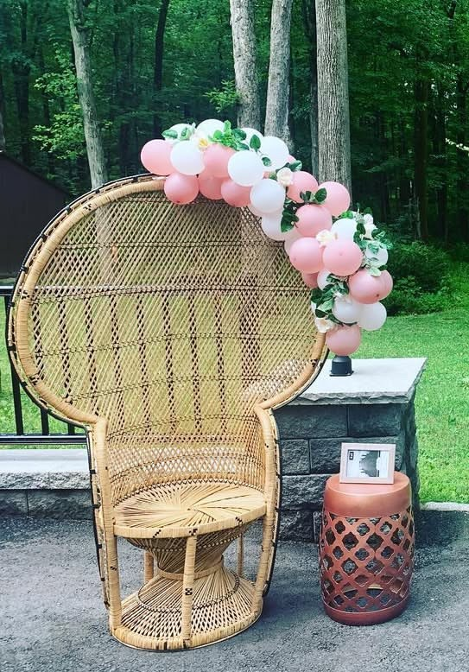
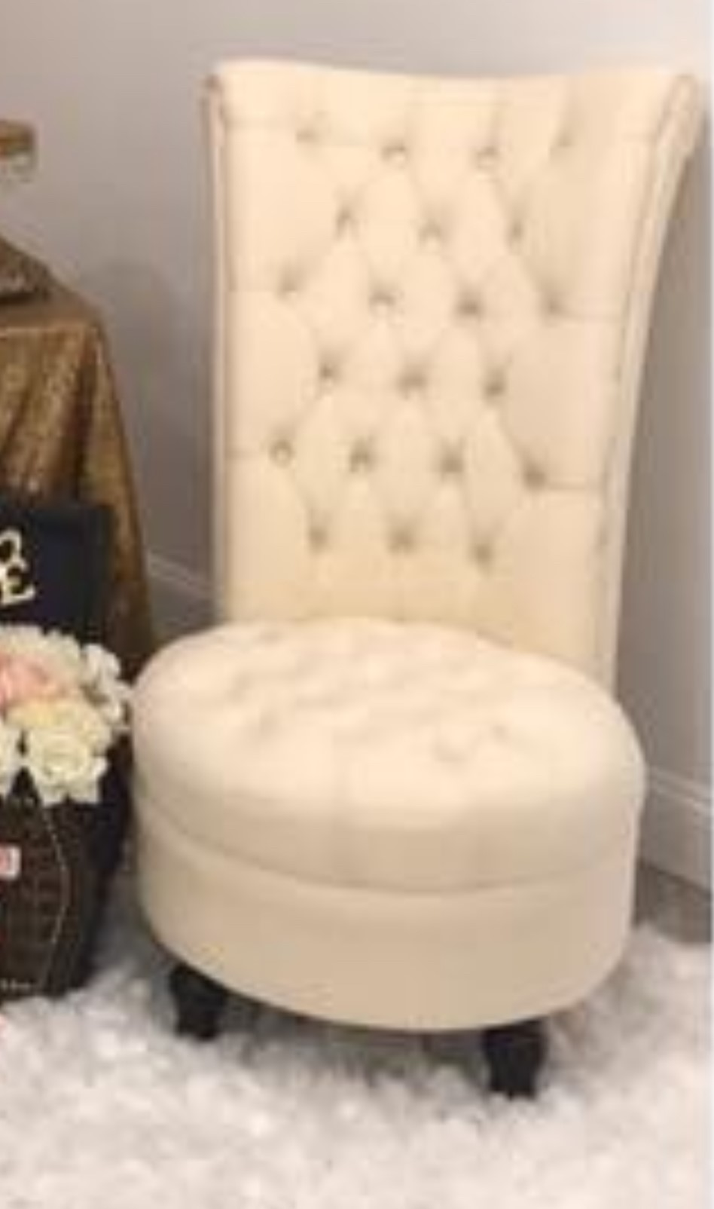
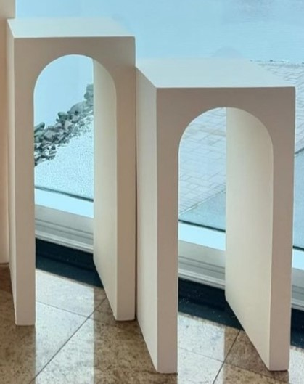
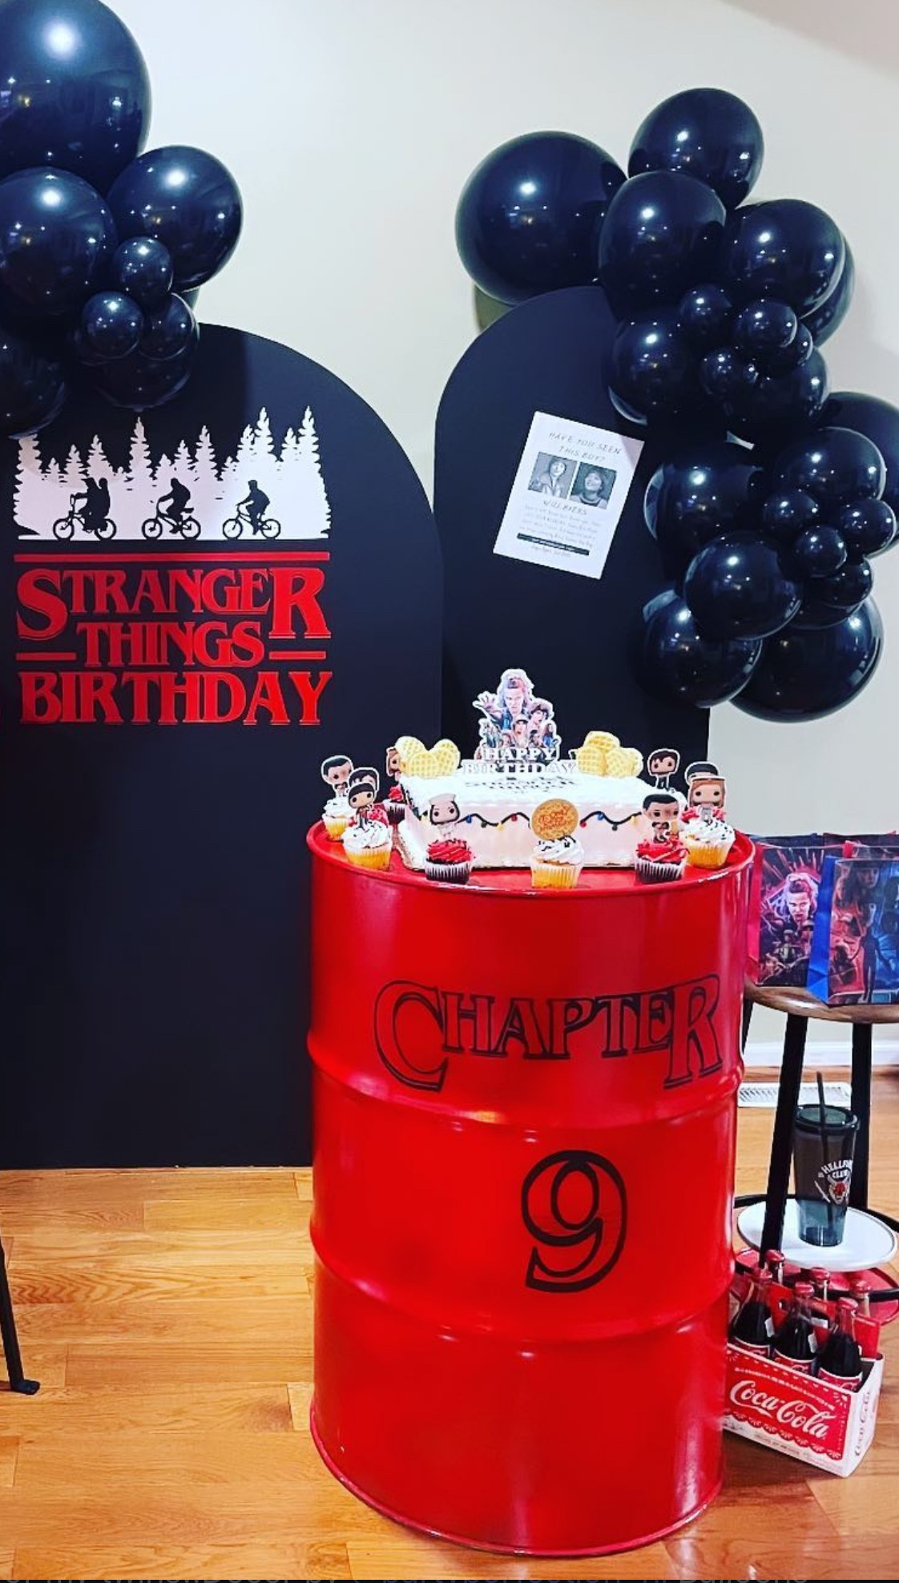
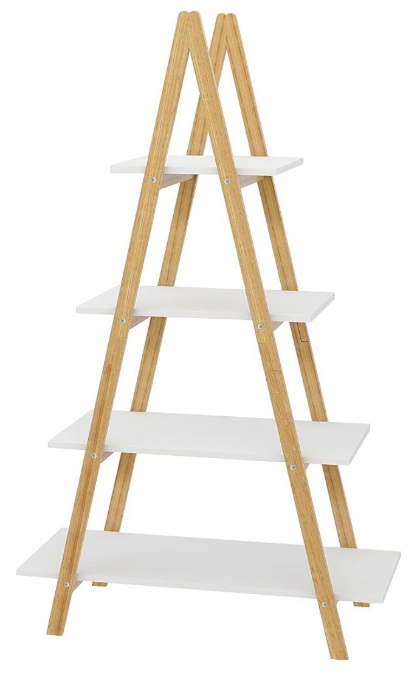
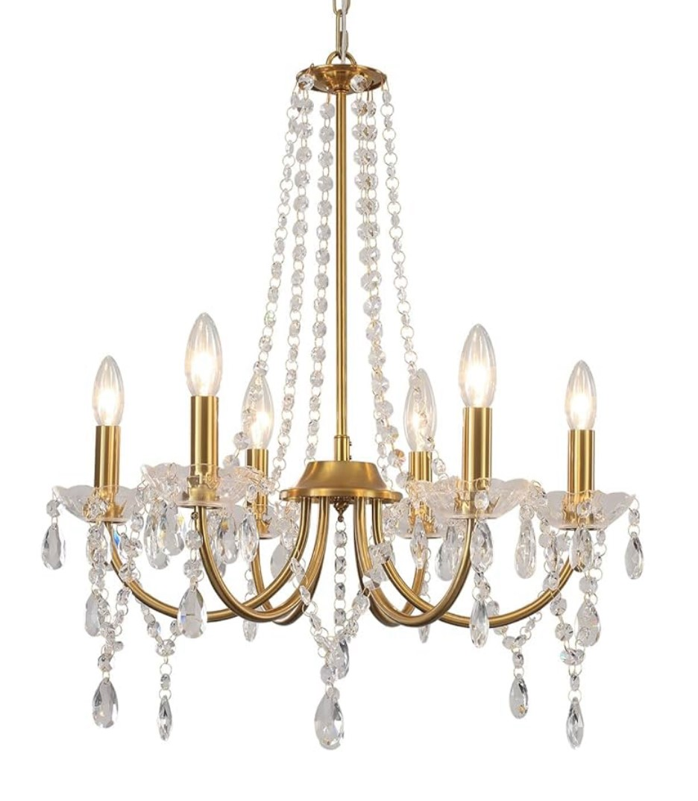

Wicker Chair $75
Tufted Chair $75
Arched Pedestals
Set $100
Large Pedestal $65
Metal Barrel $60
24 inch Chandelier $65 each
(2 available)
5 ft Ladder Stand
$50 each (2 available)

Slide 17
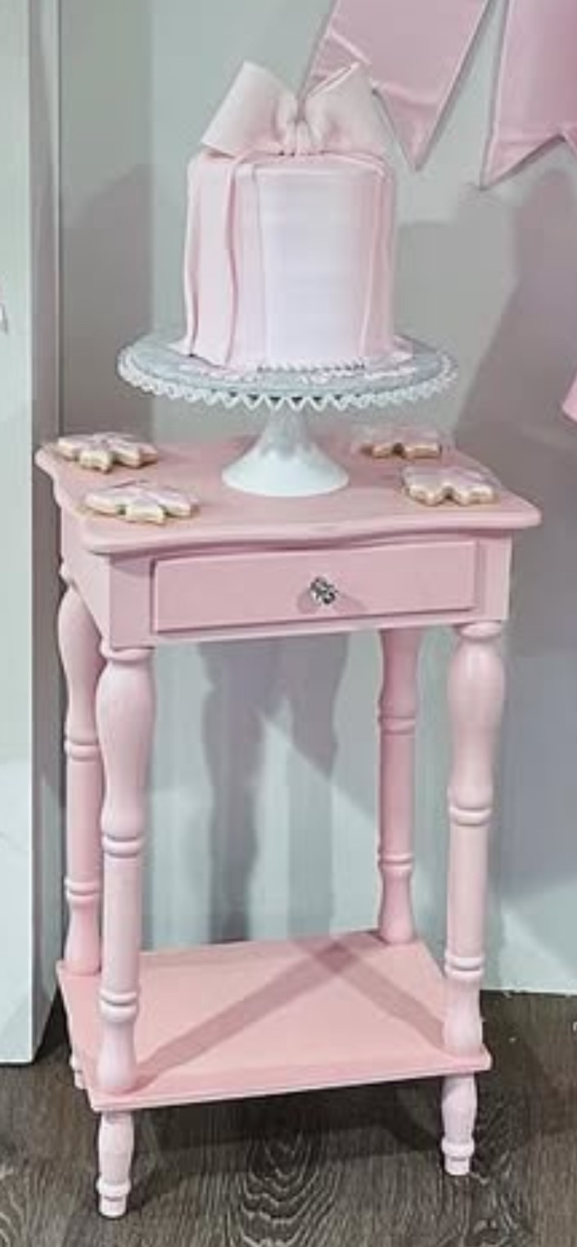
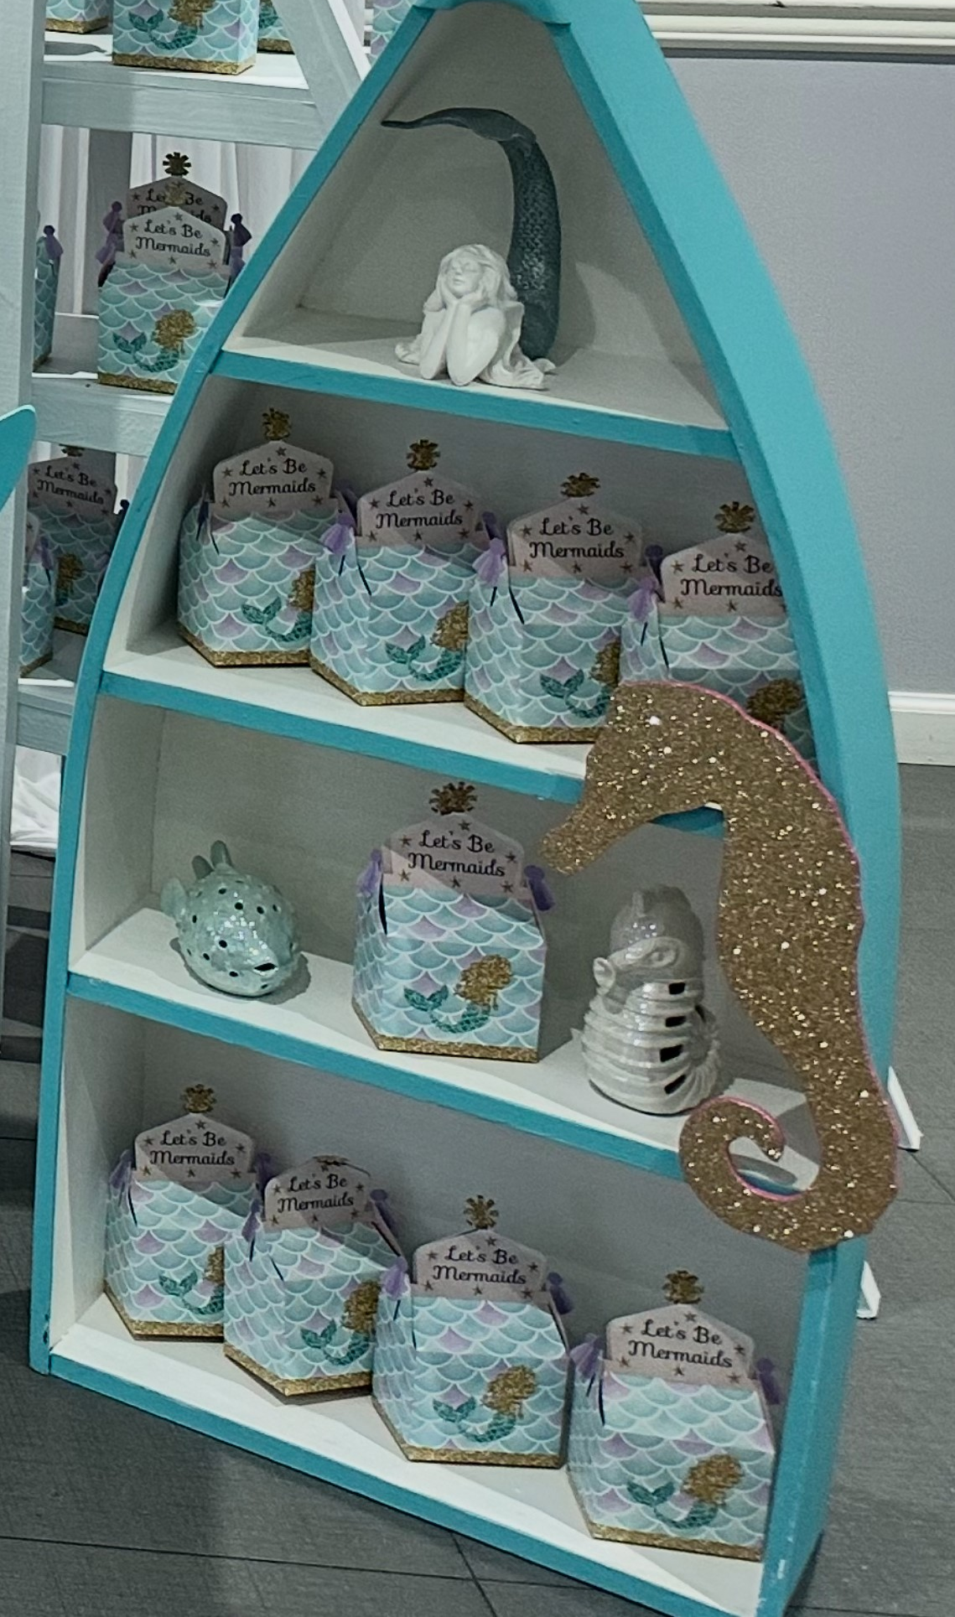
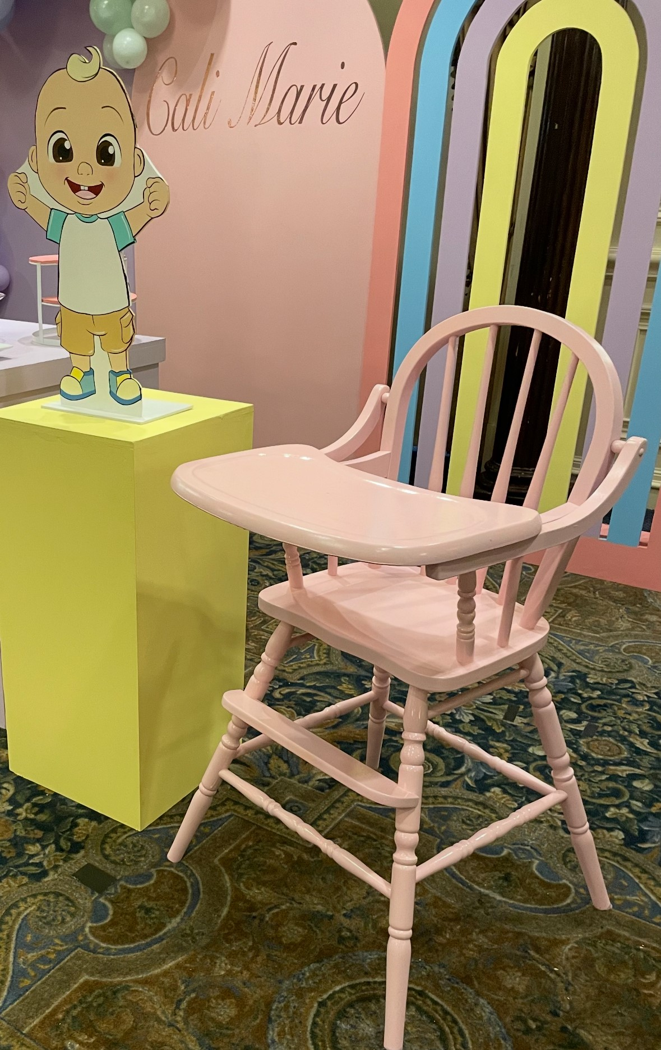
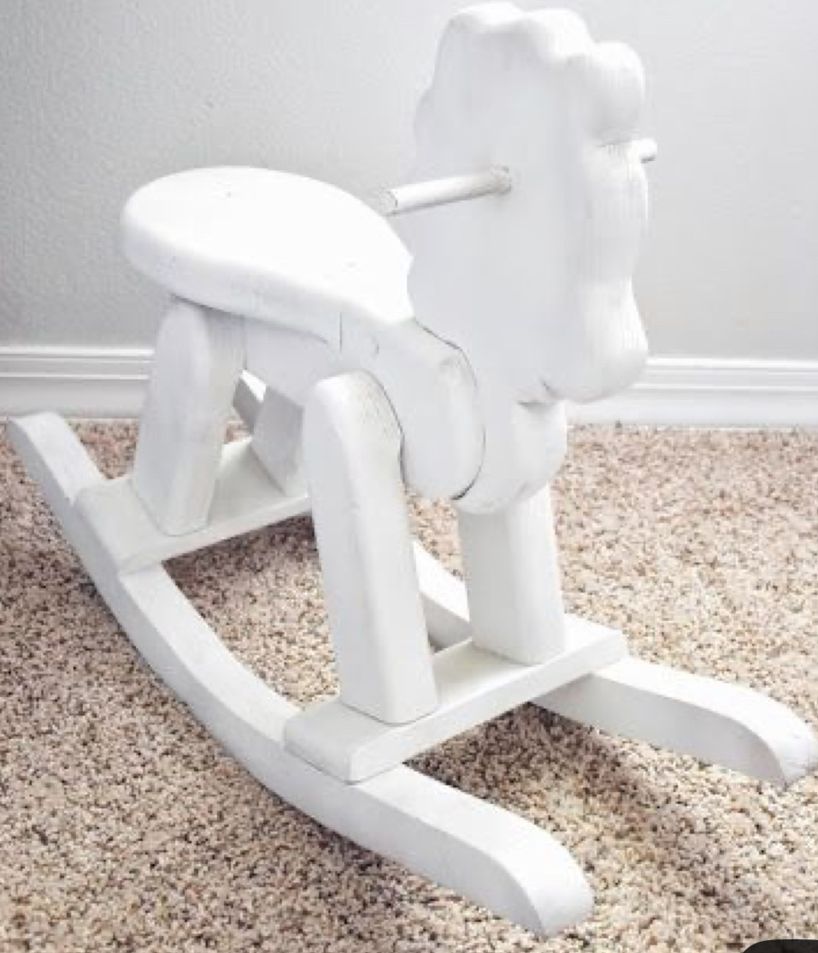
Boat Shelf $40
HighChair $35
Rocking Horse $15
Pink Table $40

Slide 18
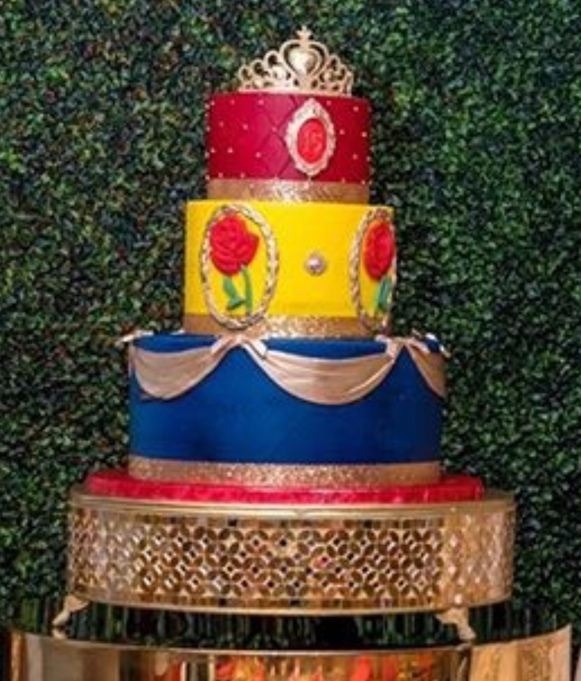
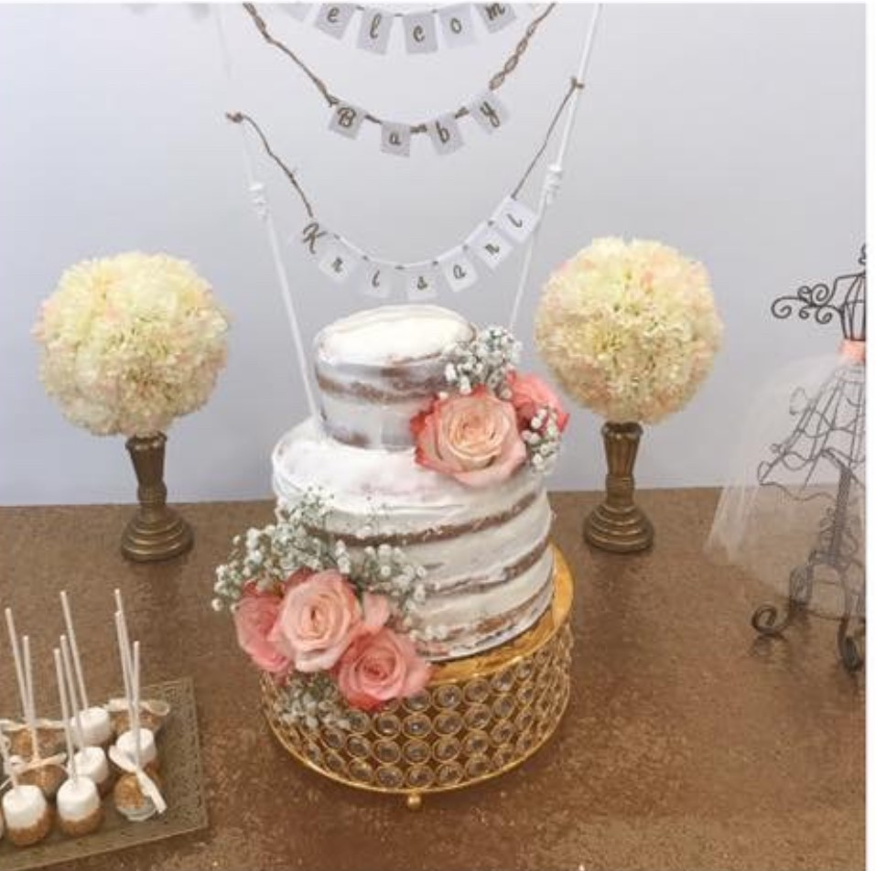
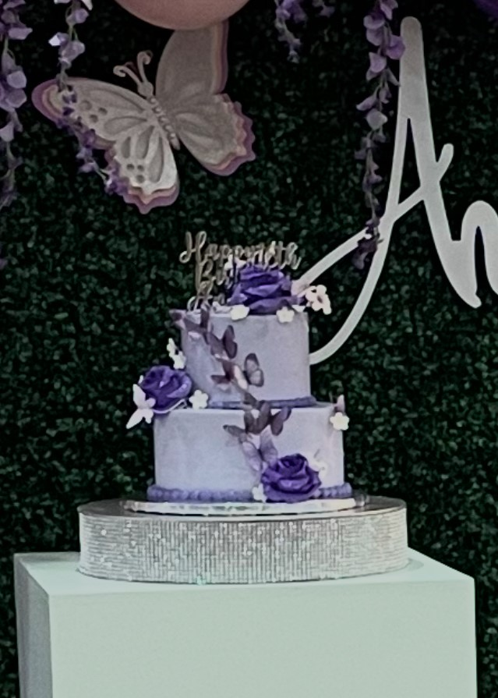




Cakestands starting at $15

Slide 19







Treat Stands starting at $10
Cake Pop Stand
2 available
2 available
2 available
2 available
2 available

Slide 20








Table skirts starting at $20
1 available (12 ft)
2 available (6ft)
Table Runner $3 each
(10 available)
2 available (14ft)
Chair Sashes $1 each
(250 available)

Slide 21






Centerpieces starting at $35

Slide 22



Wicker Placemats $1.25 each (60 available)
Gold Chargers $1.00 each (50 available)

Slide 23










Rustic Tiered Tray $15
Acrylic Card Box $15
Wooden Animals .50 each
(20 available)
Vintage Car $10
Felt Hanging Heads$10 each
Vintage Car Accessories $15
Vintage Gas Pump $10
Small Boat $10
Paddle Set $15
Traffic Sign Set $10

Slide 24







1 set available
4.7”
5.2”
6.3”
.50 cents each
$5 each set
$2 each set
100 available
10 sets available
7 sets available
2.75”
3.93”
6.29”
8.8”
11.2”
13.2”
Table Numbers $15
1-40 available
$15 set
$1 each
.75 cents each
24 available
70 available

Slide 25







$10 set
2 available
10”H
30 cup $25
1 gallon Pitcher Set $20
Retro Boom Box $15
Sign $5
Popcorn Boxes
.50 cents each
6 available
Wagon $10

