Slide 1





Synthesis of Quantitative Information About
Gender Roles in Jordan
Compiled by the staff of the Gibran Chair, University of Maryland, 2018
© University of Maryland, 2018

Slide 2
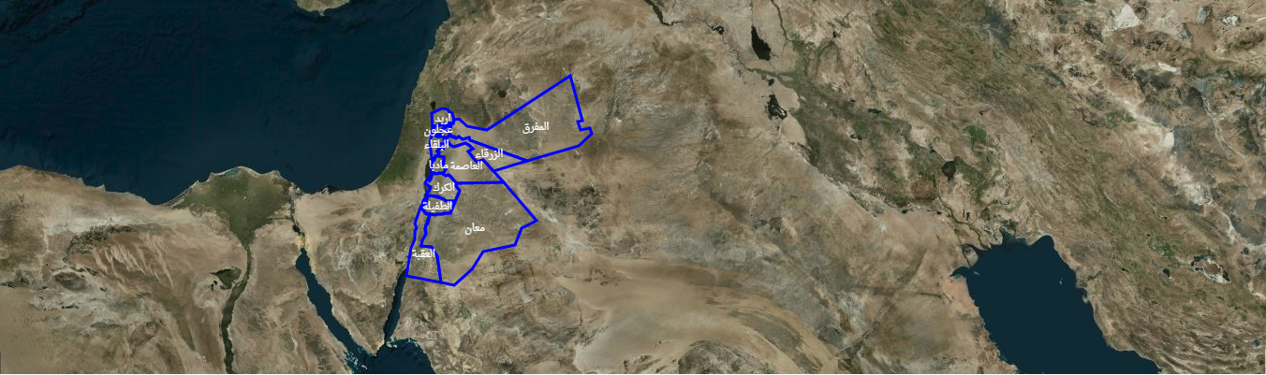
Critical Issues in
JORDAN
Compiled by the staff of the Gibran Chair, University of Maryland, 2018
© University of Maryland, 2018

Slide 3

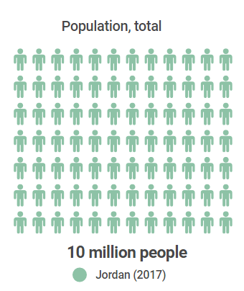




Overview
Jordan is a middle-income country, but one of the smallest and poorest economies in the Middle East, with 14% of Jordanians living below the poverty line.¹
Adult literacy in Jordan is one of the highest in the region at 99%. ²
The illiteracy rate among women (aged 15+) is 9.5% and for men, 3.4%.³
Jordan issued a family protection law against domestic violence law in August 2008.⁴
The civil service in Jordan is considered the main source of employment for most Jordanians.⁵
1 Jordan National Agenda (2006-2015).
2 World Economic Forum (2016).
3 Employment and Unemployment Survey (2015), Department of Statistics, State of Jordan.
4 Jordanian Official Gazette Family Protection Law No. 6 (2008).
5 Jordan Case Study, UNDP (2012), https://go.umd.edu/x73
© University of Maryland, 2018

Slide 4
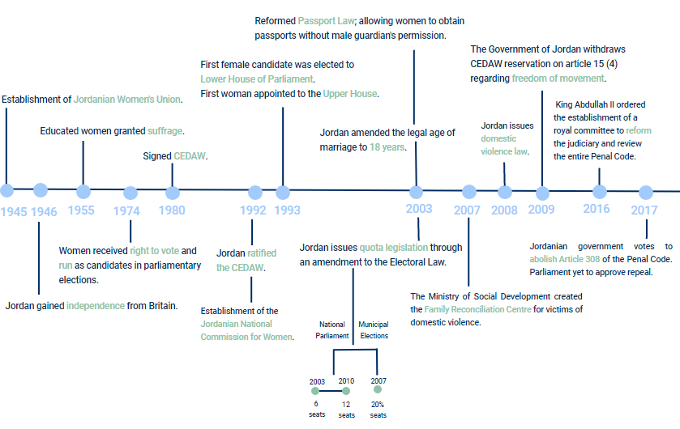

Timeline of progress of women’s issues in Jordan
© University of Maryland, 2018
Notes:
CEDAW:
From 2004 until the end of 2009, the women’s movement made a number of important gains, including the publication of the Convention on the Elimination of All Forms of Discrimination against Women (CEDAW) in the official gazette, which gave it the force of law. (UNDP, 2012)
CEDAW Article 15 (4):
Jordan signed CEDAW in 1980 and ratified it in 1992, although the country included reservations concerning Article 9(2), on nationality; Article 15(4), on freedom of housing and movement; and Article 16(1), paragraphs (C), (D), and (G), related to marital, custody, and personal status issues. In May 2009, Jordan formally reported that it was lifting its reservation on Article 15(4), leaving just two reservations in effect.
Quota system:
A gender-based quota system, first introduced for the lower house of parliament in 2003, was expanded to municipal councils in 2007.
Jordanian National Commission for Women:
a semi-governmental body established in 1992 to craft policies and legislation concerning women’s issues
Passport law:
Jordanian law upholds citizens’ rights to move freely within the country and abroad, except in designated military areas. Under the current Provisional Passport Law (No. 5 of 2003), women are no longer required to seek permission from their male guardians or husbands before obtaining or renewing their passports.
Nevertheless, the Personal Status Law allows fathers to prevent their children from traveling, and in several recent cases handled by women’s rights groups, mothers involved in divorces were barred from traveling abroad with their children due to a travel ban imposed by their husbands
Age of Marriage:
Amendments made to the Personal Status Law in 2001 (sp?) raised the minimum age of marriage to 18 years, but the chief justice retains the discretion to permit the marriage of anyone who is at least 15 years old if it is deemed to be in his or her interest.
Domestic Violence Law:
The Family Protection Law was promulgated in March 2008 and was designed to regulate the handling of domestic abuse cases by medical workers and law enforcement bodies.
Article 308:
Family Reconciliation Centre:
Jordan’s first major women’s shelter

Slide 5
Labor Force
© University of Maryland, 2018
© University of Maryland, 2018

Slide 6
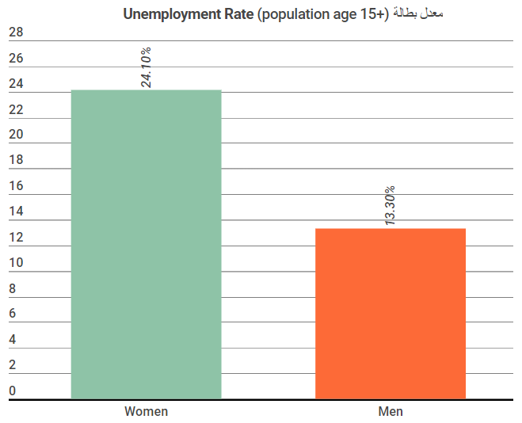
Source: Gender Indicators. (2016). Jordan Department of Statistics.
© University of Maryland, 2018
Labor Force

Slide 7
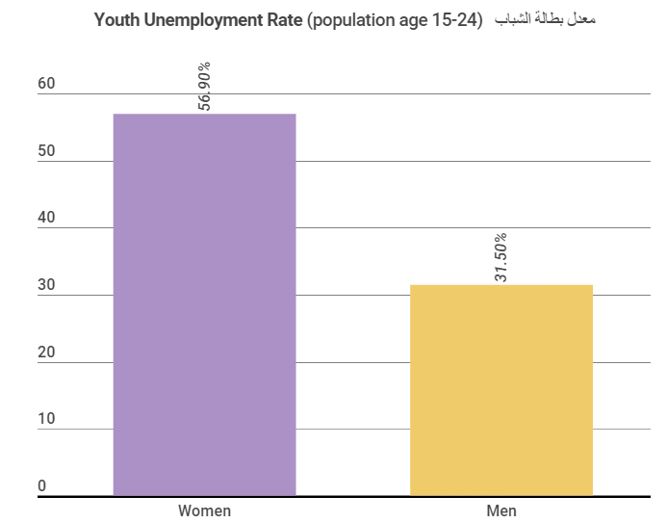
Source: Gender Indicators. (2016). Jordan Department of Statistics.
© University of Maryland, 2018
Labor Force

Slide 8
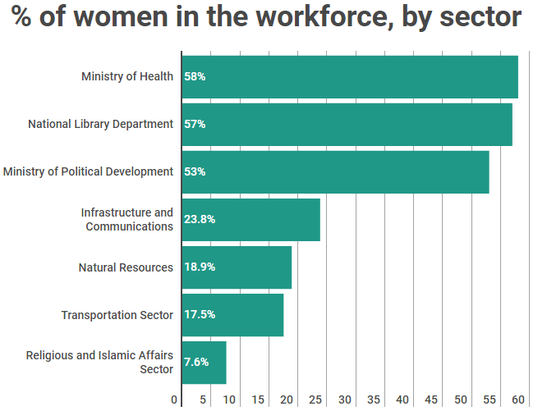
Source: Jordan Case Study (2012). UNDP.
© University of Maryland, 2018
Labor Force
Notes:
National Library Department: A department established by the Jordanian government in 1994 to collect, maintain and introduce to the public the “national intellectual products in all its types and forms”.
In addition to the above sectors, there was an increase in the number of women appointed to high-ranking positions at different government departments, including the armed forces and police corps.

Slide 9
Employee Distribution
In 2016, the percentage distribution of Jordanian women (aged 15 years and above) by occupation included:
1.5% were women legislators, senior officials and managers.
62% were women professionals.
11.9% were women technicians and associate professionals.
8.4% were women in service and sales.
0.5% were skilled agricultural and forestry and fishery workers
2.9% were women as craft and trade workers.
0.1% were women plant and machine operator and assemblers.
Source: Jordanian Woman Indicators Gender Perspective. (2016). Department of Statistics. State of Jordan.
Labor Force
© University of Maryland, 2018

Slide 10
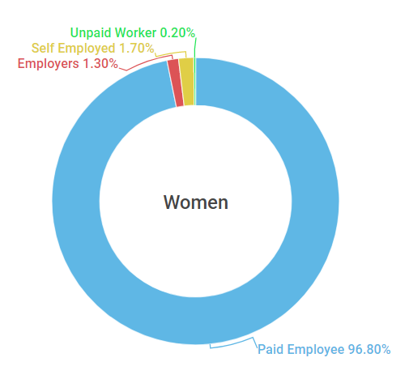
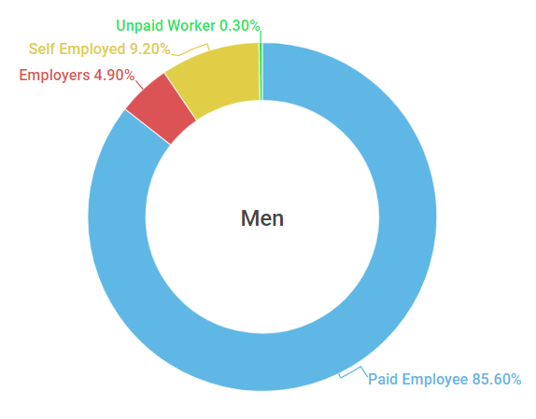
Employed Population (Aged 15+) by Employment Status (%)
Source: Employment and Unemployment Survey. (2015) Department of Statistics. State of Jordan.
© University of Maryland, 2018
Labor Force

Slide 11
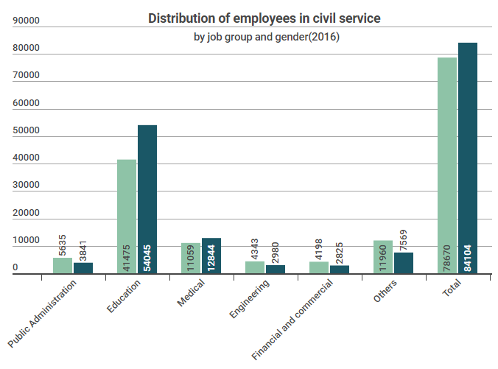
51.7%
Of women employees are in the civil service.
Source: Selective Statistics (2016). Civil Service Bureau (CSB).
© University of Maryland, 2018
Labor Force

Slide 12
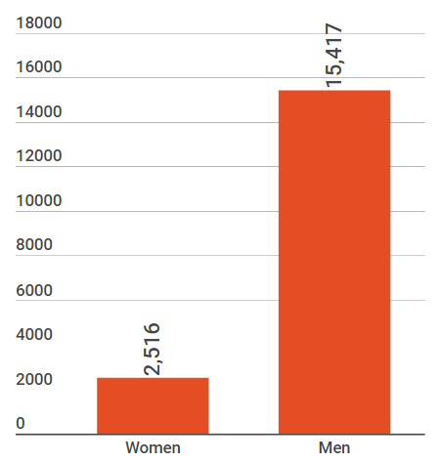
Estimated Earned Income, 2017
US Dollar
Source: Global Gender Gap, World Economic Forum, (2017).
© University of Maryland, 2018
Labor Force

Slide 13
Education
© University of Maryland, 2018

Slide 14
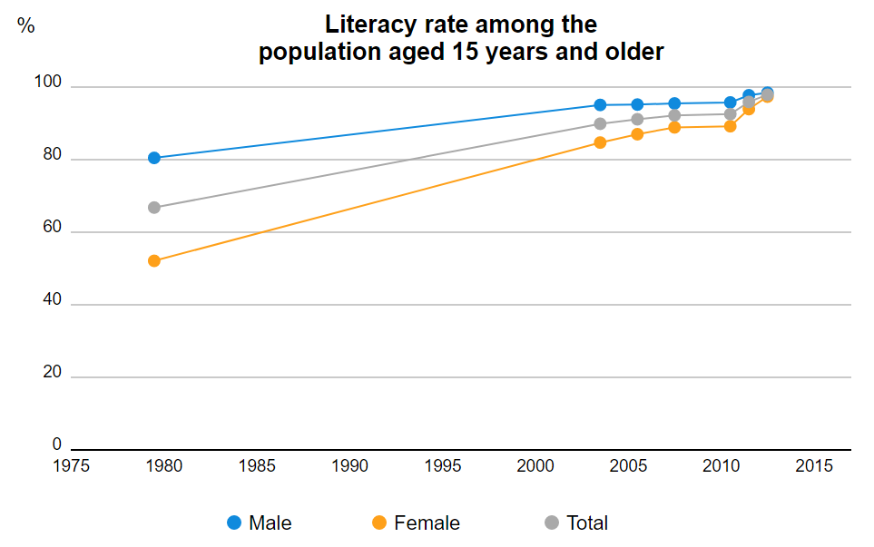
Men
Women
Source: UNESCO. (2017)
© University of Maryland, 2018
Education

Slide 15
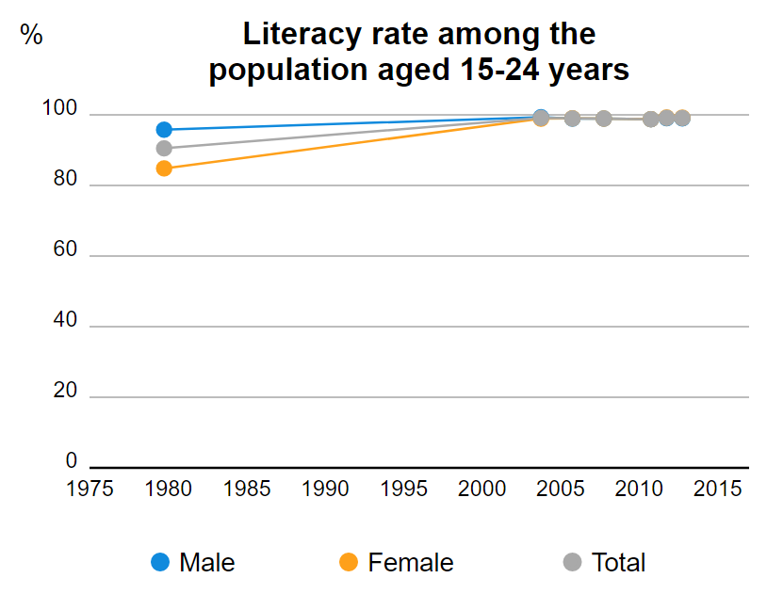
Men
Women
Source: UNESCO. (2017)
© University of Maryland, 2018
Education

Slide 16
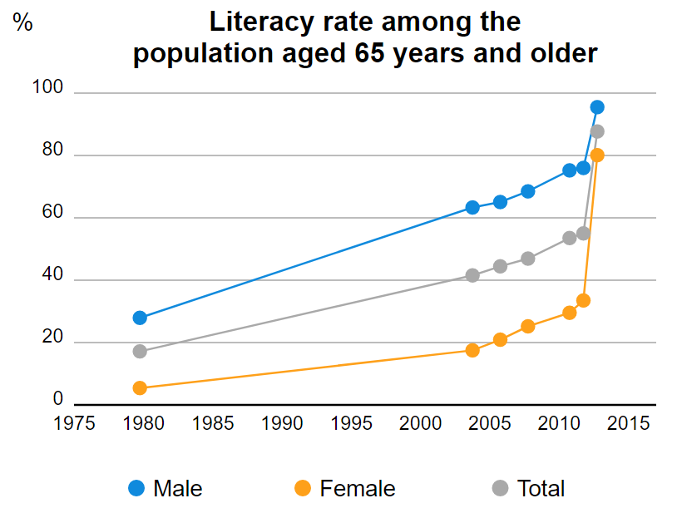
Men
Women
Source: UNESCO. (2017)
© University of Maryland, 2018
Education

Slide 17
Early/Child Marriage
© University of Maryland, 2018

Slide 18
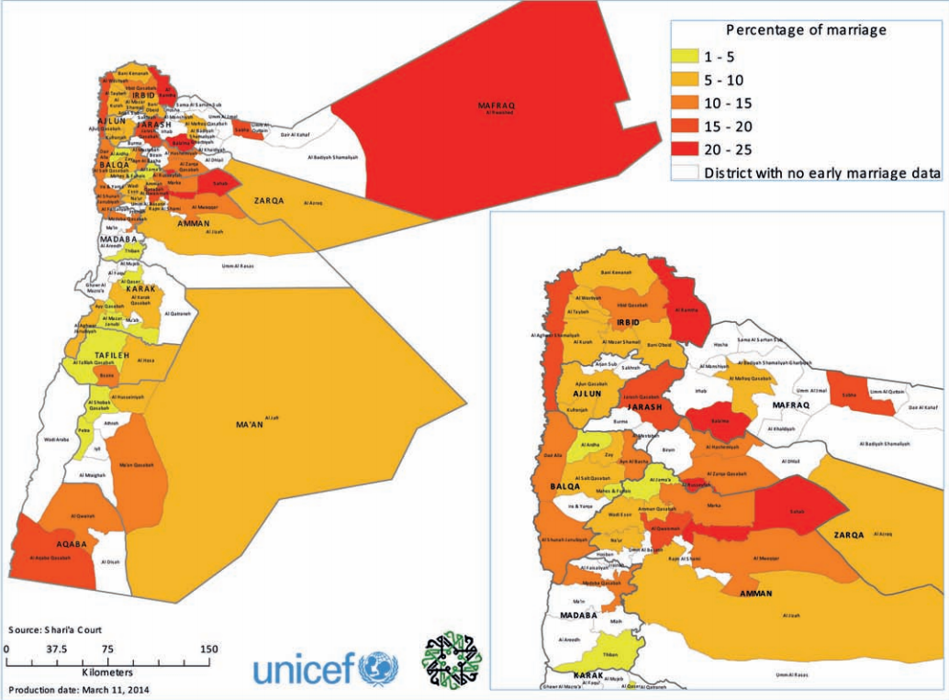
Marriage Among Girls Aged 15-17
As Percentage of All Registered Marriages
in 2012
© University of Maryland, 2018
Early/Child Marriage

Slide 19
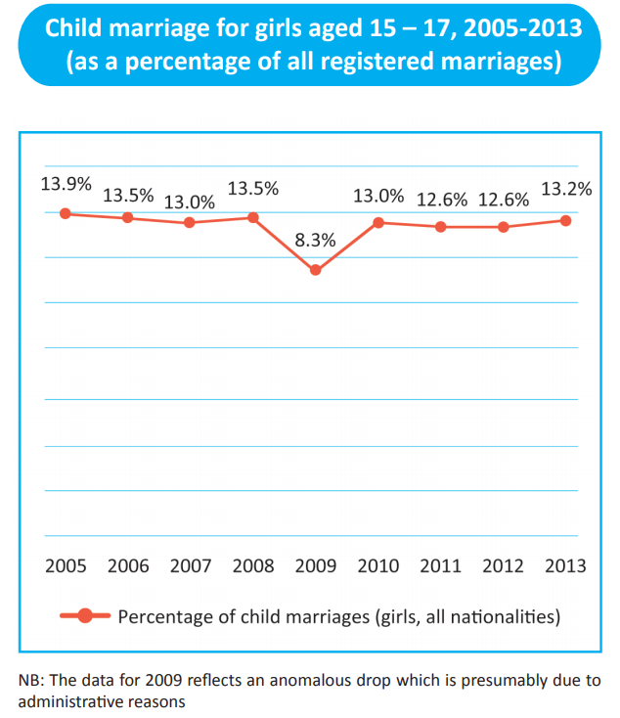
© University of Maryland, 2018
Source: UNICEF (2014)
Early/Child Marriage

Slide 20
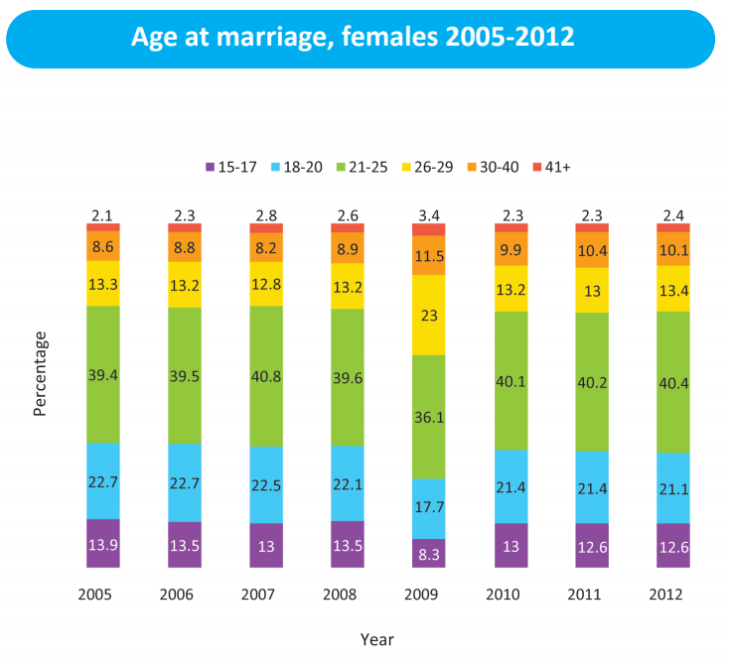
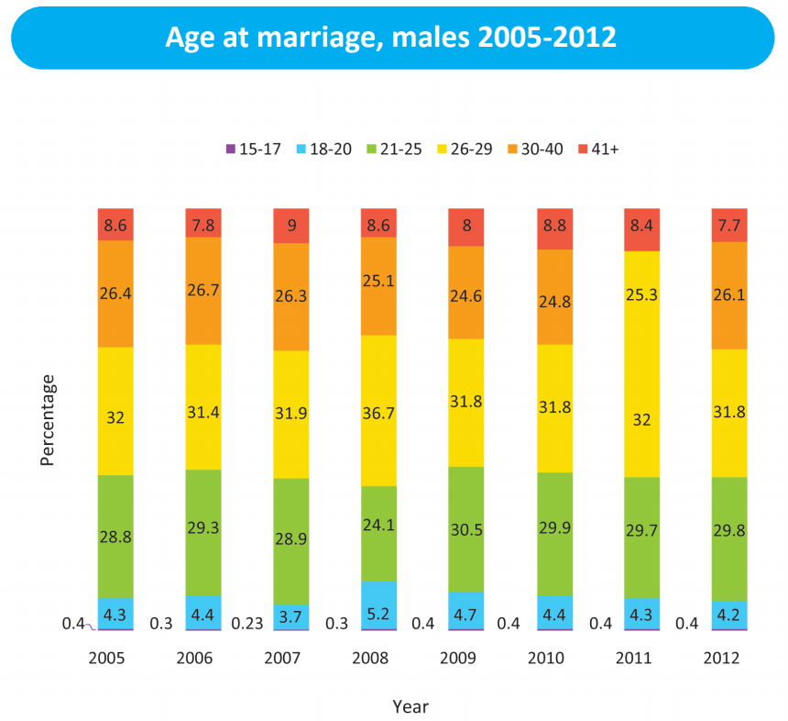
Age at marriage, women 2005-2012
Age at marriage, men 2005-2012
Source: UNICEF. (2014)
© University of Maryland, 2018
Early/Child Marriage

Slide 21
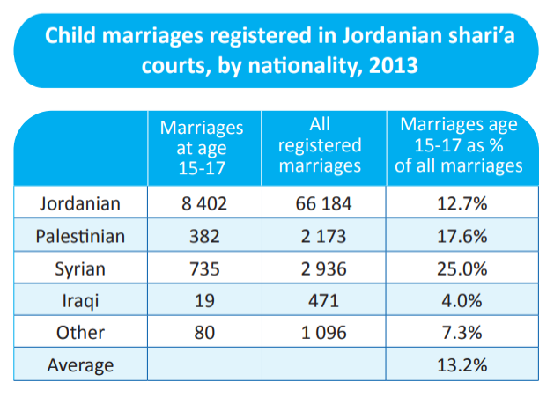
Source: UNICEF. (2014)
© University of Maryland, 2018
Early/Child Marriage

Slide 22
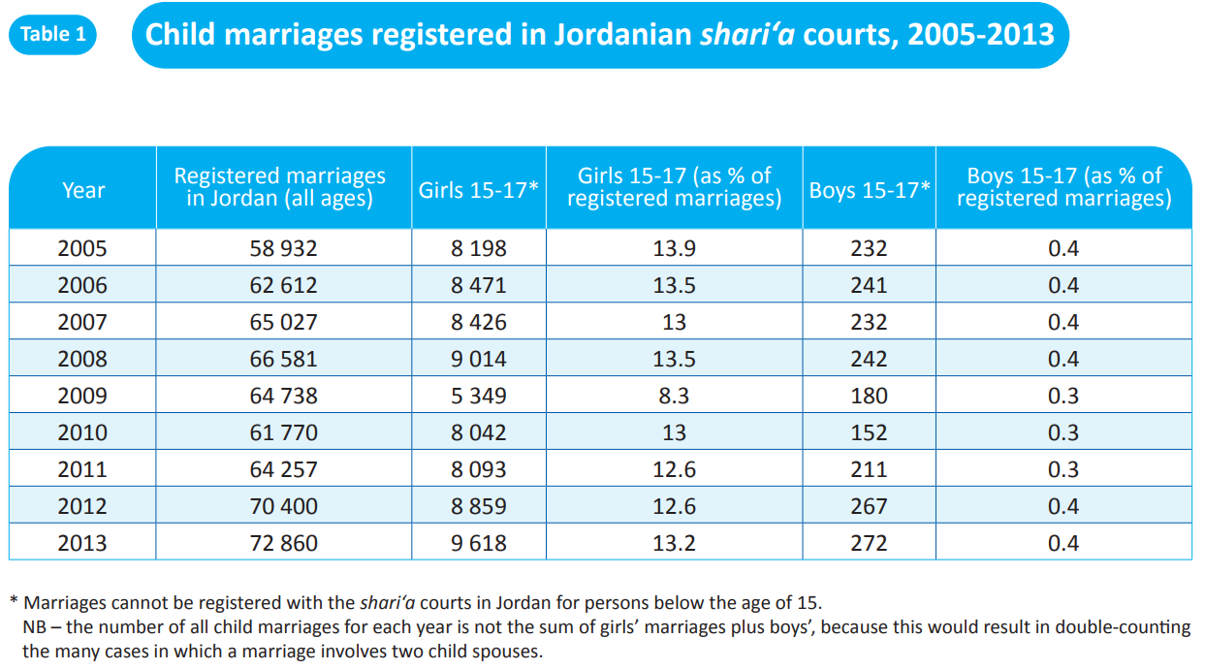
Source: UNICEF. (2014)
© University of Maryland, 2018
Early/Child Marriage

