Slide 1





MENA Region
1) MENA Gender Analysis
2) Statistics from MENA Region
May Rihani, University of Maryland, 2018
مي الريحاني، جامعة ماريلاند
© University of Maryland, 2018

Slide 2
MENA REGION
1) MENA Gender Analysis:
Impediments and Progress Toward Equitable Participation by Women in Social, Economic and Political Life
in the Middle East and North Africa (MENA)
May Rihani, University of Maryland, 2018
مي الريحاني، جامعة ماريلاند
© University of Maryland, 2018

Slide 3
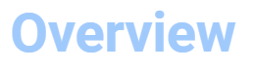
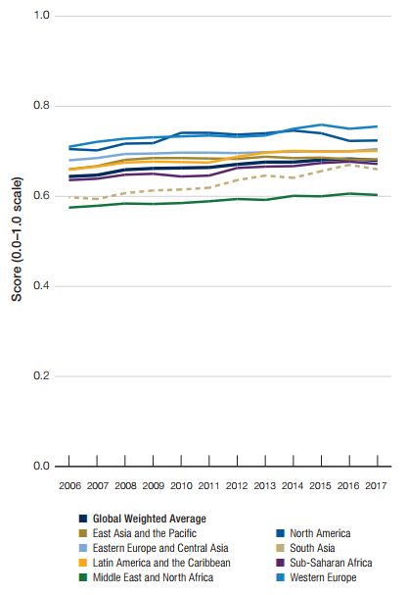
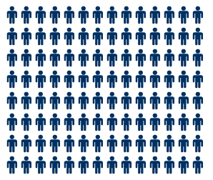
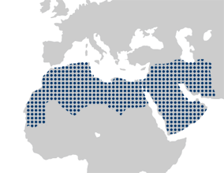
الترتيب الإقليمي
Global Gender Gap Index and subindexes evolution, 2006 - 2017, by region
Regional Ranking
نظرة عامة
117 | Tunisia ↑↑
120 | UAE ↑
126 | Bahrain ↑↑
127 | Algeria ↓↓
129 | Kuwait ↓
130 | Qatar ↓↓
134 | Egypt ↓
135 | Jordan ↓
136 | Morocco ↓
137 | Lebanon ↓
138 | Saudi Arabia ↑
142 | Syria →
144 | Yemen →
157
years to close overall gender gap in MENA region, with current rates of progress.
436 million people
(World Bank, 2016)
The region’s best-performing countries this year are Tunisia, the United Arab Emirates and Bahrain, having closed between 65% and 63% of their overall gender gaps. The lower end of the regional table is made up of Syria and Yemen, having closed 57% and 52% of their gender gap, respectively.
20-22 Countries, 3 subregions
Source: World Economic Forum, Global Gender Gap Report, 2017
MENA Gender Analysis: Overview
© University of Maryland, 2018
Notes:
MENA population: 436 million in 2016. ( 21 countries listed here)
Arab World population: (members of the Arab League): 406 million in 2016. (22 countries)
Regional ranking:
Tunisia: major rank increase: up 9 from #126 in 2016.
UAE: up 4 from #124 in 2016.
Bahrain: up 5 from up from #131 in 2016
Algeria: down 7 from #120 in 2016
Kuwait: down 1 from #128 in 2016
Qatar: major decrease of 11: down from #119 in 2016
Egypt: down 1 from #134 in 2016
Jordan: down 1 from #134 in 2016
Morocco: down 1 #137 in 2016
Lebanon: down 2 from #135 in 2016
Saudi Arabia: up 3 from #141 in 2016
Syria: rank remains the same at #142 in 2016
Yemen: rank remains the same at #144, last, in 2016.

Slide 4
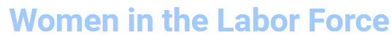
المرأة في القوى العاملة
1
Women in the Middle East and North Africa region have achieved impressive gains in a number of social indices, but still have the world’s lowest rates of labor force participation.
in 4 women in the Middle East and North Africa are employed or looking for work.
Source: World Bank, Main Report:MENA Development report, 2013
Source: World Economic Forum, Global Gender Gap Report, 2015
MENA Gender Analysis: Women in the Labor Force
© University of Maryland, 2018
Notes:
The labor force is defined simply as the people who are willing and able to work. The size of the labor force is used to determine the unemployment rate. The percentage of the unemployed in the labor force is called the unemployment rate.

Slide 5
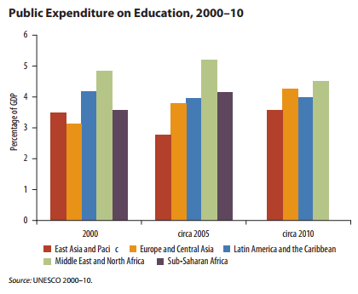
Why do Arab women not participate in the workforce, especially given that girls in Arab countries enjoy educational parity with boys?
MENA Gender Analysis: Women in the Labor Force
© University of Maryland, 2018

Slide 6
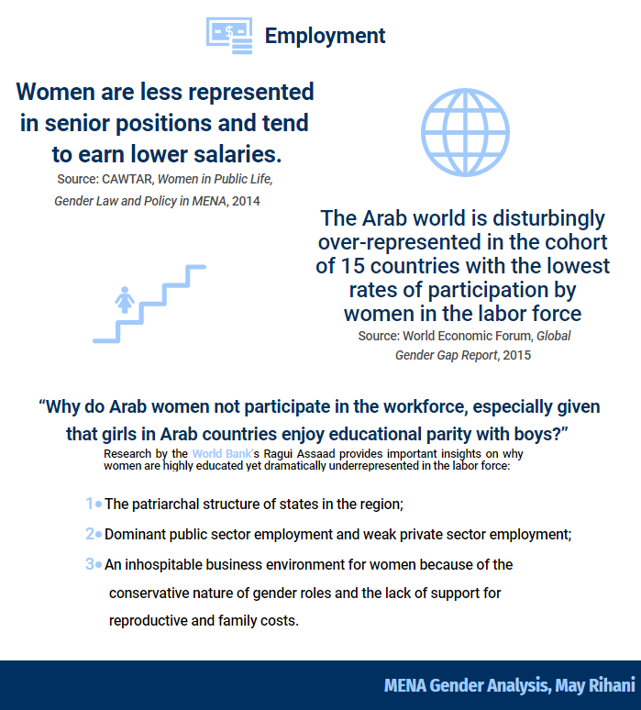
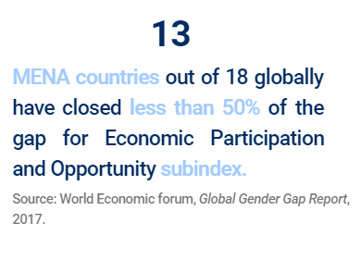
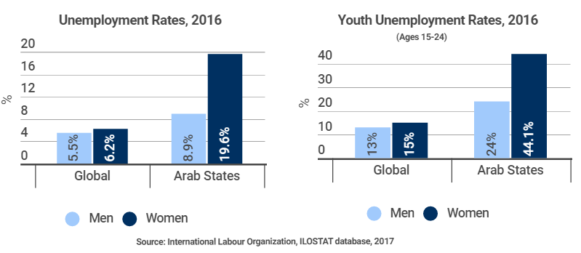
التوظيف
MENA Gender Analysis: Women in the Labor Force
© University of Maryland, 2018
Notes:
Limitations and Exceptions: The criteria for people considered to be seeking work, and the treatment of people temporarily laid off or seeking work for the first time, vary across countries. In many cases it is especially difficult to measure employment and unemployment in agriculture. The timing of a survey can maximize the effects of seasonal unemployment in agriculture. And informal sector employment is difficult to quantify where informal activities are not tracked. There may be also persons not currently in the labour market who want to work but do not actively "seek" work because they view job opportunities as limited, or because they have restricted labour mobility, or face discrimination, or structural, social or cultural barriers. The exclusion of people who want to work but are not seeking work (often called the "hidden unemployed" or "discouraged workers") is a criterion that will affect the unemployment count of both women and men. However, women tend to be excluded from the count for various reasons. Women suffer more from discrimination and from structural, social, and cultural barriers that impede them from seeking work. Also, women are often responsible for the care of children and the elderly and for household affairs. They may not be available for work during the short reference period, as they need to make arrangements before starting work. Further, women are considered to be employed when they are working part-time or in temporary jobs, despite the instability of these jobs or their active search for more secure employment. (World Bank data, 2017)

Slide 7
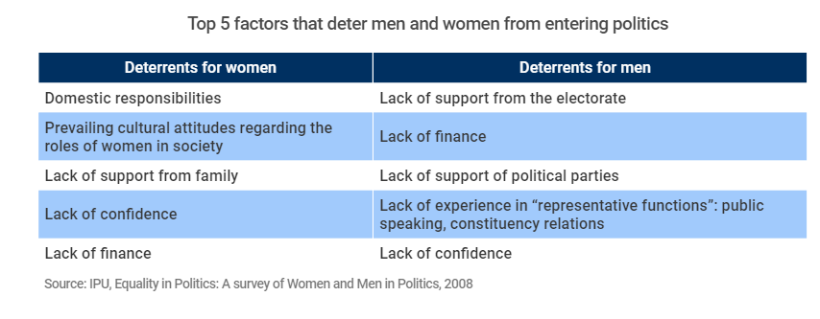
Women and Political Participation
المرأة والمشاركة السياسية
MENA Gender Analysis: Women and Political Participation
© University of Maryland, 2018
Notes:
Section introduction slide: Women and Political Participation

Slide 8
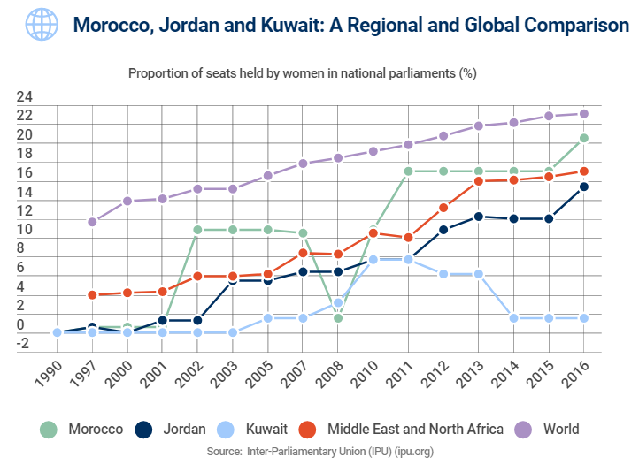
MENA Gender Analysis: Women and Political Participation
© University of Maryland, 2018
Notes:
Overview. Detailed graph on next slide.

Slide 9


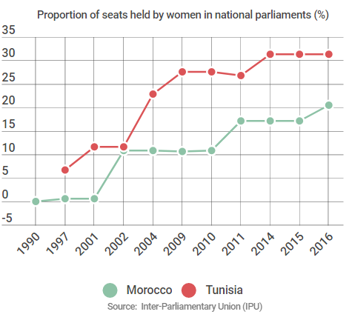
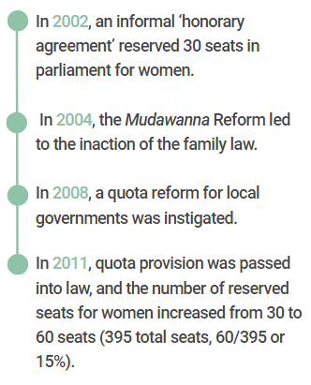
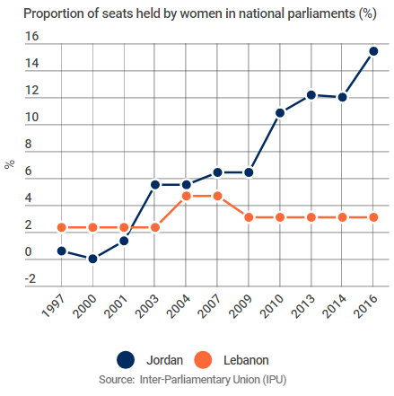

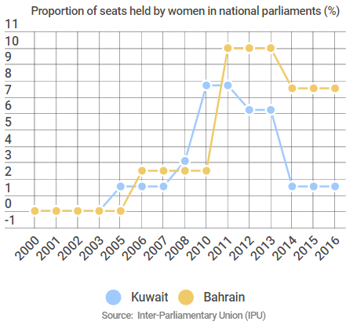
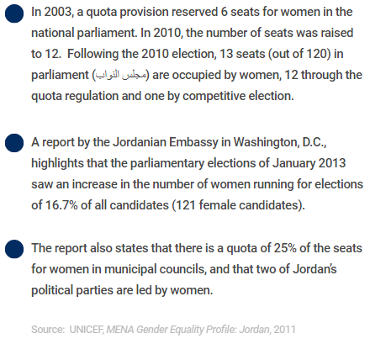
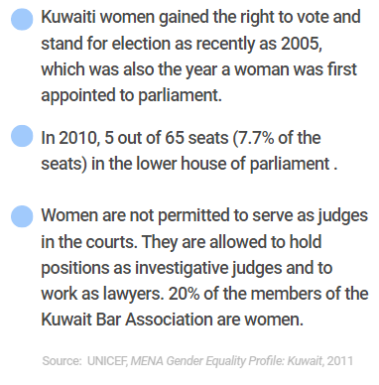
MENA Gender Analysis: Women and Political Participation
© University of Maryland, 2018
Notes:
Morocco: The 2004 Mudawwana reforms brought new promise to Moroccan women, but not total emancipation. The newest reforms developed around a general principle of extending the protections of women within the family unit, and to that end women received greater rights in regard to marriage, divorce, polygamy, and custody.

Slide 10

Women and Social Issues
المرأة والقضايا الاجتماعية
Early Marriage
18
16%
32
legal age of marriage for girls and boys in Morocco (post Moudawana) and Jordan, with exceptions.
% of young women aged 20-24 were married before the age of 18 in Morocco.
births per 1,000 women aged 15-19 in Morocco, 2006-2015
Source: World Bank, Women, Business and the Law, 2016
Source: DHS, Ministère de la Santé/Maroc, ORC Macro, and Ligue des États Arabes. 2005. Enquête sur la Population et la Santé Familiale (EPSF) 2003-2004.
Source: UNFPA, State of World Population, 2017
15, 17
26
1%, 10%, 22%
legal age of marriage for girls and boys, respectively, in Kuwait. Exceptions are not granted.
% of women married by age of 15, 18, 20 in Jordan in 2007.
births per 1,000 women aged 15-19 in Jordan, 2006-2015
Source: World Bank, Women, Business and the Law, 2016
Source: Department of Statistics (Jordan), Jordan Population and
Family Health Survey, 2007
Source: UNFPA, State of World Population, 2017
MENA Gender Analysis: Women and Social Issues
© University of Maryland, 2018

Slide 11

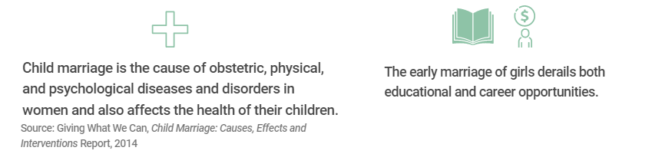
Child marriage is the cause of obstetric, physical, and psychological diseases and disorders in women and also affects the health of their children.
34.1%
of child brides have physically weak children.
8.9%
Source: Giving What We Can, Child Marriage: Causes, Effects and Interventions Report, 2014
have handicapped and disabled children.
40.4%
have suffered from gynecological diseases.
20.2%
The early marriage of girls derails both educational and career opportunities.
have had psychological disorders.
Source: Girls Not Brides,The Role of Parliamentarians in Ending Child Marriage, 2016
Source: Giving What We Can, Child Marriage: Causes, Effects and Interventions Report, 2014
MENA Gender Analysis: Women and Social Issues
© University of Maryland, 2018

Slide 12
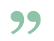
Encouraging Positive Change
نحو تغيير إيجابي
Arab societies tend to be more responsive to social traditions than to law, experience suggests that change can be achieved through the legal system.
“...in the Islamic world, basic rights in family law constitute a major dimension of gender equality and good family practices.”
Dr. Mounira Charrad, Family Law Reforms in the Arab World: Tunisia and Morocco, 2012
MENA Gender Analysis: Encouraging Positive Change
© University of Maryland, 2018

Slide 13

The 2014 Women in Public Life: Gender, Law, and Policy in the Middle East and North Africa OECD and CAWTAR report, made the following recommendations for increasing the role of women as leaders in the Arab World:
Establish measures such as quotas (voluntary or legislative) to improve the representation of women in parliaments and the political executive; adopt measures to strengthen equal access of women and men to public office.
Advance the use of leadership development programs to strengthen women’s leadership.
Adopt policies for greater work-life balance and for greater “women-friendliness” of legislatures, including instituting gender-sensitive parliamentary practices and procedures.
Support the establishment of cross-party women’s caucuses to provide support networks for women in legislatures and encourage peer cooperation.
Take active steps to prevent, identify and address political harassment and violence experienced by women when in public office.
Take steps to strengthen women’s access to high-level executive posts by creating an enabling environment and institutional mechanisms that provide support and access to female leaders, including networking among female leaders.
MENA Gender Analysis: Encouraging Positive Change
© University of Maryland, 2018

Slide 14
Sources
Department of Statistics, Jordan Population and Family Health Survey, 2007.
DHS, Ministère de la Santé/Maroc, ORC Macro, and Ligue des États Arabes, 2005. Enquête sur la Population et la Santé Familiale (EPSF), 2003-2004.
Giving What We Can. Child Marriage: Causes, Effects and Interventions, 2014.
International Labour Organization (ILO). Women at Work: Trends, 2016.
Inter-Parliamentary Union (IPU). Equality in Politics: A Survey of Women and Men in Parliaments, 2008.
Organisation for Economic Co-operation and Development (OECD), Center of Arab Women for Training and Research (CAWTAR). Women in Public Life: Gender, law and policy in the Middle East and North Africa, 2014.
World Bank. Main report. MENA development report, 2013.
World Bank Group. Women, Business and the Law 2016: Getting to Equal, 2015.
World Economic Forum. Global Gender Gap Report, 2017.
World Vision UK. Untying the Knot - Exploring Early Marriage in Fragile States, 2013.
UNICEF, MENA Gender Equality Profile: Jordan, 2011.
UNICEF, MENA Gender Equality Profile: Kuwait, 2011.
UNICEF, MENA Gender Equality Profile: Morocco, 2011.
UNDESA, Dr. Mounira Charrad. Family Law Reforms In The Arab World: Tunisia and Morocco, 2014
UNFPA. The State of World Population, 2017.
© University of Maryland, 2018

Slide 15
Thank you
© University of Maryland, 2018

