Slide 1


MENA REGION
2) Statistics from a
Gender Analysis of the
MENA Region
Compiled by the staff of the Gibran Chair, University of Maryland, 2018
© University of Maryland, 2018

Slide 2

Women’s Participation in
the Workforce
© University of Maryland, 2018

Slide 3
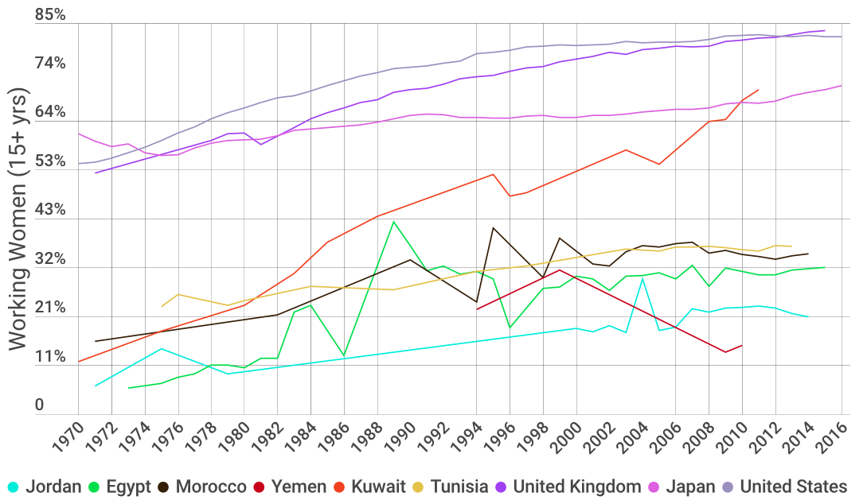
Global Participation of Women in the Workforce
Source: The World Bank , DataBank (2017)
© University of Maryland, 2018
Notes:
https://data.worldbank.org/indicator/SL.TLF.TOTL.FE.ZS

Slide 4
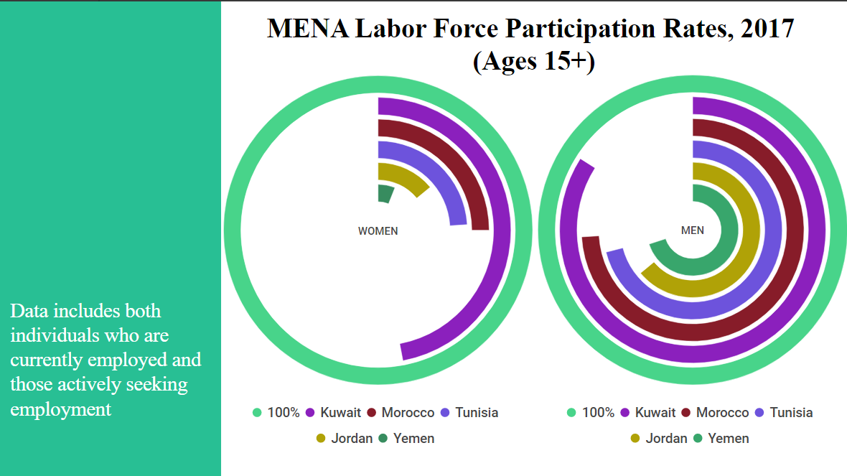
Source: Labor Force Participation Rates, The World Bank, March 2017
© University of Maryland, 2018
Notes:
https://www.unicef.org/gender/files/Kuwait-Gender-Eqaulity-Profile-2011.pdf
page 4
https://www.unicef.org/gender/files/Yemen-Gender-Eqaulity-Profile-2011.pdf
page 4
https://www.unicef.org/gender/files/Jordan-Gender-Eqaulity-Profile-2011.pdf
page 4
https://www.unicef.org/gender/files/Morroco-Gender-Eqaulity-Profile-2011.pdf
page 4
https://www.unicef.org/gender/files/Tunisia-Gender-Eqaulity-Profile-2011.pdf
page 3

Slide 5
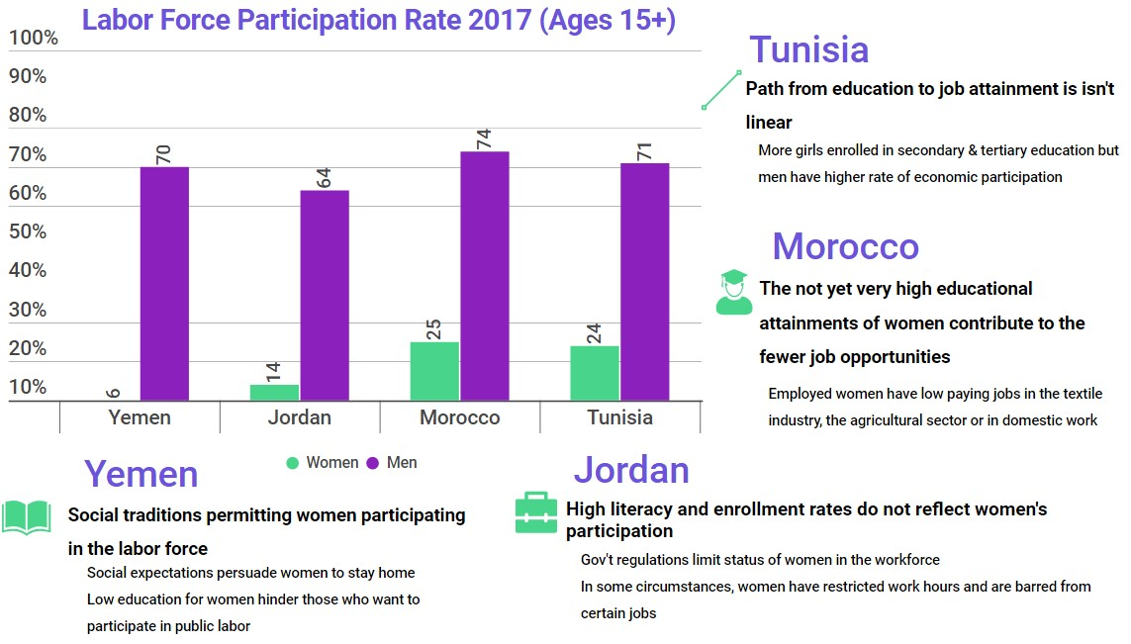
Source: Labor Force Participation Rates, The World Bank, March 2017; Freedom House, Women’s Rights in the Middle East and North Africa (2010)
© University of Maryland, 2018
Notes:
https://www.unicef.org/gender/files/Yemen-Gender-Eqaulity-Profile-2011.pdf
page 4
https://www.unicef.org/gender/files/Jordan-Gender-Eqaulity-Profile-2011.pdf
page 4
https://www.unicef.org/gender/files/Morroco-Gender-Eqaulity-Profile-2011.pdf
page 4
https://www.unicef.org/gender/files/Tunisia-Gender-Eqaulity-Profile-2011.pdf
page 3
https://freedomhouse.org/sites/default/files/inline_images/Jordan.pdf

Slide 6
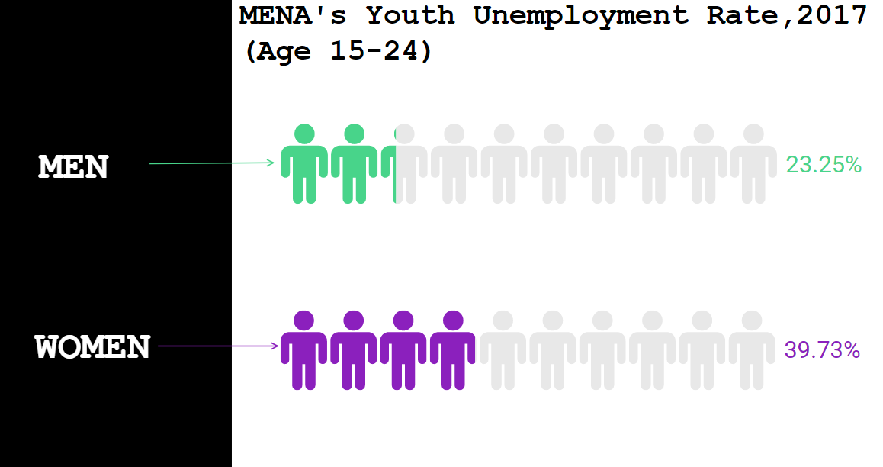
Source: Youth Unemployment, The World Bank (2018)
© University of Maryland, 2018
Notes:
http://blogs.worldbank.org/arabvoices/problem-unemployment-middle-east-and-north-africa-explained-three-charts
http://documents.worldbank.org/curated/en/373331468052751480/pdf/898440REVISED00ue030JULY020140FINAL.pdf
page 12

Slide 7
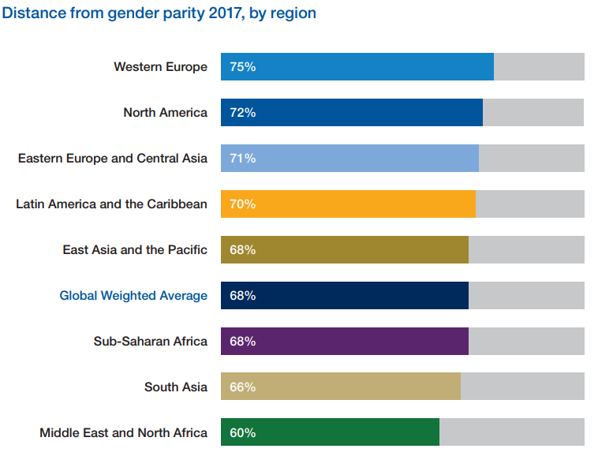
2017 Global Gender Gap: Workforce, Education, Political Participation and Health
Source: Global Gender Gap Index, World Economic Forum (2017)
© University of Maryland, 2018
Notes:
Global Gender Gap Index to see how they compare on four “pillars”: economic participation and opportunity, education, political empowerment, and health and survival.
http://reports.weforum.org/global-gender-gap-report-2016/infographics/
Page 18

Slide 8
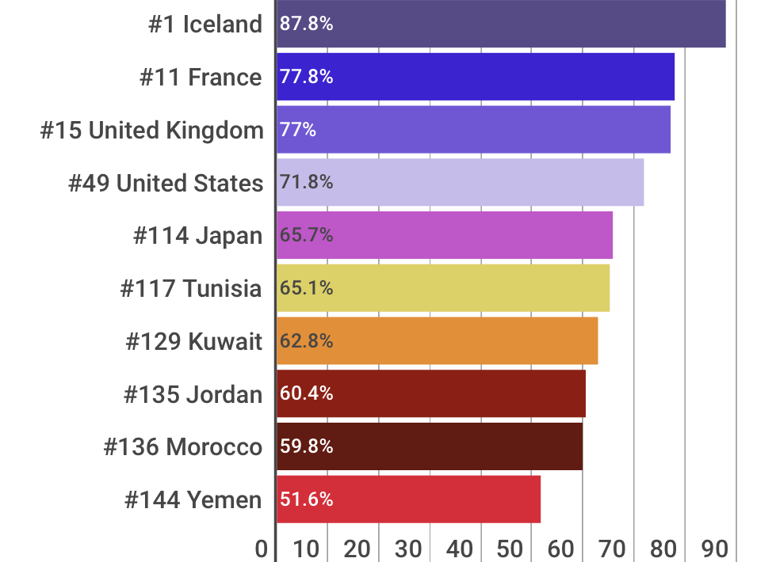
Percentage of Gender Gap Closed by Country in 2017
Source: Global Gender Gap Index, World Economic Forum (2017)
© University of Maryland, 2018
Notes:
http://www3.weforum.org/docs/WEF_GGGR_2017.pdf
page 20

Slide 9
  “It will take more than 70 years before global gender wage gaps are closed completely, if progress continues to move at its current pace.”
ILO 2016
Source: International Labour Organization, Women at Work Trends 2016 (2016)
© University of Maryland, 2018
Notes:
http://www.ilo.org/wcmsp5/groups/public/---dgreports/---dcomm/---publ/documents/publication/wcms_457317.pdf
Page xvi

Slide 10
Women’s Participation in
the Political Arena
© University of Maryland, 2018

Slide 11
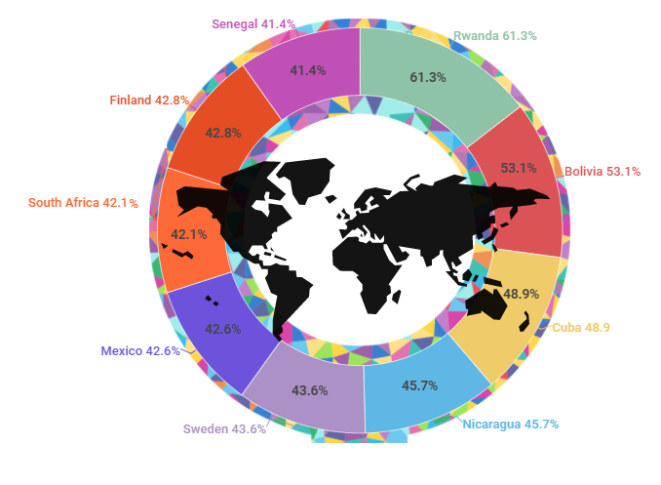
Top 10 Countries Worldwide, Percentage of Women in Lower Parliament (as of January 2018)
Source: Inter-Parliamentary Union, Women in National Parliaments (2018)
© University of Maryland, 2018
Notes:
Data from: http://archive.ipu.org/wmn-e/classif.htm
(% women in LOWER or SINGLE HOUSE of parliament)

Slide 12
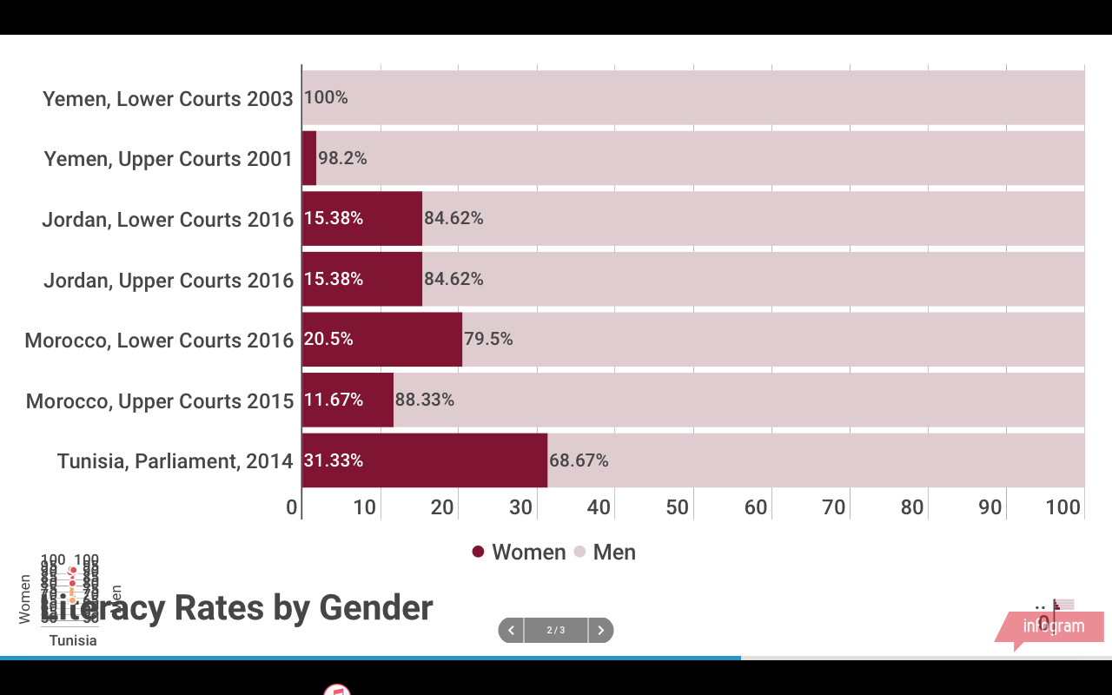
Comparison of Parliament Members by Gender
11.67%
Source: Inter-Parliamentary Union, National Parliaments Data Table (October 2017)
© University of Maryland, 2018
Notes:
http://archive.ipu.org/wmn-e/classif.htm

Slide 13
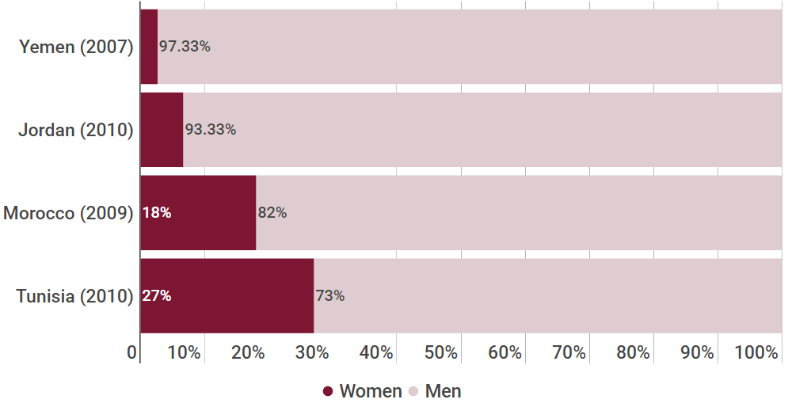
Judges: Gender Comparison
Source: UNICEF, Jordan Gender Profile (2011); UNICEF, Yemen Gender Profile (2011); UNICEF, Morocco Gender Profile (2011); UNICEF, Tunisia Gender Profile (2011)
© University of Maryland, 2018
Notes:
https://www.unicef.org/gender/files/Yemen-Gender-Eqaulity-Profile-2011.pdf
Page 3
https://www.unicef.org/gender/files/Jordan-Gender-Eqaulity-Profile-2011.pdf
Page 4
https://www.unicef.org/gender/files/Morroco-Gender-Eqaulity-Profile-2011.pdf
page 3
https://www.unicef.org/gender/files/Tunisia-Gender-Eqaulity-Profile-2011.pdf
Page 3

Slide 14
Women & Early Marriage
© University of Maryland, 2018

Slide 15
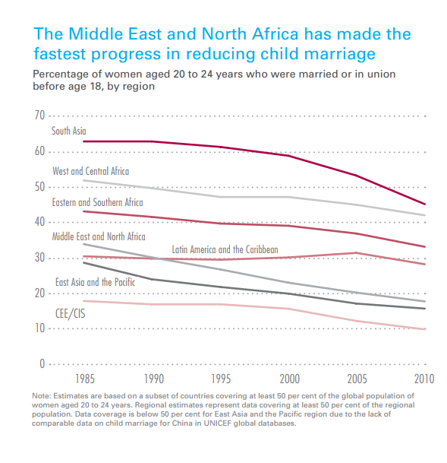
MENA Region Has Made the Fastest Progress in
Reducing Child Marriage
% of women ages 20-24 who were married before age 18, by region
Statistics from a Gender Analysis
CEE/CIS: Central Eastern Europe/Commonwealth of Independent States
Source: UNICEF, United Nations Children’s Fund, Ending Child Marriage: Progress and Prospects (2014)
© University of Maryland, 2018
Notes:
https://www.unicef.org/media/files/Child_Marriage_Report_7_17_LR..pdf
CEE/CIS: Central Eastern Europe/Commonwealth of Independent States
CEE are the former communist states of Europe e.g. Estonia, Latvia and Lithuania / CIS consists of ten former Soviet Republics: e.g. Armenia and Belarus

Slide 16
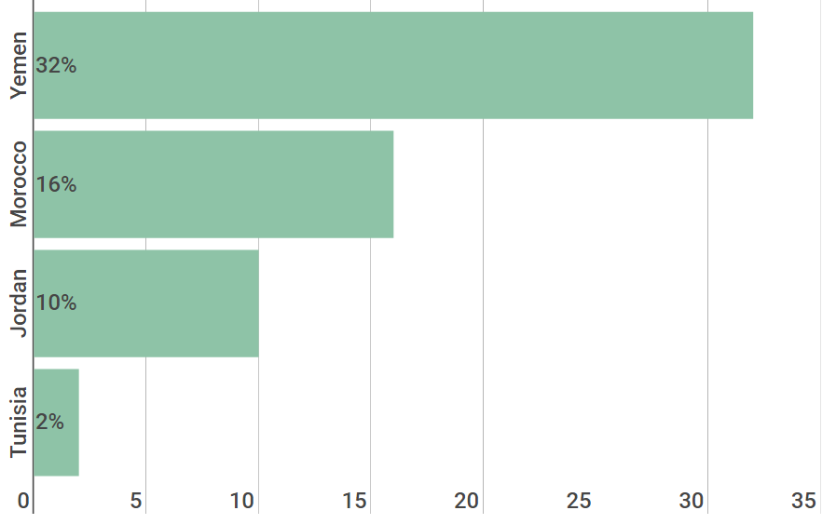
2008-2014 MENA Region’s Percentage of Women Married
Before 18 (Ages 20-24)
Source: UNICEF, State of the World’s Children (June 2016)
© University of Maryland, 2018
Notes:
https://www.unicef.org/publications/files/UNICEF_SOWC_2016.pdf
Pages 150-153

Slide 17
Women & Family Planning
© University of Maryland, 2018

Slide 18
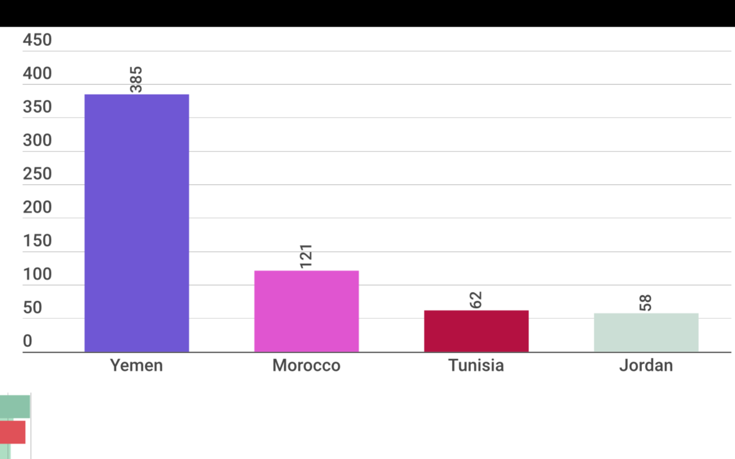
2015 Maternal Deaths per 100,000 Live Births
385
121
62
58
Source: WHO, UNICEF, UNFPA & World Bank, Trends in Maternal Mortality (2010); UNICEF, Tunisia Gender Report (2011); WHO, UNICEF, UNFPA, World Bank Group, and UN Population Division Maternal Mortality Estimation Inter-Agency Group, Maternal Mortality (2015)
© University of Maryland, 2018
Notes:
http://www.who.int/gho/maternal_health/countries/yem.pdf
http://www.who.int/gho/maternal_health/countries/mar.pdf
http://www.who.int/gho/maternal_health/countries/tun.pdf
http://www.who.int/gho/maternal_health/countries/jor.pdf

Slide 19
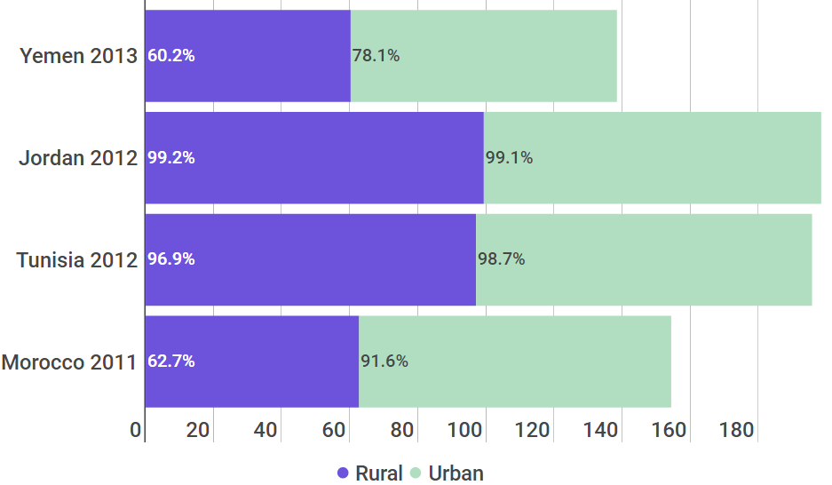
Antenatal Care Coverage: At Least One Visit
32%
99%
96%
40%
Source: Antenatal Care, UNICEF, 2018
© University of Maryland, 2018
Notes:
https://www.unicef.org/gender/files/Yemen-Gender-Eqaulity-Profile-2011.pdf
page 3
https://www.unicef.org/gender/files/Jordan-Gender-Eqaulity-Profile-2011.pdf
page 3
https://www.unicef.org/gender/files/Tunisia-Gender-Eqaulity-Profile-2011.pdf
page 3
https://www.unicef.org/gender/files/Morroco-Gender-Eqaulity-Profile-2011.pdf
page 3

Slide 20
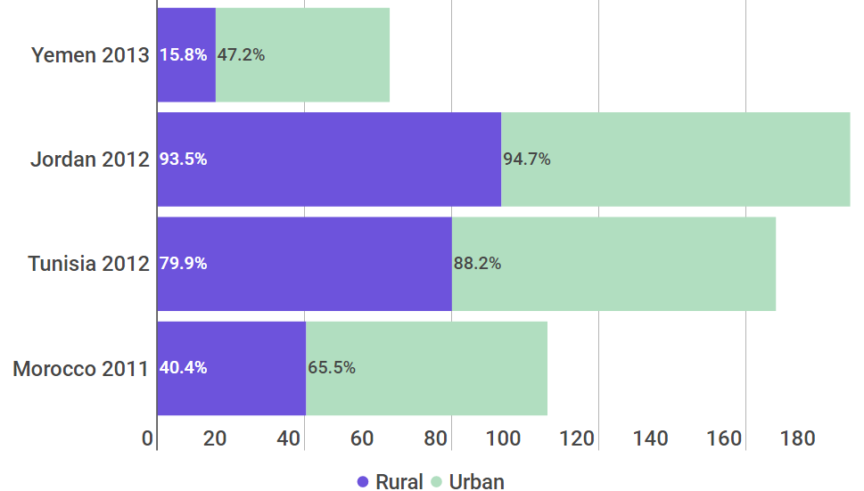
Antenatal Care Coverage: At Least Four Visits
32%
99%
96%
40%
Source: Antenatal Care, UNICEF, 2018
© University of Maryland, 2018
Notes:
https://www.unicef.org/gender/files/Yemen-Gender-Eqaulity-Profile-2011.pdf
page 3
https://www.unicef.org/gender/files/Jordan-Gender-Eqaulity-Profile-2011.pdf
page 3
https://www.unicef.org/gender/files/Tunisia-Gender-Eqaulity-Profile-2011.pdf
page 3
https://www.unicef.org/gender/files/Morroco-Gender-Eqaulity-Profile-2011.pdf
page 3

Slide 21
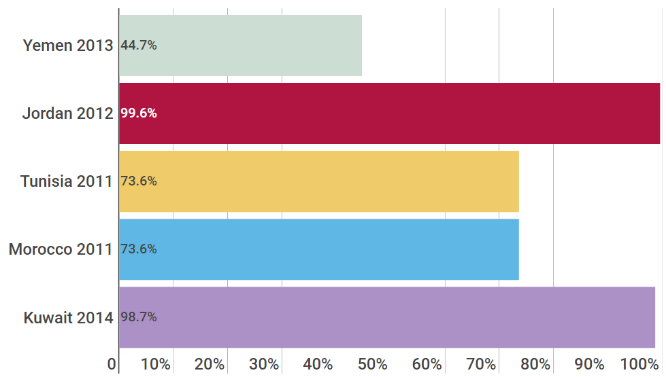
Births Attended by a Skilled Health Professional
Source: Country Profiles, World Health Organization, 2018
© University of Maryland, 2018
Notes:
https://www.unicef.org/gender/files/Yemen-Gender-Eqaulity-Profile-2011.pdf
page 3
https://www.unicef.org/gender/files/Jordan-Gender-Eqaulity-Profile-2011.pdf
page 3
https://www.unicef.org/gender/files/Tunisia-Gender-Eqaulity-Profile-2011.pdf
page 3
https://www.unicef.org/gender/files/Morroco-Gender-Eqaulity-Profile-2011.pdf
page 3

Slide 22
Women & Education
© University of Maryland, 2018

Slide 23
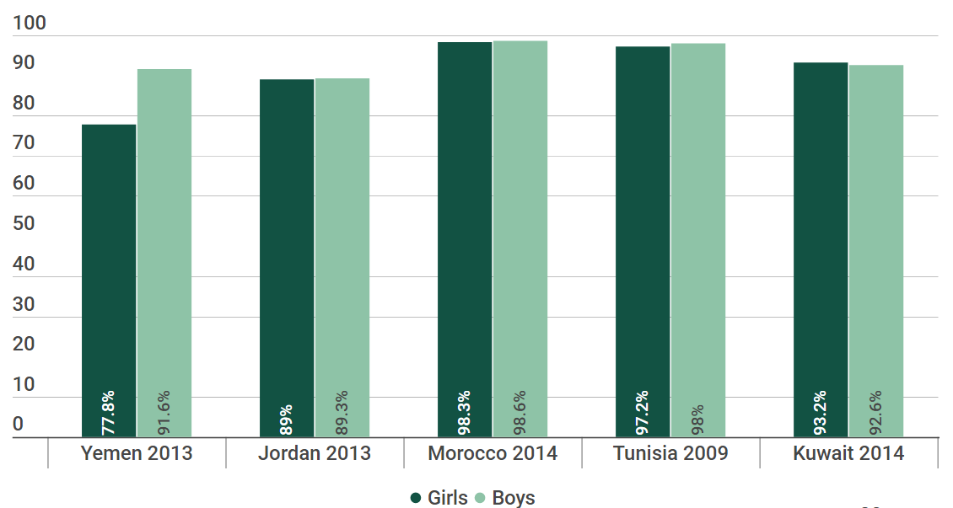
Primary School Enrolment
Source: Education Statistics, UNESCO, 2016
© University of Maryland, 2018
Notes:
https://www.unicef.org/gender/files/Yemen-Gender-Eqaulity-Profile-2011.pdf
page 3
https://www.unicef.org/gender/files/Jordan-Gender-Eqaulity-Profile-2011.pdf
page 3
https://www.unicef.org/gender/files/Morroco-Gender-Eqaulity-Profile-2011.pdf
page 3
https://www.unicef.org/gender/files/Tunisia-Gender-Eqaulity-Profile-2011.pdf
page 3

Slide 24
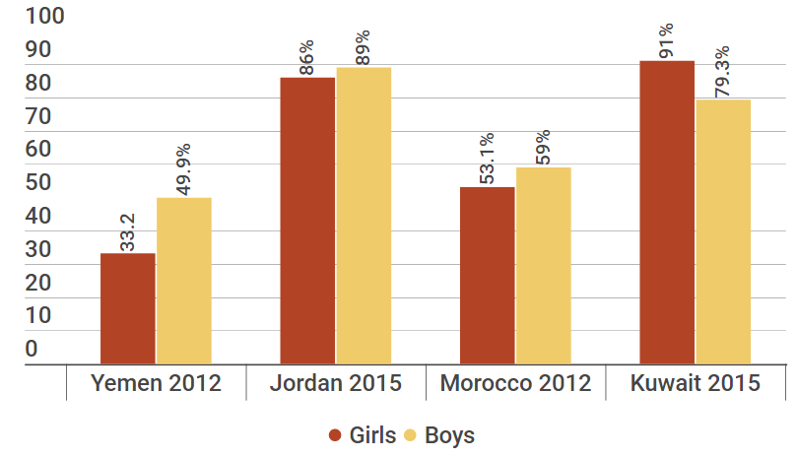
Secondary School Enrolment
Source: Education Statistics, UNESCO, 2016; UNICEF, 2015
© University of Maryland, 2018

Slide 25
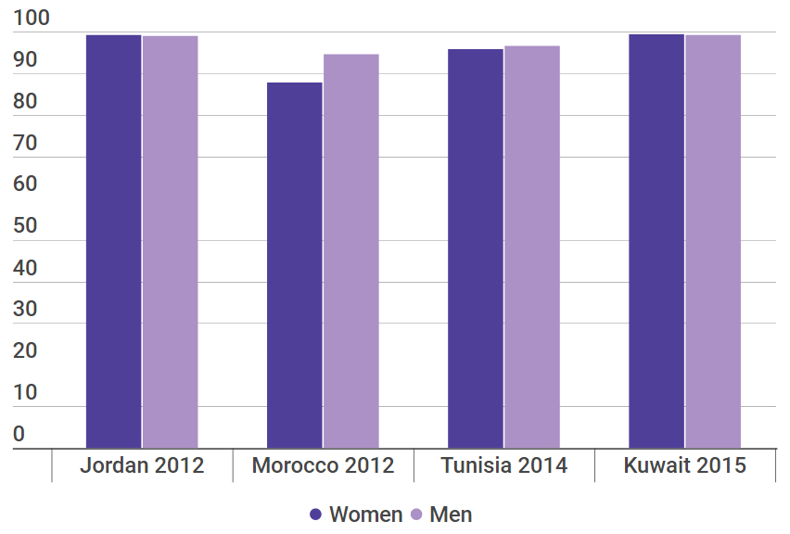
Youth Literacy (Ages 15-24)
Source: Education Statistics, UNESCO, 2016
© University of Maryland, 2018
Notes:
https://www.unicef.org/gender/files/Yemen-Gender-Eqaulity-Profile-2011.pdf
page 3
https://www.unicef.org/gender/files/Jordan-Gender-Eqaulity-Profile-2011.pdf
page 3
https://www.unicef.org/gender/files/Morroco-Gender-Eqaulity-Profile-2011.pdf
page 3
https://www.unicef.org/gender/files/Tunisia-Gender-Eqaulity-Profile-2011.pdf
page 3

Slide 26
Thank you
© University of Maryland, 2018

