Slide 1
Leanna Gautney
GREETINGS
As a chef and restaurateur, Please know, I am intrigued, excited and highly interested in your business. I want this to serve as my acceptance for a Chef/cook position, or equivalent. I am happy to serve in any position you may have, in which I may be a
right ﬁt.
Natural Chef, nutritional coach & culinary Instructor
CULINARY BACKGROUND
MY CULINARY WORK & BACKGROUND:
I am a 4th generation farmer, from a long family line of dairy farmers in Oregon. My family often had 400-600 head of cattle, marketing to several restaurants in Oregon, as well as contributing to the main industry of dairy farmers. My great grandfather was one of the ﬁrst Presidents of the Dairy Farmers Association. I have many family members (past and present) who were and are Chefs.
My family and I grew up caring for livestock & land. My grandmother, (mother’s side), was from the Deep South - a farmer, ﬁsherman and a healer (medicine woman). From the time I could walk, she and my mother had me in the kitchen working with herbs, baking, preserving farm foods and helping cook family meals. My family on my father’s side were dairy and goat farmers, chefs. I also had family who owned/operated a hotel and commercial kitchen at a private
Experience: 30+ years - Dietics, Holistic Health & Nutrition, Culinary & Mgmt
Degrees: AA, Business Admin, BA, Business Mgmt&Organizational Leadership, PhD in Natural Medicine (2025)
Certiﬁcations: US Navy, Army National Guard, Federal Law Enforcement Academy; ServSafe Food handlers, Idaho (Oct2023), Bartender School, First Aid & CPR; Certified
Functional Medicines Practitioner & Holistic Nutrition (2024)
Contact: Cell 360-434-6699 Email gautney@yahoo.com

Slide 2
campground, where I worked as a young aspiring chef.
Vegetarian, Vegan, etc. Therefore, deﬁne my cooking style as a mix of ﬁne ﬂavors, which are always inspired by fresh local ingredients and the tastes of diﬀerent cultures.
I have worked practically every position in a restaurant over my career and have been cooking for my own family since becoming a mother at 15. I’ve managed and served at bars, restaurants, pubs and catering companies. I served through church events and was the Director of a large food pantry in McMinnville, OR. I managed all aspects of the business and volunteer coordination.
I’ve been making my own sourdough breads with a 235 yr old starter, weekly for 10+yrs and have been cooking for over 40+yrs. I enjoy working with all forms of ferments - making raw cheeses, yogurts, marinaras, salsas, lactoferments, pickles, kimchi, kombucha, food alchemy, tonics, and a variety of home-canned foods and preserves, as well. All baked goods and pastries are scratch made in my home. I have several homestyle signature dishes I make regularly, that always bring diners back for more. As a natural chef, I am passionate about food science, fermentation, herbology and viticulture, making my own wines, mead and hard ciders seasonally.
A little known fact about me - I worked as an extra on Grimm & The Librarians and then competed for a spot on Master Chef (season 10) where my dish was selected by the Master Chefs. It greatly validated my cooking skills, talent for ﬂavors and my recipe, when my dish was selected over 80 other contestants! However, I was not great in convincing producers of my acting skills on TV!
I am a natural chef, currently working as a Sous chef at a senior living community in Boise. I also work as a volunteer culinary instructor, teaching farm-to-table culinary skills, preservation & cooking from scratch to Veteran families, as the executive director of our nonproﬁt we call Dunshire Ranch.
In the past I’ve participated in and won several cooking competitions, taught cooking demonstrations at county fairs and traveled all over the world with my military spouse - gaining international inﬂuence of cuisine from many mentoring chefs along the way.
I retain Excellent knowledge in creating special, healthy, raw food and detox diets. I know many creative and international cuisines from the classic American or rustic regional dishes to the modern such as Japanese, Indian, Chinese, Thai, Mexican, Slovakian, Hungarian, French, Spanish, Italian, Portuguese, Brazilian, Greek, British, Southern American, Russian, Mediterranean, Caribbean, Creole/Cajun, Keto, Macrobiotic,
Below, is a few pictures of my work. If you look up #gautneygrublove online you will ﬁnd more. My Instagram: mommag

Slide 3
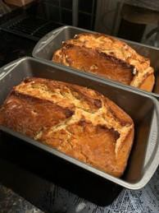
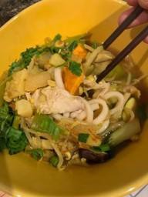
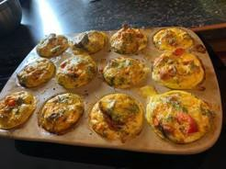
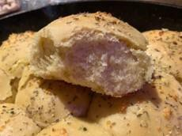
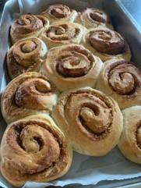
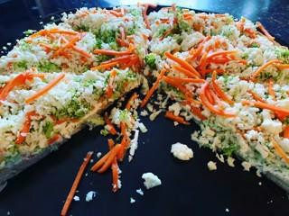
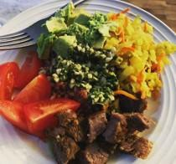
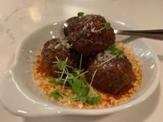
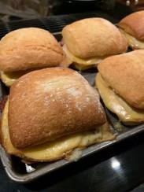
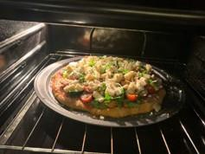
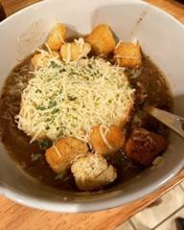
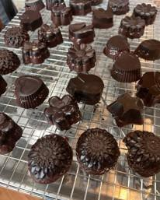
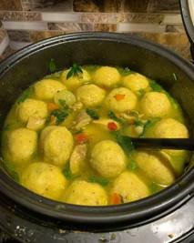
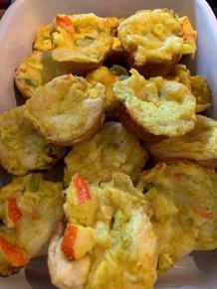
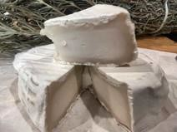
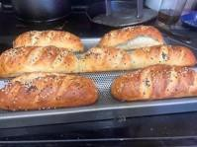
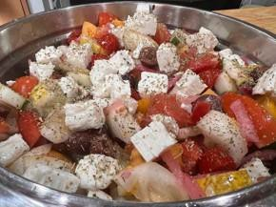
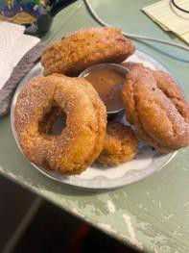
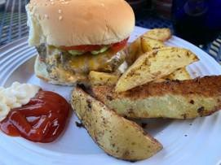
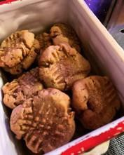

Slide 4
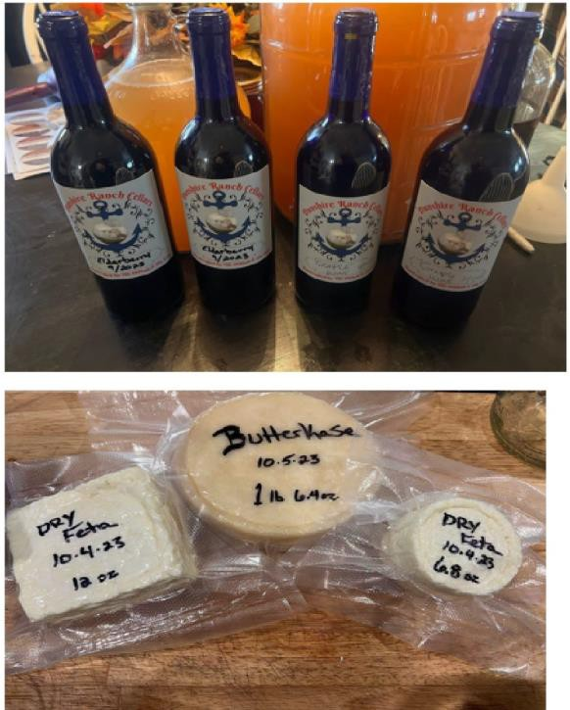
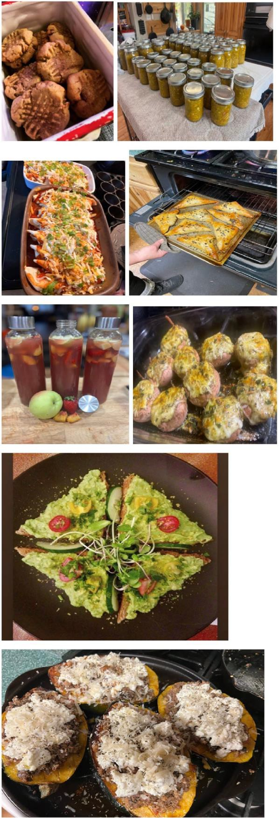
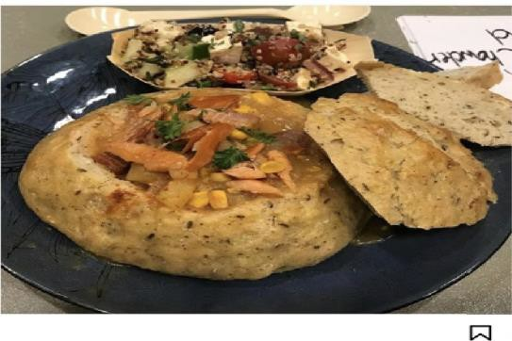
<
MOMMAG
Posts
U LTEir:=>
It Liked by mamalong3 and 12 o"thers
mommag I had some g..-eat tasting food today and even got sent to see the p..-oduce..-s of the sho\.l\t. BUT - guess I didn't have enough of an acting personality or didn't stand out enough against another cook with military background to get chosen to be on the show. It was a great experience alll together and I met a lot of great people. At least they 1ioved my food and so did everyone I sha..-,ed 1it with ...and at least I tnied! You neve..- know unless you t..-y! Thank you all fo..- you.- suppo..-t - you know rny passion for cooking!
Maybe I'll tryagain nex1: year!!;) #masterchef #cookingcompetitiion #didntge1:picked
a.

Slide 5
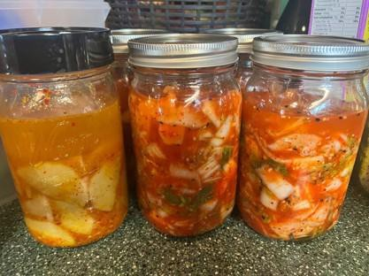
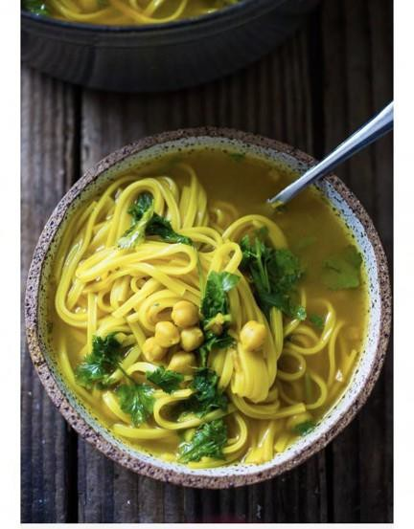
around 12 years in various establishments. Theses early years helped me understand fast-paced restaurant and hospitality industry.
I had a young family and a spouse in the Navy, so I worked nights. I ran bars for ﬁve diﬀerent restaurants, two event centers, and several pubs and night clubs in California, Washington, Nevada and Oregon. I worked as bartender for sporting events and large concerts in San Francisco and then managed bars for the Navy Base and bartended & waitressed at Casinos in Nevada.
Here’s also a quick Instagram post about foods I’ve prepared:
https://www.instagram.com/p/Bl4LCMsB4h0/
?utm_medium=copy_link
When we transferred to WA, I tended bar at a night club up to my 9th month of pregnancy with my youngest child. After she was born, I was oﬀered a bar manager position at the Top-Three Lounge at McChord Air Force Base. They had several clubs on base, so I gained experience in 7 other bars, catering events and
covering for staﬃng shortages. I
was often catering/bartending events for entire divisions of
To share a little more on my background - my ﬁrst job was as a hostess at Denny’s. I then worked as a waitress at an Indian restaurant, a Mexican Restaurant, 2 military facilities and as a
server/cook at every church I’ve been aﬃliated with. I attended
bartending school at 19, working as a bartender and manager for

Slide 6
AirForce personnel and larger base-wide events, as well.
Human Resources, psychology marketing, administrative and ﬁnancial aspects of law and business.
I went into Business and Management in 2000. I joined the Navy, serving 9yrs and held
civilian government ﬁnance positions, soon entering Federal Law enforcement. My correctional
career with the Bureau of prisons (cumulative of 7 years) and then running a Domestic Violence agency, gave me the ability to be trauma informed in my leadership and work environment. My work with inmates and survivors of domestic violence & abuse, helped me recognize diversity in backgrounds, cultures and
personalities. I’m able to adapt in
most any setting or team
collaboration - to manage a kitchen, department or division, if needed - or to work alongside as assistant or as a teammate.
The years working with public, government, as an entrepreneur, in nonproﬁts and as Exec.
Director over the last 5 yrs - my eﬀorts and vision always diverts back to the passion I have for food and nutrition, as a Natural Chef. My knowledge gained through 30+ years of personal experience in the study in the art of culinary, Natural medicine, holistic health, nutrition & herbology, means I will always be pursuing a career in both culinary and nutrition. I know, surrounding myself with other skilled Chefs and cooks with solid kitchen experience, will lead me into one day owning and running my own farm-to-table restaurant and nutrition practice. With an extensive Management and executive level customer support background, plus a high aptitude for learning & growth - I believe I am equipped to handle whatever challenges I face!
After obtaining my AA in Business in 2009 and my BA in Business Management & Organizational Leadership in 2017, I took leadership to new levels in my career, with concentrations in

Slide 7
At this time, I still manage our
family homestead & nonproﬁt, instructing homesteading culinary workshops. I am also newly
enrolled in the Institute of
Culinary Education for Culinary Arts Arrs and Food operations, with CEs in Restaurant and
Culinary Management.
Idaho Food handlers card (exp Oct2025), provided on request.
Please let me know how, where & when I may be of service. I look forward to speaking about next steps - please contact me with any further questions you may have.
I believe working in restaurants and gaining further culinary expertise through continued education, will be of a mutual beneﬁt. I know I also bring a fresh perspective and a depth of nutritional knowledge to those I assist and serve. For myself, I gain more culinary knowledge and connections, the more I work in this industry.
Best Regards!
With aloha,
Leanna Gautney
No Drugs, Light Social Drinker, Clean Criminal Record, Clean Driver’s License, Mature, Health Conscious, Flexible, Mindful, Responsible and Easy-Going Personality.

