Slide 1
Objects in the sky on
7-01-2023

Slide 2
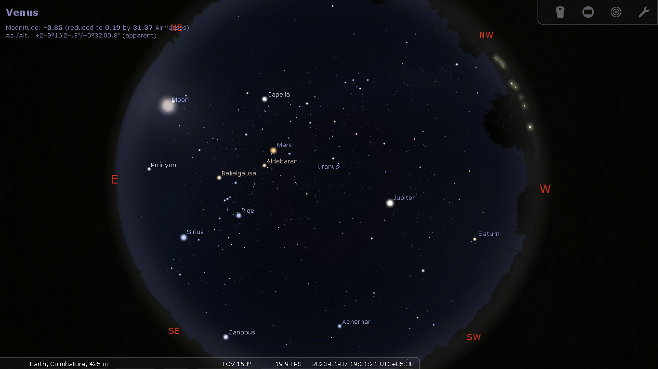

Slide 3
Solar System Objects
1. Moon (Full Moon, Rises at 6:36 PM)
2. Venus (Possible during twilight time)
3. Saturn (Best time between 7 and 7:30)
4. Jupiter
5. Mars
6. Uranus (Not seen by naked eye)*
7. Neptune (Not seen by naked eye, Difficult)*
(*Uranus and Neptune not advised to be shown)

Slide 4
Bright Stars
1. Sirius (Brightest star, distance 8.6 light year)
2.Canopus (2nd bright star, 310 ly)
3. Capella (6th bright star, 40 ly)
4. Rigel (7th bright star, 850 ly)
5. Procyon (8th bright star, 11 ly)
6. Betelgeuse
( 9th bright star, 500 ly, Red giant,Thiruvathirai)
7. Achernar ( 10th bright star, 140 ly)
8. Aldebaron( 14th bright star, 66 ly, Rohini)

Slide 5
Constellations*
1. Orion (Nataraja)
2. Taurus (V)
3. Gemini
4. Canis Major
5. Cassiopeia (W)
6. Pegasus (Great Square)
7. Auriga (Pentagon shape)
8. Perseus
9. Andromeda
(*Some Constellation are difficult to see because of Moon’s presence)

Slide 6
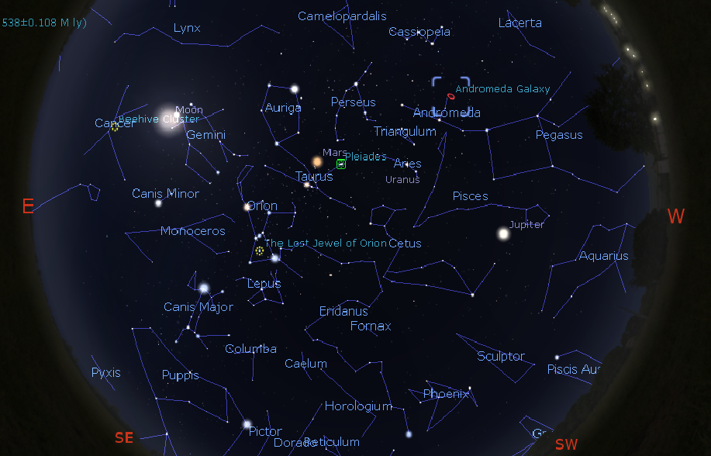

Slide 7
Deep Sky Objects
1.Pleiades (Open Cluster, Karthikai)
(444 ly, Angular size 1deg 50 minutes)
2.Orion Nebula ( Star forming place)
(1350 ly, size 12 ly)
3. Andromeda Galaxy
(2.5 Million light years, One lakh crore stars!)

Slide 8
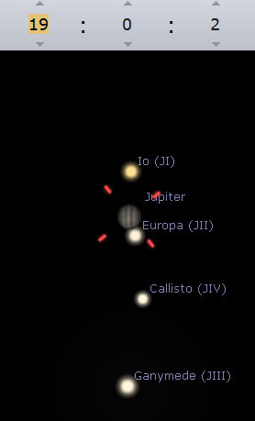
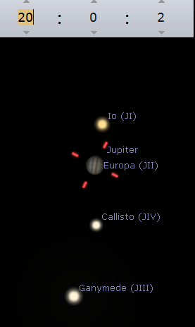
Europa Goes Behind Jupiter
At 7:50 pm!

