Slide 1
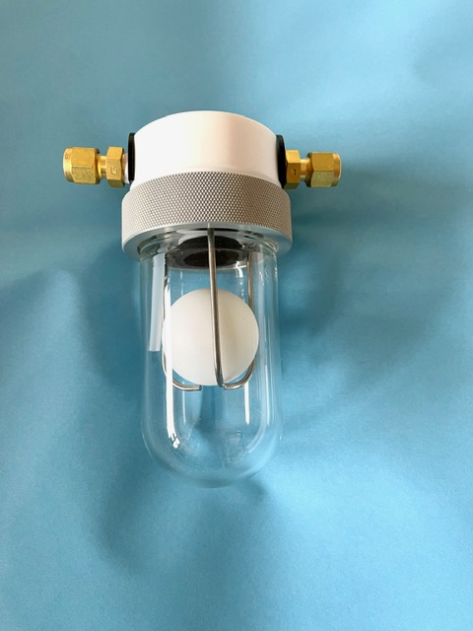
FIL-120 FILTER
Water Catch-Pot & Shut-Off Valve Housing
& NEBULAR Gas Instrumentation
Benefits
• LOW COST ENHANCEMENT
• AVOIDS COSTLY REPAIRS
• PROTECTS GAS ANALYSER
• AVOIDS LIQUID OVERFLOWS
• AUTOMATIC SHUT-OFF
The FIL-120 Filter is a low-cost housing
for your gas analyser’s protection. Analyser protection often means using a ‘particulate’ type of filter to remove liquids and solids. However, when using particulate technology the filter can overflow and contaminate the sensitive and expensive electronics of the instrument.
The FIL-120 Filter eliminates concerns. Any surplus liquid is collected in the bowl. As the liquid level rises so does the float until it shuts off the flow to the analyser and any possibilities of analyser damage are avoided, ensuring continued use without damage and costly repairs.
Inlet
Outlet
Protect your gas analyser. Service provided on a Supply and Fit or Supply Only basis.
Valve open
during
normal
operation
Valve closes
as Level
rises
ADC
No. 11 Deer Park
Harlow, Essex, CM19 4LD , United Kingdom
email: sales@adcspares.com
Telephone: +44(0)7521-706762 & +44(0)1279-863044

