Slide 1
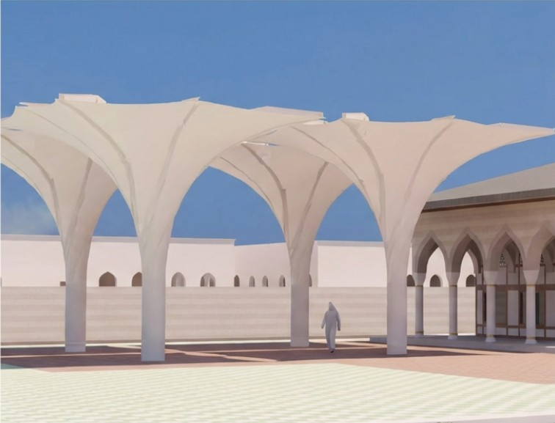
RBTCS MEDINA UMBRELLA
UNFOLDABLE UMBRELLA
Architectural
Kinetic Art Membrane Facede Structure
https://rbtcs.com.tr/medinaumbrella
Hold on the Potential of Luxury Outdoor Spaces.

Slide 2

Beyond the Seasonal Constrains
Luxury hospitatily demands that every square meter of contributes to the guest experience. Currently, open terraces and courtyards are often dictated by the elements.
We transform static outdoor areas into dynamic, year-round assets. Whether facing the scorching summer sun or winter storms, our systems ensure your outdoor venues reamin operational, comfortable and profitable.

Slide 3
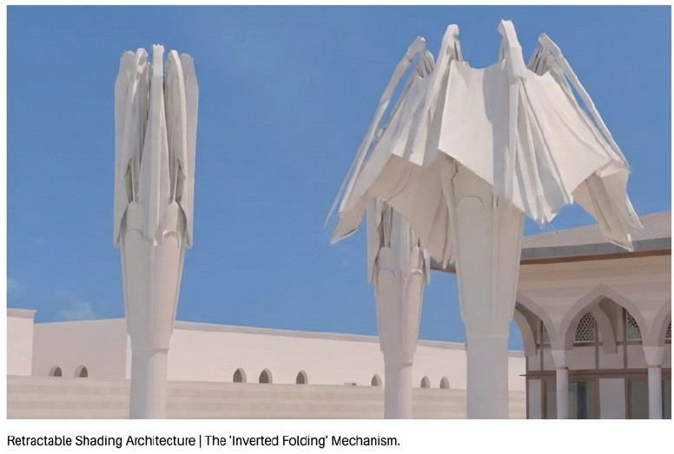
The ‘Medina’ Standart Reimagined.
Inspired by the iconic convertible umbrellas of Medina, our ‘Unfoldable’ technology brings structural grandeur to the resort environment.
This is not outdoor furniture; it is kinetic architecture that moves with precision.

Slide 4
Burkut Group S.P.C Oman Engineering Precision & Heritage
Headquarted in Switzerland,
We apply watch-making precision to large-scale structural engineering.
Our systems are design to outlast the buildings they adorn
* Engineered for longevity, not just seasonality.
* Calculated via ANSYS WB for extreme load scenarios
* Verified by top European engineering bodies.

Slide 5
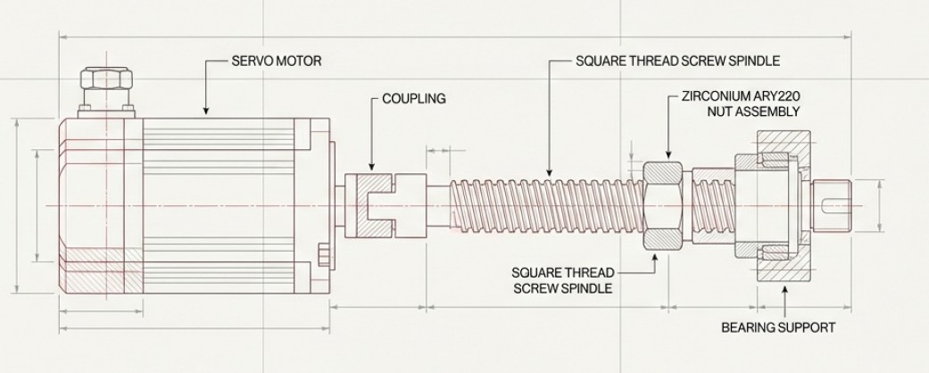
The Unfoldable Mechanism.
Specification Block
Drive System;
High Torque Servo Electric Motor
Transmission:
Square Thread Profile Screw Spindle (Material 1.4340 QT)
Nut Assembly:
Zirkonyum ARY2220
Safety Factor Minimum 4x
Design Life: more than 20 years.
At the core of every structure is a drive system builet for safety and silence.

Slide 6
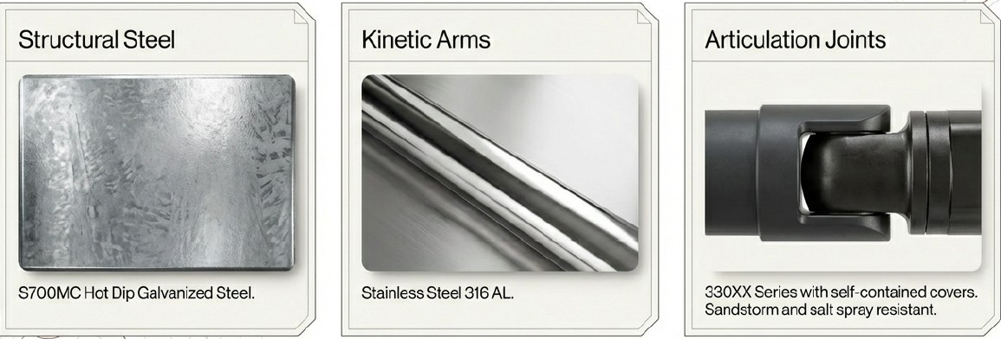
Material Mastery.
Uncompromising material selection ensures our structures withstand aggressive coastal and arid environmentals.

Slide 7
Defying the Elements.
The luxury is reliability. Our Structures are not just for shade; they are engineered to endure.
120 km / h
Wind Resistance Rating Loads Durability.
All designs are rigorously calculated via ANSYS WB simulations to withstand storm-force winds. The result is zero downtime: when the weather turns, your infrastructure remains secure.

Slide 8
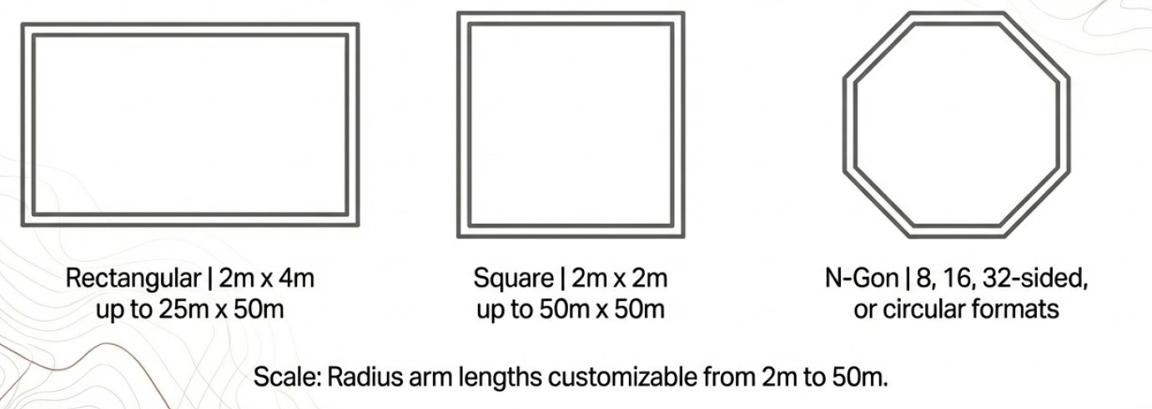
Geometric Flexibility.
From intimate courtyard to expansive plazas, the architecture adapts to your footprints.

Slide 9
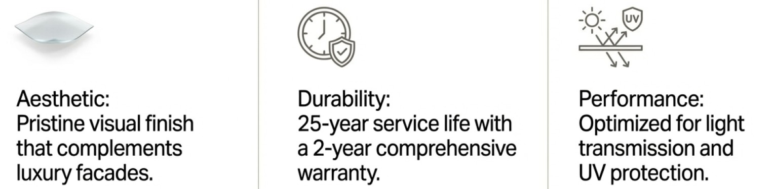
SEFAR PTFE Membrane
We utilize exclusively SEFAR PTFE and ETFE membranes, manufactured in Teknopark Istanbul Pendik KurtkoyTurkiye.

Slide 10
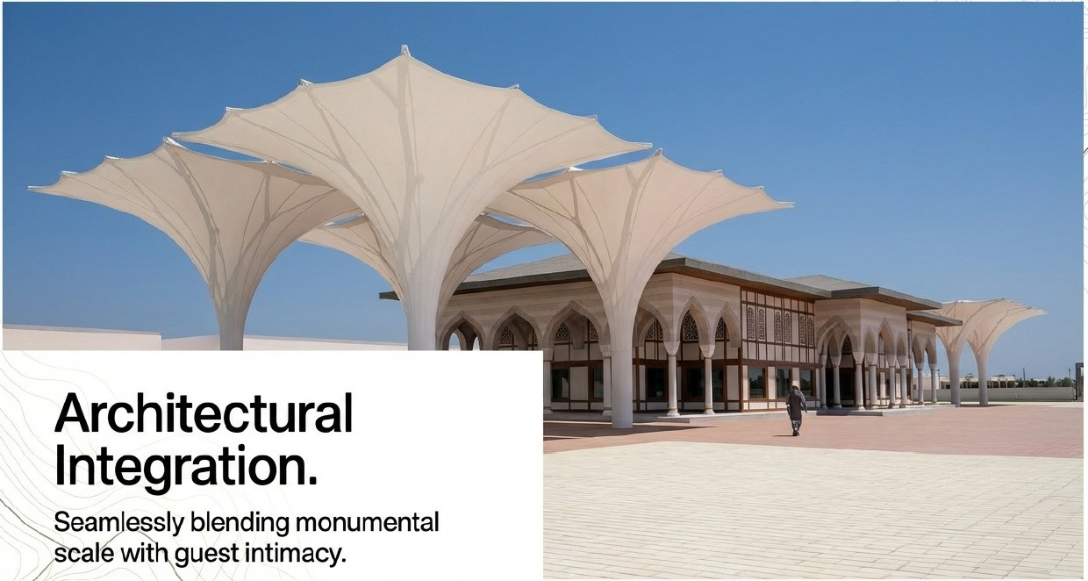

Slide 11
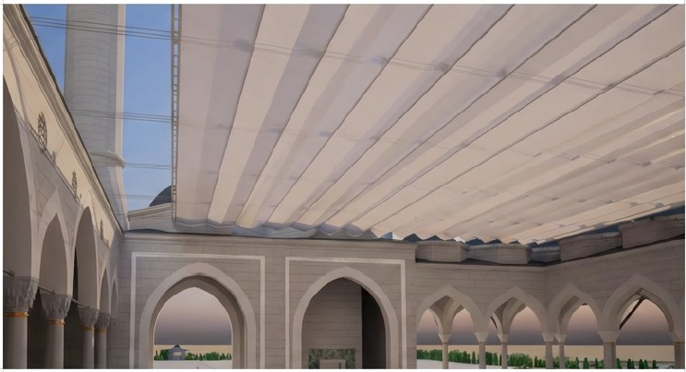
Complementary Solutions: The Kinetic Facade.
For corridors, artriums, and linear walkways, we offer the stainless steel
Cable Opening / Closing System.
*Retractable SEFAR Membrane Ceiling Structure.
*Precision tensioned stainless steel cables.
*Ideal for transitional spaces between indoor and outdoor zones.

Slide 12
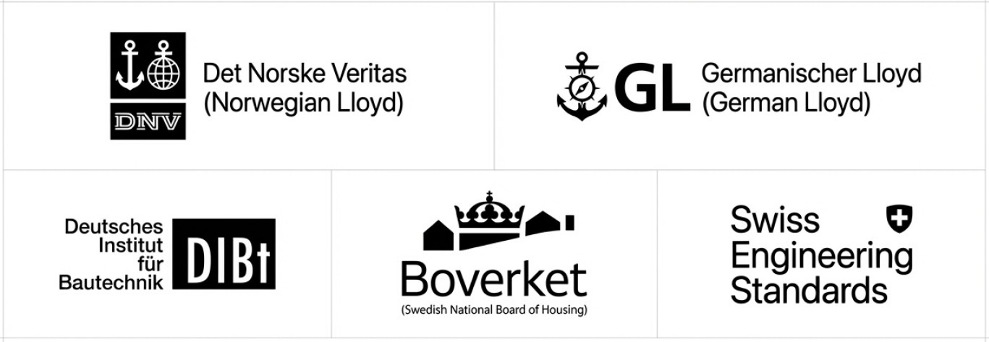
Global Validation Verification & Compliance

Slide 13
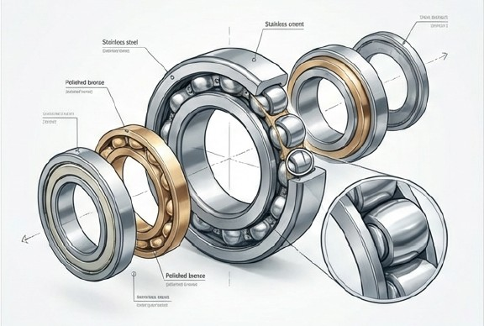
Operational Excellence.
Designed for the realities of hotel operations, minimizing maintenance
Requirements and OpEx.
Lower total cost of ownership
and no disruption to quest services.
Maintenance-Free Bearings: We utilize INA FAG bearings (medias.schaffler.de) selected for a service life exceeding 20 years without the need for maintenance or lubrication.

Slide 14
If you have any questions Call me on whatsapp at 0090 555 5530720 (Aydın AYDEMIR)

