Slide 1
Knee health in yoga
How to modify for injury or chronic pain and be safe during practice.

Slide 2
Common Questions
Is it safe to practice yoga if you have knee issues?
“Generally speaking, yes—I have personally had ACL repairs after sustaining injuries while participating in sports.
“However, it is critical to listen to your body, whether you are practicing at home or with an experienced teacher.
If you are practicing at a studio with an instructor, inform your instructor about your injury, past or present. This is key to keeping yourself safe. This information also impacts the verbal cues and potential assists your teacher provides for class,”
BUT – there is always a but

Slide 3
It may depend on the type of injury
We are all different and it depends on type of knee problem.
“If someone has a meniscal tear (cartilage problem that can present with specific pain on the inside of the joint), they might find it uncomfortable to fully bend the knee, so positions such as sitting back into child’s pose might be difficult,”
However we can use props to see if we can make the pose accessible and we can add until we find a safe positon. In this instance it might be adding blankets or blocks to raise the hips so the knee doesn’t need to go fully into flexion.

Slide 4
General degeneration
Those suffering from general degeneration due to wear and tear, or arthritis, can use yoga as a way to stretch their joints. This won’t lead to any harm or danger. It may feel uncomfortable at first, but will get easier over time. One of the best parts of yoga is the fact that it can be customized to any person. And that means anyone dealing with an injury can modify it to fit their needs.
There are floor sequences that will keep your knees safe, and, of course, arm balances and inversions give you plenty of yoga with no risk to your knees.
When it comes to leg-intensive postures, you can still practice as long as you are incredibly conscientious about your movement. All yoga requires that you are extraordinarily mindful as you practice. So, in a way, injuries bring you deeper into your practice, as they make you more aware and in-tune,”

Slide 5
Useful tips for all knee issues
Use slower transitions to prevent re-injury or inflammation. Modify a pose to reduce or eliminate irritation or pain. Skip the ones that don’t feel good and use props.
Two core elements to knee safety during yoga, particularly for those with an injury of any sort.
Avoiding any over-bend in your knee during lunges, as well as hyperextending in straight-leg positions.
Maintain a micro-bend in your knee to keep it safe. This means a bend you can feel, but others may not necessarily see. Not only will this prevent hyperextension, but also ignites the muscles surrounding the knee to build strength and support. If knee over ankle is too intense in your lunges, don’t bend that far. It’s always okay for the knee to bend short of the ankle—just not past it

Slide 6
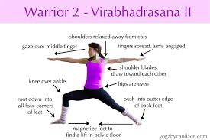
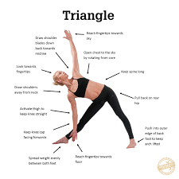
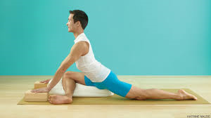
Common pose modifications
Warrior II pose to triangle pose - When transitioning from warrior II pose, which has a flexed knee joint, to triangle pose, which has an extended knee joint, activate your leg muscles, specifically your quadriceps, to avoid hyperextension.
Half pigeon pose: The gravitational weight of your body in this posture puts pressure in your knee joint. Some days it may be fine. Other days skip it or use a bolster or take reclined figure 4 pose instead

Slide 7
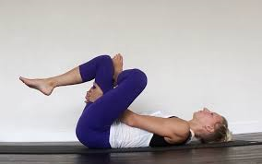
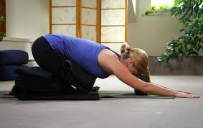
reclined figure four pose to allow more control over how much sensation you’ll feel in your joint. Additionally, flex your toes towards your shins to keep the muscles around your knees activated and prevent injury.
Child’s pose : Your knee is in extreme flexion in this pose and can be irritated—especially when the posture is held for a long duration. Place a block or bolster underneath your body, or transition to supported hero’s pose or a comfortable seat.”

Slide 8
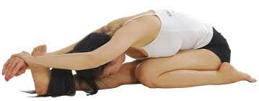
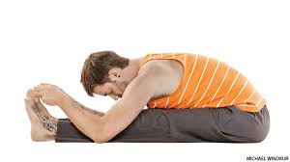
Are there poses I should avoid?
It depends on the injury. Are you seeing a pattern here?
But, in general, the safest poses are those that don’t involve the knees, or those with little weight-bearing or pressure on the knees.
With a medial meniscal tear or medial collateral ligamentous injury, Virasana, Trianga Mukhaikapada Paschimottanasana and seated twists with knee(s) bent are out of the question.
ACL injury, then standing poses such as Warrior I and II must be avoided, but Boat pose and Headstand would be fine.

Slide 9
Take away messages
The bottom line is this: if it hurts, don’t do it, standard rule!
With any injury, you have to be smart about keeping yourself safe. If a posture feels intuitively wrong, get out. No pose is worth risking deeper, long-term, or even permanent injury. Avoid or adjust anything that sends sharp pain or feels like it is straining your knee in an excessive manner.
ALWAYS talk to your teacher before class and keep that dialogue going if things change during practice.
If there is any pain at all, the yoga pose is not for you today. This does not mean you’ll never do the pose again. Pay attention. Listen to how your body is feeling each day and adjust accordingly.

Slide 10
Any Questions?

