Slide 1
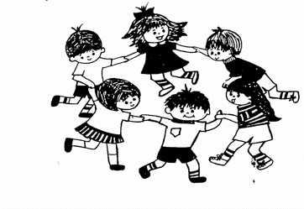
South Shore Community Center Nursery School
3 North Main Street, Cohasset Massachusetts 02025
781-383-0036
nsdirector@southshorecommunitycenter.com
www.ssccns.com

Slide 2
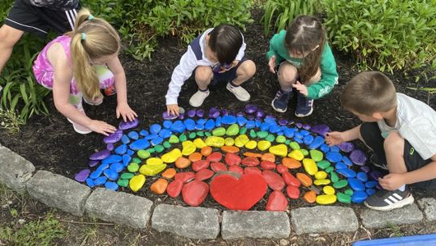
Welcome to our school! We offer programs for children who are 2, 3, 4 and 5 years old.
Yellow Room- 2 & 3 year old children
Red Room- 3 & 4 year old children
Blue Room- 4 & 5 year old children

Slide 3
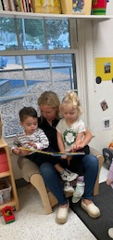
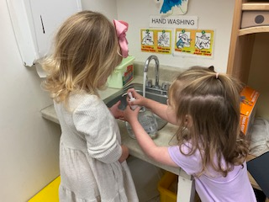
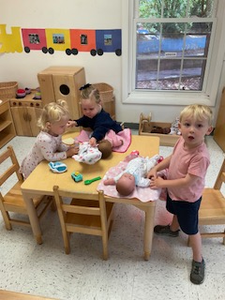
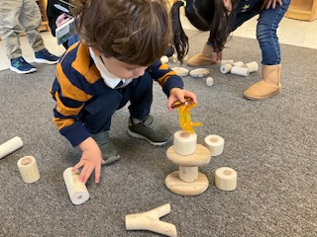
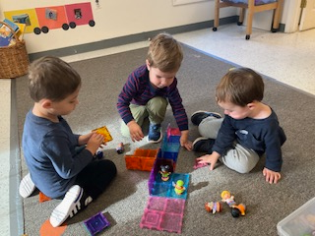
The Yellow Room Program
The Yellow Room is for 2 & 3 year old children. This program provides an opportunity to learn and build positive relationships with teachers and peers through play. Children will be immersed in language and song during their time in school. Teachers will create developmentally appropriate experiences to encourage language, social skills, physical development, and literacy. The Yellow Room Program is for children that will be 2 by September 1st.
Children begin learning self help skills, such as washing their hands with soap and water.
Reading together helps children develop a love of reading. It also helps them to learn the skills to read books (such as turning the pages, reading the words, talking about the pictures). Reading aloud also nurtures children’s language and listening skills.
Dramatic play teaches and promotes expressive language. 2 and 3 year old children begin making friends and engaging in parallel play.
Building with blocks helps to develop hand eye coordination
and spacial awareness. Block building increases concentration and strengthens hands, arms and core.

Slide 4
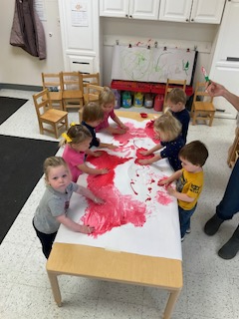
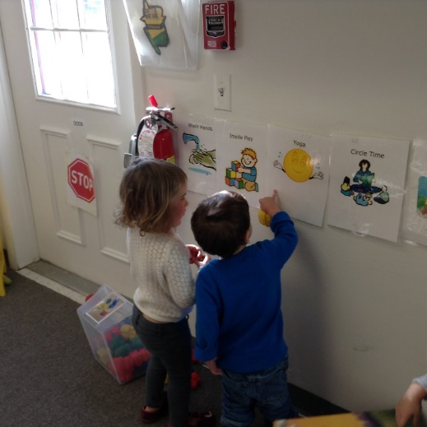
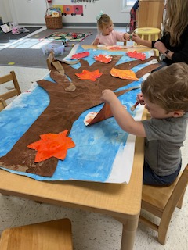
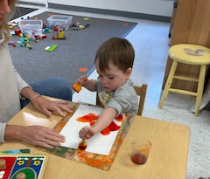
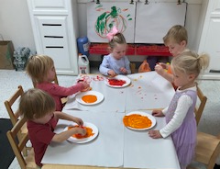
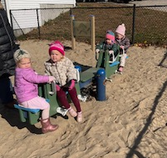
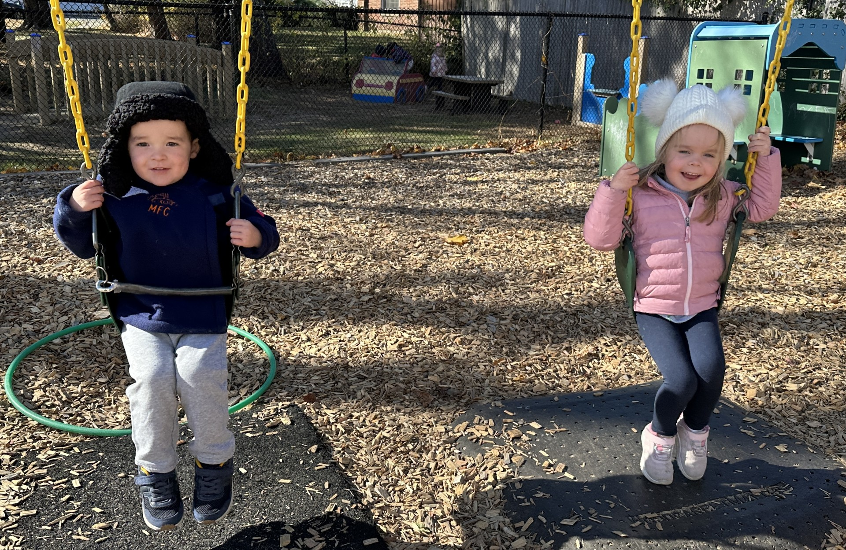
A Peek Into the Yellow Room
Yellow Room children work together to create large, meaningful murals that decorate the classroom walls. Classrooms are designed with open shelving to allow children to make independent play choices.
All of our classrooms have a universal transition board displayed at children’s eye level to help children visualize their school day.
Teachers support and encourage children as they explore various art mediums.
Children are encouraged to work independently and in small groups.
We play outside every day!

Slide 5
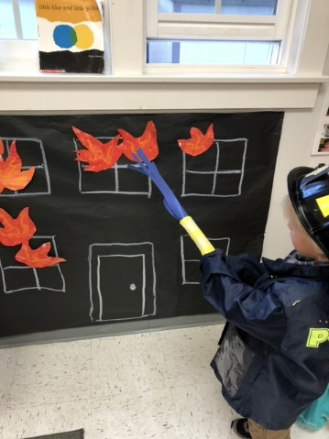
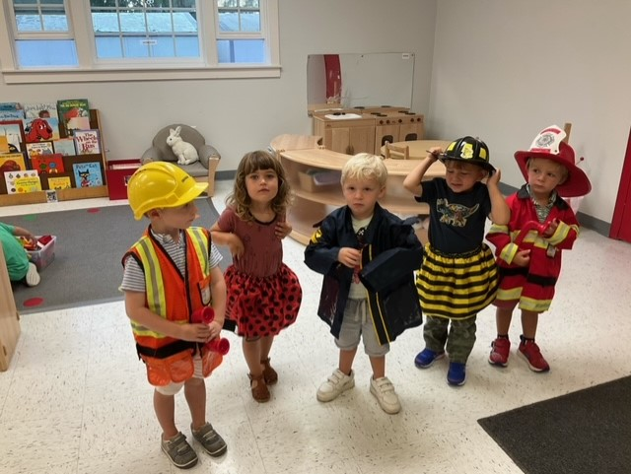
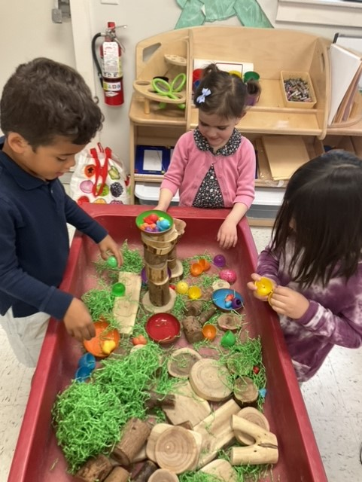
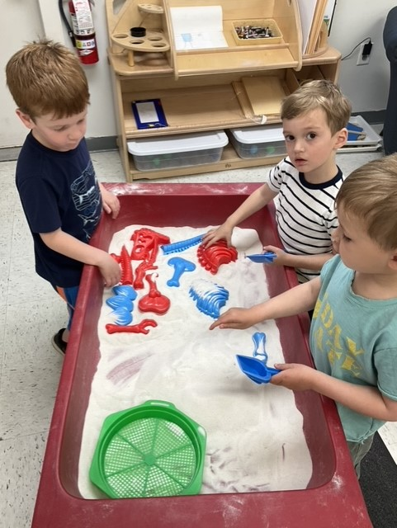
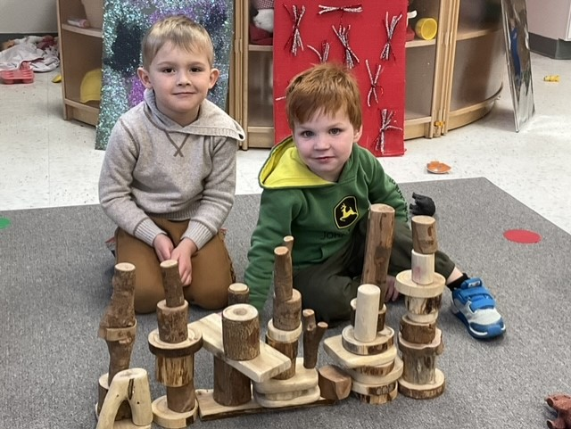
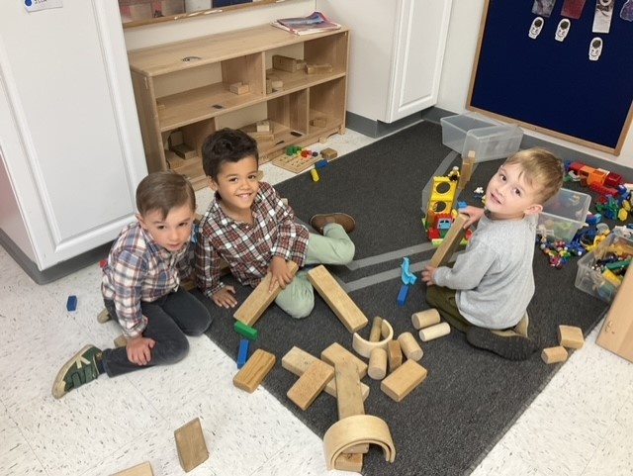
The Red Room Program
The Red Room is for 3 & 4 year old children. The children work on autonomy and building positive relationships with teachers and peers. Children are supported during social interactions by teacher modeling and encouragement. Teachers provide multi-sensory experiences to promote learning and success. Our Red Room program is for children that will be 3 by October 1st.
Children engage in pretend play scenarios in the dramatic play area of the classroom. 3 and 4 year old children seek out 1 or 2 preferred playmates, assigning and assuming roles.
Children work together, using various types of blocks. They learn by trial and error how to balance blocks so they don’t fall off. Block building improves fine motor skills and hand-eye coordination. Children’s imaginations unfold as they create various scenarios with their buildings.
Children engage in various themed sensory play experiences, exploring different textures, sounds and sights.

Slide 6
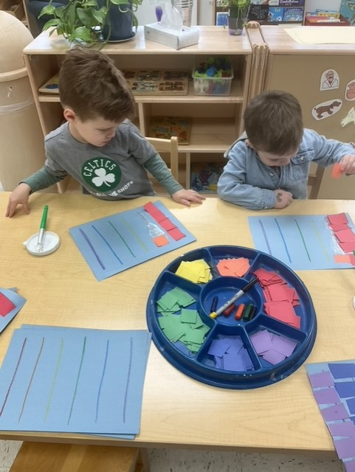
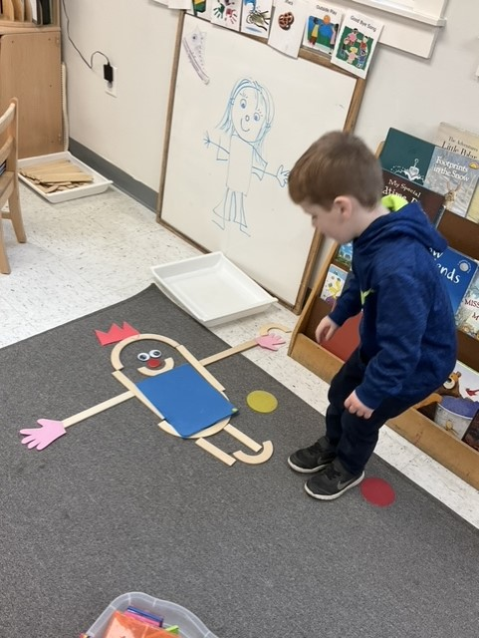
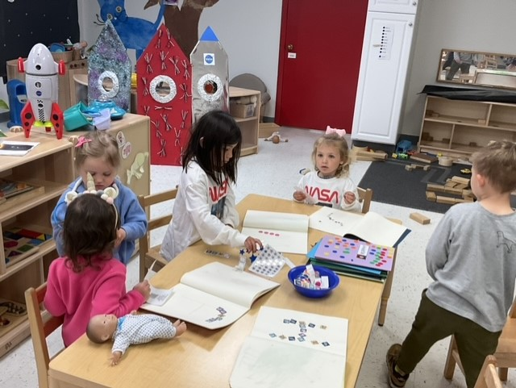
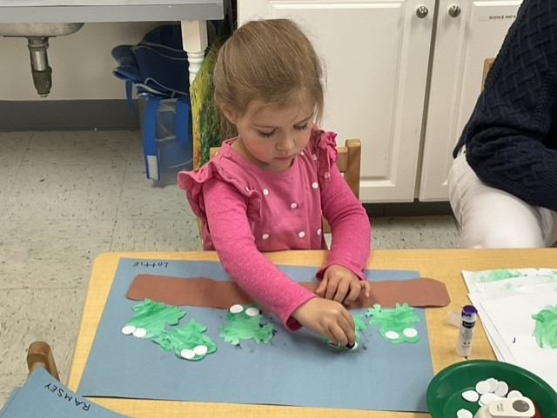
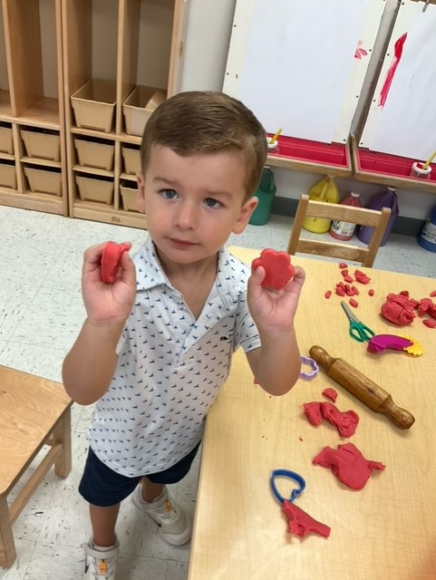
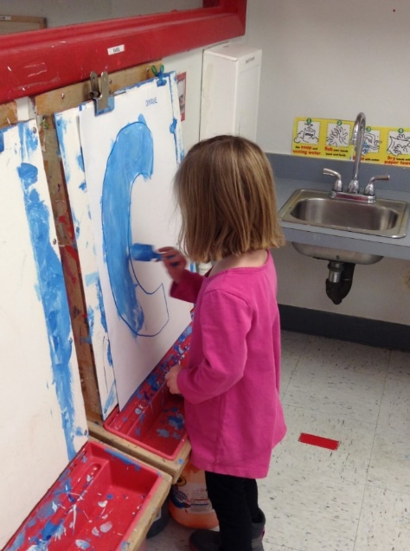
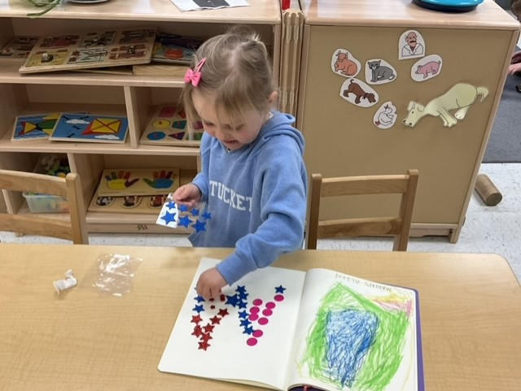
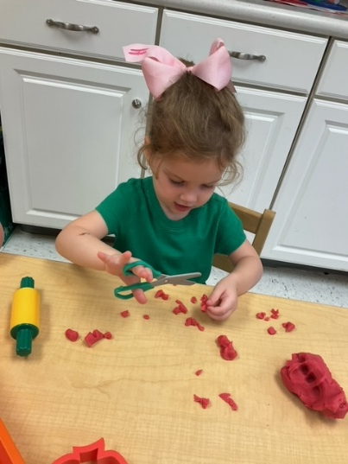
A Peek Into the Red Room
Teachers support and encourage children as they work together to explore mathematical concepts, such as counting and measuring as well as visual spacial orientation and body awareness.
Children work on age appropriate, interesting tasks, following single step instructions to complete a project. Daily projects typically relate to books, songs and classroom themes.
Children use playdough, rolling pins cookie cutters and scissors to strengthen their fine motor muscles.
Children are introduced to letters and numbers through various fun and engaging activities.

Slide 7
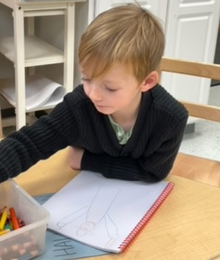
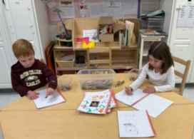
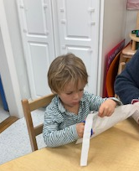
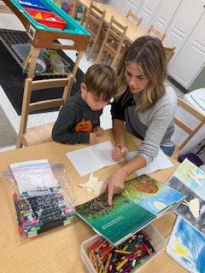
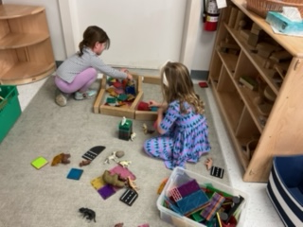
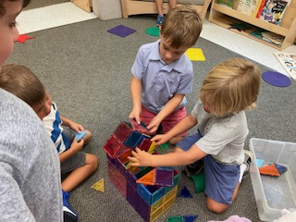
The Blue Room Program
The Blue Room is for children ages 4 & 5. This program offers open-ended activities to encourage flexible thinking and problem solving. Children are given many opportunities to build literacy, practice writing, pre-reading and math skills. The program focuses on building the organizational and self-help skills necessary for a solid start in Kindergarten. Curriculum is purposefully structured to help children gain confidence in their abilities, become responsible for themselves and show empathy for others. Our Blue Room program is for children that will be 4 by October 1st.
Children begin drawing and writing in journals weekly, documenting the progress they make throughout the school year.
Children work together, using various types of blocks. Their building becomes more detailed and intentional, requiring planning. They engage in conversations to plan what they will build and work together to complete the task.
Children complete age appropriate, interesting tasks using scissors and various writing and drawing tools. Children label pictures with written words. Daily projects typically involve multi-step instructions.

Slide 8
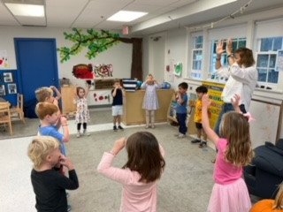
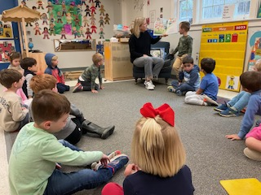
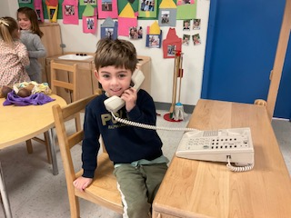
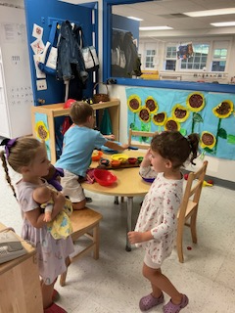
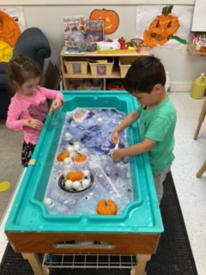
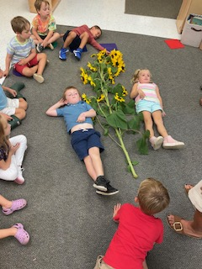
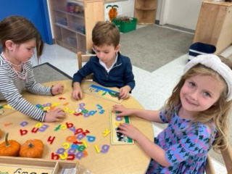
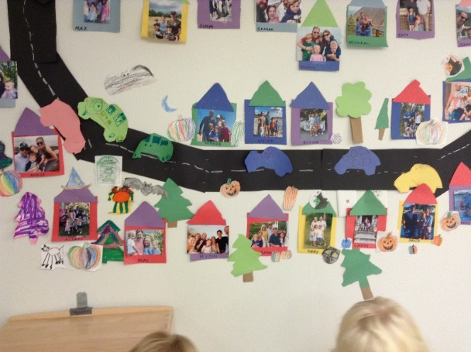
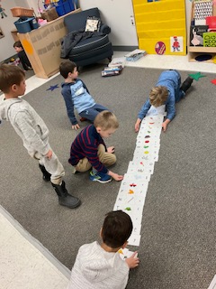
A Peek Into the Blue Room
Children in the Blue Room participate in daily meetings where they discuss the calendar and the weather. On Book Day, children bring in a book from home to share with their friends.
Children begin playing in larger groups, taking turns assigning and assuming roles in the dramatic play area. Cooperative play frequently extends over the course of several days. Teachers join children in their play, modeling appropriate social language and offering suggestions how to enhance and extend play.
Children engage in various themed sensory play experiences together, exploring different textures, sounds and sights. Children explore different units of measurement, making predictions, connections and following recipes.
Our classroom walls showcase children created murals and artwork.
Children use various manipulatives to count, create and extend patterns. Children learn concepts of more, less and number correspondence.

Slide 9
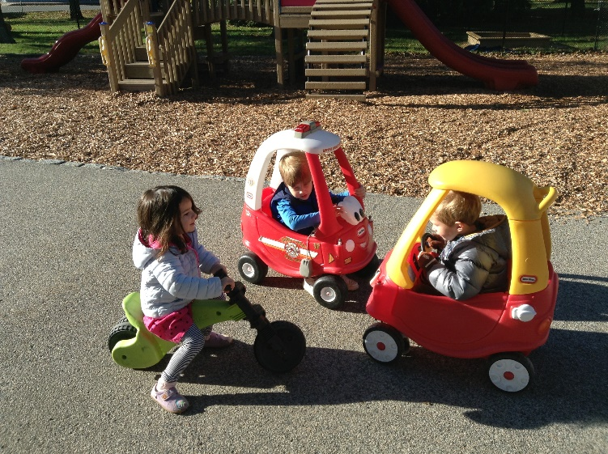
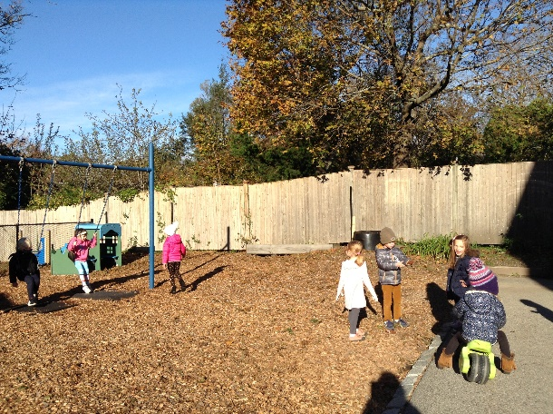
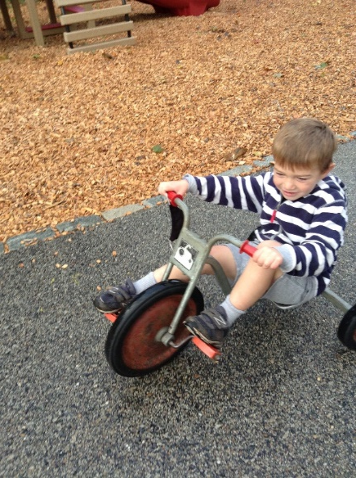
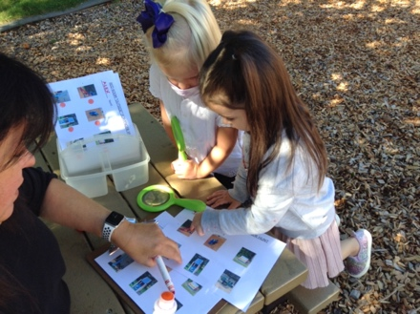
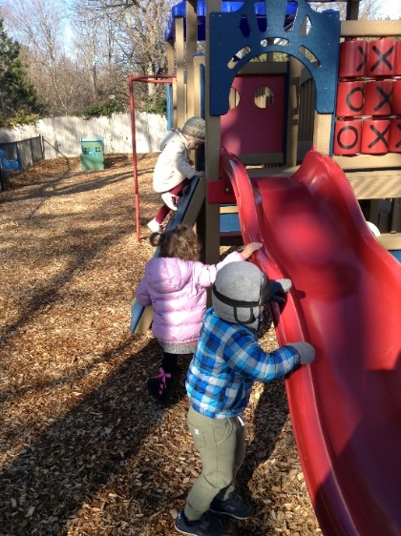
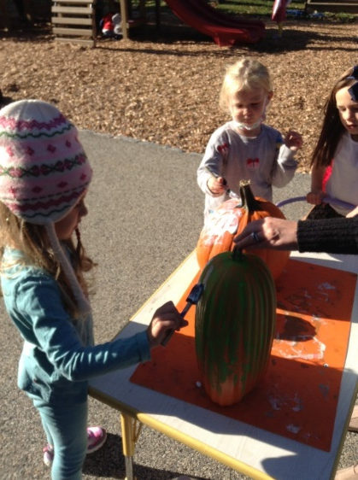
We play outside everyday! We drive cars, ride bikes, swing on the swings, climb on the play structure and go on nature scavenger hunts. Somedays we bring our projects outside!
Thank You for your interest in our school.

Slide 10
Picture with Caption Layout
Caption

Slide 11
Add a Slide Title - 1

Slide 12
Add a Slide Title - 2

Slide 13
Add a Slide Title - 3

Slide 14
Add a Slide Title - 6

Slide 16
Add a Slide Title - 7

