Slide 1


1st general pSo Meeting
September 6, 2024

Slide 2
Agenda
7:00 pm – 7:05 pm | Assembly | Mr. Holloway / Ms. Nied
 | Pledge of Allegiance School Moto
7:05 pm – 7:10 pm | Meeting call to order | Karen Smith - President
 | Introduce Student Council President : Maggie Gardner Introduce PSO
7:10 pm – 7:15 pm | Headmaster Remarks | Mr. Holloway / Ms. Nied
7:15 pm – 7:20 pm | Fall Fest | Kylee Lipsky-Snyder - Fundraising
7:20 pm – 7:30 pm | Accomplishments | Kate Wallis - VP
7:30 pm – 7:45pm | Audit Results & Monthly Financial Review | Jamie Lamb - Treasurer
7:45 pm – 8:00 pm | Q&A and Carline Raffle | PSO Board

Slide 3


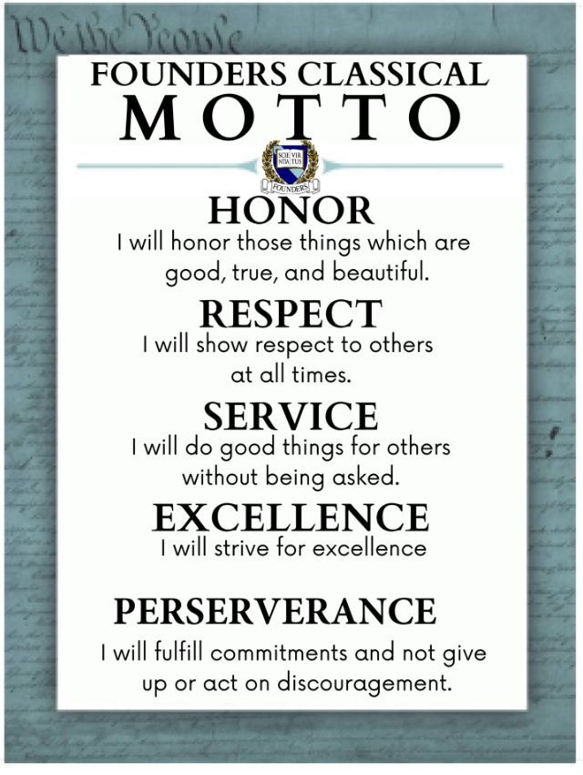

Slide 4
PSO Introduction
Elected executive board
Standing committees
President: Karen Anne Smith
Vice President: Kate Wallis
Treasurer: Jamie Lamb
Volunteer Coordinator: Elle Rivera
Recording Secretary: Tonya Morris
Communications: Natalie O'Donnell
Community Outreach: Lisa Walker
Fundraising Chair: Kylee Lipensky-Snyder
Hospitality Chair: Nina Zonta

Slide 5
Headmaster Remarks
Mr. Holloway

Slide 6

Fall fest
Sponsorship and Auction Donation requests
Aurum Sponsorship - $500
Logo and link added to auction site
Invite to participate in person at event with a booth/trunk display
Thank you sponsor signs at event
PSO website (fcafm-pso.org) & social media mentions before and after events.
Argentum Sponsorship - $250
Logo and link added to auction website
Invite to participate in person at event with a booth/trunk display
Thank you sponsor signs at event
Aereum Sponsorship - $100
Logo and link added to auction website
Invite to participate in person at event with a trunk display

Slide 7
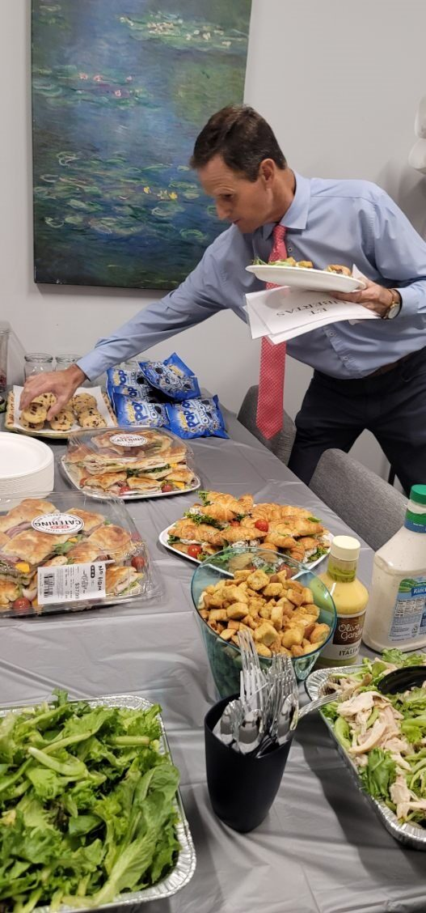
PSO in action
Meet the Teacher
Decorated the cafeteria
Provided lunch for Upper and Lower school teachers and staff
Welcomed in new families and invited them to join the PSO!

Slide 8
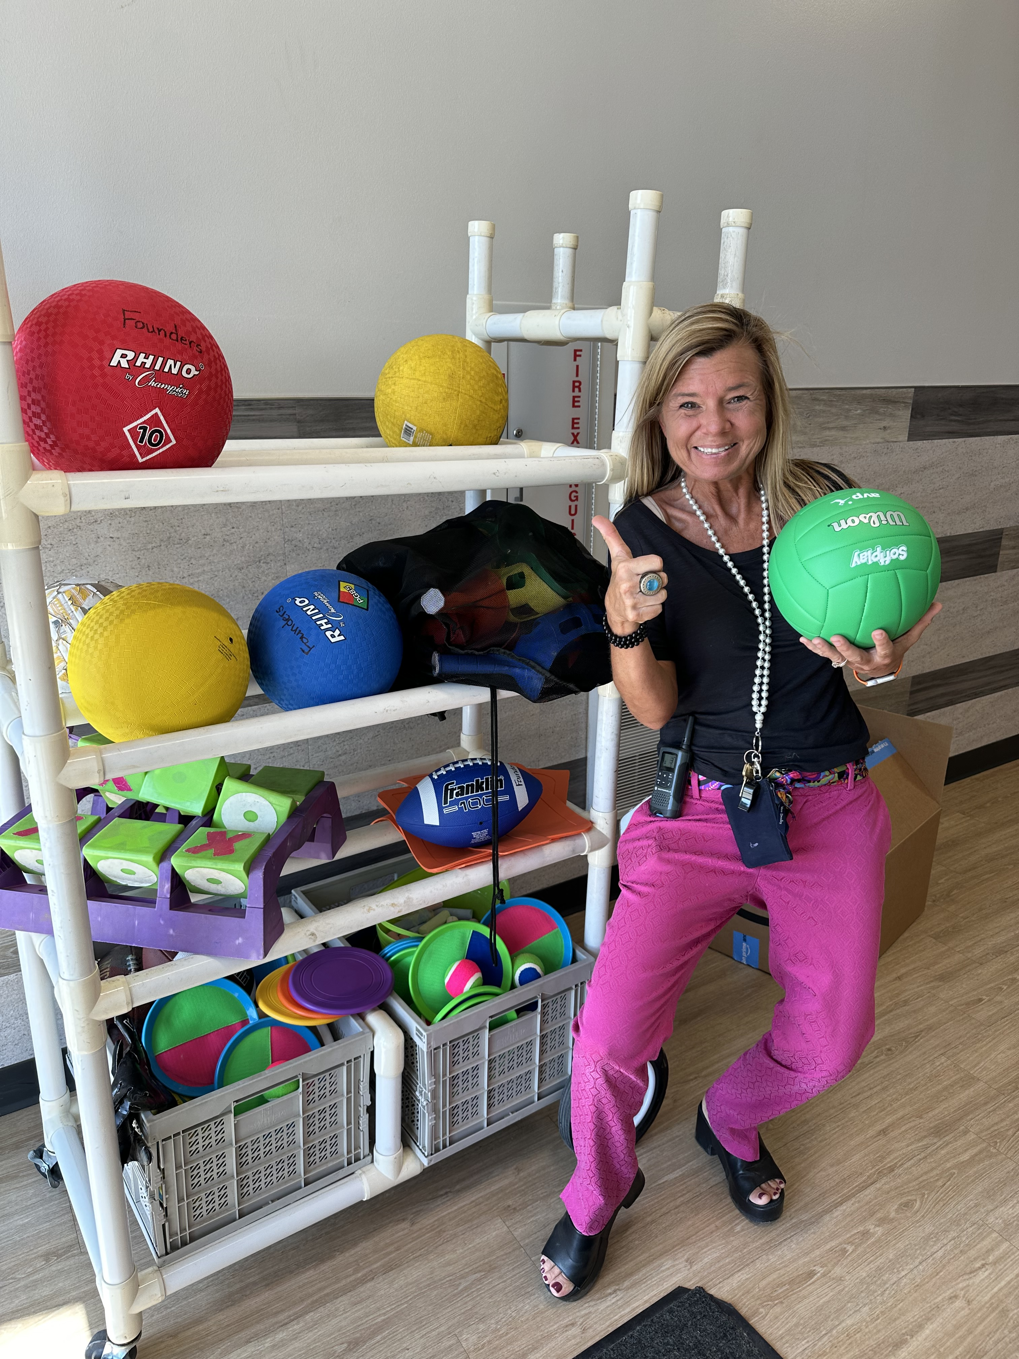
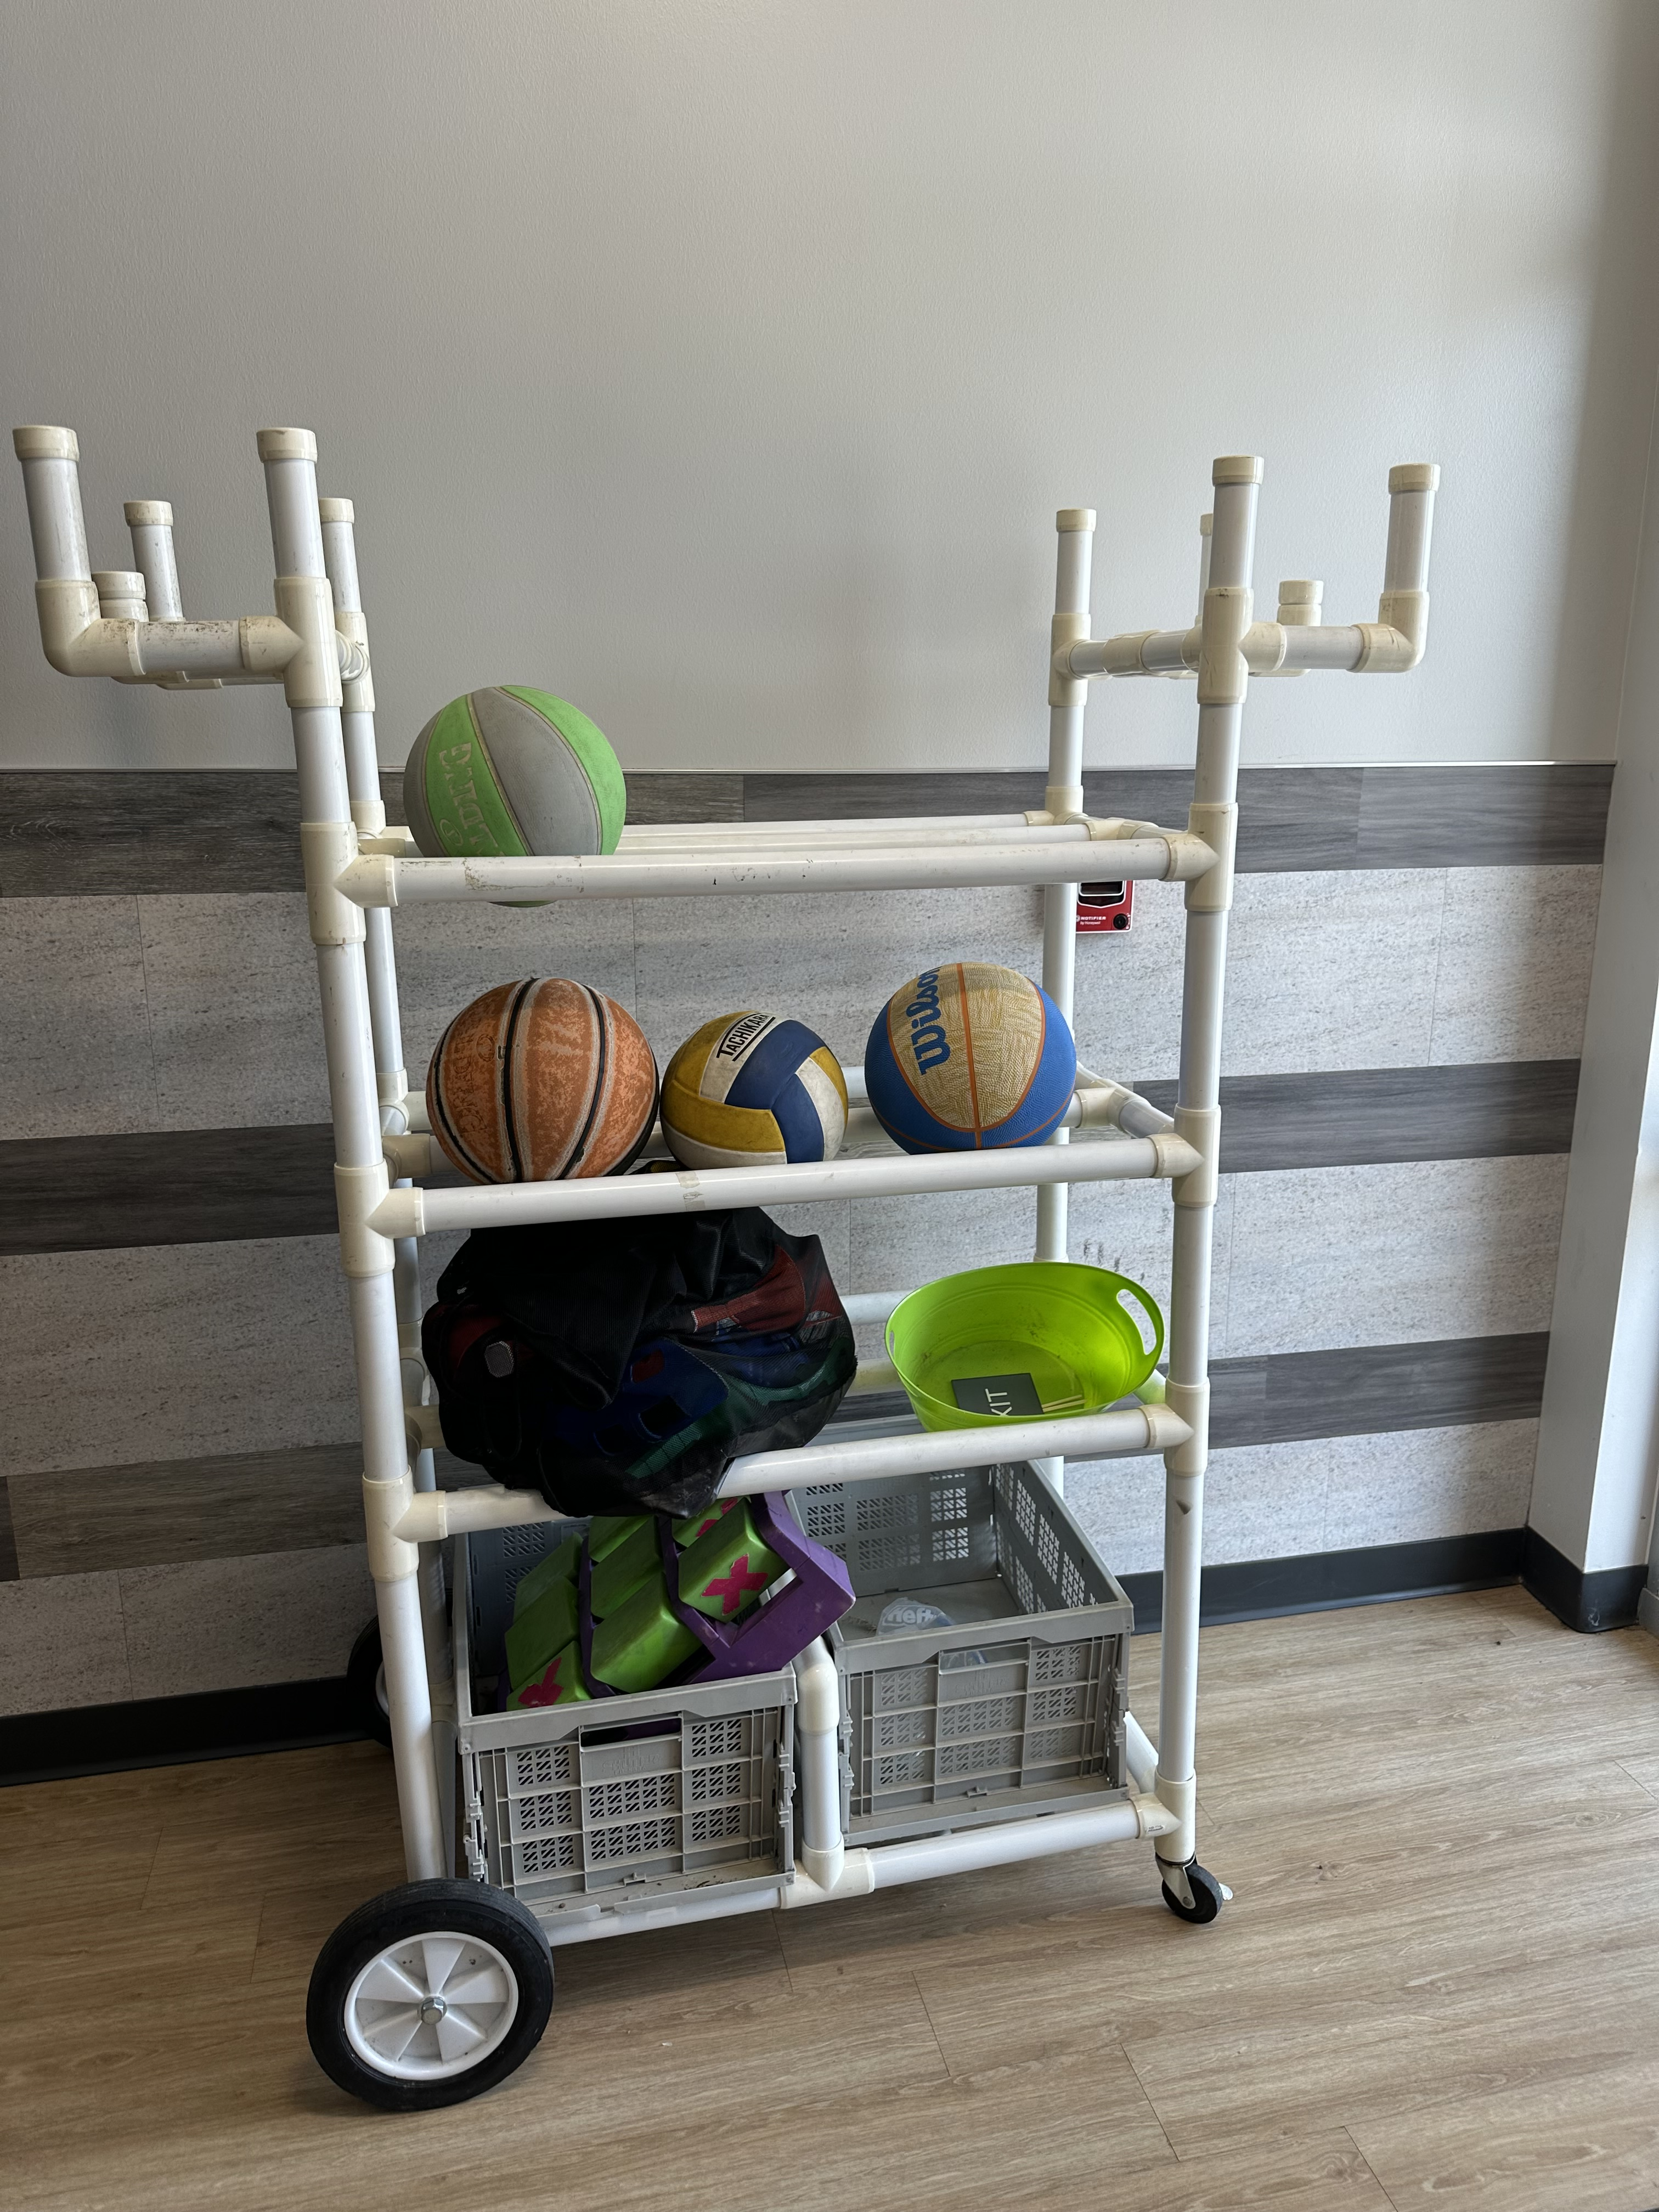
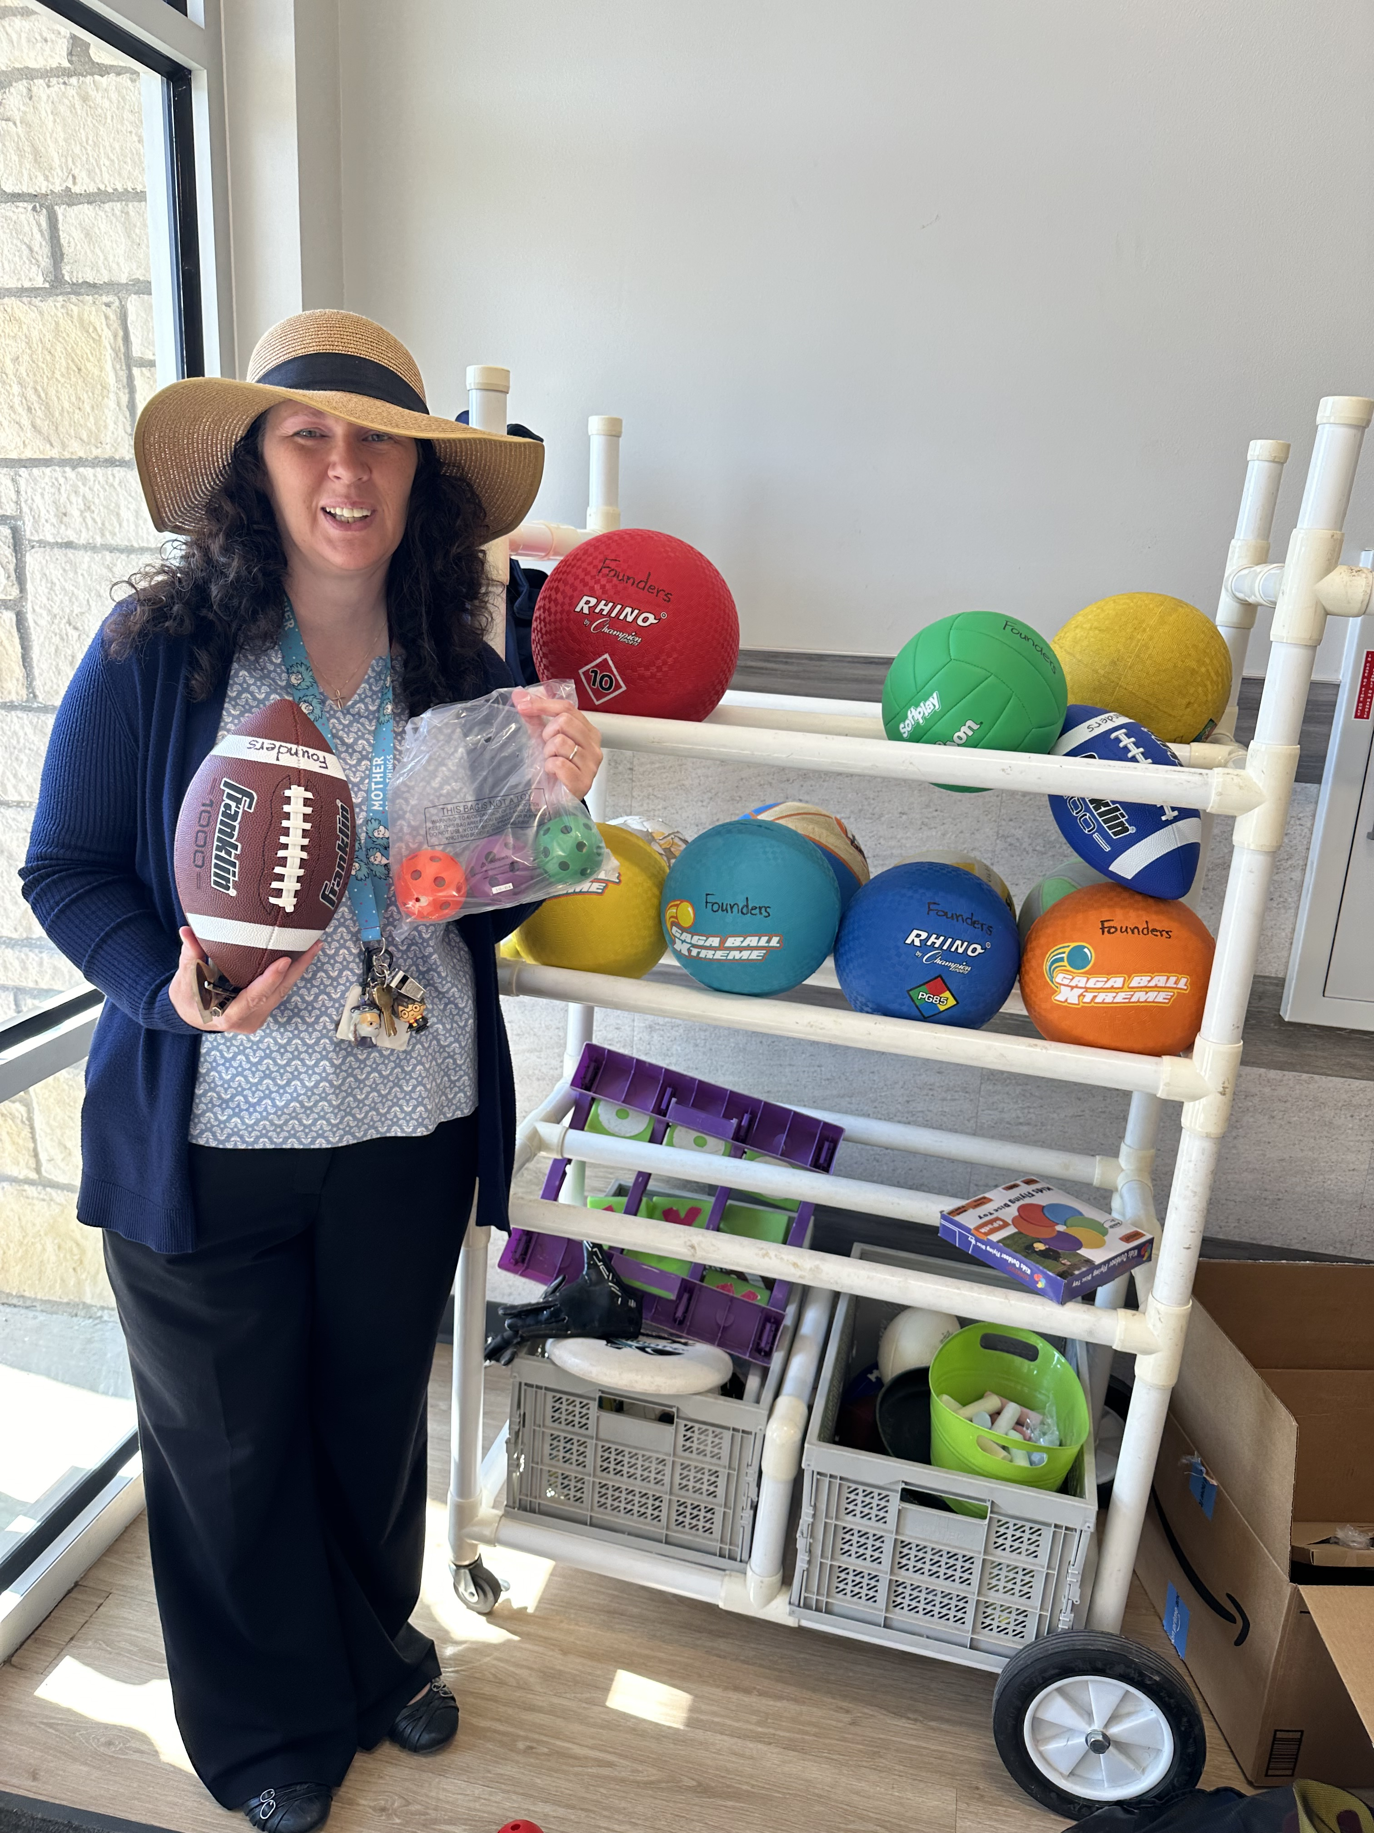
Refreshed the playground cart

Slide 9
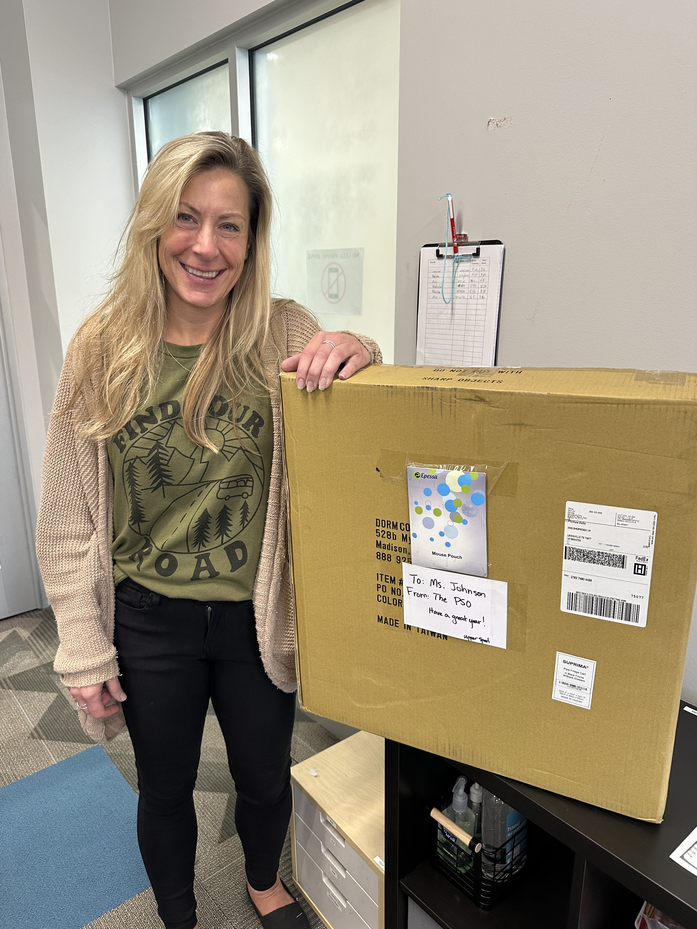
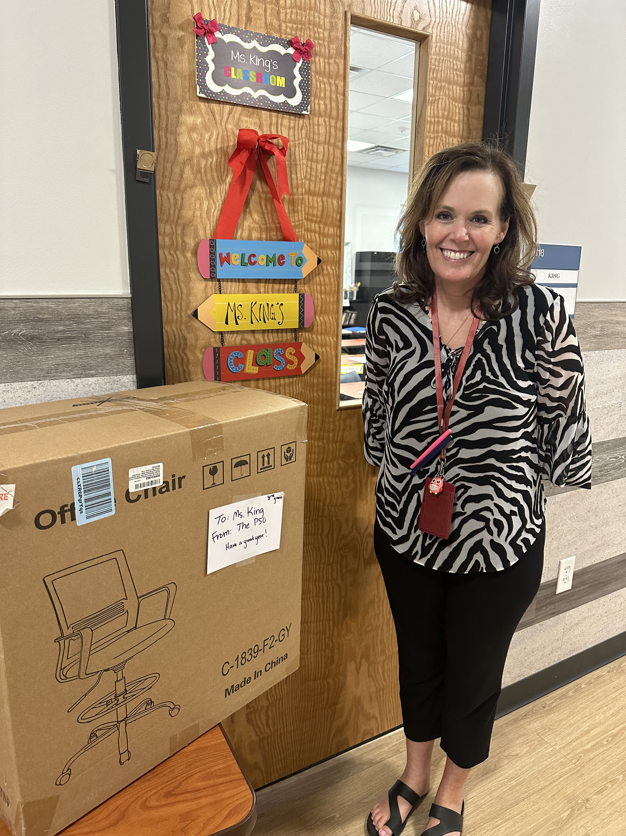
Provided $100 worth of supplies to Each new teacher

Slide 10
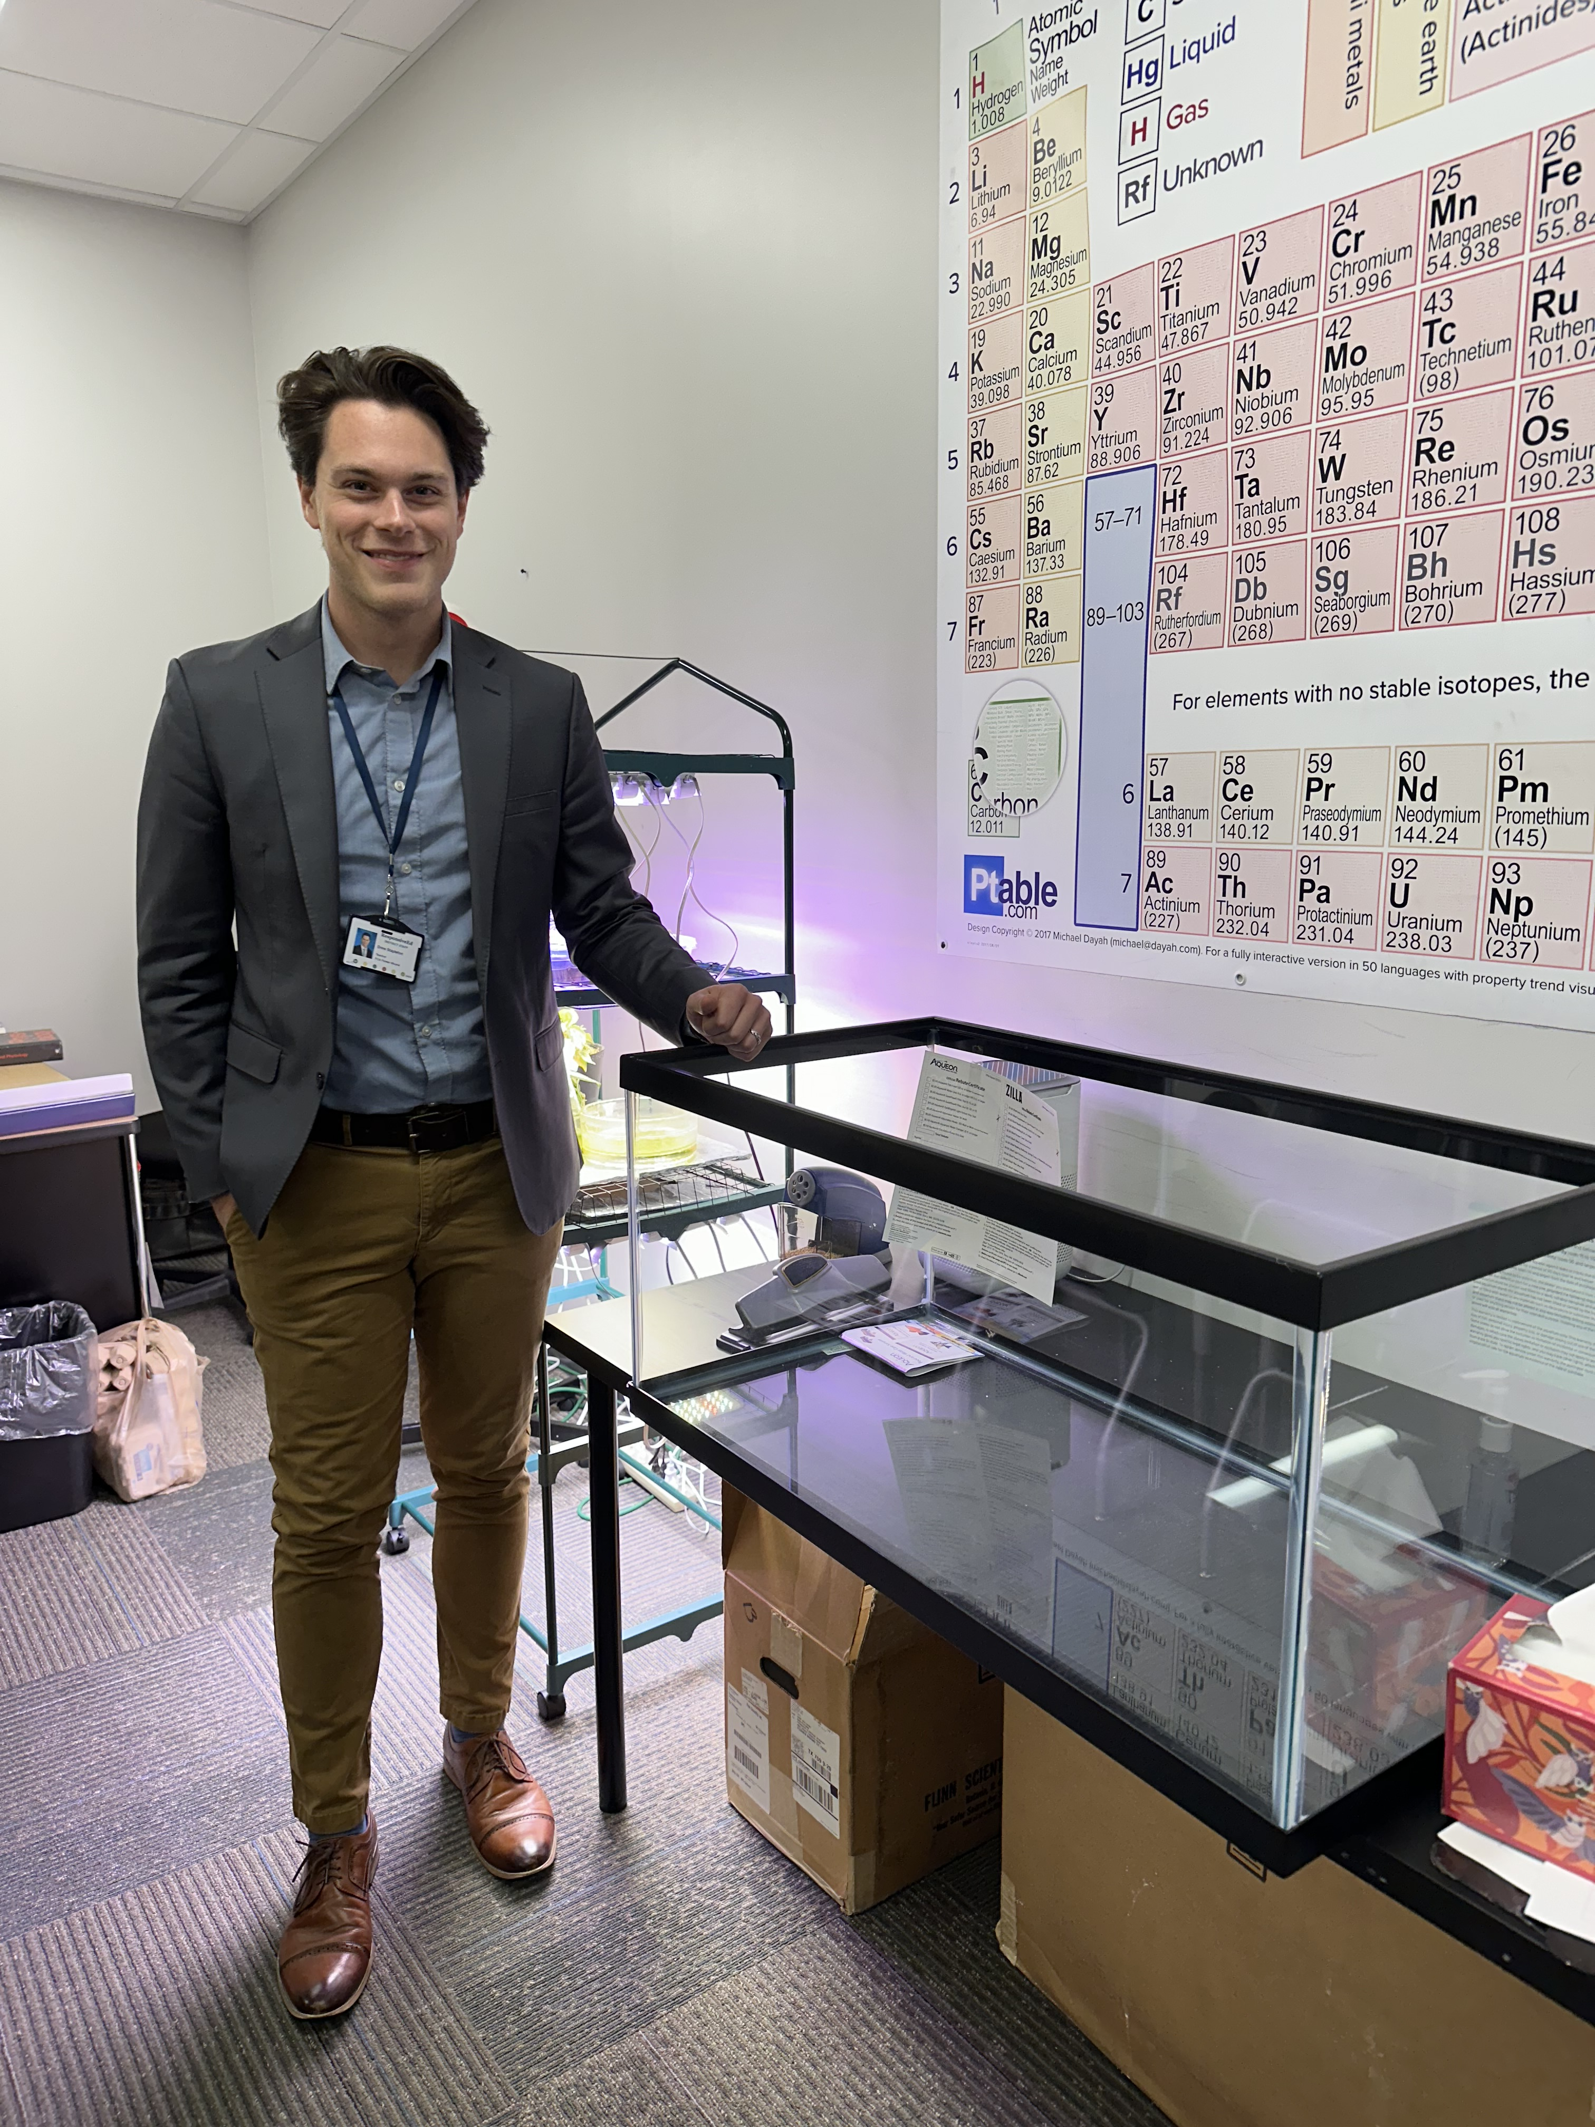
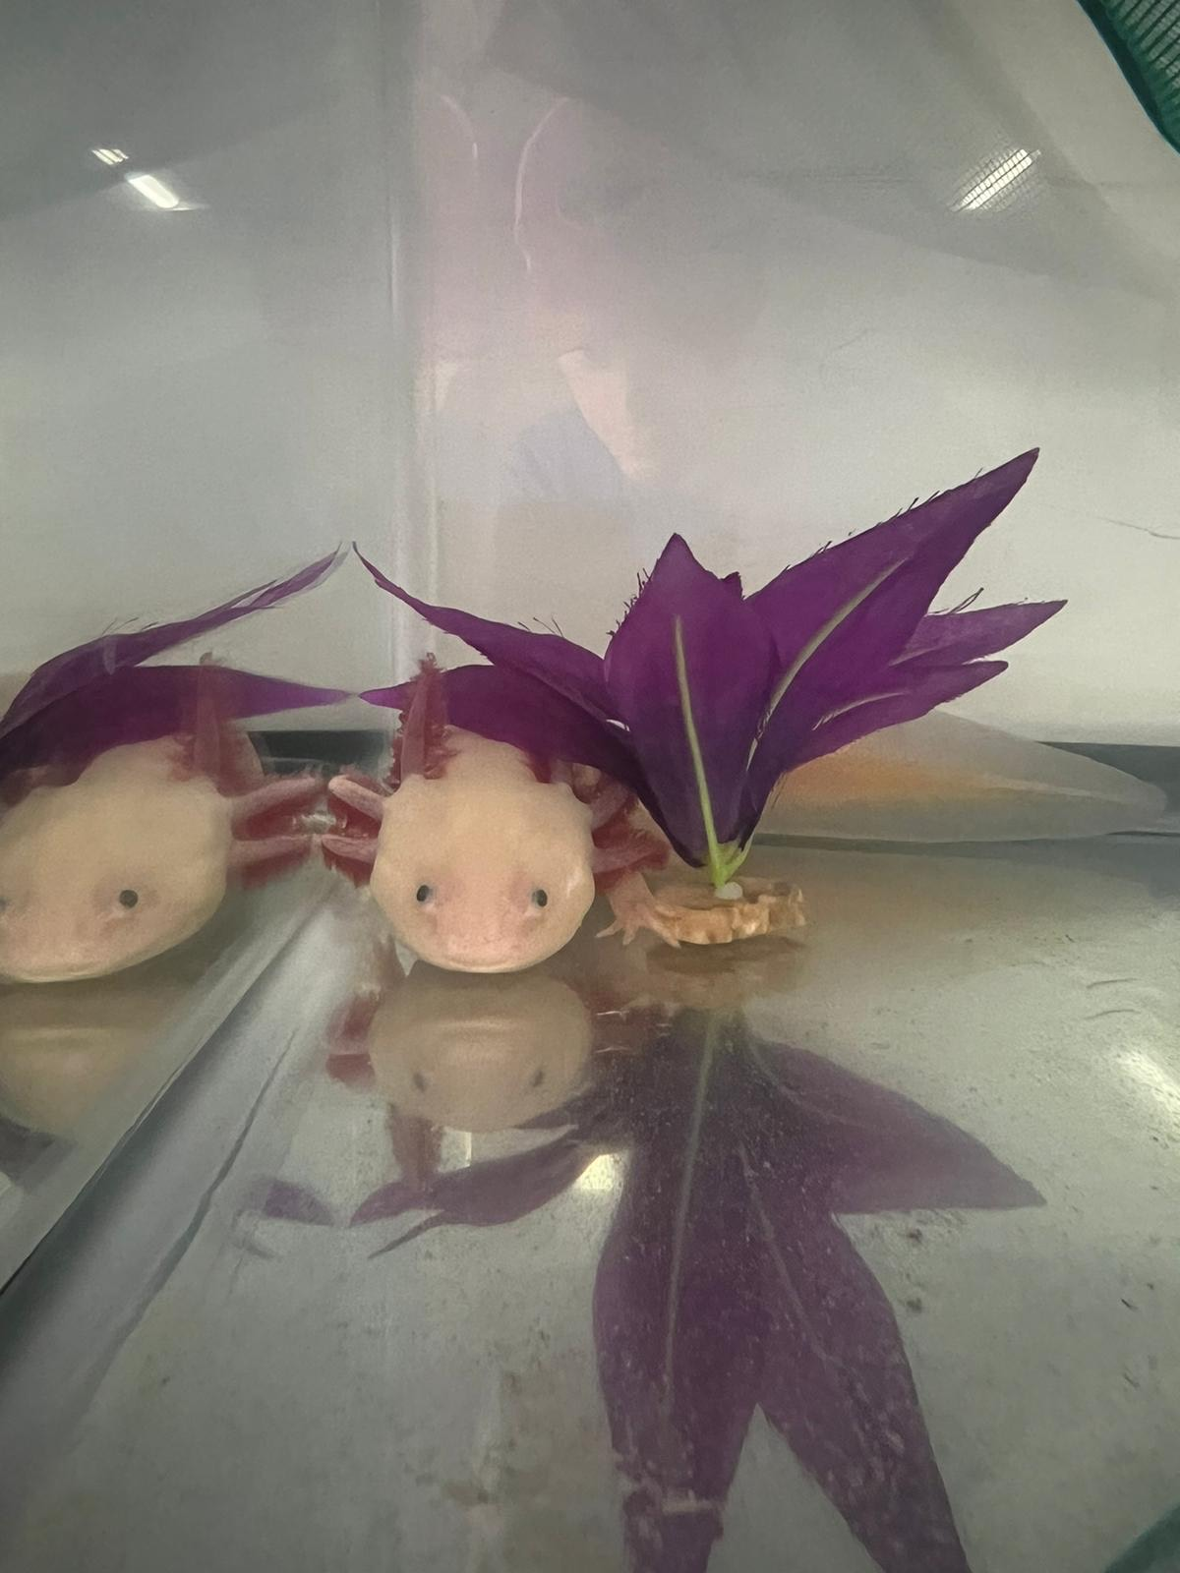
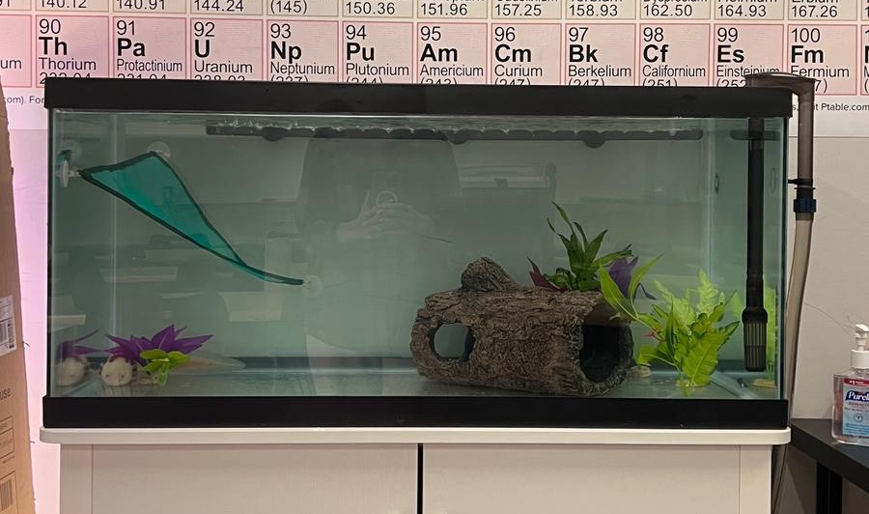
Donated $500 to student council
STUCO asked for part of their donation to be used to provide a new home for "Waddle the Axolotl".
Waddle is the beloved class pet of Mr. Stapleton and needed a larger tank.
We purchased a new 40 gallon tank, tank stand, and a water filter on their behalf.

Slide 11
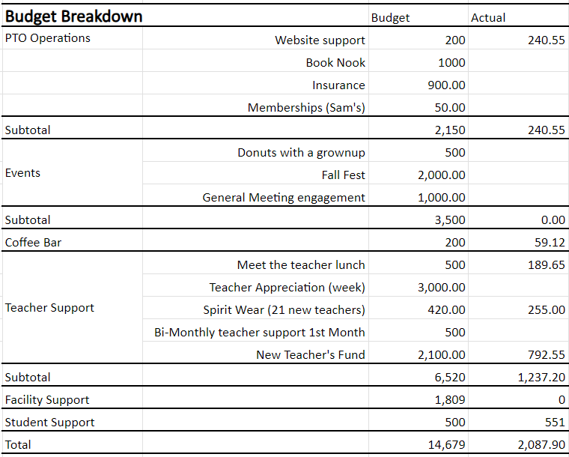
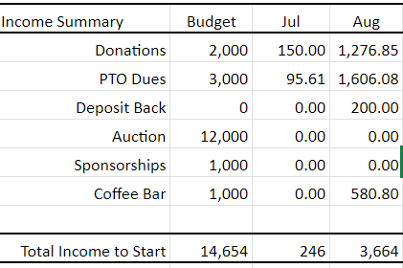
Financial report

Slide 12
FCA FM PSO
Audit Report
September 2024

Slide 13
Methodology
During the FY23-24 school year, the PSO generated a total of 98 transactions.
We selected a sample of 20 transactions that included the highest total deposit and withdrawal amounts as well as a transaction a month.
7 transactions were deposits and 13 were withdrawals.
The 13 withdrawals accounted for 72% of the PSO’s total spend.

Slide 14
Comparison of Deposits to Bank Statements
The vendor and total listed on the register matched the bank statement.
Slight Exception Noted
Deposit receipts were kept except for two deposits and no details were added to the ledger to describe the donations.
Able to go into Chase and Giving account (Benevity) to find transaction details

Slide 15
Confirmation that disbursements were properly approved
Reviewed each transaction to verify:
Prior approval was obtained during a board meeting prior to purchase.
A request for reimbursement was provided for each corresponding request.
Two signatures were present on all checks that were cashed.
Exceptions Noted
Transaction from previous school year reimbursed in July and was not mentioned in the July minutes.
One transaction was discussed in minutes but did not see an official vote on it.
Transactions for coffee were not in minutes, but were informed that it is a separate budget

Slide 16
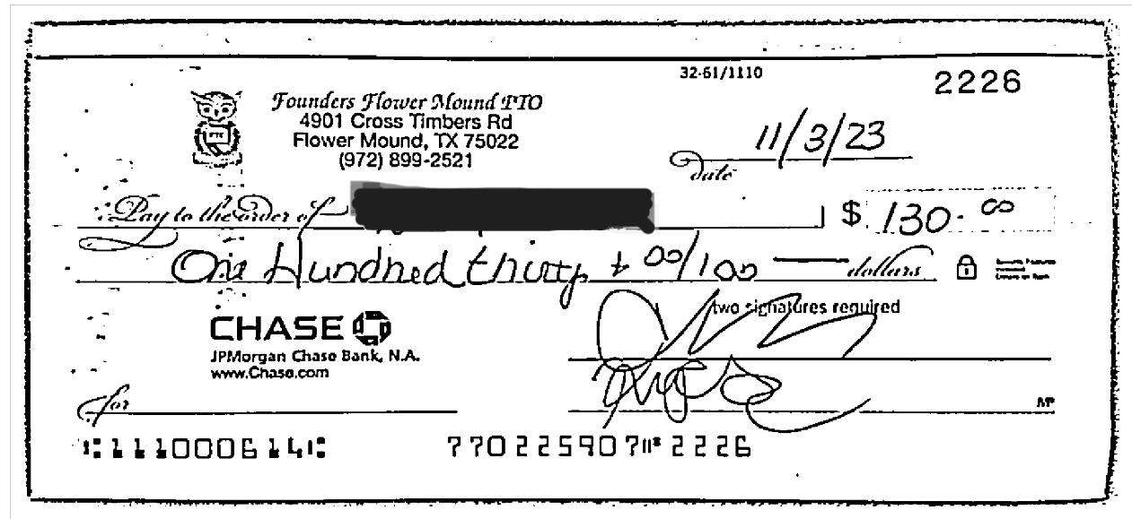
Confirmed that disbursements have been properly documented with an invoice or receipt
Exception Noted – Check #2225
  Check to reimburse a member of the board for the 32auctions website did not have receipt or reimbursement request that could be found
  This expenditure was approved in meeting minutes

Slide 17
Confirm Check and Reporting Procedures
Confirmed all checks were signed with two signatures
No exceptions noted
Reviewed the monthly treasurer reports for accurate totals of income and expenses
No exceptions noted

Slide 18
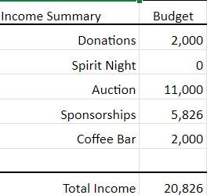
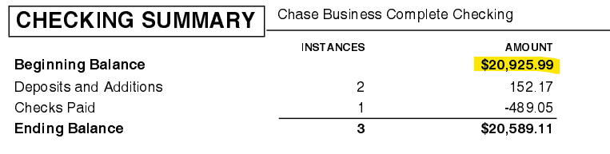

Monthly treasurer report balances
Review the monthly treasurer reports to verify that correct ending balances are correctly forwarded as beginning balances on subsequent reports.
Exception Noted
  Starting balance from the budget did not match the balance in the Chase account or ledger at the beginning of the year, therefore ending monthly balances were incorrect.
  Chase stated $20,925.99 and the budget to start was $20,826

Slide 19
Review of PSO-related financial accounts
Reviewed account information for the external websites utilized by the PSO to verify account owner information.
  Amazon account was recovered so EIN number is now not tied to previous board's accounts.
  PayPal account still has previous treasurer’s social security number tied to it.

Slide 20
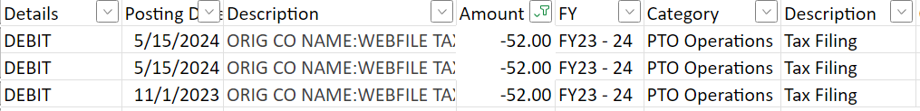
Taxes
Reviewed that federal and state taxes were filed on time
Exception Noted
  Quarterly state taxes were filed 4 times, but three times they were late resulting in a $52 fee each time

Slide 21
Fall Fest
Reviewed inventory of silent auction items on 32auctions and PSO donation log.
Only a few unsold items that were donated to the school
Exception Noted
  When checking PSO donation log, there were 14 items missing from log that were on the auction site and sold.

Slide 22
Recommendations
Board members not reimburse themselves; always use the debit card or a check with two signers
House meeting minutes in shared location and have them posted to the website
Treasurer set reminders on his/her calendar to not miss quarterly tax deadline
Add details in ledger for deposits so board and audit committee can easily see where they came from
Manage donation log so it matches auction website to ensure thank yous and tax receipts are sent to all donors.

Slide 23
Q & A

