Slide 1
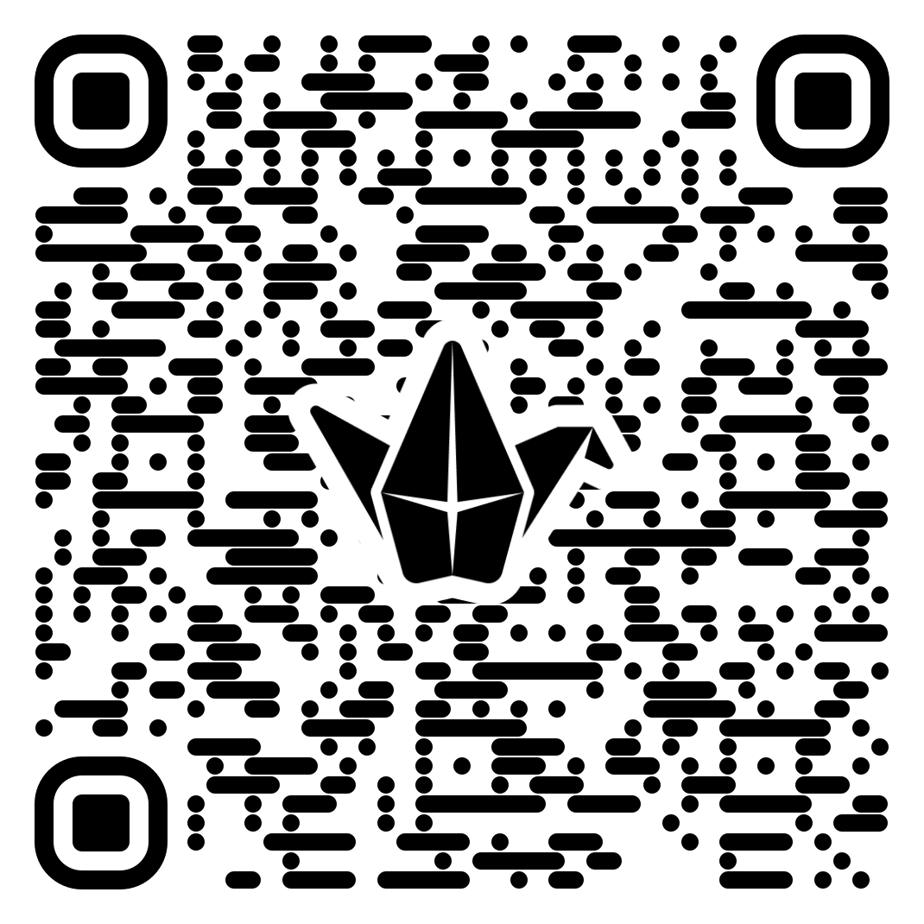

Small Changes, Big Impact
Using Student Feedback to Improve the Classroom Experience
Mary Dixson, PhD

Slide 2
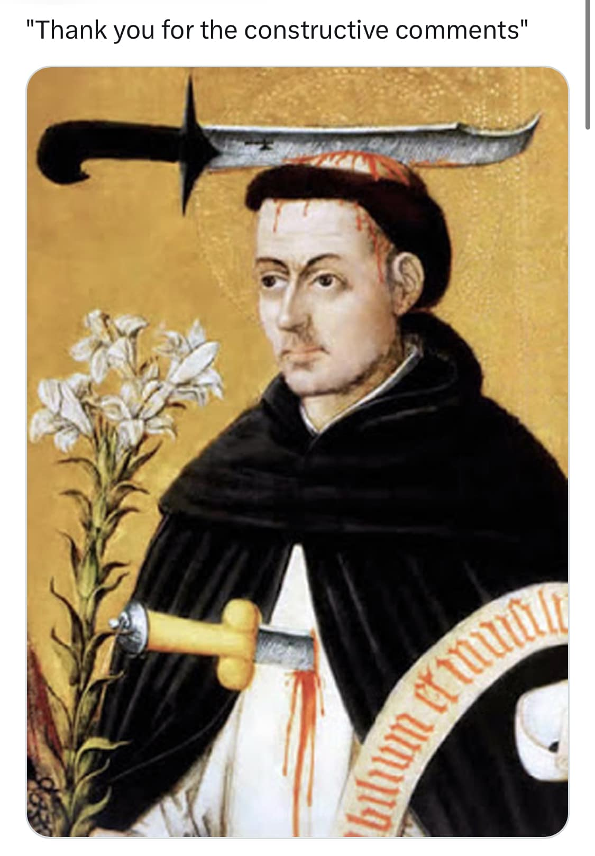
the Need for Improvement Matters
"Thank you for your constructive feedback"

Slide 3
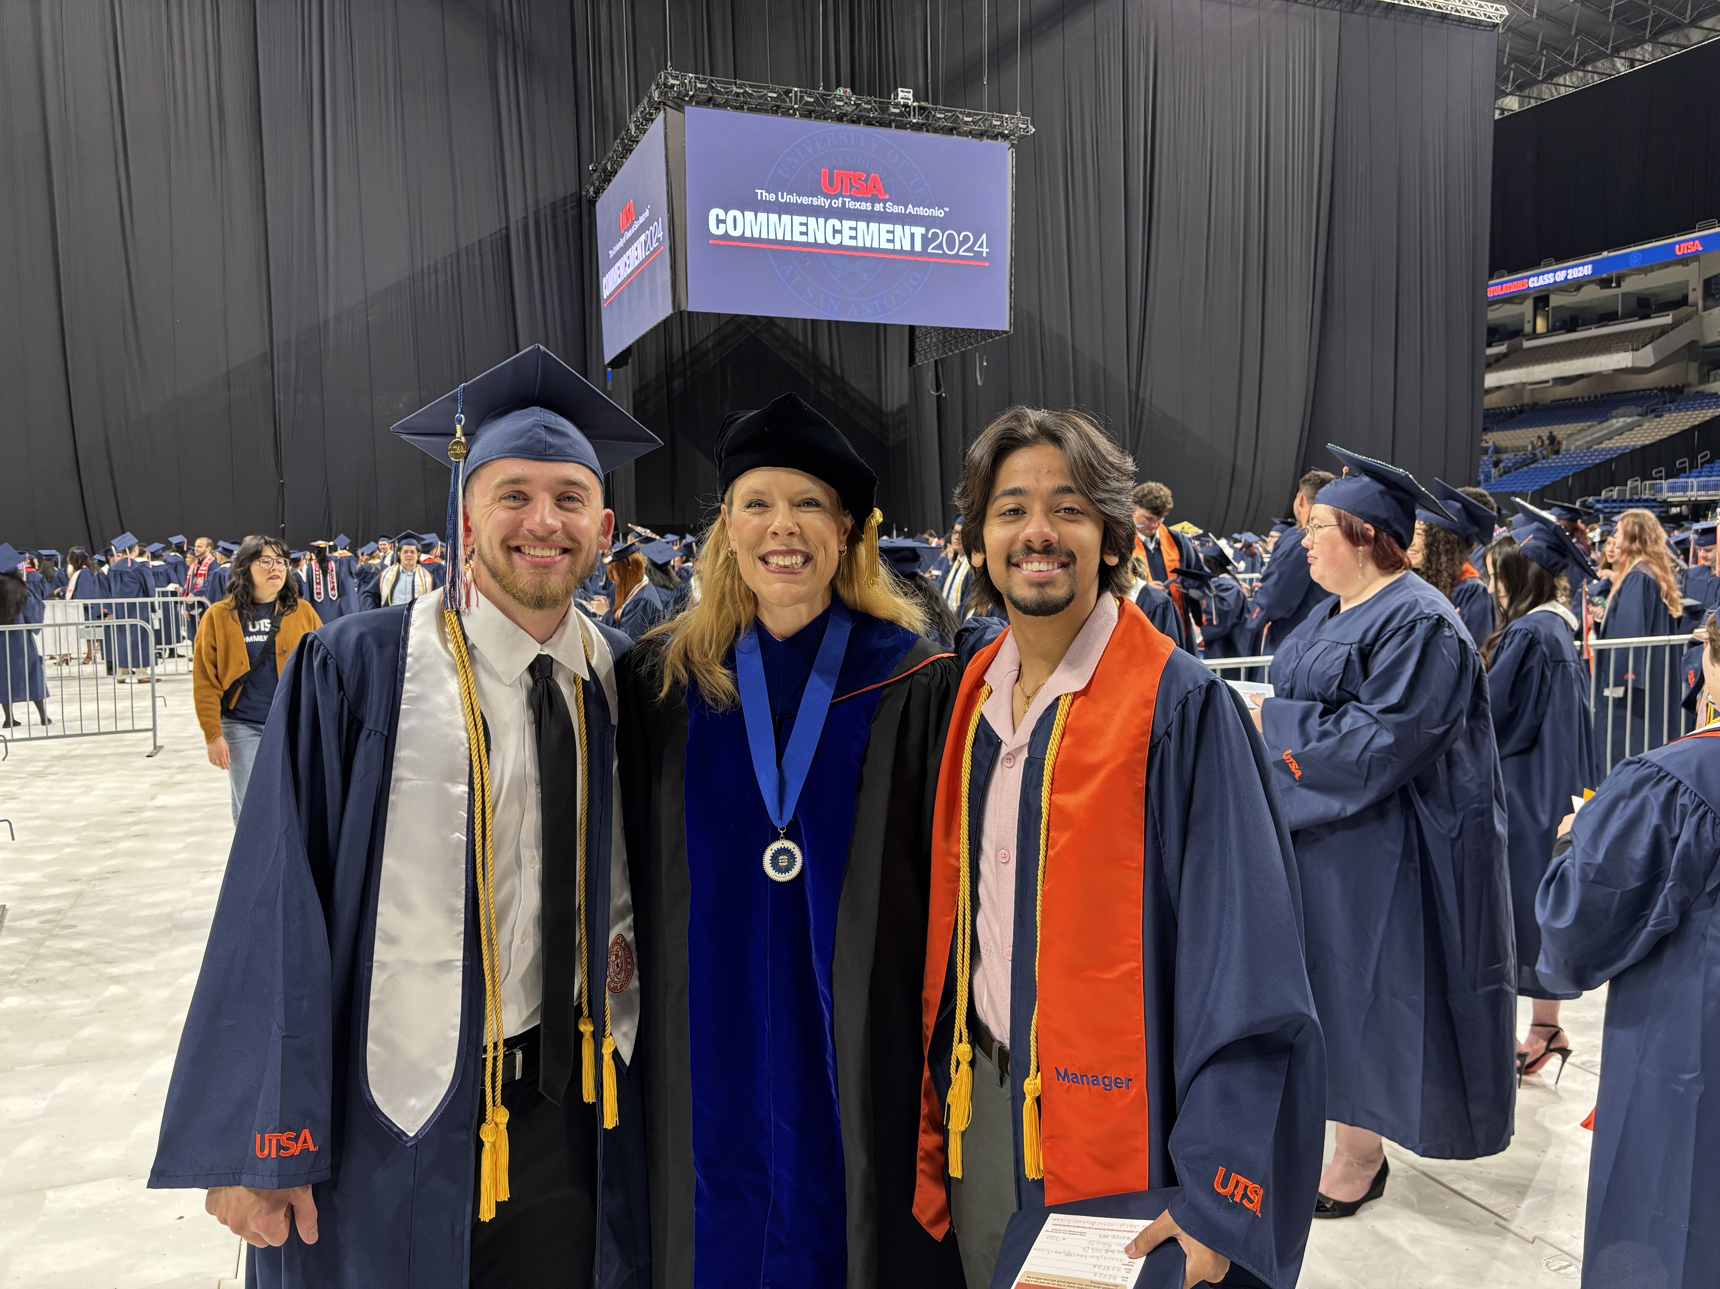
My Teaching Context
30 Years Teaching Communication
Face-to-Face & Online
Large Lecture to Grad Seminars
Undergraduate & Graduate

Slide 4
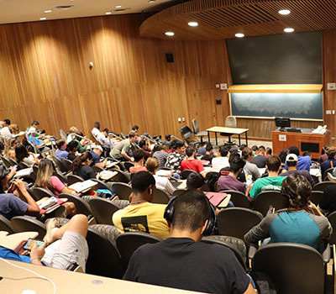
My Toughest Audience
Core Undergraduate Course
100+ Student
Lecture Hall Setting

Slide 5
Our End of Course Evaluation
Instructor clearly defined, explained course objectives and expectations
The instructor communicated information effectively
The instructor was prepared to teach for each instructional period
The instructor encouraged me to take an active role in my own learning
The instructor was available outside of class, electronically or in person
My overall rating of the course is:
My overall rating of the teaching of this course is:

Slide 6
"Overall, this instructor was an effective teacher."
Rating was 4.15 out of 5
Response rate was 43% of students
Results provided 3 weeks after course ends
What would you change based on this feedback?

Slide 7
Today's Goals
Identify the limitations of end-of-course evaluations
Apply multi-point student feedback strategies
Use student feedback to make small, manageable adjustments

Slide 8
End of Course has 3 Problems
Too few – reflects only those motivated to respond
Too broad – limited direction for specific change
Too late – students giving feedback don't benefit

Slide 9
What if we flipped it?

Slide 10
Feedback Opportunity
Every student responds
Focused questions that I can act on
Just in time to improve their experience

Slide 11
Make Feedback a Brief, Normal Part of Class
Set aside a few minutes during class
Include a feedback question in an existing assessment
Give students a way to respond privately

Slide 12
Before the Next Assignment
How clear are you about what this assignment requires?
Not at all clear / Somewhat clear / Very clear
How confident are you that you can complete it successfully?
Not at all confident / Somewhat confident / Very confident
Do you feed comfortable asking questions?
Yes/No/Unsure
What would help you feel more prepared? (Written Response)

Slide 13
Select Questions Based On
Common Issues
where students may be struggling
Specific Teaching Practices
how a course activity supports learning
Student Experience
how students experience the classroom environment

Slide 14
Common Issues
Understanding Expectations
Workload and Pacing
Confidence and Self-efficacy
Accessing Resources
Keeping Up with Coursework
Classroom Peer Issues

Slide 15
SPECIFIC TEACHING PRACTICES
Assignment instructions and examples
Group activities and discussions
Feedback
Videos/readings, and Review activities
"Which part of today's review was most helpful?"
"What do you still need help understanding?"

Slide 16
STUDENT EXPERIENCE
Belonging and connection with classmates
Respect and fairness
Comfort asking questions
Opportunities to Participate
“How comfortable do you feel asking a question in this class?”
“What would make it easier for you to ask questions or participate?”

Slide 17
What Makes a Question Actionable?
Could I make a specific change based on the answer?
End-of-course:
The instructor provided helpful feedback.
Focused:
After receiving feedback on your first assignment, how clear are you about what you need to do differently on the next assignment?

Slide 18
With a partner: Rewrite End-of-Course Questions for a Just-in-Time Feedback
The course was well organized.
The instructor provided helpful feedback.
The course activities contributed to my learning.

Slide 19
Just In Time: How to Ask
Survey Tool in Your LMS
Padlet Board
Old Fashioned Paper

Slide 20
Just in Time: When to Ask
When | What to ask about
Early in the semester | Expectations, resources, and connection
Before a major assignment | Clarity, confidence, and preparation
After an activity or assignment | What helped and what remains unclear
After making a change | Whether the adjustment helped

Slide 21
Student Feedback and a Small Change
What I heard: “I just transferred from community college and I wonder if I can fit in with everyone here.”
What I changed: Start the class with icebreaker
How I'll check back: I'll ask feedback on how it's working

Slide 22
Student Feedback and a Small Change
What I heard: “I get distracted by students doing other things in class and talking"
What I changed: Discuss class courtesy and conduct in connection to the survey
How I'll check back: I'll ask feedback on course distractions and lecture clarity

Slide 23
Student Feedback and a Small Change
What I heard: “I am an older student and tech makes me uncomfortable.”
What I changed: Add more tech how-to's and tech-focused support sessions
How I'll check back: I'll ask a tech-focused comfort question in the assignment
Be Transparent! Share feedback and changes in class

Slide 24
Activity
Think of a course you teach & complete these prompts:
I want to understand
I will ask students
I will ask when
One adjustment I could make
I will follow up by

Slide 25
One Small Change
Every student: Create safe opportunities to respond
Focused questions: Ask about something you can adjust
Just in time: Respond while students can still benefit

Slide 26
“What is one feedback question you will ask in your next class?”

Slide 27
Remember:
Feedback is only as good as your use of it.

Slide 28

You Rock!
Questions or Comments?
Notes:
Does PowerPoint enhance learning?
Penciner, Rick, MD. CJEM : Journal of the Canadian Association of Emergency Physicians; Pickering15.2 (Mar/Apr 2013): 109-12

Slide 29
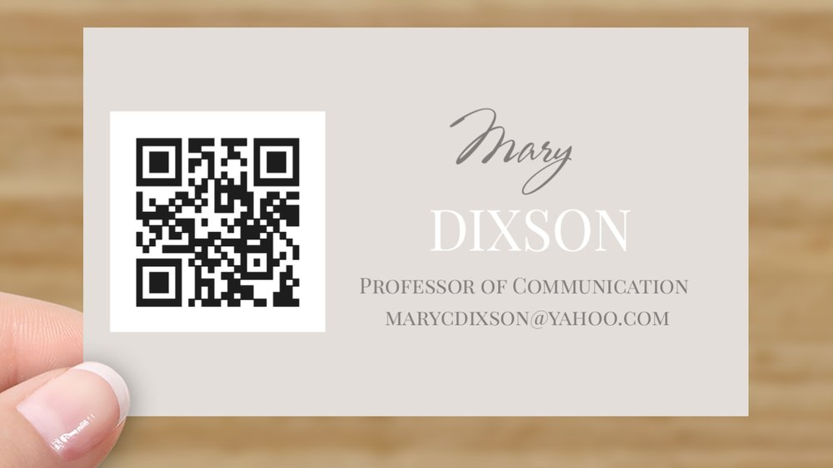

Slide 30
https://padlet.com/utsa/how-is-your-conference-going-s02495z90bcovq8pypoo

