Slide 1
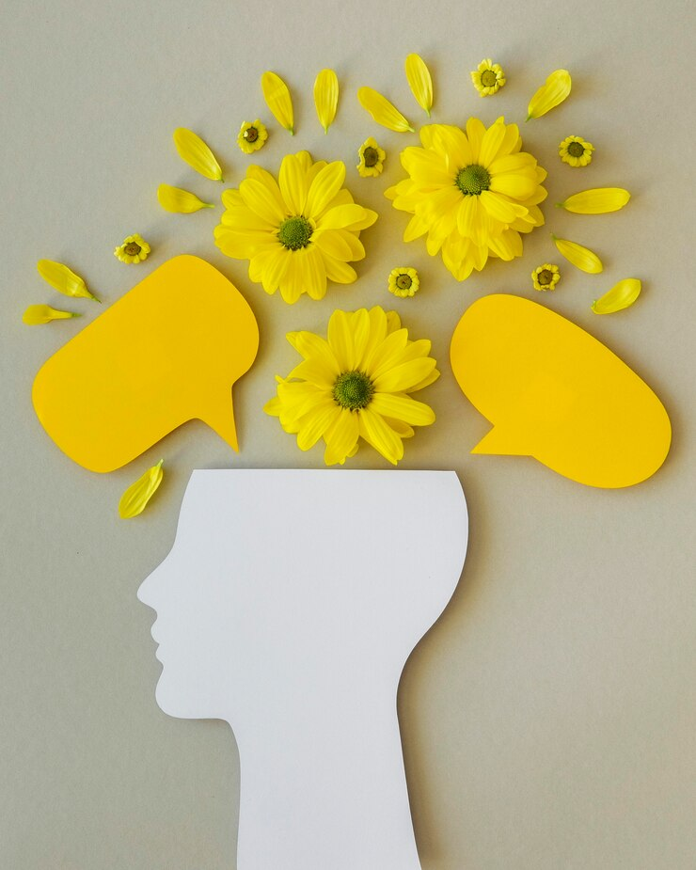
The Mulligan Principle
Great
Start
The Role of Positive Communication & Opportunities for Improvement in Promoting Resilience & Growth Mindset
Making Progress!
Mary Dixson
University of Texas at San Antonio
Freepik

Slide 2
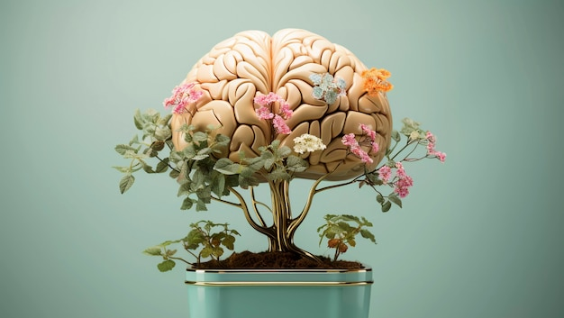
Freepik
Notes:
Freepik

Slide 3
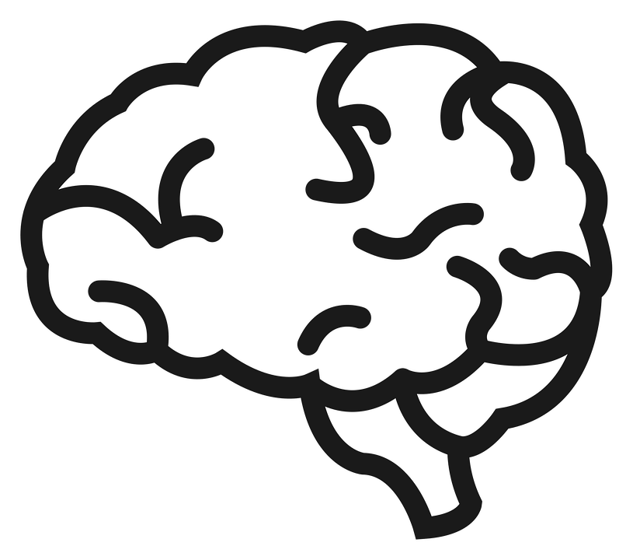
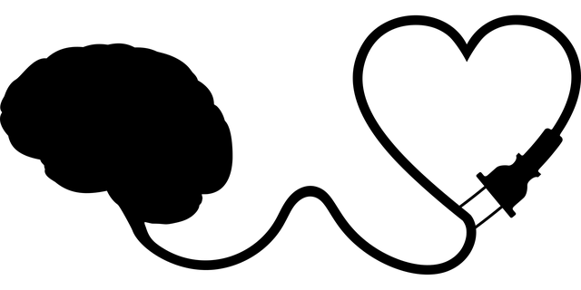
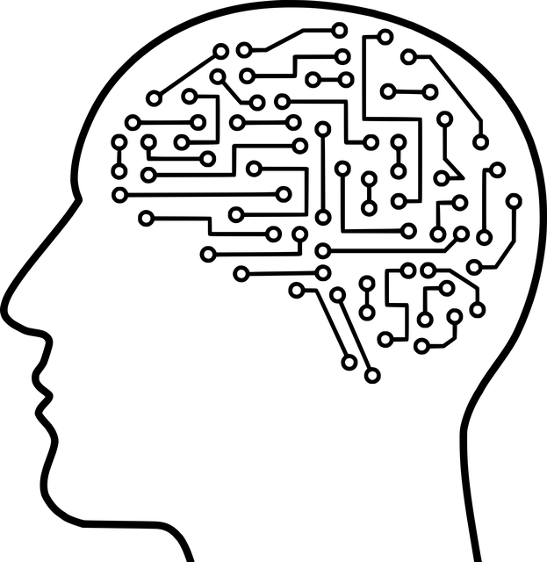
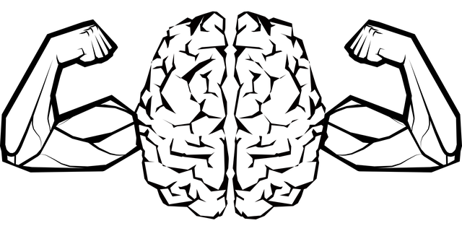
Growth Mindset – Carol Dweck
Intelligence
is Not Fixed
Wanting to
Learn Matters
We Learn Through Mistakes
Effort Leads to Improvement
Intelligence is not fixed
Intelligence is not fixed
Intelligence is not fixed
Intelligence is not fixed

Slide 4
We learn through feedback and trying again

Slide 5
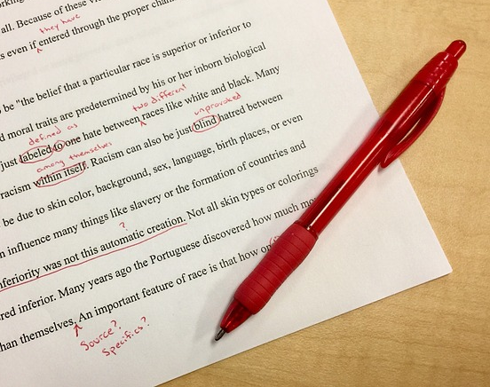
But what does feedback look like?

Slide 6
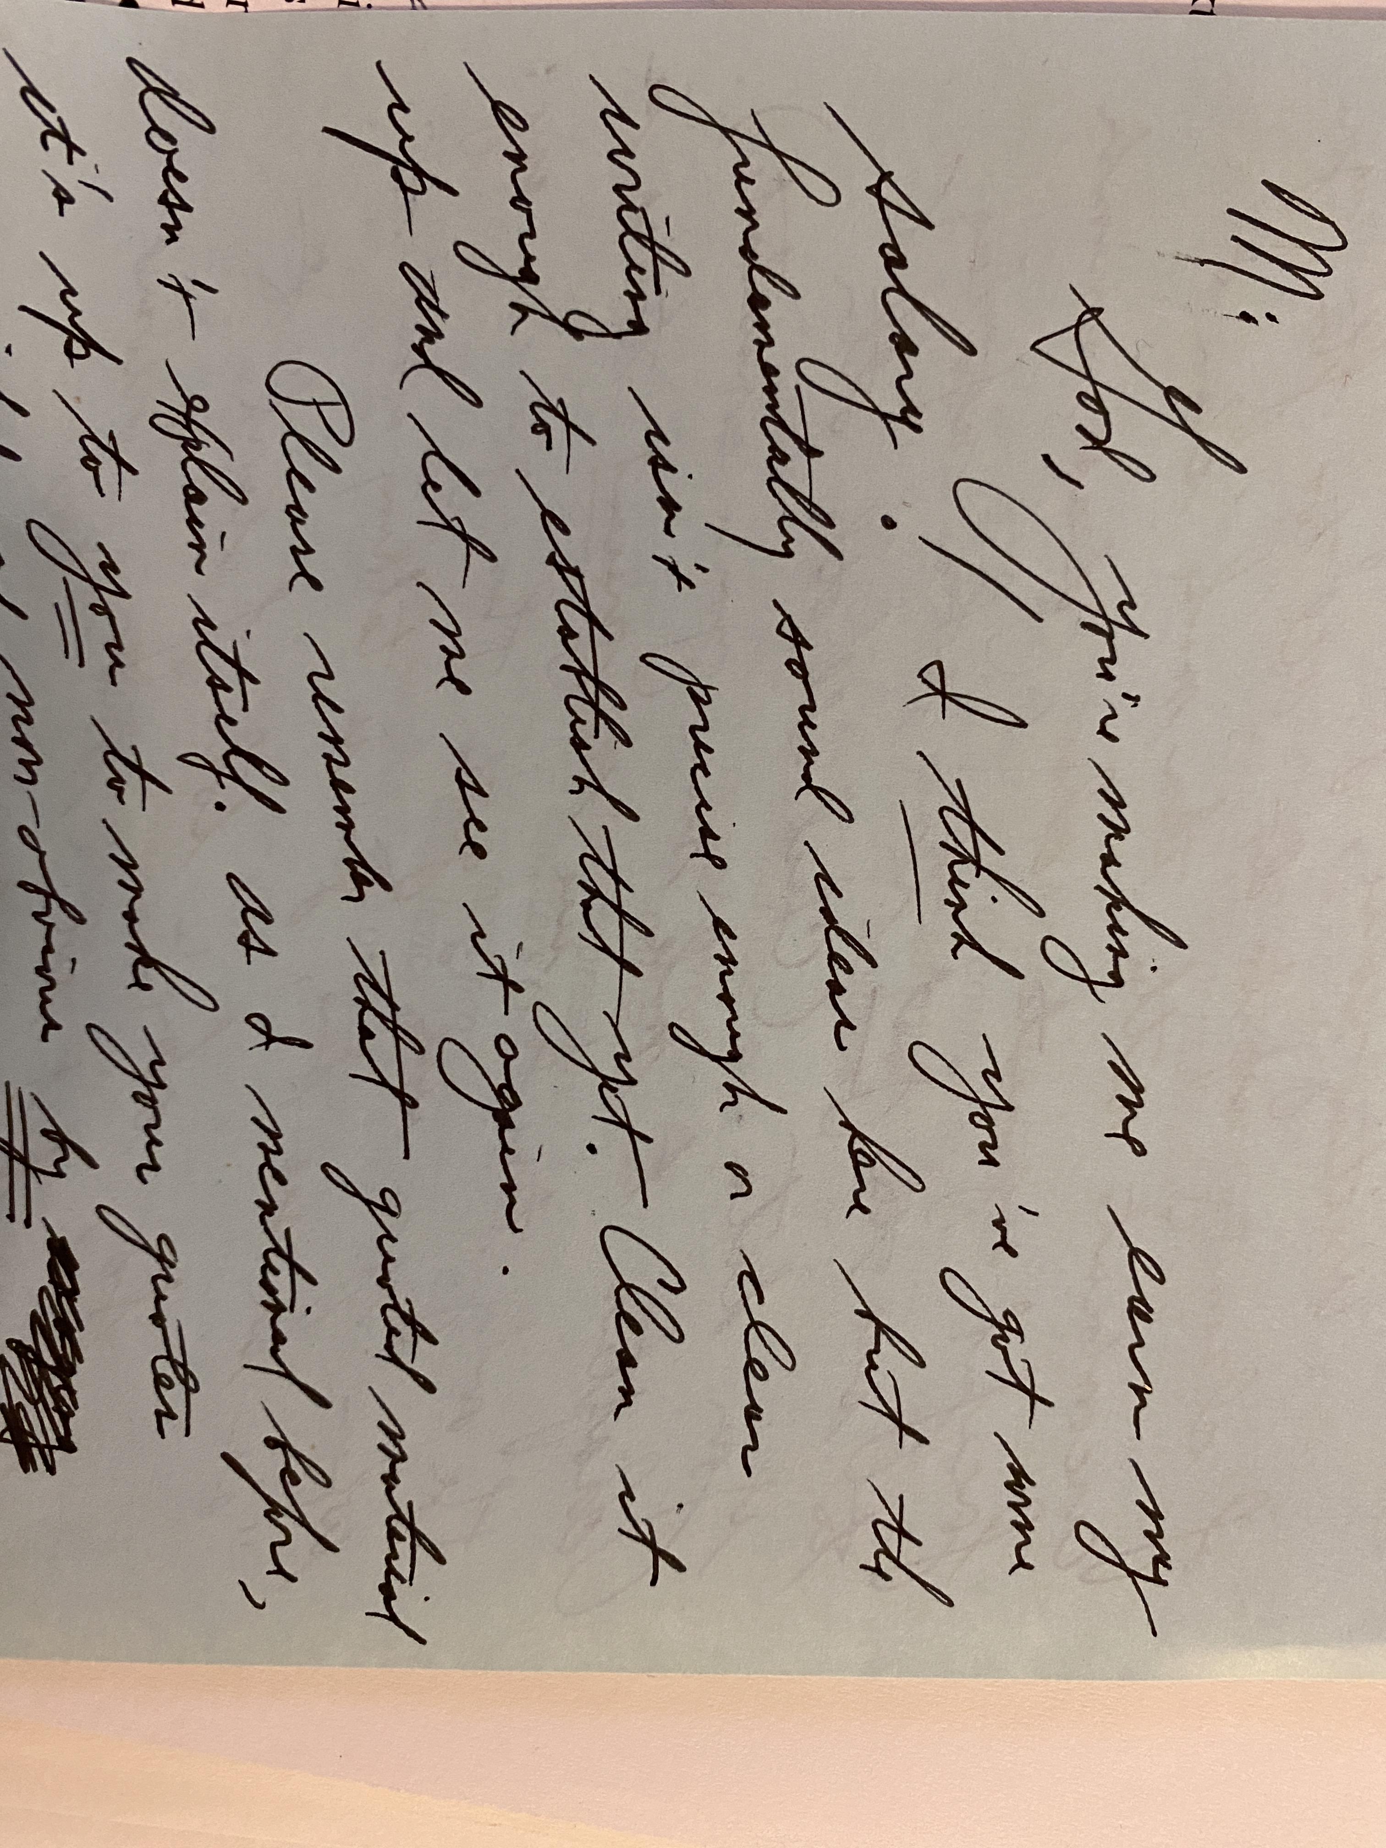
God, you're making me earn my salary! I think you've got some fundamentally sound ideas here, but the writing isn't precise enough or clear enough to establish that yet. Clean it up and let me see it again.

Slide 7
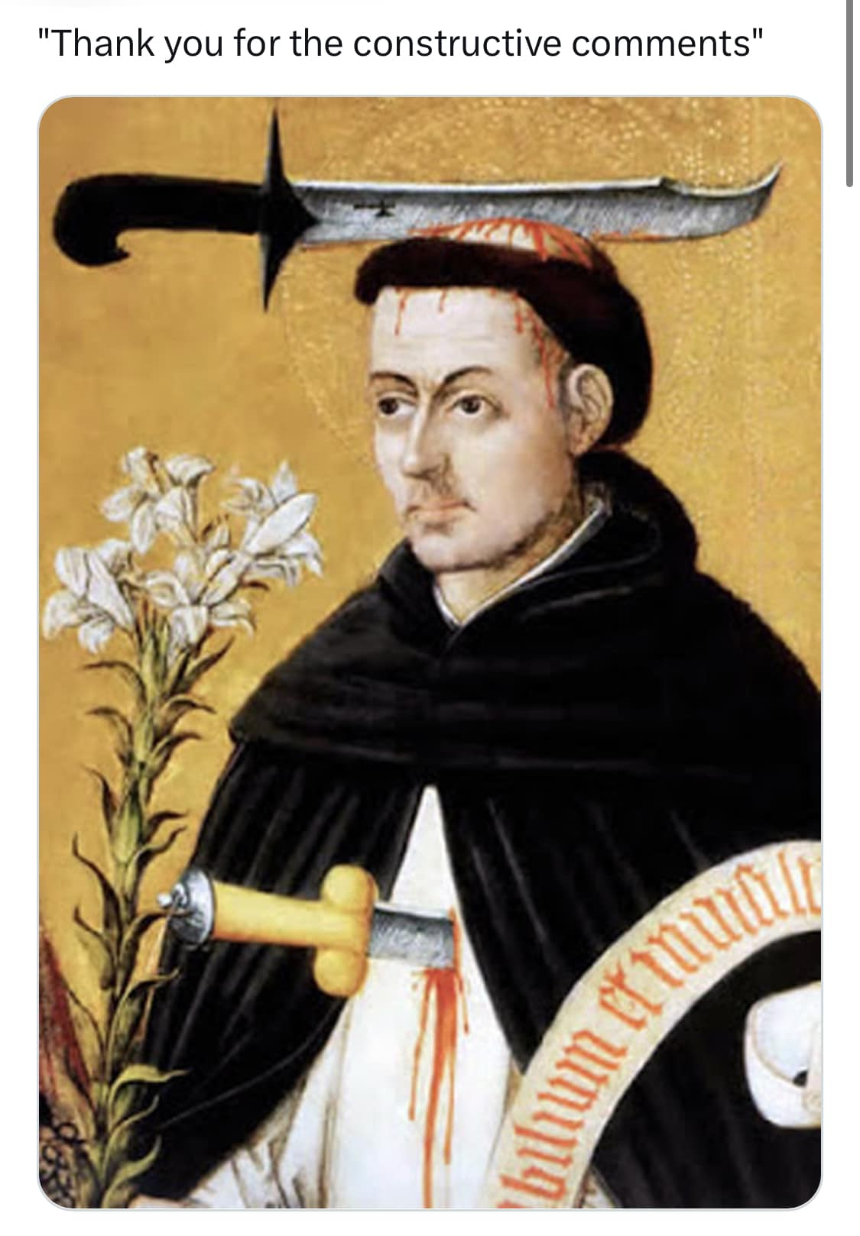
the Need for Improvement Matters
"Thank you for your constructive feedback"

Slide 8
Talk about a time when you received a negative critique of your work
How did it feel?
What was the result?

Slide 9
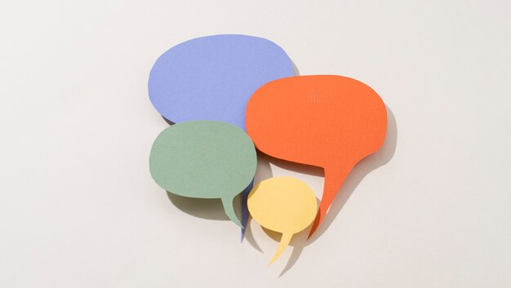
Freepik
Notes:
Image by Freepik

Slide 10
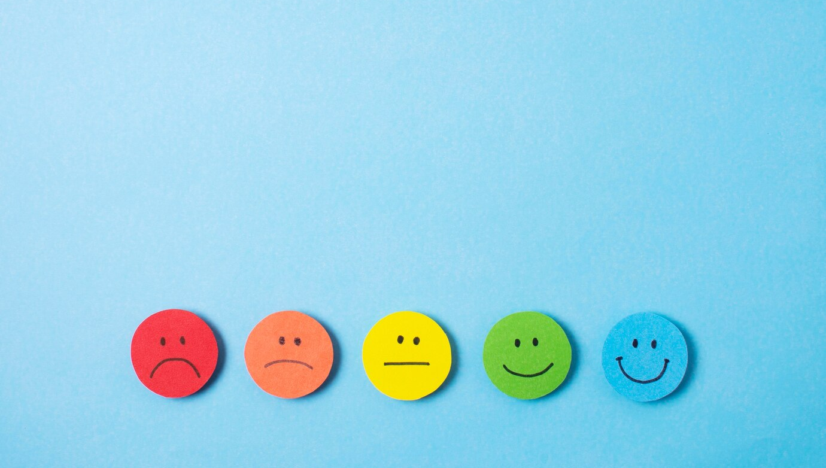
Self-esteem changes our perception of communication
Hull 1982
Notes:
HULL, J. W. (1982). SELF-ESTEEM, CONFIRMATION, AND EMOTIONAL SATISFACTION IN SMALL GROUPS. ProQuest Dissertations Publishing.

Slide 11
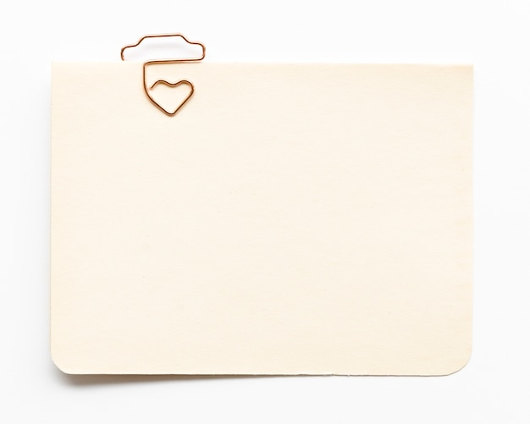
GOALS
1 Understand confirming communication
2
Link communication to growth mindset
3 Create a communication & mulligan plan

Slide 12
How do we communicate these?
Intelligence
is Not Fixed
Wanting to
Learn Matters
We Learn Through Mistakes
Effort Leads to Improvement
Intelligence is not fixed
Intelligence is not fixed
Intelligence is not fixed
Intelligence is not fixed

Slide 13
The Brain Defends Itself Against Criticism

Slide 14
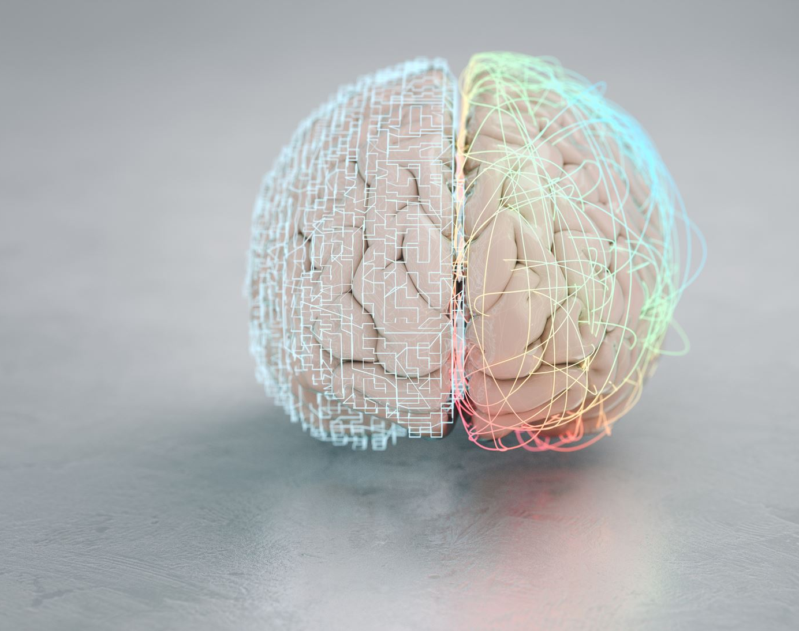
Your Brain Sees Negative Words as a Threat
Paulus 2014
Notes:
Dr. Martin Paulus https://www.thedailyjournal.com/story/news/2014/03/10/why-criticism-stops-us-in-our-tracks/6253163/
https://www.thedailyjournal.com/story/news/2014/03/10/why-criticism-stops-us-in-our-tracks/6253163/

Slide 15
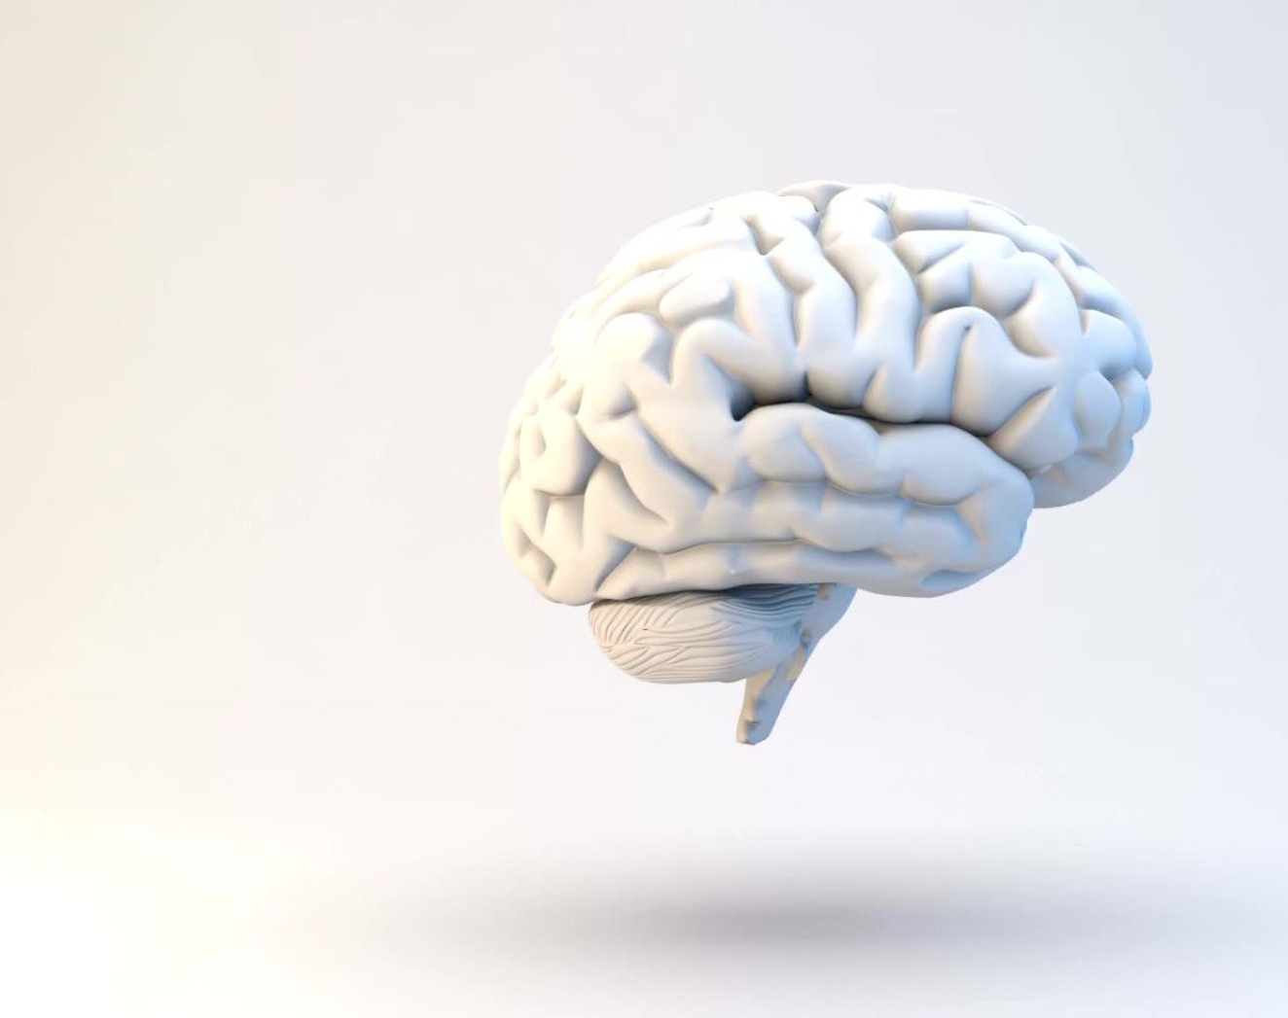
When our brain is focused on processing criticism it can't focus on much else
(Paulus 2014)
Notes:
Paulus 2014

Slide 16
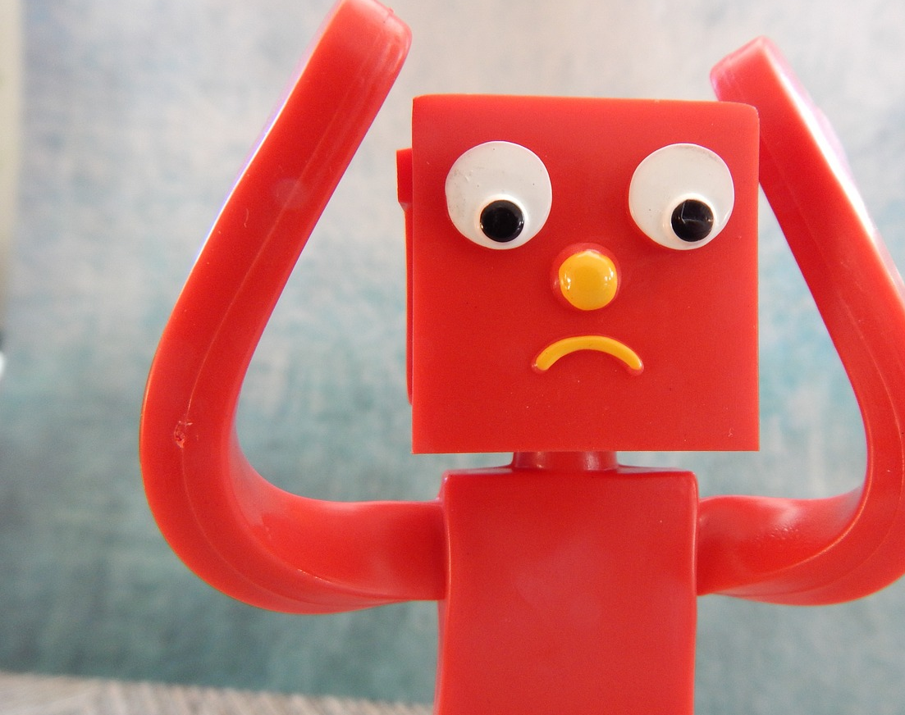
Exposure to criticism results in a rapid negative mood change
Bonduelle et al 2021
Notes:
(Bonduelle et al 2021)
Bonduelle SLB, Chen Q, Wu GR, Braet C, De Raedt R, Baeken C. Exposure to Criticism Modulates Left but Not Right Amygdala Functional Connectivity in Healthy Adolescents: Individual Influences of Perceived and Self-Criticism. Front Psychiatry. 2021 Jul 6;12:673805. doi: 10.3389/fpsyt.2021.673805. PMID: 34295271; PMCID: PMC8290839.

Slide 17
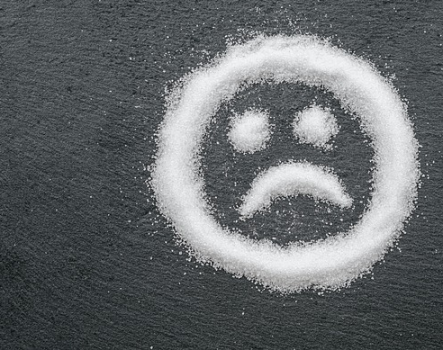
Negativity Bias
Tierney & Baumeister 2019
Notes:
Tierney & Baumeister, 2019. The Power of Bad
https://www.bbc.com/future/article/20220624-why-criticism-lasts-longer-than-praise

Slide 18
5X stronger reaction to negative encounters even if positive events are more frequent
Glomp & Hulin 2005
Notes:
Miner, A. G., Glomb, T. M., & Hulin, C. (2005). Experience sampling mood and its correlates at work. Journal of Occupational and Organizational Psychology, 78(2), 171-193. https://doi.org/10.1348/096317905X40105
Image by Freepik

Slide 19
Correlates to work withdraw and reduced task engagement
Notes:
Miner, A. G., Glomb, T. M., & Hulin, C. (2005). Experience sampling mood and its correlates at work. Journal of Occupational and Organizational Psychology, 78(2), 171-193. https://doi.org/10.1348/096317905X40105
Image by wayhomestudio on Freepik

Slide 20
When the brain is negative, you split its resources between processing action and processing negative thoughts. When you're positive, your brain can focus on learning and looking for opportunities. Shawn Achor – Author of Happiness Advantage
Notes:
Achor, S. https://www.golfdigest.com/story/happiness-experiments-why-good-golfers-are-fools
Hooley JM, Siegle G, Gruber SA (2012) Affective and neural reactivity to criticism in individuals high and low on perceived criticism. PLoS One 7: e44412.

Slide 21
Negative messages means this doesn’t happen
Intelligence
is Not Fixed
Wanting to
Learn Matters
We Learn Through Mistakes
Effort Leads to Improvement
Intelligence is not fixed
Intelligence is not fixed
Intelligence is not fixed
Intelligence is not fixed

Slide 22
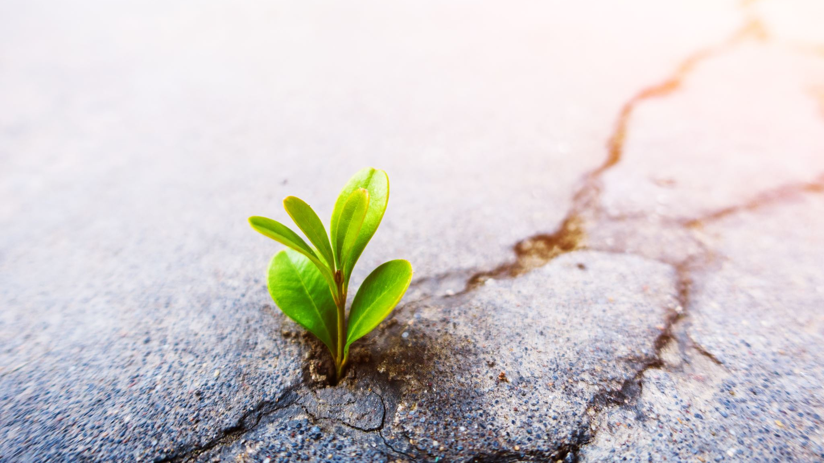
Confirming Communication & Positive Climate

Slide 23
Climate to Learn – Jack Gibbs
Interpersonal Exposure
Valid Feedback
Supportive Atmosphere
Exploratory Behavior
Notes:
Gibb, J. R. (1958). A Climate for Learning. Adult Education, 9(1), 19 . https://doi-org.libweb.lib.utsa.edu/10.1177/074171365800900106

Slide 24
Feedback in an evaluative, punitive or defensive climate leads to resistance, defensiveness, and refusal to look at the feedback Jack Gibbs (1958)
Notes:
Gibb, J. R. (1958). A Climate for Learning. Adult Education, 9(1), 19 . https://doi-org.libweb.lib.utsa.edu/10.1177/074171365800900106
Image by Freepik

Slide 25
Climate is Perceived
Words
Action
Non-Action

Slide 26
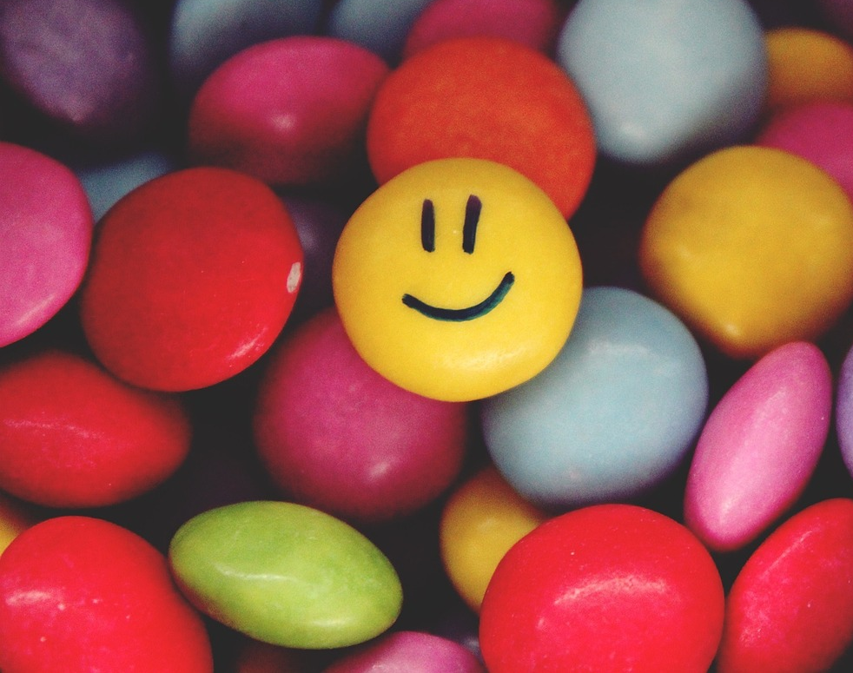
We Seek Confirming Communication

Slide 27
Confirming Communication

Slide 28
The process by which individuals are made to feel valuable and significant
(Cissna & Sieburg1981)
Notes:
Cissna, K. N., & Sieburg, E. (1981). Patterns of interactional confirmation and disconfirmation. In J. Stewart (Ed.), Bridges not walls (pp. 237–246). New York, NY: McGraw-Hill.

Slide 29
Confirming Communication
Recognizes It’s great to see you today
Acknowledges That’s a good point
Endorses I can see why this is confusing
(Cissna & Sieburg1981)
Notes:
Cissna , K. N. and Sieburg , E. 1981 . “ Patterns of interactional confirmation and disconfirmation ” . In Rigor and imagination: Essays from the legacy of Gregory Bateson , Edited by: Wilder-Mott , C. and Weakland , J. H. 253 – 282 . New York : Praeger .

Slide 30
Discuss examples of how you could use confirming communication for your classes
Recognize,
Acknowledge,
Endorse

Slide 31
Confirming Communication During Lecture
More student communication
Less excuse making
More participation
Less challenge behavior
Greater learning
Increased satisfaction
Notes:
https://www.tandfonline.com/doi/full/10.1080/03634520701787777
Goodboy, A. K., & Myers, S. A. (2008). The effect of teacher confirmation on student communication and learning outcomes. Communication Education, 57(2), 153–179. doi:10.1080/03634520701787777

Slide 32
Teacher Confirmation Leads to Student Confirmation of Each Other
Notes:
Johnson, Z. D., & LaBelle, S. (2020). Confirmation in the college classroom: the connections between teacher’s use of confirming messages and student’s own communicative behaviors. Communication Research Reports, 37(4), 172–181. https://doi.org/10.1080/08824096.2020.1800449

Slide 33
Student to Student Confirmation is Associated to Mental Health & Wellbeing
Notes:
LaBelle, S., & Johnson, Z. D. (2021). The relationship of student-to-student confirmation in the classroom to college students’ mental health and well-being. Communication Quarterly, 69(2), 133–151. https://doi.org/10.1080/01463373.2021.1887310

Slide 34
How do we apply it to assignment feedback?

Slide 35
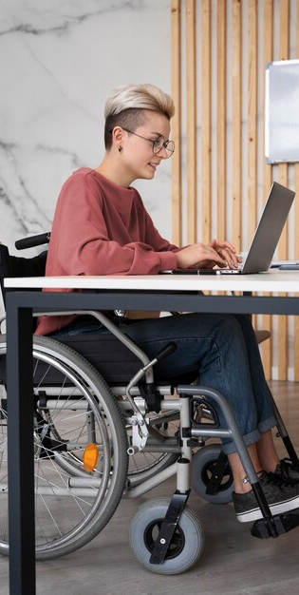
Written Messages
Tend to be more negative
Are Typically less guarded
Are interpreted more negatively
Lack nonverbal emotional cues
Notes:
Image by <a href="https://www.freepik.com/free-photo/young-adult-working-social-integration-workspace_24481701.htm#query=nice%20work%20wheel%20chair&position=31&from_view=search&track=ais&uuid=efe4e632-038a-4416-9756-9df6fb4ba392">Freepik</a>
https://crpa-acrp-bulletin.ca/2021/08/15/lets-be-clear-overcoming-the-negativity-bias/

Slide 36
Email To:
Hi!
Odd question: I’ve been doing a lot media for COVID, some funneled through UTSA. Do you want me to include that on my annual evaluation?
Thanks for all you do!
Mary Dixson
Professor of Instruction

Slide 37
Reply Received:
yes

Slide 38
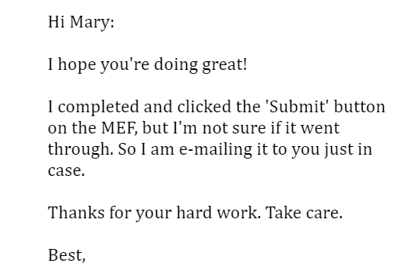
Confirming Reply

Slide 39
Confirming Communication Lays the Groundwork
Intelligence
is Not Fixed
Wanting to
Learn Matters
We Learn Through Mistakes
Effort Leads to Improvement
Intelligence is not fixed
Intelligence is not fixed
Intelligence is not fixed
Intelligence is not fixed

Slide 40
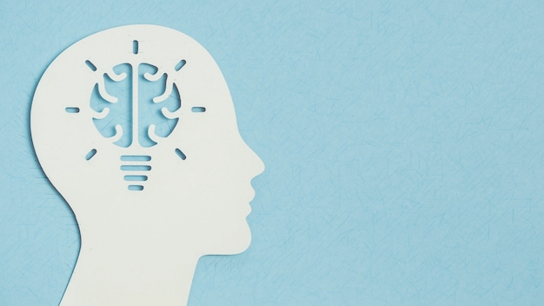
Things done well Things to change
Plus/Delta Feedback
Notes:
Image by kreativkolors n Freepik

Slide 41
Fix Change
You’ve Done this Wrong
You’ve left this out
You have a lot of errors
Let’s think about it differently
You can add this in
You can change these things

Slide 42
Names Matter
Notes:
Howard, D. J., & Kerin, R. A. (2011). The effects of name similarity on message processing and persuasion. Journal of Experimental Social Psychology, 47(1), 63–71. https://doi.org/10.1016/j.jesp.2010.08.008

Slide 43
I really like where this is headed, Chloe.

Slide 44
Offer Positives

Slide 45
I really like where this is headed, Chloe. It demonstrates excellent thinking on the topic and your introduction grabbed my attention. Keep it up.

Slide 46
Explain Deltas: What/Why/How
What to change
Why it matters
How to accomplish it

Slide 47
I really like where this is headed, Chloe. It demonstrates excellent thinking on the topic and your introduction grabbed my attention. Keep it up.
For revisions: Our goal is to have 5 research questions at the end to move us to the next step. You can add them in after the 4th paragraph.
The 5 sources you have are excellent. Our goal is to have 7 to ensure we’ve fully supported our ideas. If you add 2 more, you’ll be in great shape.

Slide 48
Encourage & Enable Improvement
Focus on next steps
Empower
Don't overwhelm
Notes:
Marshall Goldsmith https://marshallgoldsmith.com/articles/feed-forward/

Slide 49
Current Points 40/50
I really like where this is headed, Chloe. It demonstrates excellent thinking on the topic and your introduction grabbed my attention. Keep it up.
For revisions: Our goal is to have 5 research questions at the end to move us to the next step. You can add them in after the 4th paragraph.
The 5 sources you have are excellent. Our goal is to have 7 to ensure we’ve fully supported our ideas. If you add 2 more, you’ll be in great shape.
You can revise and resubmit for full-points Please submit by Wednesday so we can keep you on track.

Slide 50
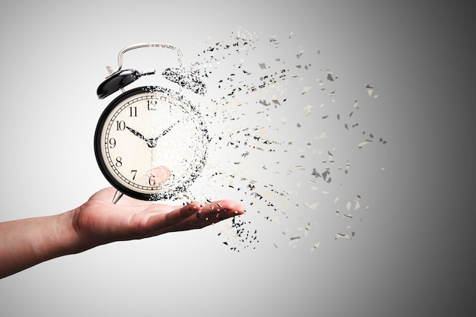

Slide 51
Small Moves = Big Change
Solid analysis
Missing 4 required sources
You have a solid analysis and a good start
Add four sources for your arguments
You have a solid analysis and great start, Meghan! Nice work.
For revisions, add in four sources. This will back up your argument

Slide 52
Mulligans acknowledge a mistake and allow retaking a shot

Slide 53
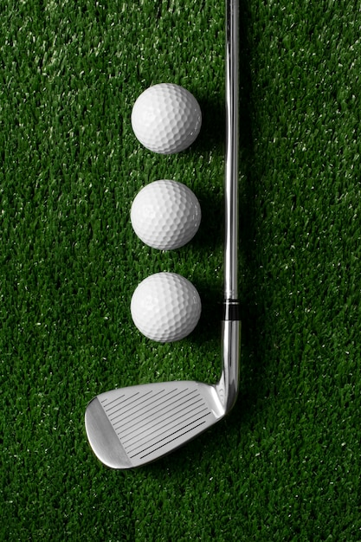
Earning a Mulligan
Complete an Exam Wrapper
Earn a retake
Complete an analysis
Earn a project resubmission
Respond to feedback
Earn a revision
Notes:
https://www.cmu.edu/teaching/designteach/teach/examwrappers/

Slide 54
Discuss examples of how mulligans might fit in your class

Slide 55
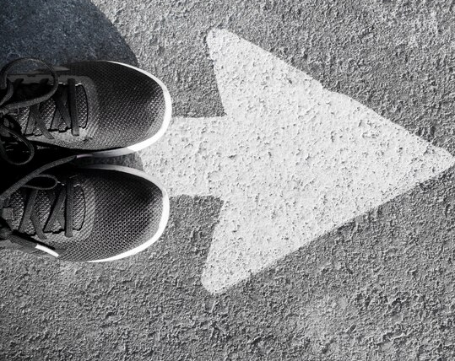
Who Would Allow More Than One Try?

Slide 56
The SAT
The LSAT
The MCAT
Comps & Defenses
The Bar
Driver's License Office
Real Estate Exam
Medical Board
Pilot's License
Olympic Gymnast Vaulters

Slide 57
GOALS
1 Understand confirming communication
2
Link communication to growth mindset
3 Create a communication & mulligan plan

Slide 58
Emotion Trumps Logic

Slide 59
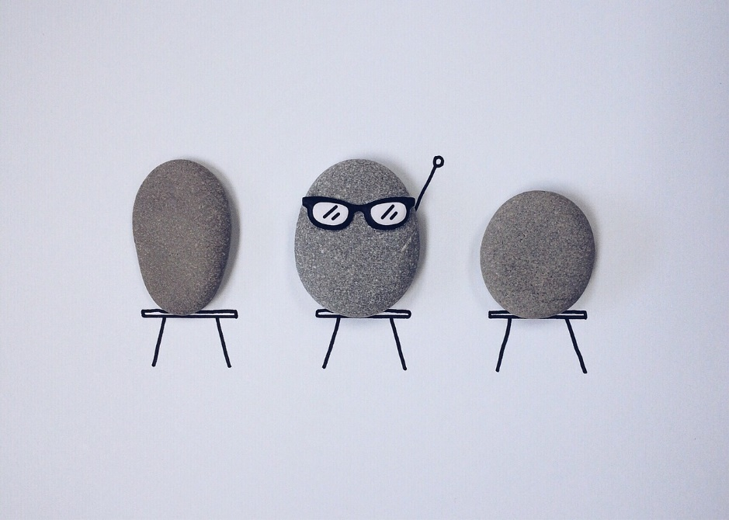
You Rock!
Questions or Comments?
Notes:
Does PowerPoint enhance learning?
Penciner, Rick, MD. CJEM : Journal of the Canadian Association of Emergency Physicians; Pickering15.2 (Mar/Apr 2013): 109-12

Slide 60
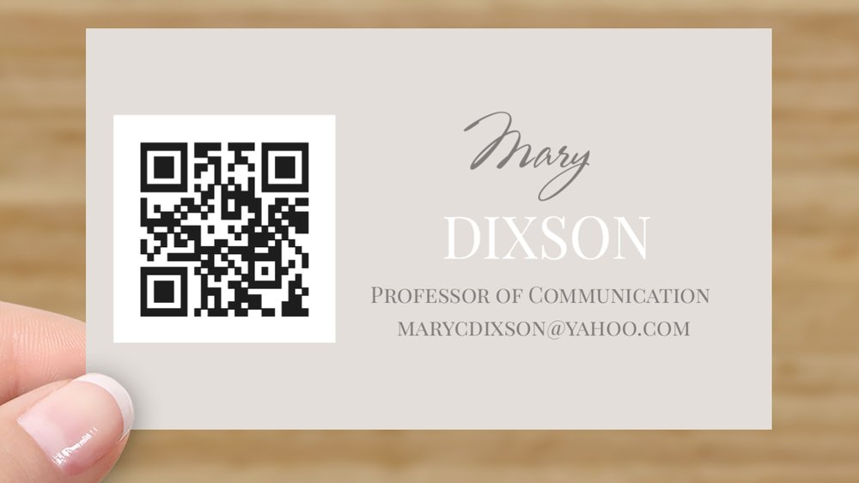

Slide 61
Resources
Exam Wrappers
https://www.cmu.edu/teaching/designteach/teach/examwrappers/
How to Give Feedback https://tll.mit.edu/teaching-resources/assess-learning/how-to-give-feedback/
Shaping a Positive Learning Environment
https://teaching.resources.osu.edu/teaching-topics/shaping-positive-learning
Communication Climate
https://open.maricopa.edu/com110/chapter/7-1-communication-climate/

Slide 62
References
Bantoc,J. (October 21, 2022). The celebrities with a love for golf. CNN. https://www.cnn.com/2022/10/21/golf/gallery/celebrity-golfers-gallery/index.html
Baumeister, R.F., Bratslavsky, E. Finkenauer, C. & Vohs, K. D. (2001). Bad is Stronger Than Good. Review of General Psychology (5)4. 323-370.
Bonduelle SLB, Chen Q, Wu GR, Braet C, De Raedt R, Baeken C. Exposure to Criticism Modulates Left but Not Right Amygdala Functional Connectivity in Healthy Adolescents: Individual Influences of Perceived and Self-Criticism. Front Psychiatry. 2021 Jul 6;12:673805. doi: 10.3389/fpsyt.2021.673805. PMID: 34295271; PMCID: PMC8290839.
Boulton, M. (August 15, 2021). Let’s Be Clear: Overcoming Negativity Bias. Bulletion of the Canadian Radiation Protection Association. https://crpa-acrp-bulletin.ca/2021/08/15/lets-be-clear-overcoming-the-negativity-bias/
Cissna , K. N. and Sieburg , E. 1981 . “ Patterns of interactional confirmation and disconfirmation ” . In Rigor and imagination: Essays from the legacy of Gregory Bateson , Edited by: Wilder-Mott , C. and Weakland , J. H. 253 – 282 . New York : Praeger .
Dweck, C. (2007). Mindset: The new Psychology of Success.
Ellis , K. 2000 . Perceived teacher confirmation: The development and validation of an instrument and two studies of the relationship to cognitive and affective learning . Human Communication Research , 26 : 264 – 291
Gibb, J. R. (1958). A Climate for Learning. Adult Education, 9(1), 19-21. https://doi-org.libweb.lib.utsa.edu/10.1177/074171365800900106
Goldsmith, M. (January 22,2007). Feedforward. Business Week. https://marshallgoldsmith.com/articles/feed-forward/

Slide 63
References
Griffiths, S (June 26, 2022). Why criticism lasts longer than praise. BBC.COM https://www.bbc.com/future/article/20220624-why-criticism-lasts-longer-than-praise
Goodboy, A. K., & Myers, S. A. (2008). The effect of teacher confirmation on student communication and learning outcomes. Communication Education, 57(2), 153–179. doi:10.1080/03634520701787777
Hull, J. W. (1982). Self-Esteem, Confirmation, and Emotional Satisfaction in Small Groups. ProQuest Dissertations Publishing.
LaBelle, S., & Johnson, Z. D. (2021). The relationship of student-to-student confirmation in the classroom to college students’ mental health and well-being. Communication Quarterly, 69(2), 133–151. https://doi.org/10.1080/01463373.2021.1887310
Miner, A. G., Glomb, T. M., & Hulin, C. (2005). Experience sampling mood and its correlates at work. Journal of Occupational and Organizational Psychology, 78(2), 171-193. https://doi.org/10.1348/096317905X40105
Paulus M. Quoted in Hanessian, L. (March 10, 2014). Why criticism stops us in our tracks. Daily Journal. https://www.thedailyjournal.com/story/news/2014/03/10/why-criticism-stops-us-in-our-tracks/6253163/ https://www.thedailyjournal.com/story/news/2014/03/10/why-criticism-stops-us-in-our-tracks/6253163/
Rhodes, T. M., & Sarbaum, J. K. (2015). Online homework management systems: Should we allow multiple attempts? American Economist, 60, 120–131.
Vaish A, Grossmann T, Woodward A. Not all emotions are created equal: the negativity bias in social-emotional development. Psychol Bull. 2008 May;134(3):383-403. doi: 10.1037/0033-2909.134.3.383. PMID: 18444702; PMCID: PMC3652533.

